Slide 1




Kentucky Angel Investment Tax Credit
Interim Joint Committee on Tourism, Small Business & Information Technology 9.25.25
Presented by David Brock & Matthew Wingate
Kentucky Cabinet for Economic Development

Slide 2

KAITC PRESENTATION OVERVIEW
SEPTEMBER 25, 2025
INNOVATION SUPPORT OVERVIEW
PURPOSE OF THE ANGEL TAX CREDIT PROGRAM
OVERVIEW OF CURRENT PROGRAM GUIDELINES
OVERVIEW OF PROGRAM ELIGIBILITY
PROGRAM BY THE NUMBERS
HOW IT HELPS BUSINESSES
QUESTIONS

Slide 3

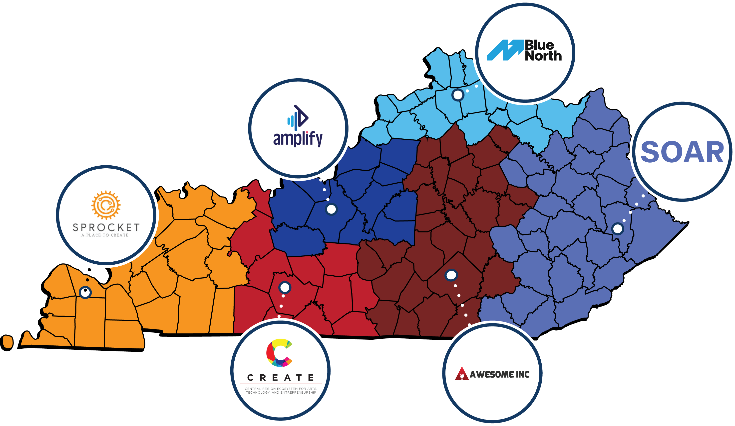
INNOVATION SUPPORT
KY INNOVATION HUBS
KY Innovation contracts with six regional Innovation Hubs to support entrepreneurs across the state. Learn more: kyinnovation.com
5-YEAR IMPACT
2,637
STARTUP JOBS
> 15,000
ENTREPRENEURS SERVED
> $600M
CAPITAL RAISED

Slide 4
INNOVATION SUPPORT
EARLY-STAGE IMPACT
STATE
SBIR/STTR MATCHING FUNDS
KENTUCKY ENTERPRISE FUND
157
45
558
$59M
SBIR/STTR MATCHING FUNDS
COMPANIES AWARDED
COMPANIES RELOCATED
COMPANIES FUNDED
COMPANY INVESTMENTS
$173M
$192M
$2.5B
FEDERAL AWARDS
PRIVATE FOLLOW-ON
PRIVATE FOLLOW-ON INVESTMENTS
LEVERAGED
INVESTMENT
FEDERAL FUNDS
FEDERAL
SSBCI PROGRAM (SINCE 2023)
STATE TRADE EXPANSION PROGRAM (STEP)
LENDING
$8M SUPPORT
$28M PROJECTS
$3.7M
240
SUPPORT
VENTURE
55
COMPANIES RECEIVED
$36M
MATCHED
EXPORT GRANTS
BUSINESSES AWARDED
CAPITAL
INVESTMENT
INVESTMENTS
STATE
SBIR/STTR Matching Funds: 157 Companies Awarded, $75M Matching Funds, $173M Federal Funds Leveraged, 45 Company Relocations
Kentucky Enterprise Fund: XX Company Investments, $59M Investments Funded, $2.5B Private Follow-On Investments
  Program administered by Keyhorse Capital within the Kentucky Science and Technology Corporation
FEDERAL
SSBCI Program Since 2023:
  Lending Support: $8M Support $28M Projects
  Venture Captial: 50 Companies Received Investment, $32M Matched Investments
State Trade Expansion Program (STEP): $3.7M Export Grants, 240 Businesses Awarded

Slide 5

PURPOSE OF THE ANGEL PROGRAM
KENTUCKY ANGEL INVESTMENT TAX CREDIT
To encourage capital investment in the Commonwealth by individual investors that will further the establishment or expansion of small businesses, create additional jobs, and foster the development of new products and technologies by providing tax credits for certain investments in small businesses located in the Commonwealth, operating in the fields of knowledge-based, high-tech, and research and development, and showing a potential for rapid growth.
Kentucky Angel Investment Act, KRS 154.20-230-240

Slide 6

OVERVIEW OF CURRENT PROGRAM GUIDELINES
KENTUCKY ANGEL INVESTMENT TAX CREDIT
POTENTIAL CREDIT AMOUNTS
  Equal to 25% of investment amount in non-enhanced counties and 40% in enhanced counties
PROGRAM CAPS
  $3,000,000 per calendar year in angel tax credits
  $200,000 individual investor limit per calendar year
  $1,000,000 of cumulative credits received for investments in a single company
CLAIMING, TRANSFER & RECAPTURE
  Non-refundable, claimed against an investor’s KY individual income tax
  15-year carry forward
  Transferable subject to Department of Revenue approval
  Businesses subject to 5-year reporting period, must remain compliant

Slide 7
PROGRAM ELIGIBILITY
KENTUCKY ANGEL INVESTMENT TAX CREDIT
QUALIFIED SMALL BUSINESS
No more than 100 full-time employees
Has a net worth of $10,000,000 or less OR Has net income after federal income taxes for each of the two (2) preceding fiscal years of $3,000,000 or less
Has more than 50% of its assets, operations and employees located in Kentucky
Investors have not met $1,000,000 aggregate cap for credits received investing in the company
The business must be engaged in:
  Bioscience
  Environmental and energy technology
  Health and human development
  Information technology and communications
  Materials science and advanced manufacturing
  Other new economy, knowledge-based activity

Slide 8
PROGRAM ELIGIBILITY
KENTUCKY ANGEL INVESTMENT TAX CREDIT
QUALIFIED INVESTOR
No more than 20% ownership and not employed by the business prior to investment
An individual, natural person certified as a Qualified Investor for the calendar year in which the investor plans to make an investment and request credits
Accredited investor as of the date the individual investor requests certification
Seeks a financial return from legitimate investments
Is not closely related to any owners, or spouses of owners, who hold in excess of a 20% ownership interest in, or individuals who are employed by, a Qualified Small Business in which the investor makes an investment and seeks an angel tax credit.

Slide 9
PROGRAM ELIGIBILITY
KENTUCKY ANGEL INVESTMENT TAX CREDIT
QUALIFIED INVESTMENT
Approved by KEDFA and offered in compliance with state and federal laws and regulations
Cash investment of at least $10,000 in equity or near-equity (such as a SAFE agreement or convertible debt instrument)
Within 80 calendar days after KEDFA approval or December 31, whichever comes first
Investor may utilize a single-member limited liability company to make a Qualified Investment as long as the Qualified Investor is the owner of the limited liability company and the limited liability company is a disregarded entity.

Slide 10
BETWEEN 2021 - 2024
373 NEW JOBS
WERE REPORTED BY BUSINESSES
PROGRAM BY THE NUMBERS
KENTUCKY ANGEL INVESTMENT TAX CREDIT
BUSINESSES CERTIFIED FOR THE PROGRAM
317
BUSINESSES CERTIFIED FOR THE PROGRAM
317
BETWEEN
2021 - 2024
373
117
117
BUSINESSES ATTRACTING AN INVESTMENT
BUSINESSES ATTRACTING AN INVESTMENT
NEW JOBS
NEW
TOTAL INVESTORS & INVESTMENTS
445 / 750
TOTAL INVESTORS & INVESTMENTS
445 / 750
JOBS
WERE
REPORTED BY BUSINESSES
INVESTMENTS & AWARDED CREDITS
$57.2M / $19M
INVESTMENTS & AWARDED CREDITS
$57.2M / $19M

Slide 11





Auburn-based Corn-fiber Packaging Startup
"The Angel tax credit program has been very meaningful in Kanbol’s efforts to source capital in our formative stages. "
HOW IT HELPS
HOW IT HELPS
POWERTECH WATER
Lexington-based Water Treatment Startup
"The program was critical for us. It was THE reason multiple angel investors chose to invest in some of our funding rounds."
BLACKBOX ENERGY SYSTEMS
Owingsville-based Smart Motor, Generator, and Sensor Startup
"The [Angel] program helped us close three investment deals and another one
is in the works...it has been a vital part of our investment strategy so far."
KANBOL
Auburn-based Corn-fiber Packaging Startup
"The Angel tax credit program has been very meaningful in Kanbol’s
efforts to source capital in our formative stages."

Slide 12

QUESTIONS?
KENTUCKY ANGEL INVESTMENT TAX CREDIT

Slide 13

THANK YOU
NewKentuckyHome.ky.gov
Notes:
Could combine key points with other slides

