Slide 1
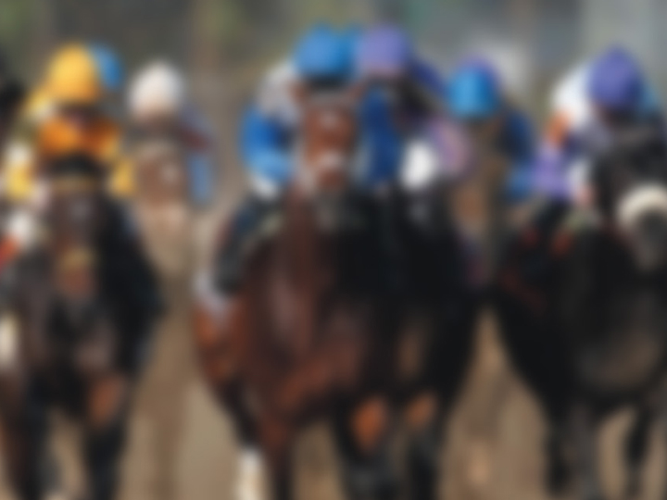

Nov. 20, 2025
Louisville Sports Commission
Building a Stronger Community Through Sports

Slide 2

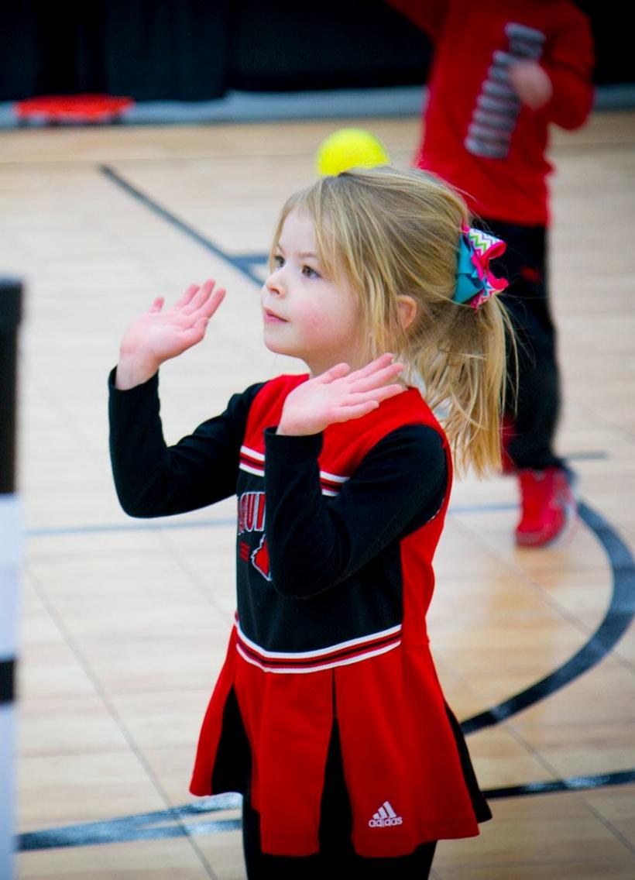
Why Sports Matter
SPORTS...
entertain…
inspire…
bring us together…
promote healthy habits…
teach life lessons.

Slide 3
Louisville Sports Commission Mission
Tourism
Hosted Events
Active Lifestyles
Owned Events
Create a legacy of economic and social vitality through sports.
Revenue
Community Building

Slide 4
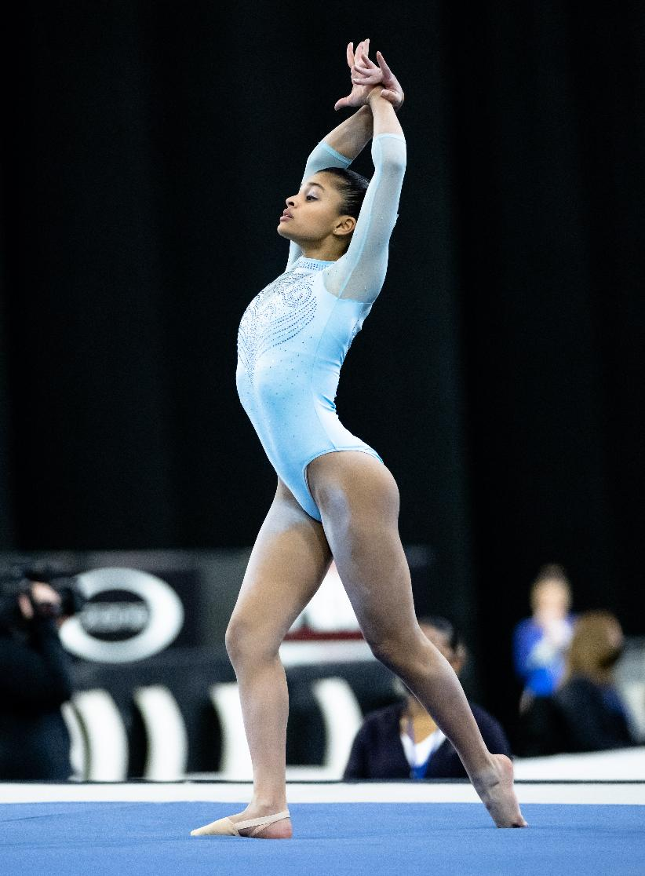
Business Operations
Non-profit founded in 1999
$2.2 million budget
Staff of eight
Partnership model
Community outreach
Great experiences

Slide 5
Business Funding
FY1999
$200,000 Total Revenue
FY2024
$2 Million Total Revenue

Slide 6
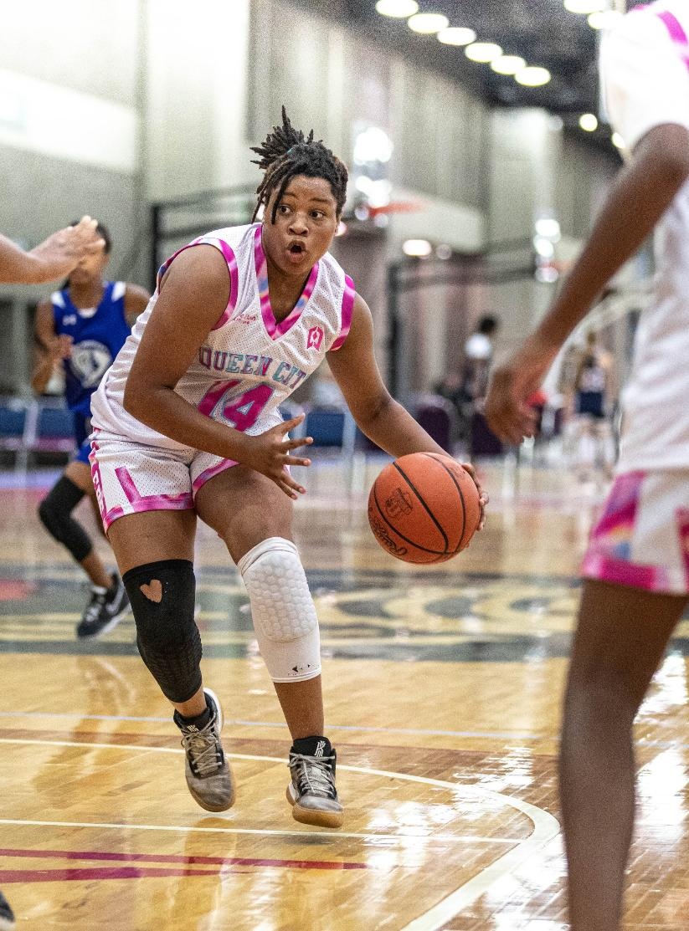
Business Imperatives
Aggressively pursue national and international sporting events that brand Louisville and attract visitors
Support facility initiatives that expand event attraction
Create events that provide positive cash flow
Promote active lifestyles

Slide 7
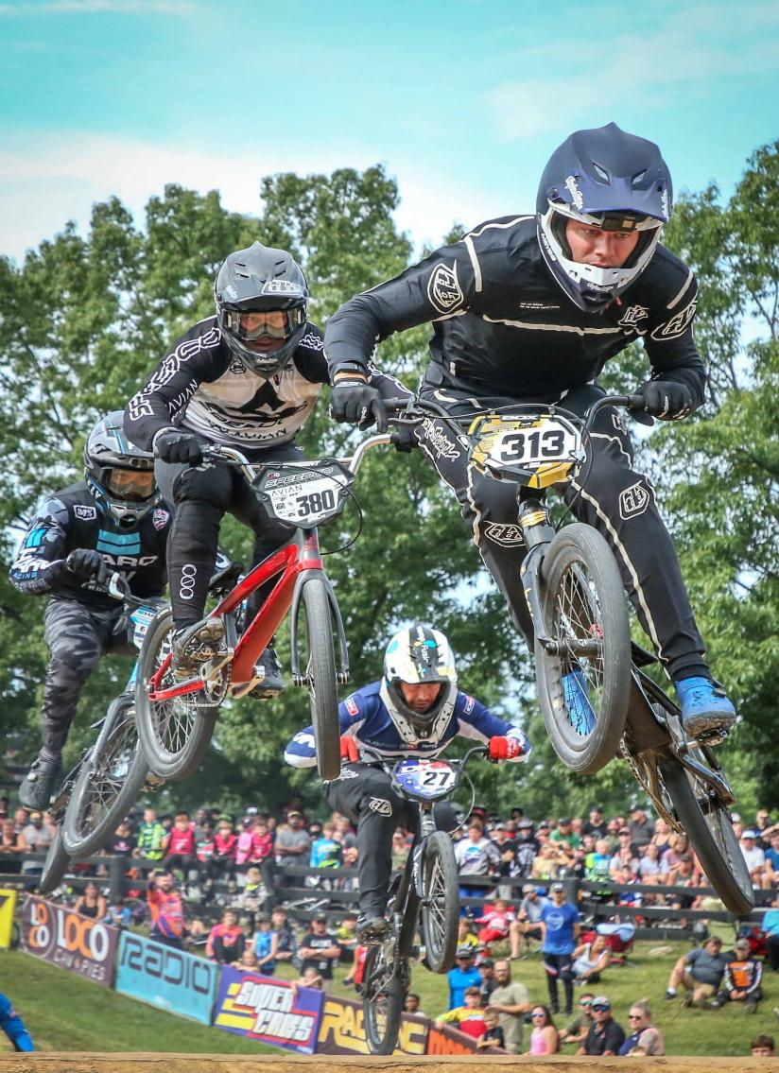
Importance of Venues
E. P. “Tom” Sawyer State Park
USA BMX Derby City Nationals
Annual event since 1984
LSC raised $1 million in 2016 to rebuild track to Olympic standards
In 2025, USA BMX signed a second 10-year agreement
Cross Country
LSC redesigned course in 2001 to collegiate standards to host regional/national meets
AAU, NAIA, NCAA, USATF
LSC annually maintains/improves course

Slide 8
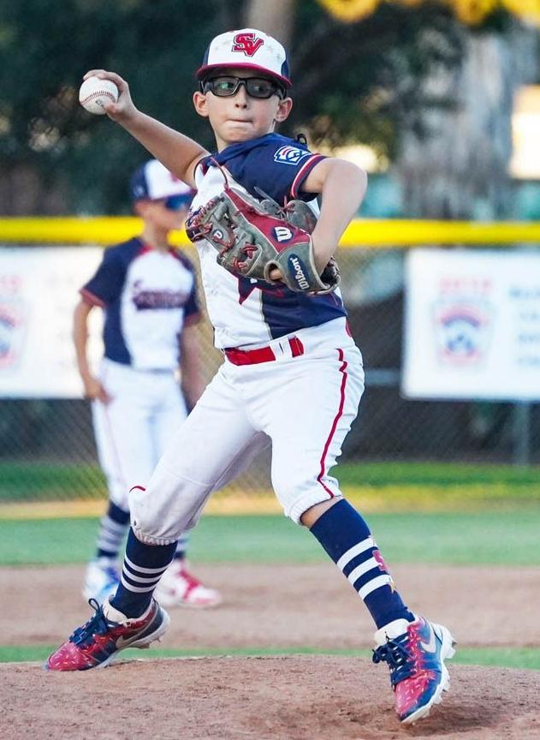
Venue Deficiencies
Field sports (soccer, lacrosse, field hockey, rugby, football)
Diamond sports (baseball, softball)
Ice sports (hockey, figure skating, curling)
Water sports (swimming, diving)

Slide 9
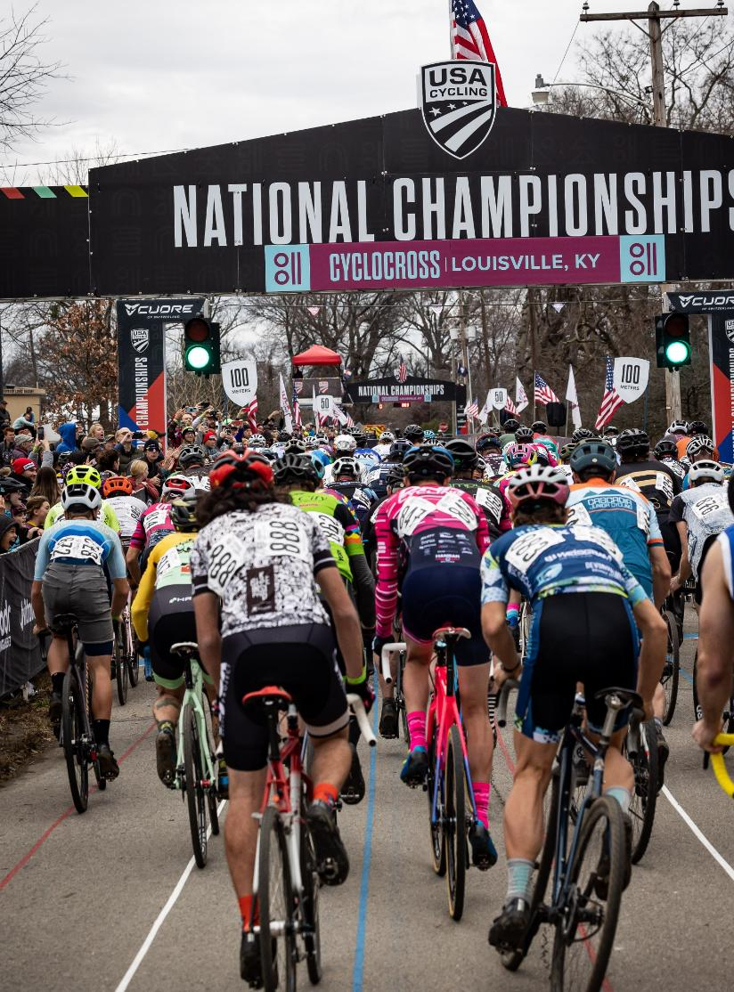
Hosted Sport Event Impact
15,000 room nights booked in FY1999
298,000 room nights booked in FY2025
Largest local travel/tourism market segment
$150 million annual visitor spending
$1.75 billion visitor spending since 1999
Positive exposure for community

Slide 10
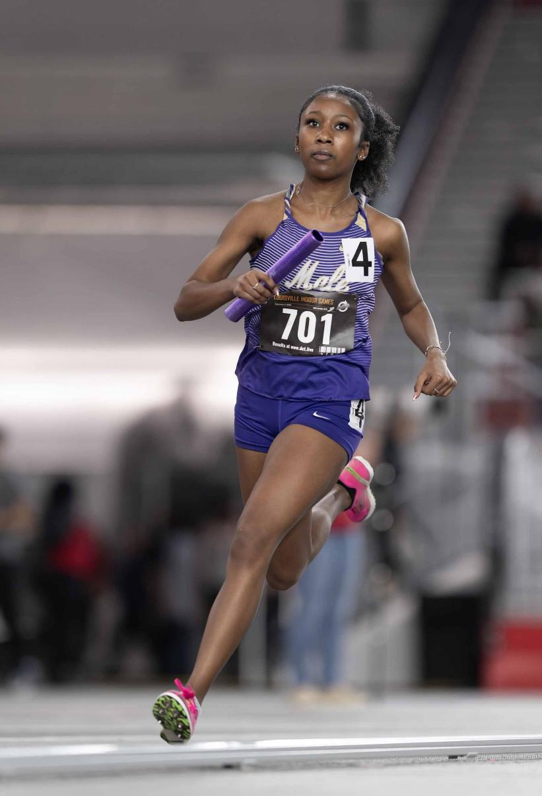
Owned and Operated Events
Louisville Pure Tap® 5K
Norton Sports Health 4-Miler
Urban Bourbon Half Marathon and 5K
Louisville Corporate Games
Swags Cross Country Classic
Louisville Indoor Games

Slide 11
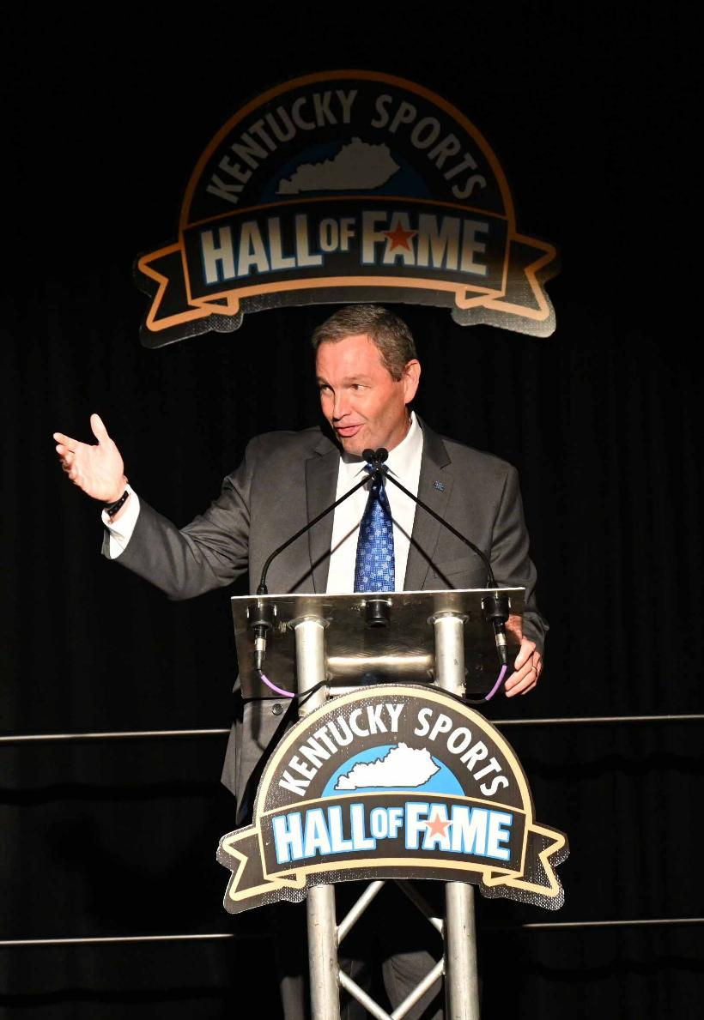
Owned and Operated Awards
Paul Hornung Award presented by Texas Roadhouse
Howard Schnellenberger MVP Award
Kentucky Sports Hall of Fame
Dr. Raymond Shea Health & Performance Champion Award
Howard Schnellenberger Battle for the Boots
Tom Musselman Sr. Gamechanger Award

Slide 12
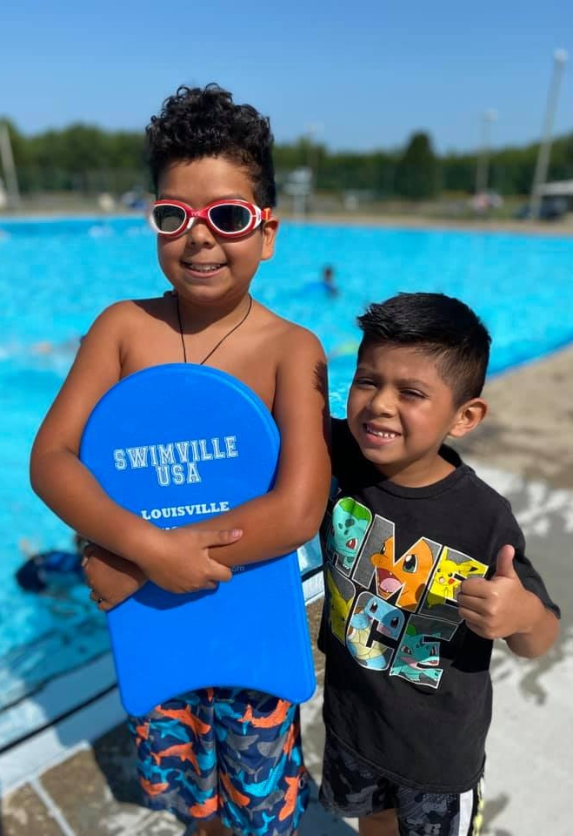
Louisville Active*
Breaking Barriers, Building Futures
MISSION Promote a culture of active lifestyles in our community as a pathway to a healthier, more productive life
*Recognized by Sports ETA as 2022 Event/Program Impact of the Year

Slide 13
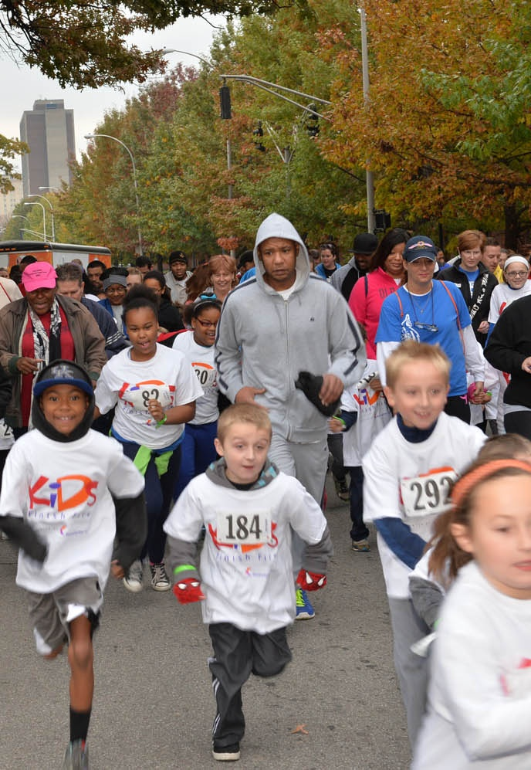

Kids Finish First
Launched 2012
Six-week program to instill habit of exercise
Kids walk, jog or run 12 total miles
Final 1.1 miles on secure course (=13.1 half marathon)
Medal and hydration/nutrition
5,000 participants to-date

Slide 14
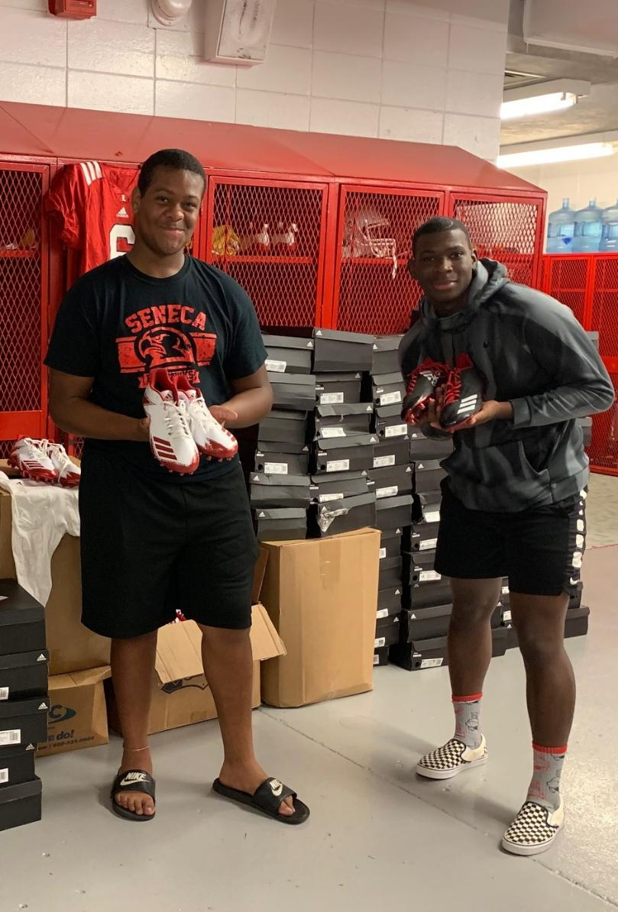
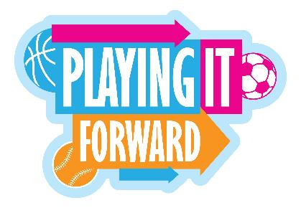
Playing it Forward
Launched 2017
Collect new, outgrown and gently used sports equipment
Distribute to youth who cannot afford it
Repurposed 16,500+ pieces of equipment, wearables to-date

Slide 15
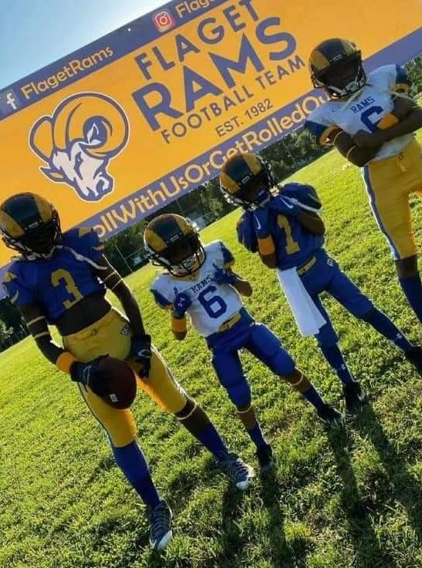

Sports Fun(d)
More Sports. More Kids. More Places.
Launched 2021
Grants for rec-level sports in marginalized areas
Existing/new programs
Provided $125,000 in grants to-date
1,600 participants to-date

Slide 16
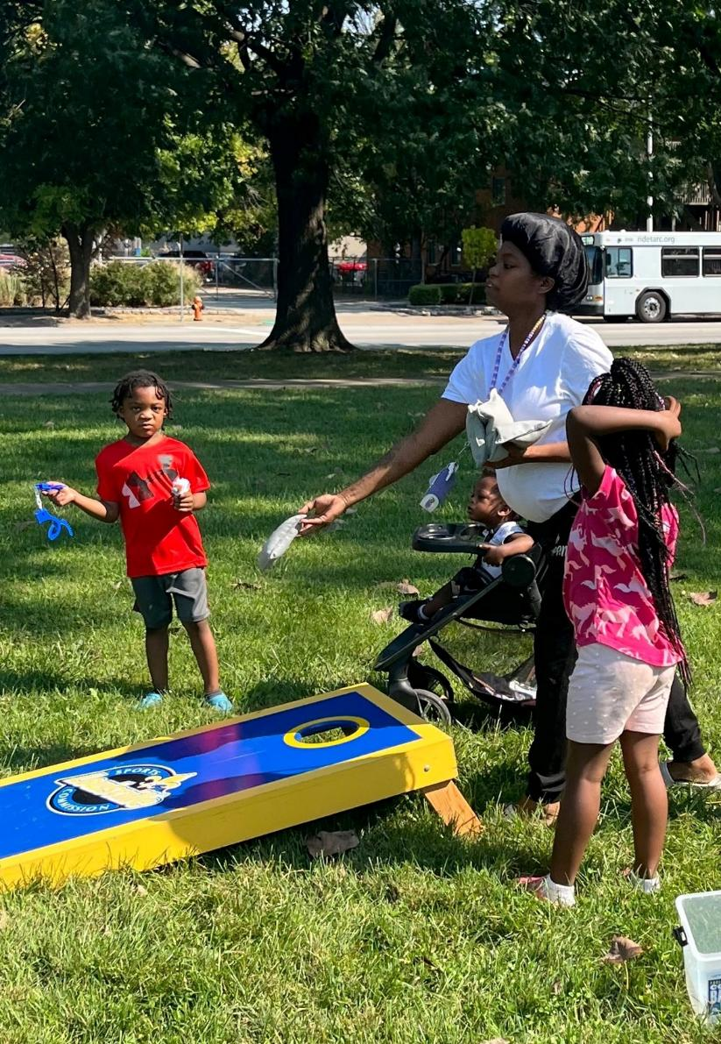

We Play
Launched 2022
One-day program
Family-friendly sports-related activities
Partner with local agencies
Beecher Terrace/Urban Strategies
Catholic Charities
Kentucky Refugee Ministries
Louisville Metro Housing Authority
Office for Safe and Healthy Neighborhoods
Seven County Services
3,000 youth/adults participated to-date

Slide 17
Questions

