Slide 1
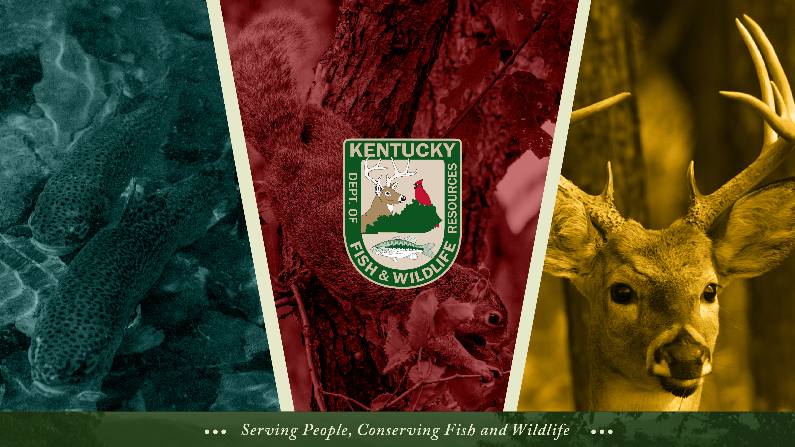

Slide 2
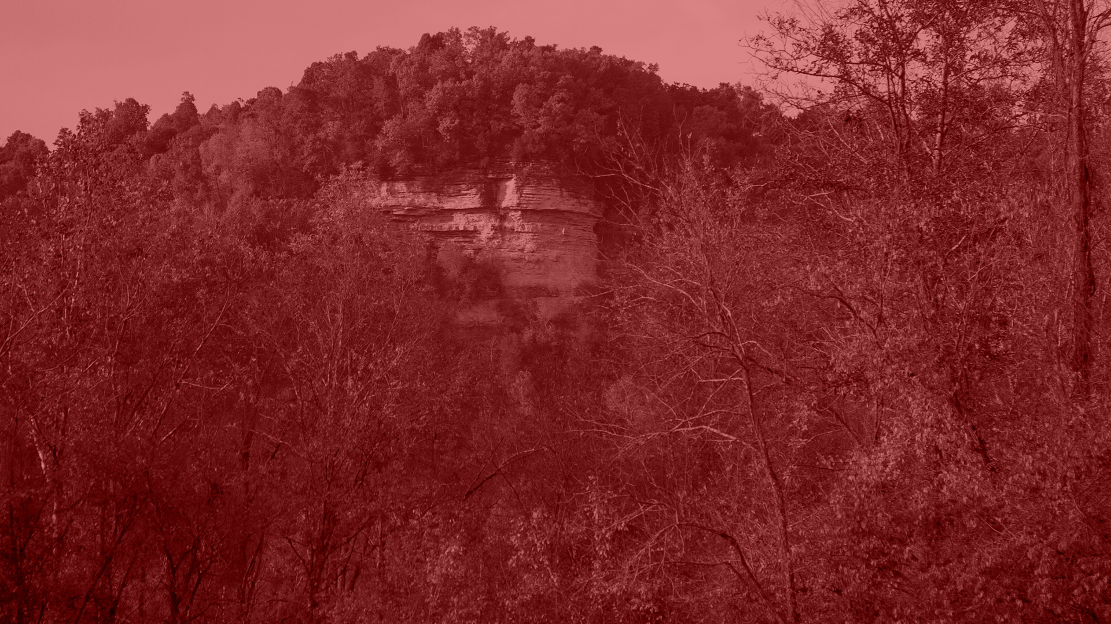
Administrative Services
. . .

Slide 3
Administrative Services
Routine Financial Audits: NO findings for the last 5 years
Annual Receipt Audit (KRS 150.152 & 150.0242)
  Includes review of internal controls
  Procurement (KRS Chapter 45A)
Federal Audit every 5 years (USFWS)
Desk Audits – USCG (United States Coast Guard), PSGP (Port Security Grant Program), USDA - APHIS (United States Department of Agriculture - Animal and Plant Health Inspection Service), etc.
Notes:
The hellbender is now the state amphibian and we have entered into a new partnership with Louisville Zoo to increase capacity.

Slide 4
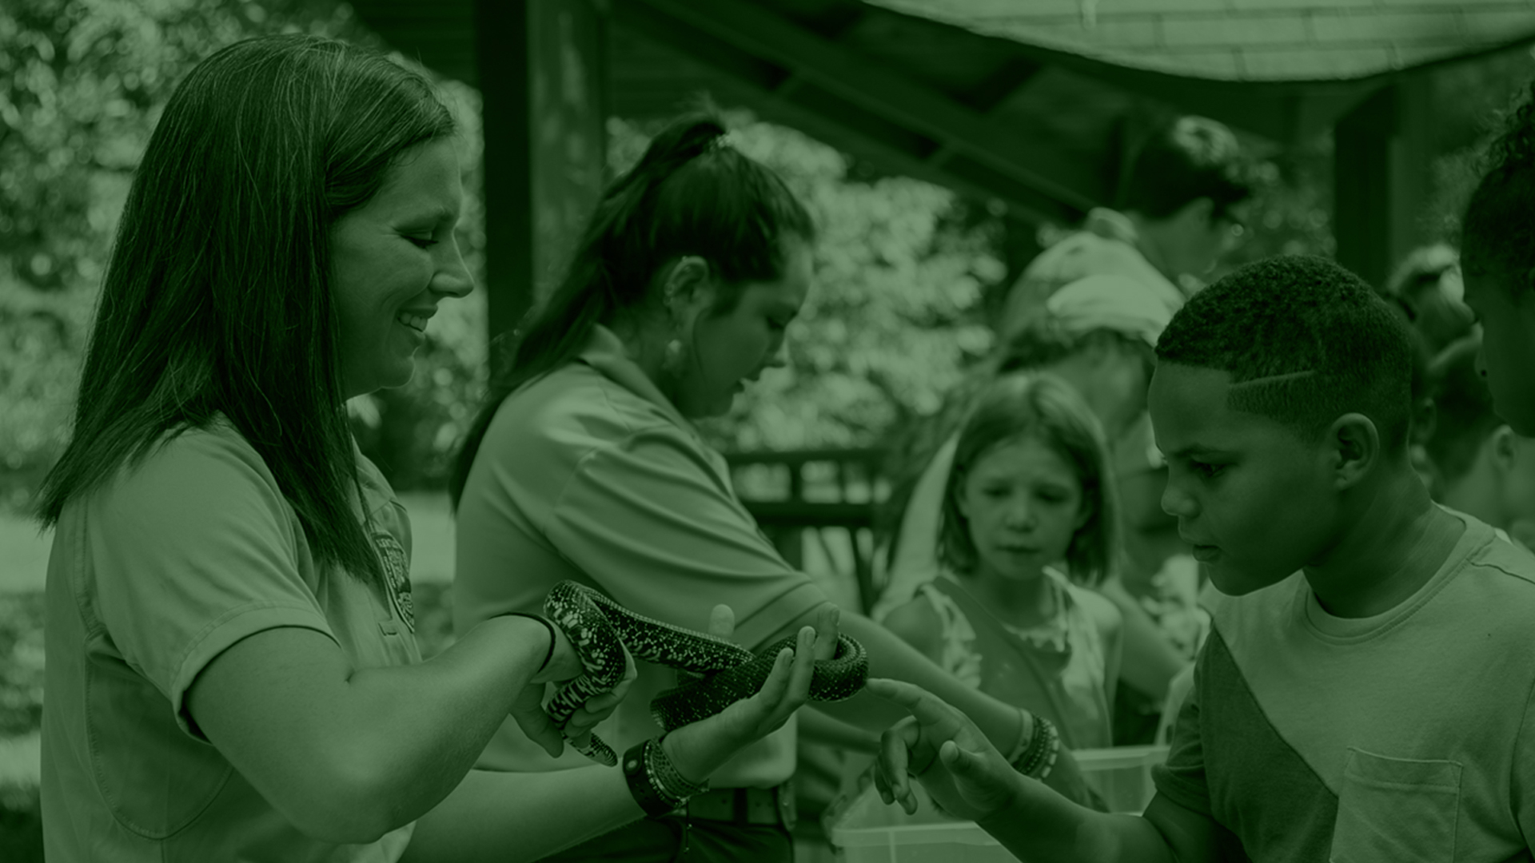
Information, Education & Marketing
. . .

Slide 5

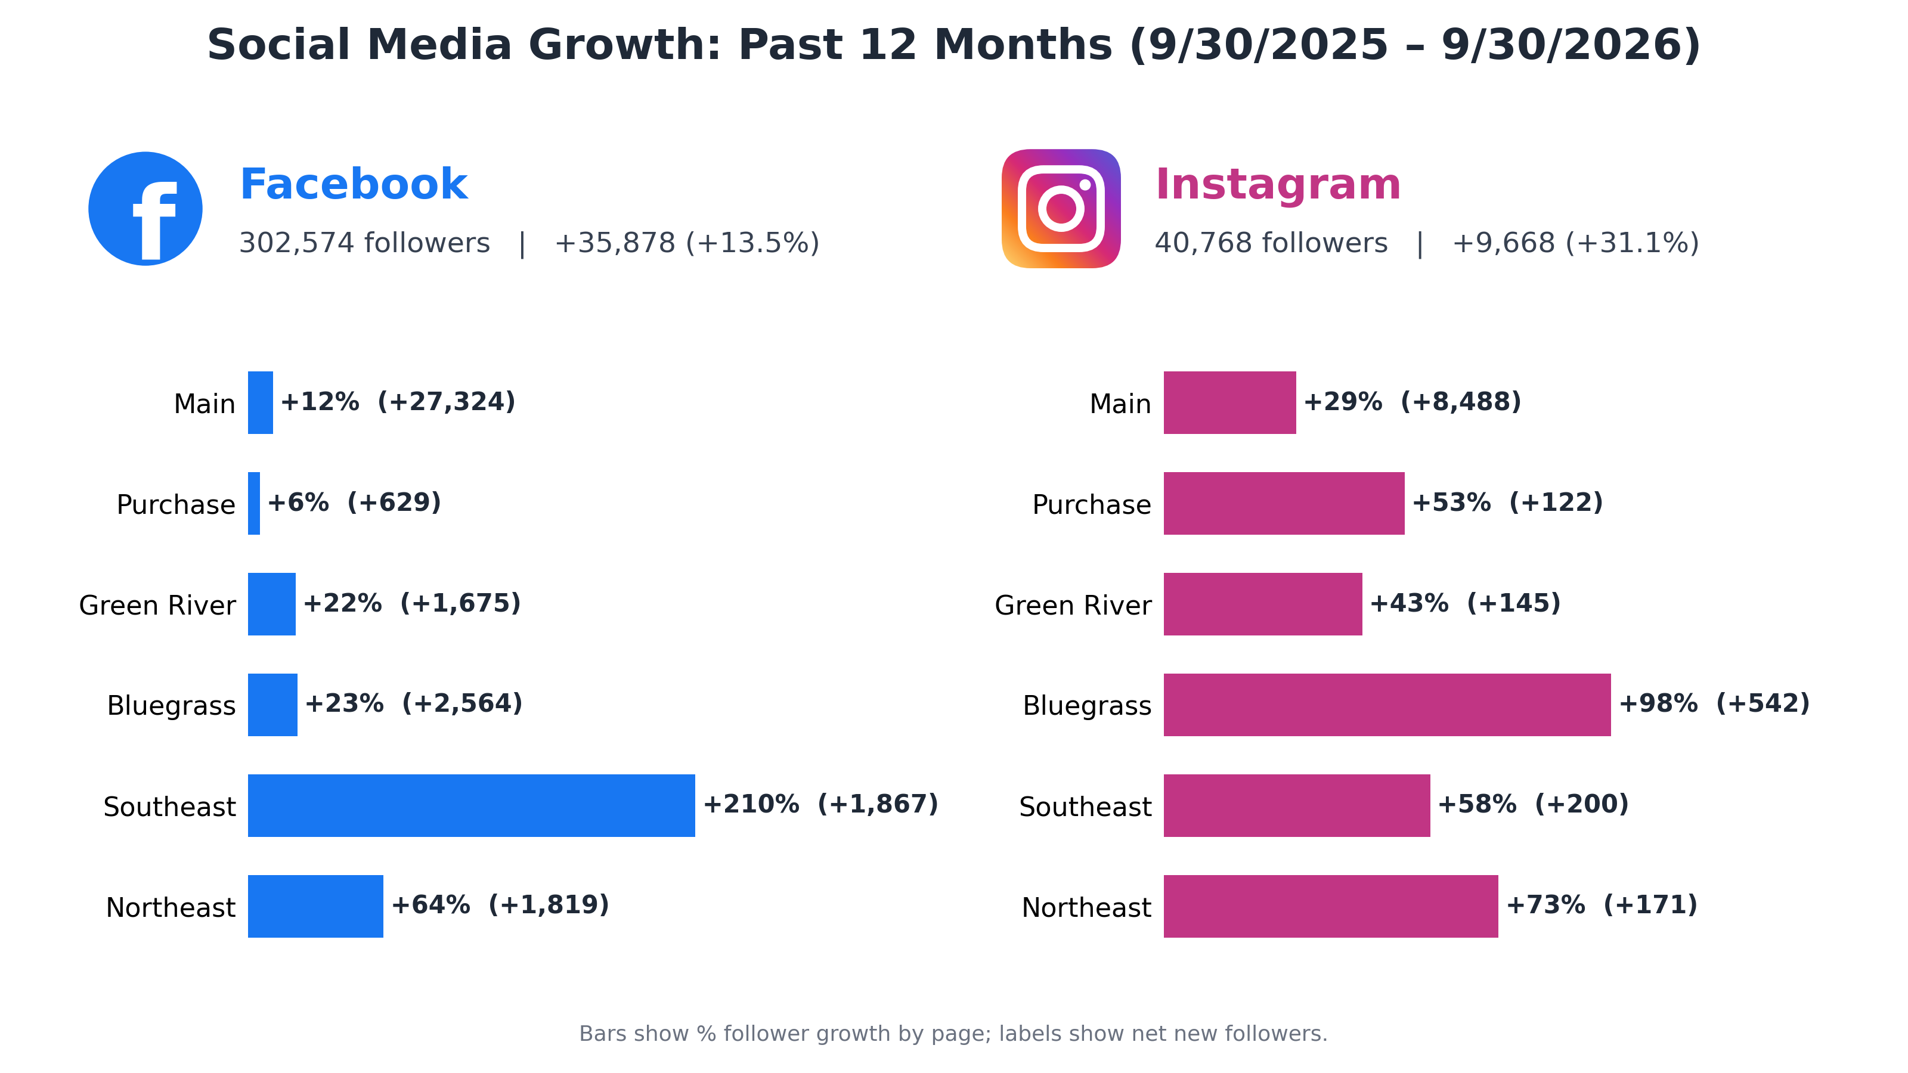
Social Media Reboot
In summer 2025, the Division consolidated social media accounts and launched five regional Facebook and Instagram pages focused on local hunting, fishing and outdoor recreation opportunities. In addition to these regional accounts, the department now manages 27 social
media
accounts reaching more than 985,000 followers/subscribers combined across four platforms (Facebook, Instagram, YouTube, X).

Slide 6
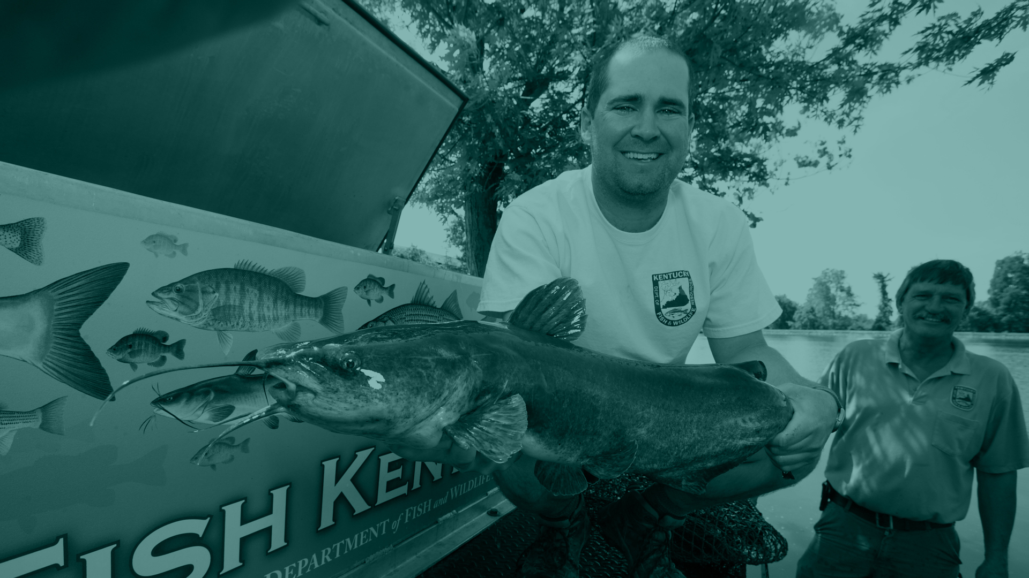
Fisheries
. . .

Slide 7
Notes:
Looking at the harvest effort through August of this year the levels are tracking to exceed 2025 harvest but still a significant decrease from 2024 level.
The invasive carp subsidy for Kentucky Lake and Lake Barkley is $0.15/lbs.

Slide 8
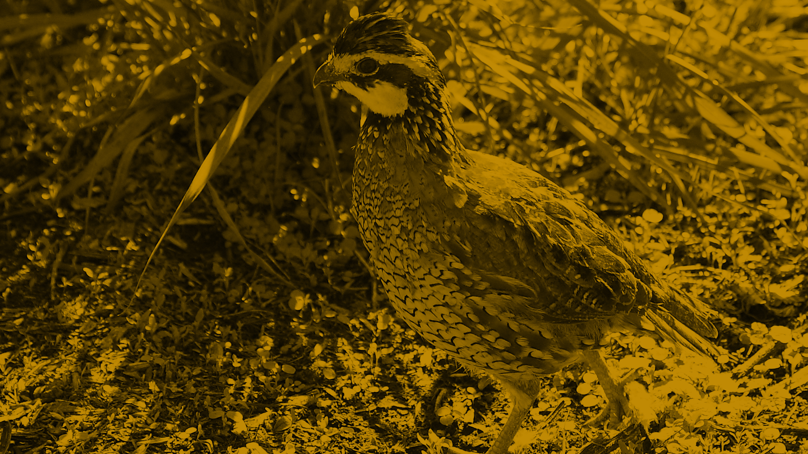
Wildlife
. . .

Slide 9
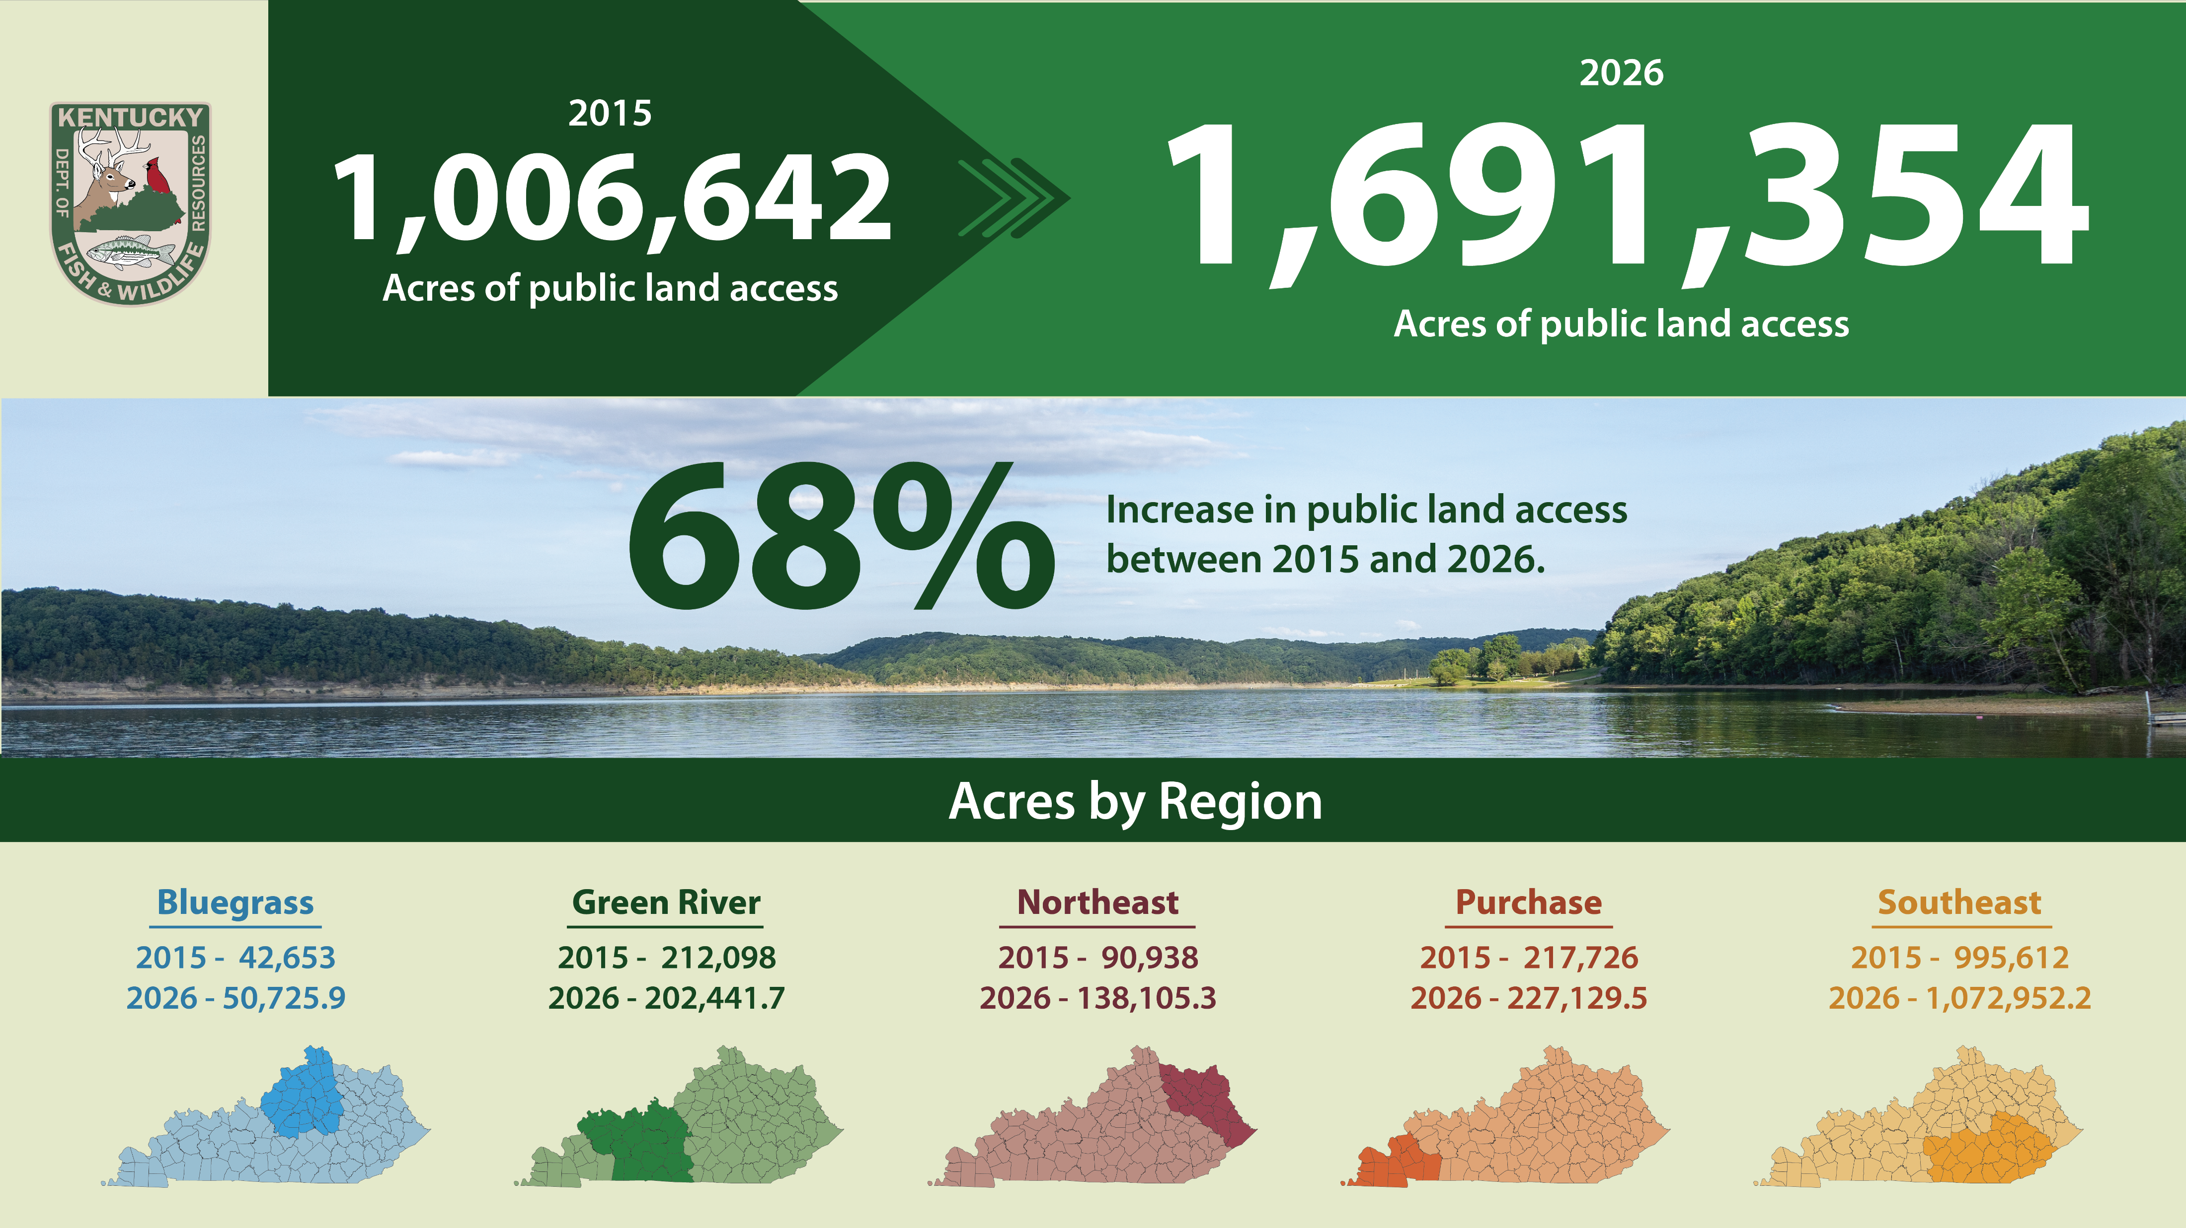
Notes:
Take home message – we continue to prioritize creative strategies to acquire land and provide public access for hunting, fishing and outdoor related recreation.

Slide 10
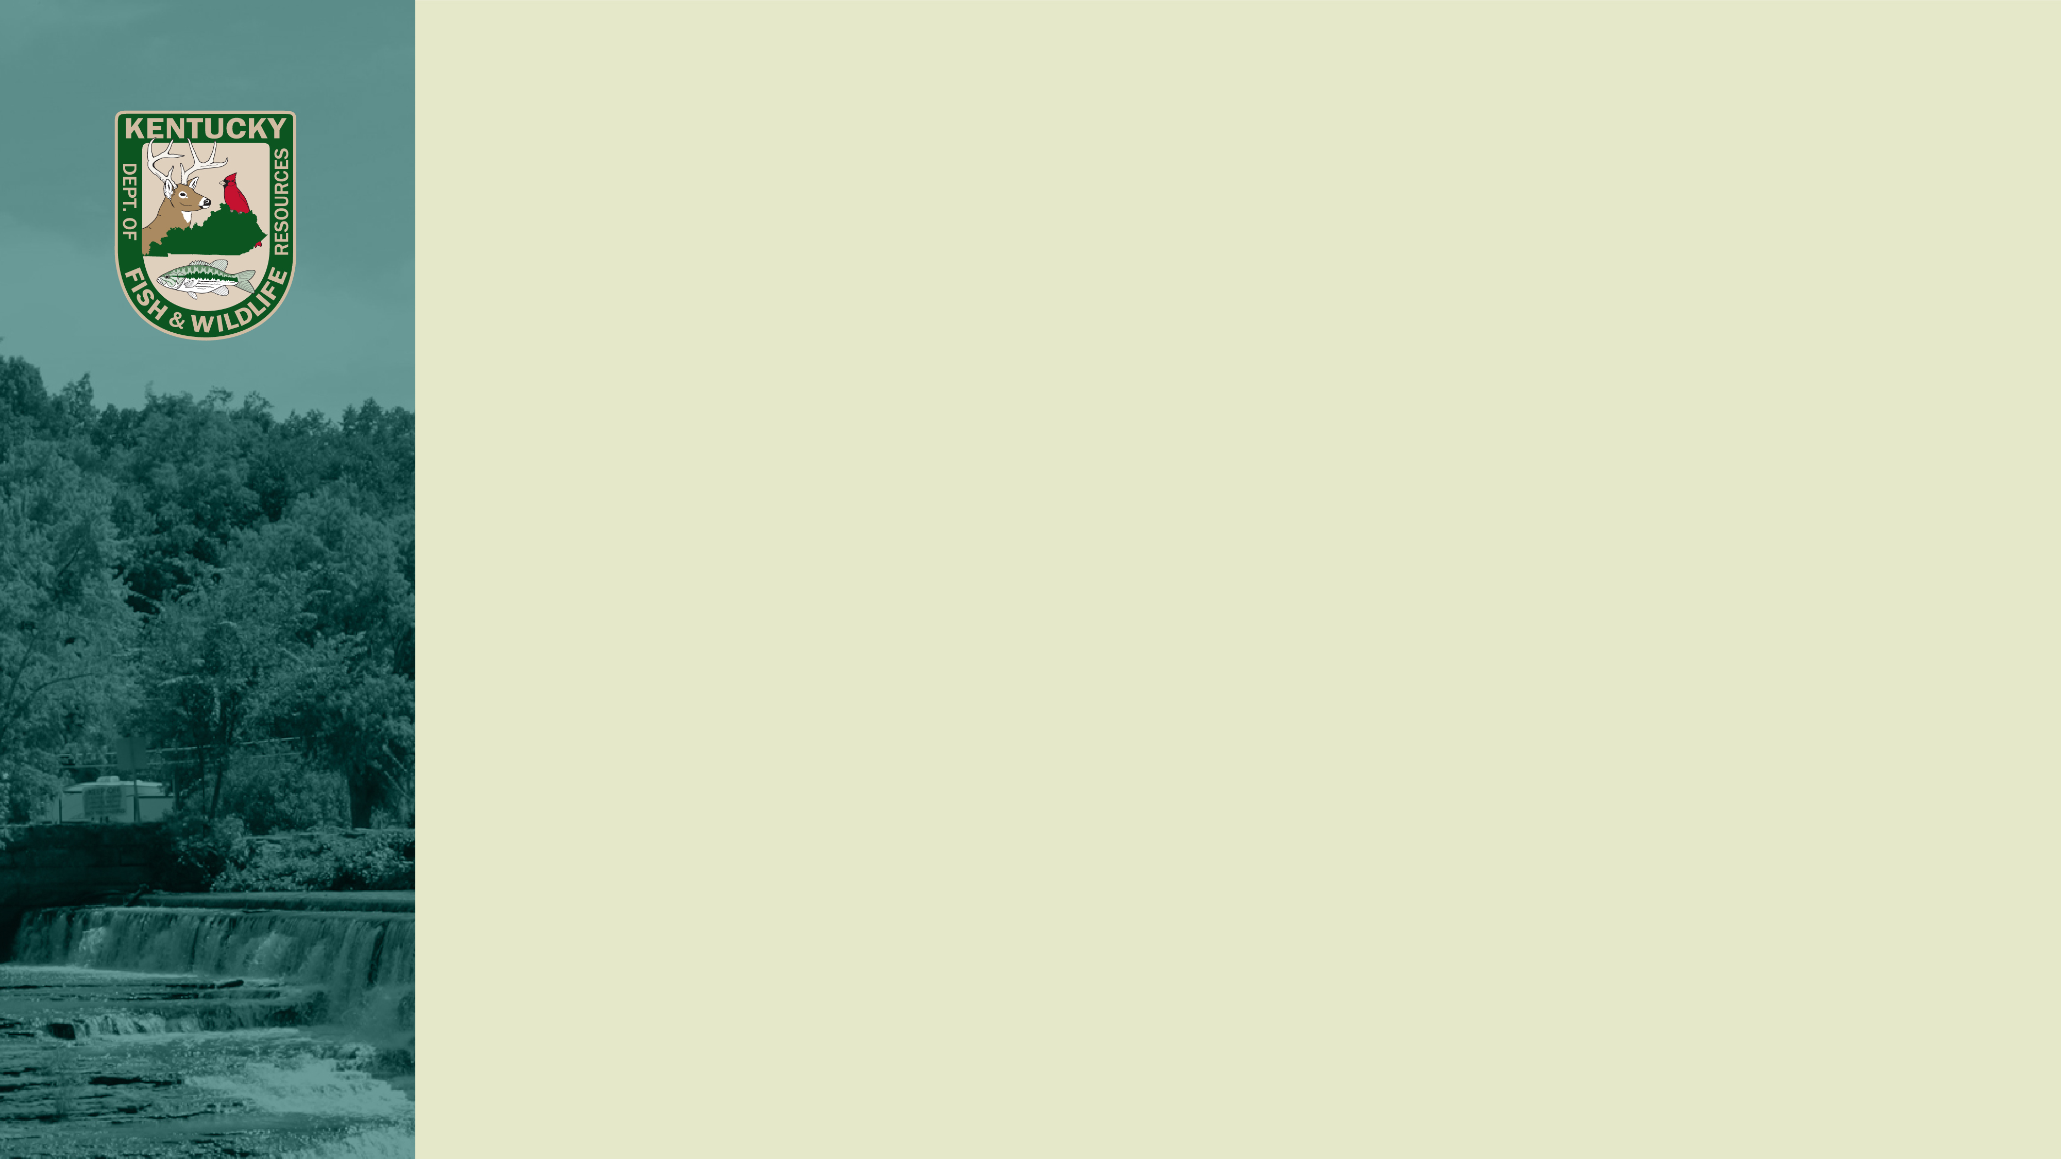
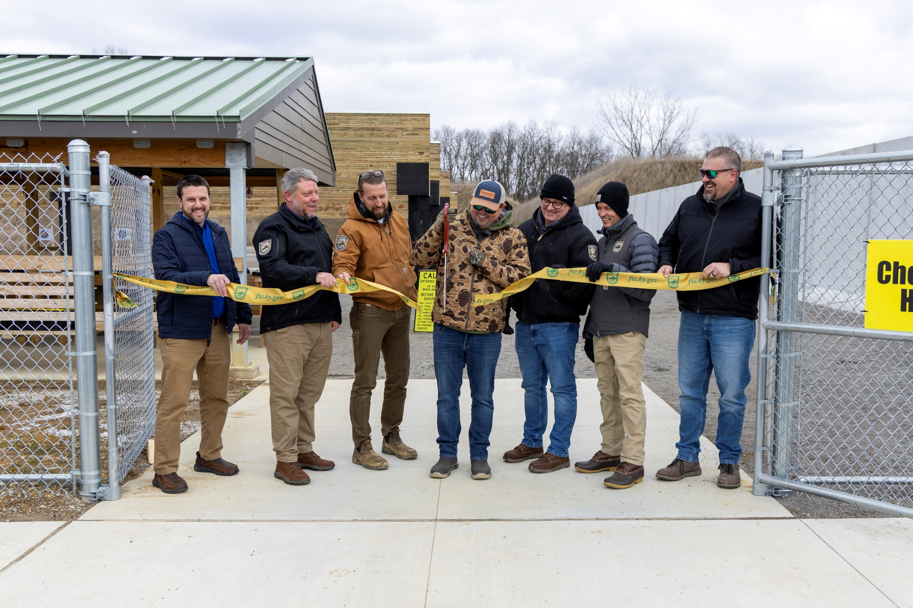
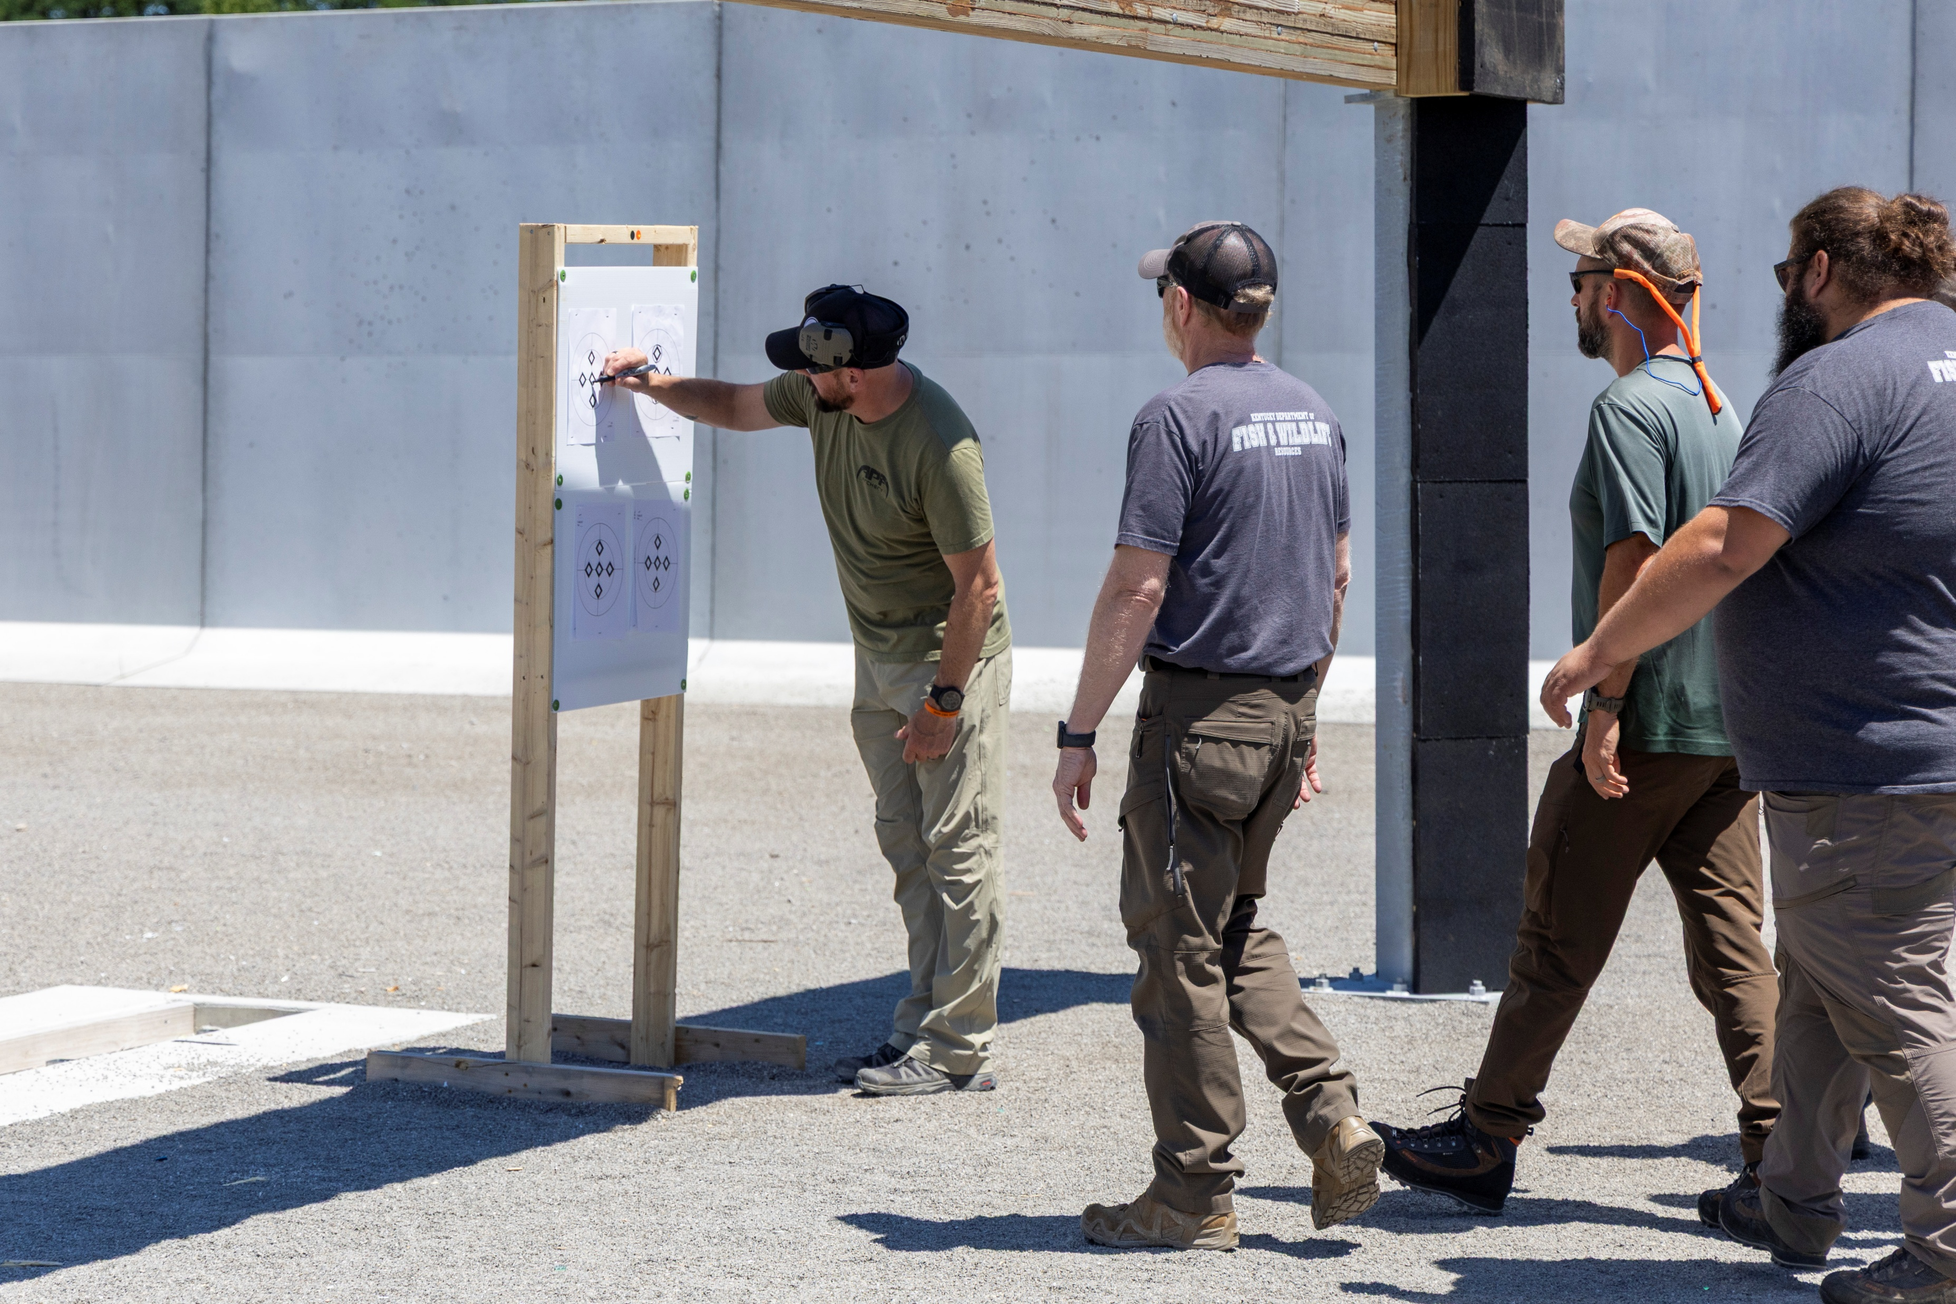
Wildlife
Approximately 40 Wildlife Division staff completed Basic Firearms Training with another 20 completing Advanced Shooting in Sensitive Areas training.
Opened the new Veteran’s WMA shooting range and office complex.
Notes:
Take home message – staff trainings have been a priority for the division this year which ultimately equates to a higher caliber workforce available to better serve the public.

Slide 11
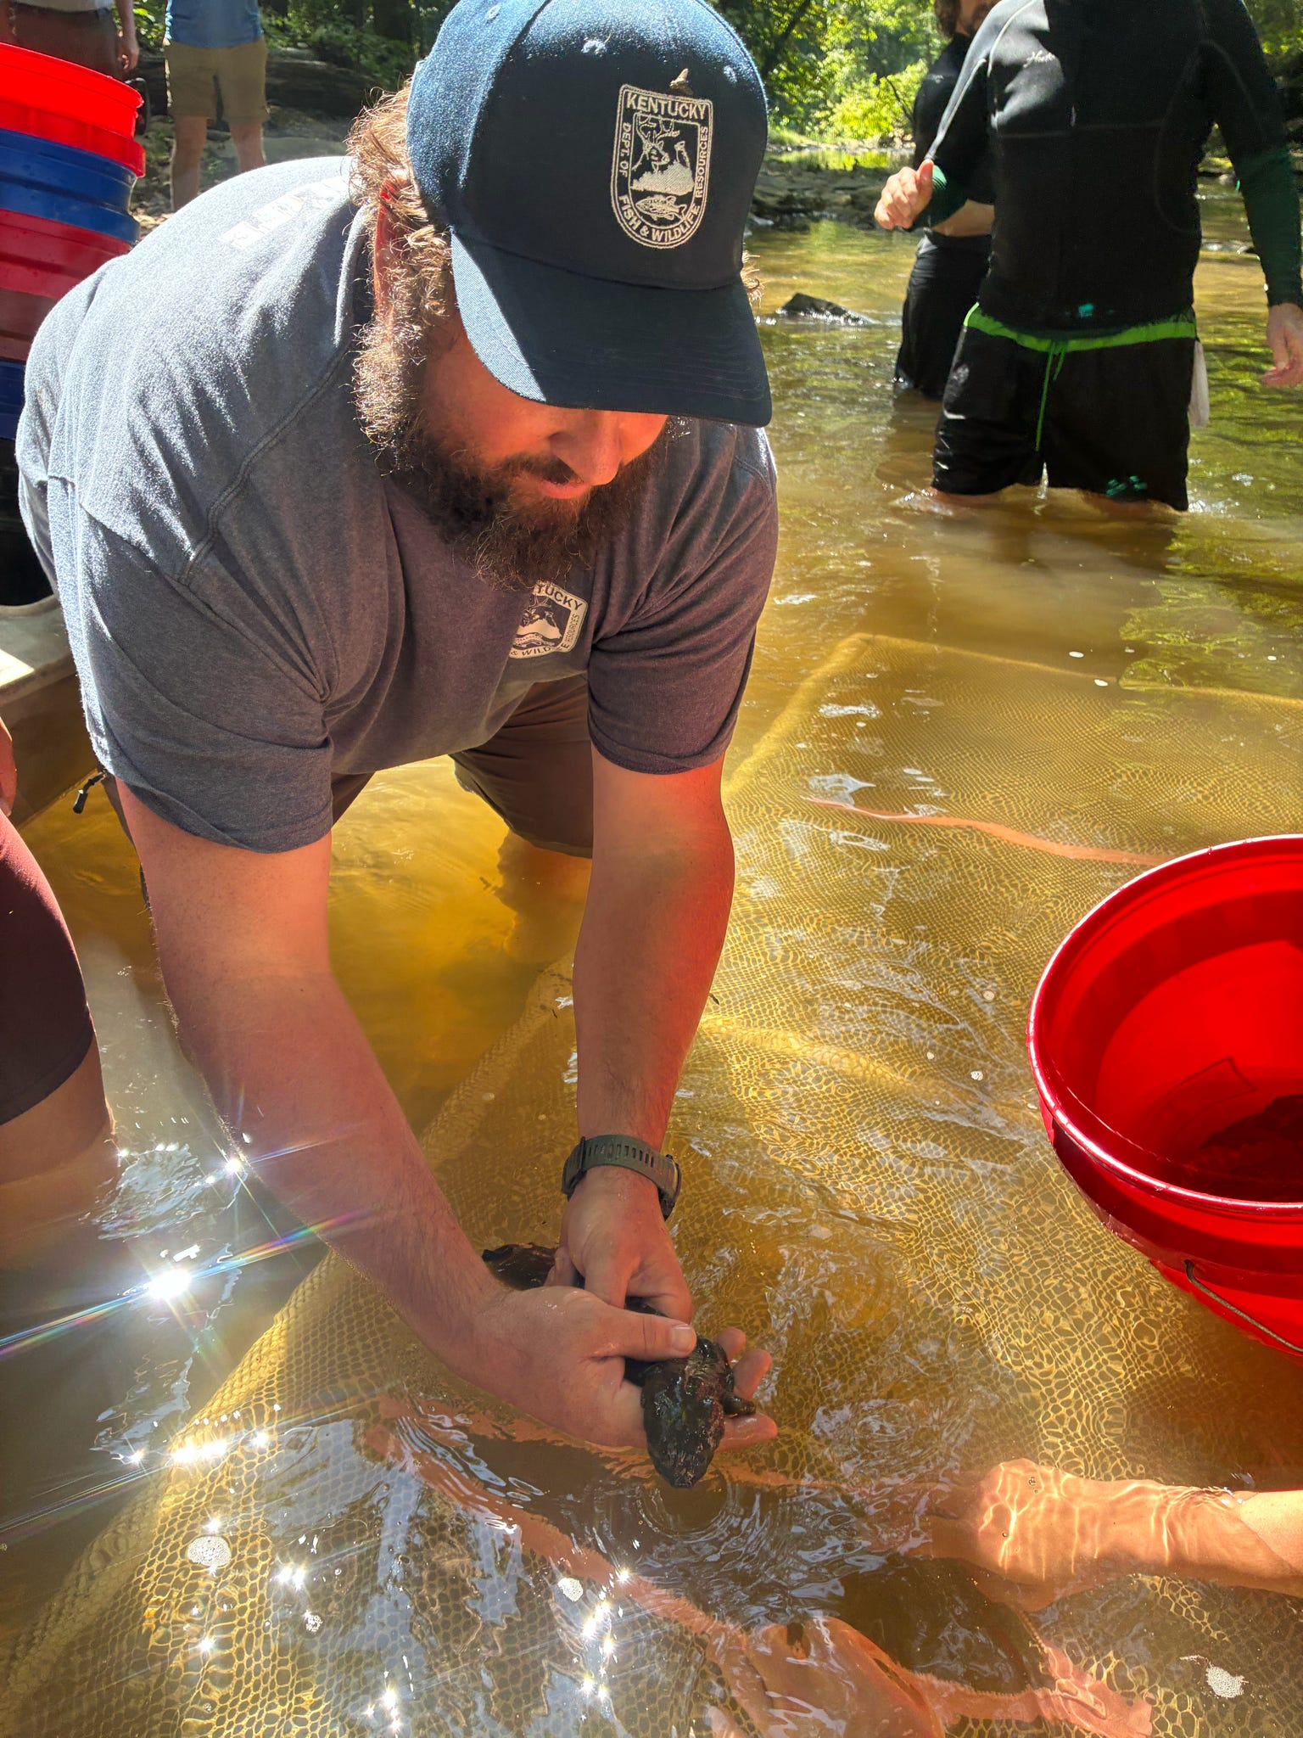
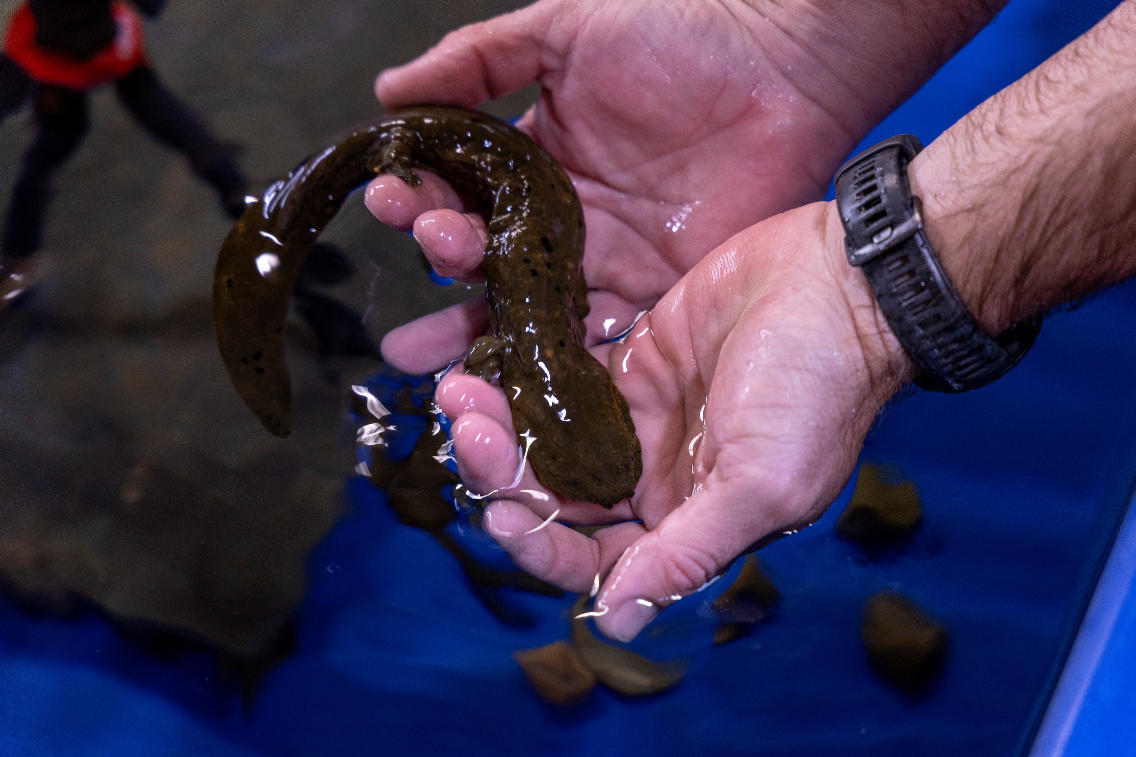
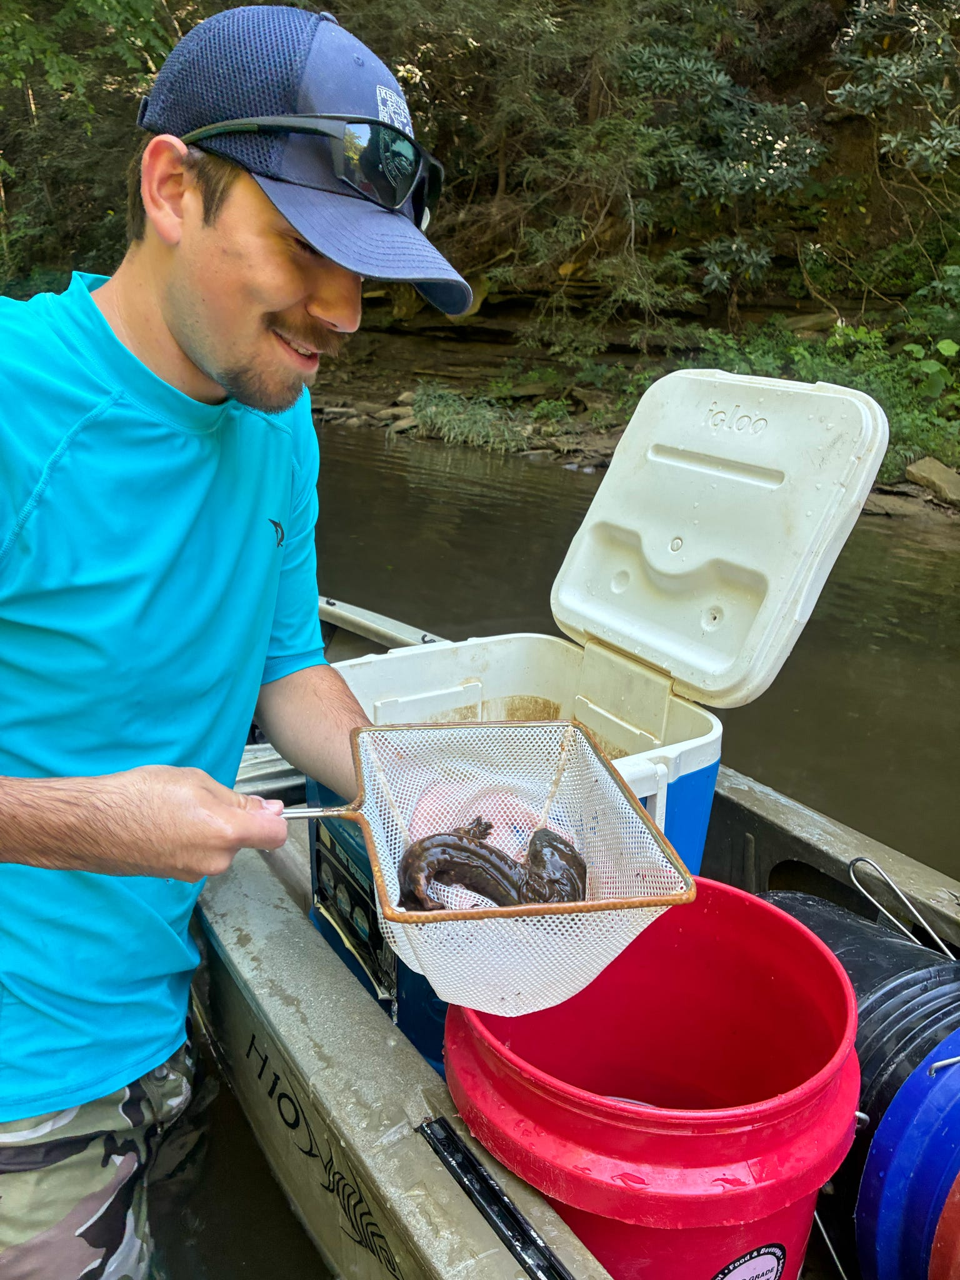
Wildlife
KDFWR continues to raise young hellbenders in captivity by hatching eggs collected from wild nests. This process greatly improves survivorship of young animals. When young reach releasable size, they are tagged and returned to the wild. This summer, our team released 117 animals at four locations to help bolster existing populations.
  The hellbender is now the state amphibian and we have entered into a new partnership with Louisville Zoo to increase capacity.
Notes:
The hellbender is now the state amphibian and we have entered into a new partnership with Louisville Zoo to increase capacity.

Slide 12
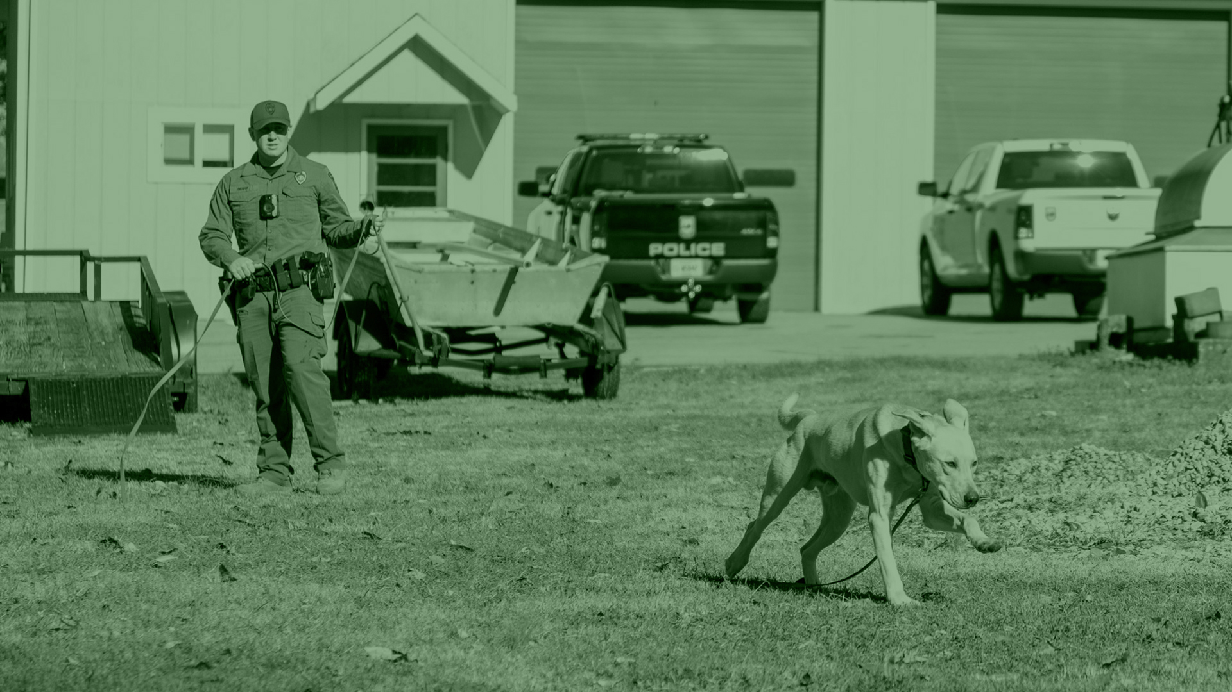
Law Enforcement
. . .

Slide 13
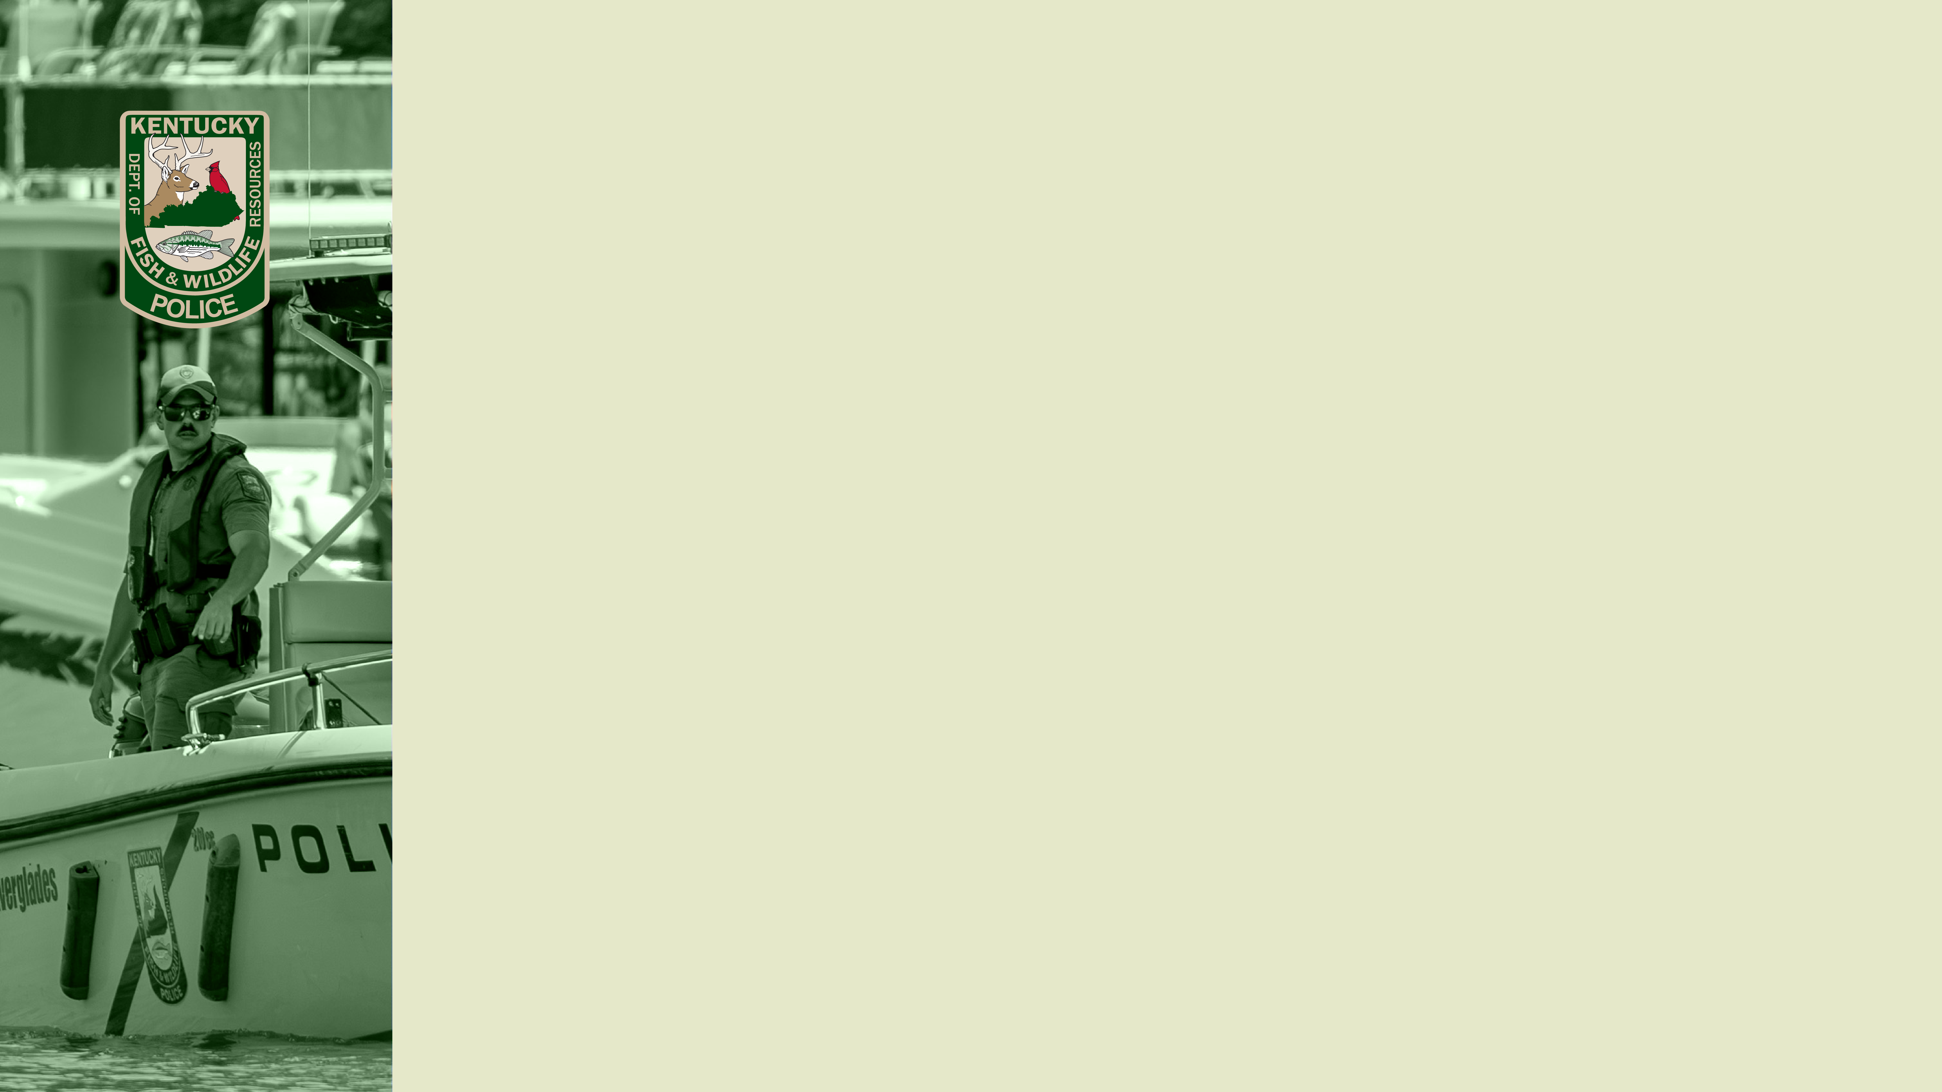
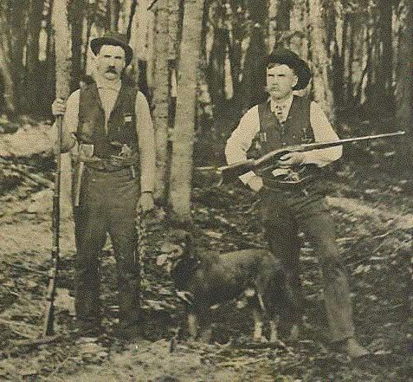
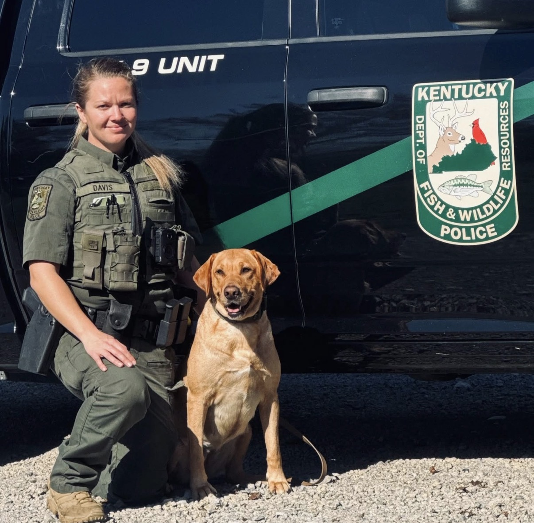
1912-Present
Kentucky Game Wardens ……… the Commonwealth’s oldest state law enforcement agency, serving since 1912

Slide 14
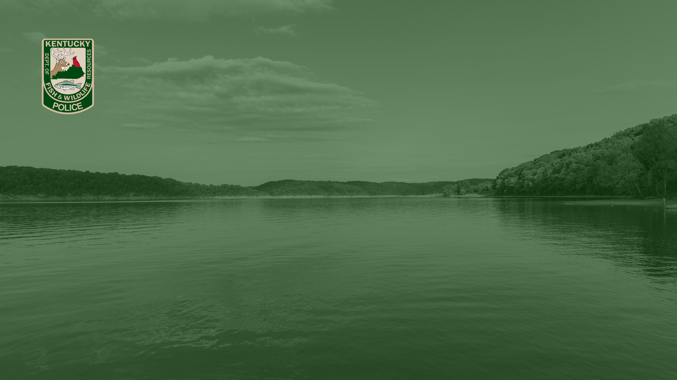
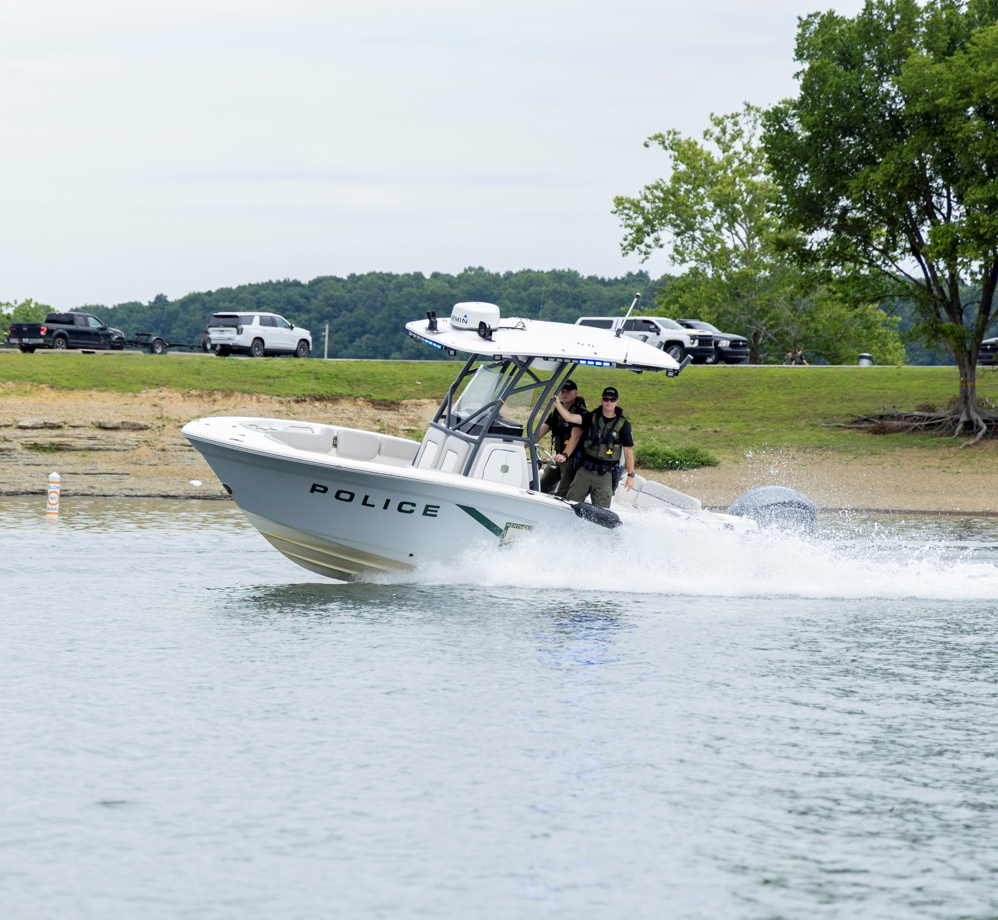
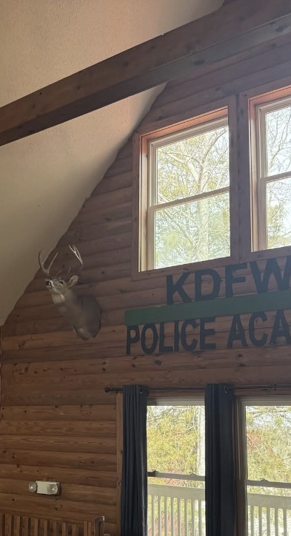
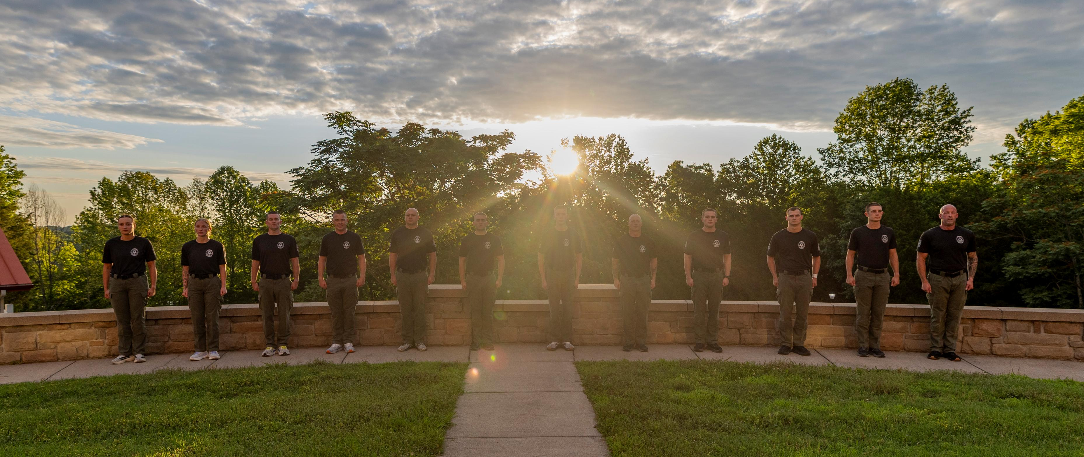
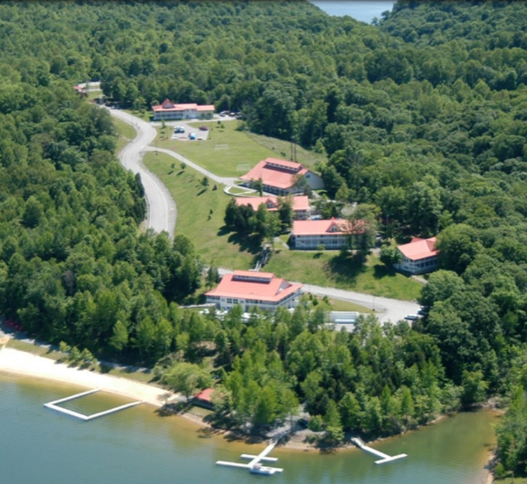
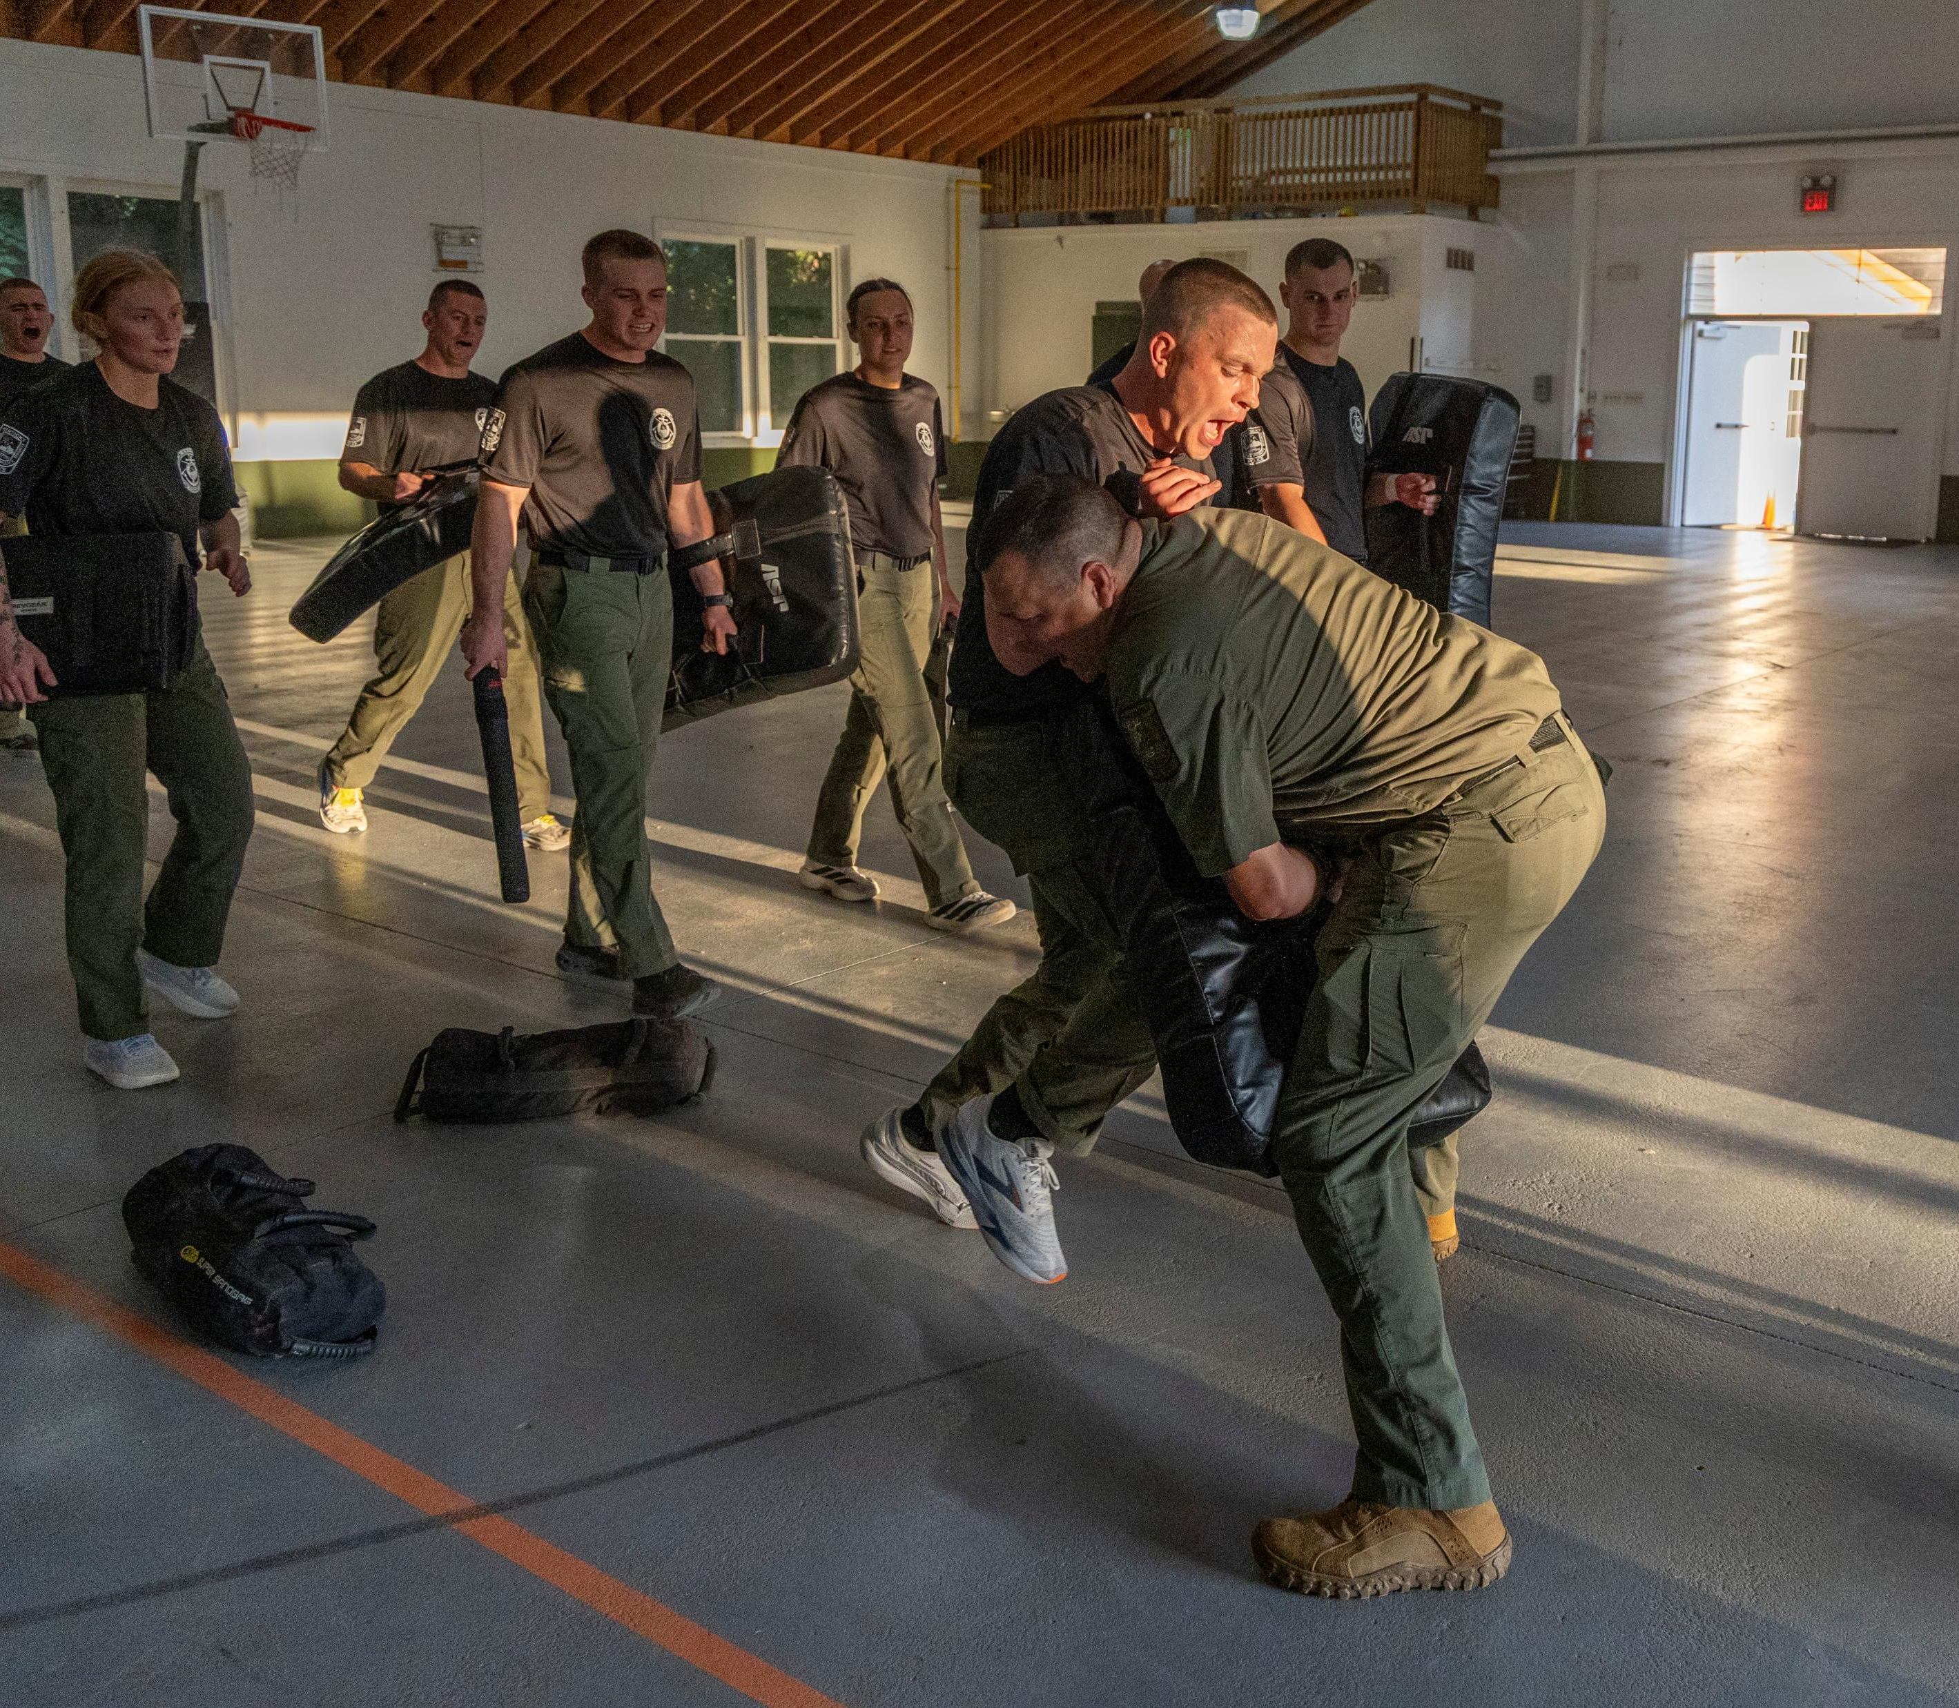
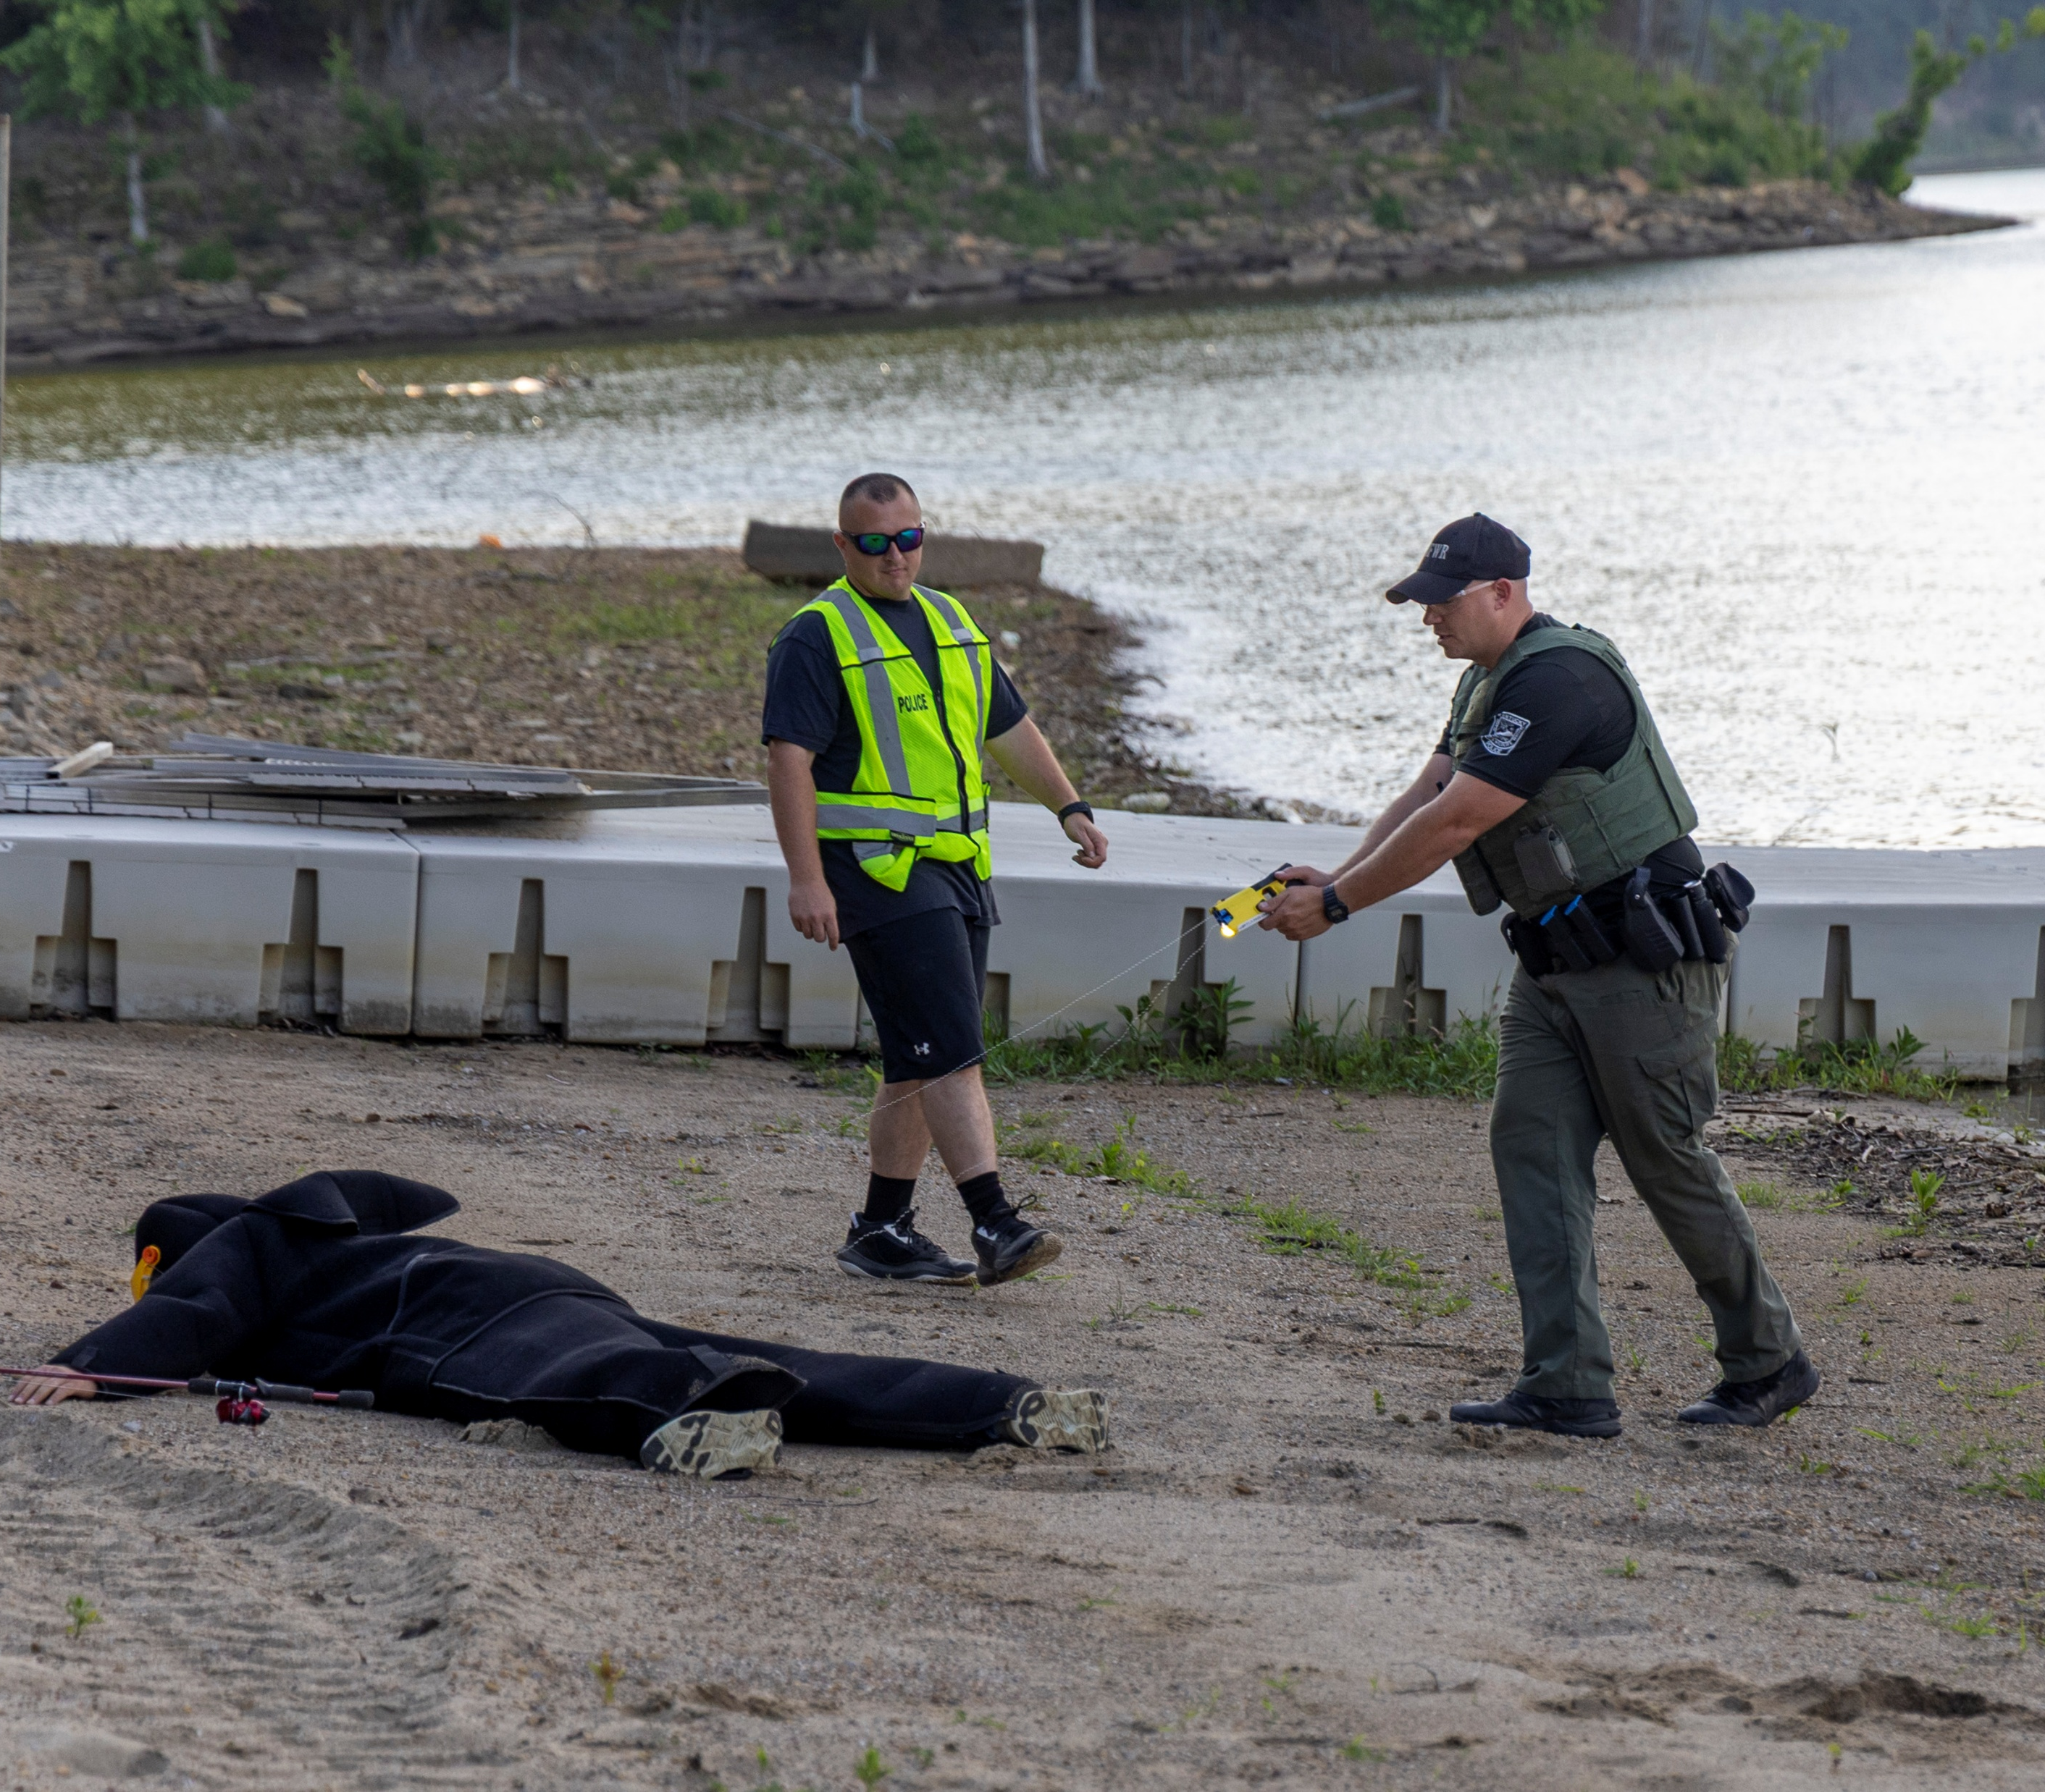
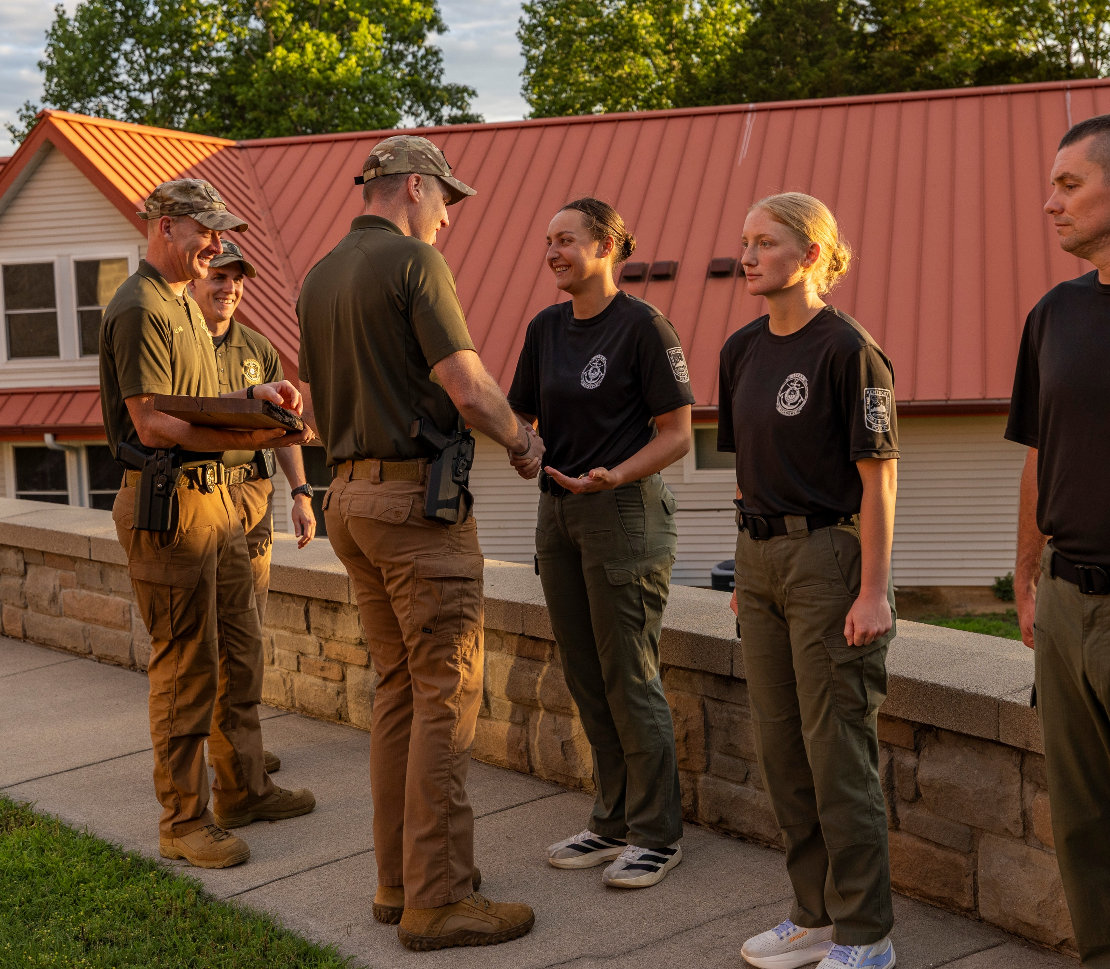
Camp Kentucky Afield
Home of the Kentucky Game Warden Training Center

Slide 15
Wardens have completed trainings through various avenues such as:
The FBI National Academy
The National Conservation Law Enforcement Leadership Academy
The Criminal Justice Executive Development Program at the Department of Criminal Justice Training

Slide 16
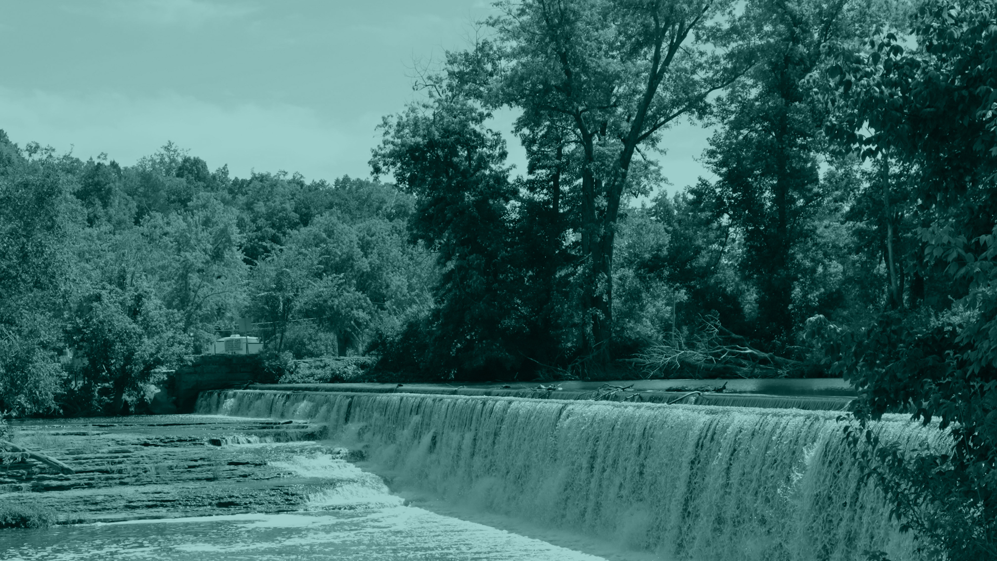
Engineering, Infrastructure, & Technology
. . .

Slide 17
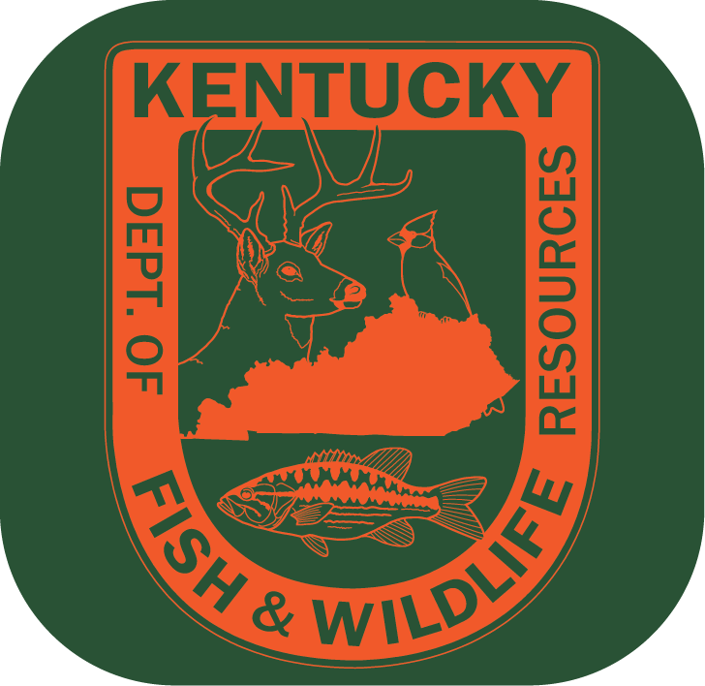
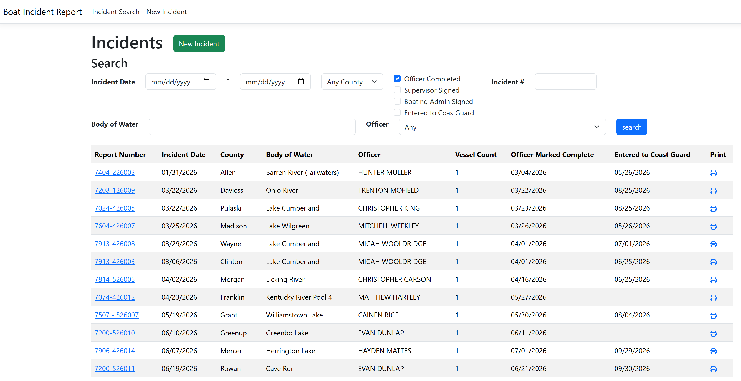
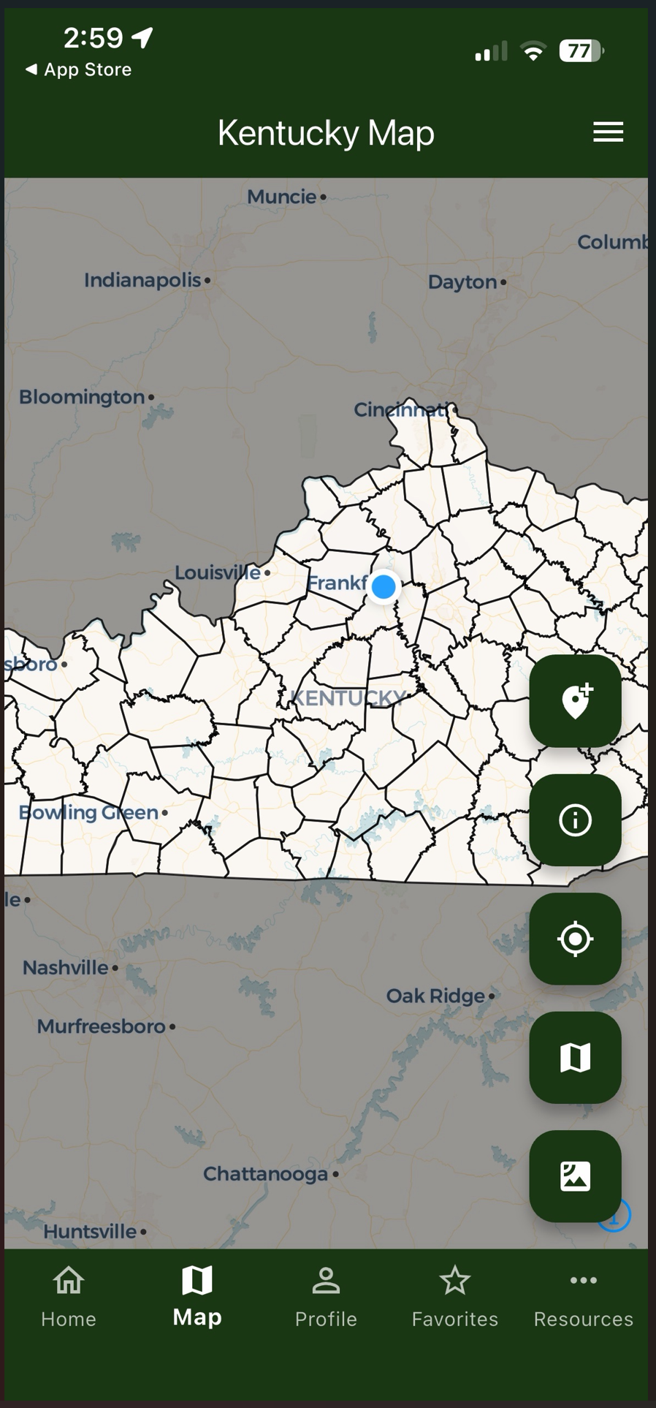
Information & Technology Branch
Developed and deployed several new applications, including:
  EIT Funds application
  Boat Accident reporting application
  CWD Mobile App (with Wildlife)
  Provided ongoing maintenance and enhancements for core licensing and quota systems (Quota Hunts, Elk Quota, etc.), supporting annual cycles and peak seasons with minimal downtime.

Slide 18
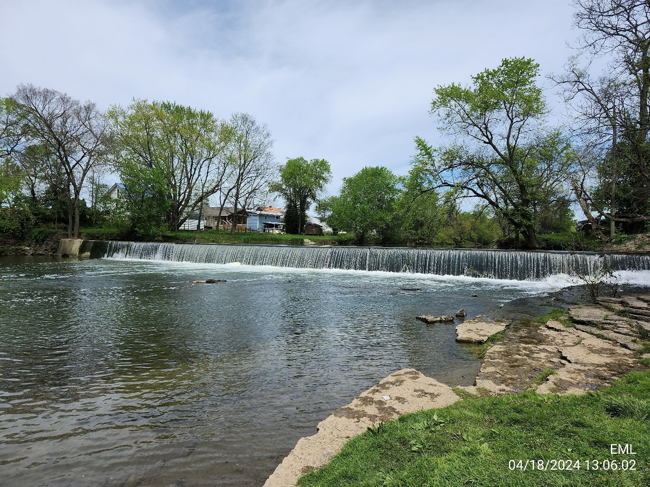
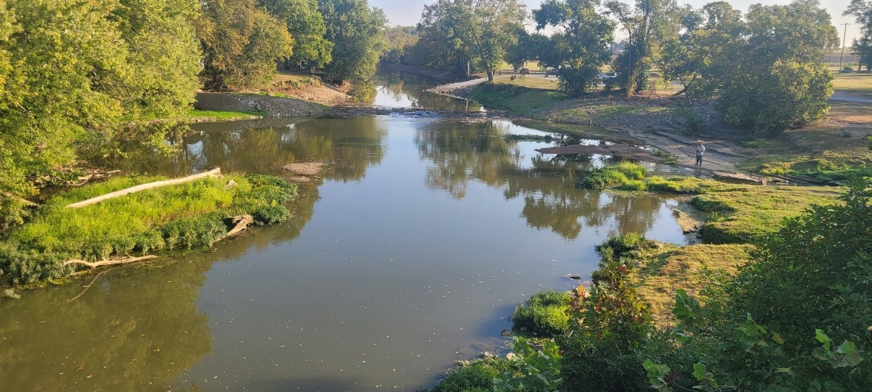
Environmental/Engineering
Dam removal projects:
  Removed the dam on Elkhorn Creek at Great Crossings in partnership with the US Fish and Wildlife Service and Kentucky Waterways Alliance.
    removed trash
    stocked catfish
  Green River lock and dam #6:
    Assisted US Fish and Wildlife in removing more of the old dam to increase free flowing river in Mammoth Cave National Park and to improve paddle craft navigation.
The FILO program completed two pollution clean-up projects:
  Plugged two leaking, abandoned oil wells to eliminate pollution next to Green River in Warren County, eliminating the threat to fisheries, wildlife, and mussel resources

