Slide 1
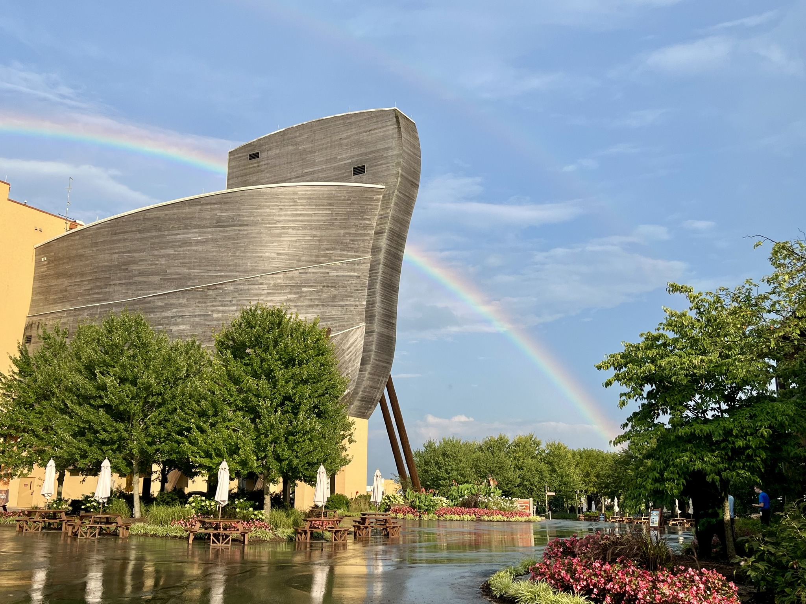
Ark Encounter Impact:
10 years
Notes:
Introductory comments

Slide 2
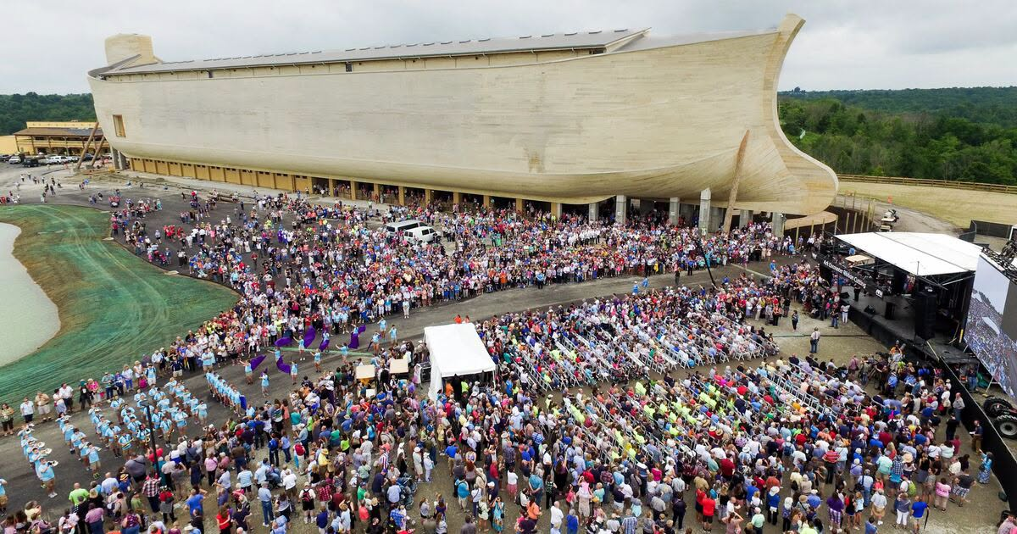

Slide 3
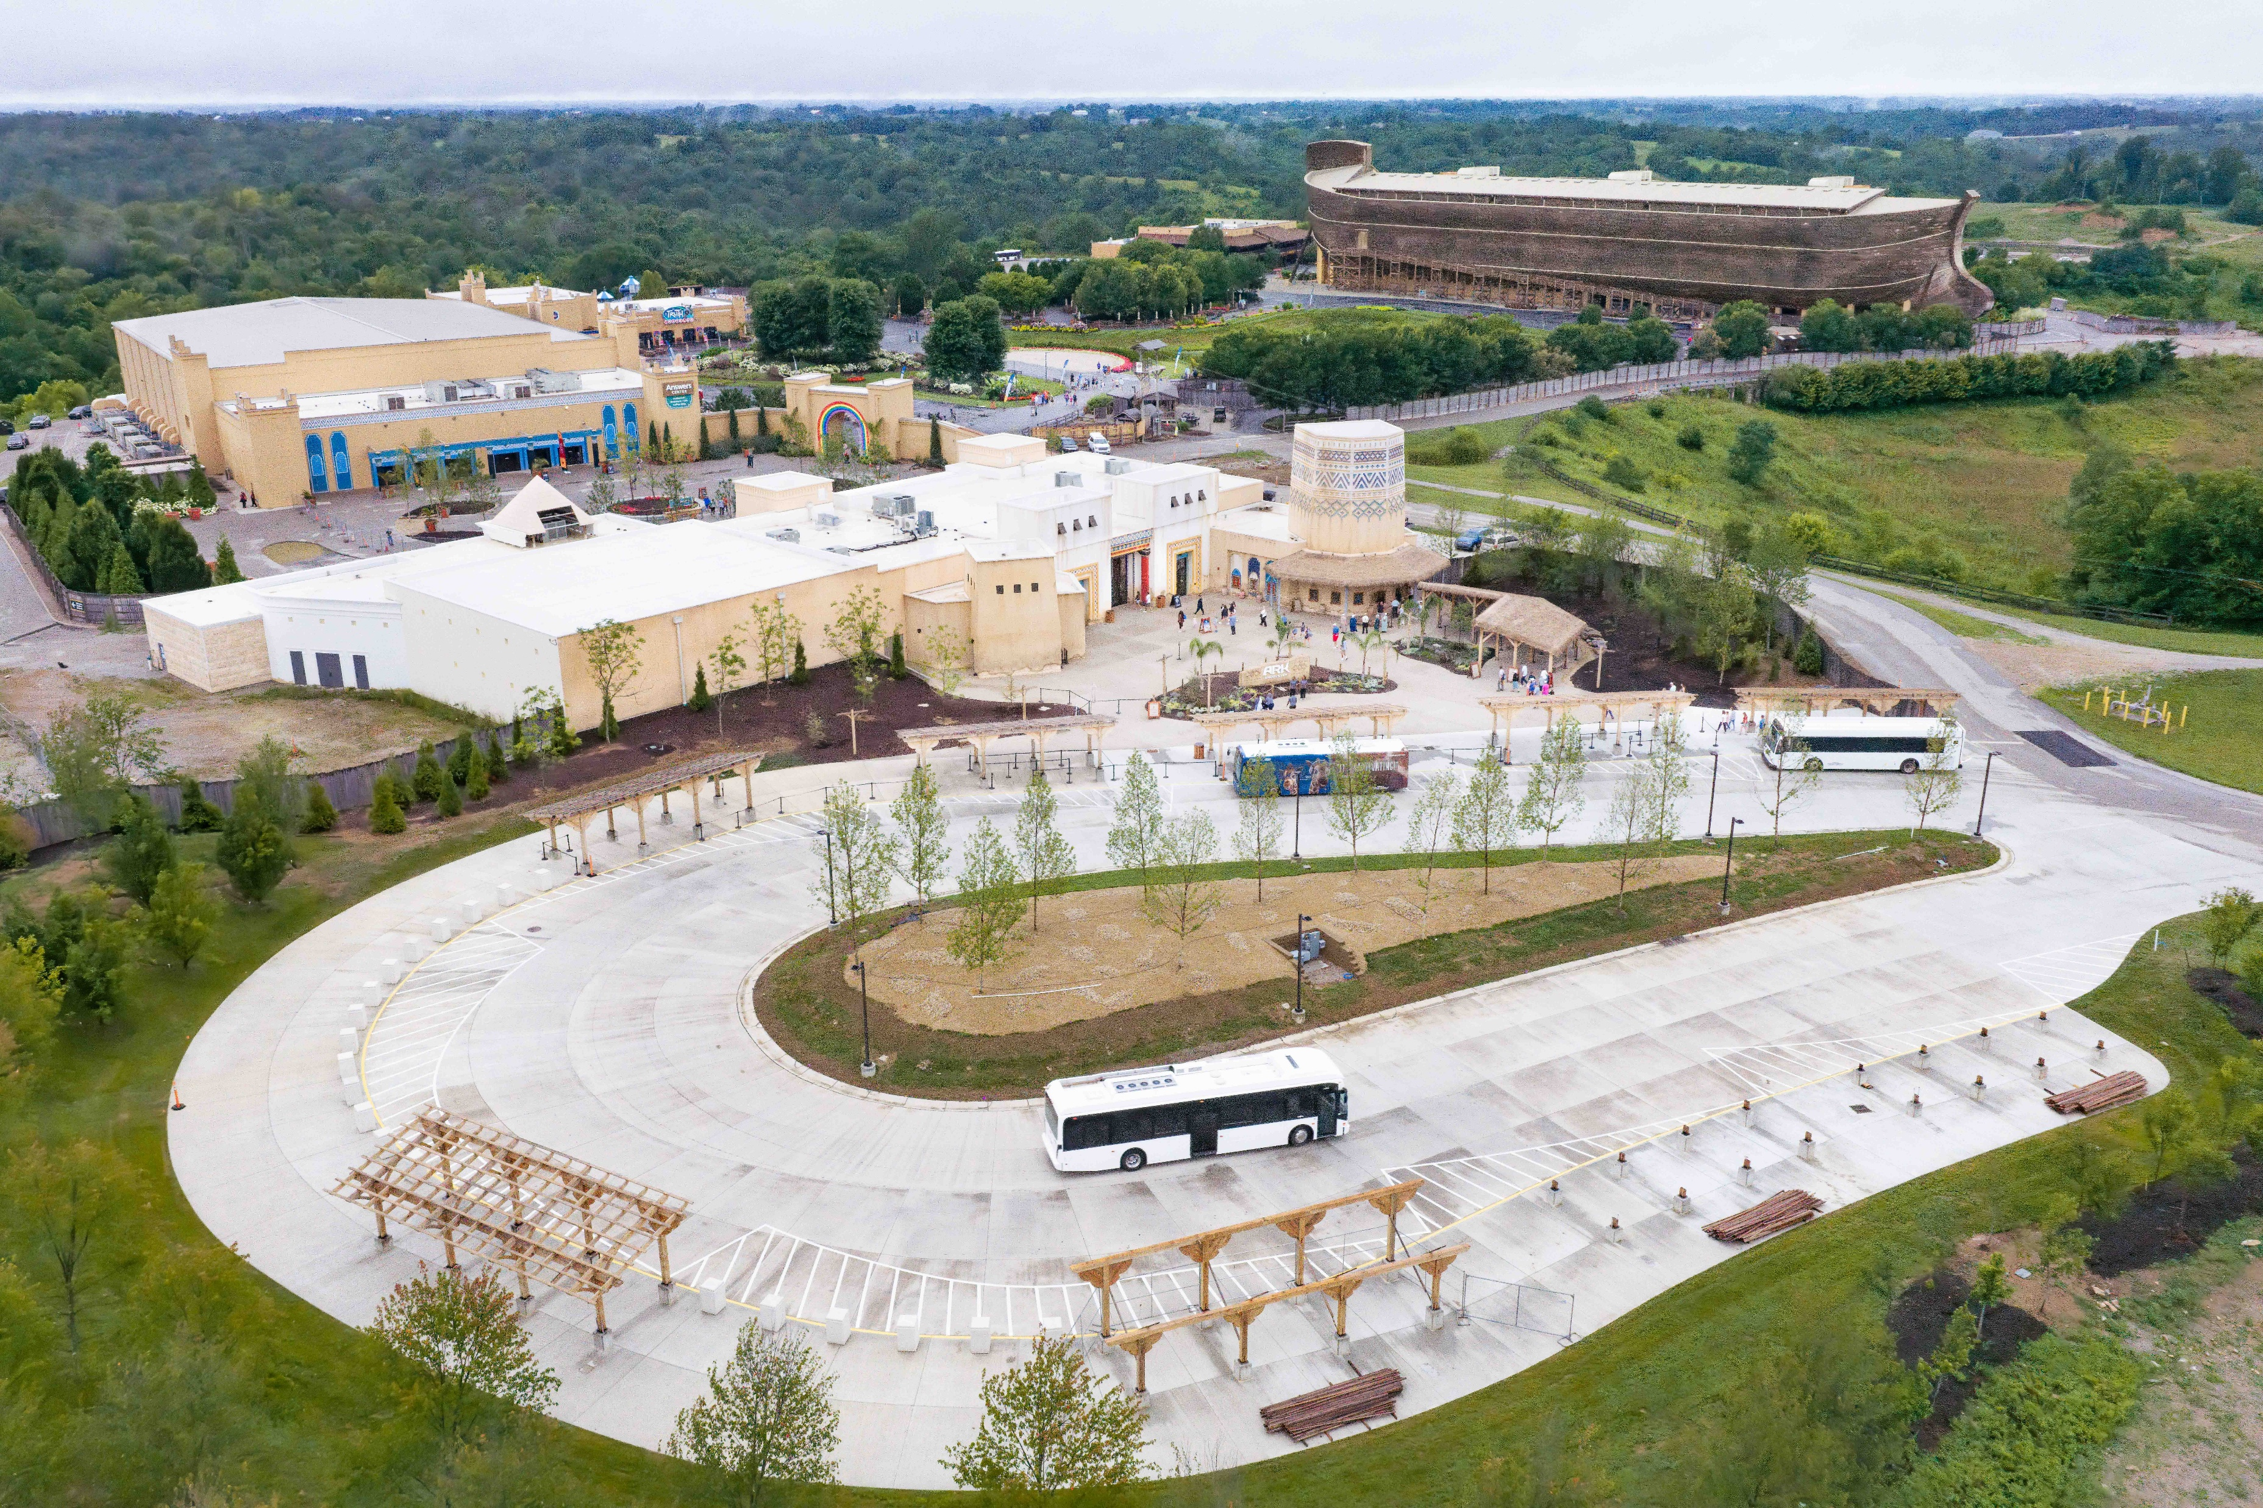

Slide 4
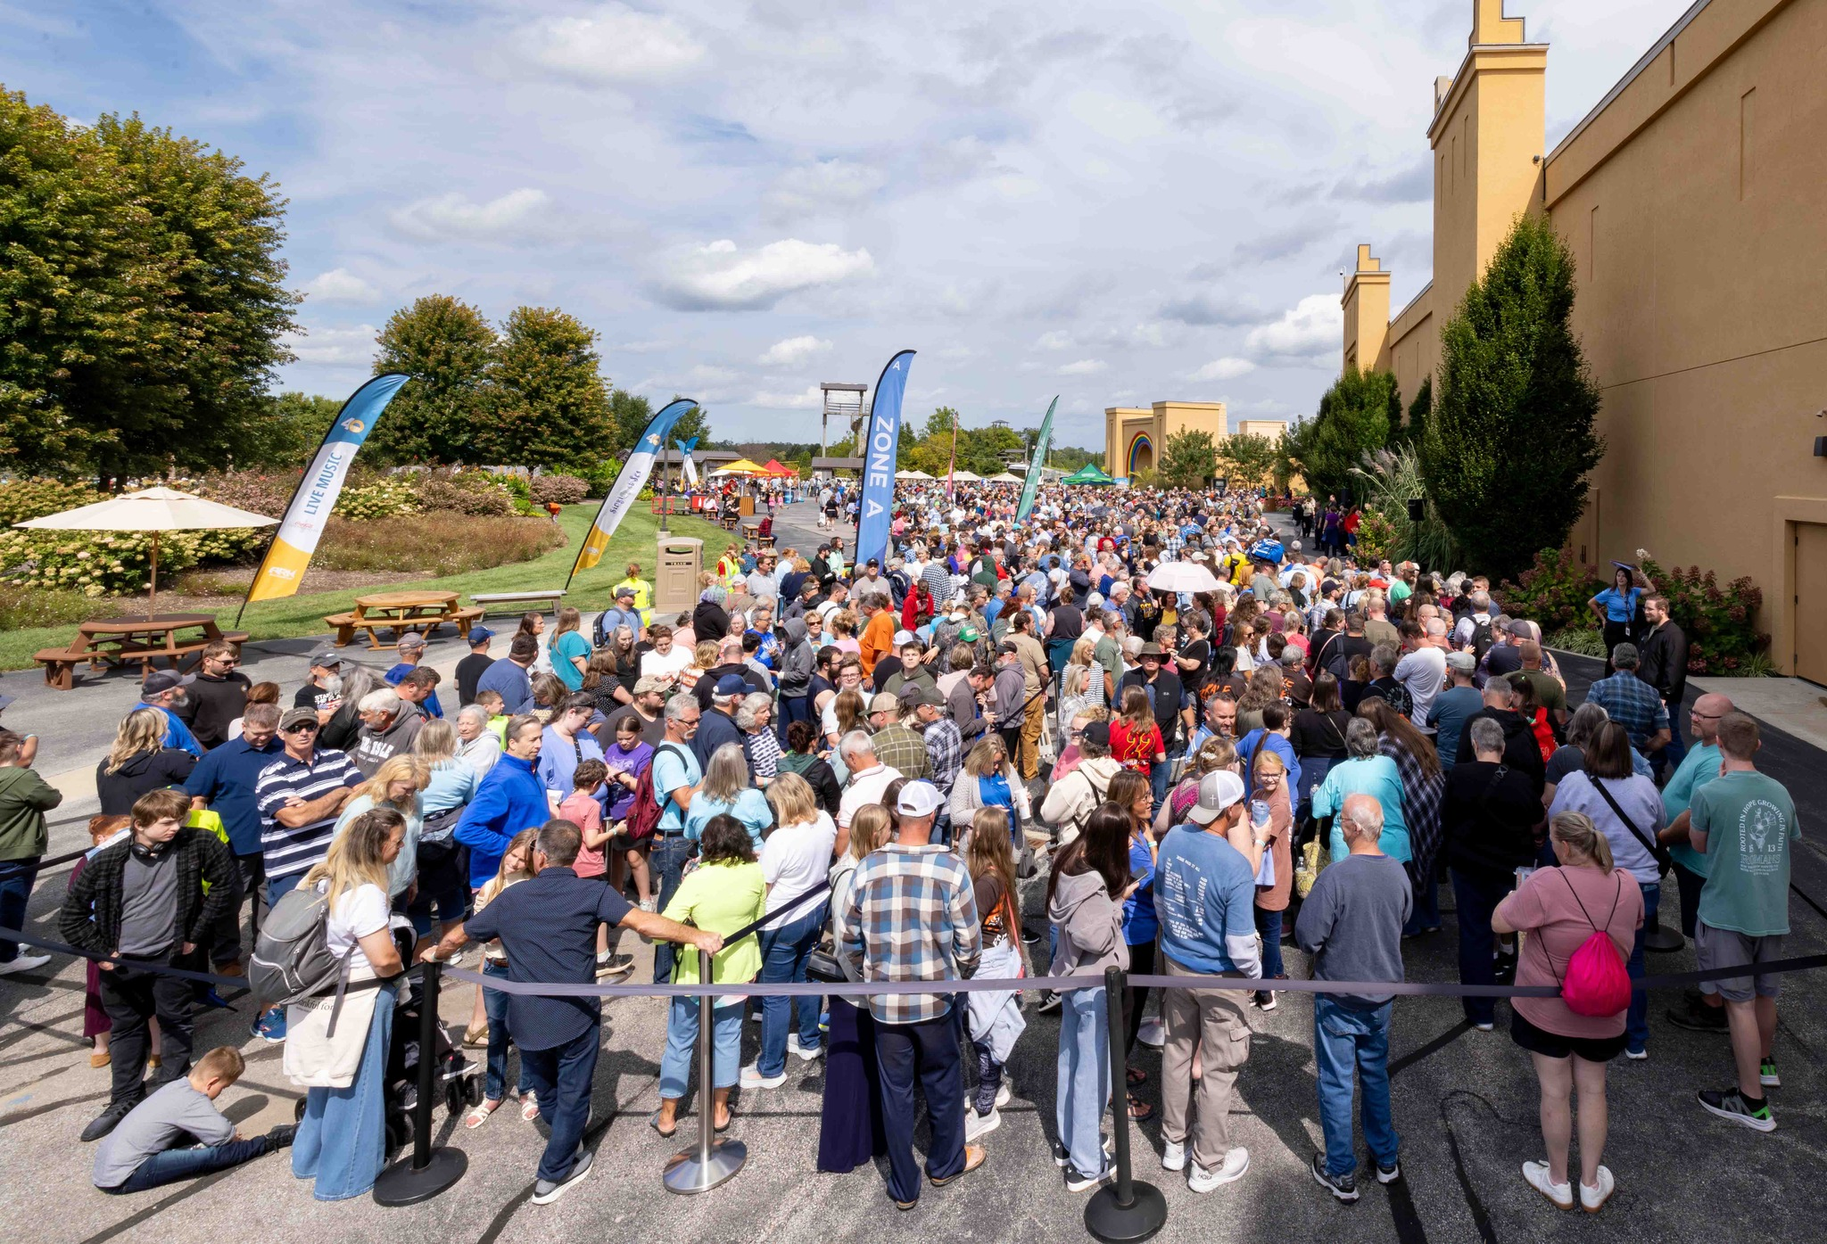
Maddy and Regan Katz
9,256,753 guests
Notes:
Ark Welcome Center

Slide 5
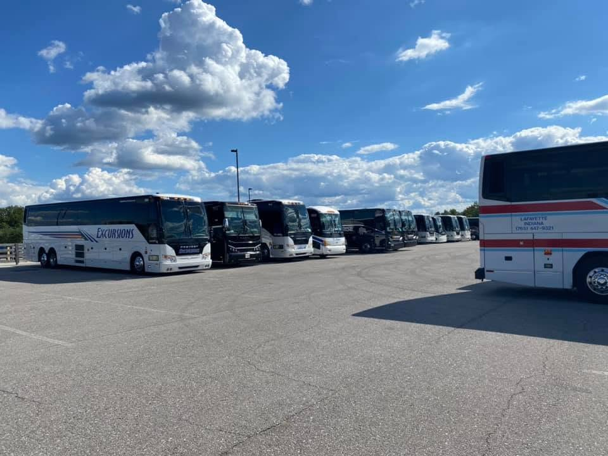
Maddy and Regan Katz
16,871 bus groups

Slide 6
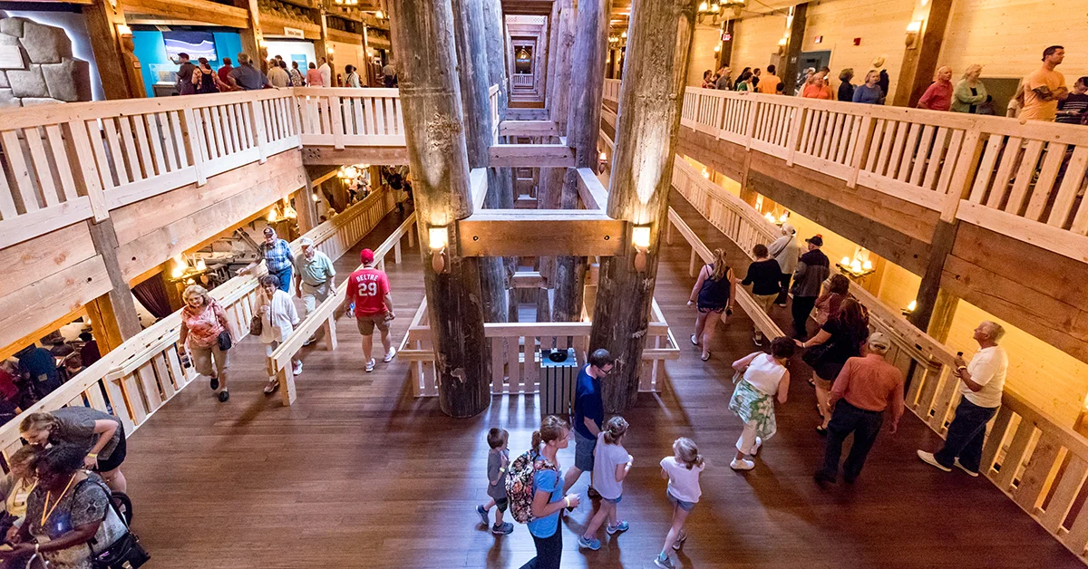
Maddy and Regan Katz
92% visit from outside our region.

Slide 7

“
The Ark Encounter’s 10-year anniversary is also a milestone for Northern Kentucky’s visitor economy. With more than 90% of its guests coming from outside the region, the Ark continues to draw new visitors who stay in our hotels, dine in our restaurants, explore nearby attractions, and generate meaningful sales tax revenue for the Commonwealth of Kentucky. It has become a powerful economic driver and an important part of how Northern Kentucky welcomes the world.
Julie Kirkpatrick
President & CEO, meetNKY
— Julie Kirkpatrick
President & CEO, meetNKY

Slide 8


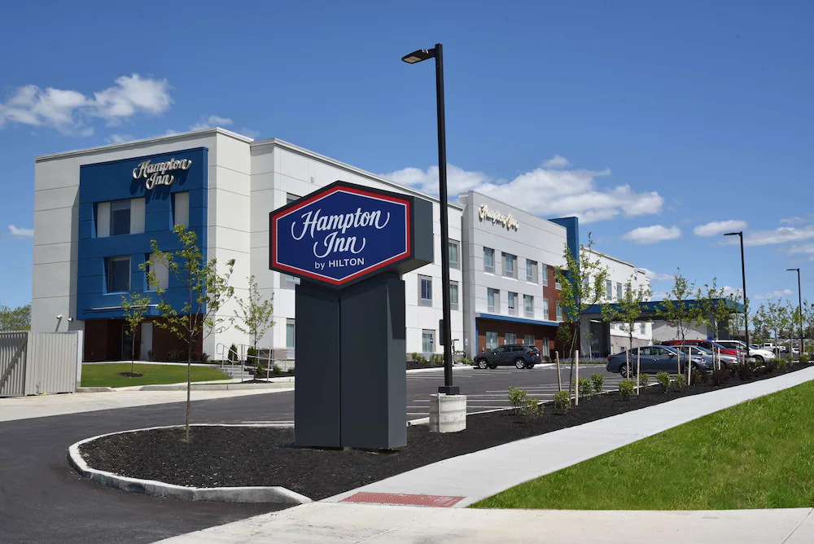



20+ hotels
Hotel Development Across Northern Kentucky
Driven by Ark Encounter Demand (since 2016)
Hampton Inn & Suites
Holiday Inn Express & Suites
Hampton Inn
Comfort Suites
Home2 Suites by Hilton
Hilton Garden Inn
Williamstown • Dry Ridge • Richwood, KY

Slide 9
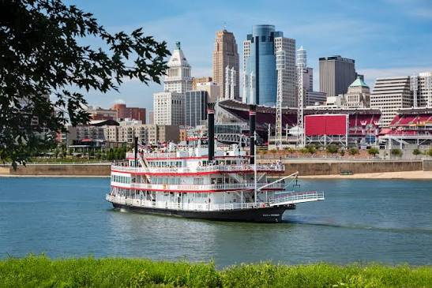

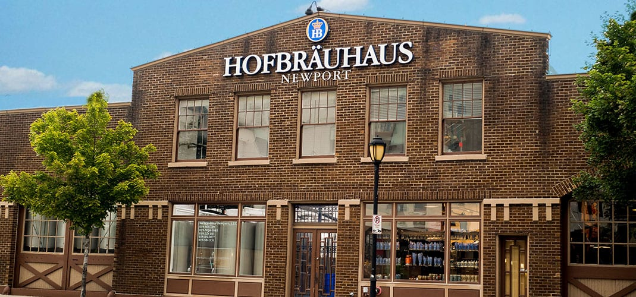
THE ARK ENCOUNTER’S IMPACT: ELEVATING NORTHERN KENTUCKY ATTRACTIONS
More Visitors. More Stays. More Economic Growth for NKY.
BB Riverboats
Since the Ark Encounter opened, BB Riverboats has seen a significant increase in guests, driven by more overnight stays and stronger visitation to the region.
Newport Aquarium
The Ark Encounter has helped drive more tourists to Northern Kentucky, resulting in higher attendance and continued growth for the Newport Aquarium.
Hofbräuhaus Newport
Increased regional tourism from the Ark Encounter has fueled greater traffic and business success for Hofbräuhaus Newport.
The Ark Encounter is more than a destination — it’s a catalyst for growth that strengthens Northern Kentucky’s entire tourism ecosystem.

Slide 10
A GROWING ECONOMIC IMPACT ACROSS THE COMMONWEALTH
Ark Encounter tourism dollars reach far beyond Northern Kentucky — into Louisville, Lexington, and communities statewide
ARK ENCOUNTER
Williamstown, KY
NORTHERN
KENTUCKY
LOUISVILLE
LEXINGTON
COMMONWEALTH OF KENTUCKY

Slide 11

Notes:
Ark Welcome Center

Slide 12
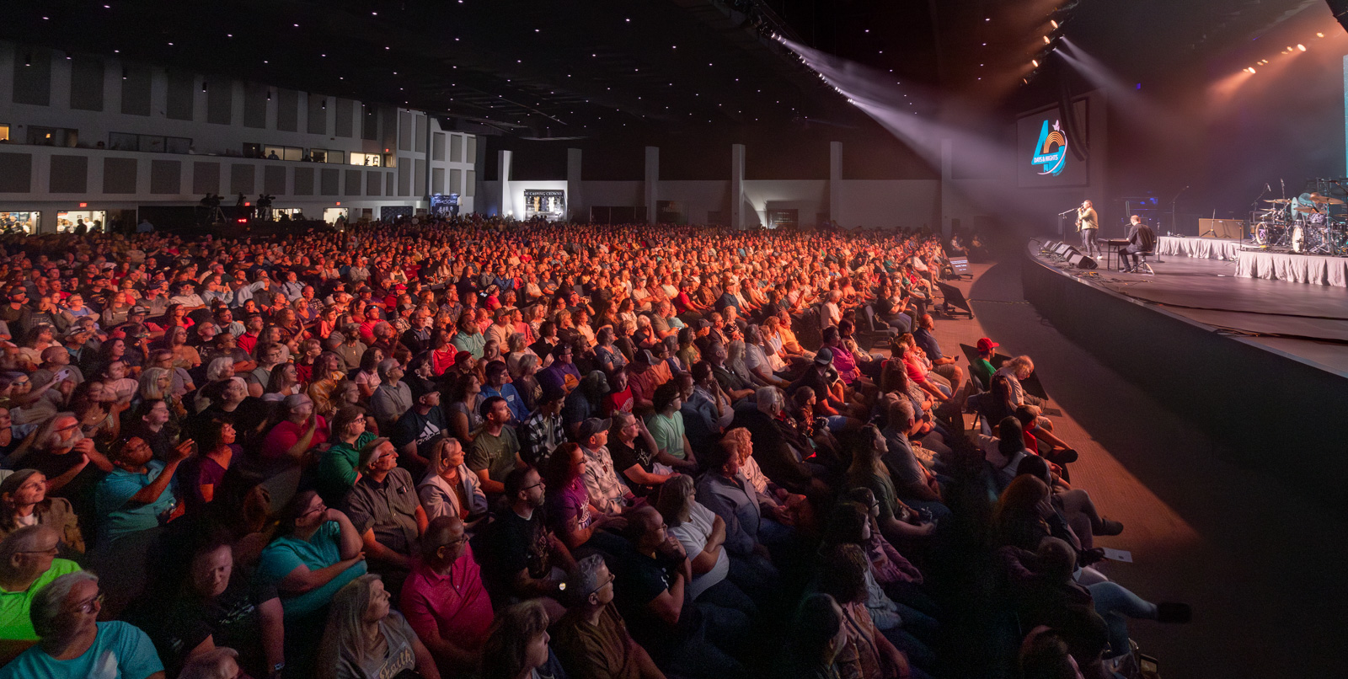

Slide 13


Slide 14
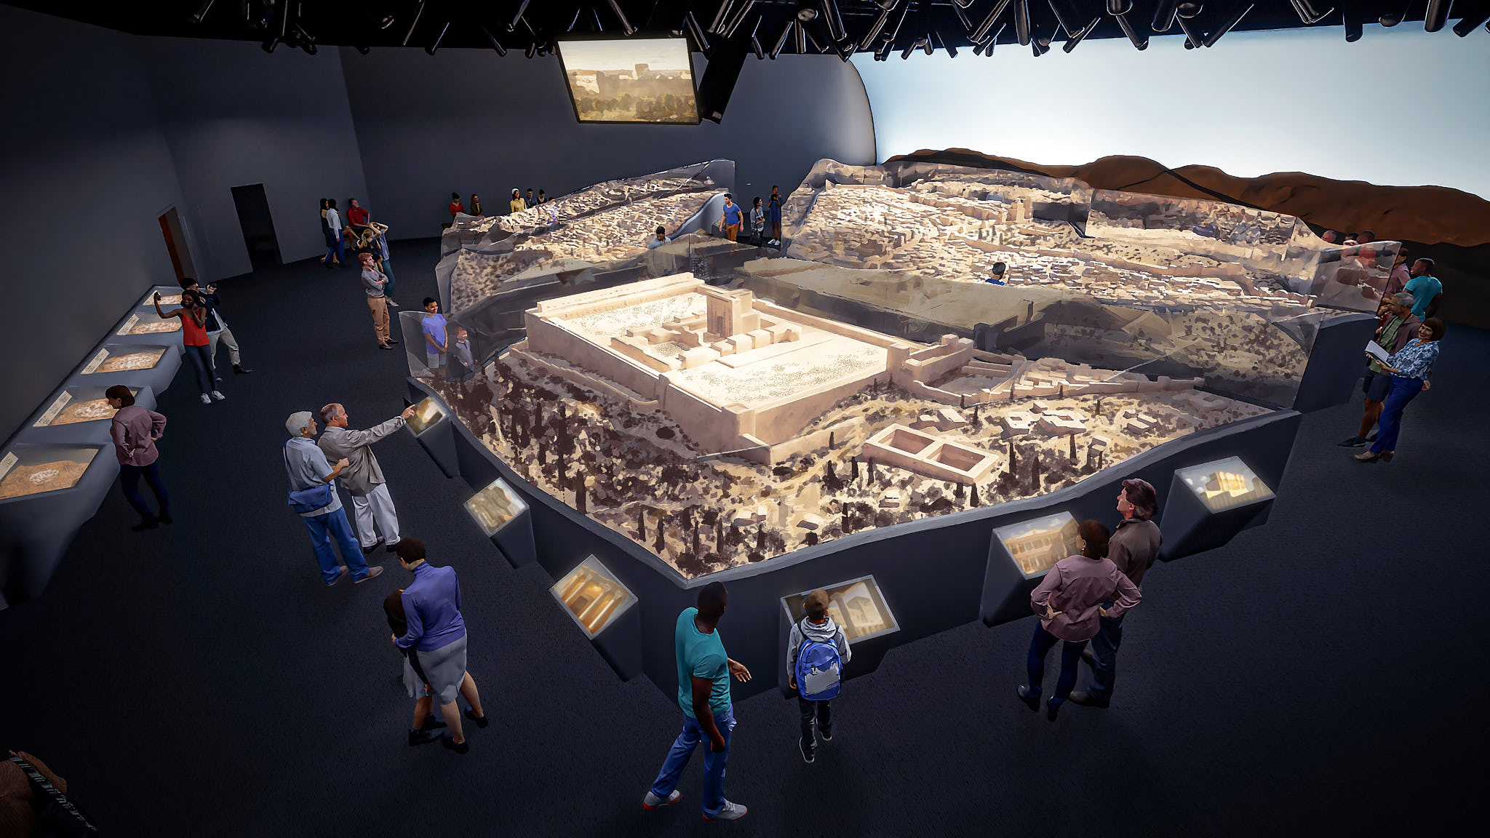

Slide 15

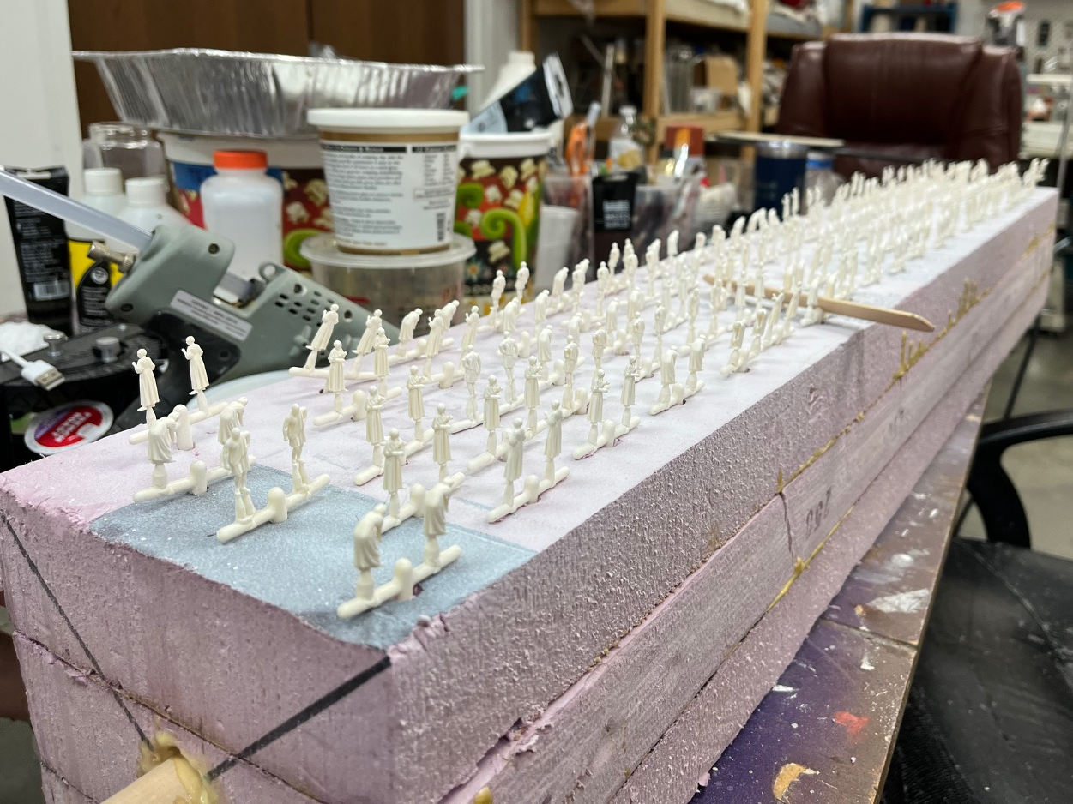
Notes:
Siocast

Slide 16

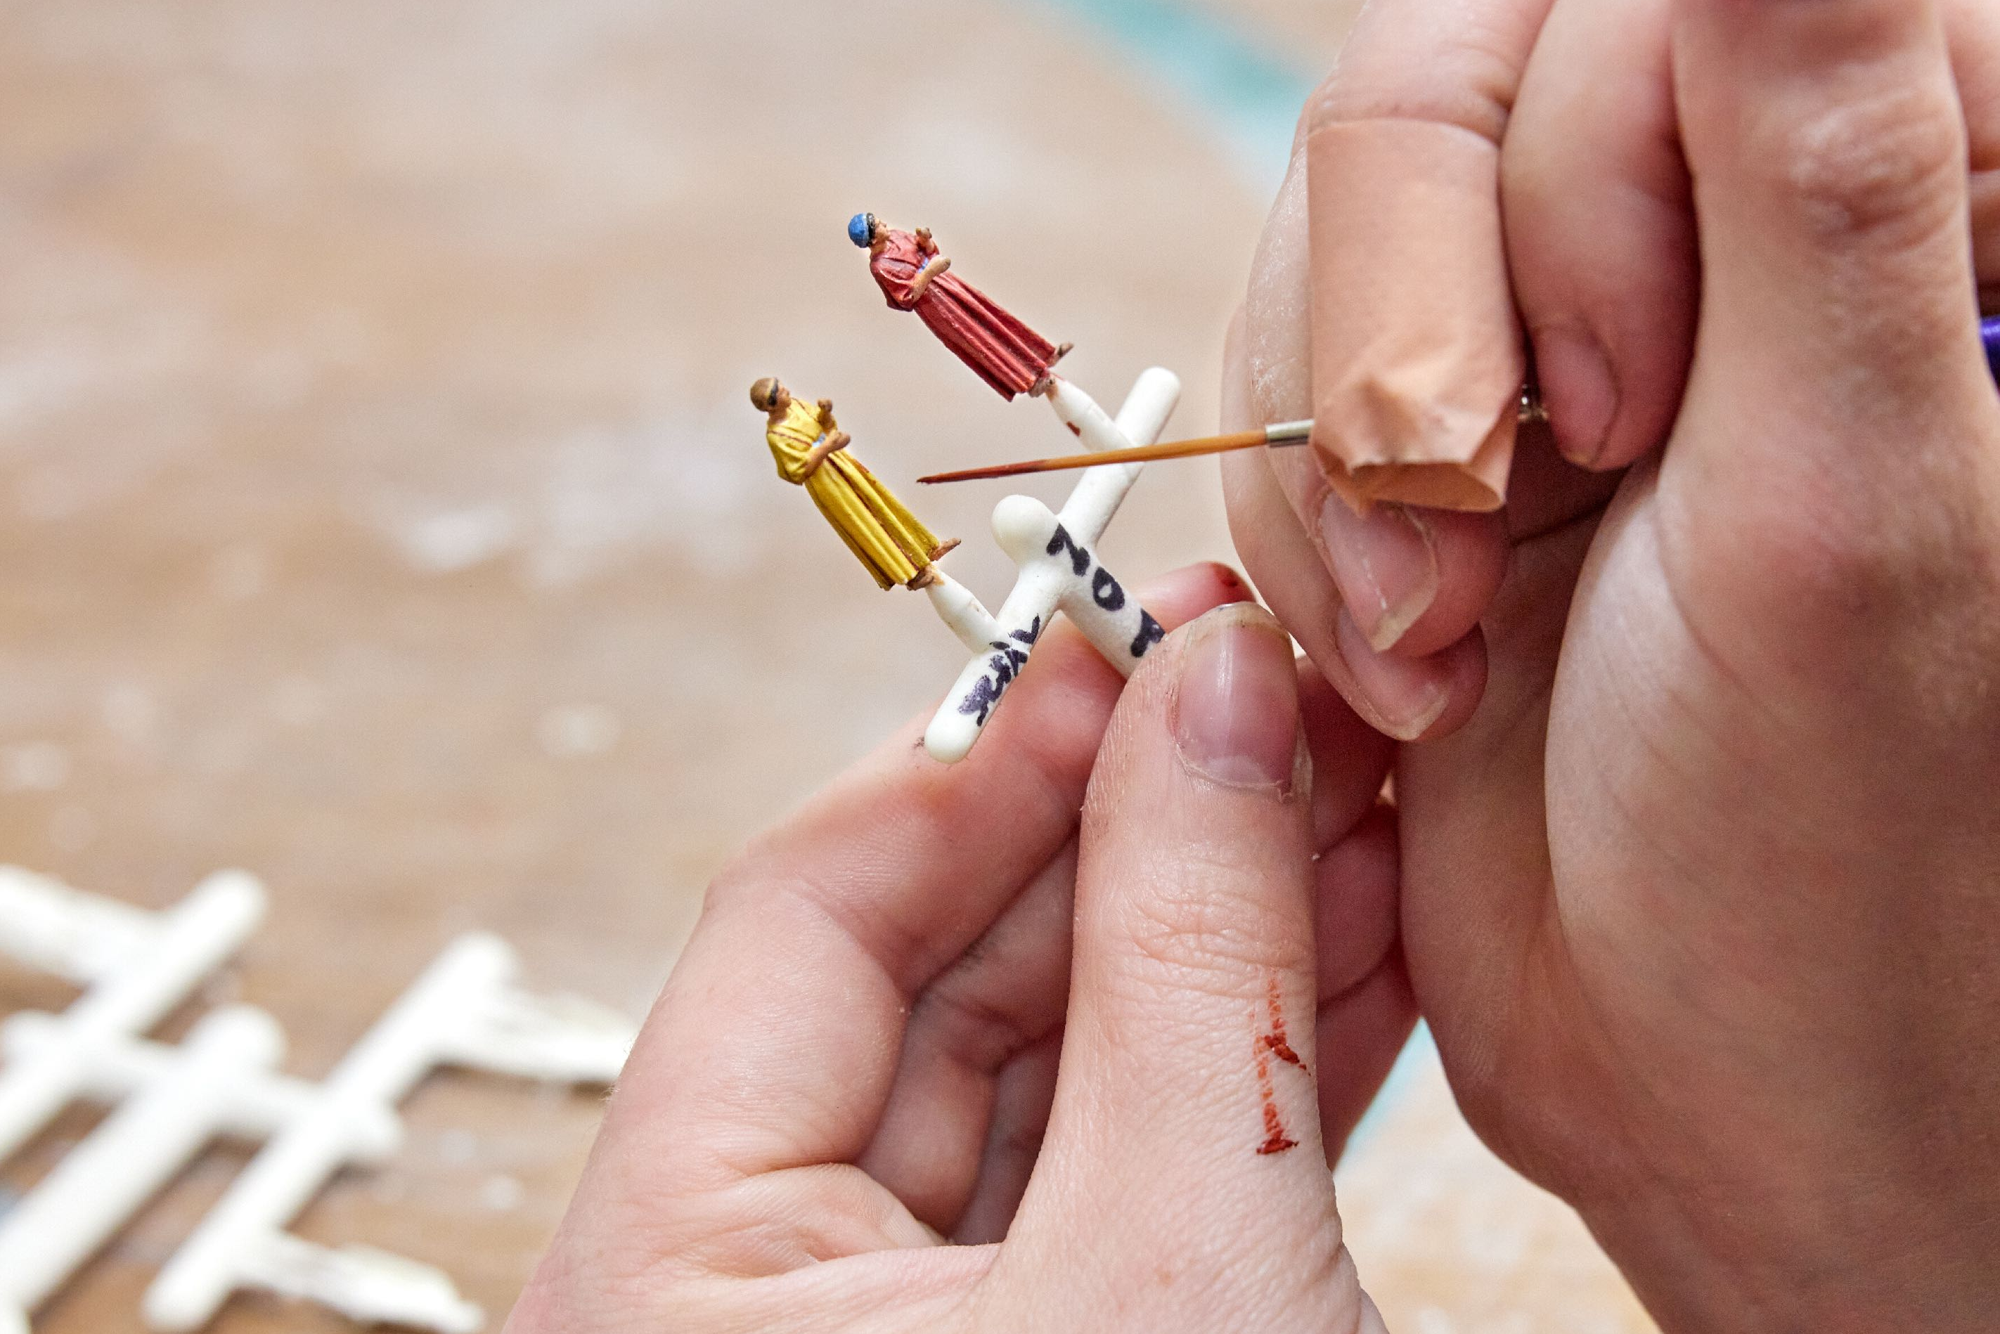
Notes:
Siocast

Slide 17

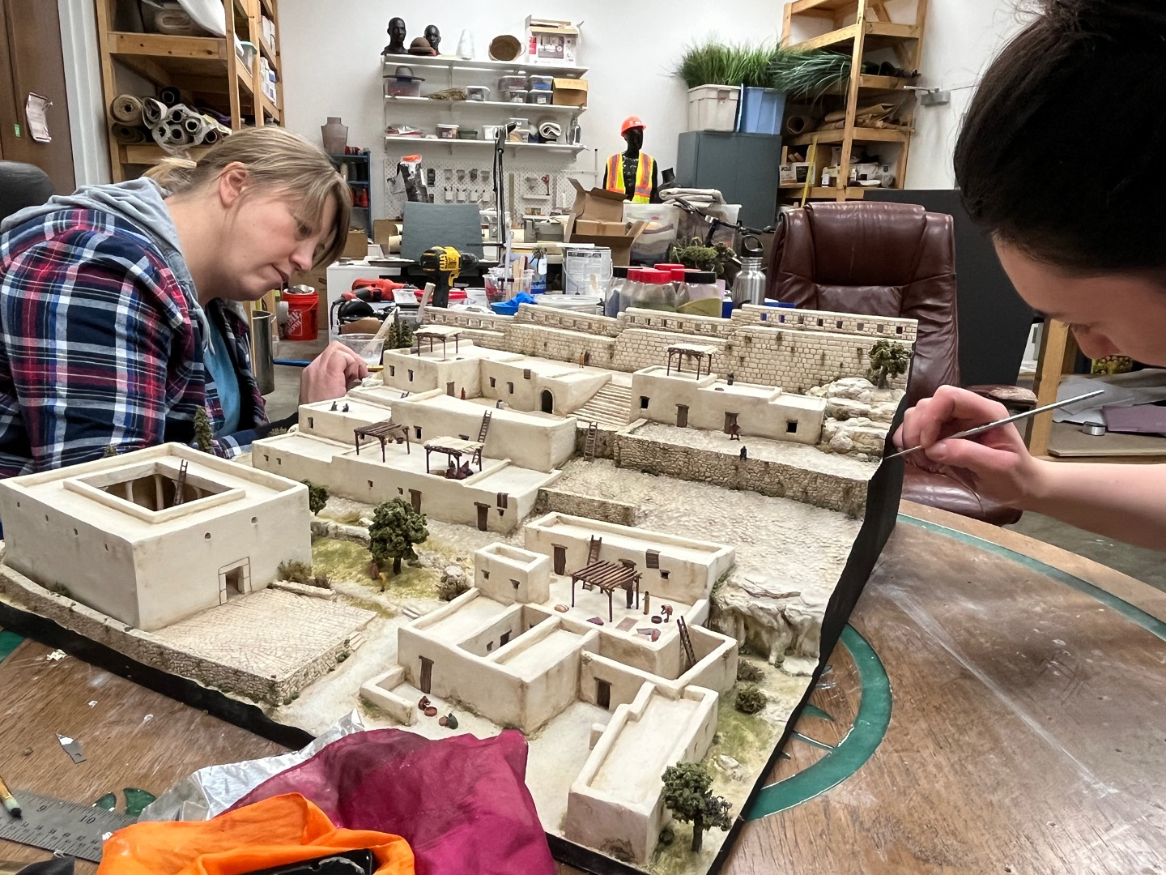

Slide 18

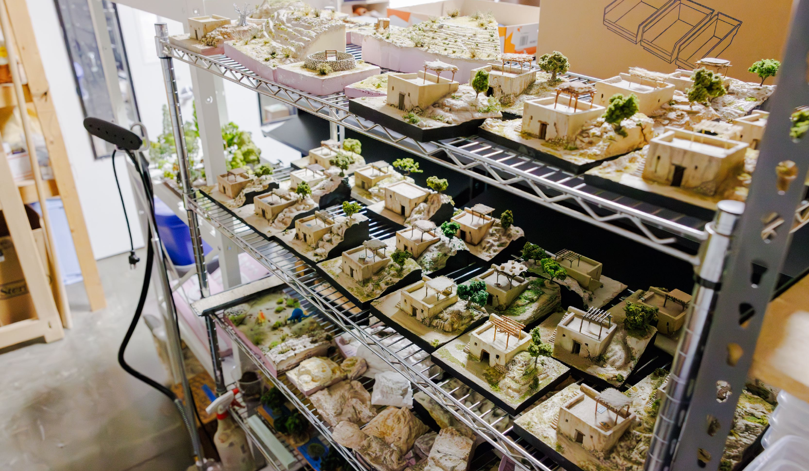

Slide 19


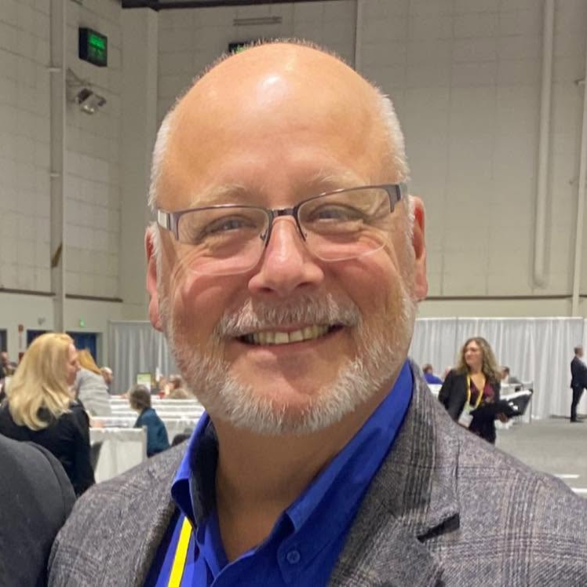
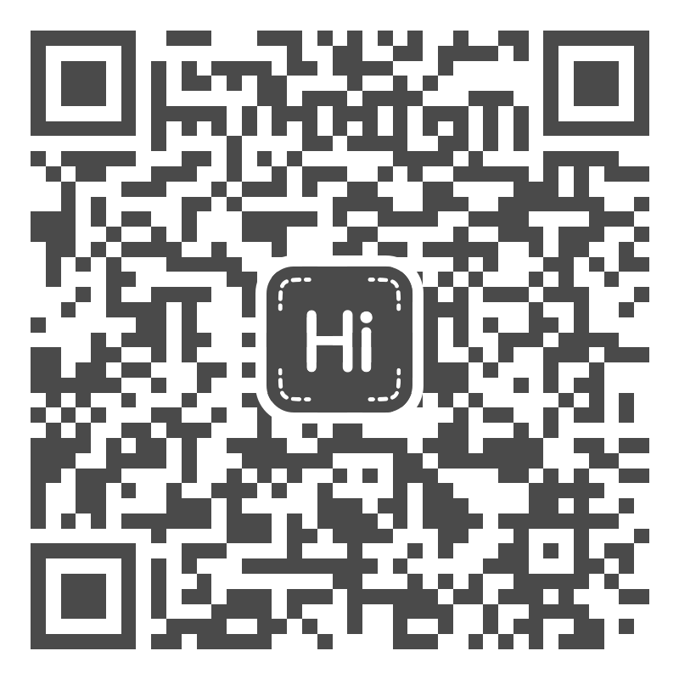
BOARD OF DIRECTORS
Kentucky Travel Industry Association (KTIA)
CONTACT
elutz@arkencounter.com
859-240-6642
Eddie Lutz
Director of Attraction and Resource Sales
Ark Encounter / Creation Museum
Scan to Connect

