Slide 1
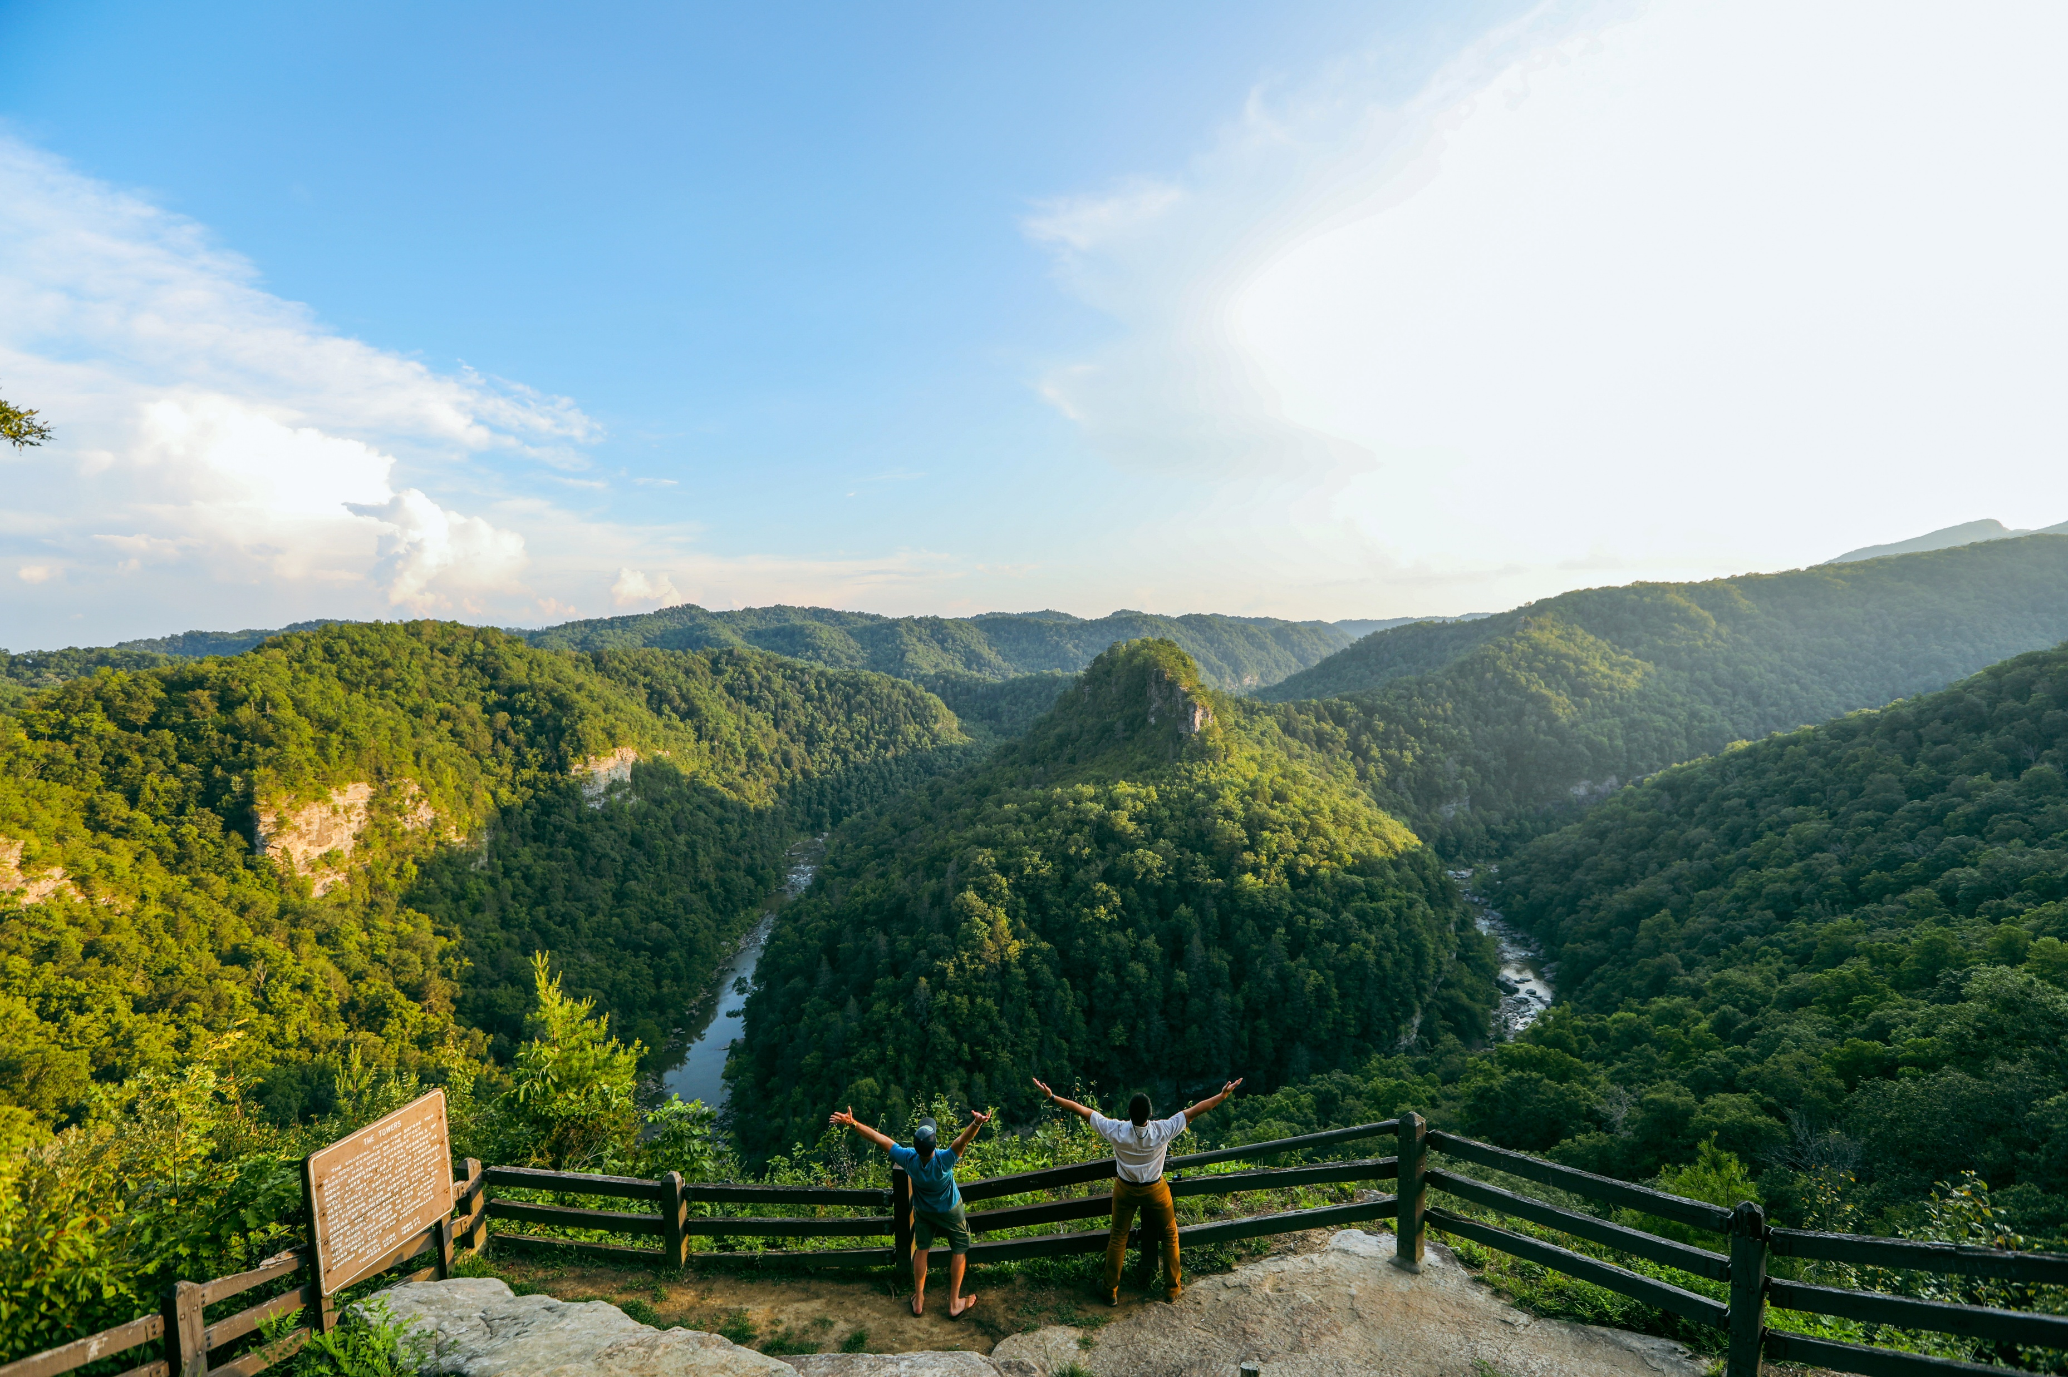
In the Beginning…….

Slide 2
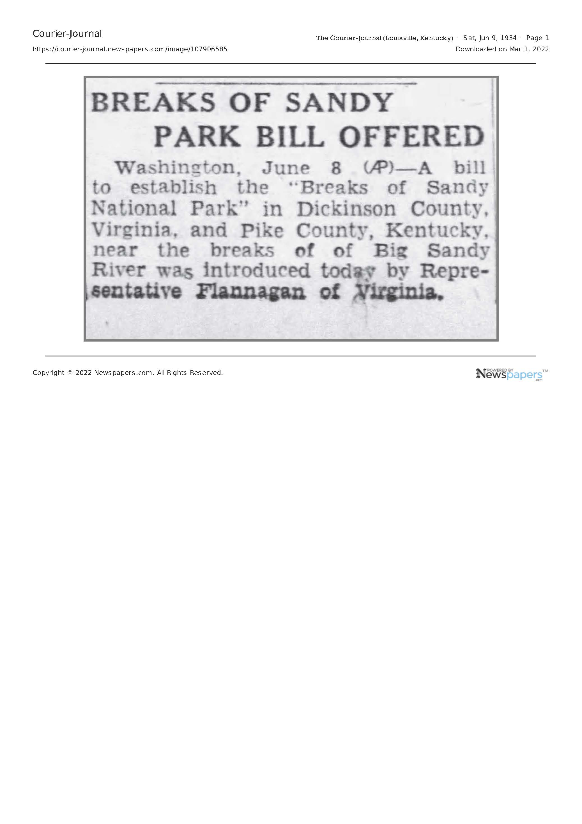

Slide 3
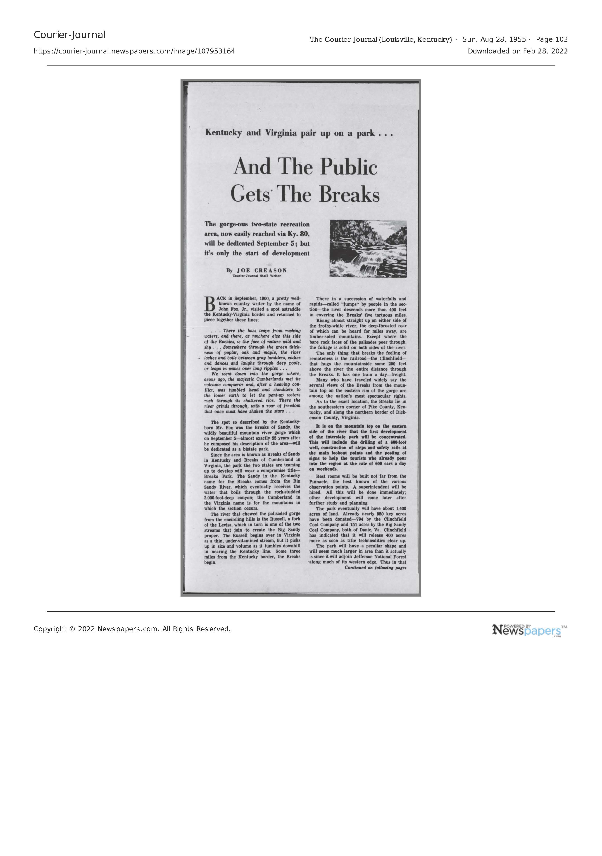

Slide 4
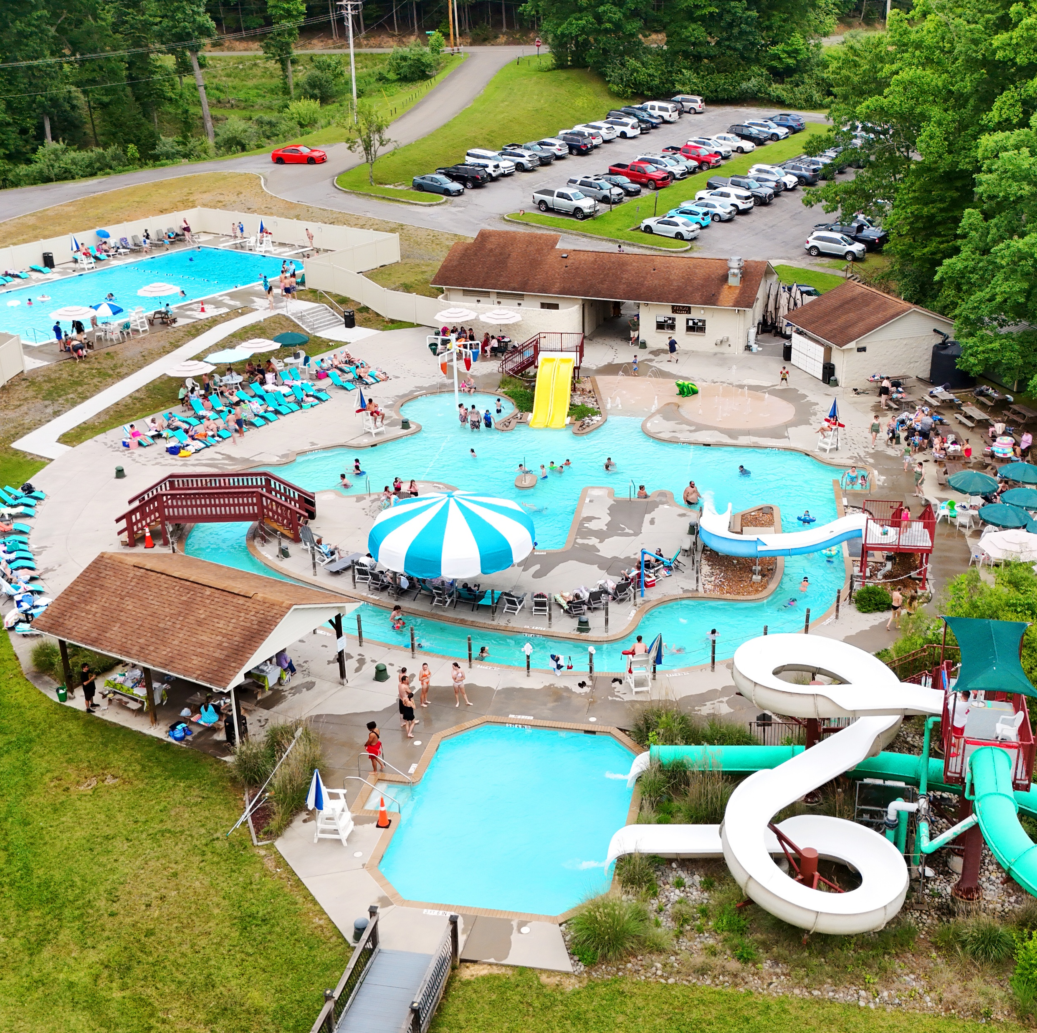
And what did we do with it????
77 hotel rooms, 164 campsites, 14 cabins, waterpark, restaurant, 2 conference facilities, amphitheater, 300,000 annual visits

Slide 5
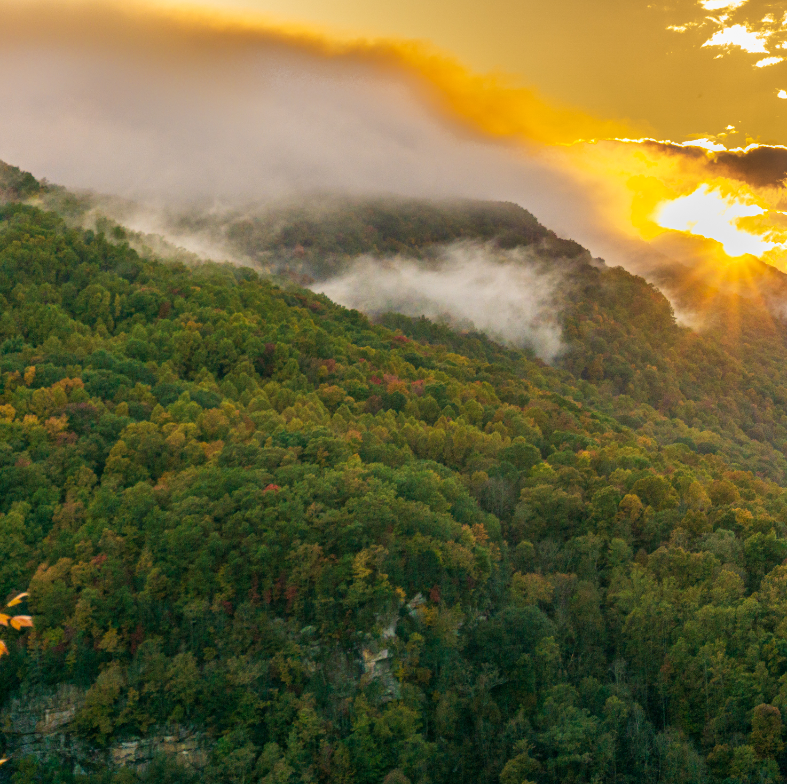
Conservation
5,000 Acres Protecting one of the deepest and most scenic river gorges in the Eastern US

Slide 6
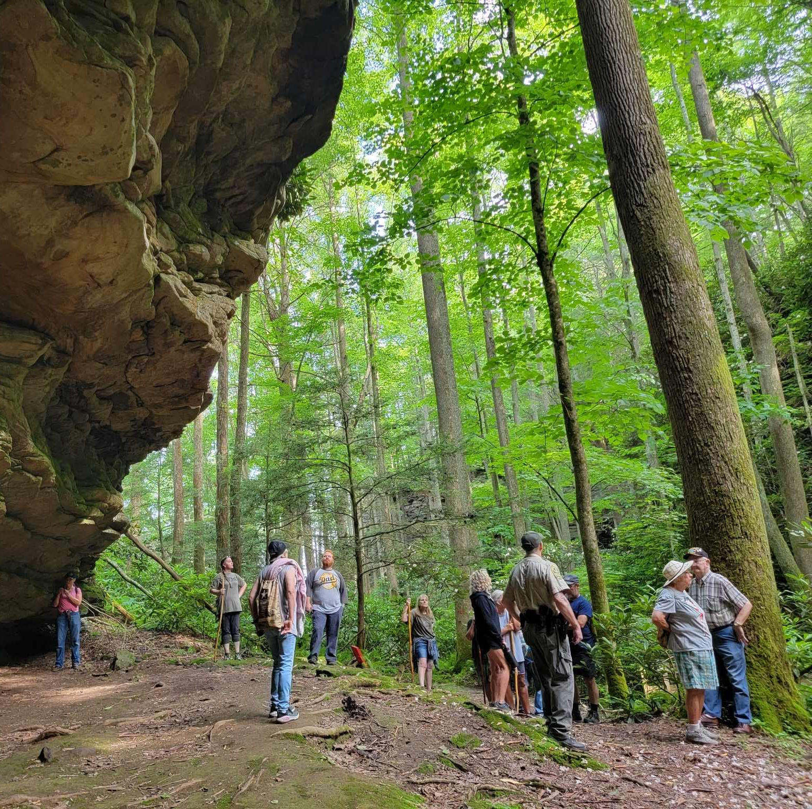
Trails
Linkage to over 300 miles of trails, including hiking, biking, and off-road

Slide 7
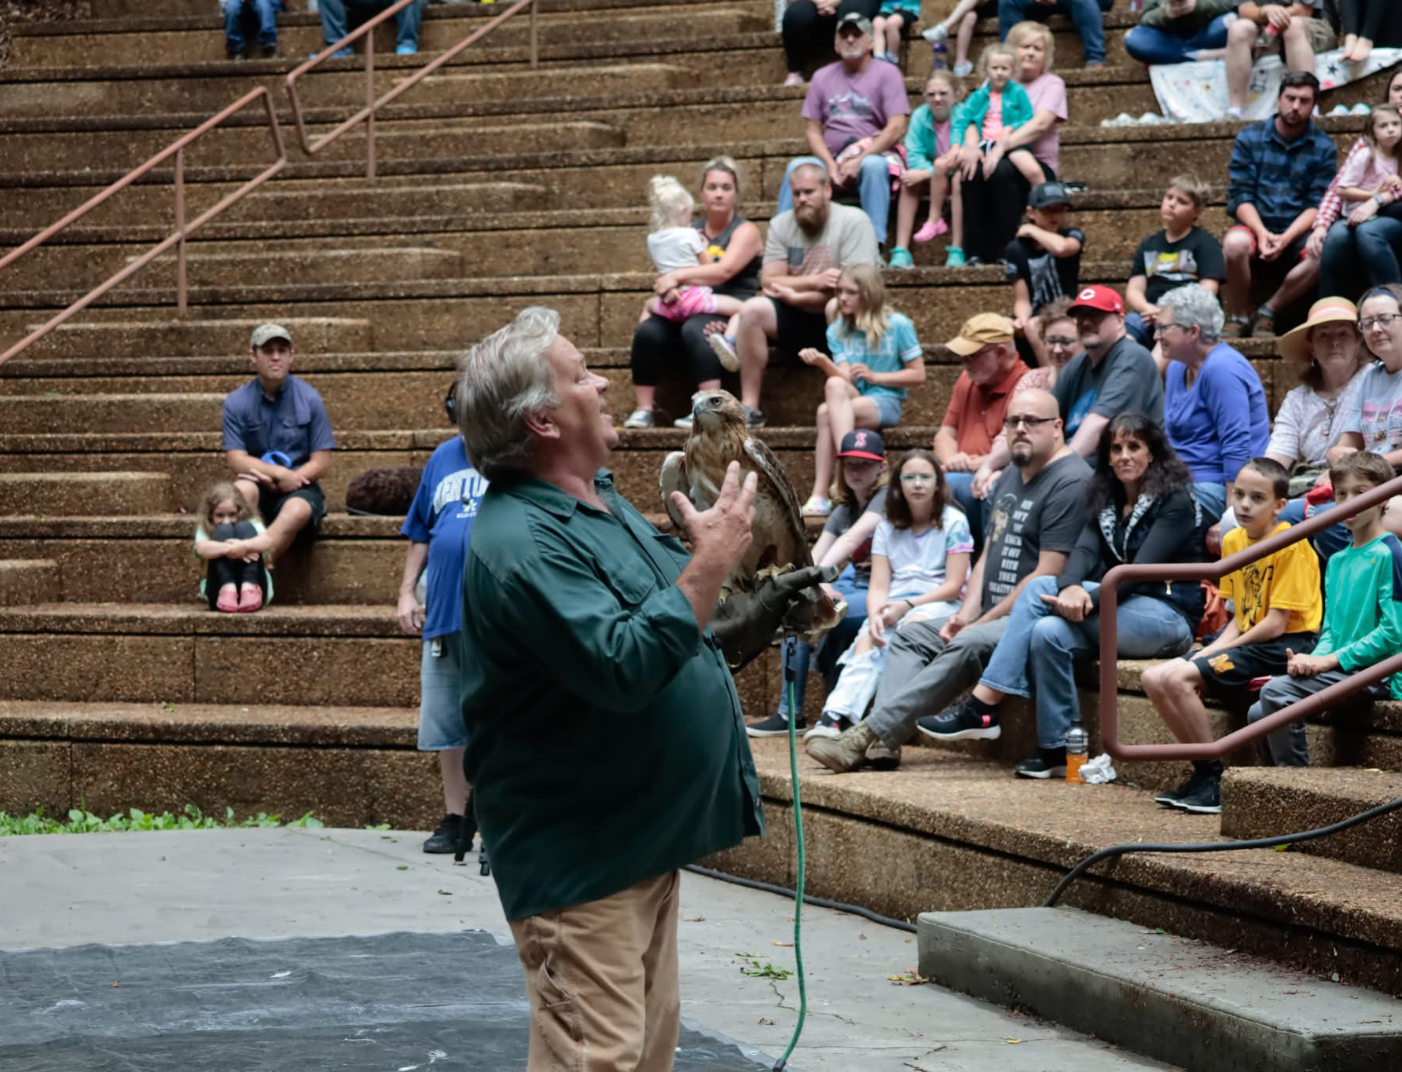
Programs
Serving over 15,000
guests annually with
free educational
programming,
including local
schools

Slide 8
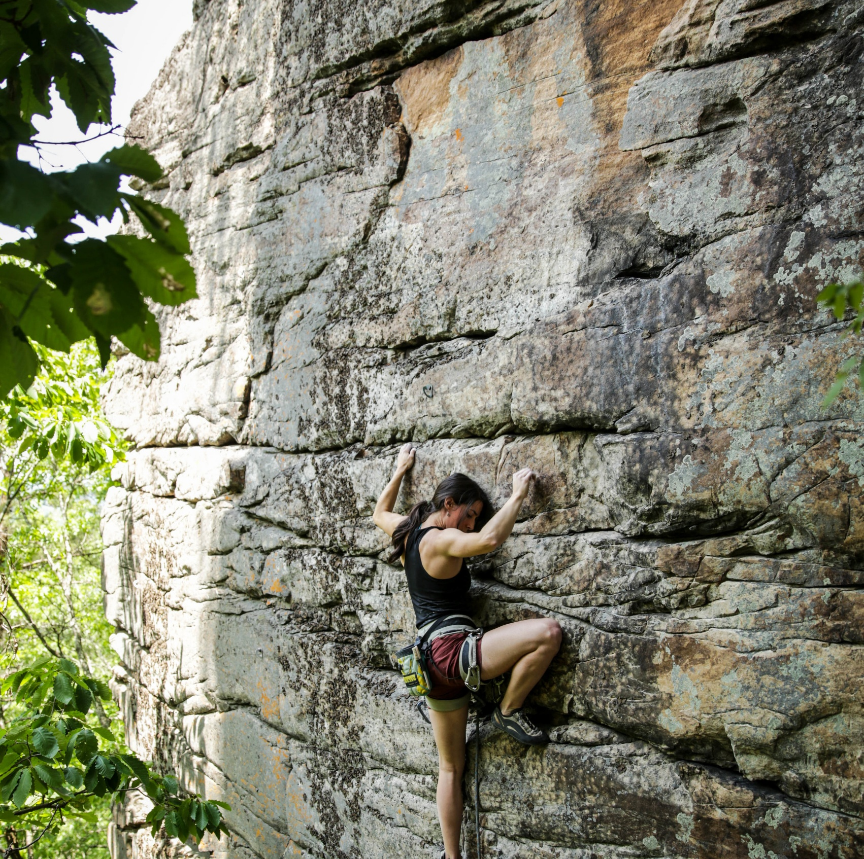
Climbing and Bouldering
Development of over 500 climbing routes and bouldering problems….more than any state park in KY or VA

Slide 9
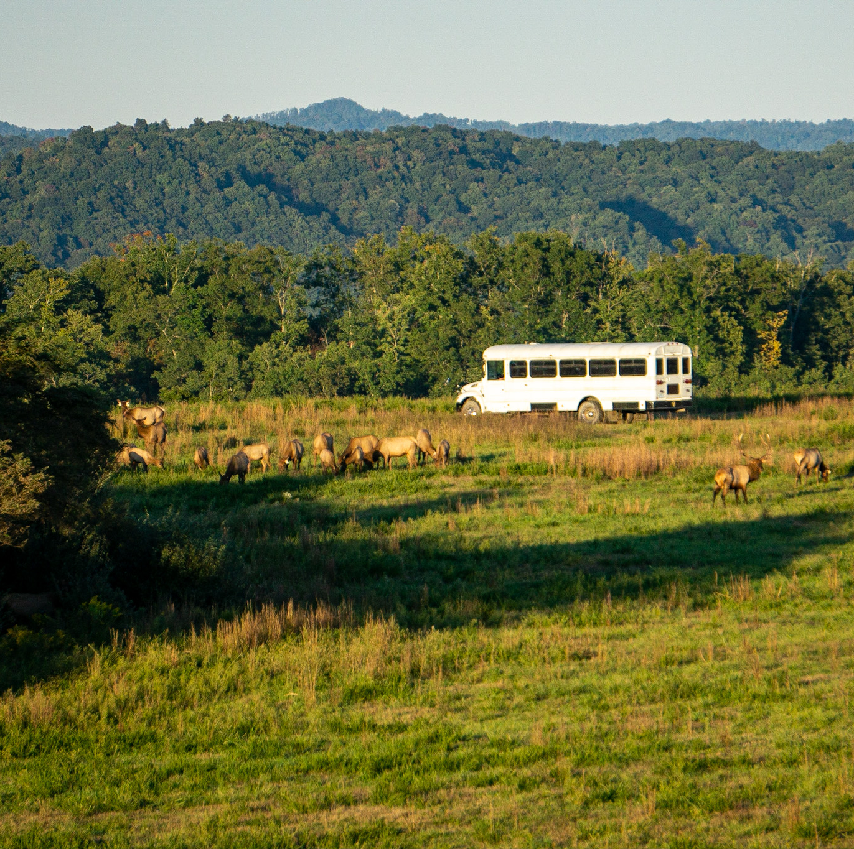
Wildlife Viewing
Offering seasonal elk viewing tours which have introduced thousands of guests to VA and KY’s restored elk herd

Slide 10
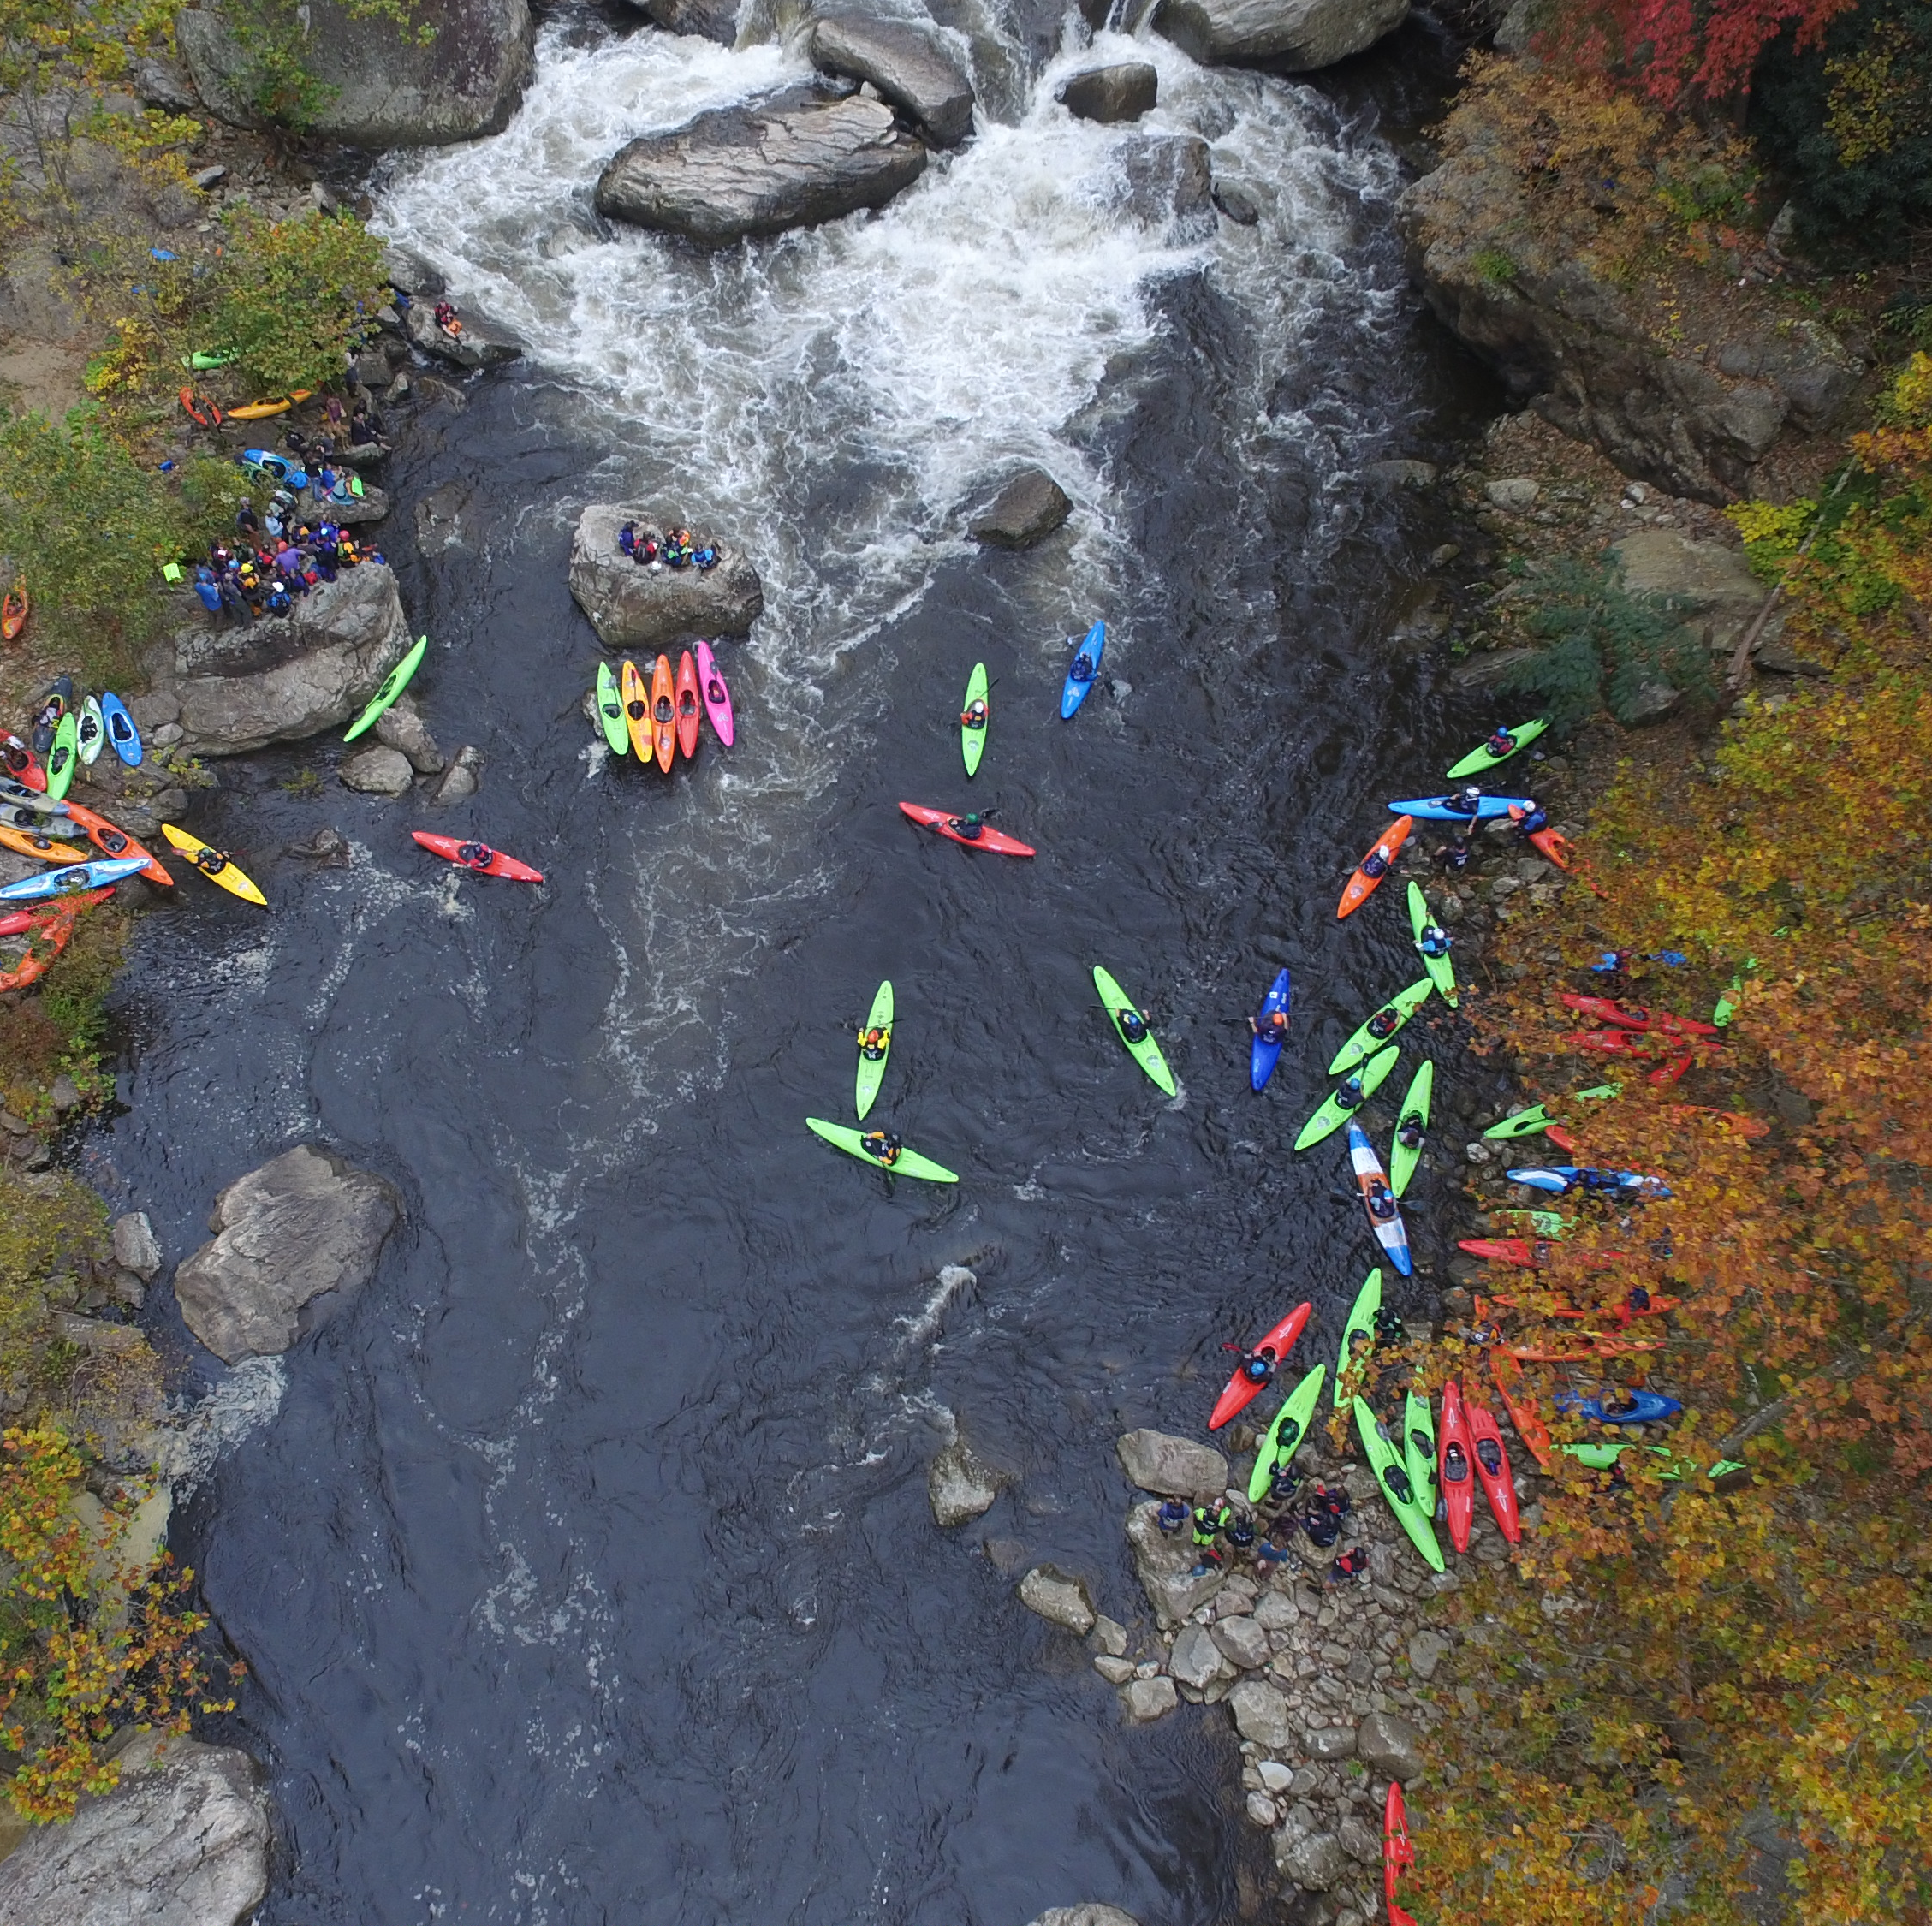
Paddlesports
Protection of the Russell Fork Gorge and KY’s most challenging call V+ whitewater run

Slide 11
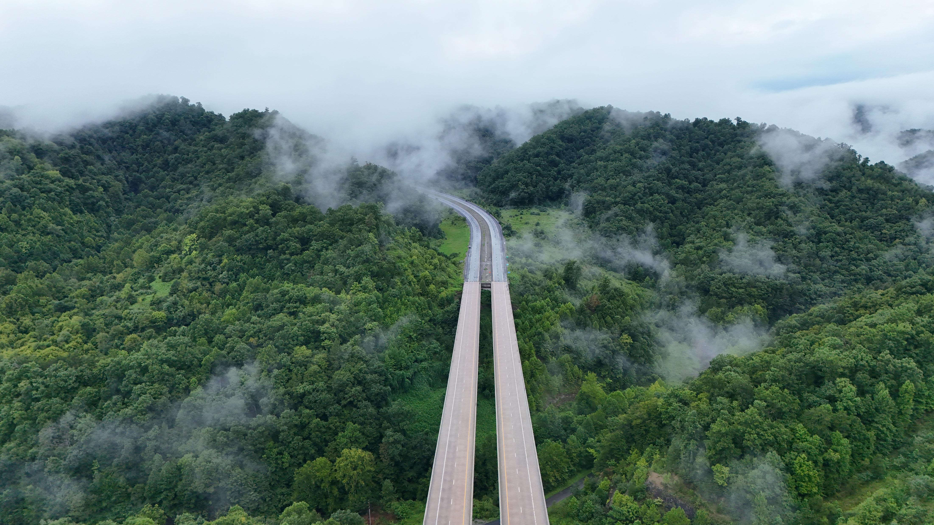
The Road Ahead

Slide 12
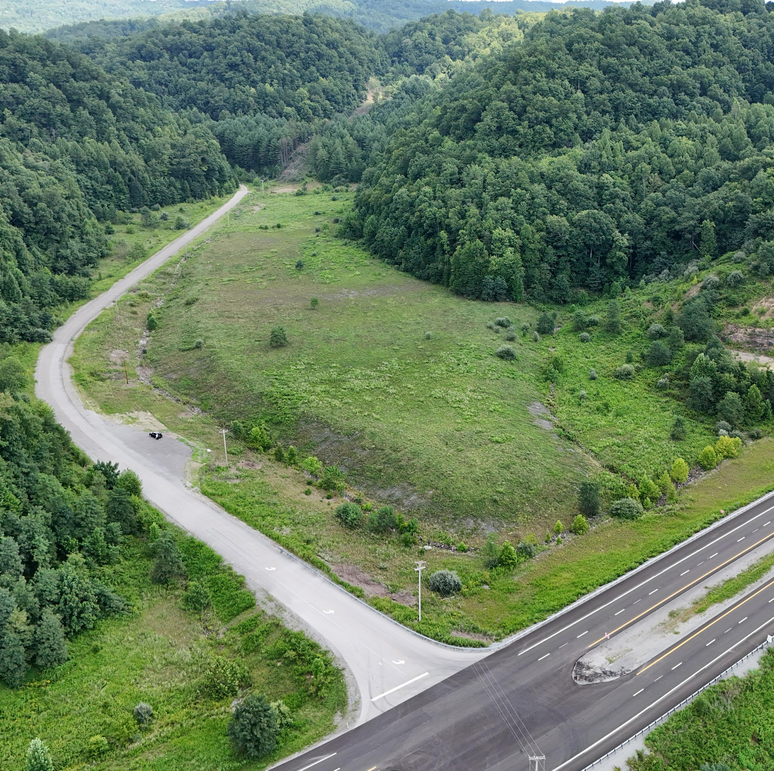
Wolfpen Campground
Development of an approximately 30-acre site, adjacent to U.S. 460 at the KY-VA state line

Slide 13
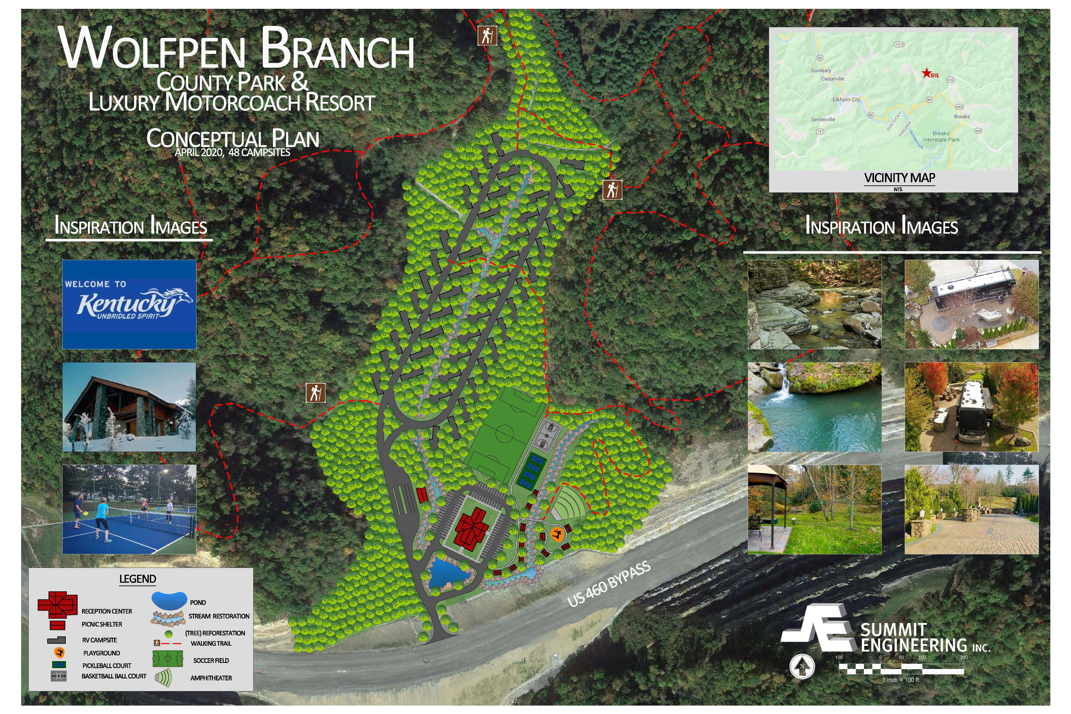

Slide 14
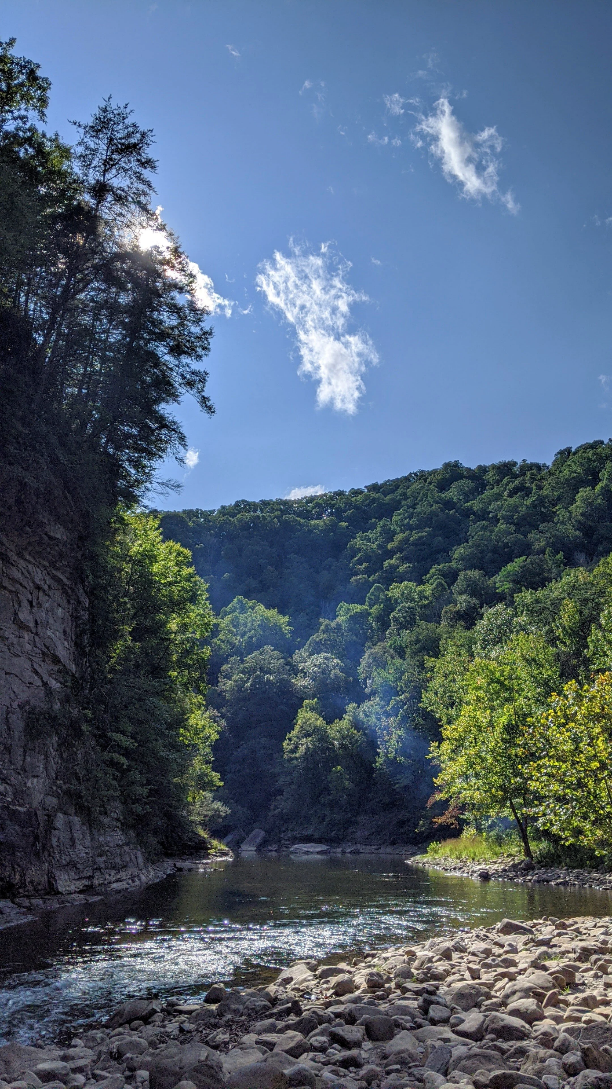
Ratliff Hole River Access Area
Renovation of the most utilized river access area in the park. Phase I includes reopening the restrooms, paving the roads, and stabilizing the bank. Phase II includes permanent riverside camping.

Slide 15
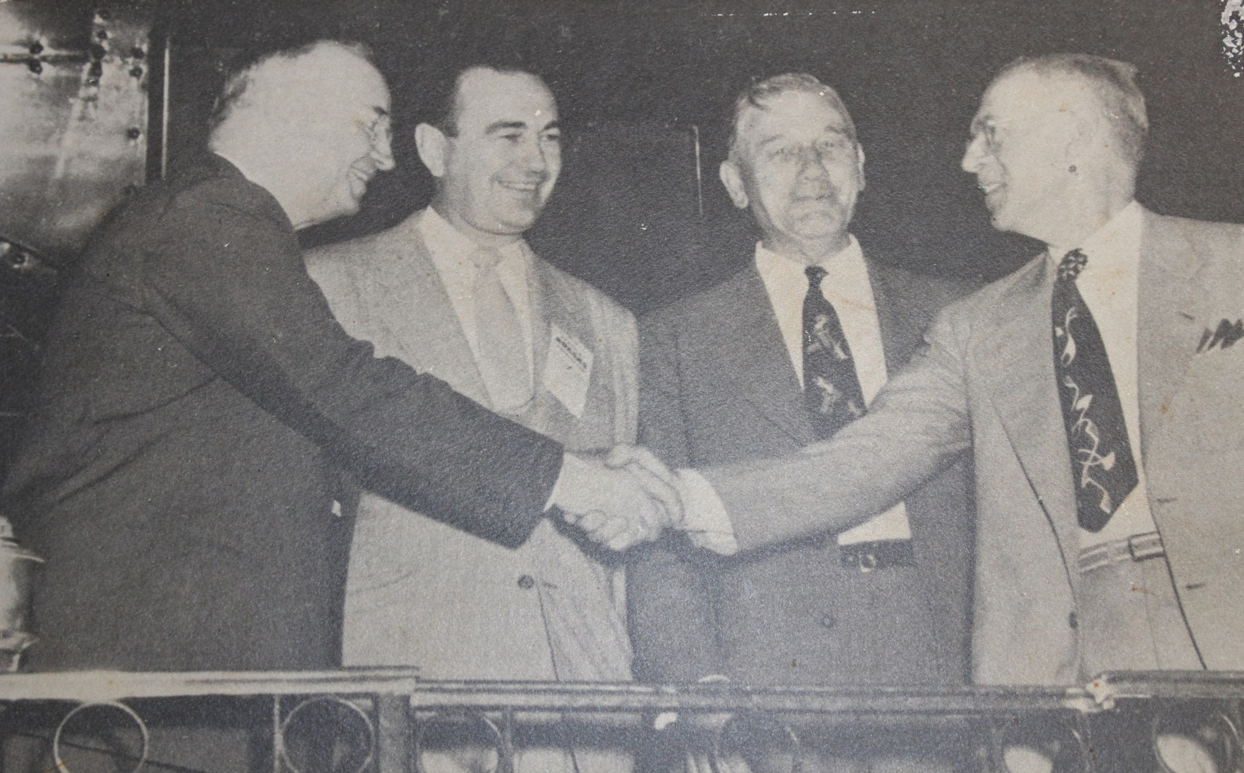
Working together to serve the citizens of KY and VA

