Slide 1
SHIFT 2024 Update Budget Review Subcommittee August 2, 2023
Jason Siwula, PE
Deputy State Highway Engineer
Mikael Pelfrey, PE
Director – KYTC Division of Planning

Slide 2
How is the HIGHWAY PLAN put together?

Slide 3
Kentucky’s HIGHWAY PLAN captures needs and translates NEEDS into PROJECTS
Project Development
Construction
Operations
Planning

Slide 4
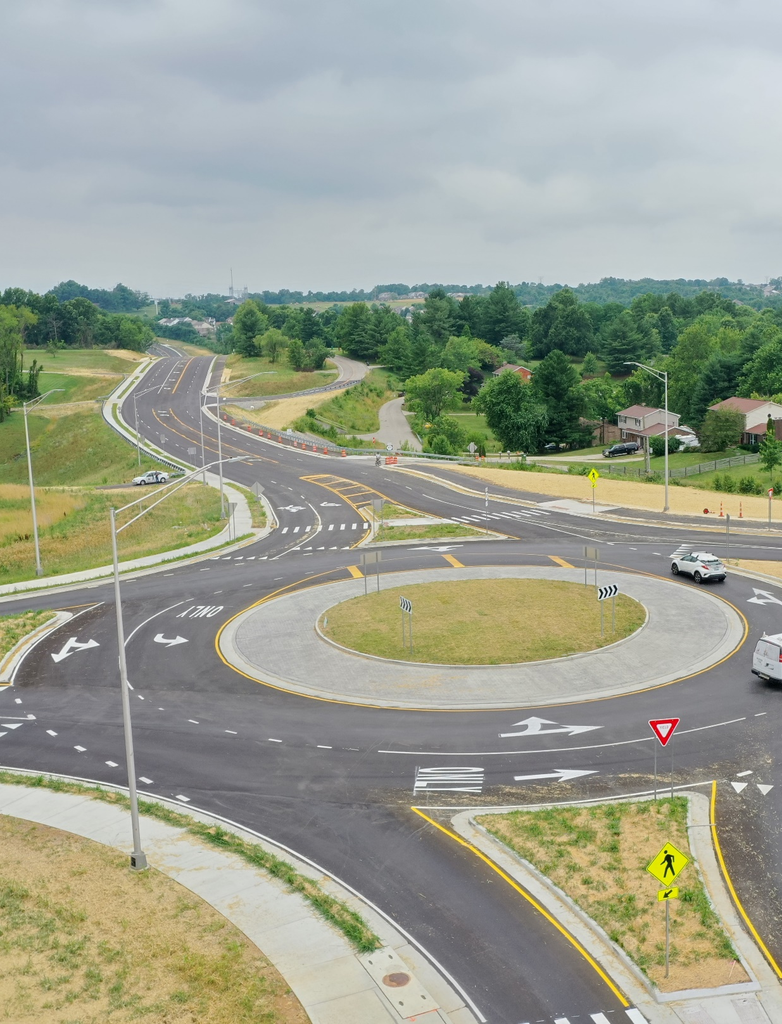
SHIFT Focuses on
Larger Highway
Improvement Projects
Projects Included
Large Scale Safety Improvements
Road Widening
Reconstruction
New Interchanges
New Routes

Slide 5
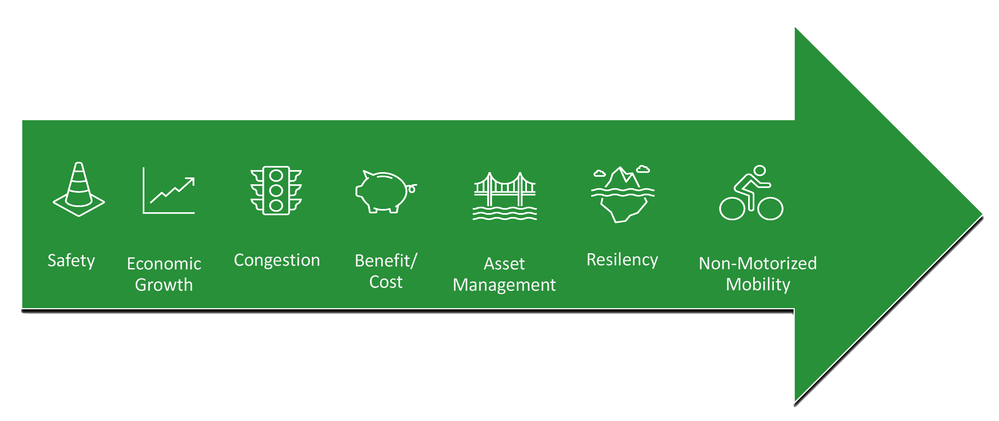
Formula Components

