Slide 1
Multi-modal Funding in Kentucky
BR Subcommittee on Transportation
Jeremy Edgeworth
Freight, Rail and Waterways Coordinator
Division of Planning
Frankfort, Kentucky | August 2, 2023

Slide 2
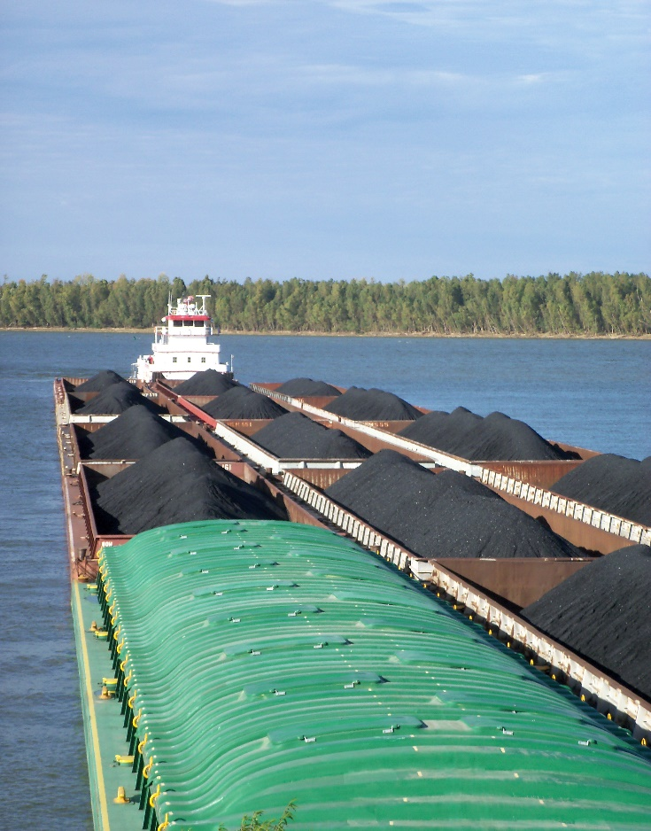
Kentucky’s Waterway Network

Slide 3
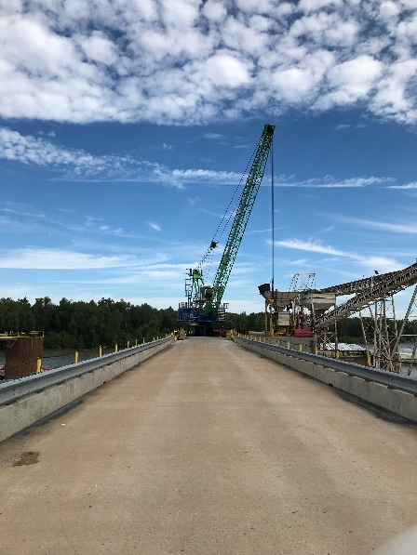
Kentucky’s Public Riverports

Slide 4
HB 241 Transportation Cabinet Budget Bill
Acts of the 2022 Regular Session, House Bill 241/VO,
Part I, Section A, Subsection 1 (4)
(4) Riverport Improvements: Included in the above General Fund appropriation is $500,000 in each fiscal year to improve public riverports within Kentucky. The Secretary of the Transportation Cabinet, in conjunction with the Kentucky Water Transportation Advisory Board, shall determine how the funds are distributed.

Slide 5
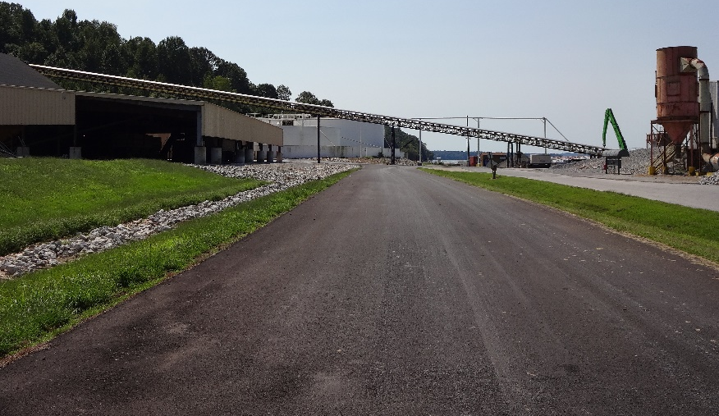
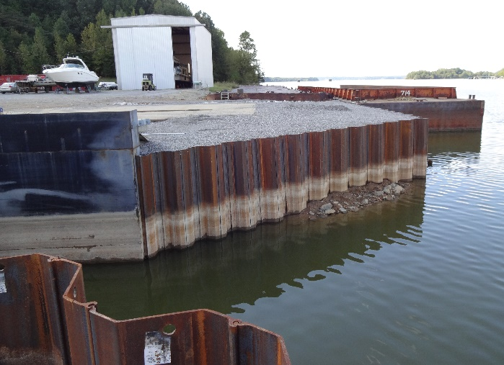
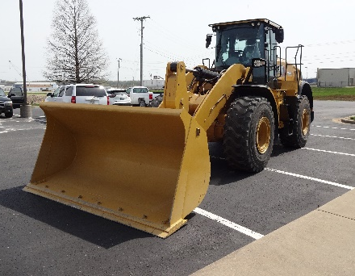
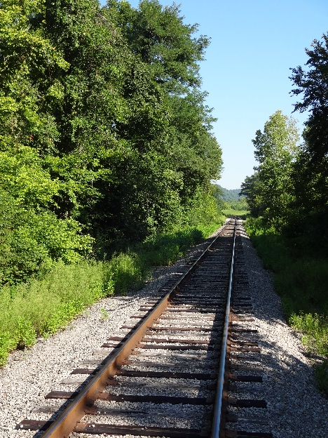
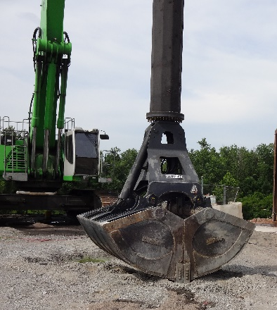
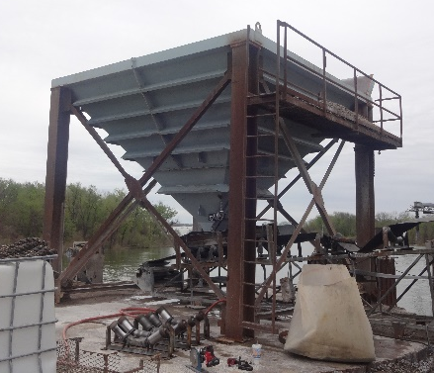
Kentucky Riverport Improvement (KRI) Program
Allowable KRI projects:
Eligible projects provide dredging or improve Riverport facilities, infrastructure, or critical material handling equipment.
50/50 match

Slide 6
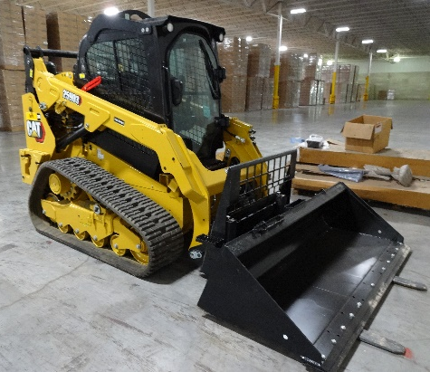
FY 2024 Kentucky Riverport Improvement Awards Available Funds: $500,000.00
Riverport | Project | Total Cost | KRI Awarded
Eddyville | Caterpillar 330 Hydraulic Excavator Project | $368,122.00 | $184,061.00
Henderson | Automated Truck Scale Project | $244,000.00 | $122,000.00
Owensboro | 10,000 lb Forklift Project | $32,339.14 | $16,169.57
Owensboro | 25,000 lb Forklift Project | $231,719.20 | $115,859.60
Owensboro | Compact Track Loader Project | $62,799.66 | $31,399.83
Paducah | 4th Street Concrete Aprons Project | $61,020.00 | $30,510.00
 | Total | $1,000,000.00 | $500,000.00

Slide 7
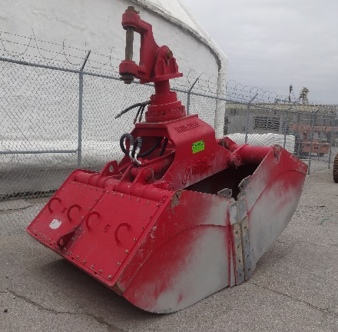
FY 2023 Kentucky Riverport Improvement Awards Available Funds: $500,000.00
Riverport | Project | Total Cost | KRI Requested
Eddyville | Barge Positioning Winch System Project | $210,116.00 | $105,058.00
Eddyville | Laydown Yard Project | $220,458.00 | $110,229.00
Hickman | Dock Dredging Project | $63,600.00 | $31,800.00
Hickman | Mooring Dock Cell Repair Project | $100,000.00 | $50,000.00
Owensboro | Bucket for Liebherr LH 120 Project | $114,980.00 | $57,490.00
Owensboro | Caterpillar 903D Wheel Loader Project | $73,580.00 | $36,790.00
Owensboro | Grapple for Sennebogen 875 | $71,824.00 | $35,912.00
Paducah | Bulk Commodity Receiving Hopper Project | $145,442.00 | $72,721.00
 | Total | $1,000,000.00 | $500,000.00

Slide 8
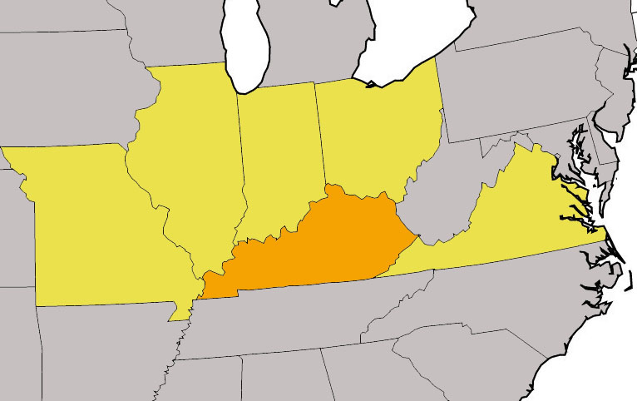
State Riverport Funding: Missouri
Three annual funding programs to assist its ports:
Port Administration Funding-$850K
$600K Divided by formula between the public port authorities for use in any expense related to port business.
$250K used for preliminary engineering for future port construction projects
Port Capital Improvement Program-$9.4M
Program provides capital improvement grants for eligible public port facilities.

Slide 9
State Riverport Funding: Missouri
Freight Enhancement Program-$1M annually
Nonhighway capital projects to improve the efficient movement of freight. The program is open to all modes.
$30M in FY 23 from their allocation of federal American Rescue Plan Act (ARPA) funds.

Slide 10
State Riverport Funding: Illinois
Illinois Marine Transportation System Plan provides a resource the state used to garner fiscal support with a major port redevelopment appropriation of $150M dollars for the next 6-year period.
50/50 match requirements
$40 million dedicated to create a new public port in Cairo, Illinois

Slide 11
State Riverport Funding: Indiana
Public Ports are state owned, no state funded capital improvement programs.

Slide 12
State Riverport Funding: Ohio
Maritime Assistance Program (MAP)
$56M for FY20-FY25
50/50 match requirement.
Eligible projects included land acquisition, construction and repair of warehouses, railroad tracks, roadways, gates, fencing, wharfs, dredging, acquisition of cargo handling equipment, mobile shore cranes, stationary cranes, craneways, conveyors, bulk handling equipment, ship loading and unloading equipment and planning and design costs.

Slide 13
State Riverport Funding: Virginia
State run port authority owns and operates four seaports and one inland intermodal logistics center or non-marine inland port terminal.
The port authority has a $42 million annual budget for the ports and provides several grant programs for infrastructure development like the $5 million infrastructure Grant Program for the Port of Virginia.
Match requirements vary from 50/50 to 80/20.
There are also major tax incentive programs for barge and rail users.

Slide 14
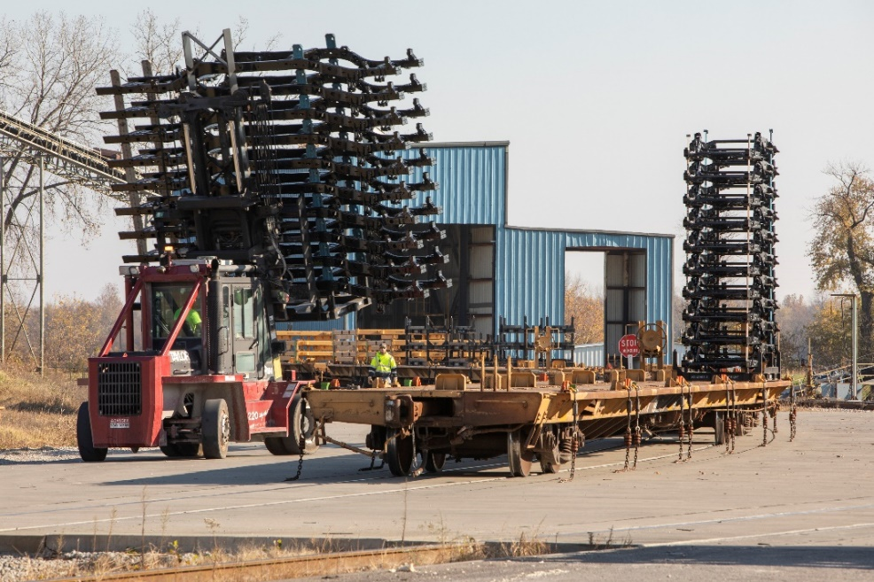
Kentucky’s Rail Network

Slide 15
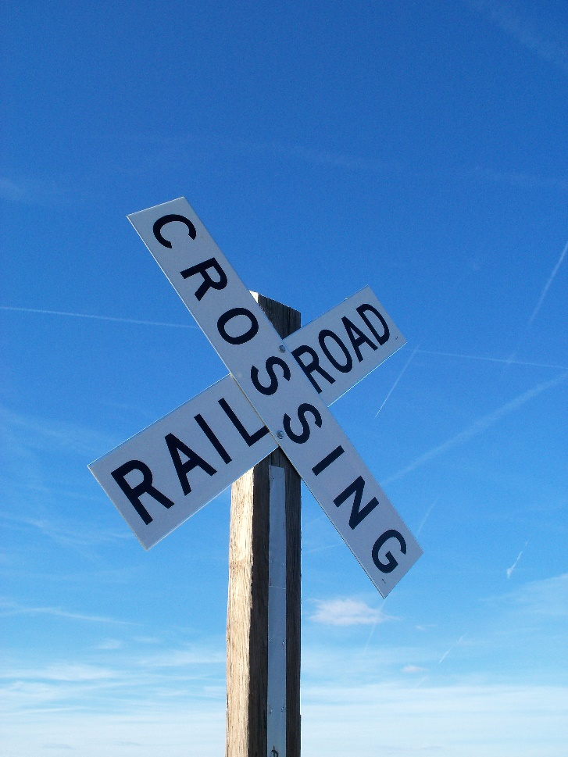
HB 241 Transportation Cabinet Budget Bill
Acts of the 2022 Regular Session, House Bill 241, SCS 1,
Part I, Section A, Subsection 4 (4)
(4) Highway Construction Contingency Account…..Also included in the Highway Construction Contingency Account for Railroads is $1,600,000 in each fiscal year for public safety and service improvements which shall not be expended unless matched with non-state funds equaling at least 20 percent of the total amount for any individual project. Additionally, in each fiscal year, up to $350,000 of the $1,600,000 appropriation may be used to establish and administer the Kentucky Rail Office in the Kentucky Transportation Cabinet.

Slide 16
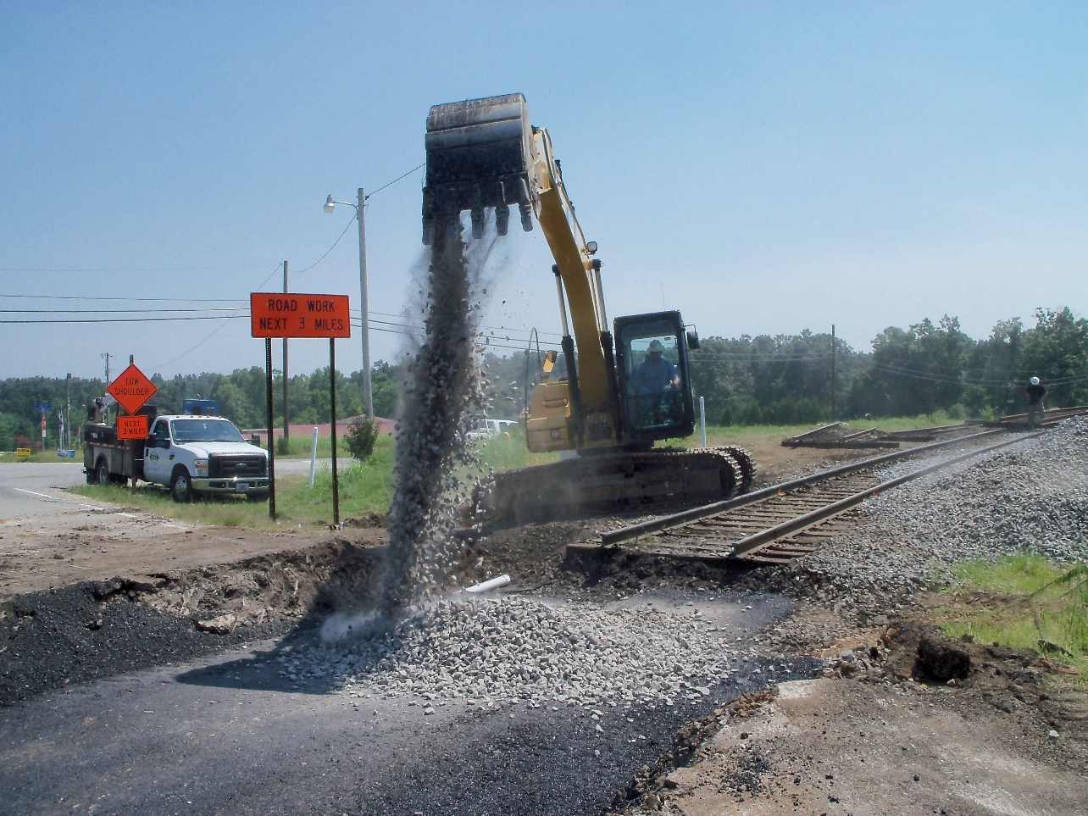
Kentucky Rail Crossing Improvement (KRCI) Program
Allowable KRCI projects for any at-grade public crossing:
Crossing rehabilitation
Crossing safety equipment improvements
Removal of obstructive vegetation

Slide 17
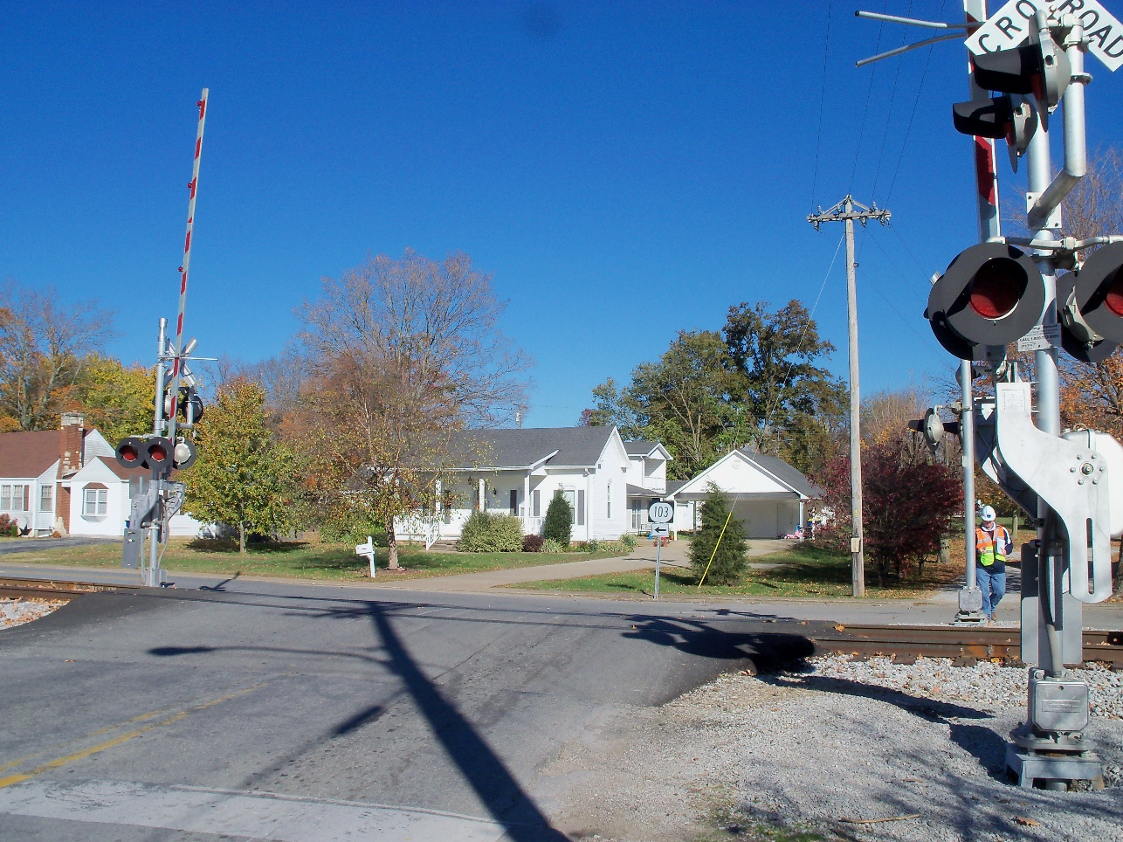
Kentucky Rail Crossing Improvement (KRCI) Program
FY 24 Grants
$1,250,000.00 available
33 applications for $4,439,579.76 in grants.
FY 23 Grants
$2,214,586.67 available
$1,250,000.00 in FY 23 funds
$964,586.67 in past years unexpended KRCI funds
22 applications for $2,812,473.38 in grants.

Slide 18
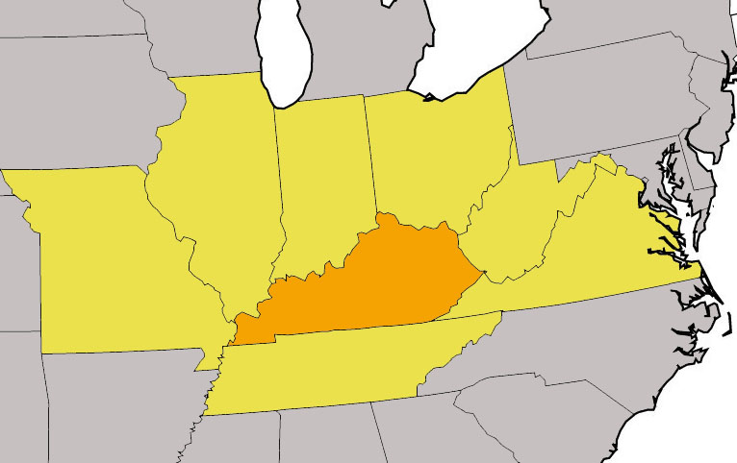
State Freight Rail Funding: Missouri
Freight Enhancement Program-$1M annually
Nonhighway capital projects to improve the efficient movement of freight. The program is open to all modes.
FY 2014-FY 2020 11 rail projects awarded $3.28M
Highway-Rail Crossing Safety Program- $3-4M annually
$18.35M from FY 2015-FY 2019.
Source: 2022 Missouri State Freight & Rail Plan

Slide 19
State Freight Rail Funding: Illinois
Illinois Rail Freight Program-$3.2M in FY 16
Provides low-interest loans and grants to finance rail improvements.
Funding for the program is provided through two revolving loan funds – the Rail Freight Loan Repayment Fund, which utilizes federal funds from the former Local Rail Freight Assistance Program (LRFA), and the State Loan Repayment Fund, which utilizes state funds from past General Revenue Appropriations.
Illinois Grade Crossing Protection Fund-$27M
Helps local jurisdictions (counties, townships and municipalities) pay for safety improvements at highway railroad crossings on local roads and streets.
Source: 2017 Illinois State Rail Plan Update

Slide 20
State Freight Rail Funding: Indiana
Industrial Rail Service Fund-$2.6M annually
Funding for shortlines to rehabilitate track structures, such as replacement of ties, ballast, and rail, bridge construction and bridge repairs, and projects improving access to serve customers, such as rail spurs or sidings.
Railroad Grade Crossing Fund-$750K annually
Funding for improved signage and pavement markings, improvements to crossing surfaces, lighting upgrades to LED, crossing closures, median barriers, and other measures.
Local TRAX-$121M in 2018
Land acquisition and construction cost of high-priority railroad grade separations, grade crossing closures, or other safety enhancements at railroad intersections with local roads.
Source: 2021 Indiana State Rail Plan

Slide 21
State Freight Rail Funding: Ohio
Fiscal years 2017 and 2018, Ohio Rail Development Commission approved $5.9 million in grant funds and lent $790,000 for freight rail projects.
Fiscal years 2018 and 2019, $2 million per year in state funding was available for freight grants.
Due to February East Palestine train derailment, additional rail safety funding has been allocated for FY 24-FY25.
Wayside Detector Expansion Grants $10M
Orphan Rail Crossing Program $1M
Rail Safety Crossing Match $100M
Rail Development Grant and Loan Program $6M annually
Source: 2019 State of Ohio Rail Plan

Slide 22
State Freight Rail Funding: West Virginia
West Virginia invested $1.9 million to support its 184 miles of state-owned rail assets in fiscal year 2017.
West Virginia State Rail Authority (WVSRA) does not currently have a discretionary grant or loan program, it does have the ability to issue bonds to implement projects if the revenues generated are sufficient to service the bonds.
Source: 2020 West Virginia State Rail Plan Update

Slide 23
State Freight Rail Funding: Virginia
Shortline Railway Preservation Fund
Rail Preservation projects consist primarily of bridge and track upgrades, signal system upgrades, yard improvements, siding enhancement, and tie and rail replacement. For FY23, DRPT allocated approximately $6.5 million in state funding under this program.
Freight Rail Enhancement to Increase Good and Highway Throughput (FREIGHT)
The program supports projects that improve railways, railroad equipment, rolling stock, rights-of-way, rail facilities, and engineering and design. In FY23 the program includes nine rail infrastructure development projects with a $62 million commitment from the Commonwealth Rail Fund.
Source: 2022 Virginia Statewide Rail Plan

Slide 24
State Freight Rail Funding: Virginia
Rail Industrial Access Fund
The Rail Industrial Access Fund (RIA) offers grant funding to build or rehabilitate rail spurs. RIA shares approximately $5.5 million in funds from the Transportation Trust Fund with VDOT, which administers a similar roadway grant program, the Economic Development Access Program. Applicants can apply for up to $450,000 with a requirement of a 30 percent match from the applicant.
Source: 2022 Virginia Statewide Rail Plan

Slide 25
State Freight Rail Funding: Tennessee
Short Line Railroad Preservation Grant Program
Preserve rail service to local communities and expand rail connectivity to sites along existing rail corridors.
In FY2022, $85 million was provided in funding for this program.
FastTrack Infrastructure Development Program (FIDP)
For local communities to improve public infrastructure to create new jobs and business investment. Rail access to industrial sites is an eligible activity under this program.
Typical total funding amounts are $15-20 million per year but are dependent on Tennessee’s Legislature and the annual budget.
Source: 2019 Tennessee Statewide Rail Plan

Slide 26
For More Information
Jeremy Edgeworth, KYTC
Jeremy.edgeworth@ky.gov
502-782-5095

