Slide 2
Background
2017
2020
2021
2022
2023
Exploration of developing an Aviation program began at the request of economic leaders in Hopkins and Muhlenberg Counties.
Curricula for the fixed wing and helicopter programs were approved by the KCTCS Board of Regents.
Hired Director of Aviation programs.
Hired full-time Chief Flight instructors for fixed wing and helicopter programs.
Enrollment exceeded 50 students.
Programs received eligibility for VA benefits.
Enrolled first 3 students in the program (1 fixed wing/2 helicopter).
Visited other programs, consulted with aviation specialists, and researched workforce needs.
Leased the first airplane and helicopter to begin the program.
2017–2020
2021
2021
2022

Slide 3
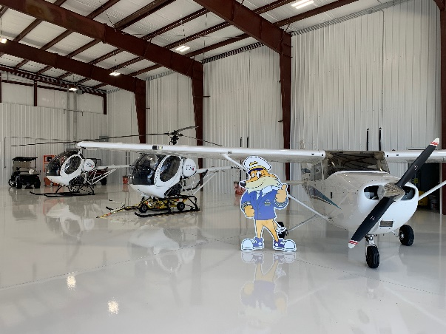
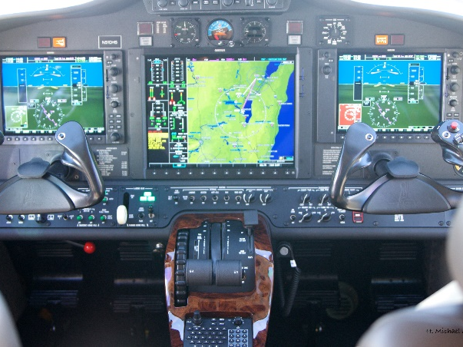
Our Commitment
MCC has invested in this program with limited funding assistance since its inception. The college currently leases all equipment used in the aviation program.
MCC Investment to Date
Land/property renovations | $1,806,000
Program development/start-up | $479,536
Equipment | $1,002,115
Aircraft contracts/fuel | $1,100,718
Insurance | $794,208
Personnel | $1,255,609
TOTAL | $6,438,186

Slide 4
Enrollment Snapshot
The first students enrolled in the MCC Aviation program in Spring 2021. The data below shows Spring 2021 enrollment and Fall 2023 enrollment.
Curriculum is designed to provide flexibility to meet student needs and demographics.
Each flight program is designed for a maximum capacity of 90 students.
Current “first attempt” pass rate on FAA practical evaluation exceeds 92%.
Program | Enrollment for Spring 2021 | Enrollment for Fall 2023
Fixed Wing | 1 | 31 (11 veterans)
Helicopter | 2 | 19 (11 veterans)

Slide 5
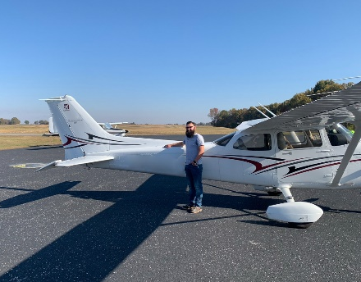
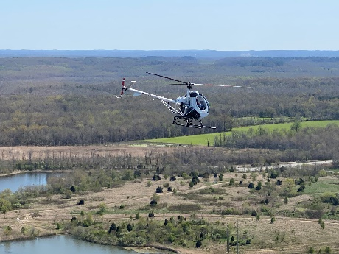
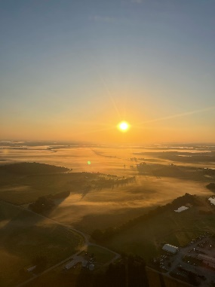
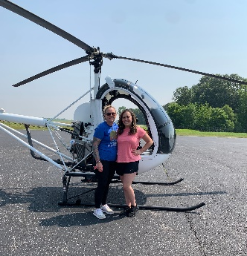
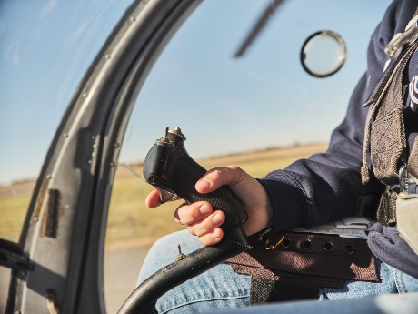
ENROLLMENT growth
WITH STUDENTS IN MIND
Flight Lab Cost (Includes insurance, maintenance, and fuel)
Present Lease Contracts |  | With Purchased Assets & Maintenance
250 hours at $281 per hour = $70,250 | Fixed Wing | 250 hours at $142 per hour = $35,500
200 hours at $531 per hour = $106,200 | Helicopter | 200 hours at $257 per hour = $51,400
Each student must fly 50 hours per semester.

Slide 6
Funding request
To grow the program, an infusion of funding is needed to alleviate the bulk of flight fees and make sure the program is more affordable for more students. A combination of lease/purchase will facilitate the volume of assets needed for growth while substantially reducing the flight fees for all students.
Capital Request 2 yr. plan based on program growth
C-172S airplanes (6) | $2,700,000
Maintenance | $320,000
R44 helicopters (6) | $2,700,000
Maintenance | $1,800,000
Insurance | $640,000
Pilots/CFIs | $2,500,000
Marketing | $100,000
TOTAL | $10,760,000

Slide 7
What makes MCC Different?
MCC has the only associate degree-level flight program in Kentucky.
Students receive 5 FAA certifications within the associate degree.
The program allows for rapid movement to meet workforce needs.
We are Kentucky’s only collegiate helicopter flight training program.
The Aviation program currently serves students from Western Kentucky, Tennessee, Indiana, and Ohio.
Currently in partnership with Madisonville Regional Airport and Muhlenberg County Airport.
Collaborating with high schools to establish STEM programs in Aviation.
Proximity to Fort Campbell allows us to assist veterans and transitioning military personnel.
Approximately 15% of currently enrolled students are female.
MCC utilizes 3 Redbird fixed wing simulators and 3 Redbird helicopter simulators.
All fixed wing flight training delivered in Technically Advanced Aircraft (TAA).
The program is strengthened by a high level of community support.

Slide 8
THANK YOU!

