Slide 1
The Aviation Industry in Kentucky

Slide 2
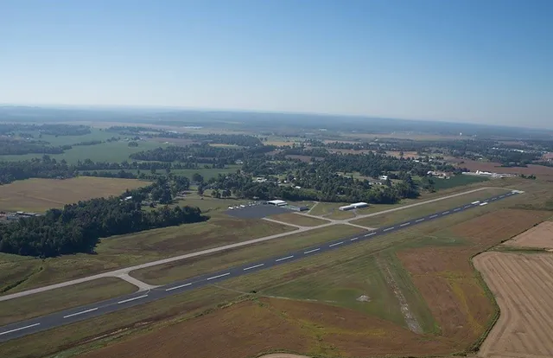
General Aviation Airports
Purpose
Daily Operations
Local Economic Impact
Typical Needs

Slide 3
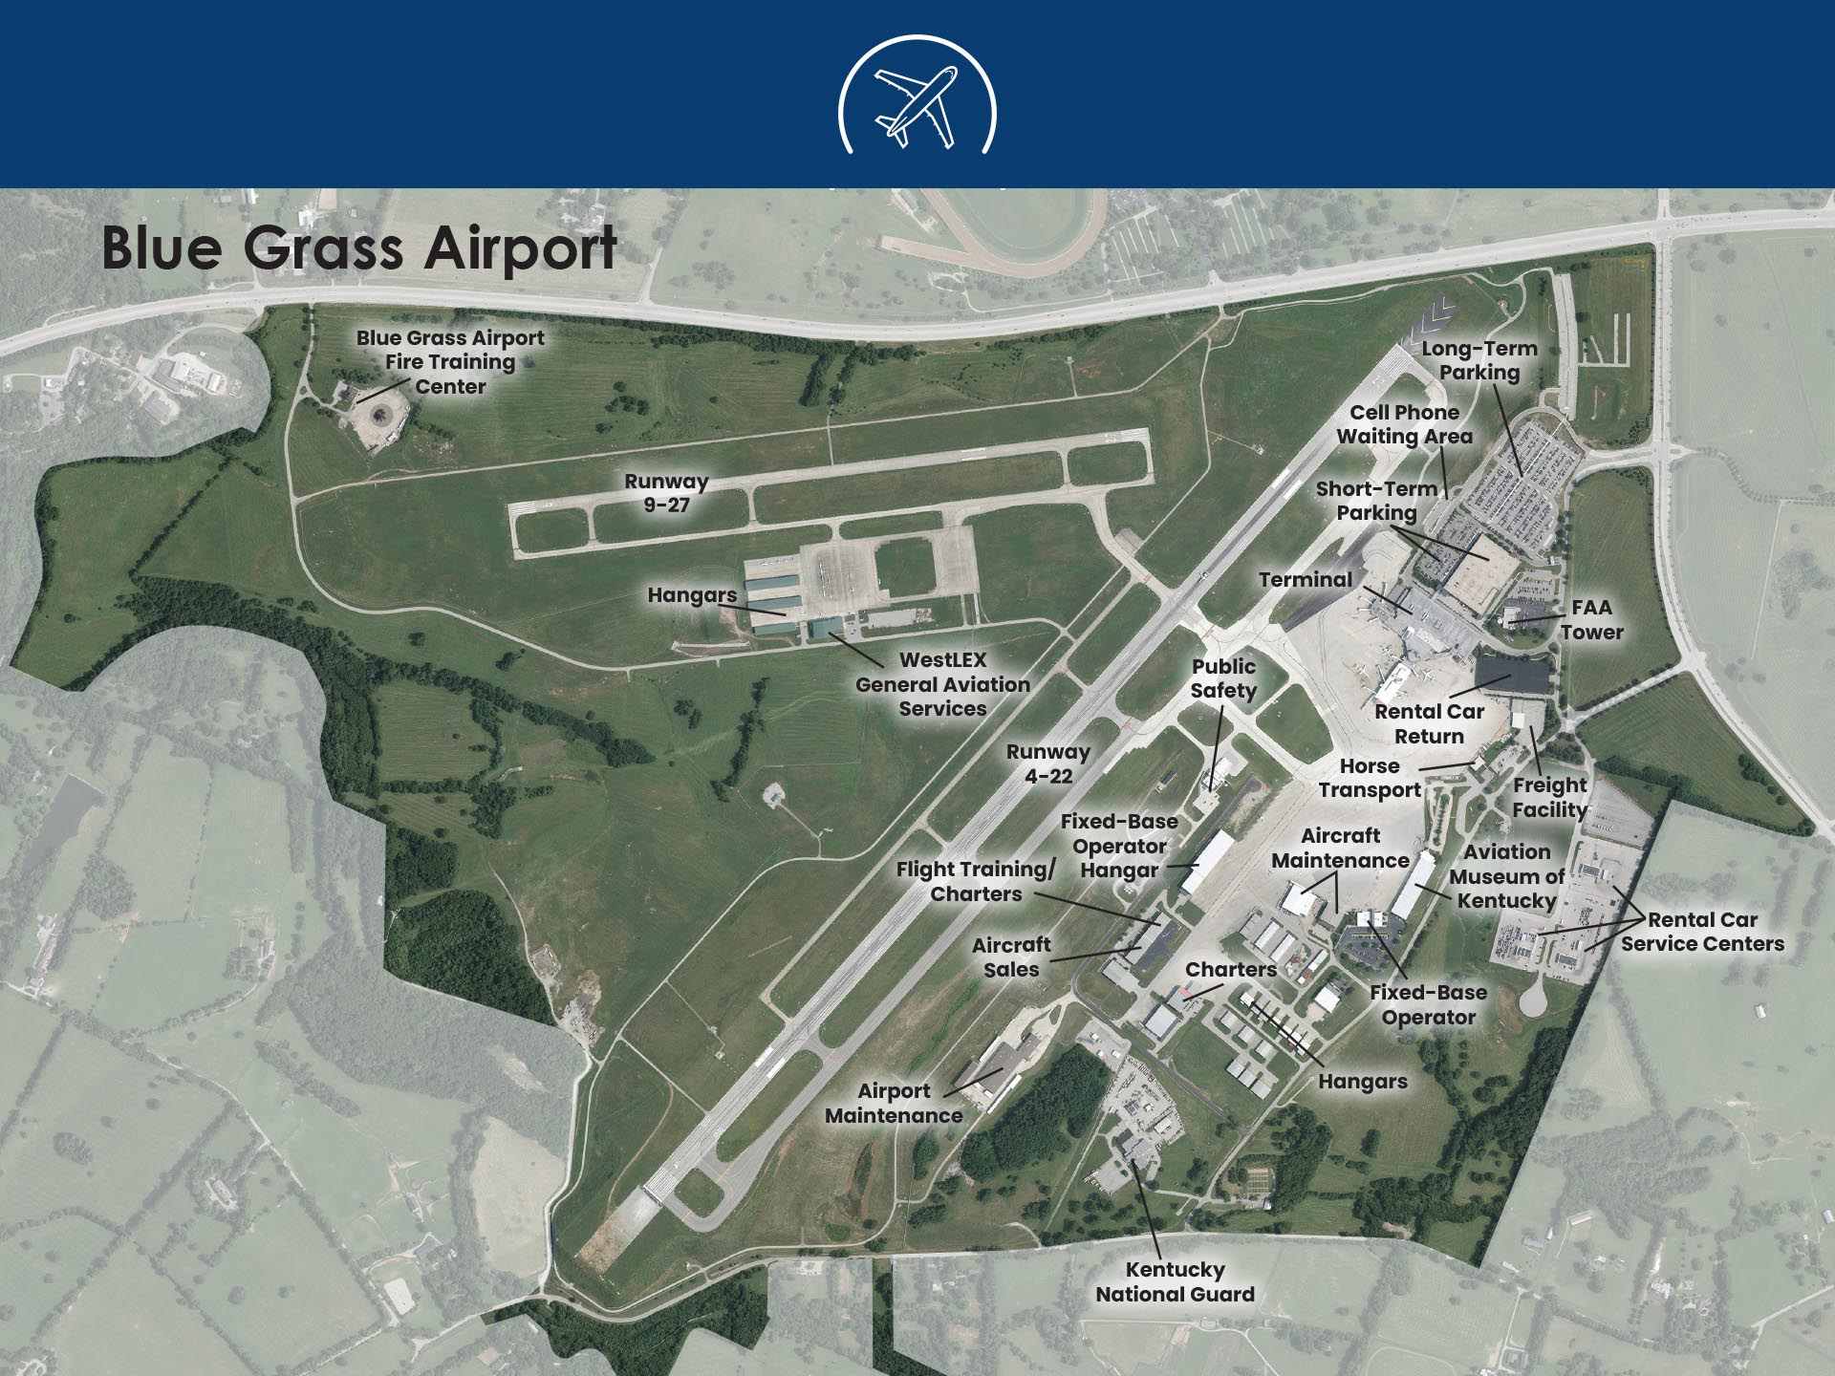
Commercial Airports
Purpose
Daily Operations
Local Economic Impact
Typical Needs

Slide 4
Airport Challenges & Needs
KDA System Needs Study
Pavement
Runway Improvements
Aprons
Terminals

Slide 5
Funding Proposal To Address Needs
$7.95M each year for General Aviation Airport support
$7.95M each year for Commercial Service Airport support
$15M each year for infrastructure investment, such as pavement needs, available to all airports

Slide 6
Thank You!
Emily Herron, Airport Manager, Madisonville Regional Airport Eric Frankl, Executive Director, Blue Grass Airport
Jennifer Kirchner, Executive Director,
Kentuckians for Better Transportation (KBT) Paul Steely, President, Kentucky Aviation Association (KAA)

