Slide 1
Electric Vehicle Power Excise Tax
Budget Review Subcommittee on Transportation
October 18, 2023

Slide 2
KEY HB 8 PROVISIONS CODIFIED IN KRS 138.477
(2) On or after January 1, 2024:
(a) An excise tax with an initial base rate of three cents ($0.03) per kilowatt hour is imposed on electric vehicle power distributed in this state by an electric vehicle power dealer for the purpose of charging electric vehicles in this state; and
(b) A surtax with an initial base rate of three cents ($0.03) per kilowatt hour is imposed on electric vehicle power distributed in this state by an electric vehicle power dealer when the electric vehicle charging station is located on state property.
(5) This tax shall be:
Administered by the department; and
Transferred to the road fund as defined in KRS 48.010.
(6) (a) The tax shall be added to the selling price charged by the electric vehicle power dealer at the electric vehicle charging station on electric vehicle power sold in this state.
(b) If there is no selling price at the charging station, the electric vehicle power dealer shall be responsible for paying the tax on the electric power distributed by the electric vehicle charging station, except in the case of an electric vehicle charging station installed prior to July 1, 2022.
(7) (a) The tax imposed shall be paid by the electric vehicle power dealer to the State Treasurer.
(b) The electric vehicle power dealer is liable for the electric vehicle power tax.
(8) Every electric vehicle power dealer shall, by the twenty-fifth day of each month, transmit to the department reports, on the forms the department may prescribe, on the total kilowatt hours distributed and the amount of tax collected. Payment of the tax shall be due with the report.

Slide 3
REGISTRATION
Electric Vehicle Power Dealers will register electronically through DOR’s online portal.
Electric Vehicle Power Excise Tax Application will be available for registrants December 1, 2023.
Dealers will need their FEIN to create a log in.
Registration application will consist of general business questions regarding business name, address, location, corporate officers, and tax account numbers.
Charging station(s) information will be collected as follows:

Slide 4
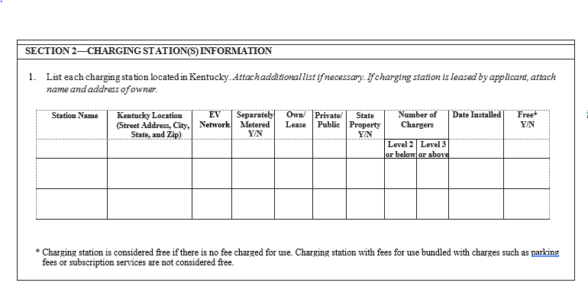
TAX REGISTRATION APPLICATION FOR ELECTRIC VEHICLE POWER EXCISE TAX

Slide 5
TAX FILING
Electric Vehicle Power Excise Tax Return will be available for electronic filing after February 1, 2024.
Tax return and payment are due monthly on the 25th following the reporting month. The first filing deadline is February 25, 2024.
Tax Returns must be filed and paid electronically.
Tax return will consist of two sections:
Section I – Tax computation (Information from Section II will automatically carry to Section I to calculate tax due).
Section II – Separate schedules of kilowatt hours distributed for charging stations not located on state property and those located on state property.
Applicable penalties and interest will calculate for late filings and payments.

Slide 6
TAX RATE ADJUSTMENTS
Tax rates shall be adjusted to be effective on January 1, 2025, and on each January 1 thereafter.
Tax rates shall be adjusted by the change in the quarterly National Highway Construction Cost Index 2.0 (NHCCI 2.0).
Tax rates may not increase or decrease more than 5% annually and may not decrease below the initial base tax rate of $0.03 per kilowatt hour.
DOR shall provide notification of the adjusted tax rates for the upcoming calendar year to all dealers at least twenty (20) days in advance of the first day of each calendar year.

Slide 7
FREQUENTLY ASKED QUESTIONS
https://taxanswers.ky.gov/Sales-and-Excise-Taxes/Pages/Electric-Vehicle-Power-Tax.aspx
Does the tax apply to EV stations where the public is able to use the charging stations free of charge?
According to the provisions of KRS 138.477, the tax is still due even if there is no charge for the power distributed from the charging station unless the charging station was installed prior to 07/01/2022.
What party is responsible for reporting and payment of the EV charging station excise taxes?
The tax is due from the person that owns or leases the EV charging station.
If there is a charge for use of the charging station, is the excise tax required to be listed separately from the selling price?
Yes, the excise tax must be separately stated from the selling price.
How is the sales tax calculated for EV charging stations that require payment for usage?
The sales tax is due on the gross receipts received from use of the EV charging stations. Separately stated EV charging excise taxes collected from the customer are not part of gross receipts subject to sales tax. See KRS 139.010(17)(c)3.
Are charging stations owned and operated by the federal government subject to this tax?
No, federal entities are not subject to this tax. However, if a third party owns or leases the charging station for use on federal property, the third party is still liable for the tax.
NOTE: Charging stations installed before 07/01/2022 and providing free charging services are not subject to the tax.

Slide 8
FREQUENTLY ASKED QUESTIONS
https://taxanswers.ky.gov/Sales-and-Excise-Taxes/Pages/Electric-Vehicle-Power-Tax.aspx
Are public EV charging stations owned by state and local governments subject to this tax?
Yes, these governmental entities are responsible for reporting and paying the tax per kilowatt hour of electricity distributed. Also, the additional $0.03 per kilowatt hour surtax is due from charging stations located on state property.
Are private charging stations (fleet customers only, limited workplace access) subject to the EV excise tax?
No, unless the EV charging station is available to general public vehicular traffic, the kilowatt hours distributed through the stations are not subject to the excise taxes. Examples of restricted access may include special card access, code access, locked gates limiting access, other barriers, etc.
Are charging stations provided for patrons of a business subject to this tax?
Yes, charging stations provided by businesses accessible to general public vehicular traffic are subject to the tax.
Are charging stations reserved for tenants of multi-family housing units subject to this tax?
Restricted access charging stations to tenants only are considered private charging stations (see question #7). However, if the charging stations located at multi-family housing units are accessible to general public vehicular traffic, the electricity distributed is taxable even though the stations are designated for residential use.
How will the tax be calculated if the charging station is not separately metered to record the kilowatt hours distributed?
It is the responsibility of the charging station owner/operator to calculate the tax based upon kilowatt hours distributed and to maintain records on how the calculations were made. After market EV charging station meters are available at retail from various sources.

Slide 9
ELECTRIC VEHICLE POWER EXCISE TAX WEBSITE
https://revenue.ky.gov/Business/Pages/Electric-Vehicle-Power-Excise-Tax.aspx

Slide 10
ELECTRIC VEHICLE POWER EXCISE TAX WEBSITE
https://revenue.ky.gov/Business/Pages/Electric-Vehicle-Power-Excise-Tax.aspx

Slide 11
CONTACT INFORMATION
Department of Revenue:
https://revenue.ky.gov/Business/Pages/Electric-Vehicle-Power-Excise-Tax.aspx
Tax Answers:
https://taxanswers.ky.gov/Sales-and-Excise-Taxes/Pages/default.aspx
Excise Tax Section Email:
dor.webresponseexcisetax@ky.gov
Excise Tax Section Phone Number:
502-564-3853
Office of Sales & Excise Taxes
Executive Director: Richard Dobson Richard.Dobson@ky.gov 502-564-5523
Division of Miscellaneous Taxes
Director: Kim Hensley KimberlyF.Hensley@ky.gov 502-782-1644
Assistant Director: Toni Fields Latonia.Fields@ky.gov 502-564-2087

