Slide 1
Kentucky Association of Highway Contractors - Report on Industry Capacity
M. Chad LaRue, P.E.
Executive Director

Slide 2
Is The Highway Construction Industry at Capacity?
Results of Recent Industry Survey
Historical KYTC Letting Information
Historical KYTC Asphalt Tonnage

Slide 3
KAHC Industry Survey Results
32 Companies Participated in Survey
Company Size Ranges from 6-652 employees – Median size: 88
These Companies Collectively Employ over 5,000 people
Measured Capacity Based on Months of Backlog
Source: KAHC Pulse Survey (Aug-Sept 2024)

Slide 4
KAHC Capacity Survey-Continued
One Year Ago- 18/32 Backlog of Six Months or Greater (56%)
Today-14/32 Backlog of Six Months or Greater (44%)
75% Have Same or Reduced Gross Revenues Compared to This Time Last Year
More than two-thirds (69%) of respondents indicated “Pursuing more private/commercial project opportunities”
Companies’ KYTC Backlog have Reduced by 39%
Source: KAHC Pulse Survey (Aug-Sept 2024)

Slide 5
KAHC Capacity Survey-Continued
“…we are having a difficult time keeping employees and equipment busy.”
“Based on our marginal backlog, we have recently reduced the work hours of our paving crews. Because our work is seasonal, this has a greater impact on our hourly employees and makes it more difficult for us to compete with other industries.”
“If it had not been for obtaining work in various other states this season, we would have lost a significant number of employees.”
“We are at 50 percent of capacity.”
“We have ample capacity to increase our backlog. Our backlog has decreased by over 70% from this time 2 years ago.”
“…we have limited many of our construction crews to 40 hours. In addition, our dump truck drivers are averaging 40 hours and we have cut back on the number of subcontract haulers.”
“Our operations focus on Indiana and Kentucky and we allocate resources accordingly. We have currently allocated more resources into Indiana due to reduced opportunities in Kentucky.”
“We are at real risk of laying off employees that we cannot readily replace the skill, knowledge, and experience.”
Source: KAHC Pulse Survey (Aug-Sept 2024)

Slide 6
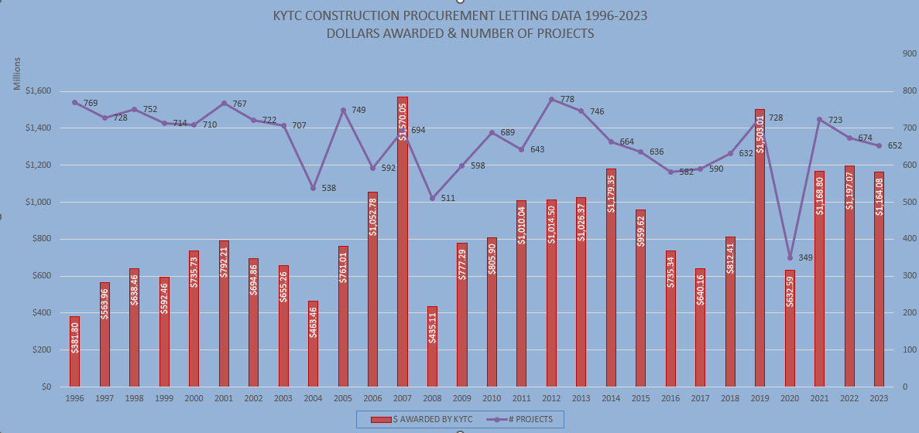
Historical KYTC Letting Data
Notes:
YTD Comparisons 24-22
24-$715,422,478-355
23-$782,157,231-497
22-$839,781,350-520
21-$705,901,169-496

Slide 7
Historical KYTC Letting Data

Slide 8
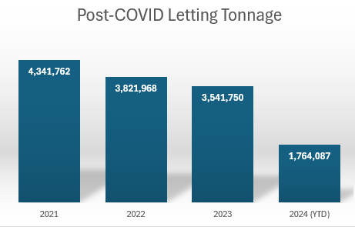
Historical KYTC Asphalt Tonnage

Slide 9
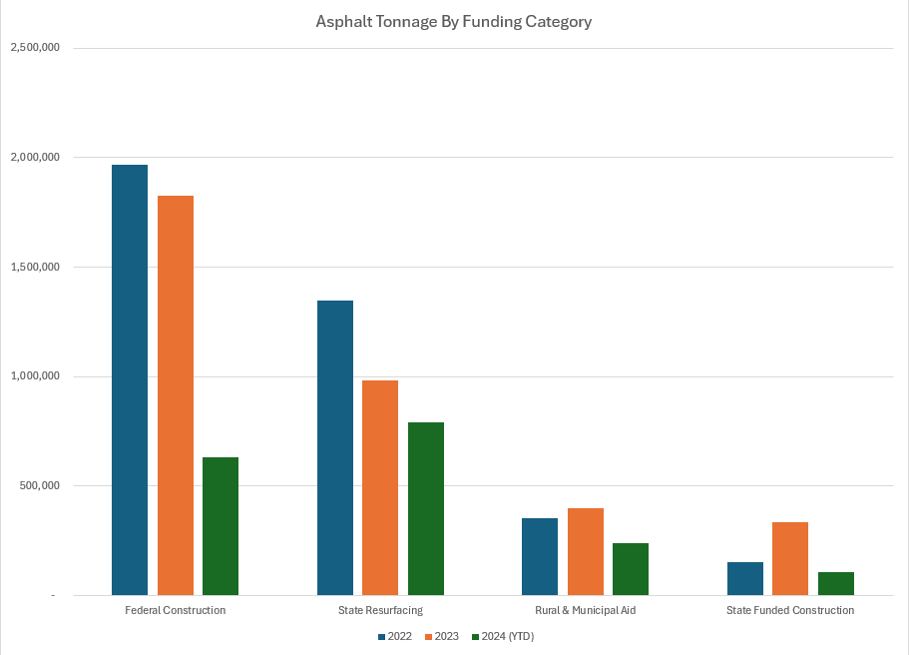
KYTC Historical Asphalt Tonnage-Continued

Slide 10
In Summary
Plenty of Capacity in Kentucky’s Highway Construction Industry
Industry is Feeling a Contraction in 2024
Volatility Inhibits Industry Growth
Industry Stands Ready & Has Ability to Deliver on State, County, City Promise to Taxpayers of Safe, Efficient Transportation

Slide 11
M. Chad LaRue, P.E. Executive Director clarue@kahc.org

