Slide 1
BUDGET REVIEW SUBCOMMITTEE
ON TRANSPORTATION
September 18, 2024
Contracting Update
John Moore, PE, Deputy State Highway Engineer
Department of Highways

Slide 2
Mission
To provide a safe, efficient, environmentally sound and fiscally responsible transportation system that delivers economic opportunity and enhances the quality of life in Kentucky.
Notes:
Following a rough year in 2020 due to COVID, KYTC has bounced back with back to back to back robust letting years, each over $1 billion in contracts. For CY 2024 we are looking to hold another robust letting year having already let $715M in projects through August. With the lettings remaining for the year, we expect another $1 billion dollars in lettings for 2024.
Members of the industry have expressed concern about the slow pace of contracts this year, especially in the paving sector. In August as a result of these concerns, we met with industry leaders to confirm their observations and share the outlook for the balance of 2024.

Slide 3
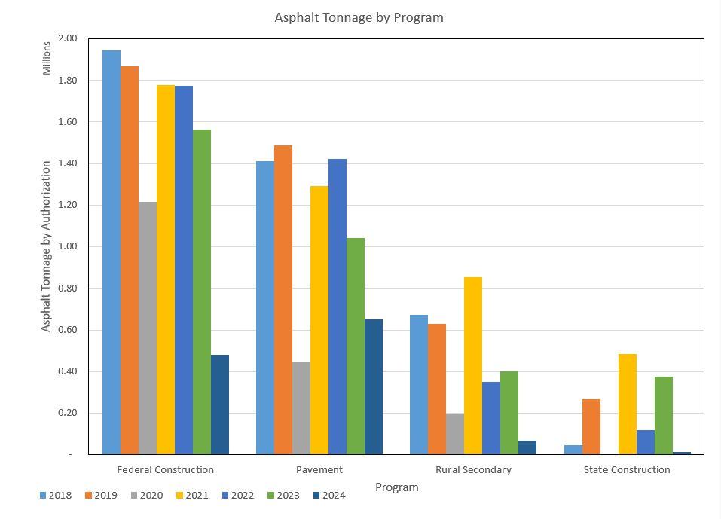
Notes:
Brian Wood from PAIKY shared a similar trend of asphalt tonnages since 2021. For completeness we replicated the analysis and extended it to include 2018 and 2019 for more history. The tonnage history does indicate a downward trend of tonnages in recent years. This was a somewhat surprising trend based on programmatic expenditures so we also looked at overall expenditures over the same period.

Slide 4
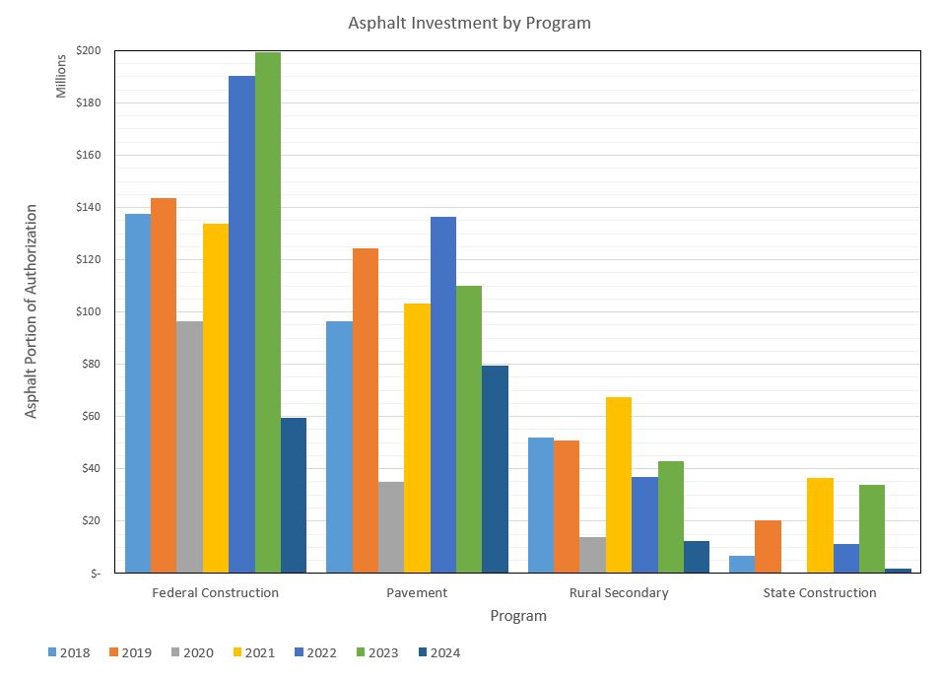
Notes:
With the exception of 2020 the spending trends are flat to increasing year over year. Lettings to date in 2024 have lagged as they tend to do in a budget year which brings with it a new Highway Plan.

Slide 5
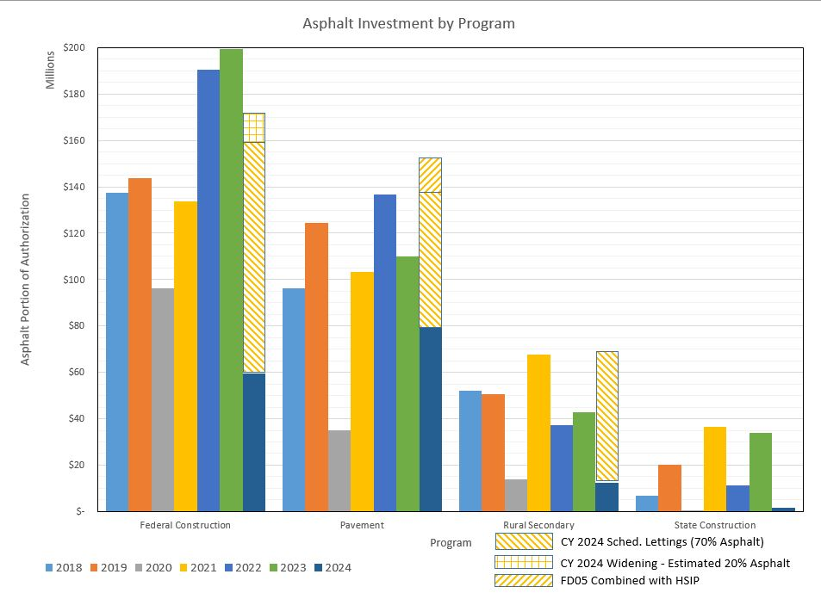
Notes:
To assuage some concerns, we included the outlook for the balance of the year, which is updated here through August lettings. Project projections by program are shown in hashed lines which show a robust conclusion to the year in all program areas.
Note Federal Construction includes only asphalt intensive projects (pavement rehabs and interstate widening projects).
Pavement is anticipated to recover beyond previous years.
Rural Secondary program administered by Rural and Municipal Aid advises a very strong end of the year.
Note I did not include a forecast for State Construction but the looming High Growth Community projects will begin to impact that category this year and beyond.

Slide 6
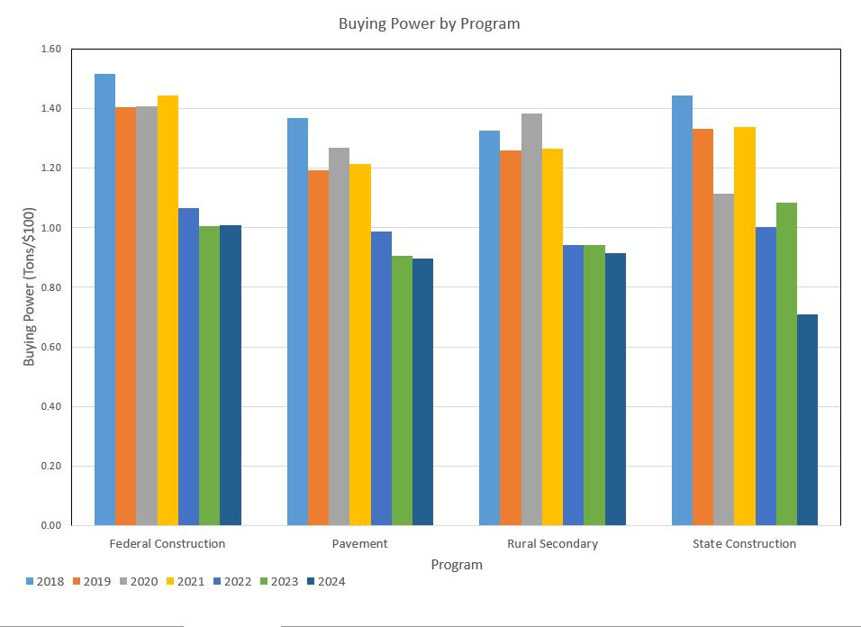
Notes:
To understand the discrepancy between tonnages and spending, we analyzed the buying power of our project dollars. As shown there is a significant loss in buying power after 2021. In order to return to pre pandemic tonnages, we will need a combination of increased buying power within the industry and increased investments to meet the needed treatment schedule depicted in KYTC’s Asset Management Plan.

Slide 7
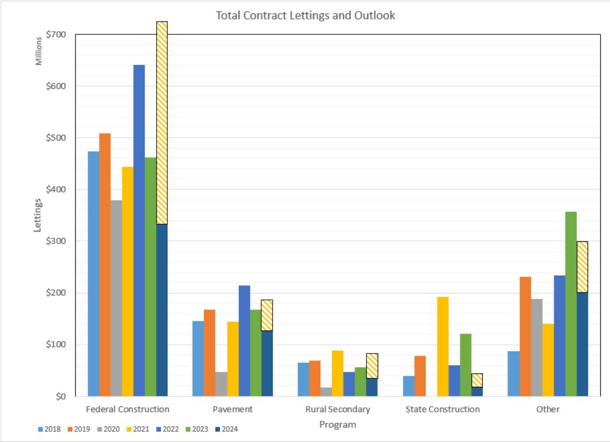
Notes:
For completeness, we included a quick assessment of overall lettings (not restricted to asphalt quantities). Similar trends are apparent that letting amounts have lagged behind the unusual recent peak investment years. We added similar forecasts for the balance of the year. Note that similar issues persist regarding translating investment dollars to contractor backlog.

Slide 8
Outlook
Anticipate a strong end to CY 2024
Reviewing treatment approaches to ensure good condition of the roadway system
Reviewing investment strategy to determine if adjustments should be made

Slide 9
Questions…
John Moore, PE, Deputy State Highway Engineer
Department of Highways
502-782-5053
JohnW.Moore@ky.gov

