Slide 1
BUDGET REVIEW SUBCOMMITTEE ON TRANSPORTATION
October 16, 2024
Cash Management System
Personnel Review
Riverlink Bridges
Mega Projects Grant Update

Slide 2
BUDGET REVIEW SUBCOMMITTEE ON TRANSPORTATION
October 16, 2024
KYTC Cash Management System
Shaun McKiernan, Executive Director Office of Budget and Fiscal Management
Ron Rigney, Transportation Engineer, Director Department of Highways

Slide 3
CASH MANAGEMENT SYSTEM Background
Established for 2000-02, modified in 2002-04 to require minimum Road Fund balance of $100 million, included in subsequent budget bills
Permits KYTC to authorize funding for highway projects by employing a cash flow financing program, which provides projected available cash by month for current Fiscal Year plus projected available cash for the next two (2) Fiscal Years
KYTC estimates balances in future periods using anticipated:
Monthly Road Fund Revenues
Federal Reimbursements
Non-Six-Year Highway Plan Program Outflows (maintenance, revenue sharing, resurfacing, vehicle regulation, debt service, other state agencies, etc.)
Active Project (Six Year Plan) Spending
Intended to gauge system capacity

Slide 4
CASH MANAGEMENT SYSTEM Background (Cont’d)
As presented in the State Highway Plan:
Decisions about when to obligate state project dollars and how much state project work can be afforded at any point will be made by the Secretary of Transportation and based on monthly cash management evaluations received from KYTC’s Authorization Review Team (ART).
The ART consists of the Cabinet’s:
Secretary
Deputy Secretary
State Highway Engineer and deputies
KYTC Budget Director

Slide 5
CASH MANAGEMENT SYSTEM Project Initiation
All planned Highway Plan projects follow the same basic steps:
A Project Phase is appropriately identified for funding in the Enacted Highway Plan for the current biennium
Project or Program Manager submits funding requests the Division of Program Management to authorize funds for use on the identified project phase
The Division of Program Management checks project schedule in Highway Plan and funding availability
Are the funds available within the scheduled funding code?
Are there programmatic constraints (e.g., over-programming of that funding category)?
Are funds available when evaluated against the cash management constraints?
YES
NO
Program Management prepares authorization document for the Secretary’s approval
Program Management holds the project in abeyance until:
funding issue has been resolved
the project carried forward in next highway plan

Slide 6
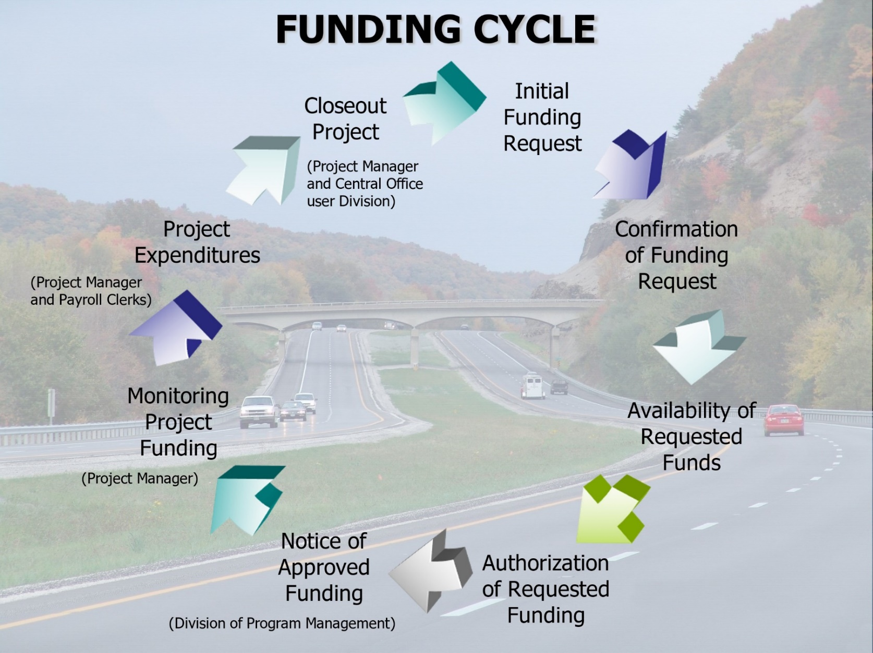
CASH MANAGEMENT SYSTEM Project Funding Requests

Slide 7
BUDGET REVIEW SUBCOMMITTEE ON TRANSPORTATION
October 16, 2024
KYTC Cash Management System
Shaun McKiernan, Executive Director Office of Budget and Fiscal Management
Ron Rigney, Transportation Engineer, Director Department of Highways
- QUESTIONS -

Slide 8
BUDGET REVIEW SUBCOMMITTEE ON TRANSPORTATION
October 16, 2024
KYTC Personnel Review
Tracy Hyatt, Executive Director Office of Human Resources Management

Slide 9
PERSONNEL REVIEW Employee Work Hours
Maintenance Crews, HR, Budget, IT, 30% of Division of Vehicle Regulation
Cabinet Employees Working:
40 hours per week 2,646 61%
37.5 hours per week 1,670 39%
Total 4,316
Estimate of Cost to move employees to 40 hours: $14.6 M

Slide 10
PERSONNEL REVIEW Remote Work Policy
KYTC policy adheres to the Personnel Cabinet’s policy
Eligibility and selection for participation in a telecommuting program shall be the decision of the agency, with no implied or specific right to participation being granted to an employee.
Requires a formal agreement between the employee, manager and office/department head and Appointing Authority.
The employee’s duties, responsibilities, and conditions of employment remain the same as if the employee were working at their primary workstation.
All employees who partial telecommute shall be required to work from their primary workstation or assigned field location a minimum of three days per week. Management at their discretion may require employees to work more than three days per week. Management may also require employees to be present at their primary workstations on a specific designated day per week.
The agency may terminate or modify the telecommuting arrangement at any time.

Slide 11
PERSONNEL REVIEW Vacancies
Funded Vacant Positions 559
Highways 384
Division of Vehicle Regulation 131
General Administration 29
Other 15
Temporary Employees 330

Slide 12
PERSONNEL REVIEW Timeline for New Hires
STEPS | Duration
Register posting | 5-15 days
HRG (Human Resources Generalist) Certified Register | 2 days from receipt from Personnel Cabinet
Interview and Recommendation Process to Department Head | 15 days
HRG Recommendation Packet Review | 5 days
Appointing Authority Review/Approval | 2 days

Slide 13
BUDGET REVIEW SUBCOMMITTEE ON TRANSPORTATION
October 16, 2024
KYTC Personnel Review
Tracy Hyatt, Executive Director Office of Human Resources Management
- QUESTIONS -

Slide 14
BUDGET REVIEW SUBCOMMITTEE ON TRANSPORTATION
October 16, 2024
Ohio River Bridges
Amanda Ratliff Spencer, PE, Assistant State Highway Engineer Department of Highways

Slide 15
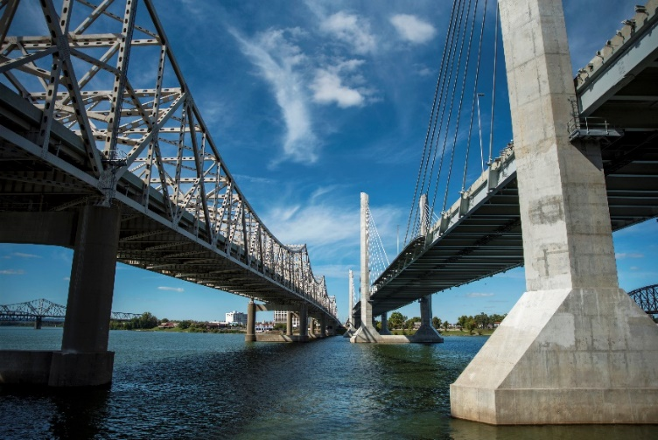
OHIO RIVER BRIDGES Project History
One of the largest transportation undertakings in the nation
Kentucky led Downtown Crossing, Indiana led East End Crossing
Improved regional safety, capacity and mobility
Tolling began December 2016
Both states are meeting financial obligations

Slide 16
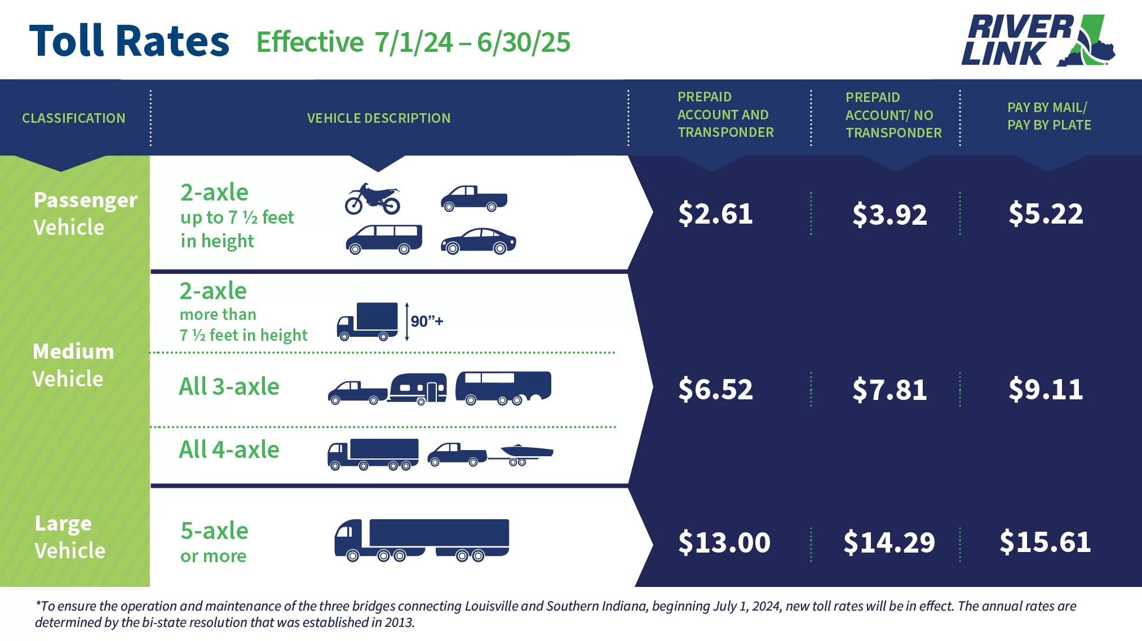
OHIO RIVER BRIDGES Toll Rates
FY | Class 1 AVI Rate | Approved Rate Increase
2025 | $2.61 | 3.4%
2024 | $2.52 | 4.9%
2023 | $2.40 | 8.3%
2022 | $2.21 | 2.6%
2021 | $2.15 | 2.5%

Slide 17
OHIO RIVER BRIDGES Revenue
Operating Revenue | FY 2024 | FY 2023
Tolls | $66,173,937 | $64,676,214
Fees | $9,485,007 | $6,263,073
Total Operating Revenue | $75,658,944 | $70,939,287

Slide 18
OHIO RIVER BRIDGES Debt Service
 | FY 2024 | FY 2023 | Remaining Schedule
Toll Revenue Bonds | $15,297,491 | $14,257,141 | $632,096,823
TIFIA Loan | $18,171,208 | $18,265,248 | $742,228,038
Total Debt Service | $33,468,699 | $32,522,389 | $1,374,324,861

Slide 19
OHIO RIVER BRIDGES Operating Cost – ORB Partners
Vendor | Function
Quarterhill (Formerly ETC) | Back Office System and Customer Service Operations
Global Agility Solutions | Supplemental Customer Service Operations
Perdue Brandon | Collections (has not started)
TransCore | Roadside (Gantries, Cameras, Sensors)
HNTB | Toll Services Advisor
LBMC (Formerly Strothman) | Revenue Control Manager
Blue and Co., LLC | Financial Compilations
Parsons | Public Relations
Fieldtrip | Marketing
Wyatt, Tarrant, and Combs, LLP | Legal Services

Slide 20
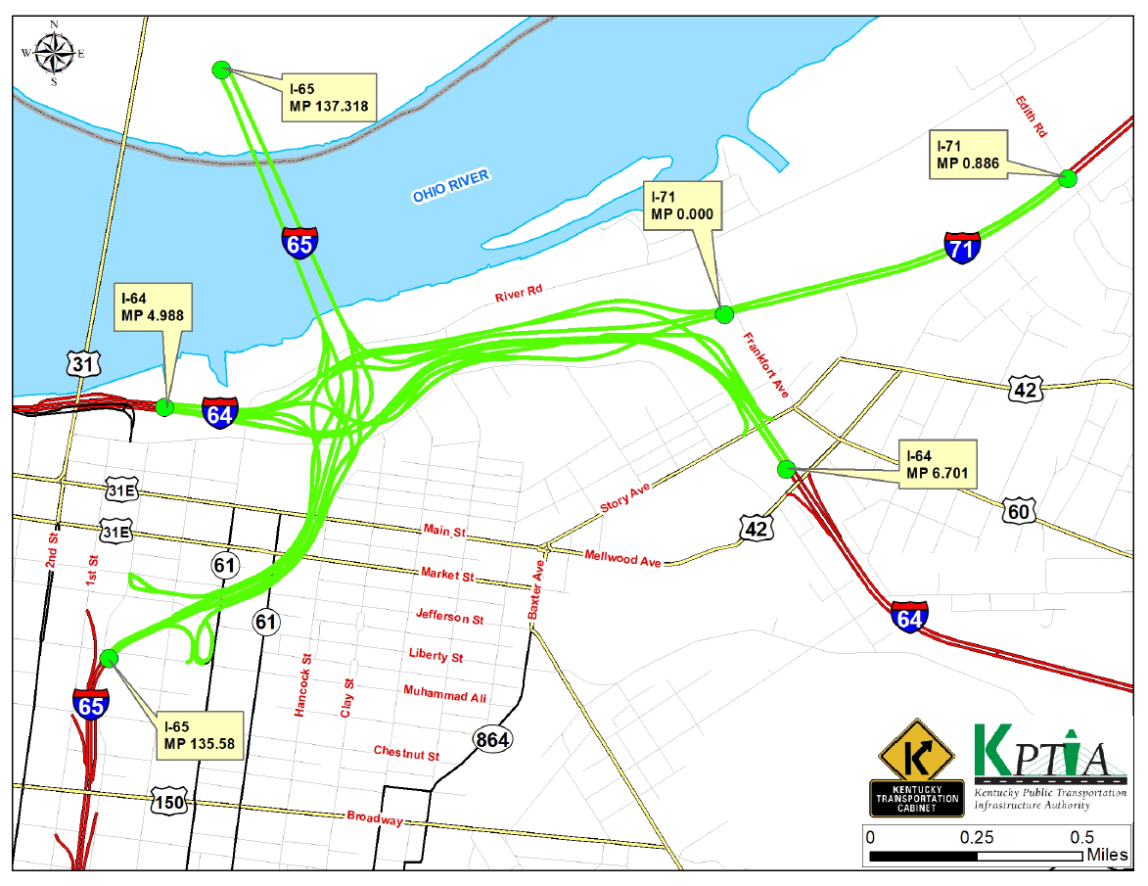
OHIO RIVER BRIDGES Operating Costs – Maintenance Limits

Slide 21
OHIO RIVER BRIDGES Overview of Costs
 | FY 2024 | FY 2023
Total Operating Revenue | $75,658,944 | $70,939,287
Total Operating Expenses | ($14,421,475) | ($13,838,890)
Debt Service | ($33,468,699) | ($32,522,389)
Balance | $27,768,770 | $24,578,008

Slide 22
BUDGET REVIEW SUBCOMMITTEE ON TRANSPORTATION
October 16, 2024
Ohio River Bridges
Amanda Ratliff Spencer, PE, Assistant State Highway Engineer Department of Highways
- QUESTIONS -

Slide 23
BUDGET REVIEW SUBCOMMITTEE ON TRANSPORTATION
October 16, 2024
Mega Projects Grants Update
Jim Gray, Transportation Secretary
James Ballinger, PE, State Highway Engineer Department of Highways

Slide 24
BUDGET REVIEW SUBCOMMITTEE ON TRANSPORTATION
October 16, 2024
Mega Projects Grants Update
Jim Gray, Transportation Secretary
James Ballinger, PE, State Highway Engineer Department of Highways
- QUESTIONS -

