Slide 1
2026 BUILD GRANT AWARDS UPDATE

Slide 2
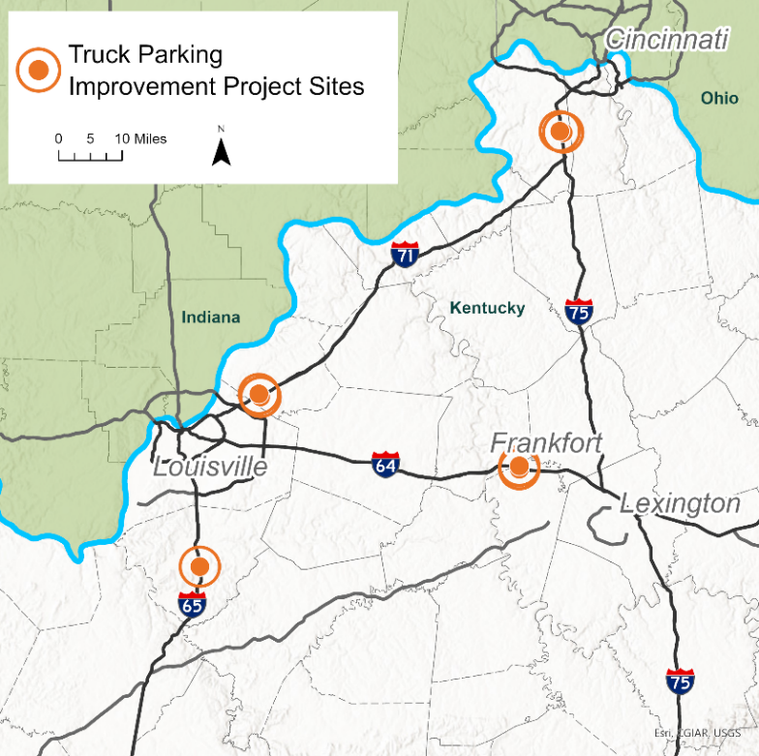
Truck Parking Improvement Project-
Enhancing Kentucky’s Freight Network Corridors
Submitted by KYTC
The project will add 387 designated truck parking spaces and includes expanded and enhanced Truck Parking Information Management System (TPIMS) at seven existing sites along the major interstate corridor of I-71, I-75, I-64, and I-65.
Total Estimated Project Cost: $48.6 million
  BUILD Grant - $25 million
  Other Federal Funds - $13.9 million
  State Road Funds - $9.7 million
I-71 NB anticipated to let Fall 2026
Anticipate all sites to be let by Spring 2028
Interstate / Direction | Mile point | County | Current Spaces | Additional Spaces
I-71 Northbound | 13 | Oldham | 14 | 47
I-71 Southbound | 13 | Oldham | 12 | 22
I-75 Northbound | 177 | Boone | 54 | 73
I-75 Southbound | 177 | Boone | 67 | 88
I-64 Eastbound | 60 | Woodford | 13 | 33
I-64 Westbound | 60 | Woodford | 13 | 64
I-65 Southbound | 113 | Bullitt | 28 | 60
Total | 201 |  |  | 387
Figure 1: Project Overview

Slide 3
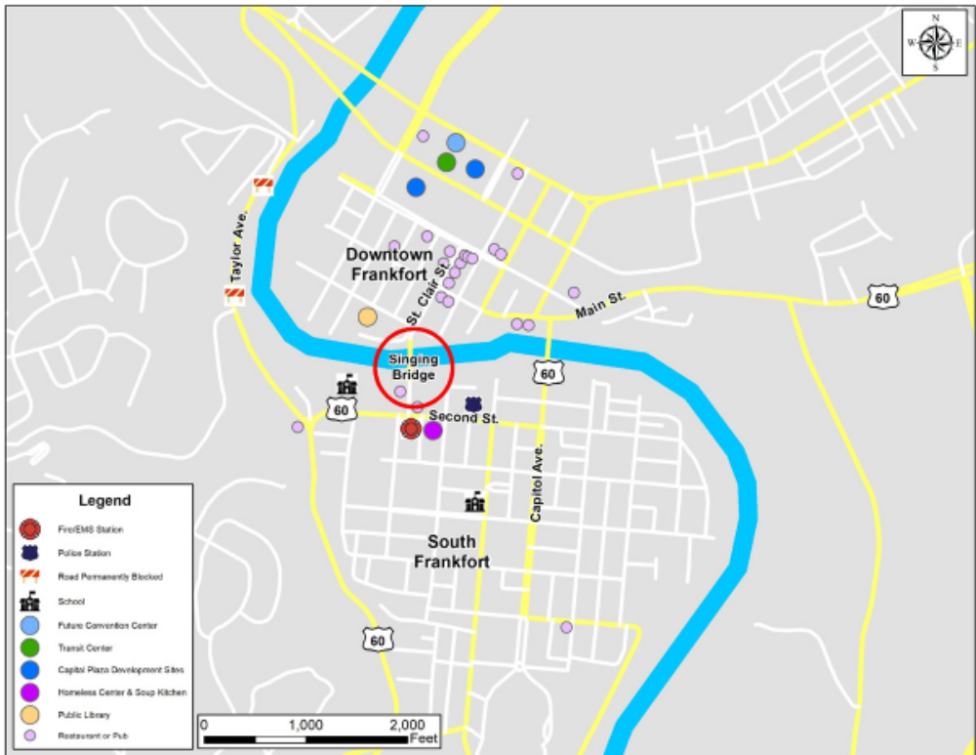
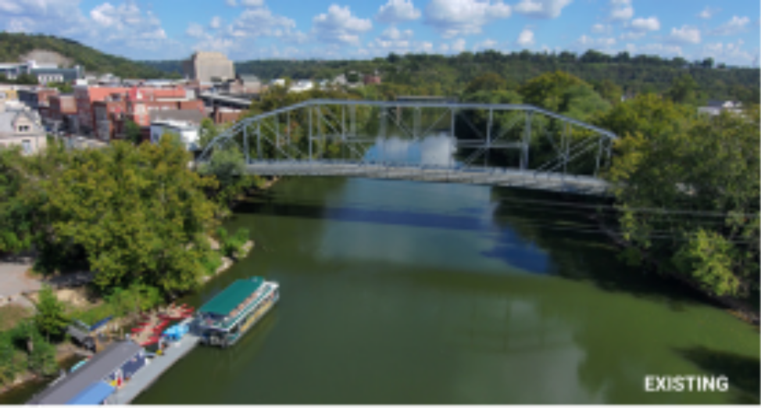
Singing Bridge Replacement Project-Frankfort, KY
Submitted by KYTC
The project will replace the existing 130-year-old Singing Bridge over the Kentucky River in downtown Frankfort.
Total Estimated Project Cost: $40.1 million
  BUILD Grant - $24 million
  Other Federal Funds - $8.08 million
  State Road Funds - $8.02 million

Slide 4
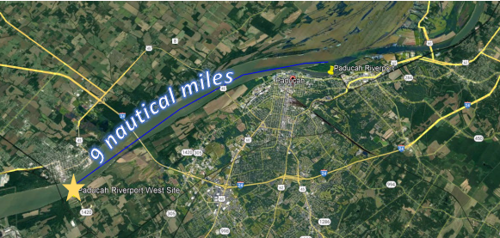
Paducah McCracken County Riverport West Project
Submitted by Paducah McCracken County Riverport Authority
The project will construct a new 200-foot public barge terminal adjacent to a 1,000-acre rail facility, a location with triple Class I rail access (CN, BNSF, P&L). Phase I constructs the initial berth and supporting landside infrastructure; future phases outside the scope of this project would complete the three-berth terminal with full rail connectivity.
Total Estimated Project Cost: $29.9 million
  BUILD Grant - $24 million
  Non-federal funds- $5.9 million

