Slide 1
Fiscal Year 2025-26
Road Fund Report
Shaun McKiernan
Executive Director
Office of Budget and Fiscal Management

Slide 2
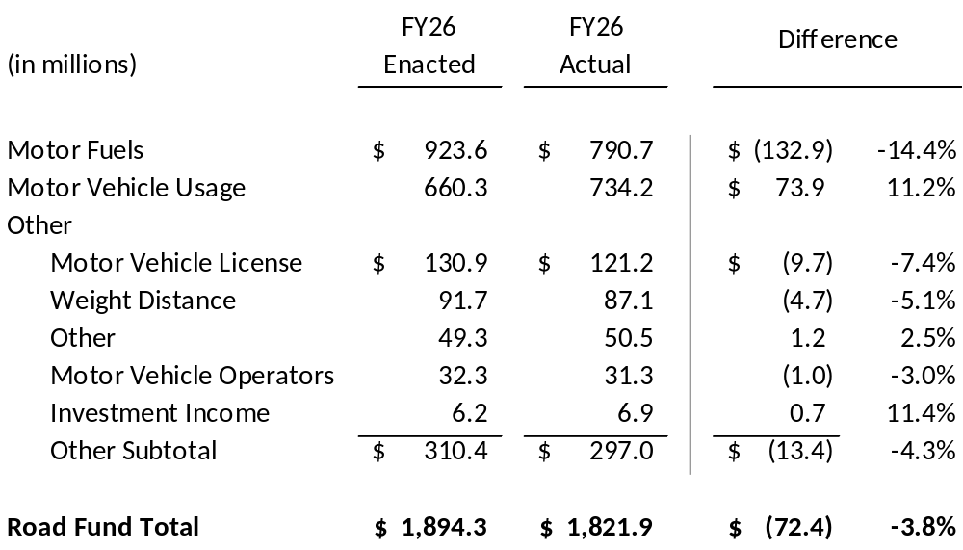
FY 2026 ROAD FUND REVENUE
Enacted Estimate vs. Actual

Slide 3
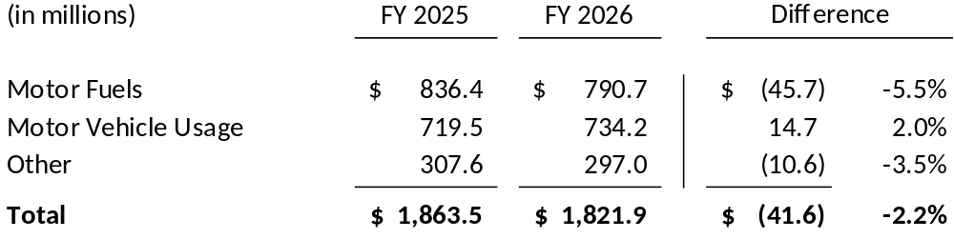
ROAD FUND REVENUE
FY 2025 vs. FY 2026

Slide 4
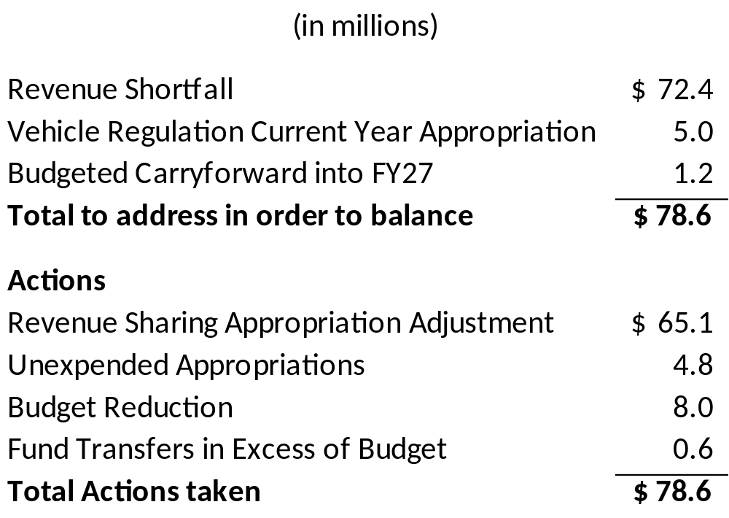
FY 2026 ROAD FUND
Budget Balancing

