Slide 1
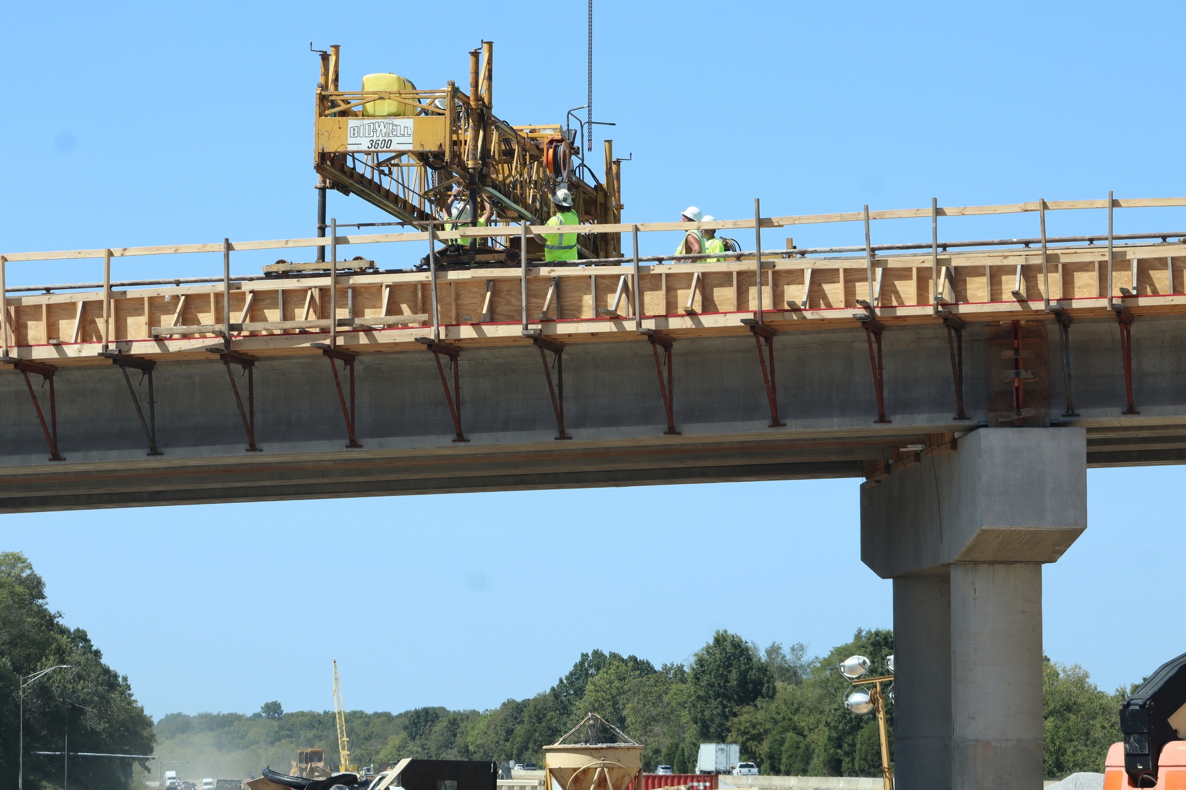
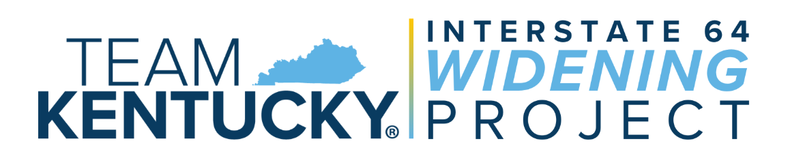
Budget Review Subcommittee on Transportation | Oct. 7, 2026
Matt Bullock
Chief District Engineer​
KYTC District 5​​

Slide 2
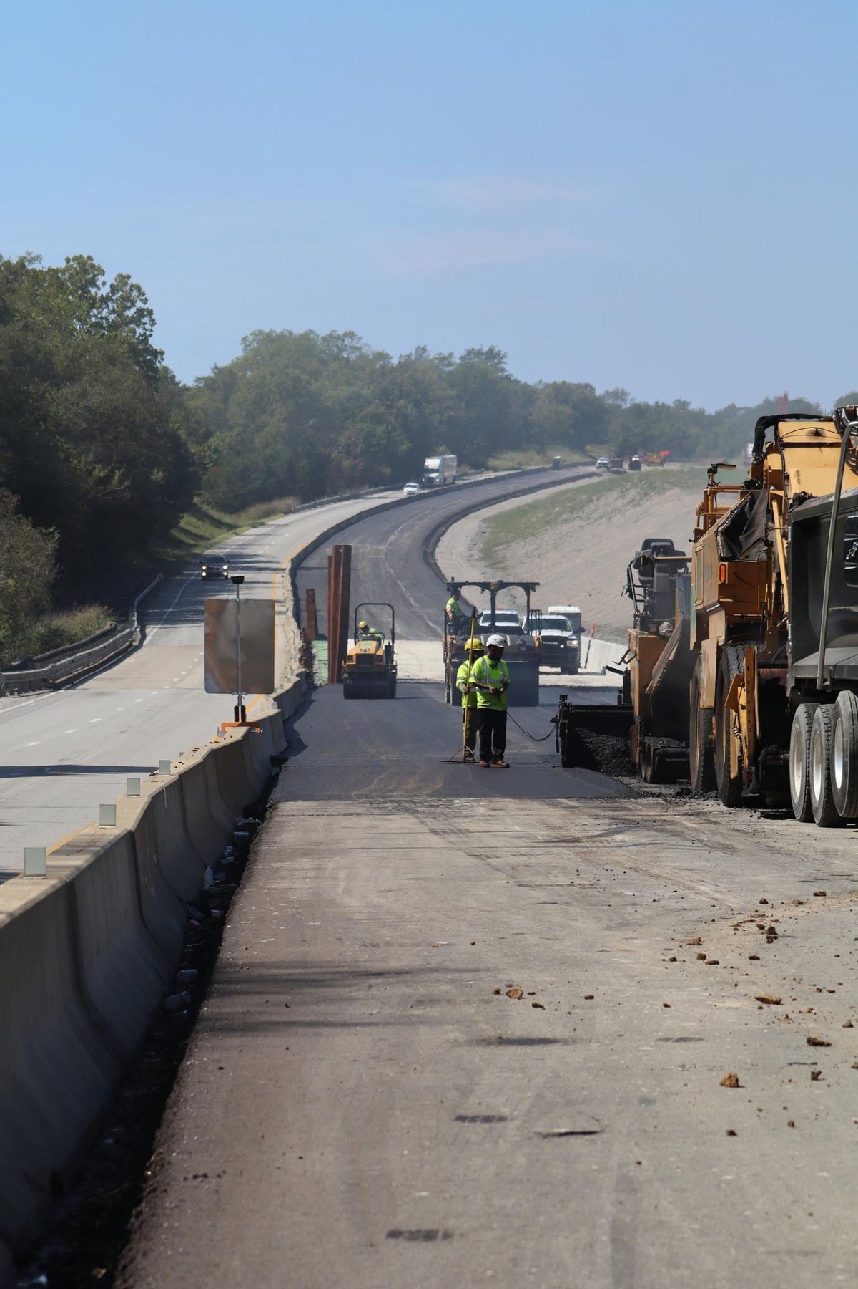




What the Project Includes
Widening six miles of I-64 from KY 55 (Exit 32) to the Shelbyville weigh station from four to six lanes
Total project cost: approximately $118 M
80% federal funding / 20% state funding
Began in February 2025
Scheduled for completion in Fall 2027
HIGHLIGHT
I-64 carries approximately 50,000 vehicles per day through Shelby County

Slide 3
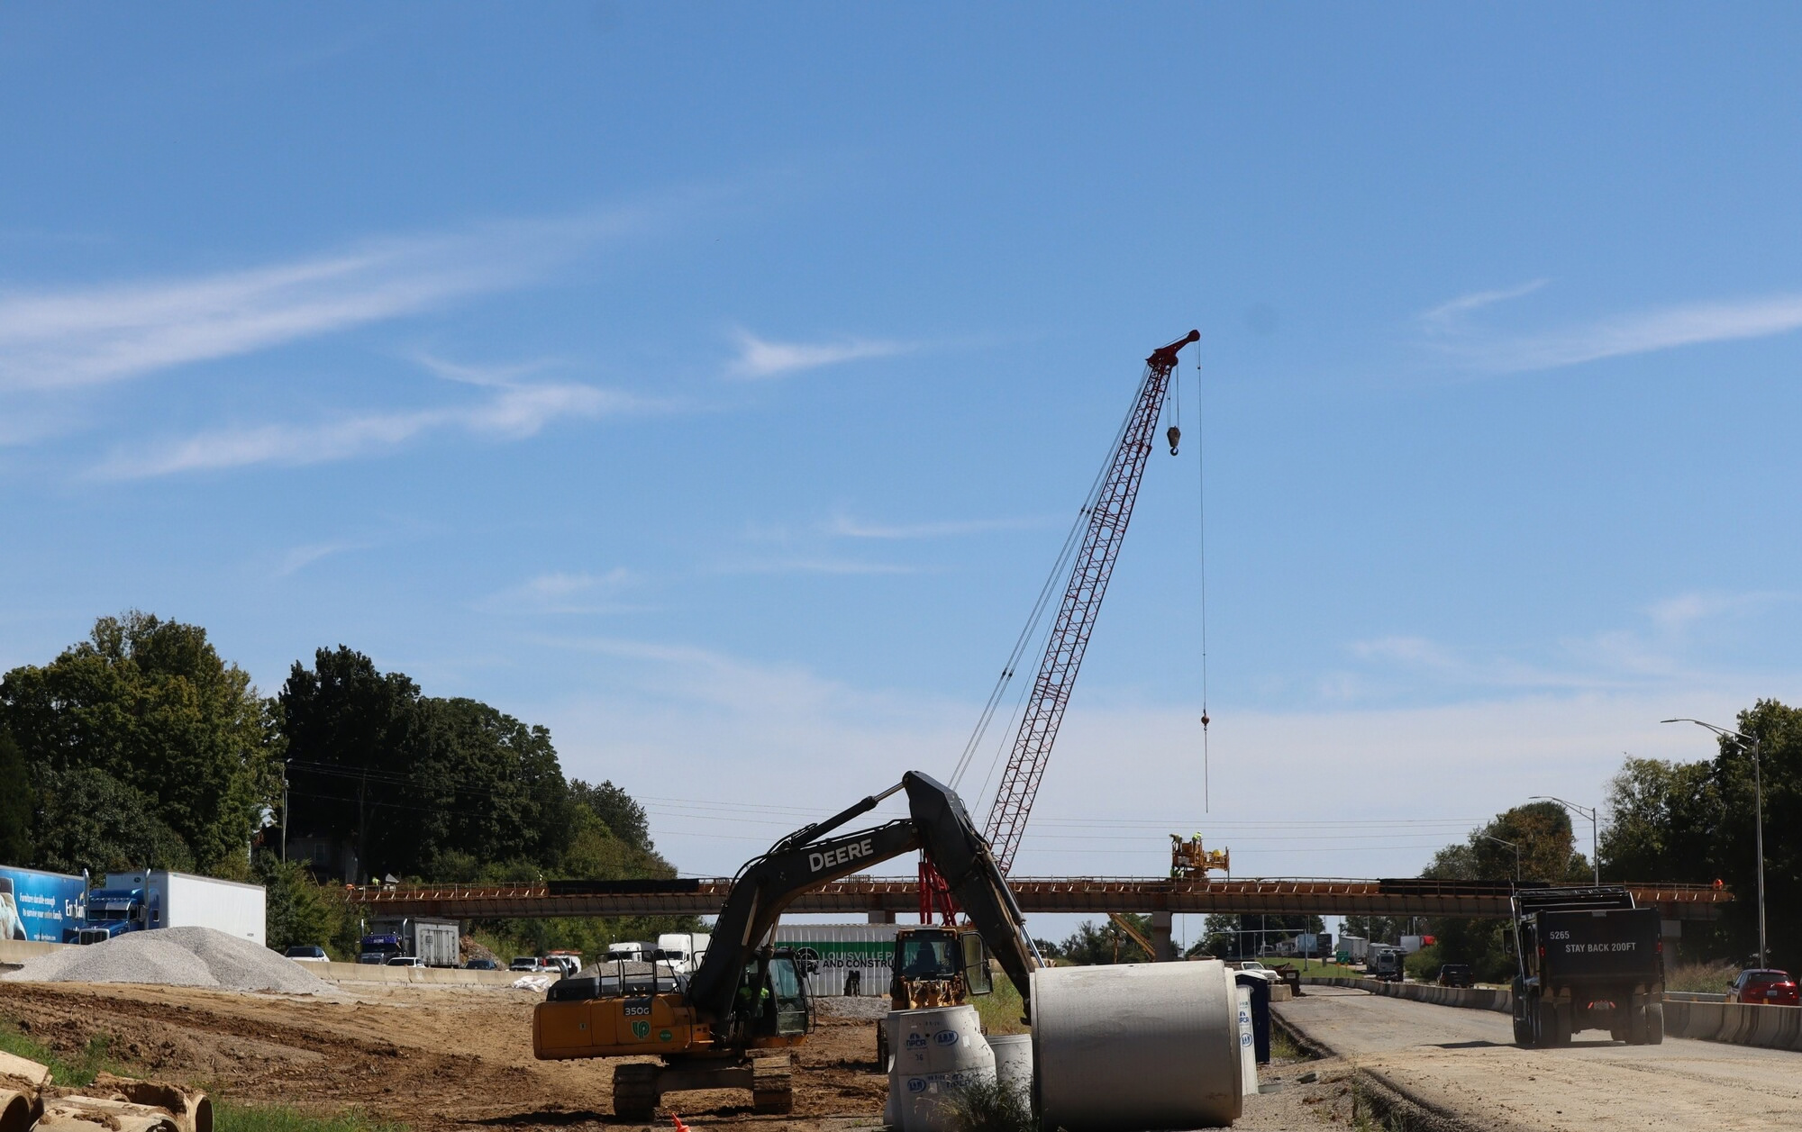

Building Bridges
Reconstructing three bridges over I-64
  KY 2861 / Zaring Mill Road - 90 day closure in 2025
  KY 53 / Mount Eden Road - Construction is currently underway. Traffic will remain open during construction
  KY 1790 / Hooper Station Road - Currently closed; scheduled to reopen in October 2026
Rebuilding and widening two I-64 bridges
  Clear Creek
  Guist Creek
HIGHLIGHT
These bridges are more than 65 years old and have reached the end of their service life.

Slide 4
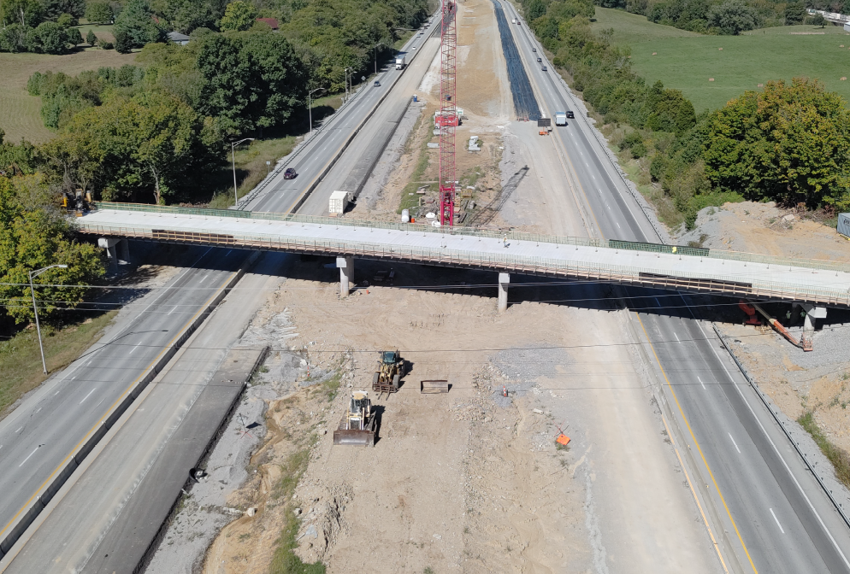
KY 1790 / Hooper Station Road - Currently closed; scheduled to reopen in October 2026

Slide 5
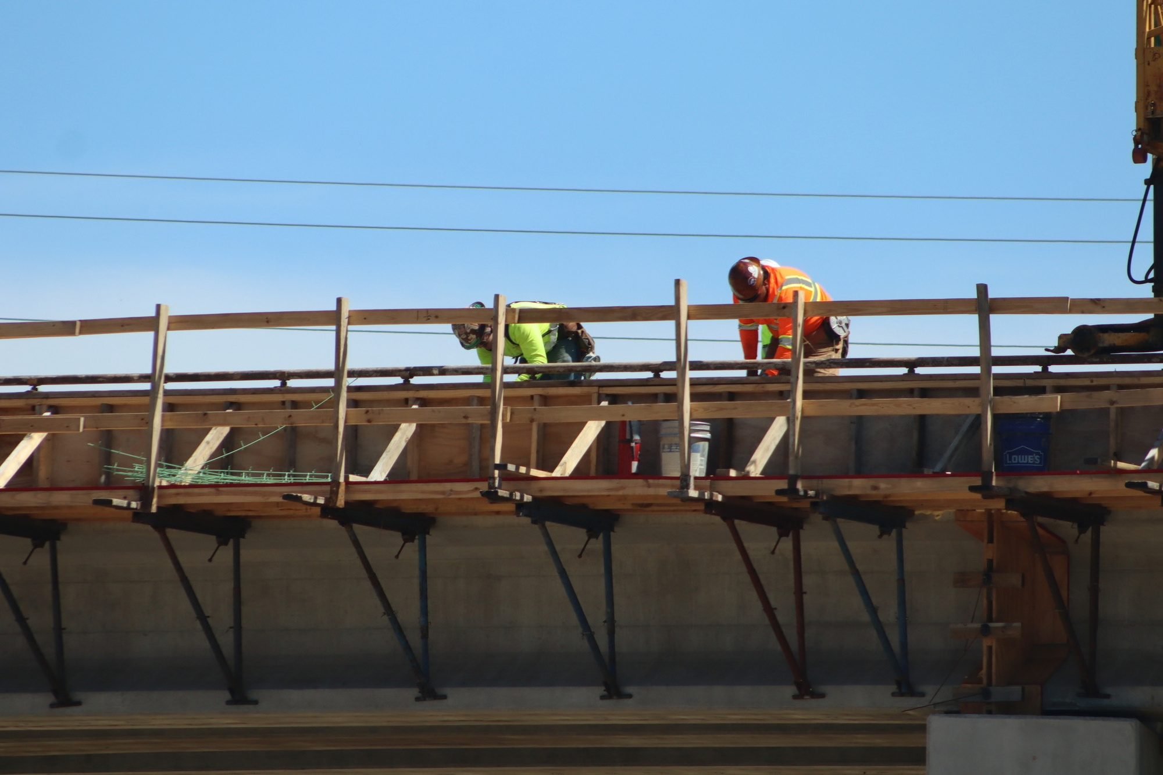
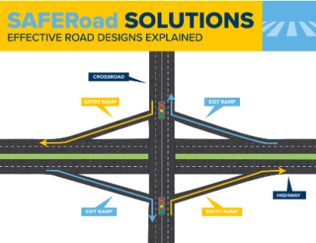
KY 53 Interchange
  The existing KY 53 interchange has a combination of cloverleaf and diamond configurations.
  The project will convert it to a signalized diamond interchange.

Slide 6
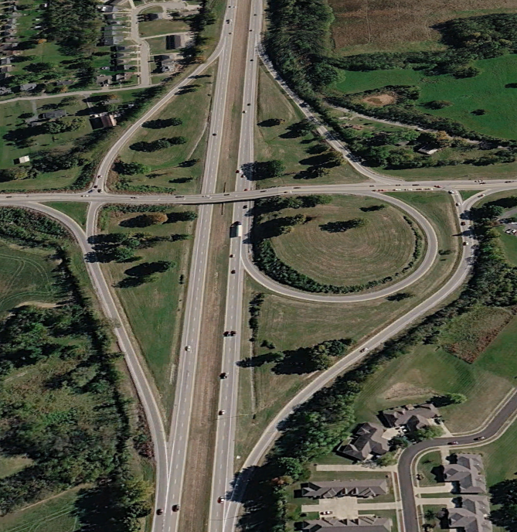
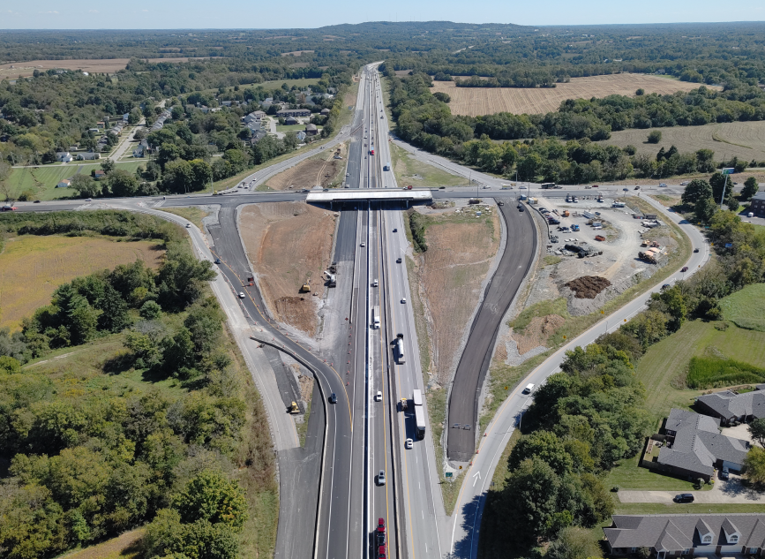
I-64/KY 53 (Mt. Eden Road)
Interchange Reconstruction
August 2025
September 2026

Slide 7
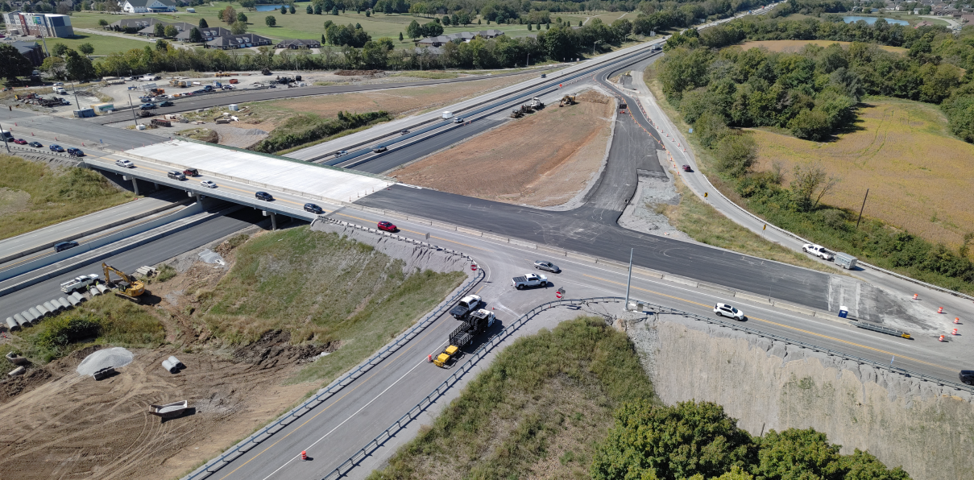
I-64/KY 53 (Mt. Eden Road)
Interchange Reconstruction

Slide 8
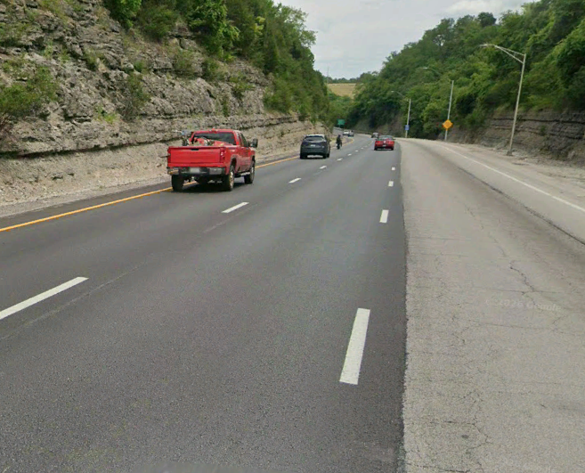
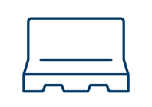
Franklin County I-64
Pavement (Asphalt) Rehabilitation for approximately 5 miles from U.S. 127 to U.S 60
Total project cost: $10.5 M
80% federal funding / 20% state funding
Began in August 2025
Completion in Fall 2026
U.S. 60 Barrier Wall Retrofit
HIGHLIGHT
Previously completed 2014. Raised roadway profile: Milled off 3 inches, replaced with 5 inches

Slide 9
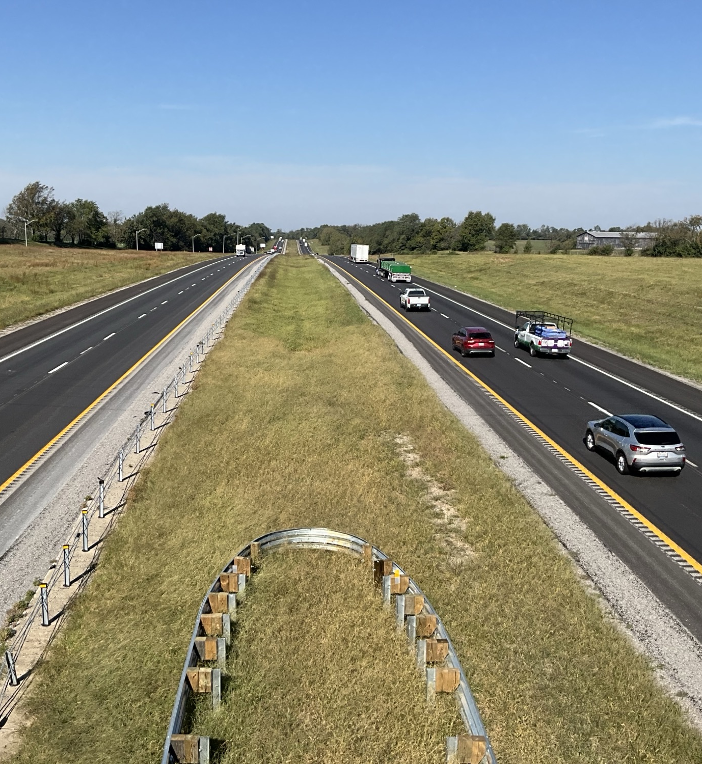
Woodford, Scott, Fayette County
I-64
Pavement (Asphalt) Rehabilitation for approximately 9 miles from U.S. 127 to U.S 60
Bridge maintenance, cleaning, barrier wall, and guardrail improvements for 6 bridges along I-64
Total contract cost: $14.4 M
80% federal funding / 20% state funding
Began in March 2026
Completion in September 2026
HIGHLIGHT
Reconstructed On-Ramps at Midway

Slide 10
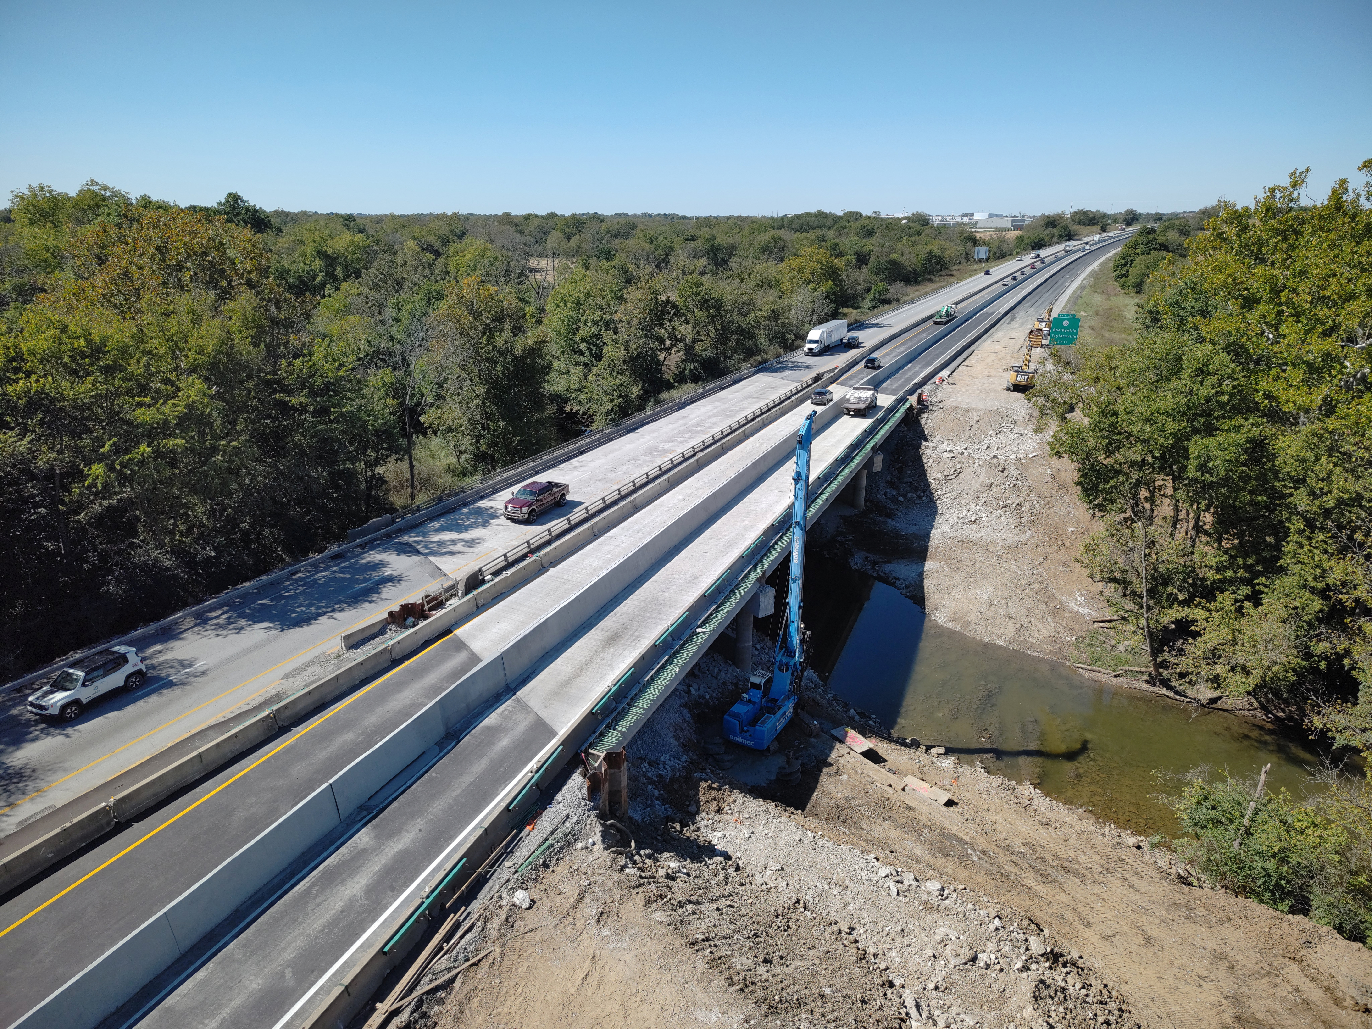




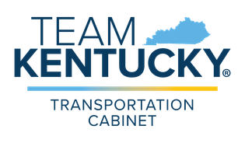
QUESTIONS?
Matt.Bullock@ky.gov
@KYTC
@KYTC120
@KYTransportation
@KYTransportation

