Slide 1
Horse Country
ANNE SABATINO HARDY, EXECUTIVE DIRECTOR

Slide 2
Board of Directors
P. Headley Bell – Mill Ridge Farm
Price H. Bell, Jr. – Mill Ridge Farm
Allison Hancock Bishop – Claiborne Farm
Brutus J. Clay – Runnymede Farm
Luke H. Fallon, DVM – Hagyard Equine Medical Institute
Adam Johnson – Kentucky Bourbon Trail
Mary Quinn Ramer – VisitLEX
Duncan Taylor – Taylor Made Farm
Rusty Thompson – Darley America
Shannon Arvin – Stoll Keenon Ogden, Secretary
Previous: Clifford Barry, Pin Oak Stud; John Phillips, Darby Dan

Slide 3
Adena Springs
Airdrie Stud
Ashford
Blackwood
Brookdale
Claiborne
Darby Dan
Darley
Denali
Diamond A
Fasig-Tipton
Gainesway Farm
Hallway Feeds
Hagyard Equine Medical Institute
Hermitage
Hurstland
KTA/KTOB
Kentucky Equine Humane Center
Keeneland
Keene Ridge
Lanes End
Mill Ridge
Mt. Brilliant
Pin Oak Stud
Rood and Riddle Equine Hospital
Runnymede
Saxony Farm
Secretariat Center
Siena Farm
Spendthrift
Spy Coast Farm
St. George
Stone Farm
Stonestreet
Taylor Made
The Jockey Club
Three Chimneys
Winstar Farm
Winter Quarter

Slide 4
Mission: Connect guests to the horse, land & people through experiences that inspire love of the animal and Kentucky Vision: Lifelong passion for the horse and Kentucky

Slide 6
The Road to 1 Million

Slide 7
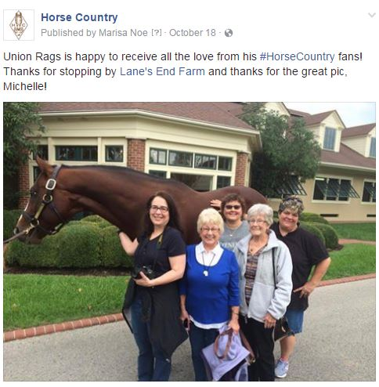
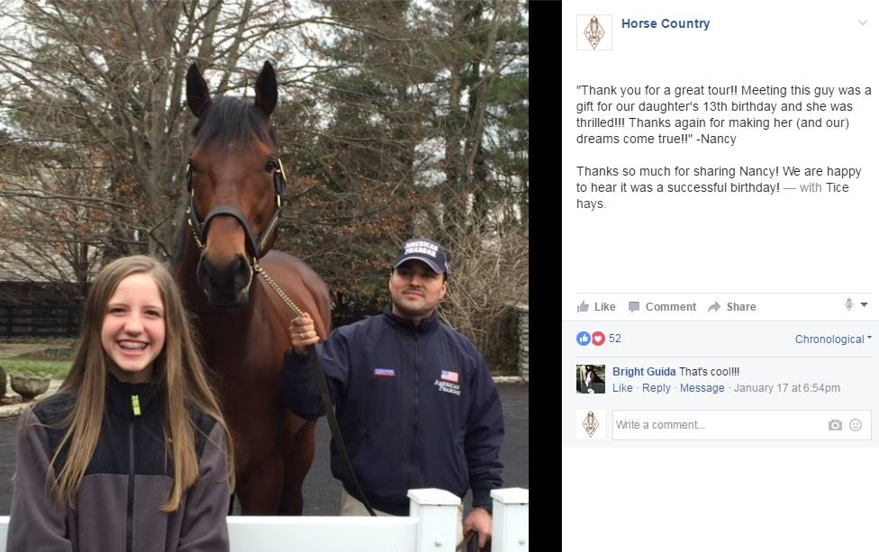
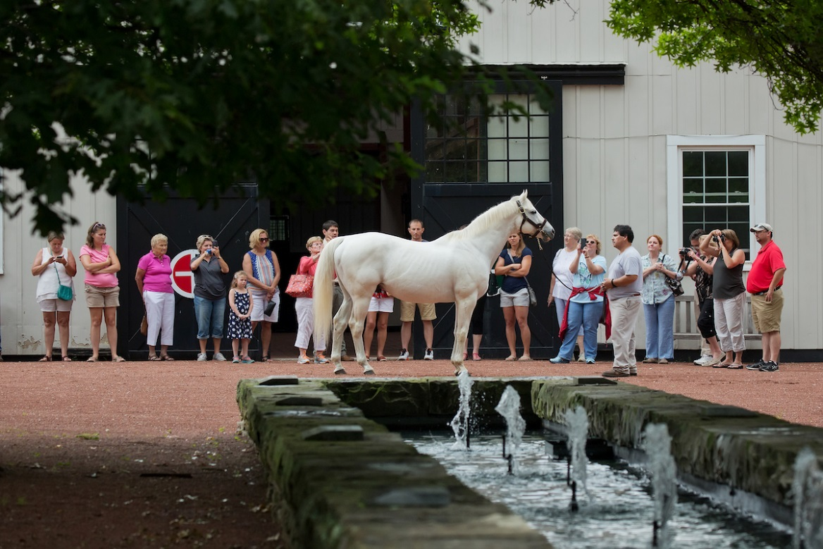
100K…and growing

Slide 8
The Future in Horse Country
Economic Development
Tourism impact
Job growth
New Markets: Beyond the fan
Top Chef
Investors in racing
New Experiences

Slide 9
