Slide 1
Kentucky Horse Racing Commission
Marc A. Guilfoil, Executive Director
Jamie H. Eads, Deputy Executive Director
Notes:
Introduction/Thank you for opportunity and would like to provide a general update on the Division of Incentives & Development—which includes 3 breeder incentive funds & 3 purse development funds. I’d also like to thank the legislature for continuing to support our equine programs in KY. Every racing state offers some form of incentive to keep equines in that state. KY is unique in that we offer our incentives on a world-wide basis and we are the only state that offers rewards to owners and breeders of 13 different equine breeds.

Slide 2
THOROUGHBREDS: Kentucky Breeders’ Incentive Fund and Kentucky Thoroughbred Development Fund
KTBIF: 80% of the 6% stallion stud fee tax
$140M since 2006: Awards are distributed to KY breeders for winning eligible races across the globe:
“Regardless of how Roaring Lion does in the Classic, he has already made a valuable contribution to Naify's program. She breeds in Kentucky to take advantage of the Kentucky Thoroughbred Breeders' Incentive Fund, which pays for grade/group 1 or grade/group 2 wins anywhere in the U.S., Canada, England, France, and Ireland. To date, Roaring Lion has accumulated $35,000 in incentive funds. “
Bloodhorse.com on 11/2/18
August 15 deadline: 9,146 mares nominated; will continue to accept nominations until 12/31/18 for pregnant mares, weanlings & yearlings.

Slide 3
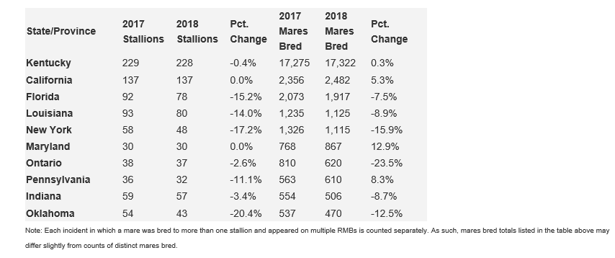
THOROUGHBREDS: Report of Mares Bred in North America source: The Jockey Club

Slide 4
THOROUGHBREDS: Kentucky Breeders’ Incentive Fund and Kentucky Thoroughbred Development Fund
KTDF: a portion of the tax on all thoroughbred wagers at Kentucky racetracks funds the Kentucky Thoroughbred Development Fund.
Provides added money to
Significant increase over the last few years:
2017: $9,678,897
2018 (thru 9/30/18): 7,945,857

Slide 5
STANDARDBREDS: Kentucky Sire Stakes
Standardbred programs combine two taxes: 13% of the 6% stallion tax along with the pari-mutuel tax to fund the Kentucky Sire Stakes

Slide 6
STANDARDBREDS: Kentucky Sire Stakes
Fair included KYSS Championship races
Equine education component—KEEP, New Vocations, Harness Horse Youth Foundation & a parade of breeds
Highlighted all things Kentucky—local music entertainment, artist, food trucks, bourbon & craft beer.

Slide 7
ALL OTHER EQUINE BREEDS:
KHBIF: receives 7% of the 6% stallion sales tax and those funds are distributed over 11 non-racing approved KY Affiliates. Since inception, over $11.8M since 2006
Over the last several years we have been working with the advisory committee and legal team to revise this regulation to allow us to cast a broader net and increase participation in the fund. On October 1 we met with representatives from all breeds to discuss concerns with the goal of continuing to revise the regulation while still providing rewards owners and breeders of Kentucky-bred horses.
KQPAADF: Purse program & to date, those funds have not been disbursed.

