Slide 1
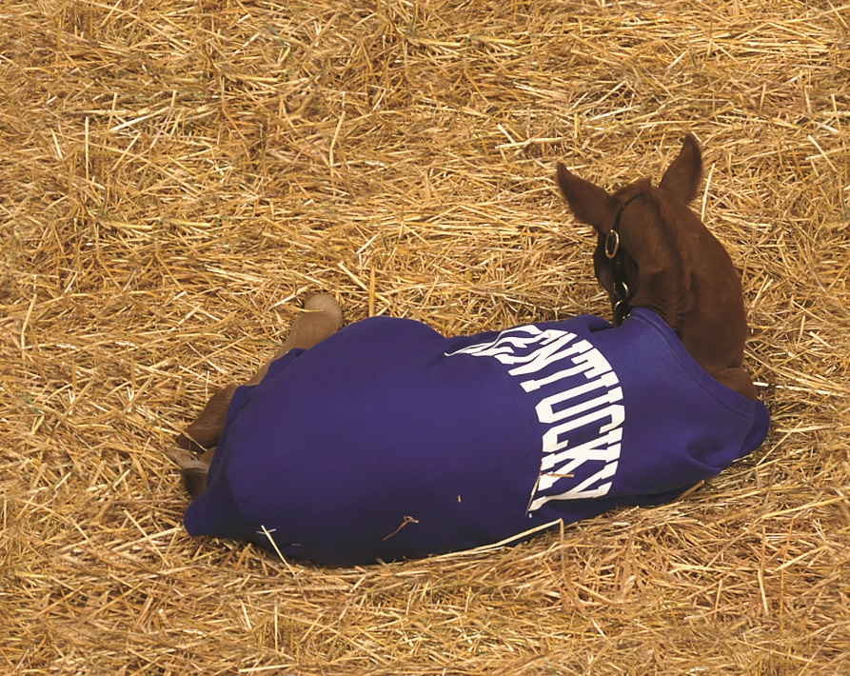
University of Kentucky Report
Interim Joint Subcommittee on Equine Issues
November 18, 2019
Dr. Nancy Cox, Dean
Dr. James MacLeod, Director
UK Ag Equine Programs
University of Kentucky
College of Agriculture, Food and Environment

Slide 2
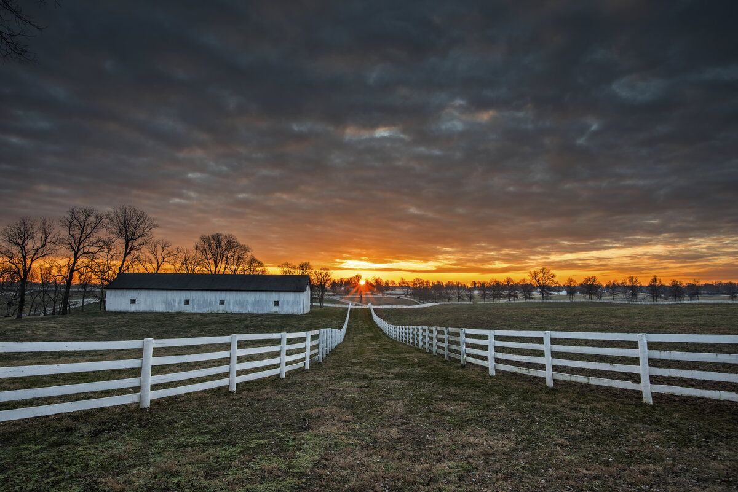
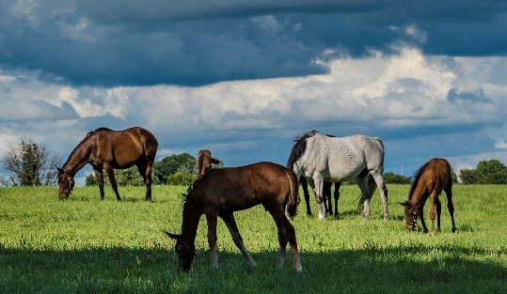
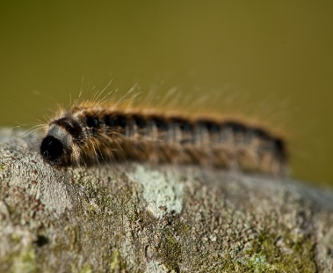
Equine at UK: National and International Leadership, But a Direct Positive Impact on Kentucky
Legacy of equine research has evolved from health and nutrition to all facets of equine science.
Recommitment to the industry in the aftermath of Mare Reproductive Loss Syndrome crisis in 2001.
New programs launched 2005 as UK Equine Initiative.
New areas of excellence in education, economics, environment, pharmacology and racetrack safety.
More than 50 faculty and staff provide diverse expertise and scientific approaches.

Slide 3
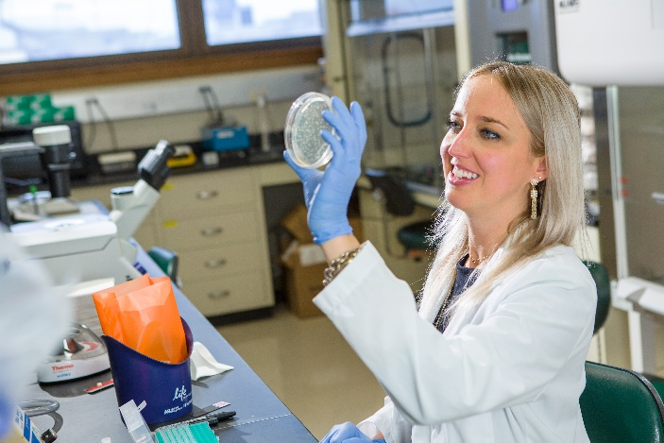
Workforce Development: UK and Our Partners
UK undergraduate: Equine Science & Management
Emphasis in science, business, communications/leadership
330 students currently enrolled
418 alumni in 11 years
Graduate/professional equine-affiliated programs
Equine health studies at the Gluck Equine Research Center
Agricultural disciplines including Animal Science, Plant and Soil Science, Economics, Engineering
Other UK colleges and departments, including Medicine, Nursing, Law, Business, Engineering, Computer Science
All skill levels, lifelong learning, leverage programs
Adult and youth education: UK agricultural Extension
Multiple university and industry partnerships
Basic, career and technical education programs

Slide 4
Equine Science and Management Undergraduate Program
2019 demographics: 21% first generation
418 total graduates as of April 2019
High industry retention
Tip of the iceberg for industry needs

Slide 5
Equine Science and Management Alumni Employment (April 2019)

Slide 6
Equine Science and Management Alumni Employment (April 2019)
We are the reverse of a ‘brain drain’ in terms of employment. Not only are we keeping our ‘best and brightest’ young citizens within the state, but we are drawing the ‘best and brightest’ from around the country to Kentucky.
Importantly, they stay in Kentucky!!!

Slide 7
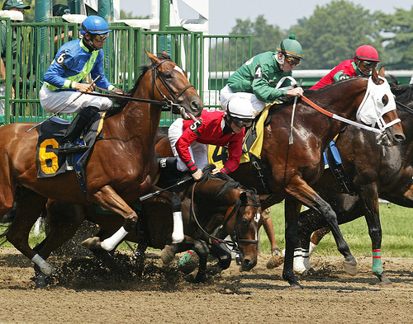
Complex, Multidimensional Challenges Require Comprehensive, Multidisciplinary Solutions
Horse
Safety
Rider
Surface

Slide 8
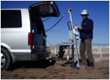
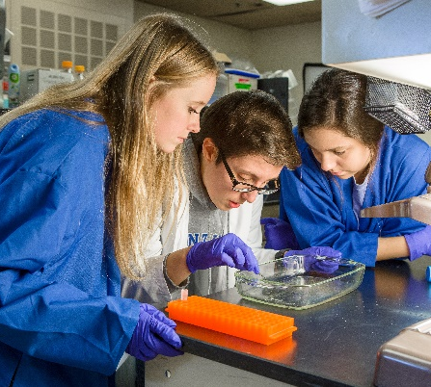
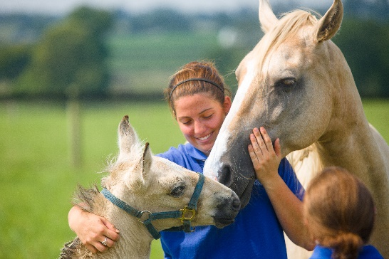
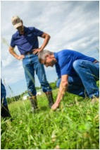
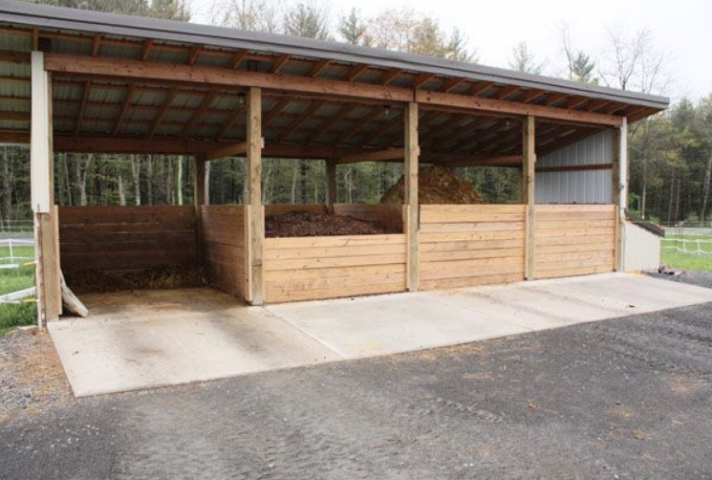
Research and Public Outreach Programs
Safety
Horse musculoskeletal health and well-being
Rider injury prevention and health assessment
Surfaces, racing and show
Medication pharmacology, toxicology and testing
Farm Facilities and Pasture
Barn design and ventilation
Manure and insect management
Optimizing pastures
Environmental stewardship
Youth and Adult Educational Programs
4-H equine programs
Adult equine programs
Legal, business and cultural equine programs
Second career options for retired equine athletes
Equine-assisted therapy and workforce training
Equine welfare research

Slide 9
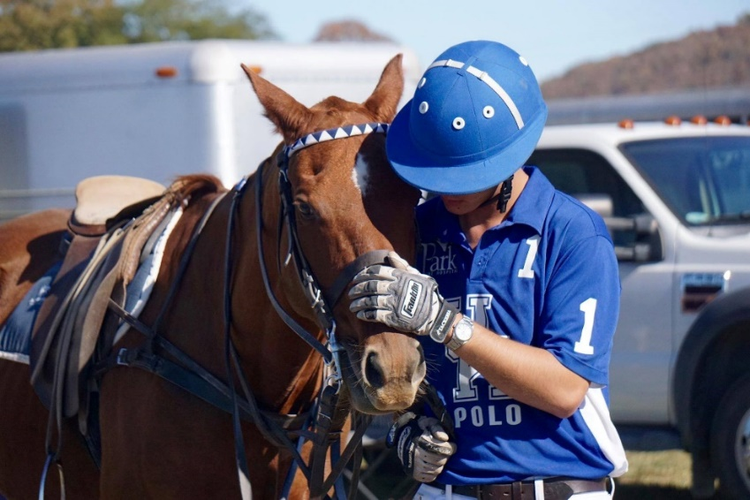
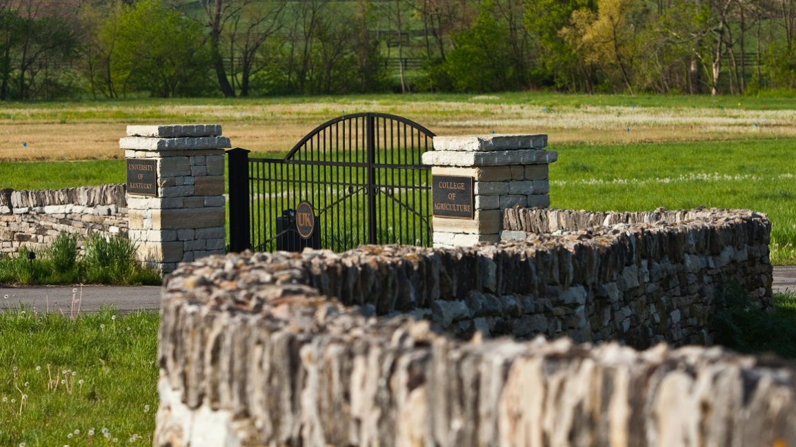
Questions and Discussion
Thank You

