Slide 1
THE OFFICE OF VITAL STATISTICS OVERVIEW
Christina Stewart, State Registrar, Branch Manager
Jeffrey Sparks, Administrative Section Supervisor
November 6, 2023

Slide 2
Vital Statistics Enacted
Collection of Birth and Death records began in 1911.
Collection of Marriage and Divorce records were centralized in 1958.
Births
Established
Marriages
Divorces
Stillbirths
Deaths
Foreign

Slide 3
Vital Statistics’ Mission Vital Statistics performs four (4) distinct core functions for the Commonwealth.
Vital Statistics
Vital Records
Public Requests
Protection
Collaboration

Slide 4
Core Functions
Vital Records
Registration/Certification
Amendments and Corrections
Public Requests
Certificate Issuance
Data Requests
Protection
Protection and Security
Collaboration
Valid Collection
Preservation
Confidentiality
Shared Appropriately
Data Quality and Accuracy
Timely and Ongoing

Slide 5
KRS 213.031
Duties of state registrar
Administer and enforce the provisions of this chapter and the administrative regulations issued hereunder; issue instructions for the efficient administration of the system of vital statistics; direct the system and Vital Statistics Branch and be custodian of its records; supervise the activities of all persons when they are engaged in the operation of the system; and conduct training programs to promote uniformity of the system's policy and procedures throughout the Commonwealth.

Slide 6
KRS 213.076
Certificate of death shall be filed
A certificate of death or a provisional certificate of death for each death which occurs in the Commonwealth shall be filed with the Cabinet or as otherwise directed by the state registrar…

Slide 7
Historical Vital Records Registration Trend
YTD through September 2023

Slide 8
Deaths Registered by Year
YTD through September 2023
2009
2023
Average 48,000 per year

Slide 9
Deaths Registered by Month 2022
January
December
Average 4,775 per month

Slide 10
901 KAR 5:025
Kentucky Electronic Death Registration System (KY-EDRS)
All certificates of death shall be filed with the cabinet using the Kentucky Electronic Death Registration System.
Medical Certifiers and Funeral Directors
A medical certifier or funeral director shall register and obtain access to the KY-EDRS.

Slide 11
KY-EDRS Registration Workflow

Slide 12
KRS 213.141
State Board of Elections
(5) The cabinet shall notify the State Board of Elections monthly of the name, address, birthdate, sex, race, and Social Security number of residents of the Commonwealth who died during the previous month. This data shall include only those persons who were over the age of eighteen (18) years at the date of death. No fee or compensation shall be allowed for furnishing these lists.

Slide 13
Death Data Transfer To The State Board of Elections

Slide 14
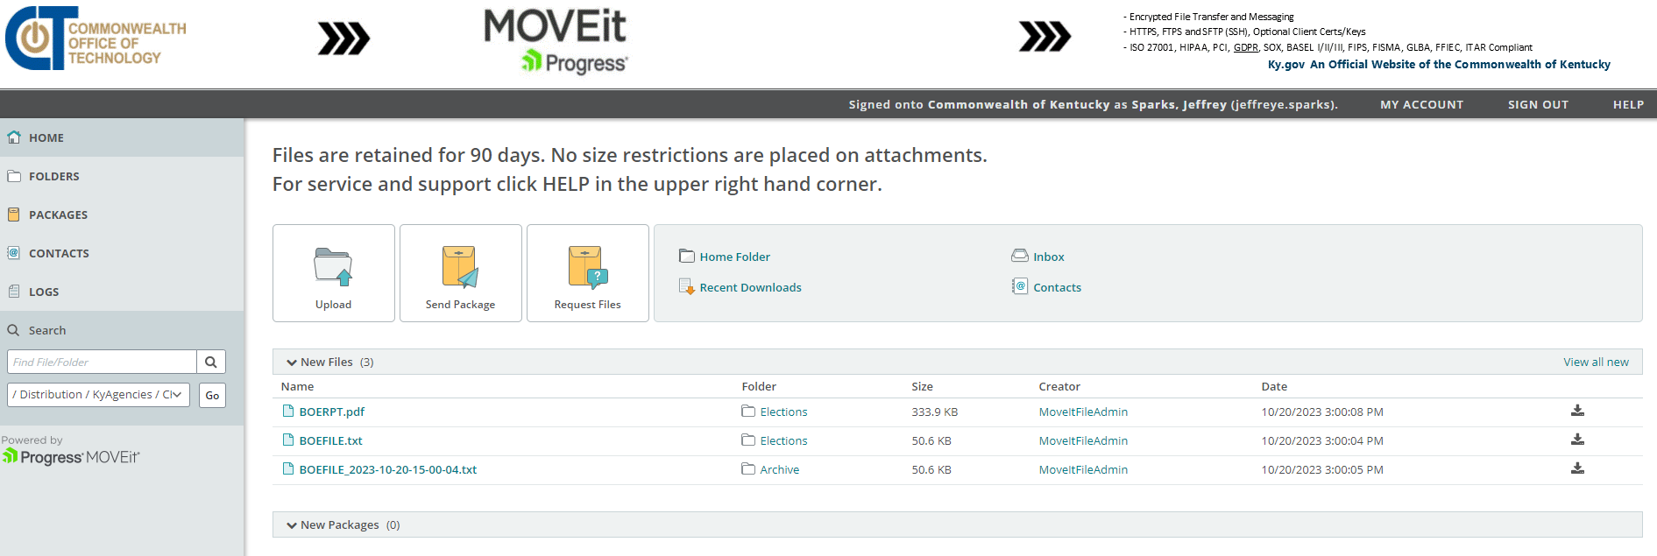
Secure FTP Site

Slide 15
State Board of Elections
Data element name | PDF
First Name | Y
Middle Initial | Y
Last Name | Y
Date of Death | Y
Date of Birth | Y
SSN | Y
Gender | Y
Race | Y
County | Y
City | Y
Street | Y
Age | Y
Data Elements Provided Weekly

Slide 16
Christina Stewart
State Registrar/Branch Manager
Office of Vital Statistics
Christina.Stewart@ky.gov
Jeffrey E. Sparks, Jr
Administrative Section Supervisor
Quality Assurance Section
Office of Vital Statistics
JeffreyE.Sparks@ky.gov
https://chfs.ky.gov/agencies/dph/dehp/vsb/Pages/default.aspx

