Slide 1


Public Water and Wastewater Task Force
Donna McNeil, Executive Director
Lisa Daniel, Financial Advisor
August 28, 2019

Slide 2
Overview
  Funding Sources & Availability for Utilities
  Other Funding Options
  Items for Consideration

Slide 3
Funding Sources - Grants
  Kentucky Infrastructure Authority
    Small and Disadvantaged Community Water Systems ($698,000)
  Kentucky Department of Local Government
    Appalachian Regional Commission
      Area Development ($4,958,537)
      Central Appalachia Distressed Counties Infrastructure ($14,498,739)
      Distressed Counties ($9,457,940)
    Community Development Block Grants ($7,732,782)

Slide 4
Funding Sources - Grants
  Energy and Environment Cabinet
    Abandoned Mine Lands
      AML Waterline Grant ($3,500,000)
      AML Pilot Waterline and Treatment ($2,000,000)
    Clean Water Act Section 319 (Non-Point Source) ($1,571,731)
    Brownfields (varies from $200,000 up to $1,000,000 per project)

Slide 5
Funding Sources - Grants
  USEPA
    Brownfields (varies) https://www.epa.gov/brownfields/types-brownfields-grant-funding
  Kentucky Economic Development Cabinet
  Kentucky Department of Transportation
  US Army Corps of Engineers Section 595
  Delta Regional Authority

Slide 6
Funding Sources - Loans
  Kentucky Infrastructure Authority
  USDA/Rural Development
  USEPA
    Water Infrastructure Finance and Innovation
    Brownfields
  National Rural Water Association
  Rural Community Assistance Partnership
  Kentucky Association of Counties

Slide 7
Funding Sources-Both
  USDA/Rural Development

Slide 8
KIA Mandates
Provide assistance for water services
  Administer Federal Clean Water & Drinking Water loan programs (MOA with EEC)
Maintain Water Resources Information System (WRIS)
Gather water resource data for development and management
Promulgate regulations related to potential borrowers financial, managerial, and technical information

Slide 9
About KIA (January 1, 2019)
$1.4 billion in assets
Administering 34 state grants
Over 600 active loans
  4 programs
  2 State, 2 Federal
239 borrowers
KIA Website: http://kia.ky.gov/

Slide 10
KIA Funding Sources
Clean Water State Revolving Fund (CWSRF) & Drinking Water State Revolving Fund (DWSRF)
    Capitalization grant from USEPA
    Requires 20% state match (general funds)
    Availability includes loan repayments (principal and interest)
Infrastructure State Revolving Program (Fund B) & Governmental Agencies Program (Fund C)
    Availability includes loan repayments (principal and interest)
Notes:
WRIS stands for Water Resource Information System
It was developed around 18-20 years ago through collaboration between various stakeholders that included water and wastewater systems and local, regional, and state agencies. It’s most significant impact has been the implementation of the 2020 plan to extend public water and wastewater services to the entire state and regionalizing systems as much as possible.
*CURRENT SERVICEABLE POPULATION*
*CURRENT NUMBER OF PUBLIC WATER & WASTEWATER SYSTEMS*
The WRIS is a system that is comprised of database model that includes a data base of non-spatial system data and project profiles that are collected and maintained by the Area Development Districts. System data are updated annually and project profiles are reviewed at least once annually and new profiles are approved by Water Management Councils quarterly. This system also includes a geographic information system that maps features of existing water and sewer infrastructure and proposed WRIS Components. The system has a public interface called the WRIS Portal where users can access system and project profiles as well as download various types of reports.
The information in the WRIS Portal are data that have been deemed as needed for water and wastewater infrastructure planning and project development. It has grown and expanded over the years to accommodate changing needs and priorities. We hope that this group will help us identify any missing data that is needed for current planning as well as help us identify any information that has become irrelevant.

Slide 11
KIA Funding Availability
FY2019 FY2020
  CWSRF - $72 million $75 million
  DWSRF - $50 million $52.5 million
  Fund B - $5 million $5 million
  Fund C - $2 million $2 million
  Total - $129 million $134.5 million
WRIS Funding Needs = $4.97 Billion
    $2.28 billion drinking water
    $2.69 billion wastewater
Notes:
WRIS stands for Water Resource Information System
It was developed around 18-20 years ago through collaboration between various stakeholders that included water and wastewater systems and local, regional, and state agencies. It’s most significant impact has been the implementation of the 2020 plan to extend public water and wastewater services to the entire state and regionalizing systems as much as possible.
*CURRENT SERVICEABLE POPULATION*
*CURRENT NUMBER OF PUBLIC WATER & WASTEWATER SYSTEMS*
The WRIS is a system that is comprised of database model that includes a data base of non-spatial system data and project profiles that are collected and maintained by the Area Development Districts. System data are updated annually and project profiles are reviewed at least once annually and new profiles are approved by Water Management Councils quarterly. This system also includes a geographic information system that maps features of existing water and sewer infrastructure and proposed WRIS Components. The system has a public interface called the WRIS Portal where users can access system and project profiles as well as download various types of reports.
The information in the WRIS Portal are data that have been deemed as needed for water and wastewater infrastructure planning and project development. It has grown and expanded over the years to accommodate changing needs and priorities. We hope that this group will help us identify any missing data that is needed for current planning as well as help us identify any information that has become irrelevant.

Slide 12
Items to Consider
Loan program to improve financial, managerial, and/or technical capacity of utility.
  Utility must implement best management practices
  Utility receives principal forgiveness, IF specific metrics are met showing improvement
  Examples: reduction of water loss, consolidation or merger with another utility, or financial controls to safeguard against theft

Slide 13
Items to Consider
KIA funding workgroup
  Facilitate better communication: funding agencies and regulators
  Develop website to link with other funding sites
Automatic rate adjustment clause annually
  Consumer Price Index (CPI) based
  Periodic rate studies (every 5 years) to confirm adequate rates

Slide 14
Items to Consider
Mandate training for all water utility decision-makers
  Based on best management practices
Maintain a replacement reserve account
  Required by most funding agencies until loans repaid

Slide 15
Items to Consider
Encourage regionalization & consolidation
  One management team with separate systems
  Consolidate or merger of physical facilities
  Merger of separate systems
  Consolidate purchase contracts or services
    Examples: Tank inspections, purchasing treatment plant chemicals

Slide 16
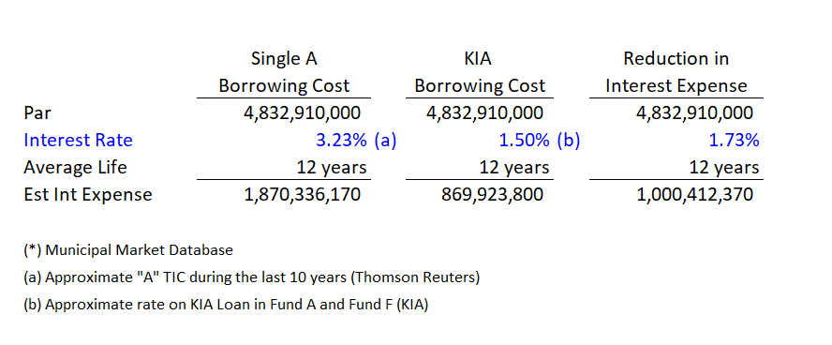
Using KIA creates more project funds, less interest expense
KIA creates more project funds, less interest expense
Low cost funding provided by KIA allows more dollars to be used for projects funds rather than interest expense.
Consider, during the last 10 years, $4.8B of municipal bonds* were issued by Kentucky municipalities for water and wastewater infrastructure projects away from KIA
If these municipalities had borrowed through the State Revolving Funds, approximately $1 Billion of additional project funds would be available for project costs.

Slide 17
Other State Water Infrastructure Initiatives
Other State Water Infrastructure Initiatives
New Jersey - Water Infrastructure Savings Enabling (“WISE”) Act –
  NJEIFP financing is a cost-effective solution that not only facilitates more sustainable user rates, but also optimizes capital budgets by reducing annual loan repayments thus freeing up resources for additional projects.
  enhance transparency
  ensure local government units consider the NJEIFP
  Applies to projects of $1 million or greater
  Pursuant to the WISE Act, authorities and other local units seeking Local Finance Board (“Board”) approval to finance such projects shall include an EIT Financial Cost Estimate (“Cost Estimate”) with their Board applications.
  The Cost Estimate, obtained via EIT’s WISE Calculator, compares the cost for financing environmental infrastructure projects through an independent bond issuance versus the NJEIFP.

Slide 18
KIA can leverage existing loan pool to provide immediate funding
More Capacity for Water Infrastructure
KIA can further leverage existing loan pool to provide immediate funding
Leveraging increases the current capacity to loan money and accelerate projects through the issuance of debt
Debt is solely secured by the borrower repayments and other assets of the state revolving fund
No additional state funds are pledged and the debt is not considered an obligation of the state
KIA can leverage to raise funds through the municipal bond market in the near term to meet clean water and drinking water infrastructure demands.

Slide 19
Leveraging Example
Leveraging Example
Federal and State
Grants ($120)
Bonds
($98, 4.0%, 20yr)
$220M Loans
($218, 2.0%, 20yr)
$222.36
Recycle Grant Money to make more Loans over Time
1.85:1
Loan to Grant
Bond Debt Service
$101.98
Recycled Grants
$120.44

Slide 20
Other State Water Infrastructure Initiatives
Indiana – HB 1406: Water infrastructure assistance fund and program. Provides that money from certain sources in the water infrastructure assistance fund (fund) is continuously appropriated for the purposes of the law concerning the water infrastructure assistance program.
  $20 million annual loan and financial assistance program to help communities replace things like aging pipes. To be eligible for financial help, cities must try to collaborate with other towns on projects and create a plan for how they’ll use the dollars.
  Forty percent of the fund would go to help small water utilities that can't often pay for these expensive improvements on their own.
  Provides that a participant, to receive a loan, grant, or other financial assistance from the fund: (1) must have an asset management program
North Carolina The Division of Water Infrastructure and the North Carolina DEQ:
  “North Carolina’s Statewide Water and Wastewater Infrastructure Master Plan: The Road to Viability” (the Master Plan). This plan addresses water and wastewater infrastructure needs and ways to implement best management practices in the following three areas:
    Infrastructure Management, Organizational Management and Financial Management.
    https://files.nc.gov/ncdeq/WI/Division/Statewide_Water_and_Wastewater_Infrastructure_Master_Plan_2017.pdf

Slide 21
QUESTIONS?
Donna McNeil, Executive Director
Kentucky Infrastructure Authority
Donna.McNeil@ky.gov
        502-892-3496 (direct line)
KIA Website: http://kia.ky.gov/
Financial Advisor: Lisa Daniel
daniell@pfm.com

