Slide 1
Addressing Failing Systems in Tennessee
Public Water and Wastewater System Infrastructure Task Force
John Greer
Technical Secretary to the WWFB and UMRB
Utilities Specialist

Slide 2


COT
Overview
Justin P. Wilson
Comptroller
Administration, Legal & Public Affairs
Property
Assessments
State Assessed
Properties
State Board of
Equalization
Research & Education Accountability
Management
Services
Technology
Solutions
State Audit
Local Government Audit
State & Local
Finance
Investigations

Slide 3
WWFB/UMRB
Introduction
Water and Wastewater Financing Board (WWFB)
Utility Management Review Board
Created in 1987
In 2007 moved administratively from Tennessee Department of Environment and Conservation (TDEC) to Comptroller of the Treasury (COT)

Slide 4
WWFB
Water and Wastewater Financing Board
Municipalities (260)
Counties (12)
Authorities (10)
Water and Wastewater only

Slide 5
UMRB
Utility Management Review Board
Utility Districts (179)
Water
Wastewater
Natural Gas
Fire

Slide 6
WWFB
Water and Wastewater Financing Board
9 members
2 ex-officio
7 appointed by Governor
All grand divisions of Tennessee represented

Slide 7
UMRB
Utility Management Review Board
9 members
2 ex-officio
7 appointed by Governor
All grand divisions of Tennessee represented

Slide 8
WWFB/UMRB
Members, Ex-Officio
Comptroller Designee (Chair)
TDEC Designee

Slide 9
WWFB
Appointed Members
Two members representing utility districts
Two members representing municipalities
One member representing government finance
One member representing manufacturing interest
One member representing environmental interest
Notes:
Why are utility districts represented on this board? When the Boards were created in 1987 a utility district that applied for state revolving loan funding could elect to be regulated by the WWFB. That election has never been made, but the board has not been updated to reflect this. The Governor appoints the members, but 68-221-1008 says he shall consult with certain groups to determine qualified members.
The Governor consults with:
Tennessee Association of Utility Districts on three appointments
Both utility district representatives
a municipal representative that is an active employee of a water facility
Tennessee Municipal League on one municipal representative
Tennessee Environmental Council on the environmental representative
Tennessee Association of Business on the manufacturing representative

Slide 10
UMRB
Utility Management Review Board
Three Utility Managers
Three Utility Commissioners
One Consumer Representative

Slide 11
WWFB
WWFB Member Locations
MONTGOMERY
ROBERTSON
MACON
CLAY
PICKETT
HANCOCK
HAWKINS
SULLIVAN
JOHNSON
STEWART
SUMNER
FENTRESS
SCOTT
CAMPBELL
CLAIBORNE
LAKE
OBION
WEAKLEY
HENRY
HOUSTON
TROUSDALE
JACKSON
OVERTON
UNION
GRAINGER
WASHINGTON
CARTER
CHEATHAM
WILSON
SMITH
HAMBLEN
GREENE
UNICOI
DYER
BENTON
DICKSON
DAVIDSON
PUTNAM
MORGAN
ANDERSON
JEFFERSON
GIBSON
CARROLL
HUMPHREYS
DEKALB
WHITE
CUMBERLAND
KNOX
COCKE
LAUDERDALE
CROCKETT
HICKMAN
WILLIAMSON
RUTHERFORD
CANNON
ROANE
SEVIER
HAYWOOD
MADISON
HENDERSON
DECATUR
MAURY
WARREN
VAN BUREN
BLEDSOE
RHEA
LOUDON
BLOUNT
TIPTON
PERRY
LEWIS
MARSHALL
BEDFORD
MEIGS
CHESTER
COFFEE
GRUNDY
SEQUATCHIE
MCMINN
MONROE
SHELBY
FAYETTE
HARDEMAN
MCNAIRY
HARDIN
WAYNE
GILES
MOORE
BRADLEY
LAWRENCE
LINCOLN
FRANKLIN
MARION
HAMILTON
POLK

Slide 12
UMRB
UMRB Member Locations
MONTGOMERY
ROBERTSON
MACON
CLAY
PICKETT
HANCOCK
HAWKINS
SULLIVAN
JOHNSON
STEWART
SUMNER
FENTRESS
SCOTT
CAMPBELL
CLAIBORNE
LAKE
OBION
WEAKLEY
HENRY
HOUSTON
TROUSDALE
JACKSON
OVERTON
UNION
GRAINGER
WASHINGTON
CARTER
CHEATHAM
WILSON
SMITH
HAMBLEN
GREENE
UNICOI
DYER
BENTON
DICKSON
DAVIDSON
PUTNAM
MORGAN
ANDERSON
JEFFERSON
GIBSON
CARROLL
HUMPHREYS
DEKALB
WHITE
CUMBERLAND
KNOX
COCKE
LAUDERDALE
CROCKETT
HICKMAN
WILLIAMSON
RUTHERFORD
CANNON
ROANE
SEVIER
HAYWOOD
MADISON
HENDERSON
DECATUR
MAURY
WARREN
VAN BUREN
BLEDSOE
RHEA
LOUDON
BLOUNT
TIPTON
PERRY
LEWIS
MARSHALL
BEDFORD
MEIGS
CHESTER
COFFEE
GRUNDY
SEQUATCHIE
MCMINN
MONROE
SHELBY
FAYETTE
HARDEMAN
MCNAIRY
HARDIN
WAYNE
GILES
MOORE
BRADLEY
LAWRENCE
LINCOLN
FRANKLIN
MARION
HAMILTON
POLK

Slide 13
WWFB
Water and Wastewater Financing Board
Purpose (Tenn. Code Ann. § 68-221-1007)
  To correct financial losses
    Reasonable user rate increases (expense decreases)
    Negotiate consolidations
Legislative Objective (Tenn. Code Ann. § 68-221-1008)
  Self-supporting water and wastewater facilities
  Act for the public welfare

Slide 14
UMRB
Utility Management Review Board
Legislative directive (Tenn. Code Ann. § 7-82-706)
  Act for the public welfare
  Carry out the General Assembly’s intent that utility districts be operated as self-sufficient enterprises.

Slide 15
WWFB/UMRB
Both Boards
Regulatory Procedures
  Formal Review
  Board Investigation
  Informal Hearing
  Contested Case
  Litigation
Notes:
Formal review is the first level and what most districts are familiar with…response to statutory referrals related to financial distress and water loss;
This is what most of you have seen when you receive a letter from our office that says you are before the Board on a certain date and we will help you put a plan together. .
Board Investigation: This should not be a scary process, but it allows us to dig deeper and help people
Informal Hearing: Customer complaints or when someone disputes a fee or charge.
Contested Case: Administrative law judge helps the board (more formal hearing)—rate petitions and rate protests and if board decides to initiate a case to determine whether a UD commissioner should be ousted
Litigation: last resort. To enforce board orders, to mandate good faith negotiations for consolidations; to enforce water loss compliance. This will never happen if a Utility will be proactive in making a plan to fix whatever issue they are having

Slide 16
WWFB/UMRB
Both Boards
How does an entity get referred?
  All government utilities in Tennessee must submit an audit to our office annually
  Audits are performed by independent CPA firms or by our office for county systems
  Tennessee requires the AWWA free reporting worksheet to be included in the audit

Slide 17
WWFB/UMRB
Both Boards
What gets an entity referred?
Financial
  2 years with a negative change in net position
  Deficit total net position
  Default on any debt instrument
Water Loss
  Validity score of 80 or less or non-revenue water as a percent by cost of operating system of 20% or greater

Slide 18
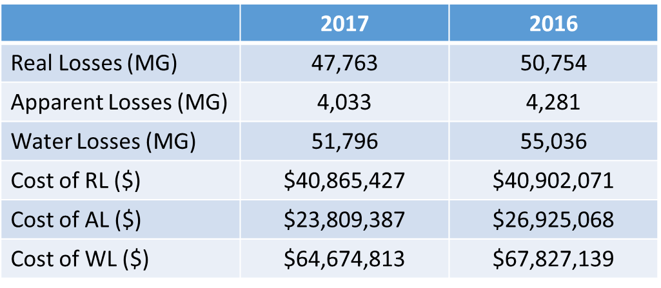
WWFB/UMRB
Non-Revenue Water (not audited)

Slide 19
WWFB/UMRB
Both Boards
What gets an entity referred?
2 years with a regulatory loss
  Revenues minus expenses minus grants and capital contributions
  We also take out all pension assets and liabilities

Slide 20
WWFB/UMRB
Both Boards
What gets an entity referred?
Training
  All utility board members in Tennessee are required to receive training
  The UMRB can remove board members who fail to meet the training requirement
  The WWFB can impose reasonable sanctions including the loss of funding through the State Revolving Fund

Slide 21
WWFB/UMRB
How we partner with local utilities
Education
  Two-way street
Technical Assistance
  Board members

Slide 22
WWFB/UMRB
How we partner with local utilities
Collaboration with local, state and federal agencies
  Tennessee Department of Environment
  State Revolving Fund
  Economic and Community Development
  United States Department of Agriculture
  Tennessee Association of Utility Districts
  Tennessee Municipal League

Slide 23
WWFB/UMRB
How we partner with local utilities
Financial Planning
  Build long term plans
  Share information about the resources available
Managerial Assistance
  Tough Decisions

Slide 24
WWFB/UMRB
How we partner with local utilities
We are able to help utilities through our informal proceedings

Slide 25
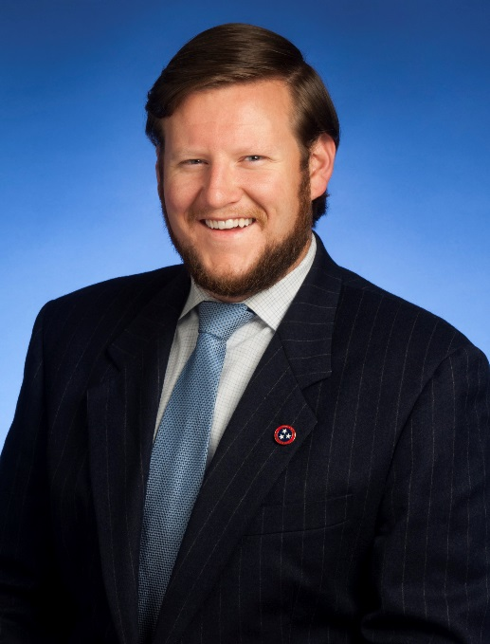
Contact Information
 |  | John Greer Utilities Specialist Technical Secretary to the Boards Comptroller of the Treasury Division of Administration Cordell Hull Building 425 Fifth Avenue North Nashville, Tennessee 37243 Phone: (615) 747-5260 utilities@cot.tn.gov
Notes:
Questions and comments

