Slide 1
Safe Water, Healthy Communities
centralstateswaterresources.com

Slide 2

CSWR: Our Mission
Central States Water Resources is working to bring safe, reliable and environmentally responsible water resources to every community in the U.S.
Be the #1 water utility in the US providing service to small communities.

Slide 3
CSWR: Our Vision
Transforming communities by using technology and innovation to quickly assess and invest in reliable infrastructure that meets or exceeds stringent state and federal safety standards, ensuring all communities across the U.S. have access to safe, clean and reliable water resources while protecting the aquifers, lakes, rivers and streams that are essential to our world.

Slide 4
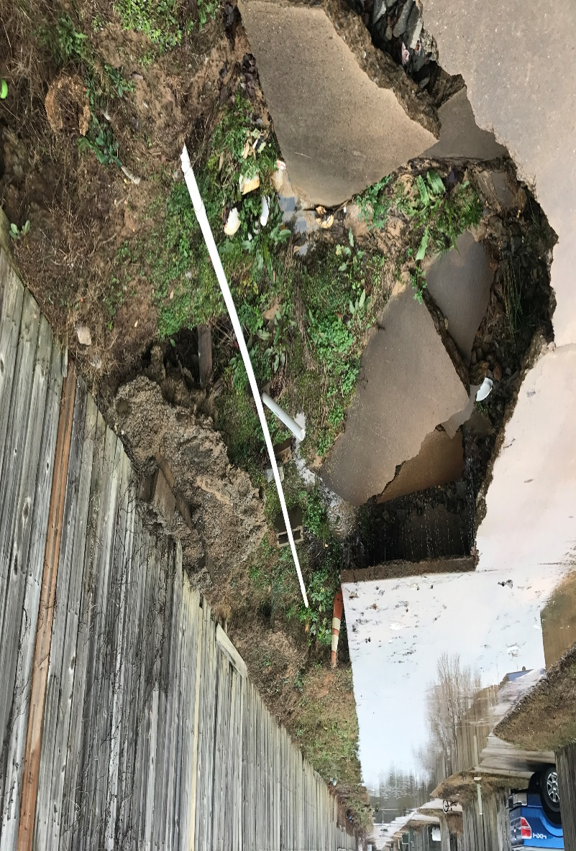
The Need
One in every four Americans is exposed to potentially unsafe drinking water or wastewater systems.
Water systems across the U.S. often lack staff, expertise and funding to address critical water safety, reliability and quality standards.
Most water systems having been in operation for decades, often causing unsafe and environmentally damaging conditions including unsafe lead levels and E.coli contamination.
CSWR aggressively establishes affordable, regulatory-compliant water and wastewater treatment facilities for underserved communities and private facility owners.

Slide 5
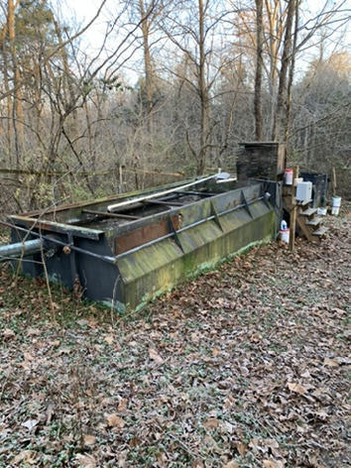
The Need
Regulatory changes have driven thousands of small water utilities out of regulatory compliance.
Owners of these systems are often cut off from capital market financing even though the individual utilities are frequently cash flow positive.

Slide 6
CSWR: Expertise
Our uniquely experienced team puts innovation to work, ensuring communities have a clean, safe water supply and reliable wastewater systems.

Slide 7
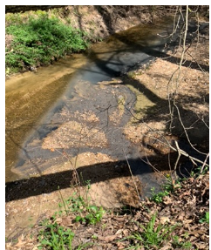
Expertise at Work
We acquire water systems that are often woefully outdated and dangerous — often unbeknownst to their customers.
We use innovation to create 180-degree transformations in communities’ water and wastewater systems — many of which have been in operation for more than a half-century.
We get owners out of the business who don’t have the technical expertise or resources to provide safe, reliable water.
Technology such as remote monitoring management keeps CSWR water resources safe and reliable for community members.

Slide 8
Community Partners
CSWR’s investments into water resources are also investments into communities at large, ultimately enhancing value and driving outside investment.

Slide 9
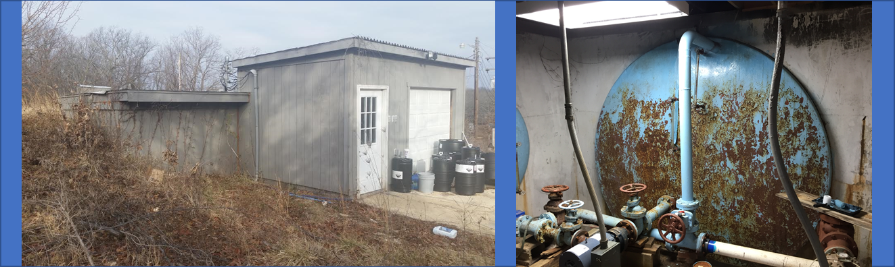
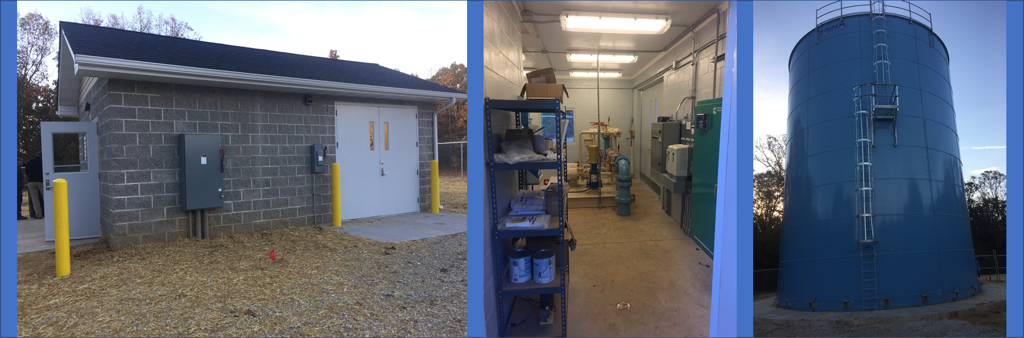
Community Partners
CSWR engages with community owners and leaders in need of help, purchases utility assets, and partners with communities to improve service and value.
By repairing outdated water and wastewater systems, CSWR increases the value of each community it serves.
Water quality has a direct impact on home values, according to the EPA, as the average American uses 176 gallons of water daily.
CSWR has a track record of enhancing community value in dozens of communities and for thousands of people in multiple states.
Before vs. After

Slide 10
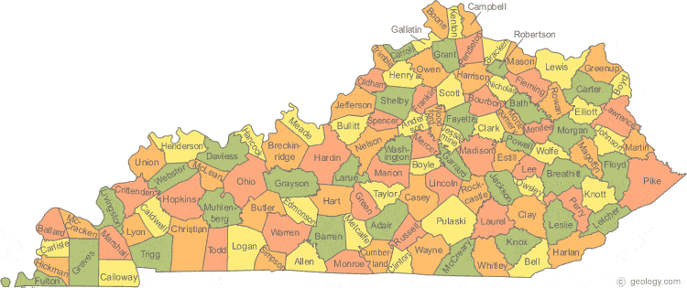
CSWR in Kentucky
CSWR recently obtained PSC approval to acquire 9 water utilities in Kentucky and is in the process of filing to acquire 6 more.
CSWR works with the Kentucky Division of Water and the Public Service Commission as we identify communities that are in desperate need of critical water infrastructure investment.
CSWR purchased several small, distressed wastewater treatment plants currently under enforcement actions or that have existing environmental issues.
CSWR will invest in these communities to bring professional service to consumers and sustainability to communities.

Slide 11

Why CSWR Works for Kentucky
Privately held – a private solution to a very public problem.
Investing in under-served communities that larger, investor-owned public utilities don’t want to acquire or operate.
Strong track record of regulatory compliance and operational excellence.
Deep experience working with and purchasing from owners of small water and wastewater utilities and quickly improving those systems.

Slide 14
Safe Water, Healthy Communities
centralstateswaterresources.com

