Slide 1

Recommendations for Kentucky’s water/WASTEWATER infrastructure
Presented by
Greg C. Heitzman, PE, MBA
BlueWater Kentucky
Presentation to Kentucky Task Force on Water Infrastructure
October 23, 2019

Slide 2


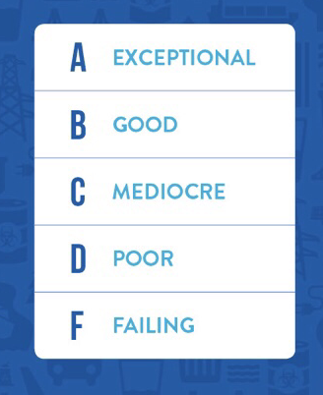
2019 Kentucky Infrastructure Report Card
“Mediocre”
Drinking Water = C+
Waste Water = C-
https://www.infrastructurereportcard.org/state-item/kentucky/

Slide 3
Kentucky's success since SB 409 authorized in 2000
15 Regional Water Management Councils to coordinate planning
State-wide water GIS database => KY WRIS
Drinking Water coverage at 95%
Water and Wastewater system consolidation
Water System interconnections through regional cooperation
Improved compliance record in water and wastewater
Industry Collaboration through KY Water Advisory Council
Active Industry Associations (AWWA, KMUA, KWWOA, Rural Water, etc.)
Coordinated Agency Funding (KIA, RD, DLG, AML, ARC, CDBG, etc.)
Training from AWWA, KDOW, RCAP, Rural Water, UK, etc.
R&D support from UK, UL, WKU
Partnerships among Best Practice Water/WW systems

Slide 4
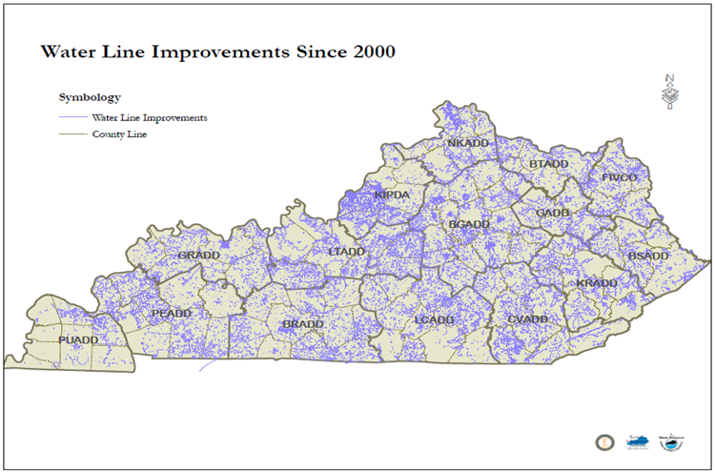
Kentucky Water Systems
435 Public Water Systems
213 Water Treatment Plants(average age 36 years)
1,842 Water Storage Tanks (average age 26 years)
58,783 Miles of Water Main
  Average age 38 years
  20% over 50 years
Estimated 25,000 lead service lines
Source: KY Infrastructure Authority and KY Division of Water

Slide 5
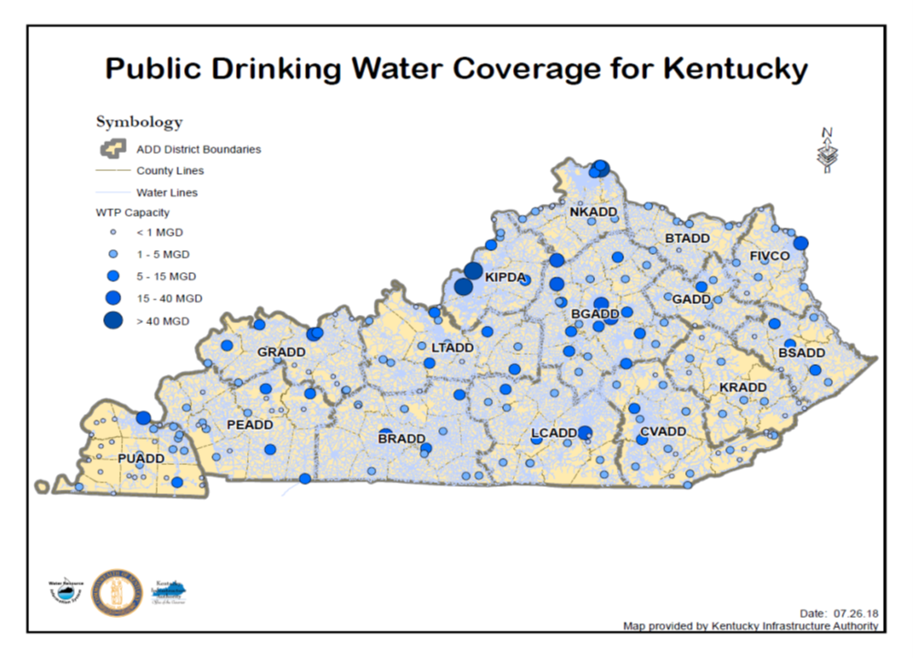
Public Water Service Availability
2000 - Governor Paul Patton’s 2020 Water Vision thru Senate Bill 409
435 Kentucky Public Water Systems serve 4.5 million people
95% of Kentuckians have access to public water system (top 5 in US)
Recognized nationally for regional planning and consolidation
Source: KY Infrastructure Authority and KY Division of Water

Slide 6
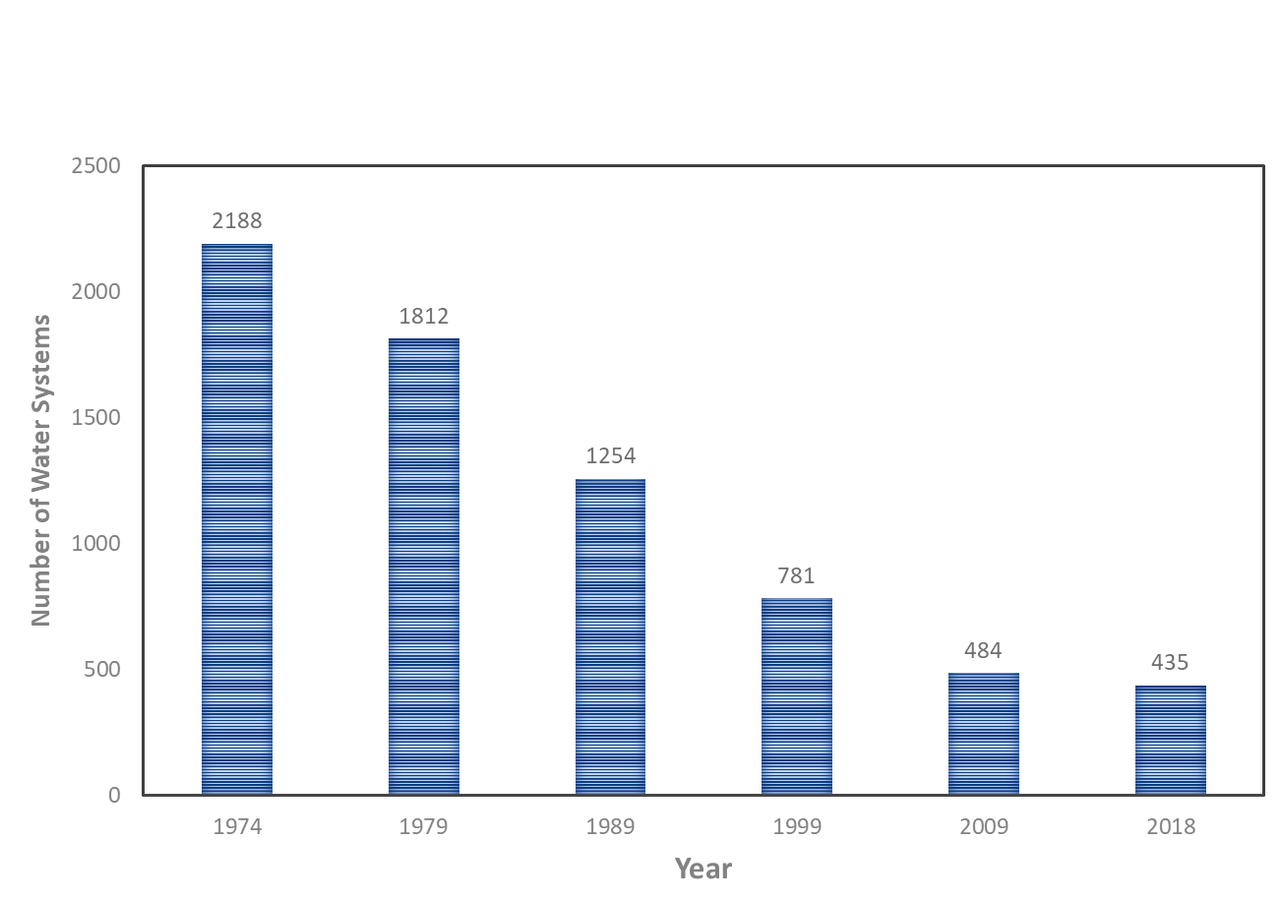
Consolidation of KY Water Systems
80% decline in number of water systems over 45 years (one of best in US)
Source: KY Division of Water

Slide 7
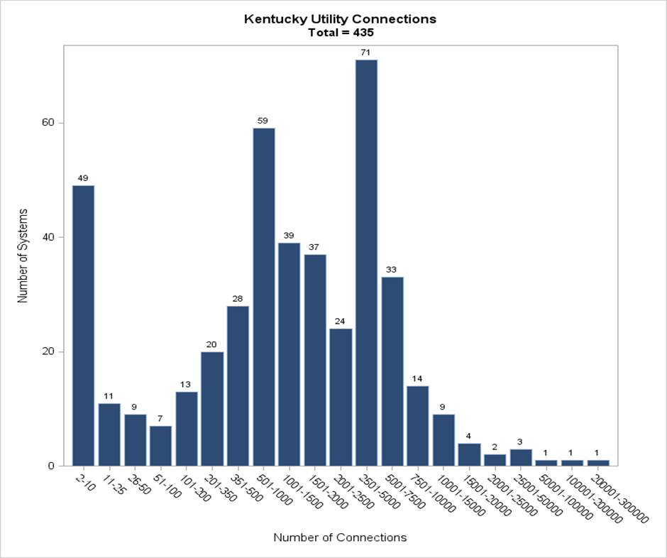
Kentucky Water System Profile
Top 12 Systems Serve:
37 % of KY Population
54% of Water Produced
296 Small Systems
Louisville Water Company
Kentucky-American Water Co
Northern Kentucky Water District
Bowling Green Municipal Utilities
Owensboro Municipal Utilities
Ashland Water Works
Paducah Water Works
Frankfort Plant Board
Somerset Water Service
Logan-Todd Regional Commission
Glasgow Water Company
Hardin County Water District No. 2
Top 12 Large Systems
Source: KY Division of Water

Slide 8
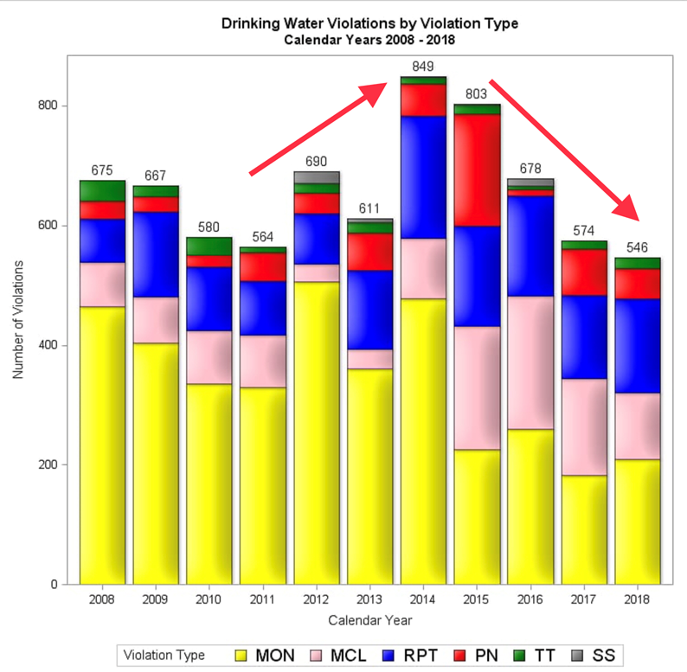
KY Drinking Water Regulations
Decline in Violations last 5 years from 849 in 2014 to 546 in 2018
Increase in 2014 for Disinfection By-Product Violations
DBPs have declined through 2018 with technical assistance from KY DOW and KY Rural Water
Expect improvement again in 2019
Source: KY Division of Water

Slide 9
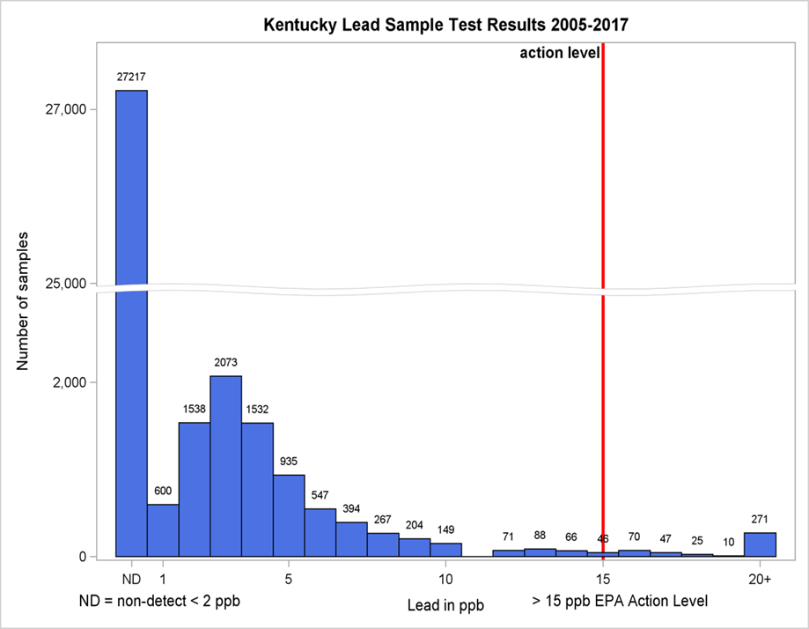
Lead Compliance Record
All 435 Public Water Systems are compliant with EPA Lead and Copper Rule
Kentucky in generally in good shape if EPA sets “Target” Level at 10 parts per billion (ppb)
EPA estimates KY has 53,000 Lead Service Lines
KY estimate is less than 25,000 Lead Service Lines, since Louisville has reduced lead service line inventory from 70,000 in 1940 to less than 500 in 2019
Need State-wide Lead Inventory
Proposed EPA Target Level
10 ppb
Current EPA Action Level of 15 ppb
Source: KY Division of Water

Slide 10
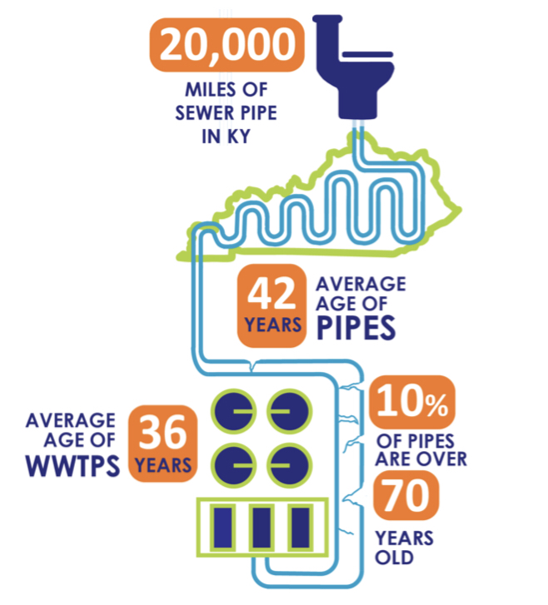
Kentucky WASTEWater Systems
17 Consent Decrees in KY to eliminate sewer overflows
Ky Wastewater Systems have reduced sewer overflows from 5.8 billion gallons in 2003 to 3.1 billion gallons in 2018
Source: KY Division of Water

Slide 11
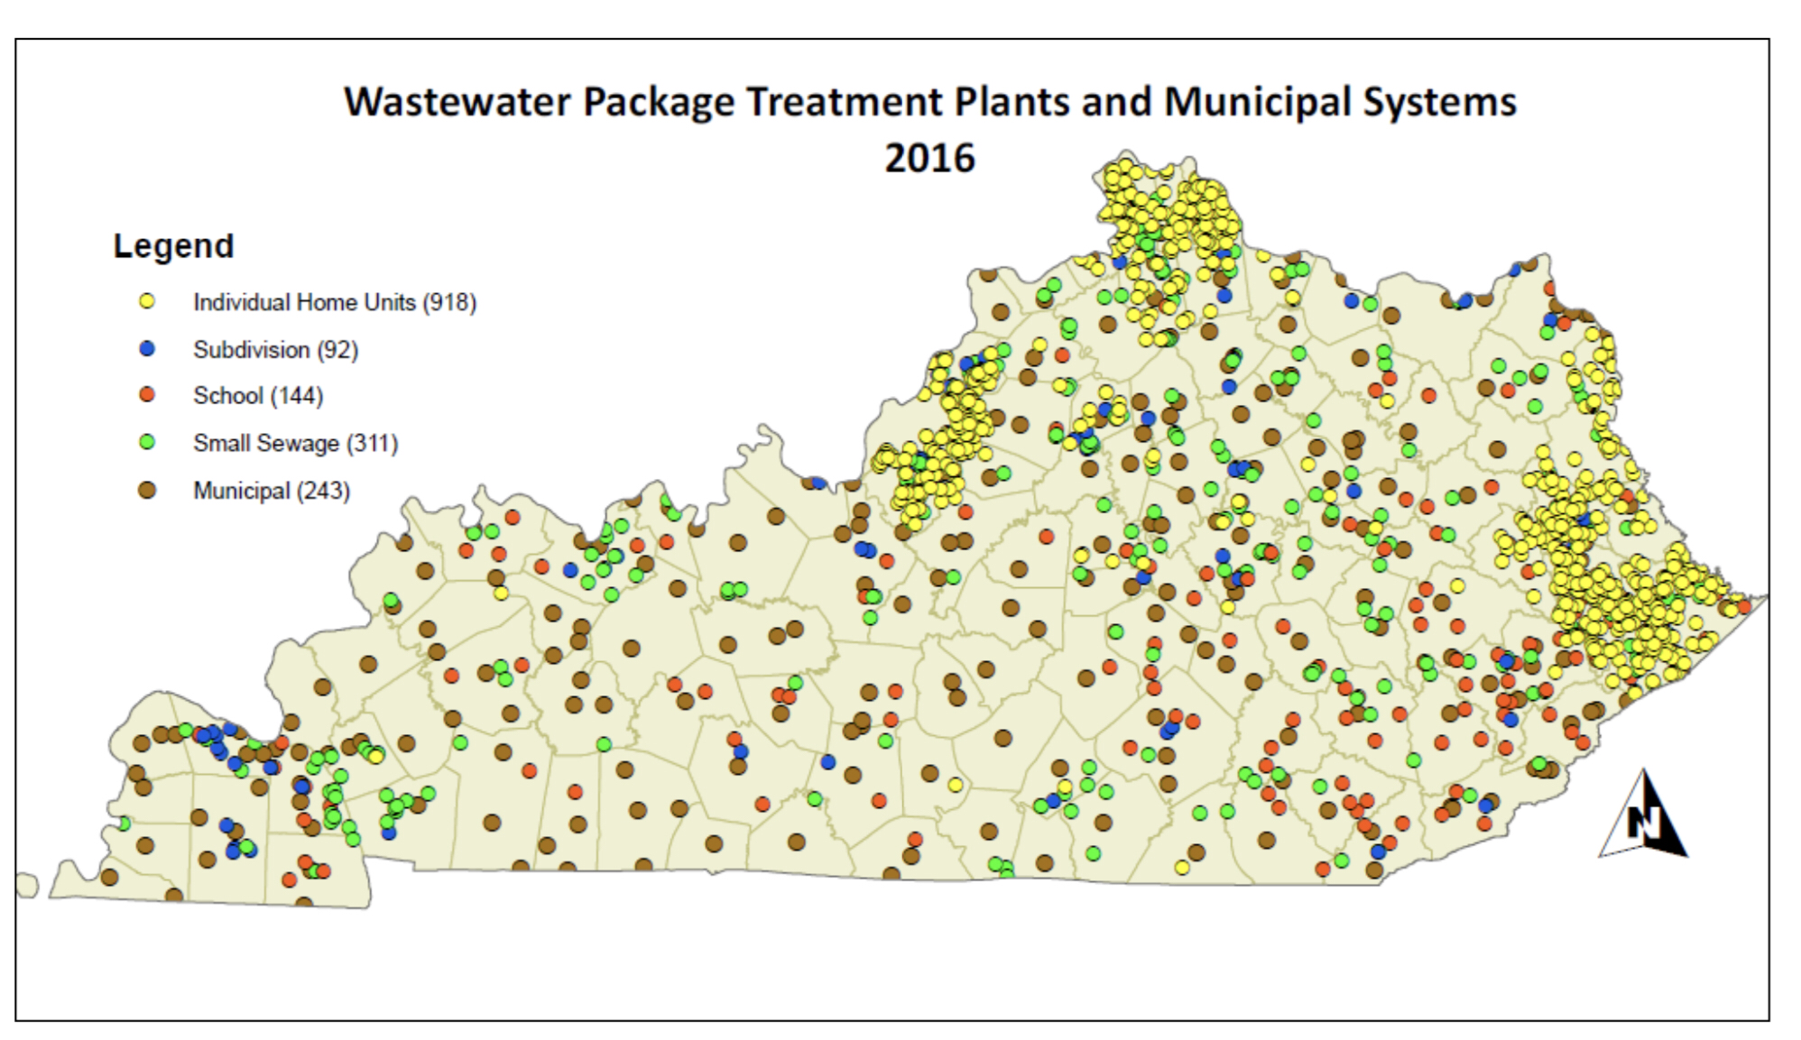
Public WASTEWATER Service Availability
60 percent of Kentucky’s population has access to wastewater treatment plant (5% increase since 2011)
Remaining 40% percent uses private wastewater systems or have illegal straight pipes to Kentucky waterways
Need to eliminate straight pipe discharges
Source: KY Division of Water

Slide 12
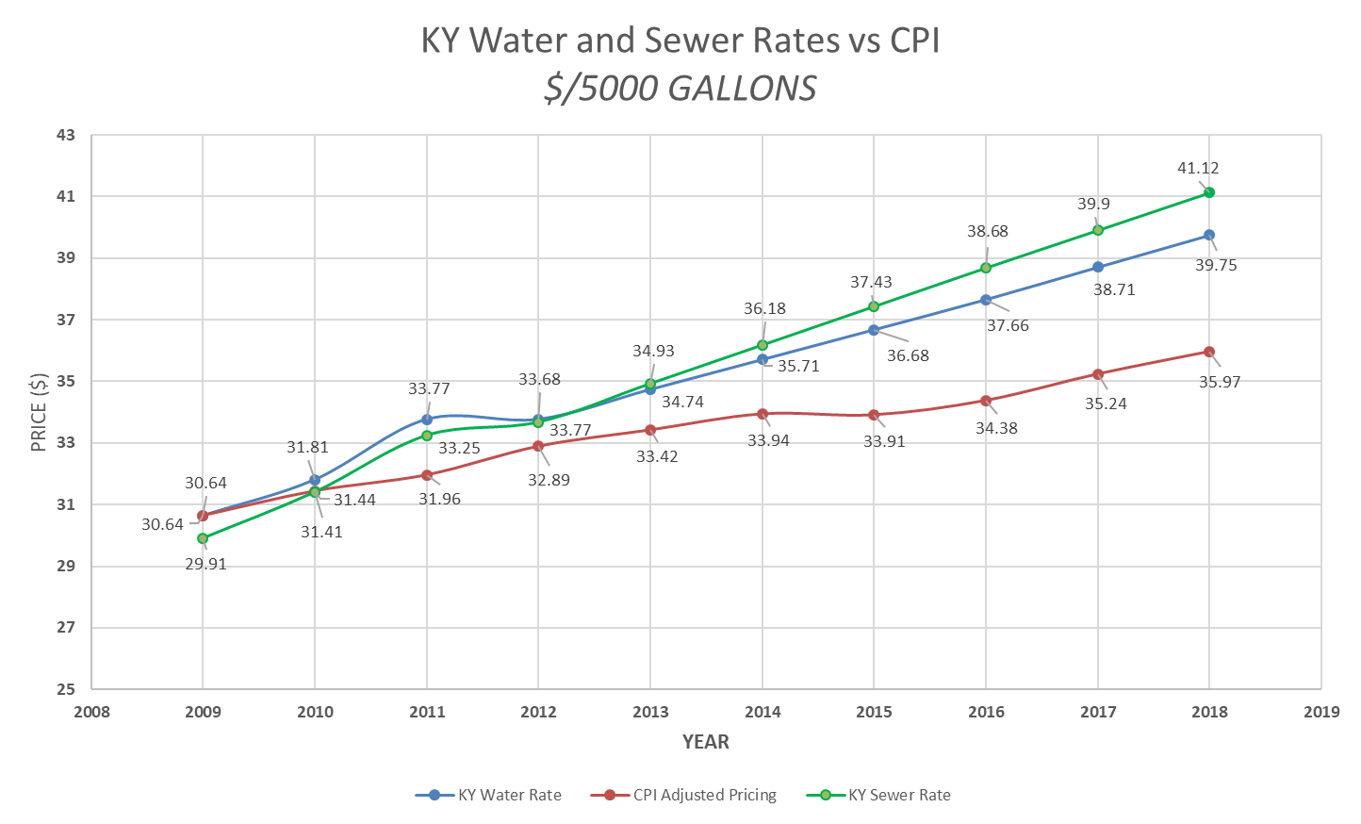
Water and WASTEWATER RATES
Average KY Water Bill for 5,000 gallons/month
  2012 - $33.77
  2018 - $39.75
  2.75% average annual increase (CPI about 2%)
Average KY Wastewater Bill for 5,000 gallons/month
  2012 - $33.68
  2018 - $41.12
  3.0% average annual increase (CPI about 2%)
Total W/WW Bill Averages $80.87/month or $970/Year
  Some KY communities exceed $100 per month or $1,200/Year
Averages 2% of KY Median Household Income of $48,375
  Some KY communities at 2.5% of KY MHI
Source: KY Rural Water/Cannon & Cannon Rate Survey

Slide 13


Top challenges for water/wastewater
#1 CONTINUED COMPLIANCE WITH REGULATIONS
  Disinfection By-Products (DBP) in drinking water
  Lead and Copper ➔ Focus IS now on Lead In Schools
  America’s Water Infrastructure Act of 2018 (AWIA)
  Algal Toxins and PFAS (perfluoroalkyl) substances
  Combined and Sanitary Sewer Overflows (CSO/SSO)
  Stormwater Management ➔ MS4
  Nutrient loading in streams (nitrogen and phosphorus fertilizers)
  Pesticides and Herbicides

Slide 14
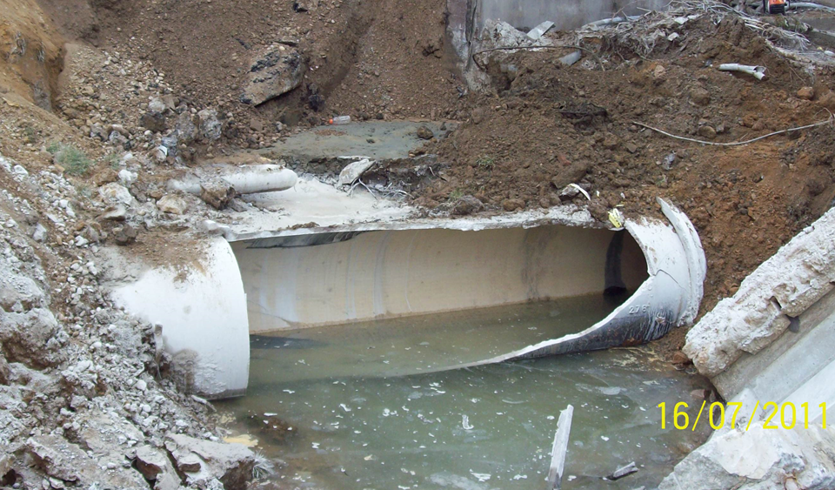
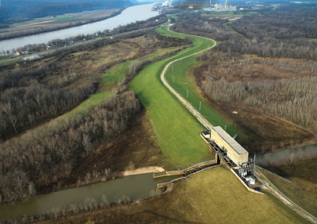
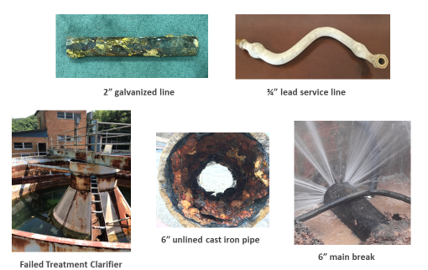
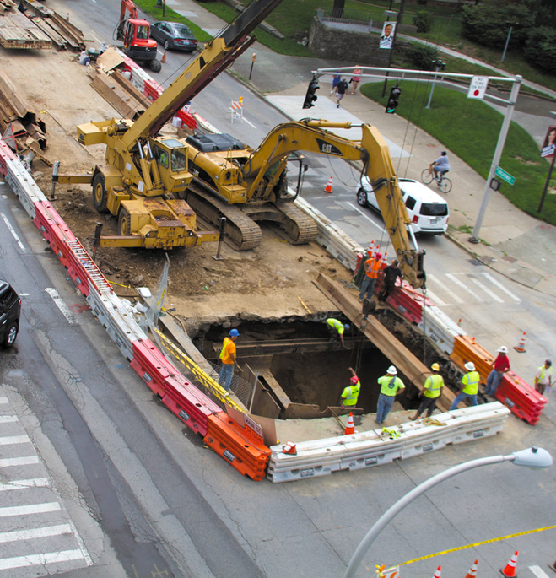
Top challenges for water/wastewater
# 2 AGING INFRASTRUCTURE
  Water - Aging treatment, storage, pumping, distribution
  Wastewater – Aging collections, storage, treatment, pumping, flood protection
  Growing deferred maintenance
  Slow adoption of Asset Management and Life Cycle Analysis
  Lack of capital planning (5,10,20 years)
  Funding and Procurement Cycle
48” Water Main Break
Flood Protection Pumps and Levees
Sewer Collapse

Slide 15
Top challenges for water/wastewater
$8.2 Billion Funding Gap for KY Drinking Water ($1,800/person) over next 20 years
$6.2 Billion Funding Gap for KY Wastewater ($1,400/person)
#3 INFRASTRUCTURE FUNDING
  Current customer rate base is not adequate to fund infrastructure needs
  Funding focus has been on new infrastructure and not on repair, maintenance and replacement
  Loans are replacing grants (systems waiting on grants)
  Limited funds available for soft costs (planning, new technology, best practice, life cycle analysis)

Slide 16
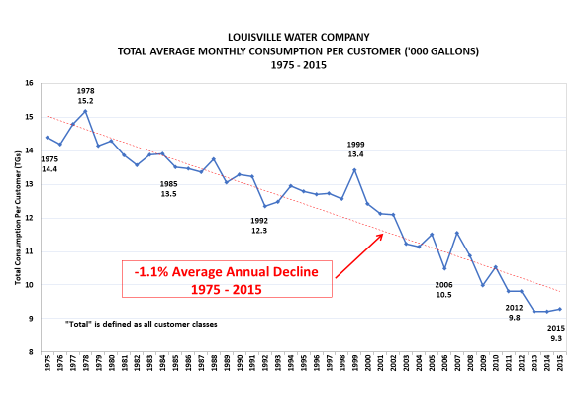

Top challenges for water/wastewater
#4 CONSUMPTION & RATES
  Kentucky is generally a slow or no-growth economy
  Water consumption is declining:
      transition to service economy
      recycling/reuse
      low-flow plumbing fixtures
      therefore …. fixed costs are spread over fewer gallons sold
  Different rate approval methods (PSC -regulated vs Municipal)
  Reluctance by elected officials and appointees to raise rates due to public pressure
  Affordability of water becomes a concern in some communities when full-cost pricing is implemented

Slide 17
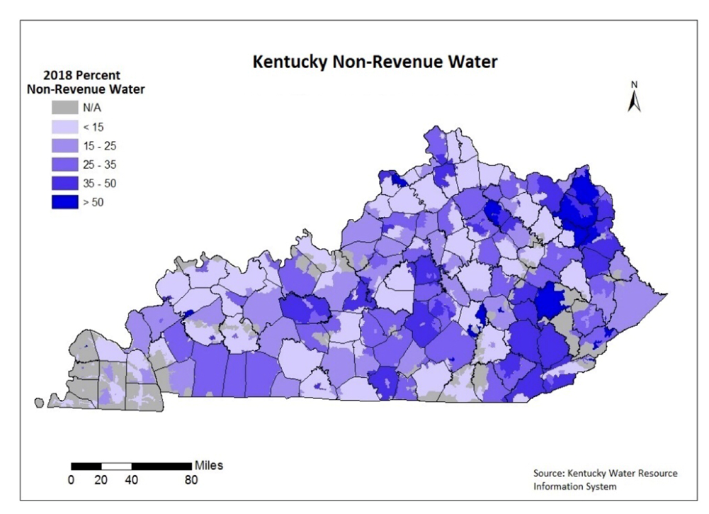
Top challenges for water/wastewater
#5 Water Loss
  KY Water Loss averages over 30 percent
  Inconsistent methods of measuring water loss
  No statewide standard practice
  PSC method vs municipal methods
  Extensive use of estimates
  Percent water loss not industry best practice
  Need economic approach to water loss ($ value of water)

Slide 18


Top challenges for water/wastewater
#6 WORKFORCE
  Retiring Boomer workforce
  Projected gap in licensed operators and technical staff
  Non-competitive salary and benefits in robust economy
  State pension crisis impact on workforce and balance sheet
  Agency staff shortage (DOW, KIA, PSC)
  Changing expectations of millennial workforce
    Teamwork
    Mobility
    Technology

Slide 19
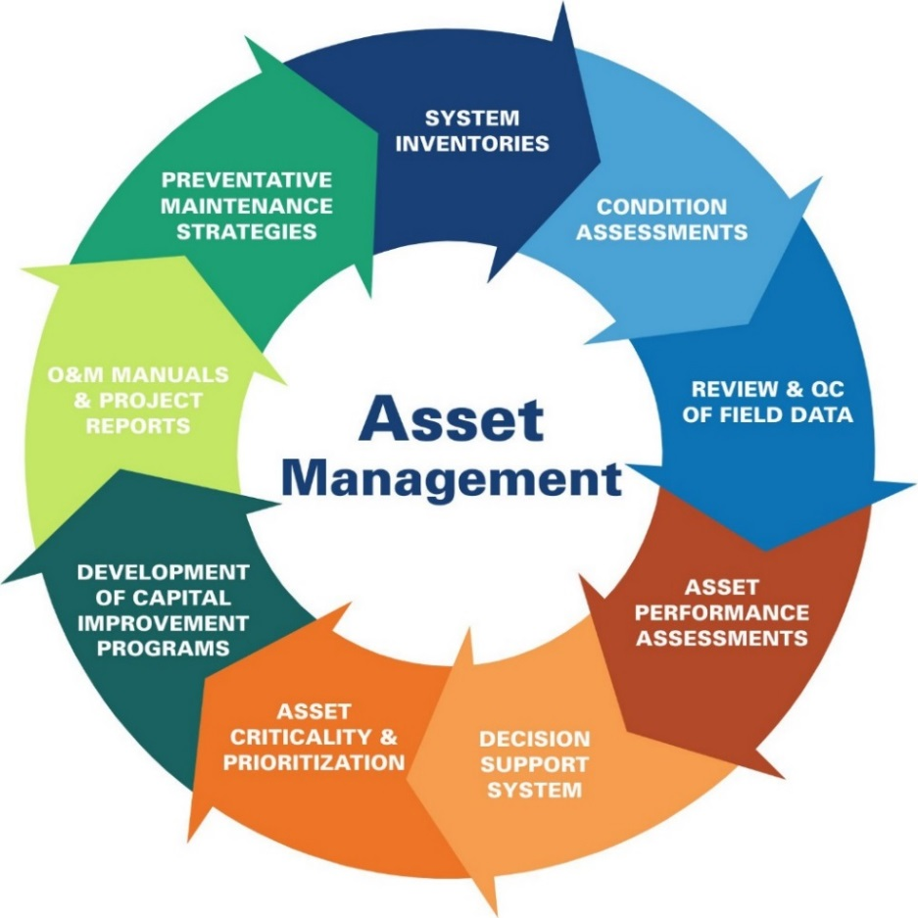

Top challenges for water/wastewater
#7 Planning & Best Practices
  Lack of Business/Strategic Planning
  Lack of Asset Management & Capital Planning
  Best Practices slow to adopt
  Slow to adopt new technology (IoT)
  Outdated procurement regulations (slow/inefficient)
  Life cycle costing rarely evaluated

Slide 20
Recommendations by
BlueWater Kentucky
Continue Kentucky Drinking Water and Clean Water Advisory Councils.
Continue to enhance water planning in Kentucky required under SB 409:
      Improve accuracy and consistency of WRIS data
      Engage local Water Management Planning Councils
      Fully fund staff and technology resources
Leverage federal funds with state funding (i.e. Indiana WIFIA approach).

Slide 21
Recommendations by
BlueWater Kentucky
Establish annual $50 million Kentucky Water Infrastructure Fund:
      To assist water/wastewater/stormwater systems in planning, engineering, design and construction
      Revolving loan program with up to 30% annually for grants
Develop Kentucky uniform water/wastewater performance criteria and rating system:
      Include technical, managerial and financial criteria
      Collaborate with industry to develop rating system and key performance metrics
      Develop peer review process to improve performance
      Recognize and award and top-rated systems
      Publish W/WW system ratings
      Take corrective action on failing water systems
Create financial incentives (principal forgiveness) for assessing capacity and achieving performance levels in areas of:
      Technical - regulatory compliance/operations
      Finance - financial capacity, cost of service rates, audits
      Managerial – asset management, planning, water loss, customer service, system reliability, consolidation, interconnects, risk management plans

Slide 22
Recommendations
by
BlueWater Kentucky
Adopt full cost pricing of water using industry standards (AWWA M1):
      Adopt rate indexing to W/WW based CPI
      Use infrastructure surcharges to address funding gaps
      Use system development charges to fund growth infrastructure
Adopt industry standard for water audits and loss control programs (AWWA M36).
Establish “Centers for Excellence in Water” through partnerships with utilities, water industry associations and academic institutions:
      Water quality/operations
      Infrastructure/asset management
      Water loss
      Finance
      Customer service
      Innovation/Best Practices in water

Slide 23
Recommendations by
BlueWater Kentucky
Conduct state-wide studies on the following:
    Water loss
    Lead service/plumbing inventory
    System interconnections for reliability and drought relief
    Affordability of water/wastewater for low/fixed income households
Revise administrative regulations to:
      Define technical, managerial and financial roles for KY PSC, DOW and KIA to eliminate duplication and streamline processes
      Provide authority to DOW/KIA/PSC to address failing water systems (technical, managerial financial) and ability to intervene and take corrective action
      Establish water and wastewater rate indexing allowing annual rate adjustments. (CPI or equivalent)
Require water and wastewater systems to prepare 10-year Capital Improvement Plans for Asset Management and infrastructure Renewal.

Slide 24
SOURCES
AND REFERENCES
Kentucky Division of Water
Kentucky Infrastructure Authority/WRIS
Kentucky Rural Water Association
KY-TN AWWA
ASCE Infrastructure Report Card – Drinking Water 2019
ASCE Infrastructure Report Card – Wastewater 2019
2018 KY Rural Water/Cannon & Cannon Rate Survey

Slide 25
DISCUSSION AND QUESTIONS
Greg C. Heitzman, PE, MBA
Retired CEO Louisville Water
and Louisville MSD
www.bluewaterky.com
502-533-5073

