Slide 1
Water Loss: The Cost, the Cause and Possible Solutions
Presented by Chairman Michael Schmitt
Kentucky Public Service Commission
To the Public Water and Wastewater Infrastructure Task Force
October 23, 2019
Any views expressed in this presentation are those of the presenter and do not reflect official positions of the PSC.

Slide 2
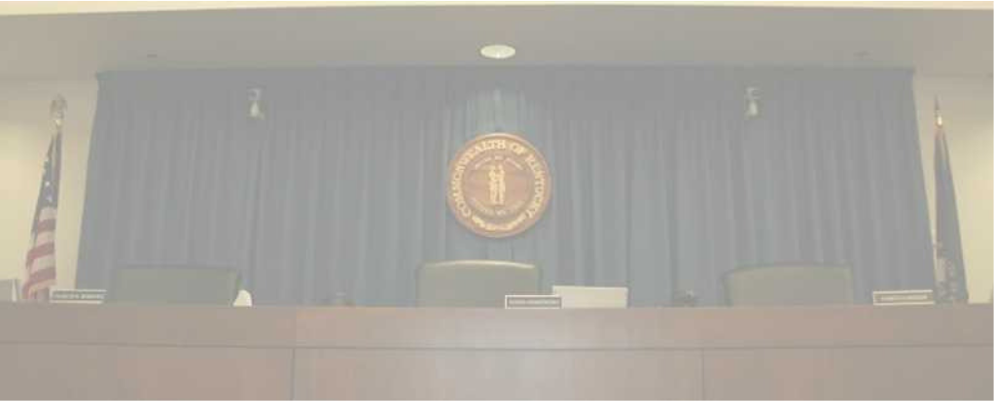
PSC Mission
To foster the provision of safe and reliable service at a reasonable price to the customers of jurisdictional utilities while providing for the financial stability of those utilities by setting fair and just rates, and supporting their operational competence by overseeing regulated utilities.

Slide 3
PSC Jurisdictional Water Utilities—By the Miles
PSC Regulated | Pipeline Miles | Not Regulated by PSC | Pipeline Miles
Investor-Owned Utilities | 2,076 | Louisville | 4,155
Water Districts | 31,837 | Other | 7,303
Water Associations | 5,815 | Municipal Wholesale | 13,215
Total PSC Regulated | 39,728 | Total Not Regulated by PSC | 24,673
Approximately 62 percent of water pipeline
miles in Kentucky fall under PSC jurisdiction

Slide 4
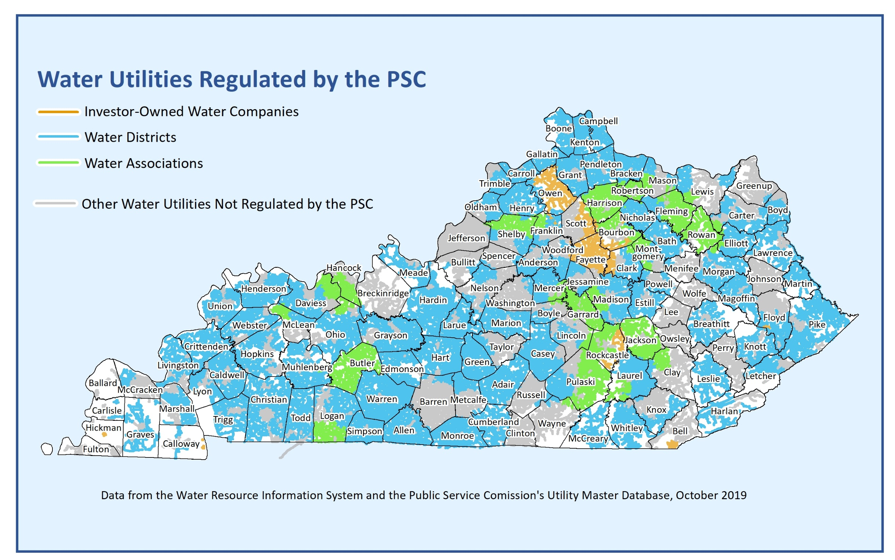

Slide 5
Water Loss Defined
Water produced + water purchased
-
Water sold + water used for fire protection + water used in treatment & distribution operations
=
Unaccounted-for water loss
Unaccounted-for water loss over 15 percent is considered high.
Water loss of more than 35 percent is excessive and largely indicative of significant operational deficiencies and failing infrastructure.

Slide 6
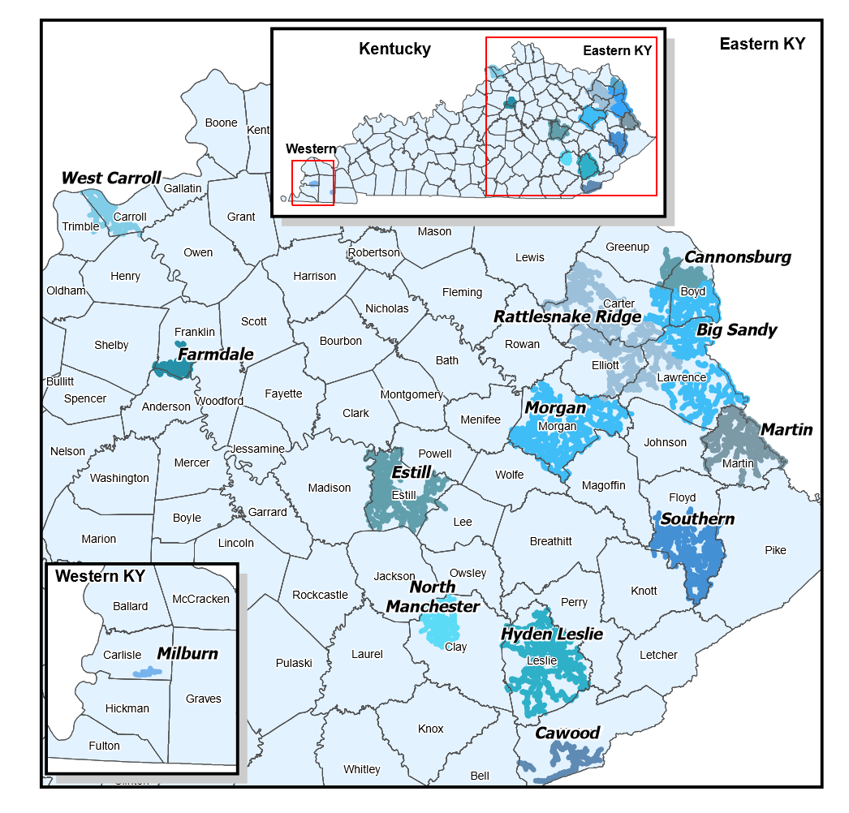
Water Loss Investigation
March 12, 2019—Commission initiated an investigation (Case No. 2019-00041) to review 11 jurisdictional water utilities that reported water loss of more than 35 percent in their annual reports.
Formal hearings conducted in July 2019.
Ongoing investigations of Martin County Water District and Cannonsburg Water District

Slide 7
Water Loss—the Causes and the Costs
Types of water loss:
(1) From customer meter inaccuracies, billing system errors, or theft; and/or
(2) From leaks in the distribution system or from storage overflows
With both types of water loss, utilities lose revenue, production costs increase, and customers pay more for inadequate service.

Slide 8
A | B | C | D | E | F | G | H | I | J | K
Water Utility | 2018 Water Produced (000 Gal) | 2018 Water Purchased (000 Gal) | 2018 Water Supplied (000 Gal) | 2018 Total Line Loss (000 Gal) | 2018 Total Line Loss (%) | 2018 Purchased Water Cost | 2018 Purchased Power Cost | 2018 Purchased Chemical Cost | 2018 Variable Cost of Supplied Water (Col G+H+I) | 2018 Value of Lost Water (Col J * Col F)
Big Sandy Water District |  | 409,693 | 409,693 | 167,013 | 40.77 | $1,167,768 | $106,766 |  | $1,274,534 | $519,569
Cawood Water District | 140,675 | 10,386 | 151,061 | 57,164 | 37.84 | $37,177 | $63,687 | $40,778 | $141,642 | $53,600
Cannonsburg Water District |  | 384,998 | 384,998 | 107,325 | 27.88 | $1,107,636 | $71,397 |  | $1,179,033 | $328,677
Estill County Water District #1 |  | 258,117 | 258,117 | 102,277 | 39.62 | $799,722 | $68,803 |  | $868,525 | $344,147
Farmdale Water District |  | 215,676 | 215,676 | 65,068 | 30.17 | $601,186 | $203,353 |  | $804,539 | $242,724
Hyden-Leslie County Water District | 390,974 |  | 390,974 | 128,496 | 32.87 |  | $271,646 | $96,555 | $368,201 | $121,011
Martin County Water District | 695,581 | 1,306,812 | 2,002,393 | 421,129 | 32.23 | $23,727 | $378,525 | $123,269 | $525,521 | $169,353
Milburn Water District |  | 9,917 | 9,917 | 3,455 | 34.84 | $26,665 | $2,959 |  | $29,624 | $10,321
Morgan County Water District |  | 278,317 | 278,317 | 115,280 | 41.42 | $787,445 |  |  | $787,445 | $326,162
North Manchester Water Association |  | 181,624 | 181,624 | 69,674 | 38.36 | $341,090 | $35,216 |  | $376,306 | $144,357
Rattlesnake Ridge Water District* | 599,536 | 4,880 | 604,416 | 359,779 | 59.53 | $20,984 |  |  | $1,519,824 | $904,677
Southern Water & Sewer District | 568,330 | 189,119 | 757,449 | 473,535 | 62.52 | $352,353 | $394,952 | $146,872 | $894,177 | $559,014
West Carroll Water District |  | 69,963 | 69,963 | 23,079 | 32.99 | $131,528 | $13,868 |  | $145,396 | $47,962
 |  |  |  |  |  |  |  |  | Total | $3,771,573
All data is from 2018 annual reports except for Martin County Water District. MCWD data is from 2017 annual report.
* Rattlesnake Ridge purchased water from City of Grayson at contract rate of $4.30 per 1,000 gallons and produces water at $2.50 per 1,000 gallons.

Slide 9
OPERATOR | Total Risk Factor Score | Last Inspection | Water Loss above 25%
Eastern Rockcastle Water Association, Inc. | 44 | 2/24/2017 | *
Martin County Water District | 32 | 1/31/2018 | *
Southern Water & Sewer District | 28 | 5/16/2018 | *
Black Mountain Utility District | 26 | 10/30/2018 | *
Cawood Water District | 26 | 3/29/2018 | *
Ledbetter Water District | 24 | 8/7/2018 | *
Rattlesnake Ridge Water District | 24 | 5/9/2018 | *
Hyden-Leslie County Water District | 22 | 2/8/2017 | *
Knott County Water & Sewer District | 21 | 3/30/2017 | *
Magoffin County Water District | 20 | 11/16/2016
Muhlenberg County Water District | 20 | 6/16/2016
Farmdale Water District | 19 | 6/4/2018 | *
Morgan County Water District | 19 | 6/13/2018 | *
Cumberland County Water District | 18 | 3/8/2017 | *
Big Sandy Water District | 17 | 5/24/2018 | *
Evaluation criteria include number of deficiencies noted during inspection; utility’s failure to resolve deficiencies; water loss above 15%; and management/employee changes.

Slide 10
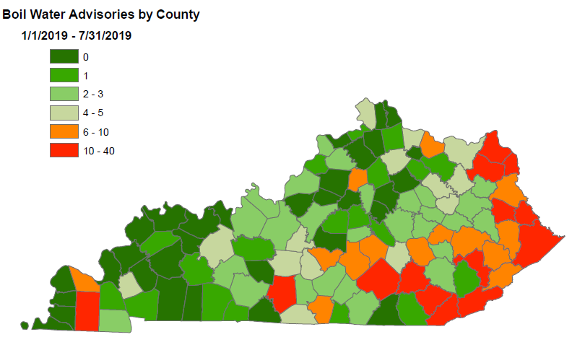

Slide 11
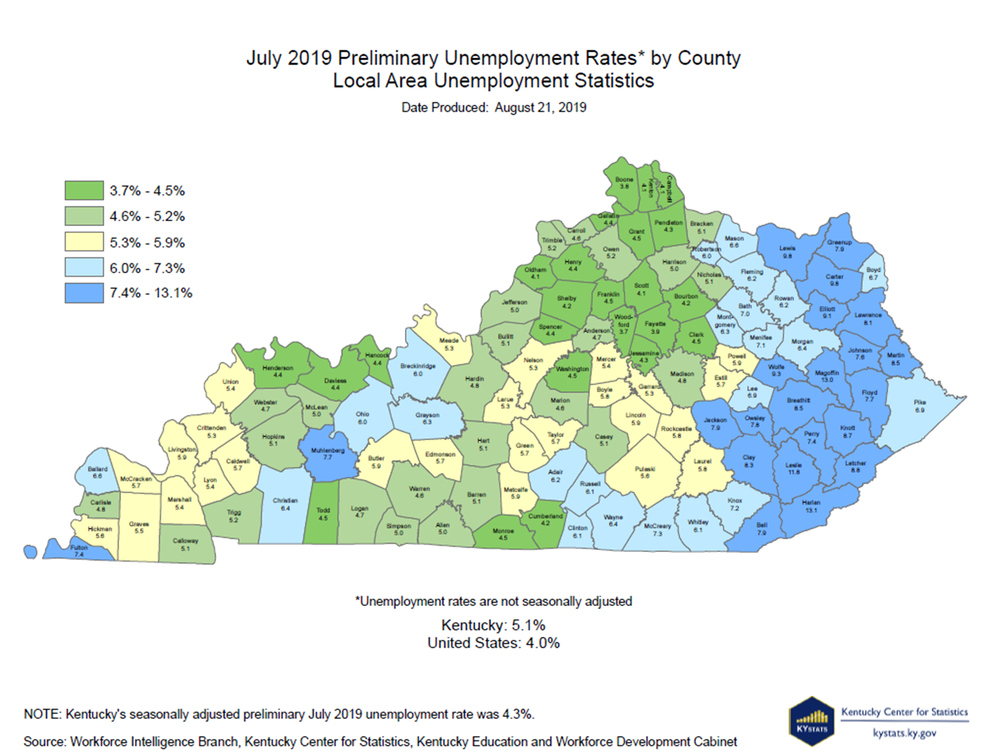

Slide 12
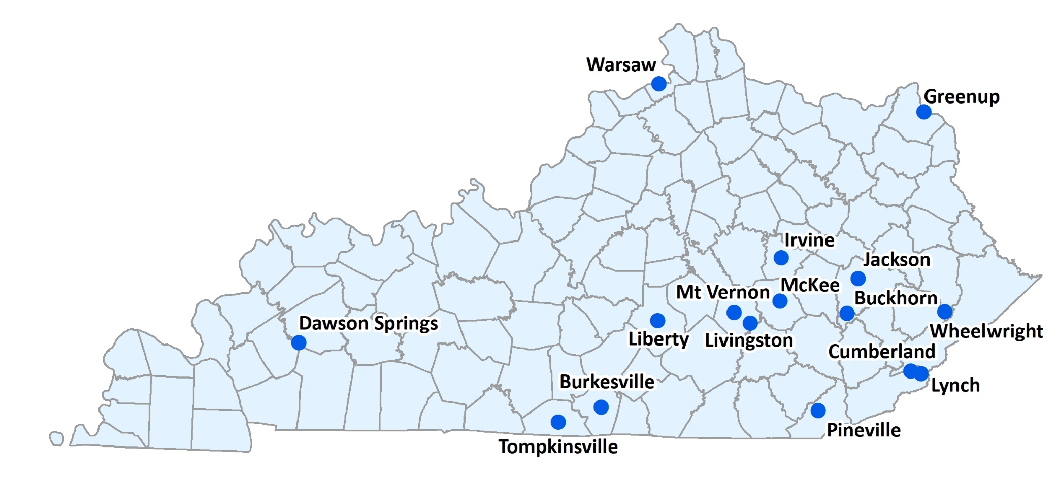
Water Loss—Municipal Water Utilities
Municipality | Non-Revenue Water Percentage*
Tompkinsville | 76
Warsaw | 75
Buckhorn | 73
Wheelwright | 73
Liberty | 68
Lynch | 68
Cumberland | 67
Pineville | 66
Jackson | 66
Livingston | 66
Greenup | 65
Dawson Springs | 65
Mt. Vernon | 63
McKee | 63
Irvine | 63
Burkesville | 62
*[(Gallons produced and/or purchased) – (gallons sold)] ÷ (gallons produced and/or purchased). These numbers do not include wholesale purchases and sales.

Slide 13
Customer Rates—Highest Among All Water Utilities
 | Monthly Charge | Volumetric Charge | Multiplier | Total Usage Charge | Total Bill
Water Utility | per month | per 1,000 gallons |  |  | 4,000 gallons/mo.
North Hopkins | $33.14 | $16.19000 | 2 | $32.38 | $65.52
Caldwell County | $25.17 | $13.04000 | 3 | $39.12 | $64.29
Rattlesnake Ridge | $19.32 | $14.40000 | 3 | $43.20 | $62.52
Breathitt County | $29.45 | $14.73000 | 2 | $29.46 | $58.91
Southern | $58.82 | $0.00000 | 0 | $0.00 | $58.82
Corinth | $18.34 | $13.49000 | 3 | $40.47 | $58.81
Crittenden-Livingston | $20.72 | $11.77000 | 3 | $35.31 | $56.03
West Carroll | $30.33 | $10.72000 | 2 | $21.44 | $51.77
Western Mason County | $39.82 | $5.79000 | 2 | $11.58 | $51.40
Sandy Hook | $28.57 | $11.19000 | 2 | $22.38 | $50.95

Slide 14
Characteristics Common Among Struggling Water Utilities
Inadequate or Inconsistent Oversight and Management
Lack of experience or training
Failure to establish water loss targets or leak detection protocols
Poor recordkeeping
Poor Financial and Accounting Practices
Infrequent rate increases; failure to match rates with expenses
Rate increases through other means (e.g., through grants & loans)
Unauthorized debt
Unsustainable accounting practices such as using depreciation to cover operating costs
Detrimental Extraneous Influences/Local Pressure

Slide 15
If concerns other than the health and welfare of the utility and its customers are permitted to factor into the decision-making process, the long-term viability of the utility as a business will be compromised.

Slide 16
Potential Solutions
New or Enhanced Statutory or Regulatory Requirements
Qualifications of water utility general manager
Employment of a staff engineer
Qualified infrastructure improvement plan (QIP)
Qualified infrastructure improvement surcharge or rider
Authority to effect merger or consolidation

Slide 17
Potential Solutions
Augmented Regulatory Oversight
Commission Infrastructure Engineer—to review, approve and provide oversight of QIP
Improved Oversight and Management of Water Utilities
Eliminate partisan political pressure
Creation of regional water boards
Annual audit requirements
Periodic rate and operations review

Slide 18
Conclusions & Next Steps
Continue to enhance collaboration and communication between Commission and EEC-DOW and with funding agencies.
Commission will examine its own regulatory requirements regarding disallowing recovery for water loss that exceeds 15%.
Avail ourselves of all available tools.
Issue order directing action plan for the utilities investigated pursuant to 2019-00041.
Publish report setting forth investigation findings, conclusions and recommendations.

