Slide 1

Public Water and Wastewater System Infrastructure Task Force Meeting 4
Discussion and Recommendations
Kentucky Rural Water Association
Gary Larimore, Executive Director
October 23, 2019

Slide 2
Founded in 1979 370 Member Utilities Training Technical Assistance Advocacy 19 Professional Staff

Slide 3
Executive Director
Gary Larimore
Assistant Director
Andy Lange
Administrative/Finance
Pamela Byrd
Donna Meador
Bobbie Shanahan
Information Technology
Bryan Burns
Education Services
Randall Kelley
Janet Cole
Drinking Water Programs
Arianna Lageman
Clem Wethington
Danny Stinson
Dell Harris
Joe Burns
Todd Ritter
Tim Blanton
Cody Kirby
Wastewater Program
Steve Capps
Energy Program
Jason Pennell
Source Water Program
Matt Glass
KRWA Staff

Slide 4
KRWA Training Summary
Since 1979, KRWA has trained more than 80,000 people at our two day trainings, conferences and other training opportunities.

Slide 5
KRWA Training Summary
Total Attendees FY 19…..……………….. 2,647
Certification hours offered…………. 268 / 196
Certification hours earned..………… 12,246
Drinking Water………. 7,752
Wastewater………….. 3,777
Online………………… 287.5 / 429.5
PSC hours earned……………..….…... 555
UMP Designations conferred……..…… 16
UMC Certifications earned…………….. 0
Total Training Hours Earned….…………. 12,801
Number of training days……………..… 74

Slide 6

Program Accomplishments:
682 students
Conducted over 110 classes since 1999
Over 185 utilities
437 UMP / Graduates
UMP - Utility Management Professional

Slide 7
KRWA Technical Assistance
Over 78,000 on-site technical assistance visits have been made by KRWA program personnel since 1979

Slide 8
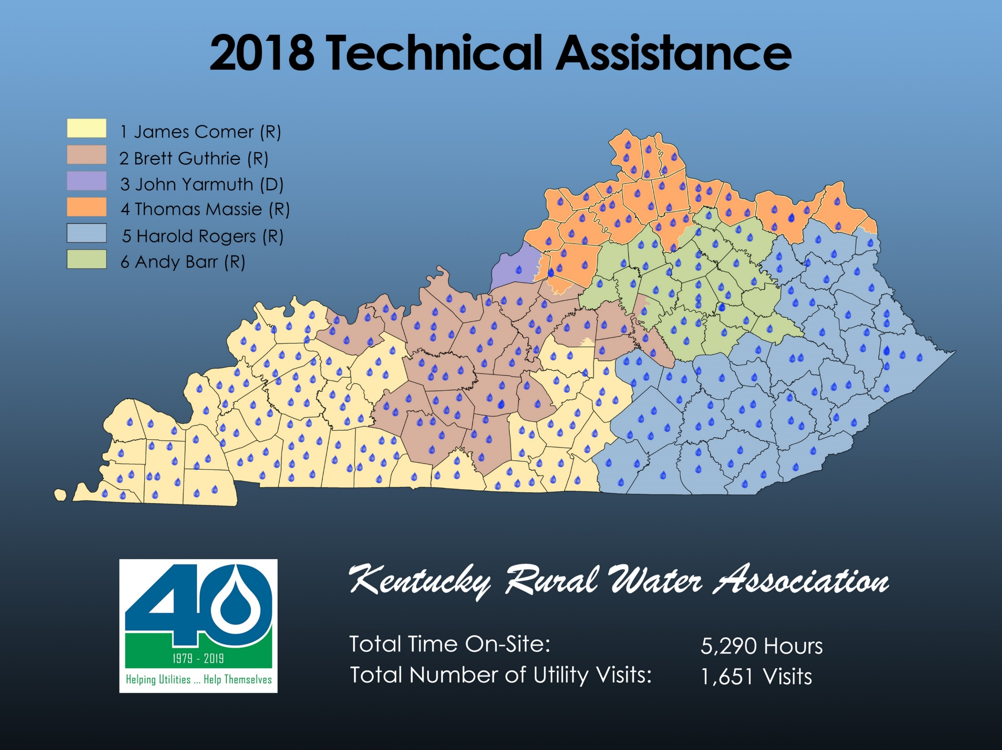

Slide 9
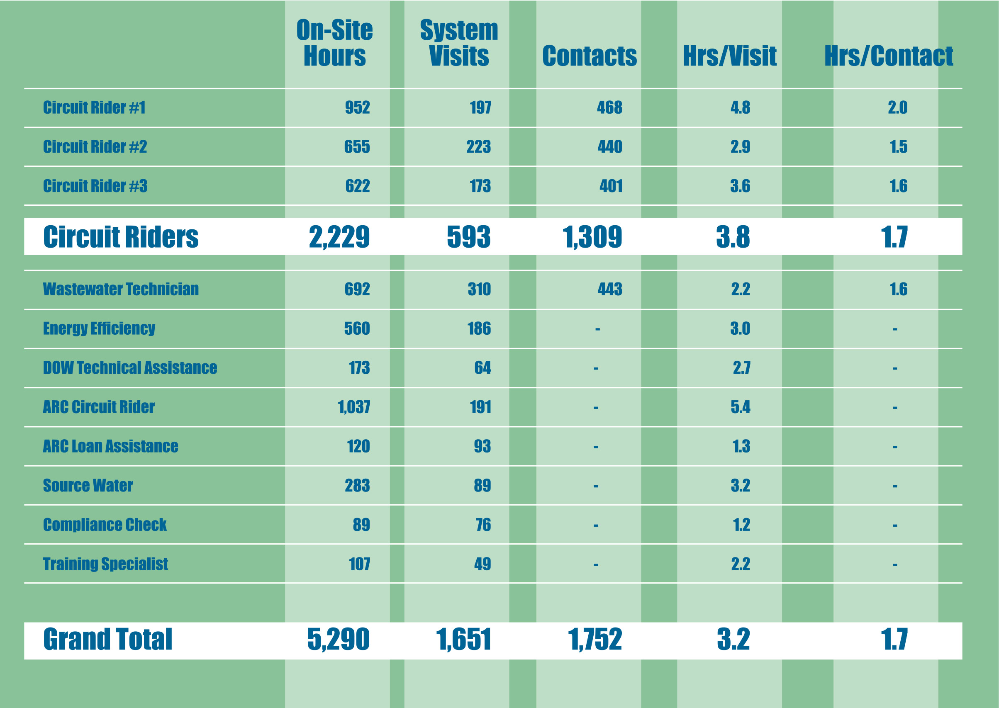
KRWA Technical Assistance

Slide 10
KRWA Water and Wastewater Services
Mapping
Manhole Inspection
Smoke Testing
Flow Monitoring
Pipeline Video Inspection
Groundwater Protection Plans
Operation & Maintenance Manuals
Rate Studies
Website Development and Hosting
Leak detection, valve exercising & flushing plans

Slide 11



Slide 12

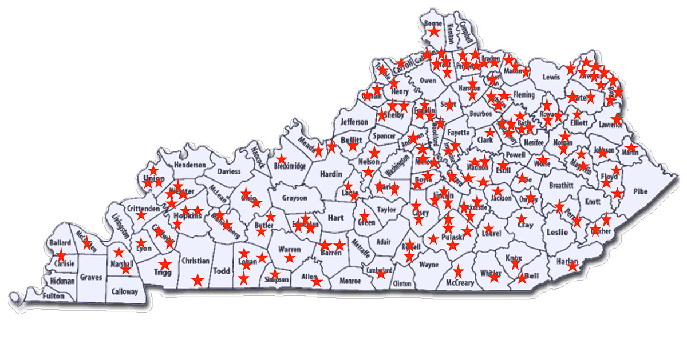
Compliance Check Program
FY 2019
Estimated Savings - $1.1 Million
2019 Compliance Check Participants
(4 to 1 Return on Investment)

Slide 13

Kentucky Rural Water
Finance Corporation
Interim Finance Program
Flexible Term Finance Program
$
Program began June 2001
253 Loans for over $445 million
Flexible term from 1 to 30 years
Estimated 25 year borrowing
rate as of 8/16/2019: 2.75%
A+ rated program
447 borrowers to date
Approximately $1.065 billion
loaned since 1995
2.1 % - 2. 7% Average cost of funds
Current loan rate – 2.95%
$
$

Slide 14
Recommendations
Extend work of Task Force or create stakeholder group to finalize recommendations.
Establish uniform evaluation process to identify public water and wastewater utilities that lack capacity – Technical Managerial & Financial.
Develop Triggers for Identifying Marginal Utilities – Indexes – Affordability & Operating Ratio
Late on Audits, Annual Reports
Deficit Retain Earnings for two or more years
Non-Revenue Water Cost as % of Total Operating Expense
Persistent Non-Compliers – SDWA - CWA

Slide 15
Recommendations
Identify Needs of Marginal Utilities
Holistic approach to assessments
Peer Review – Utility Optimization – Comprehensive Evaluation
Develop Action Plans
Follow-up and Implementation are the Keys
Provide Resources for Implementation of Action Plans
Financial Assistance
Technical Assistance
Training Assistance

Slide 16
Recommendations
Require Annual Reports – Financial Audits for all Utilities (Regulatory Accountability and Follow-up)
Regular Rate Reviews
Allow/Encourage Rate Indexing (PSC jurisdictional)
Track Water Loss – Non-Revenue Water (NRW) cost as a % of Total Operating Expenses, not volumetrically
Explore Emergency Intervention Methods

Slide 17
Recommendations
All Water/Wastewater Utilities Should Be Evaluated and Held to Same Standards.
PSC jurisdictional vs Non-jurisdictional
Explore a hybrid regulatory oversight process that’s a mix between TN and KY – explore other states.
PSC Quasi-Judicial process burdensome and costly
Encourage Training for all Board/Commissioners/Decision Makers – include County & City appointing Officials

Slide 18
Recommendations
Develop Loan Fund – KIA for marginal systems to improve financial, managerial, and/or technical capacity
Provide Incentives for Improvement and require accountability
Provide funds for operational support, technical assistance and training.
Enhance/Continue Support Water Resource Information System (WRIS)
Get Better Data – Make Better Decisions

Slide 19
Public Water and Wastewater System Infrastructure Task Force Meeting 4
Discussion and Recommendations
Kentucky Rural Water Association
Gary Larimore, Executive Director
October 23, 2019

