Slide 1
KYTC DISTRICT 8 Project Update
ADAIR – CASEY- CLINTON – CUMBERLAND – LINCOLN-
MCCREARY – PULASKI –ROCKCASTLE – RUSSELL- WAYNE

Slide 2
​THE KYTC MISSION
To provide a safe, efficient, environmentally sound and fiscally responsible transportation system that delivers economic opportunity and enhances the quality of life in Kentucky

Slide 3
DISTRICT 8 - LOOKING AHEAD
6 YR PLAN PROJECTS
Active Construction
Enacted 6 Year Plan Projects
Bridging Kentucky
Pavement Asset Management
KYTC SHIFT Unfunded Priority Needs
HIGHWAY SAFETY IMPROVEMENT PROJECTS (HSIP)
MAINTENANCE

Slide 4
Active Construction
I-75 Rockcastle County - ATS Construction – 6 Lane Major Widening
MP 65 - 69 $33M January 2017 – August 2018
MP 65 - 55 $81M January 2018 – October 2020
Bonus –Base w/all lanes open 60-65 MM
October 2019
US 127 Russell County Hi-View Construction – New Alignment
Jamestown Bypass – North Bank Cumberland River - $24.3 M
December 2016 – 370 Working Days – Spring 2020
LN9008/KY 910 Interchange Russell County - Hinkle Construction Services
May 2018 - 150 Working Days – Summer 2019 - $6.4M

Slide 5
Active Construction
KY 61 and KY 90 Bridge Rehab Project – Cumberland County -$10M
Hall Contracting - January 2019 -November 2019
1st Bridge – February 2019 – August 2019
2nd Bridge – June 2019 – November 2019
KY 92 – McCreary/Whitley Counties – Hinkle Const Services - $39.2
East of McCreary/Whitley County Line – West of KY 592
Let August 2018 – Spring 2020

Slide 6
District 8’s Future – Enacted 6 Year Plan Projects
Clinton US 127 – US 127@KY 3063 to US 127@ Aaron Ridge D-2024
Clinton/ US 127 – Cumberland River to US 127@KY3063 C- 2019
Russell
Lincoln US 27 - KY 1247 to Education Way R & U - 2022
US 27 – KY 590-Bell Street w/Goshen Rd R & U - 2019 C - 2020
Pulaski KY 461 - Buck Cr-KY80 w Interchange R-2019 U-2020 C-2021
KY 635 – Eliminate at Grade RR Crossing R&U -2020 C- 2022
Rockcastle KY 461 – 4 Lane US 150 to US 25 D -2019 R-2020 U-2021

Slide 7
Bridging Kentucky
Rehabilitate, repair, or replace more than 1,000 critical structures
Estimated $700 million over six years
Deliver all bridges for construction by 2024
Improve safety and soundness of Kentucky bridges
Focus on protecting current structures
State, county and municipal bridges

Slide 8
Bridging Kentucky
340 million budgeted in 2019-2020 biennium
350 bridges funded in the biennium
17 District 8 bridges funded in biennium
- First bridge will be let in October 2018
- 5 county owned bridges

Slide 9
Pavement Asset Management
Adair LN9008 43 - 58 MM D&C 2023 $4.4M
Casey KY 70 0 - 4 MM D&C 2019 $4.1M
Pulaski US 27 0 - 7 MM C 2022 $2.7M
Rockcastle I 75 52 - 55 MM D&C 2019 $4.3M
I 75 72 - 73 MM D&C 2020 $2.3M
US 25 20 - 27 MM D&C 2020 $1.9M
Russell LN9008 62 – 72 MM D&C 2023 $8.5M
US 127 19 - 27 MM C 2022 $1.5M
Wayne KY 90X 0 - 4 MM C 2024 $1.6M

Slide 10
KYTC SHIFT Unfunded Priority Needs
Adair - KY55 Turn Lane at Betty’s Country Cooking
Casey – KY70 Reconstruct Bell Hill
KY 49 Reconstruct Brush Creek Hill
Cumberland – KY 90 Marrowbone to Leslie Curve (Norris Branch to PA Duerson Rd)
Lincoln - US 127 Turn Lane Arcadia View Dr
US 127 Turn Lane Hubble Rd
US 127 Turn Lane KY 1194
US 150 Turn Lane Wilderness Trail Rd
US 27 4 Lane Walmart to Dix River
Russell - US 127 Right Turn Lane SB beginning at EB Exit LN9008
Wayne – KY 90 – Improve from Old Mill Springs to Bridge at 19.5 (Touristville)
Pause 50 Project - R&U Authorized C 2020
KY 92 – Engineering and Environmental Study Monticello to Stearns
KY 1275- Improve Curve – Bell Lane to KY 833 (Rogers Grove Rd)
KY 1275 – 4 Lane KY 90 to Bell Lane

Slide 11
HSIP – Highway Safety Improvement Project
Roadway Departure Corridor
KY 192 Pulaski County 1 – 7 MM $1.9M 2018
KY 39 Pulaski County 3 – 13 MM $1.4 M 2018
Shoulder Initiative
KY 379 Russell County 11- 20 MM $586K 2017
KY 70 Casey County 18- 21 MM $686K 2017
LRMP (Local Risk Mitigation Project)
KY 76 New Alignment Font Hill w/ KY 80 $600K April 2018 – July 2018
KY 80/KY 379 Intersection $375K Design 2018
US 127/KY 90 Intersection Sign/Marking/Traffic Calming $315K Complete 2017

Slide 12
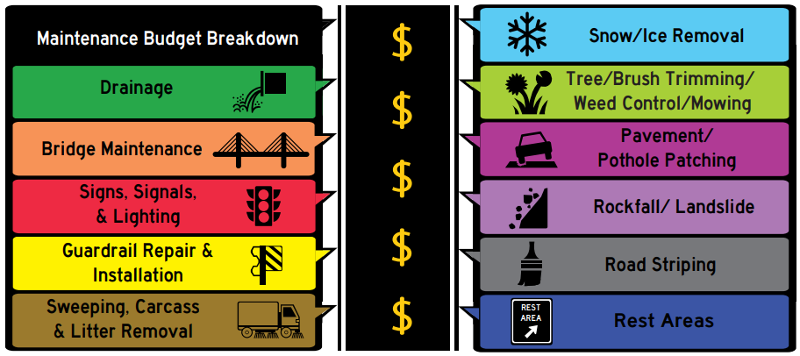
Maintenance
Major Maintenance Budget Categories

Slide 13
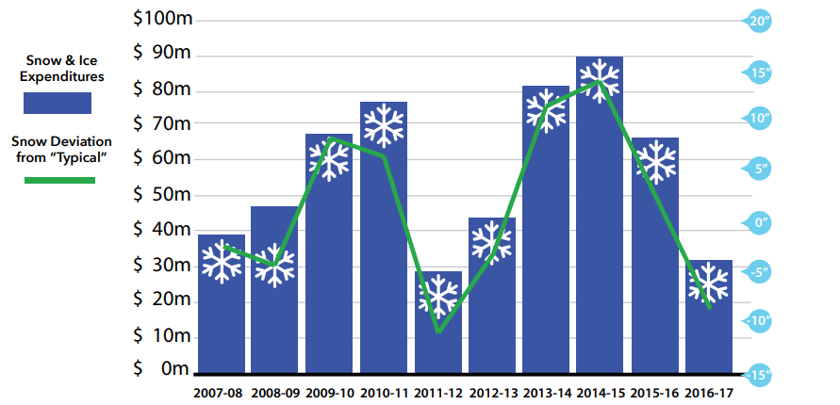
Maintenance
Snow and Ice Expenditures Mirror Winter Severity

Slide 14
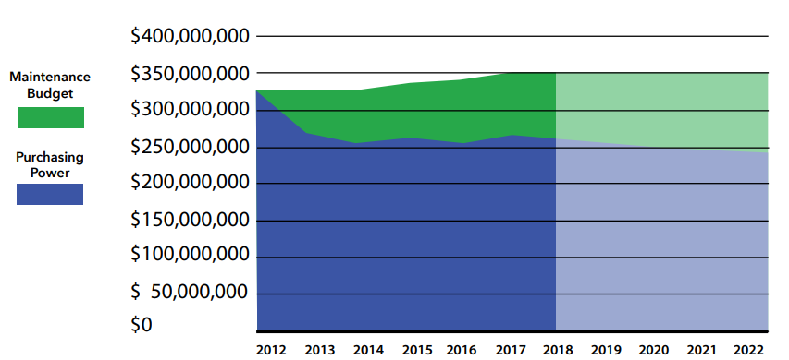
Maintenance
Impact of Inflation on Maintenance Budget
$63 MILLION
IN LOST ANNUAL PURCHASING POWER

Slide 16
CONTACT INFORMATION
Tamra Wilson, Chief District Engineer
606-677-4017

