Slide 1
Mark Day, PE AAE
Director of Development and Facilities
Immediate Past Chair, KBT
www.bluegrassairport.com Lexington, KY

Slide 2
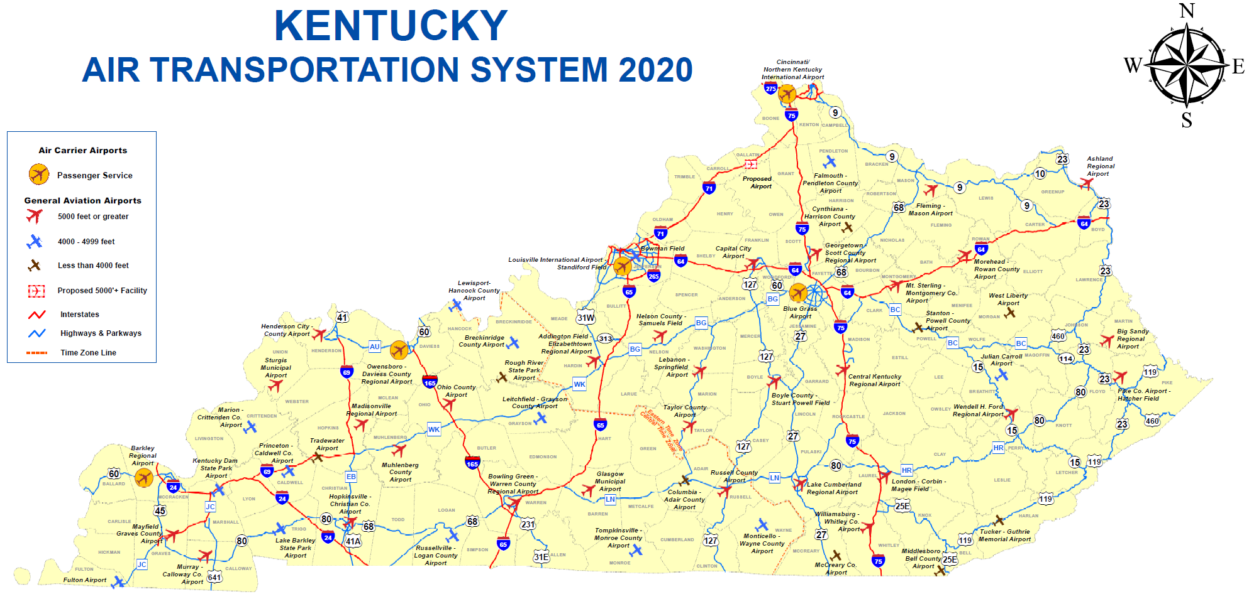

Slide 3
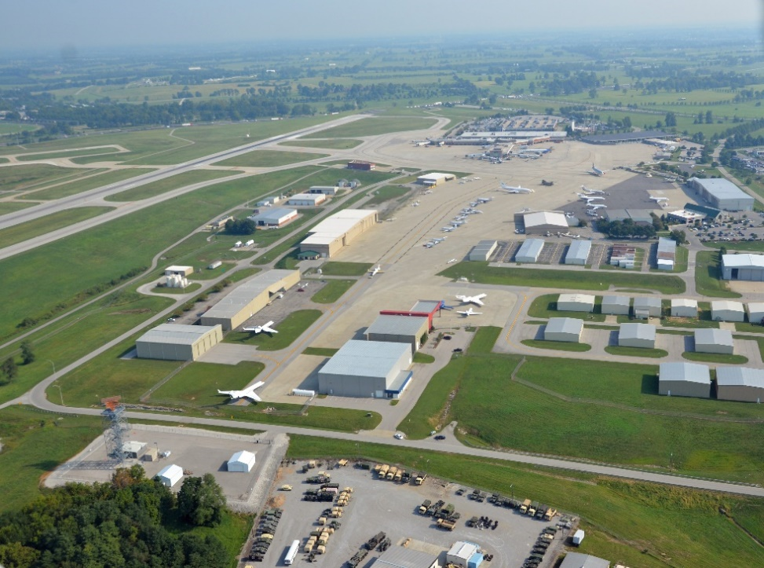
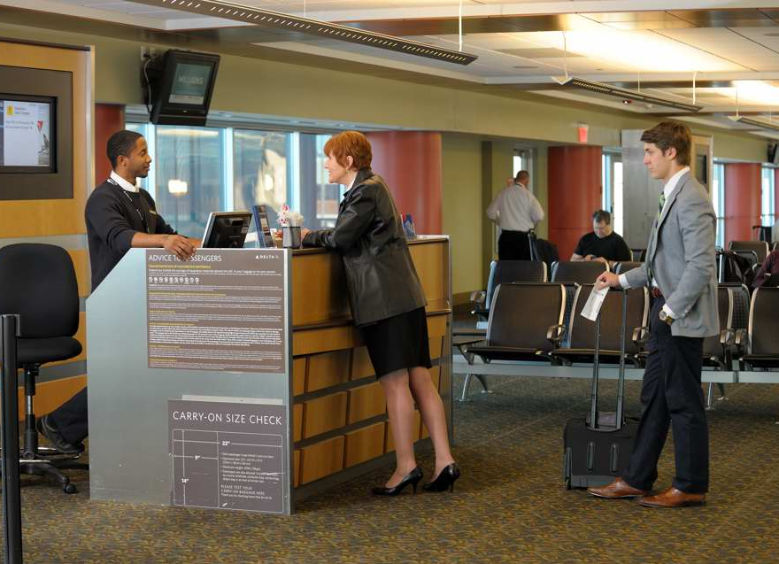
Airport Categories
Commercial and/or Cargo Service
General Aviation with limited Commercial Service
General Aviation
Airport Services
Passenger
Cargo
Economic Development
Business HQ
Flight Schools
Maintenance
Military

Slide 4
AIRPORT CAPITAL FUNDING
Safety
Security
Buildings
Pavement
Federal Aviation Administration
Kentucky Department of Aviation
City and Country Governments

Slide 5
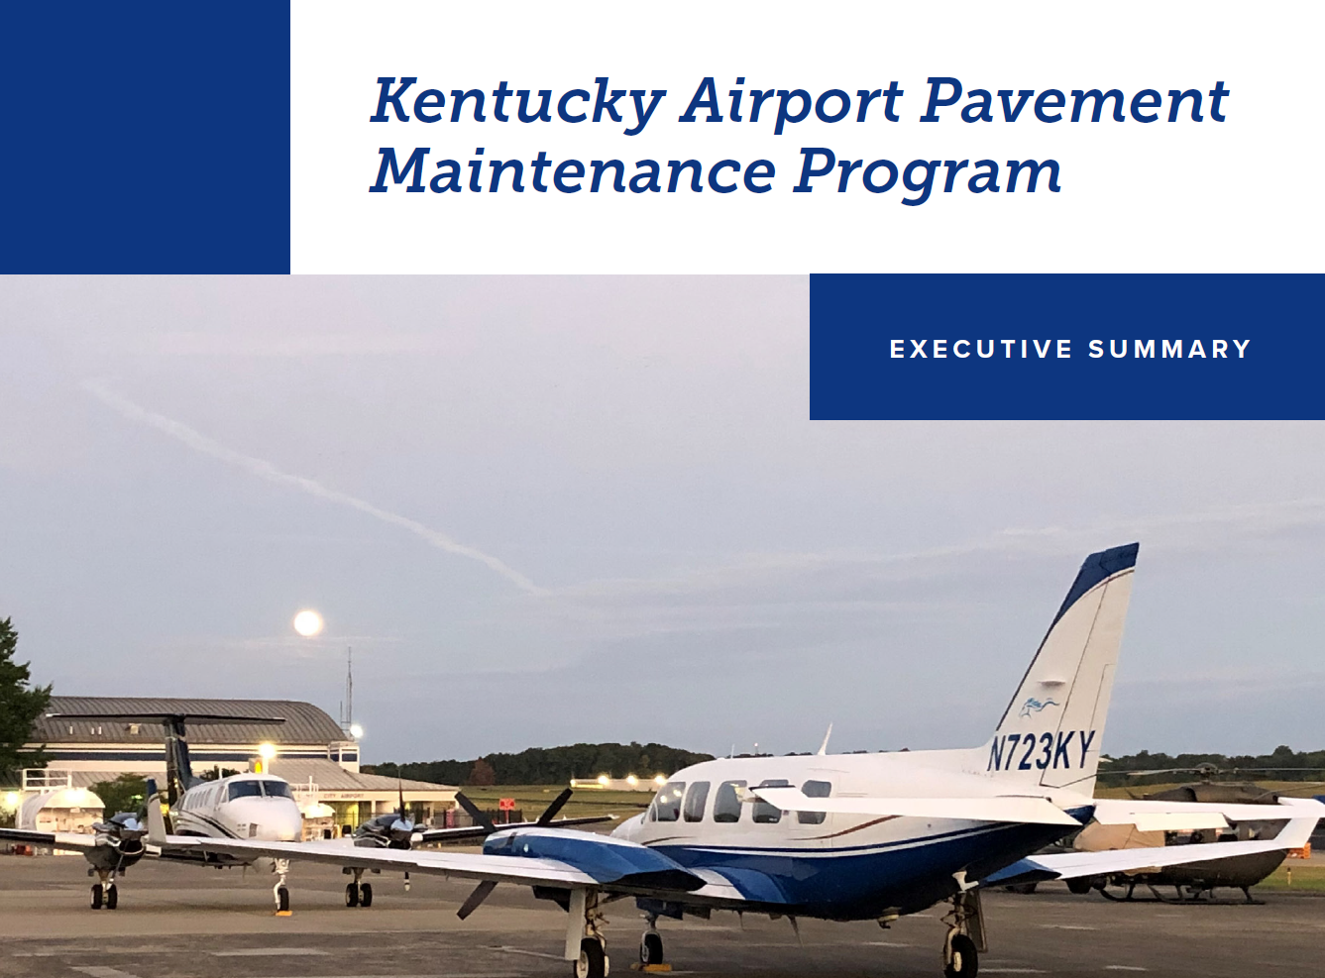
PAVEMENT, PAVEMENT, PAVEMENT
Airport Pavement Maintenance Program
7 Year Projection
$120 Million in maintenance
12 general aviation airports alone have projects between $3M-$13M
$10 Million annual need to prevent further decline

