Slide 1
Aviation Maintenance Technology
Reach new heights with FAA-certified training in the inspection, repair, and service of aircraft and engines at SCC.

Slide 2
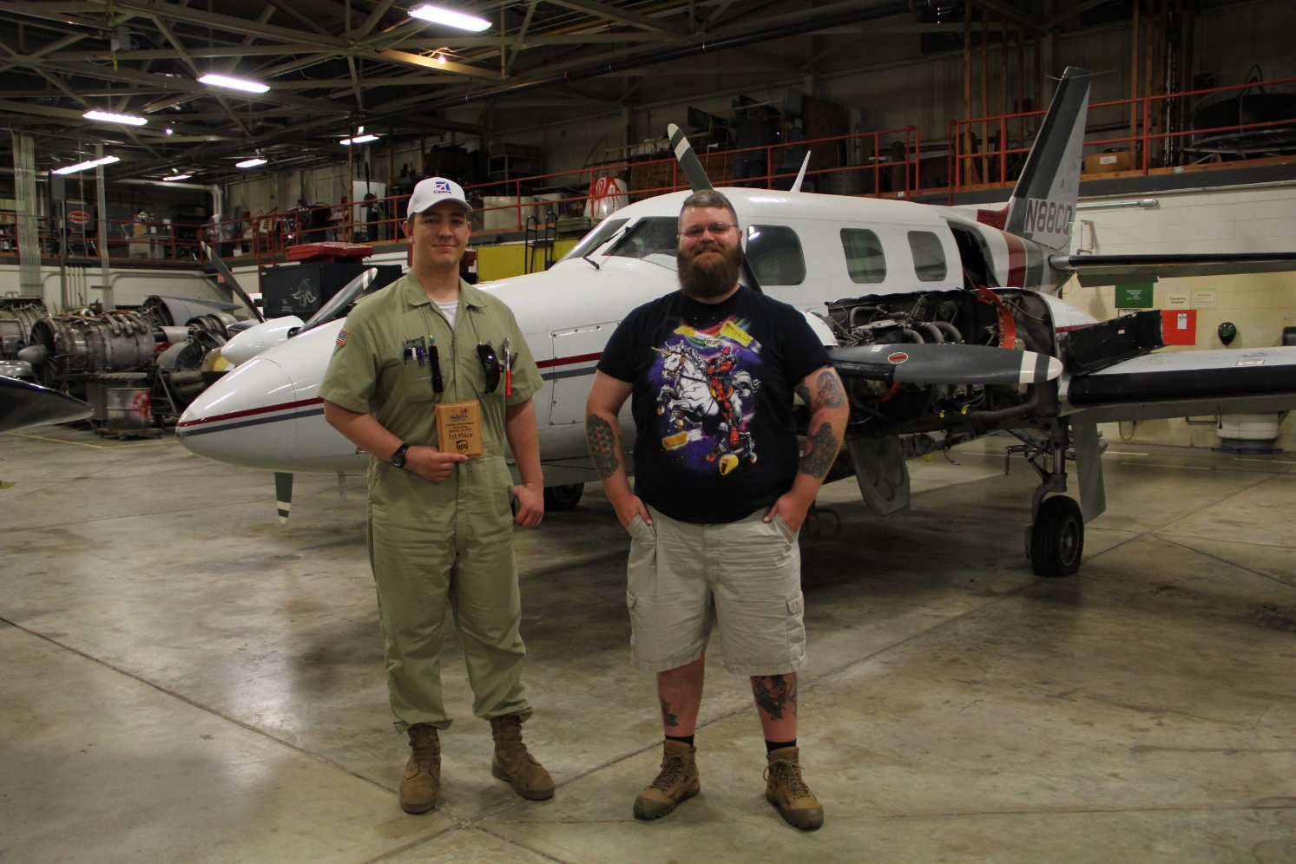
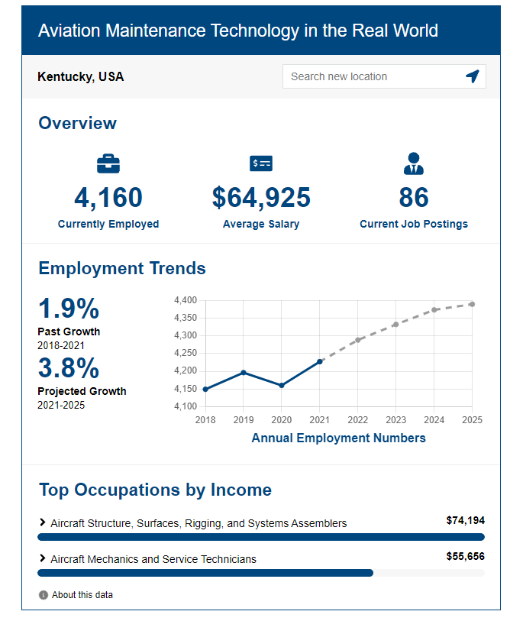

Slide 3
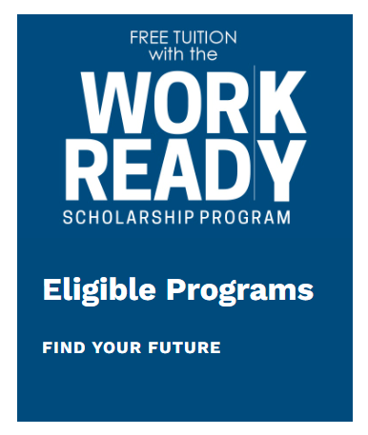
Degree, Diploma or Certificate Options
Certificates
Airframe Maintenance Technician (37-46 credit hours)
Power Plant Maintenance Technician (37-46 credit hours)
Diploma
Airframe and Power Plant Maintenance (76 credit hours)
AAS Degree
Aviation Maintenance Technology (76 credit hours)
AMT program is eligible under the Work Ready Scholarship

Slide 4
Somerset Community College is playing a strategic role in addressing the growing demand for skilled workers through our career and technical programs, specifically in Aviation Maintenance Technology.
Enrollment in SCC’s Aviation Maintenance Technology is steadily rising.
SCC recognized the need and added more offerings and classroom space to accommodate the needs of our students and community.
Now offering additional evening classes to fulfill the workforce needs.

Slide 5
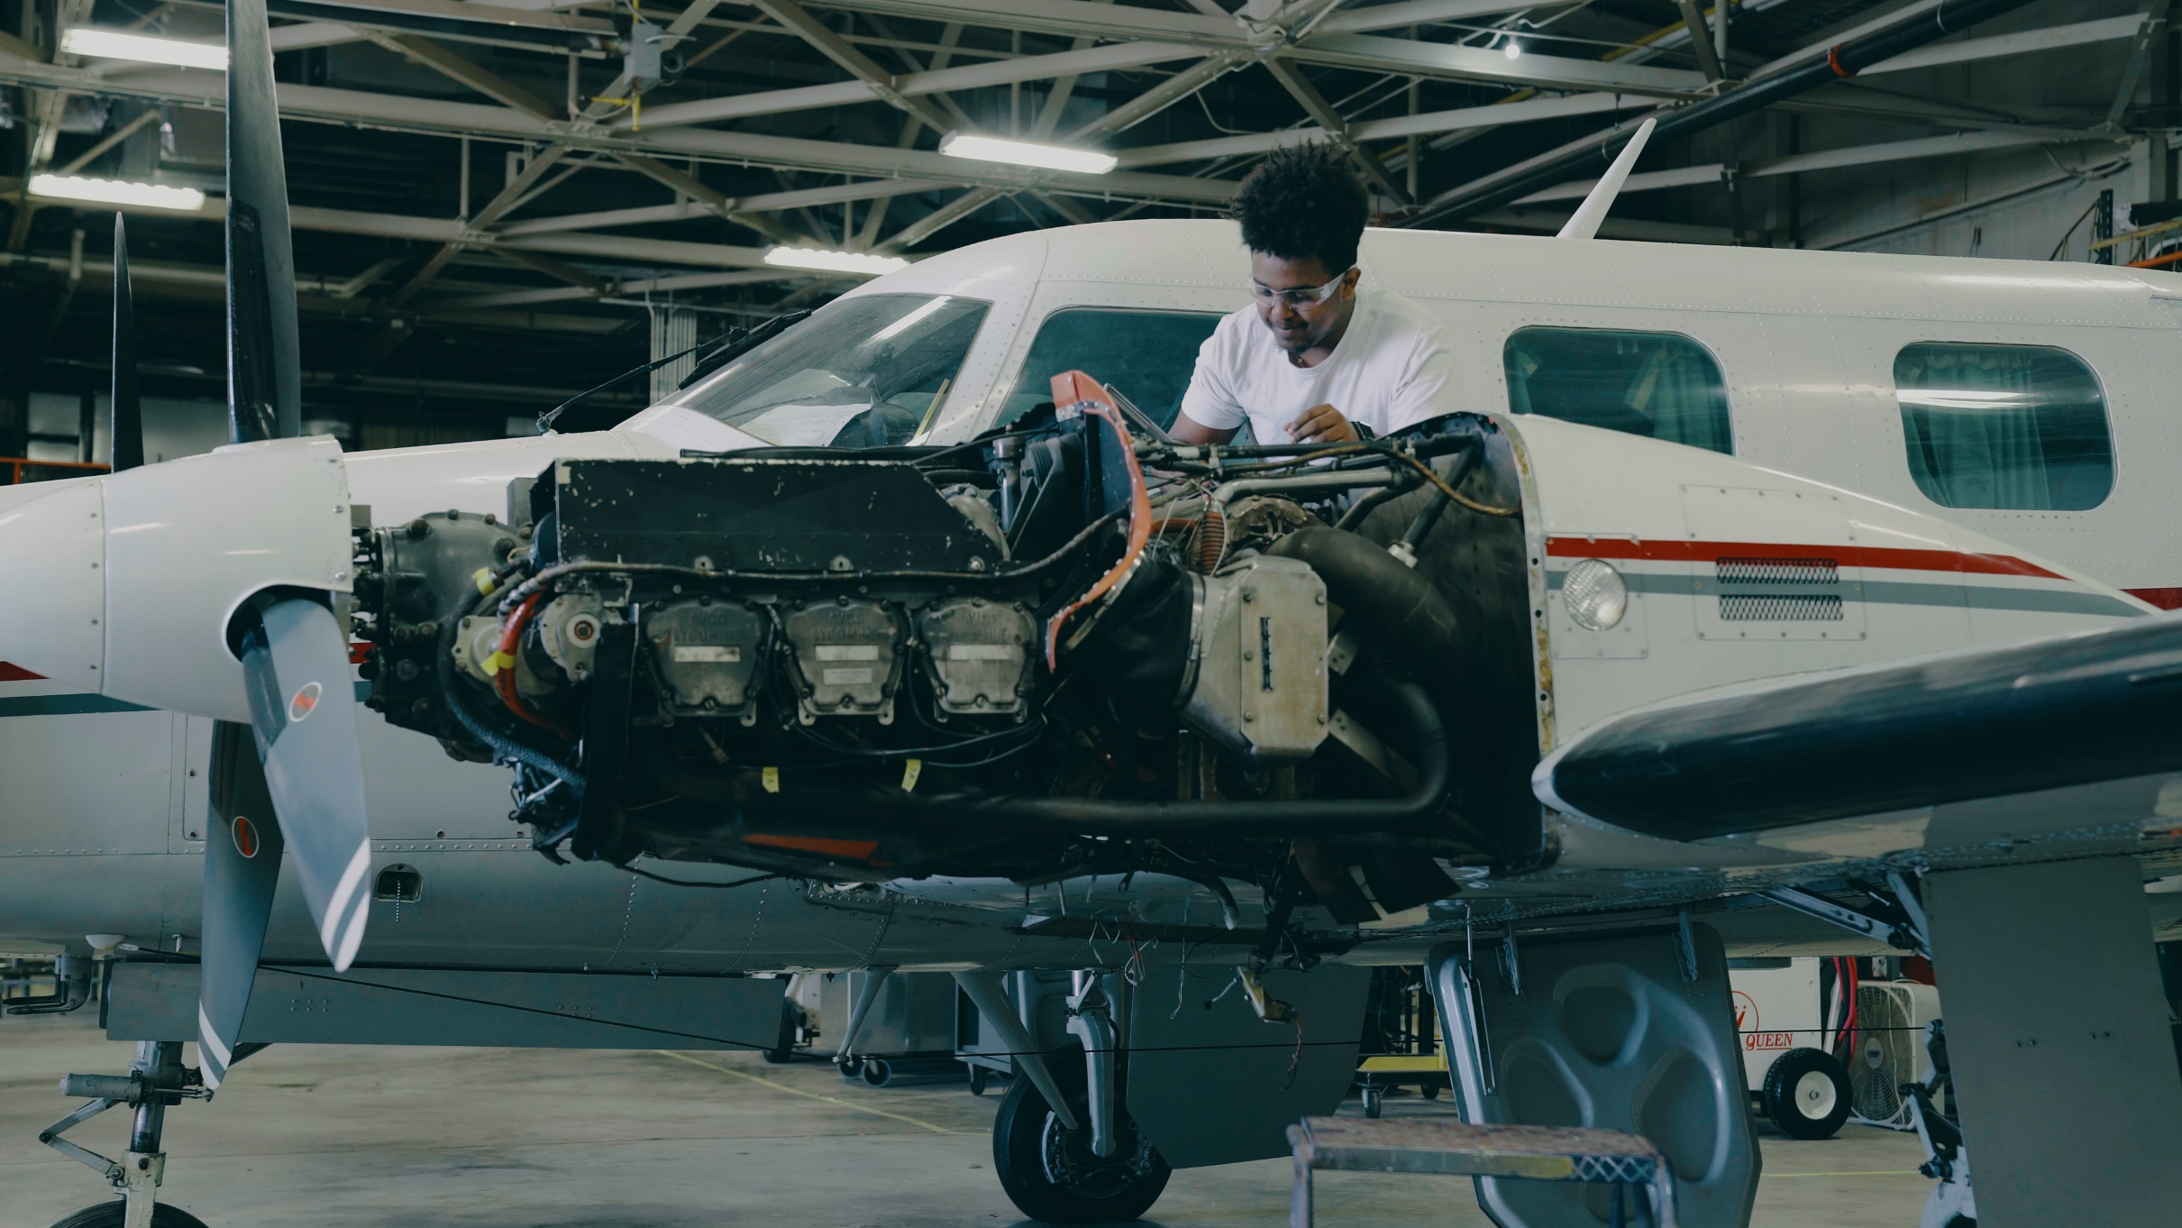
Veterans Accelerated Learning for Licensed Occupations Initiative, known as VALLO, assists veterans during the transition into civilian life by helping them get Federal Aviation Administration certified.

Slide 6
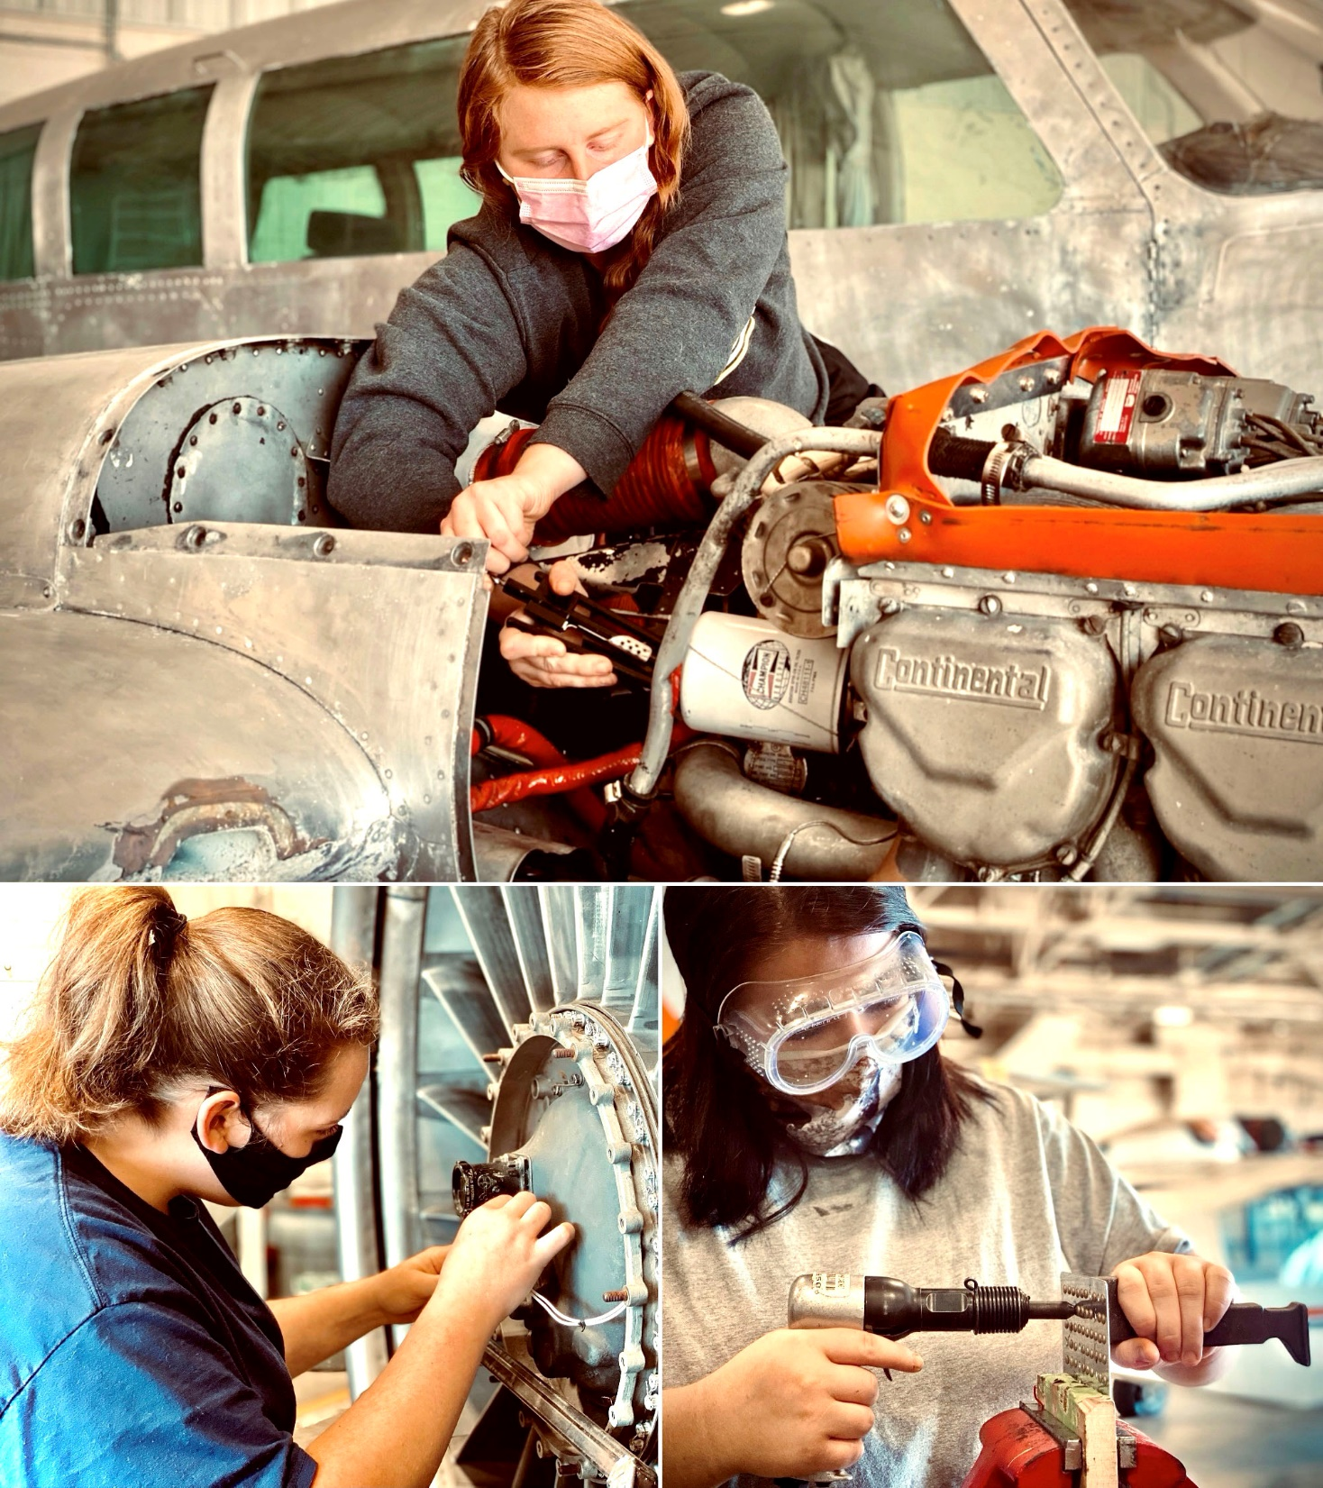
“The number of females involved in the aviation industry has steadily increased and women can be found in nearly every aviation occupation today.”
https://www.wai.org/resources/waistats

Slide 7
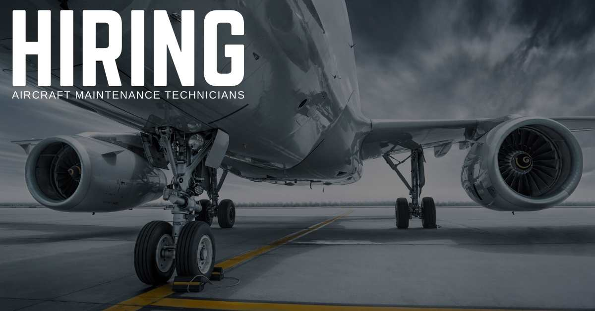
Employers Hiring our AMT Grads:
PSA Airlines
FEAM MRO Maintenance repair and Overhaul
Lockheed Martin
Thoroughbred Aviation
Medical Helicopter Bases all over KY
Wheels Up
Private Airline Companies

Slide 8
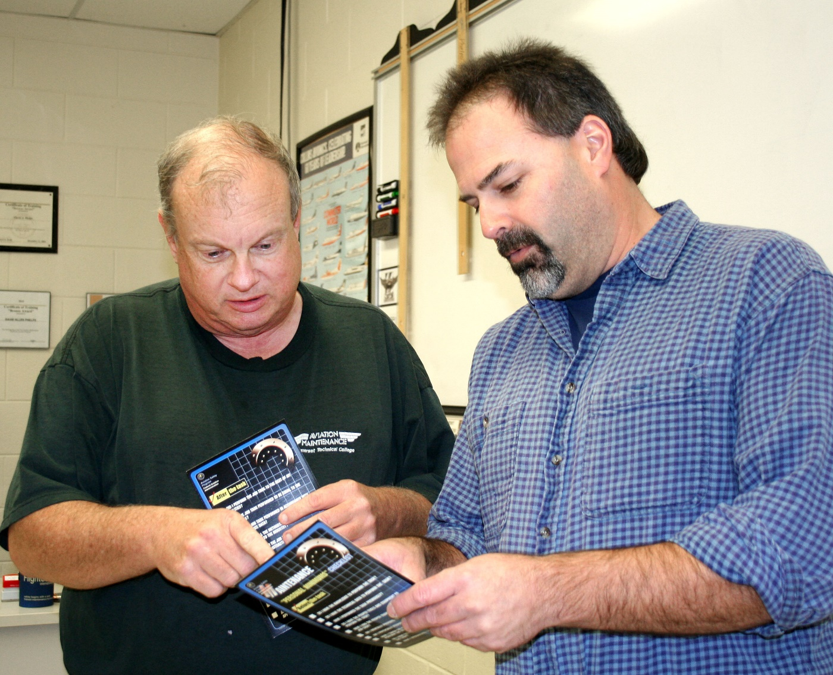
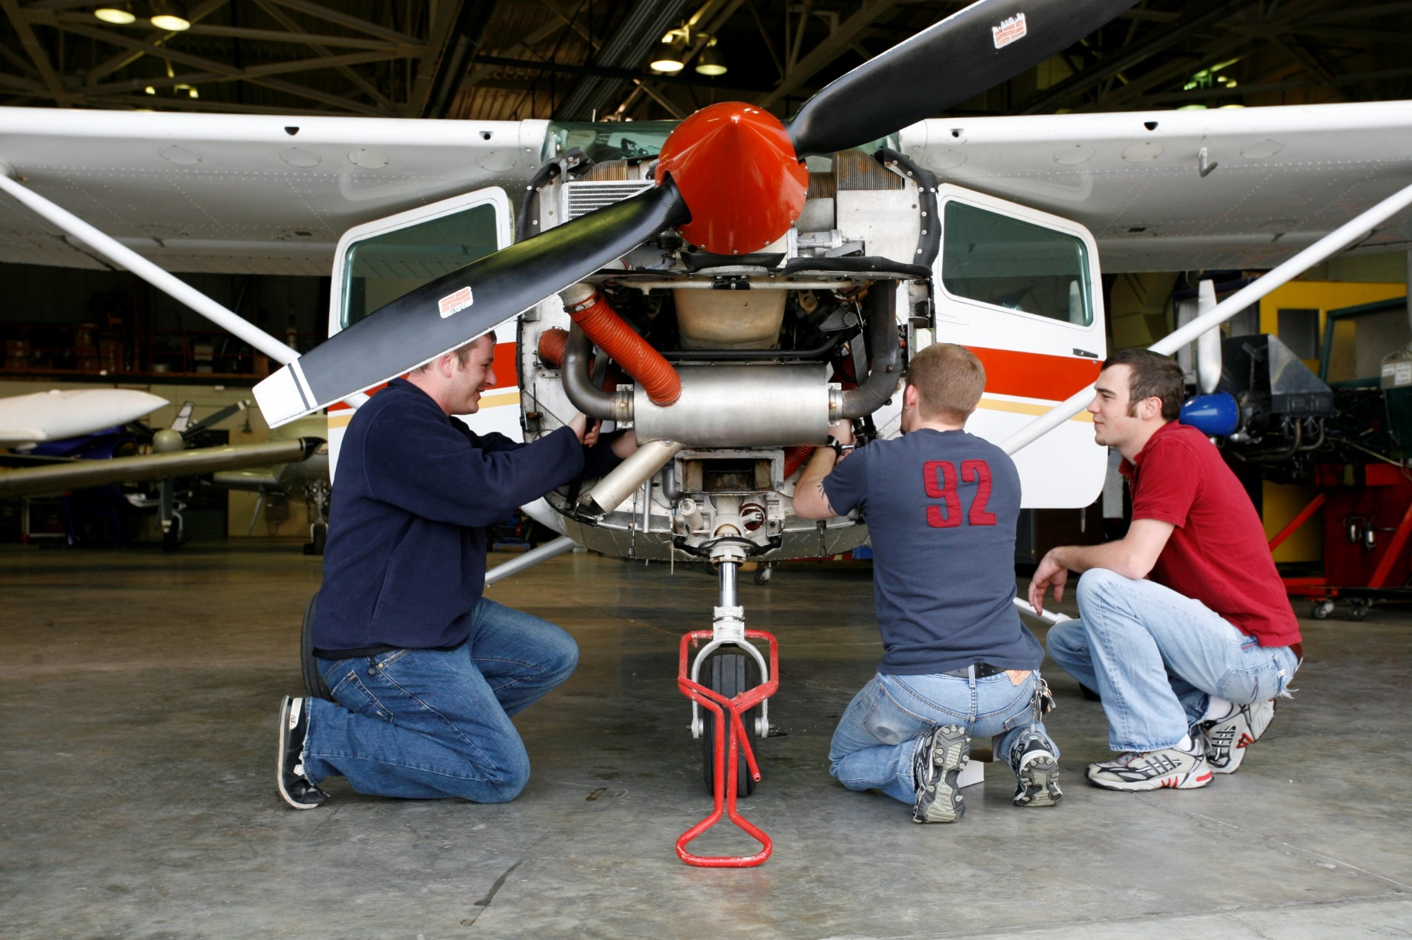
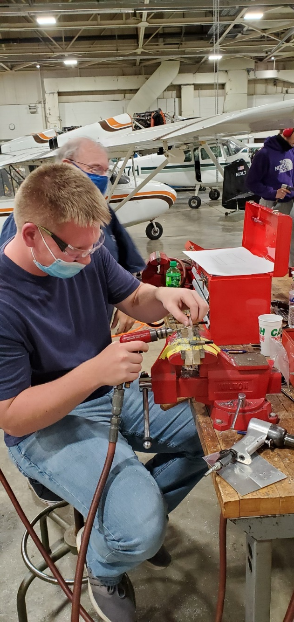
SCC Instructors are key to the success of the program
SCC Aviation Instructors are top notch with over 60+ years of real world experience.

Slide 9
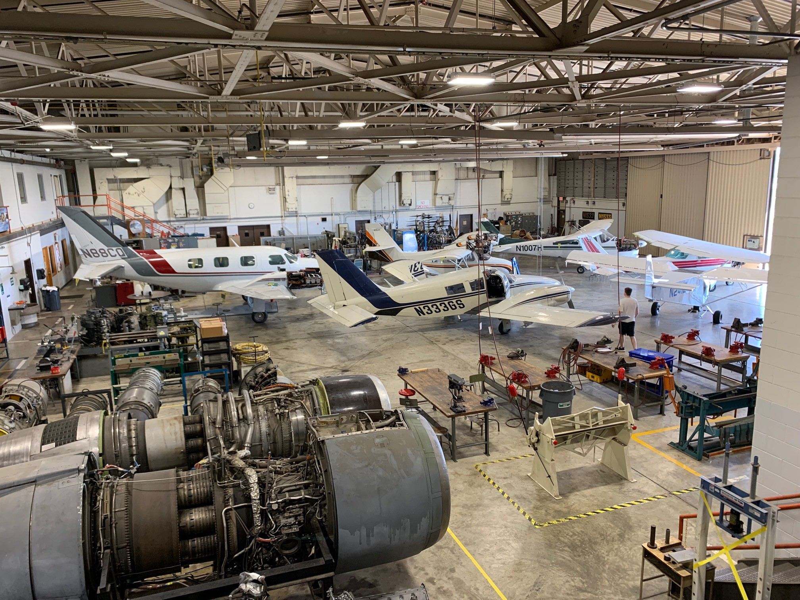
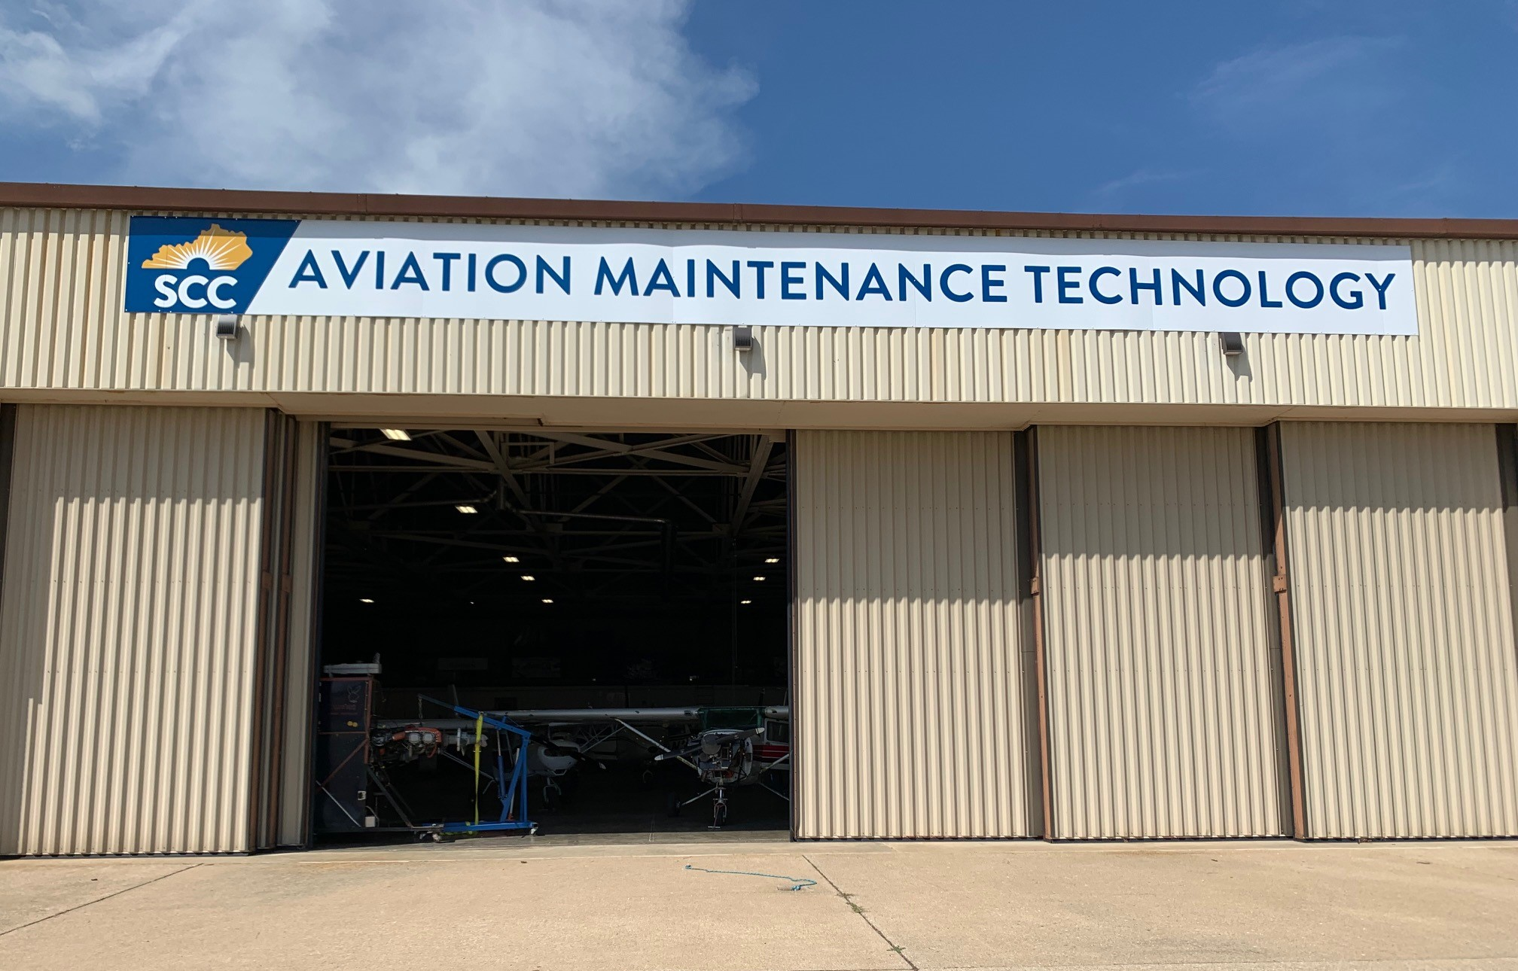
Aviation Maintenance Technology Hangar

Slide 10
Thank you
Questions?
Carey Castle
President/CEO
carey.castle@kctcs.edu
Chris Hall
Career & Technical Department Chair
chris.hall@kctcs.edu

