Slide 1
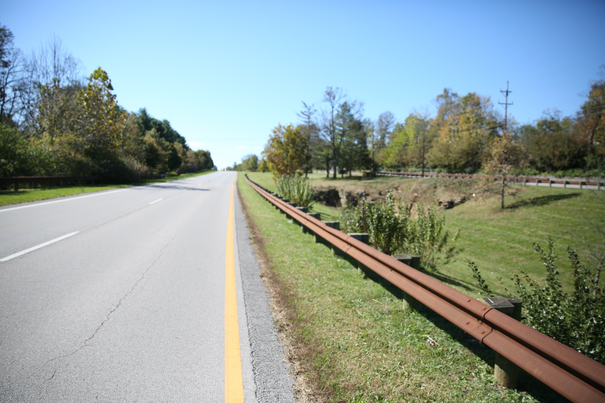
KY Office of Highway Safety Update
2021 IJC on Transportation
TRANSPORTATION.KY.GOV

Slide 2
First things first…
DON’T participate and drive!
TRANSPORTATION.KY.GOV

Slide 3
Where are we today?
TRANSPORTATION.KY.GOV

Slide 4
It’s about people.
Safety isn’t really about numbers…
TRANSPORTATION.KY.GOV

Slide 5
KY’s Strategic Highway Safety Plan 2020-2024
Bold GOAL – Under 500 Highway Deaths per year by 2024
Focus on Prevention
Six Emphasis Areas
TRANSPORTATION.KY.GOV

Slide 6
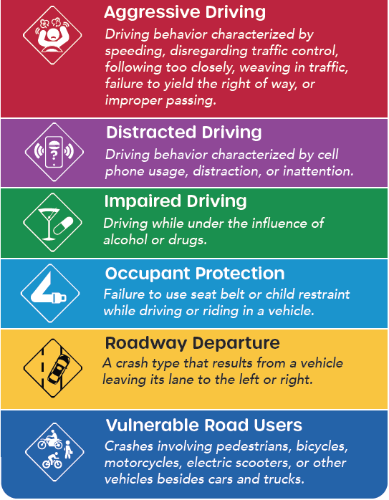
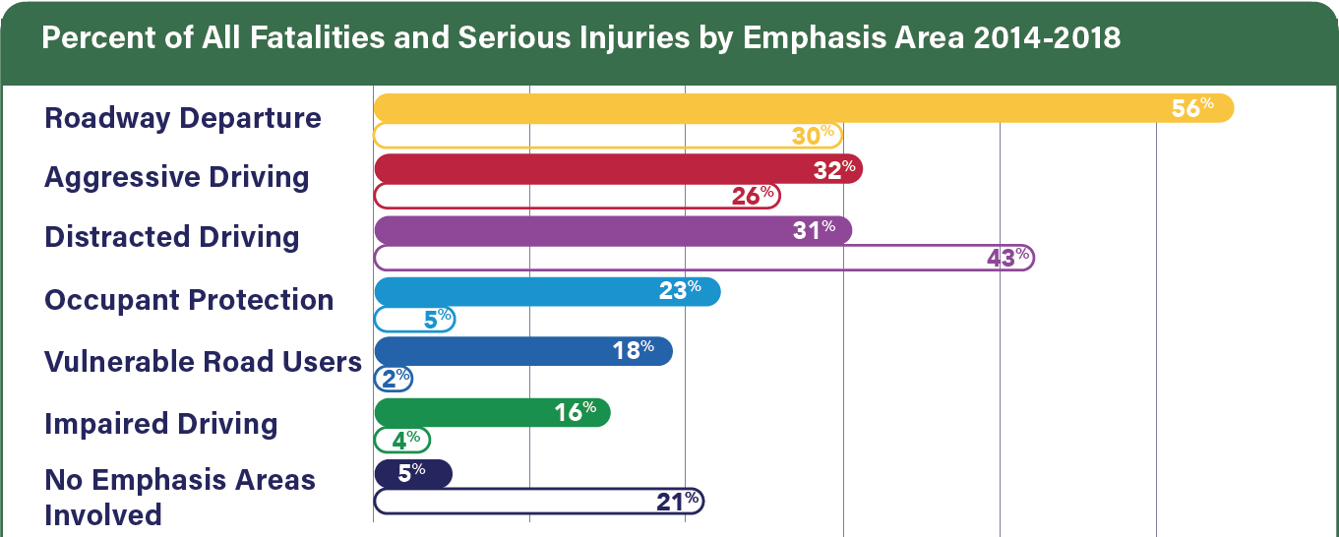
Emphasis Areas
TRANSPORTATION.KY.GOV

Slide 7
Resources
SAFEKY – KY’s 2020-2024 Strategic Highway Safety Plan
KY’s Plan to save lives and prevent serious injuries resulting from transportation crashes
SAFE KY - 2020-2024 SHSP
TRANSPORTATION.KY.GOV

Slide 8
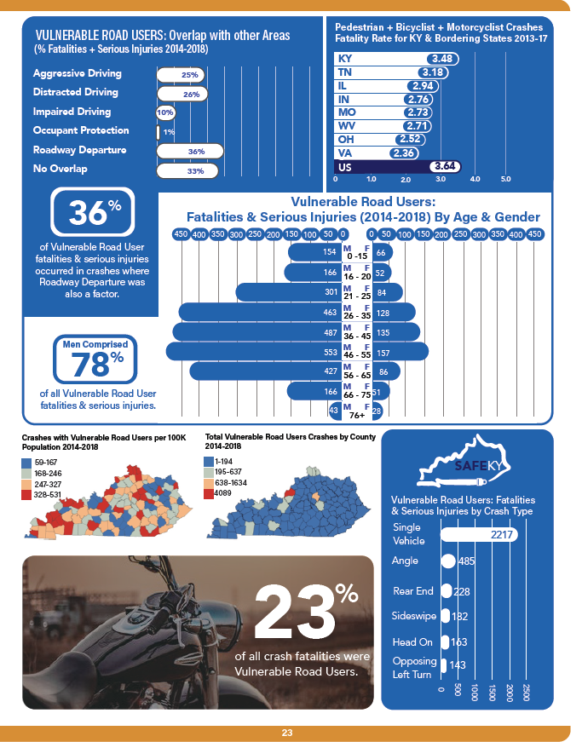

Slide 9
Motorcycle Rider Education Program
The Motorcycle Rider Education Commission is now administratively attached to the KOHS
Resources for rider training
https://ride.ky.gov/
TRANSPORTATION.KY.GOV

Slide 10
Vulnerable Road User Task Force
KYTC is working with stakeholders to develop action plans for each of our new emphasis areas.
The Vulnerable Road User (VRU) Task Force is going to meet this month to continue work on the draft action plan which was developed following a workshop earlier in the year.
TRANSPORTATION.KY.GOV

Slide 11
Bike, Walk and Drive Safe Kentucky!
KOHS is currently developing a campaign for safe biking, walking and driving.
The campaign focuses on what everyone can do to contribute to safer transportation for bicyclists and pedestrians.
TRANSPORTATION.KY.GOV

Slide 12
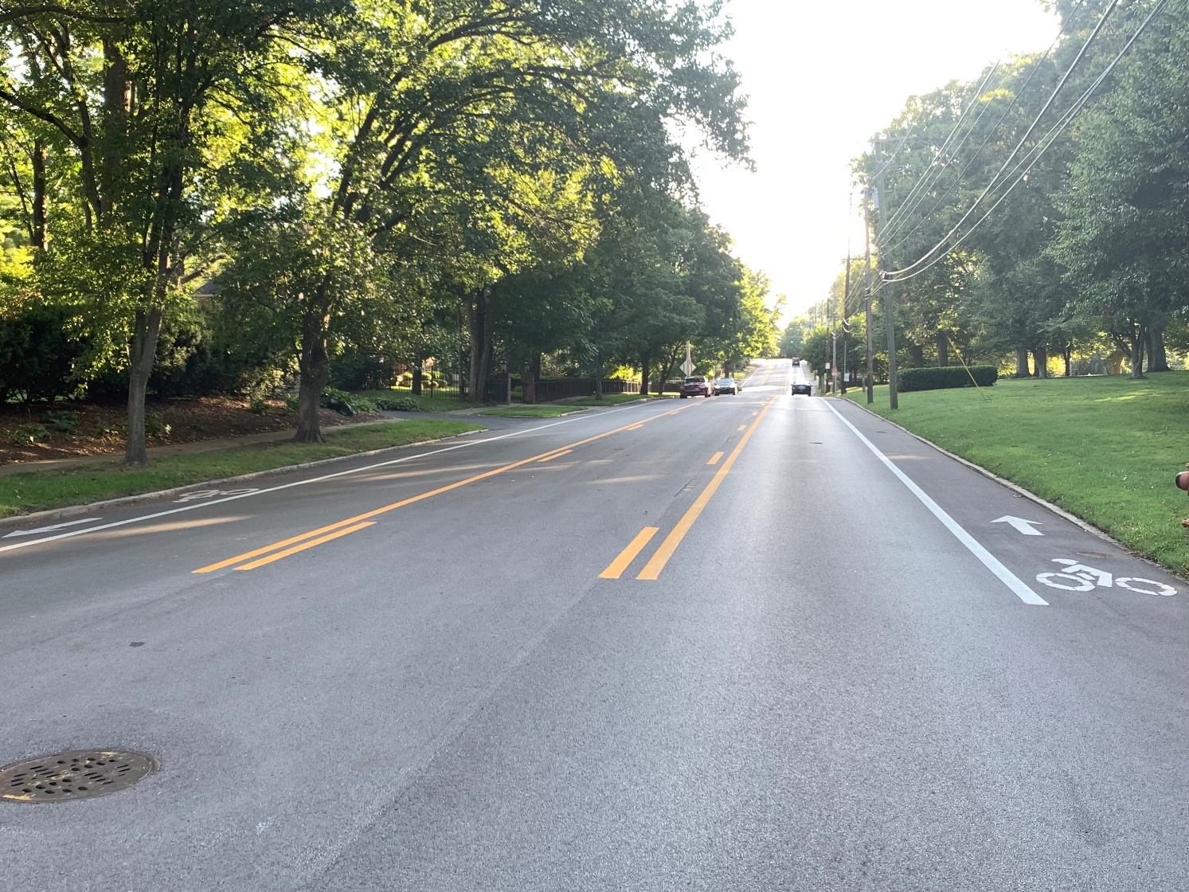
Upcoming Opportunities
KOHS is partnering with NHTSA to perform a Pedestrian / Bicyclist Assessment this fall.
Working with the Kentucky Transportation Center on multiple research projects related to improving safety and access for bicyclists and pedestrians.
TRANSPORTATION.KY.GOV

Slide 13
Partner with KOHS on the “Three I’s”
“I” can help by getting:
INFORMED about safety
INVOLVED in improving safety
INTENTIONAL about the example I set
TRANSPORTATION.KY.GOV

Slide 14
Thank You!
Jason Siwula
Assistant State Highway Engineer
Kentucky Transportation Cabinet
Jason.Siwula@ky.gov
Facebook: kyhighwaysafety
Twitter: @kyhighwaysafety
Instagram: kyhighwaysafety
TRANSPORTATION.KY.GOV

