Slide 1
Kentucky EV Charging Program Update
Interim Joint Committee on Transportation
June 6, 2023, 1:00 PM

Slide 2
Agenda
01
02
03
04
Federal Funding for EV Infrastructure
Kentucky’s
EV Charging Program
Kentucky’s
EV Charging Program Implementation
Questions and Discussion

Slide 3
Federal Funding for EV Infrastructure

Slide 4
Federal Funds for EV Infrastructure
Federal Funds for EV Infrastructure
2021 Infrastructure Investment and Jobs Act (IIJA)
also known as Bipartisan Infrastructure Law (BIL)
National Electric Vehicle Infrastructure (NEVI) Program
NEVI Formula Funds
NEVI Discretionary Grant Funds
Kentucky’s Share - $69.5M
$5.0 Billion Nationally (over 5 years)
Competitive Grants
$2.5B Available Nationally (over 5 years)
Guidance Issued on March 14, 2023

Slide 5
EV Charging Program

Slide 6
EV Charging Program Plan
2022 Plan secured first $25 million in NEVI formula program funds (FY 22 & 23)
Plan will be updated this summer once USDOT issues further guidance
Updates are expected to enhance
Contracting
Continued Stakeholder Engagement
Equity
Cybersecurity
Update will secure ~$15 million for FY 24

Slide 7
Stations on Federally Designated AFCs (Interstates and Parkways)
<1 mile
<1 mile
<50 miles
<50 miles
<50 Mile Spacing; <1 Mile From Corridor
At Least (4) 150 kW DC Fast Charging Ports (600kW Total)
Open to General Public 24/7

Slide 8
Potential NEVI Funded DCFC Station Locations
KYTC will not own, operate, or maintain stations
Industry partners will be responsible for
Construction/Installation
Ownership
Operations
Maintenance
DCFC = direct current fast charging

Slide 9
EV Charging Program Expenditures Potential Example Site
Example total cost of $1.8M for a potential site (construction and 5 years of operations & maintenance), based on this estimate:
$1.44M (80%) in the first 15 months after Notice to Proceed (NTP) to construct the station
$1.15M (Max. Federal Share, 80%)
$290,000 (Min. Site Developer Match, 20%)
Then $360,000 (20%) over five years to operate and maintain the station
$288,000 (Max. Federal Share, 80%)
$72,000 (Min. Site Developer Match, 20%)
Note: Substantial inflation remains an issue, coupled with ongoing uncertainty about capital and operating costs for NEVI compliant stations

Slide 10
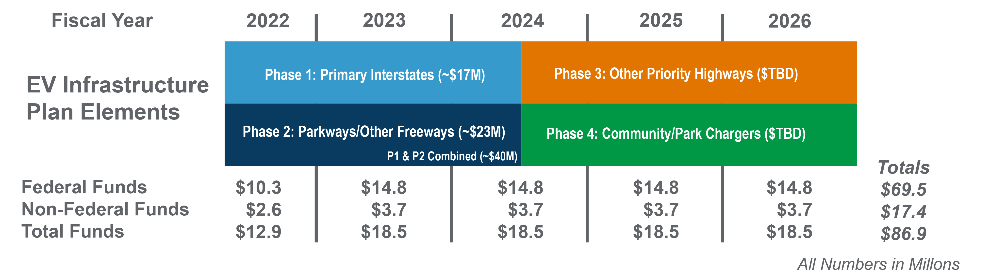
Expected Federal Funds
Projected Build-Out of AFCs by 2025

Slide 11
EV Charging Program Implementation

Slide 12
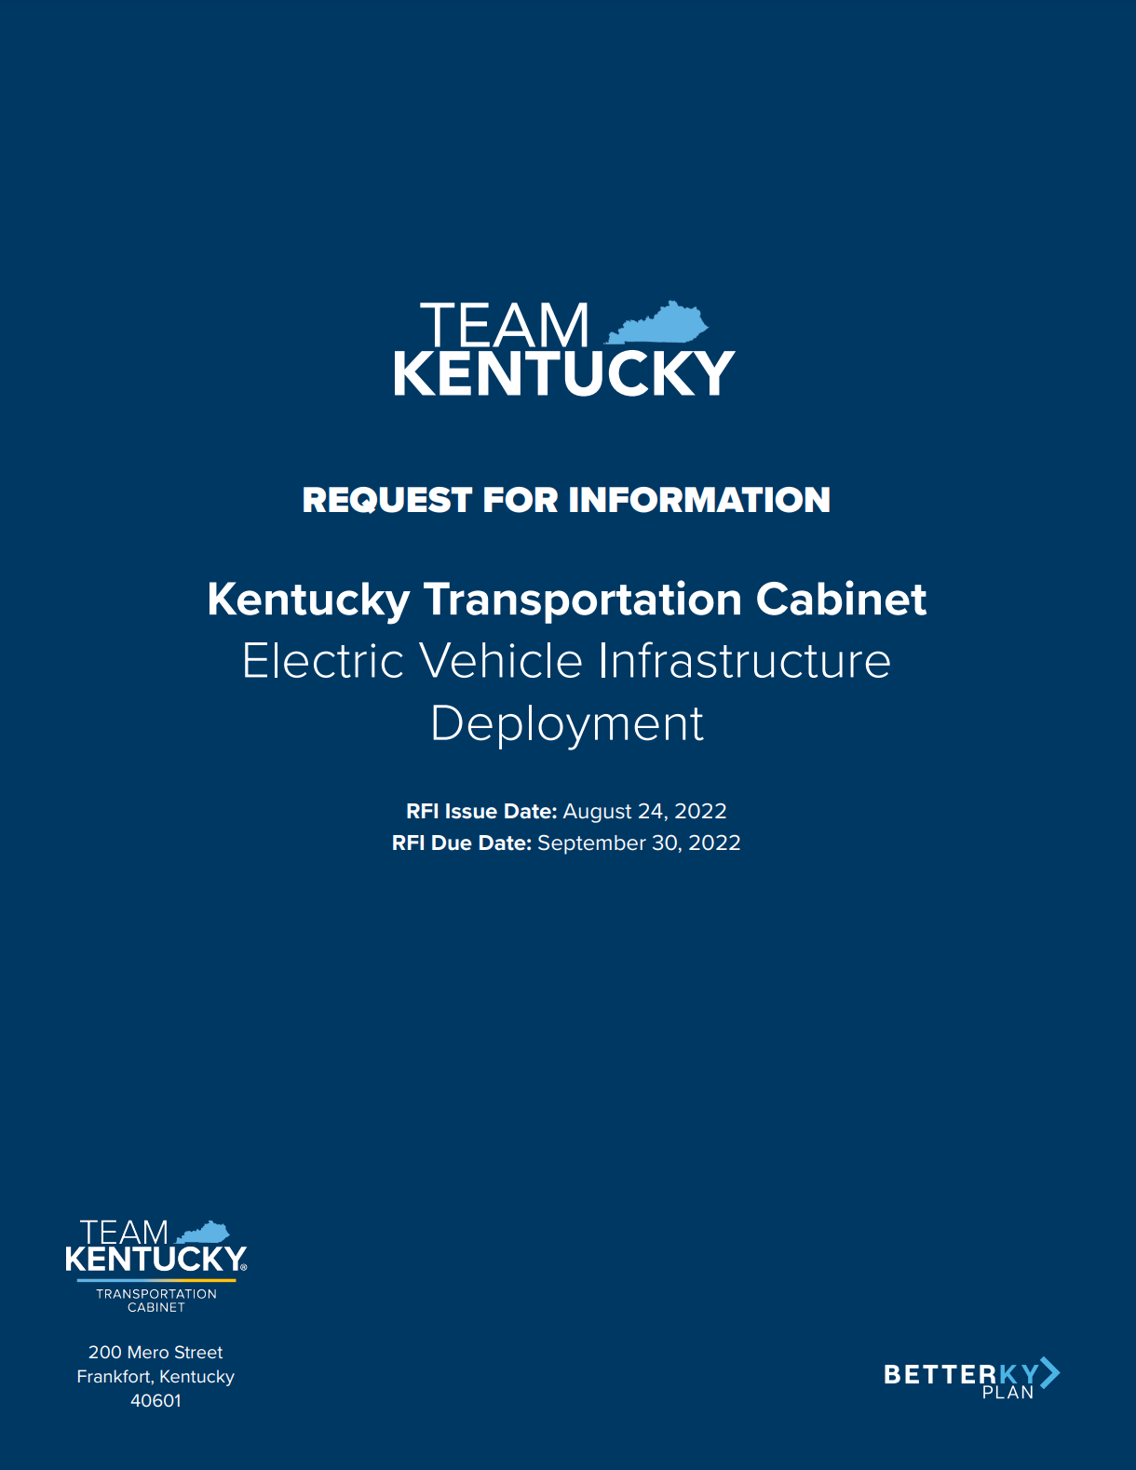
Request for Information (RFI)
Issued August 24, 2022
Sent to potential EV industry partners
Solicited input on potential procurement and contracting methods and issues
Deadline was September 30, 2022

Slide 13
RFI Engagement
Key themes
Utility coordination
Flexibility in procurement / contracting / implementation
Use NEVI funds to subsidize operations & maintenance
Most recommended a competitive site-based procurement
Especially important for rural areas
Potential risks and challenges
Supply chain and lead times
Rural operational costs and utilization levels
Permit review timelines
Utility and site-host coordination
Industry leaders generally are willing to provide the 20% match

Slide 14
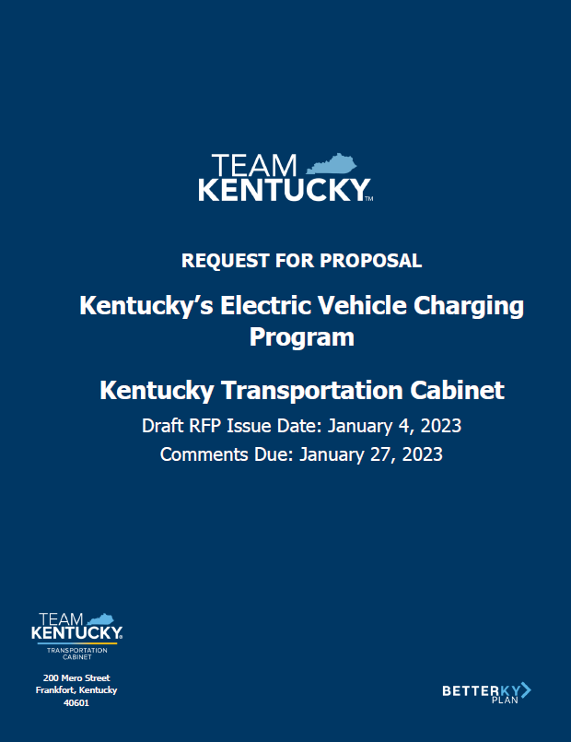
Draft Request for Proposals (RFP)
Draft RFP issued January 4, 2023, comments due January 27, 2023
More than 150 comments were received to help refine the Final RFP
Requests proposals to construct, own, operate and maintain new NEVI-compliant DC fast charging stations across Kentucky

Slide 15
First of Its Kind “Speedbumps”
Final RFP release date is anticipated for June 2023
Extension accommodated FHWA’s review process
Kentucky is expected to be about 10th in issuing our RFP

Slide 16
RFP Requirements
Contract vehicle will be through KYTC purchasing, compliant with Federal design-build procurement regulations
Bonding, insurance, and Federal requirements
KYTC will provide extensive oversight and has an inspection contract
Maximum return on investment over the 5-year program period

Slide 17
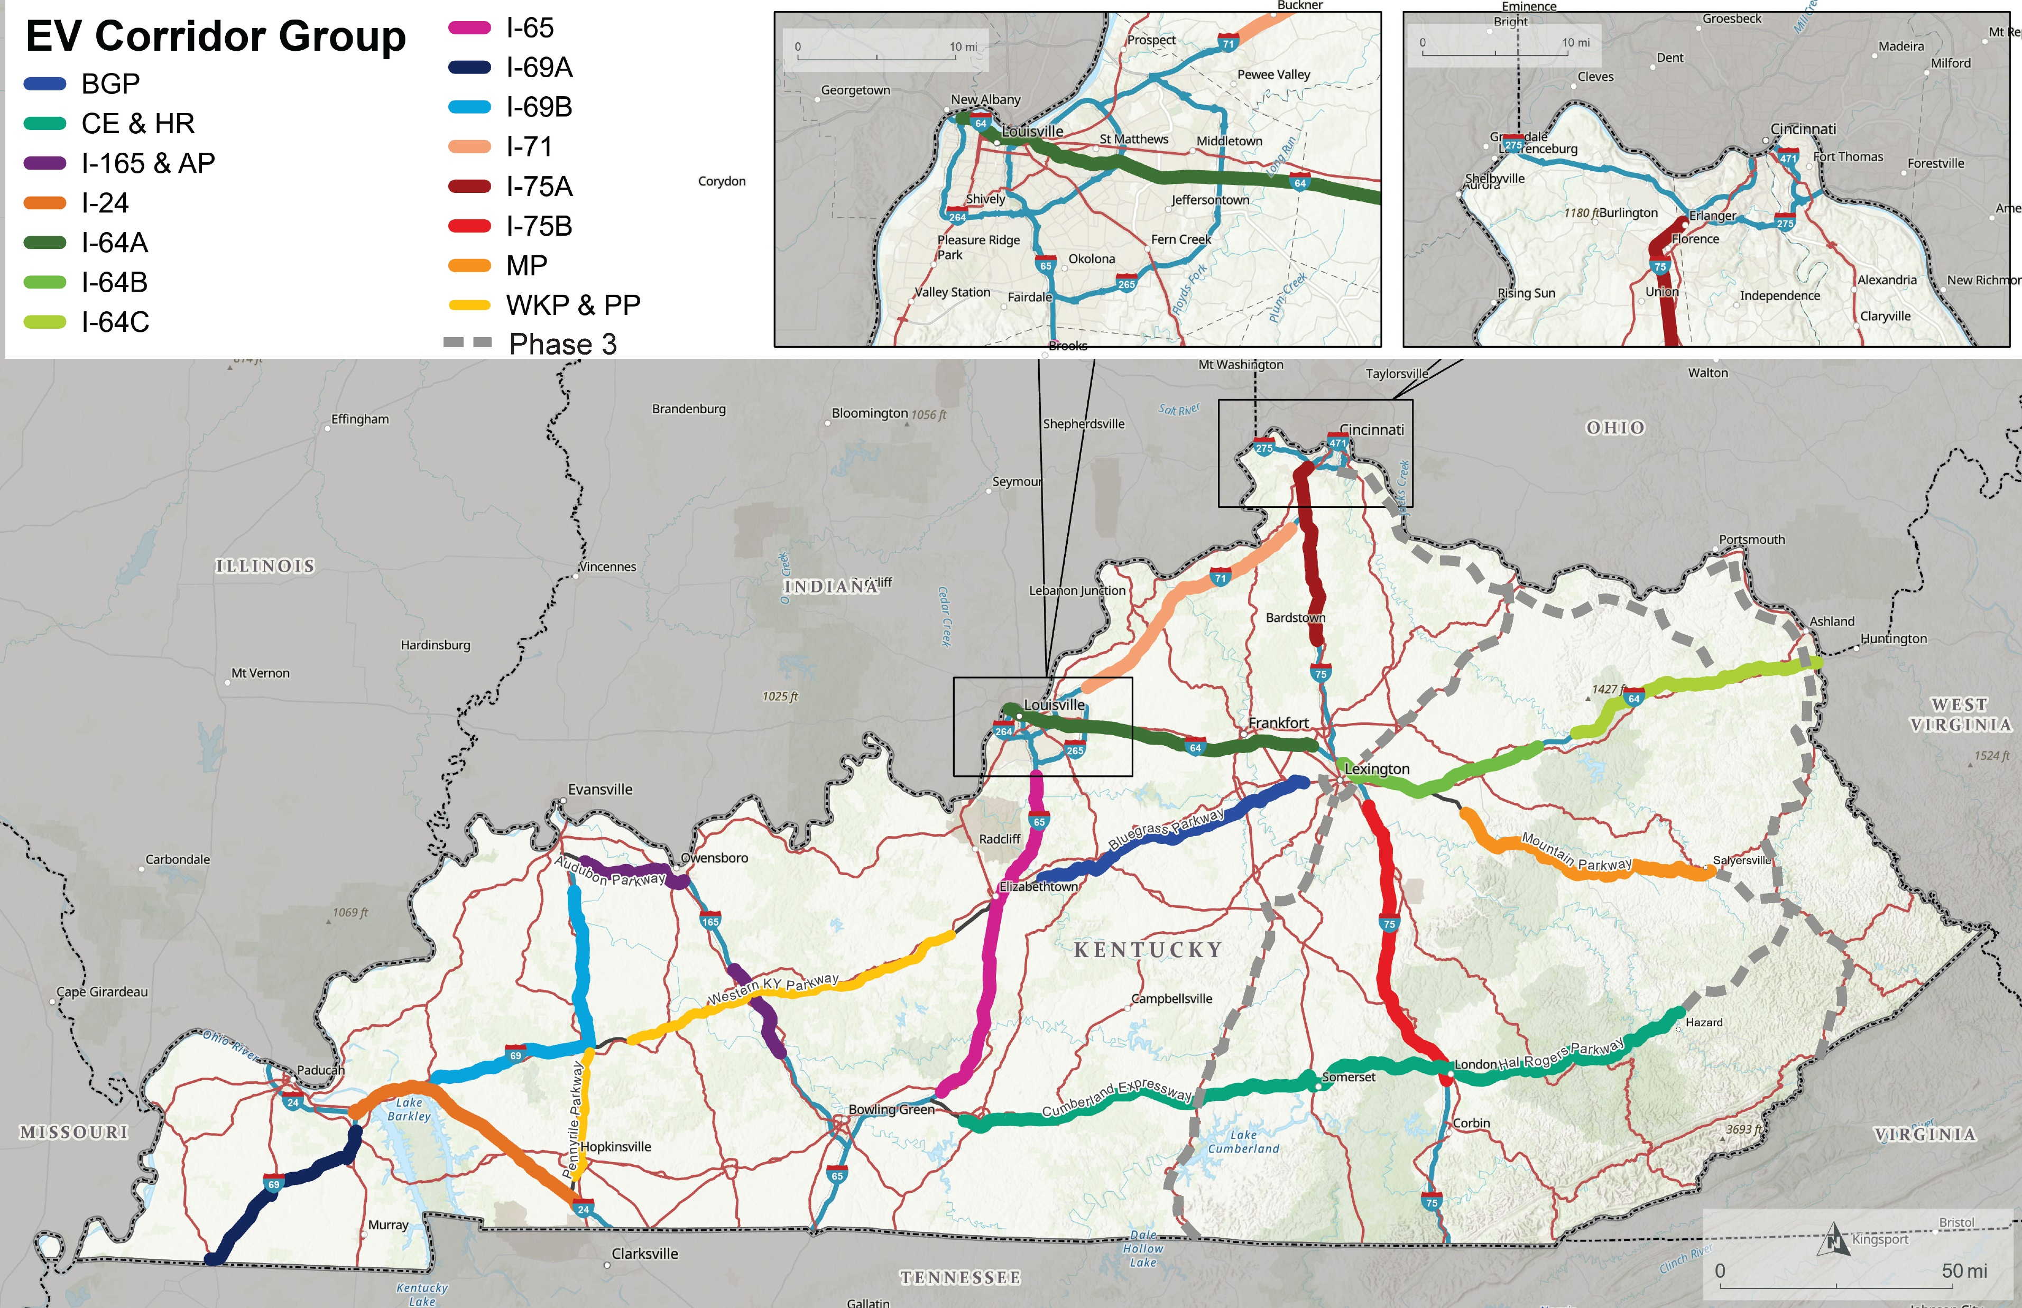
RFP EV Charging Corridor Group Map

Slide 18
RFP Scoring Criteria
Proposal consists of 3 parts:
Administrative Proposal (no points)
Technical Proposal
Cost Proposal
"Best-value" selection that considers both technical and price
Scoring Category | Available Points
Technical Proposal | 1,400
Experience, qualifications, and technical approach | 600
Proposed user experience | 250
Equity and rural considerations | 150
Site location | 400
Technical Proposal Additional Points | 200
Site considerations | 60
Experience, qualifications, and technical approach | 80
Proposed user experience | 60
Cost Proposal | 600
Total Subsidy Requested | 600
Total Proposal Points | 2,200

Slide 19
Current 2023 Schedule
Feb. 21
Networking Event
Early June
Final RFP Release
Jan. / Feb.
Draft RFP Release and Response to Comments
Late June
Stakeholder Meeting
Spring
First of its Kind “Speedbumps”
Jan.
Feb.
March
April
May
June
July
Aug.
Sept.
Oct.
Nov.
Dec.
Early July
Questions Due
Early Aug.
Proposals Due
Mid Sept.
Notice of Intent to Award
Fall 2023
NEPA and Site Host Notifications
Dec.
Award and Notice to Proceed

Slide 20
Charging & Fueling Infrastructure Discretionary Grant Program

Slide 21
Charging and Fueling Infrastructure (CFI) Discretionary Program
March 14, 2023 – June 13, 2023
Two categories:
Corridor Programs
Community Programs
$2.5 billion over five years
$700 million for FY 2022-23

Slide 22
Charging and Fueling Infrastructure Discretionary Grant Program
Eligible parties
States
MPOs
U.S. Territories
Local Governments
Authorities*
(community program only)
*that own publicly accessible transportation facilities

Slide 23
Corridor Program Grants
Up to $350 million (nationally)
Must be on Federally designated AFCs (Interstates and Parkways in KY)
Minimum award $1million; no maximum
Must use funds to contract with a private entity
Must address environmental justice
Needs to be accessible and usable by individuals with disabilities

Slide 24
Community Program Grants
Up to $350 million (nationally)
Can fund charging in any publicly accessible location in the state (not limited to AFCs)
Awards from $500,000 to $15 million
Must address environmental justice
Must be accessible and usable by individuals with disabilities

Slide 25
Community Program Grant Applicants
Agencies that have requested letters of support from KYTC
Pennyrile ADD
Cities of Livingston, Central City, and Hopkinsville
Kentucky River ADD
City of Hazard and Perry County
Louisville Metro
KIPDA
City of Taylorsville and Spencer County
City of Versailles

Slide 26
Questions and Discussion

Slide 27
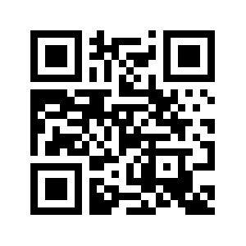
For More Information
Email Address:
EVChargingProgram@ky.gov
Program Website: EVCharging.KY.gov

