Slide 1
SPECIAL LICENSE PLATES
Interim Joint Committee on Transportation
October 17, 2023
Godwin Onodu, MPA
Director, Division of Motor Vehicle Licensing

Slide 2
Applying for a New Special License Plate
Nonprofits are eligible for special license plates.
Applications are reviewed by the Special License Plate Committee.
Nonprofits must submit plate designs at least 10 business days before the scheduled meeting.

Slide 3
Applying for a New Special License Plate
The Special License Plate Committee will hold an application if the Legislature is considering the same or a similar plate.
Once the Committee approves an application, the organization is invoiced for the cost of programming and production.
Organizations are notified if the number of current registrations falls below 500. Two consecutive years below 500 registrations will cause the plate to be discontinued.

Slide 4
Applying for a New Special License Plate
Organizations may apply for a plate redesign after three years.
Donations will be remitted to the nonprofit.
Funds must be deposited into a separate account.

Slide 5
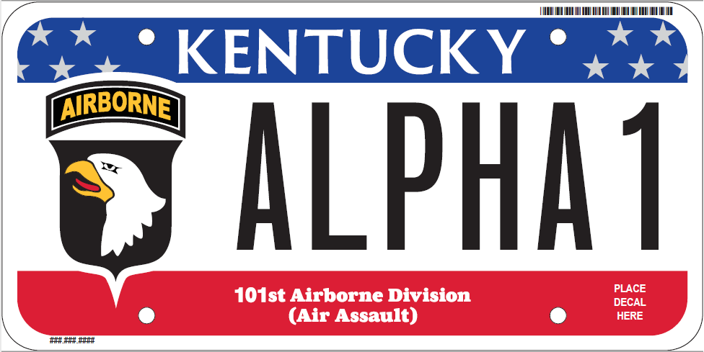
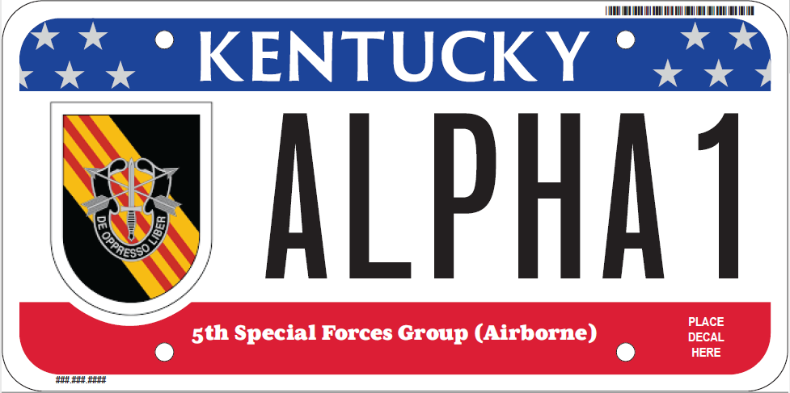
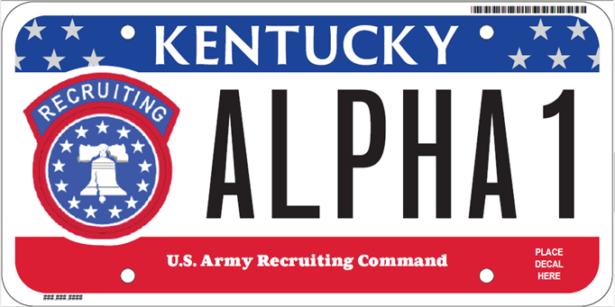
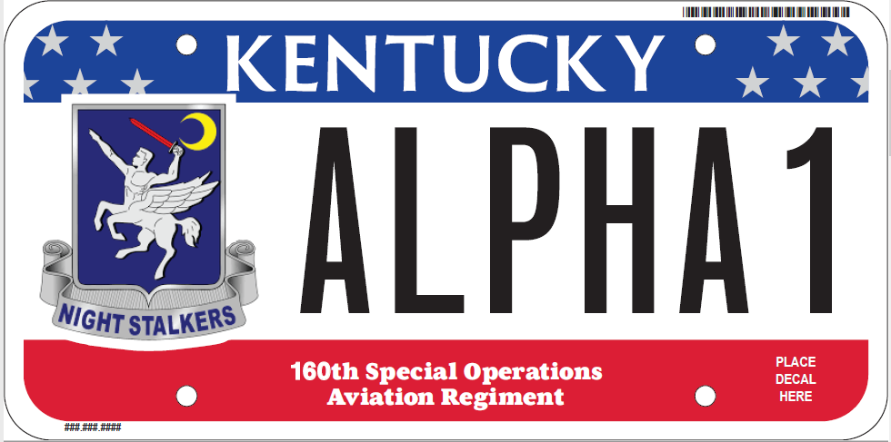
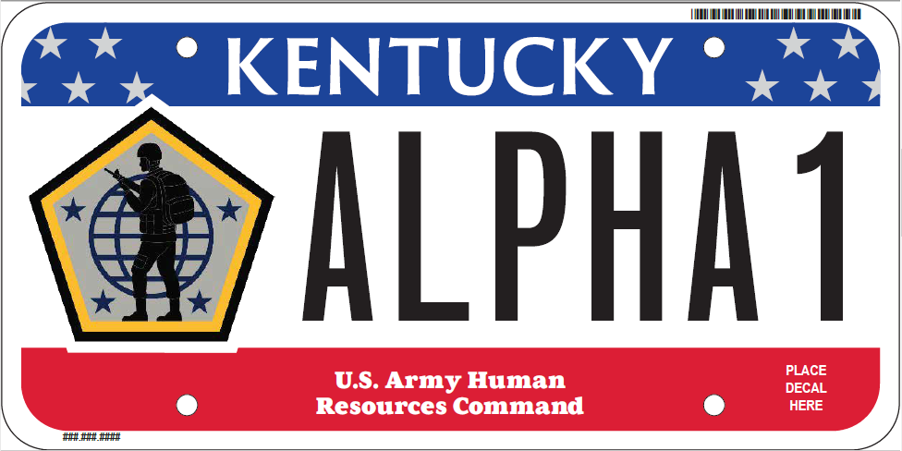
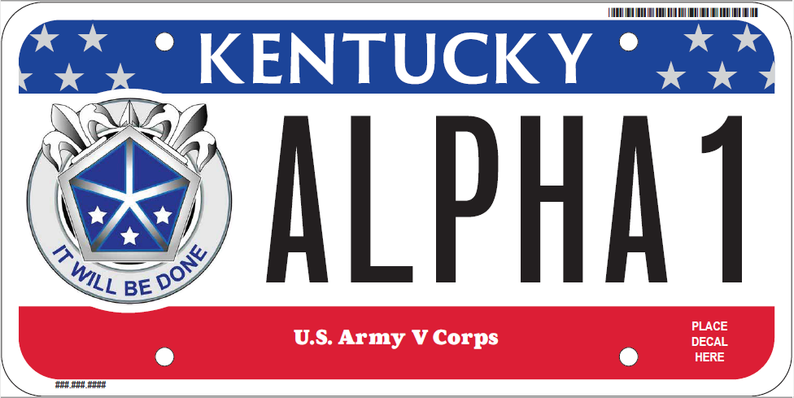
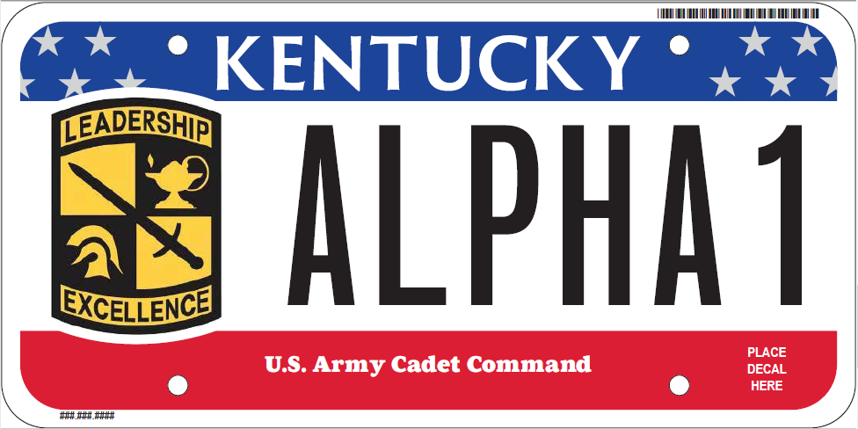
Military Heritage

Slide 6
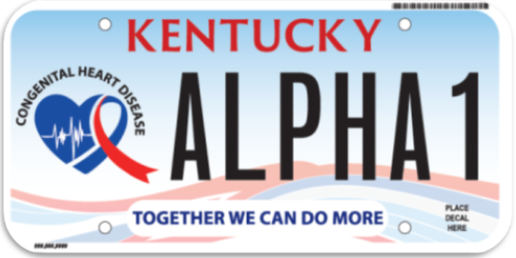
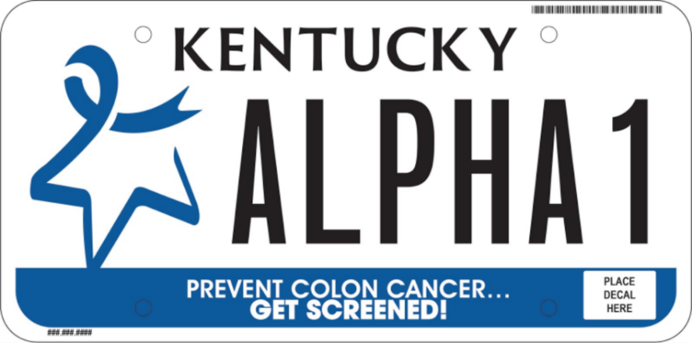
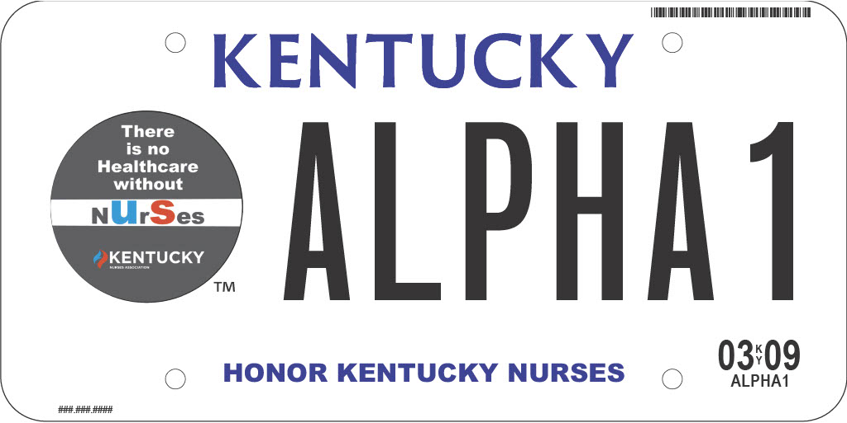
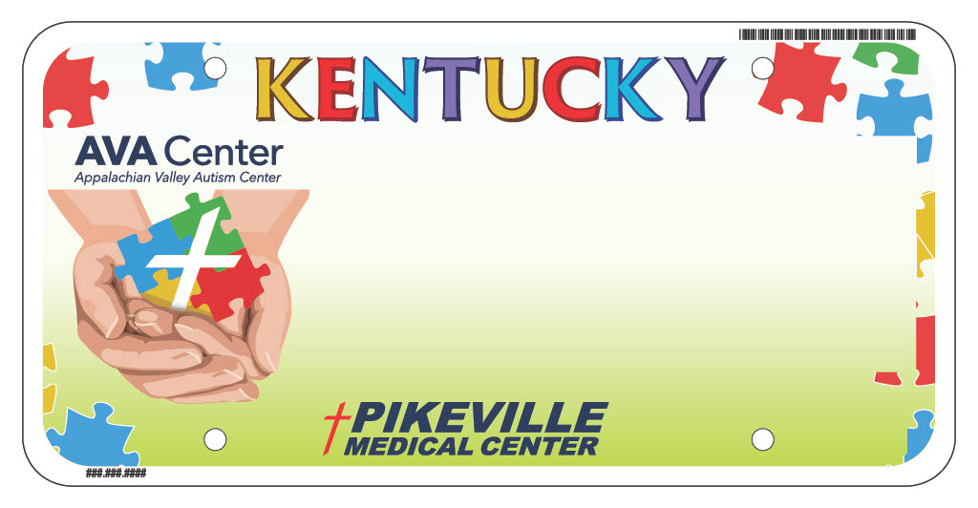
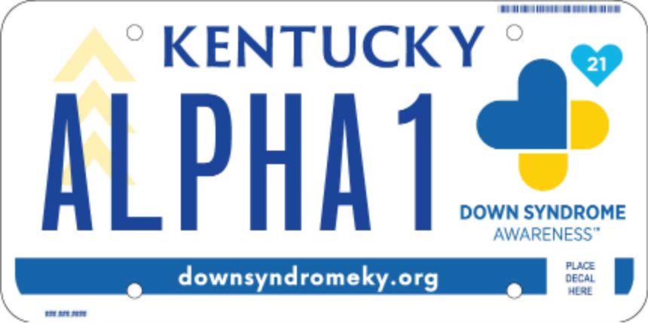
Health Related

Slide 7
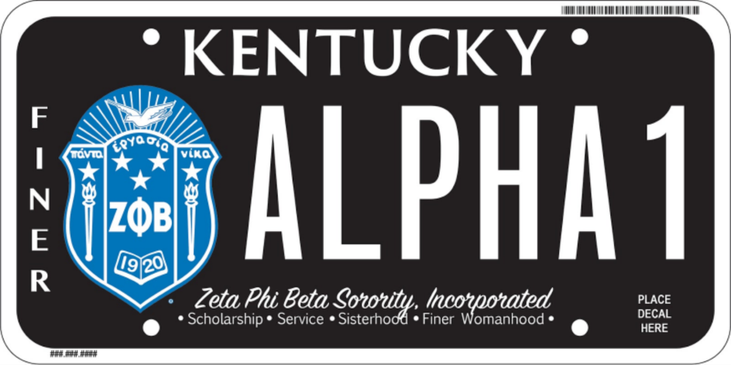
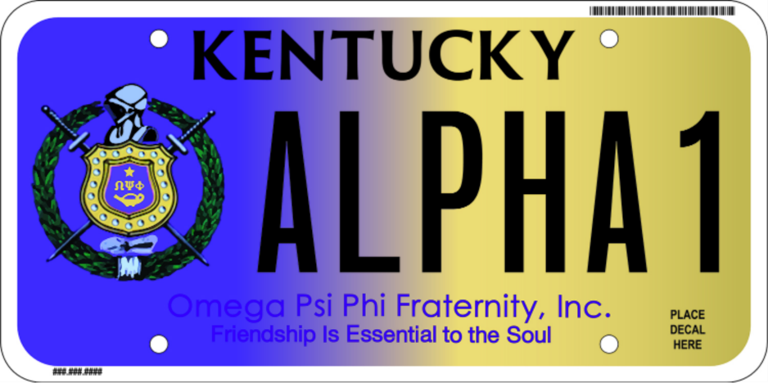
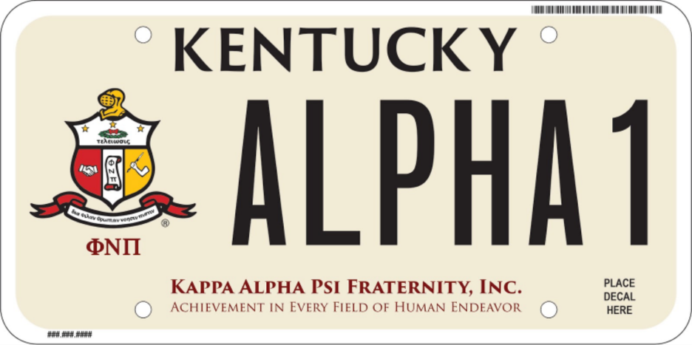
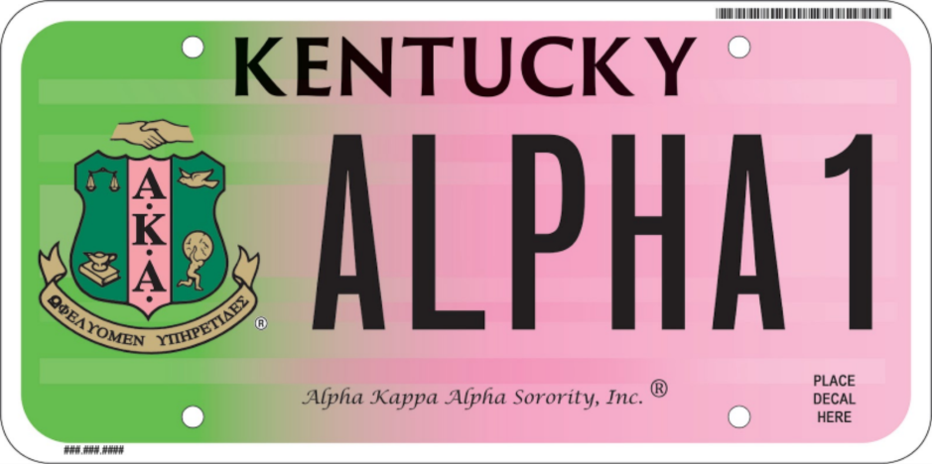
Fraternities & Sororities

Slide 8
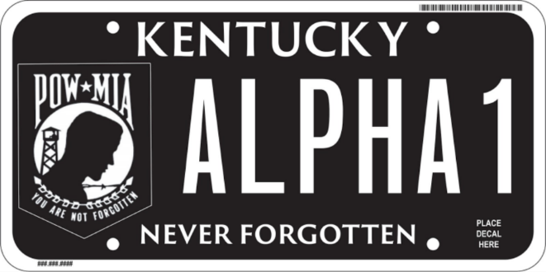
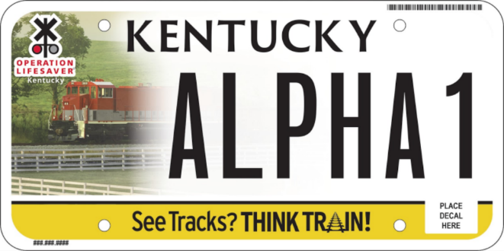
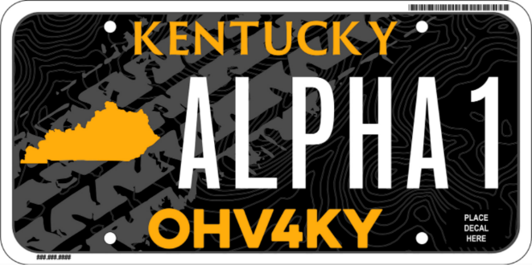
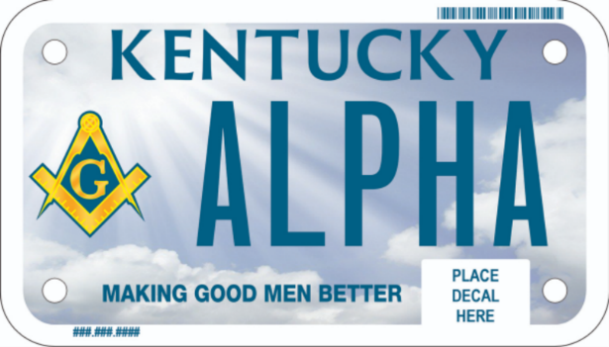
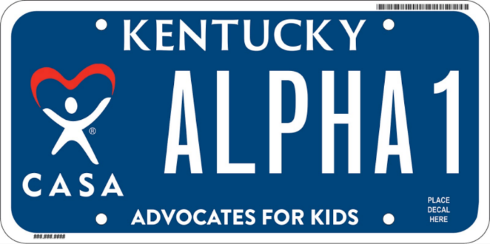
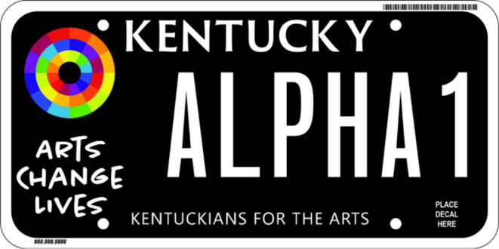
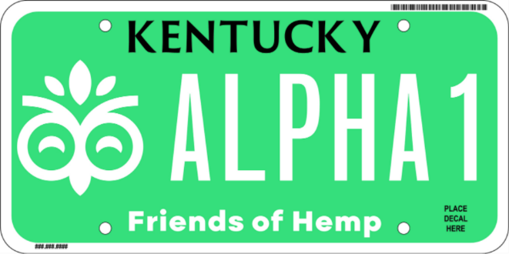
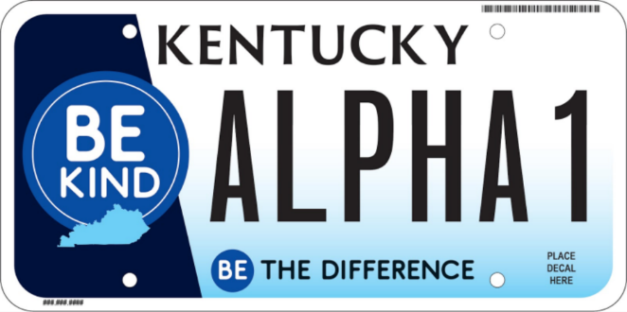
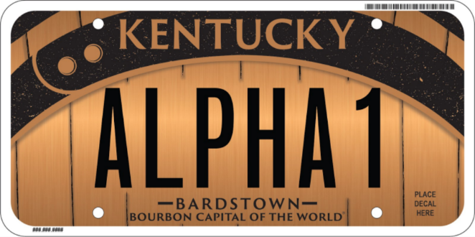
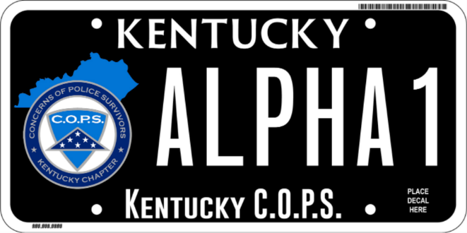
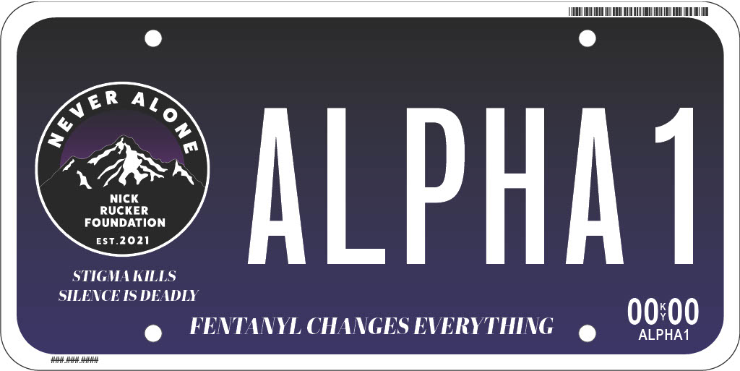
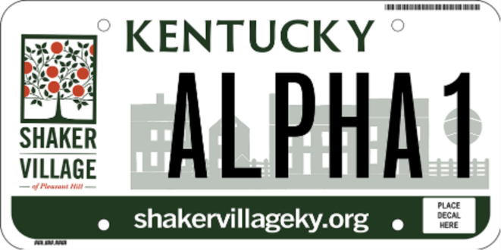
Miscellaneous

Slide 9
QUESTIONS
Interim Joint Committee on Transportation
October 17, 2023
Godwin Onodu, MPA
Director, Division of Motor Vehicle Licensing
Godwin.Onodu@ky.gov

