Slide 1
Reclaimed Asphalt Pavement (RAP)
Brian K. Wood, P.E.
Notes:
ID=d924773e-9a16-4d6d-9803-8cb819e99682 Recipe=text_billboard Type=TextOnly Variant=0 FamilyID=AccentBoxWalbaum_Zero

Slide 2
PAIKY Membership
24 producer contractor member companies
62 associate members who support the industry
Liquid suppliers
Equipment dealers
Engineering consultants
Testing laboratories
Material suppliers

Slide 3
Nearly 100 Asphalt Plants Statewide

Slide 4
Economic Impact on the Commonwealth
5,000 Highly Skilled Employees
$400 Million in Payroll and Taxes
$5 Billion Contribution

Slide 5
Brian K. Wood, P.E.
Executive Director
23 years with the association
Registered Professional Engineer
Member of the U.S. delegation to Japan to learn more about high RAP mixtures
Liaison between the contractors and KYTC on issues related to asphalt pavements

Slide 6
Industry Support for Increased Use of Reclaimed Asphalt Pavement (RAP)
Proven and Accepted Practice

Slide 7
High RAP Scanning Tour

Slide 8
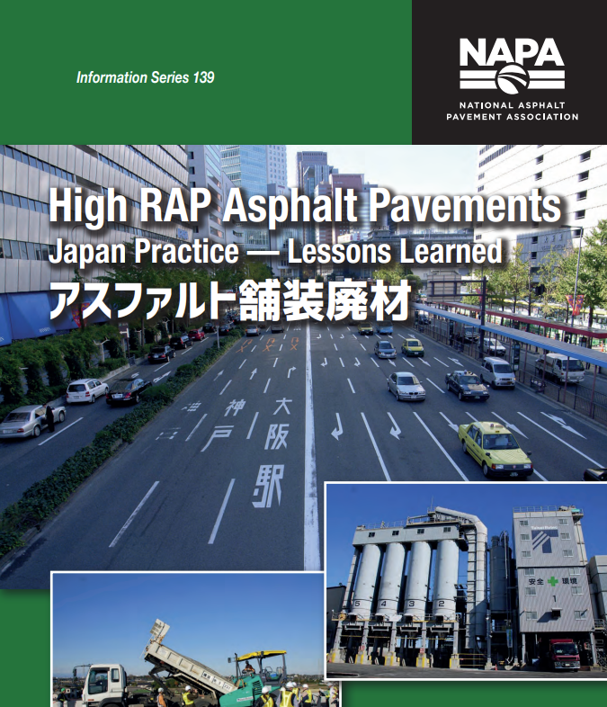
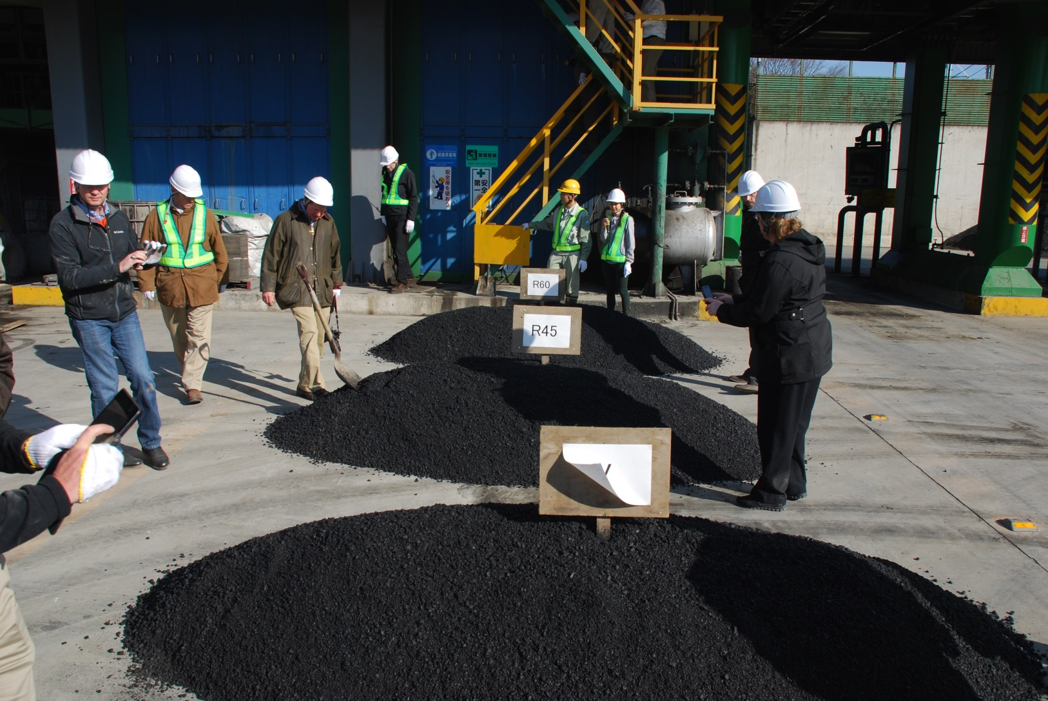
On average, Japan uses 45% RAP in their mixtures

Slide 9
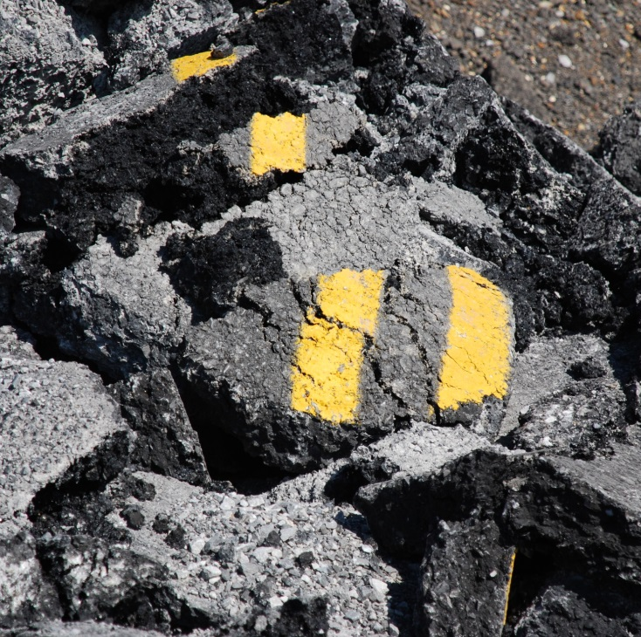
Reclaimed Asphalt Pavement (RAP)
Kentucky contractors have been using Reclaimed (or recycled) asphalt pavement (RAP) for decades.
Majority of all asphalt mixtures use a small or moderate percentage of RAP.

Slide 10
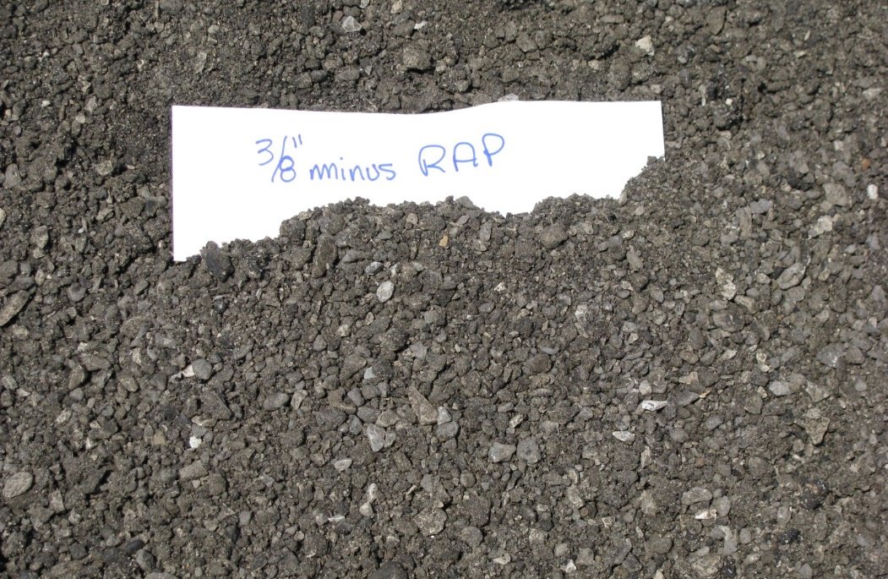
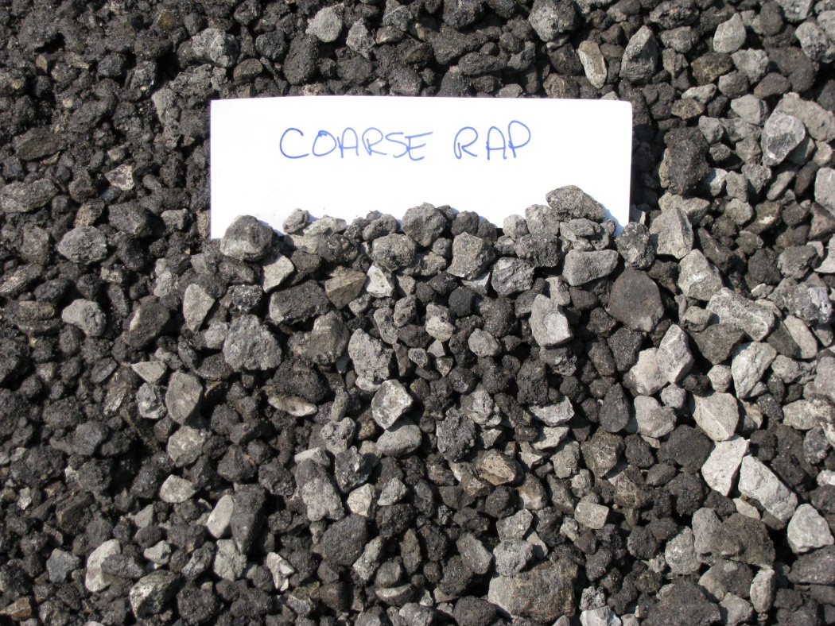
Best Practices for High RAP Mixtures
RAP is processed and separated into piles and tested for asphalt content, gradation and moisture
Processing allows for precise introduction of recycled materials alongside the virgin material in the mixture

Slide 11
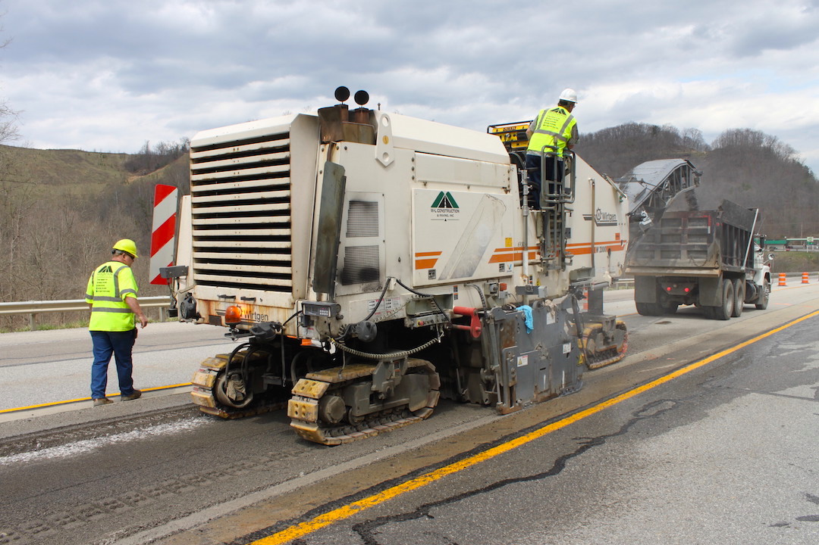
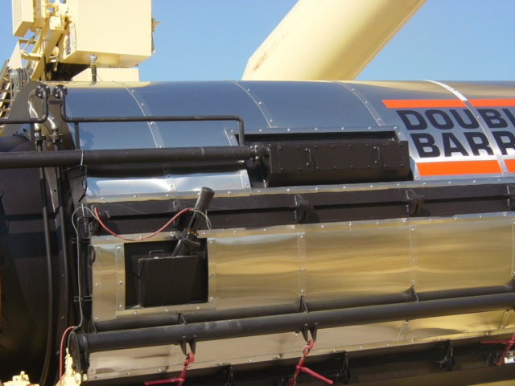
Technology Advancements
More Access to Milling
Improved Plant Technology
Processing and Fractionation

Slide 12
Cracking Test
The final piece of the puzzle is a performance test that can establish the quality of mixtures using a high percentage of recycle materials.
Kentucky utilizes the IDEAL-CT test to determine the crack susceptibility of an asphalt mixture
Four (4) years of experience with this new test method

Slide 13
Balancing Act
Contractors with sufficient access to RAP will utilize larger percentages on a regular basis
Contractors with limited access will utilize smaller or moderate amounts to balance their supply of material

Slide 14
Significant Enhancements
Research findings at the National Center for Asphalt Technology led to significant specification changes in 2019
Lower Gyrations
Lower Design Air Voids
Higher Asphalt Content
Transition from prescriptive specifications to performance-based specifications
Improved flexibility
Improved crack resistance
Improved durability

Slide 15
New Era in Asphalt
Performance specifications represent a huge shift in our industry and will allow contractors to be more innovative and efficient in their use of available resources (like RAP).
The agency and taxpayers have a performance test that ensures quality, performance, and durability of the pavement.

Slide 16
Path Forward
PAIKY and KYTC already engaged in dialogue on this topic
Recently formed the Asphalt Pavement Collaboration Committee and a task force on Recycling & Sustainability
Opportunities to expand our use of RAP by utilizing performance tests and best practices to control mix quality and improve pavement durability

Slide 17
Thank You!
Brian K. Wood, P.E.

