Slide 1
VITRONIC Machine Vision KY Work Zone Road Safety Kjell Lyngstad, President/ CEO- North America Niclas Andersson, Vice President Sales – BU Traffic
Alternative
Notes:
Alternative

Slide 2
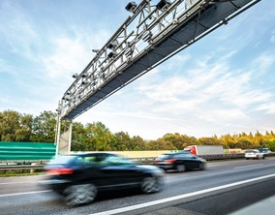
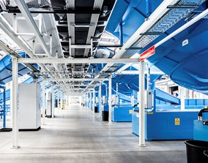
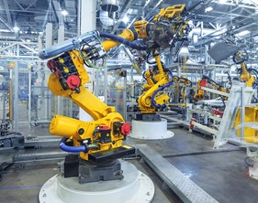
VITRONIC Highlights
25 years
70+
3x
Established in Kentucky 1999
Founded in Germany 1984
Employees In North America
45 based in Kentucky
Growth since 2021 in North America
Main VITRONIC North America Market Focus Areas:
TRAFFIC TECHNOLOGY
LOGISTICS
AUTOMOTIVE
Notes:
Since its foundation in 1984, VITRONIC has been growing continuously and is now represented on 5 continents and in over 80 countries with almost 1,300 employees. VITRONIC serves its international customers through subsidiaries in North America, Europe, Asia and Australia as well as through a worldwide network of sales and service partners. Development and production of VITRONIC systems are located at the company headquarters in Wiesbaden.

Slide 3
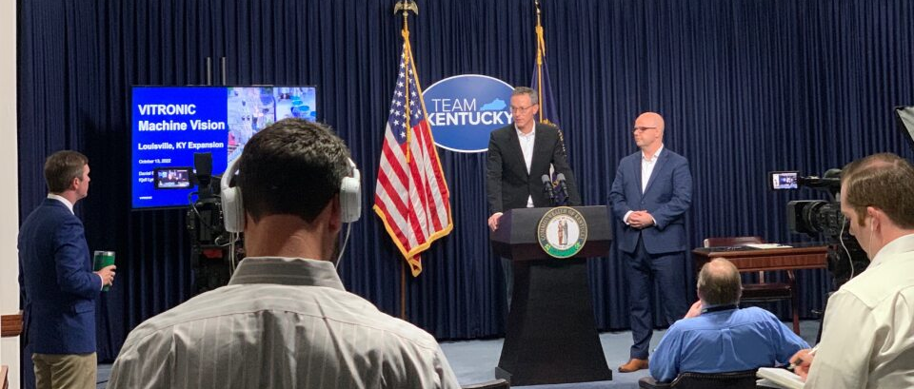
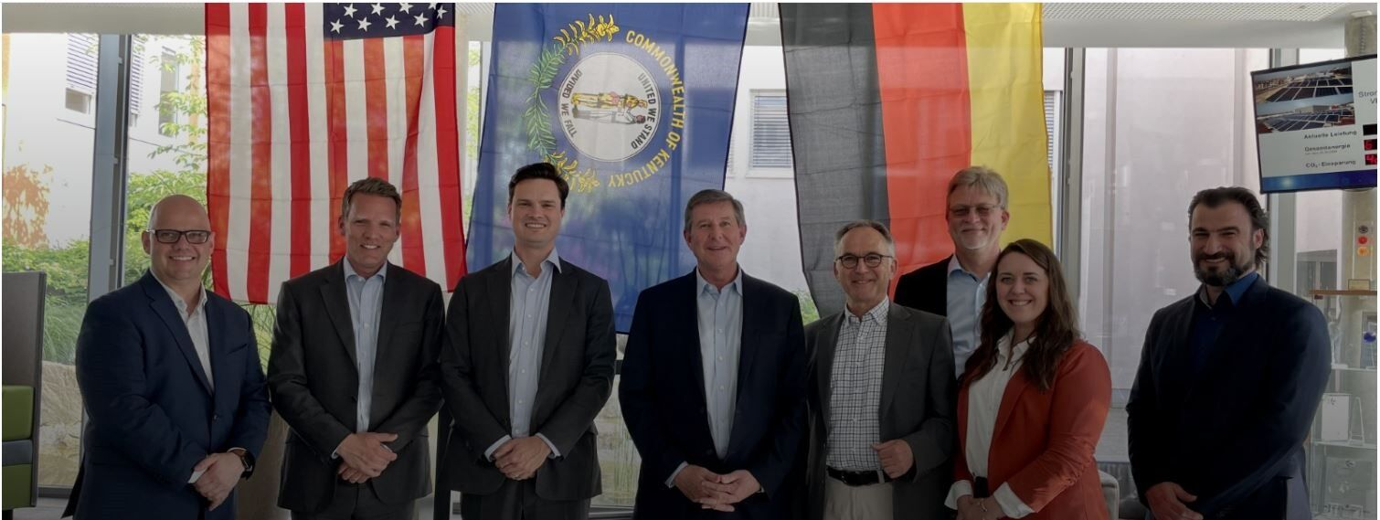
Collaboration with Kentucky Sate Government Team
Oct 2022:
Team Kentucky Press Conference
with Governor Beshear
May 2023:
Global VITRONIC HQ Visit (Wiesbaden, DE) with Secretary Noel and EDC Team

Slide 4
Traffic

Slide 5
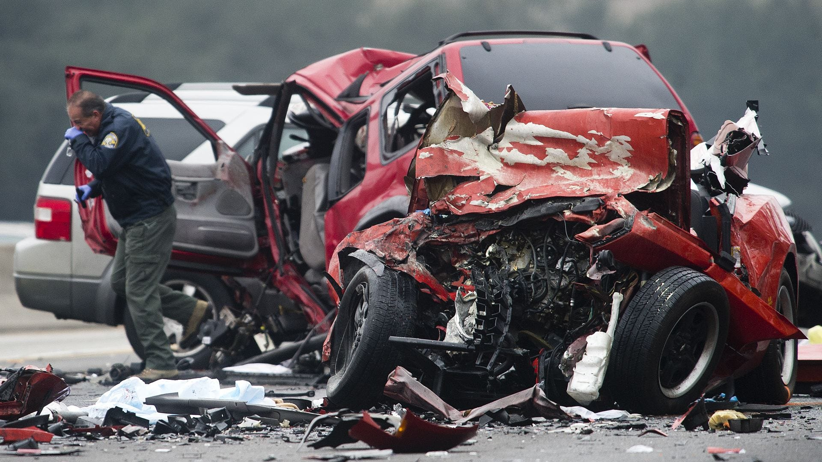
Traffic Safety Impact
42,795 people in the U.S. died in 2022 due to traffic accidents – 744 in Kentucky
Traffic accidents cost most countries 3% of their GDP ($7.8B for Kentucky)
Reductions in average speed can reduce the number of road fatalities by 30%, or over 223 lives a year in Kentucky!
Notes:
An increase in average speed is directly related both to the likelihood of a crash occurring and to the severity of the consequences of the crash. For example, every 1% increase in mean speed produces a 4% increase in the fatal crash risk and a 3% increase in the serious crash risk.
WHO Road Safety Report 2018

Slide 6
Speeding & Road Safety
Speeding is more than breaking the law, it is a critical factor for traffic safety
Reduced control of vehicle
How is speeding effecting traffic safety
Increased fuel consumption and carbon footprint
Reduced effectiveness of any protective equipment
Local roads see the most speeding, with 87% of all speeding-related traffic fatalities occurring on non-interstate roads.
Speeding contributes to 37% of the fatal crashes in work zones.
25,000 children are injured annually while walking to school as a result of speeding.
Increased risk of severe crashes
Increased stopping distance
Notes:
Far-ranging consequences of speeding include:
Greater potential for loss of vehicle control;
Reduced effectiveness of occupant protection equipment;
Increased stopping distance after the driver perceives a danger;
Increased degree of crash severity leading to more severe injuries;
Economic implications of a speed-related crash;
Increased fuel consumption/cost;
Increased pollution and carbon footprint

Slide 7
Enforcement Solutions to support Vision Zero
Advanced machine vision enables smarter and safer traffic

Slide 8
Scanning LiDAR
State-of-the-art laser technology for improved measurement and safer traffic
Innovative measurement technology for speed enforcement
1B+ citation tickets issued, with zero citations over-turned for any technical reasons
158 continuous laser beams monitor all movement
Catches up to 6x more offenders than radar
(246 ft)
Traffic Enforcement

Slide 9
Enforcement as a Service
We provide administrative and operational services for traffic enforcement that includes:
Manufacturing and supply of automated traffic enforcement systems
Installation, maintenance and operation of the full enforcement program
Includes violation issuing, mailing, and payment services
2023
Traffic Enforcement

Slide 10
Benefits of Automated Traffic Enforcement for Kentucky
Together, We create value for communities

Slide 11
Force Multiplier for Law Enforcement
Allows officers to proactively focus on crime prevention and community engagement
Increases safety for officers by moving activities from high risk, low yield to low risk, high yield
57% reduction in accidents saves 4.3 hours of officer time – Each Day!
2023
Traffic Enforcement

Slide 12
Creating Community Value
Vastly improved Kentucky road safety and saving more lives
Lower costs to handle traffic accidents and generate budget surplus for reinvestment in traffic infrastructure, schools, and community services
Secure and Generate local jobs & tax revenue (operational service people, maintenance, administrative, etc.)
Traffic Enforcement

Slide 13
Thank You for Your Attention!
Niclas Andersson
Vice President Sales – BU Traffic
​
Tel. +1 (650) 943-3216​
​niclas.andersson@vitronic.com​
www.vitronic.com
VITRONIC Machine Vision, Ltd.
11900 Plantside Drive, Suite G
Louisville, KY 40299

