Slide 1
INTERIM JOINT COMMITTEE ON TRANSPORTATION
November 8, 2024
Asset Management
Tracy Nowaczyk, PE, Assistant State Highway Engineer Department of Highways

Slide 2
Agenda
Planned Annual Investments
Asset Management Strategies
Asset Management Challenges
Maintenance and Asset Management Working Together

Slide 3
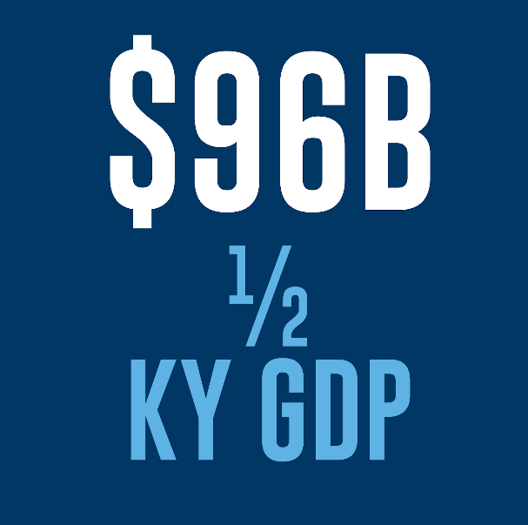
Pavement and Bridge Network is Significant
KYTC owns and maintains the 7th largest bridge network and the 8th largest pavement network in the country
These assets are valued at $96 billion

Slide 4
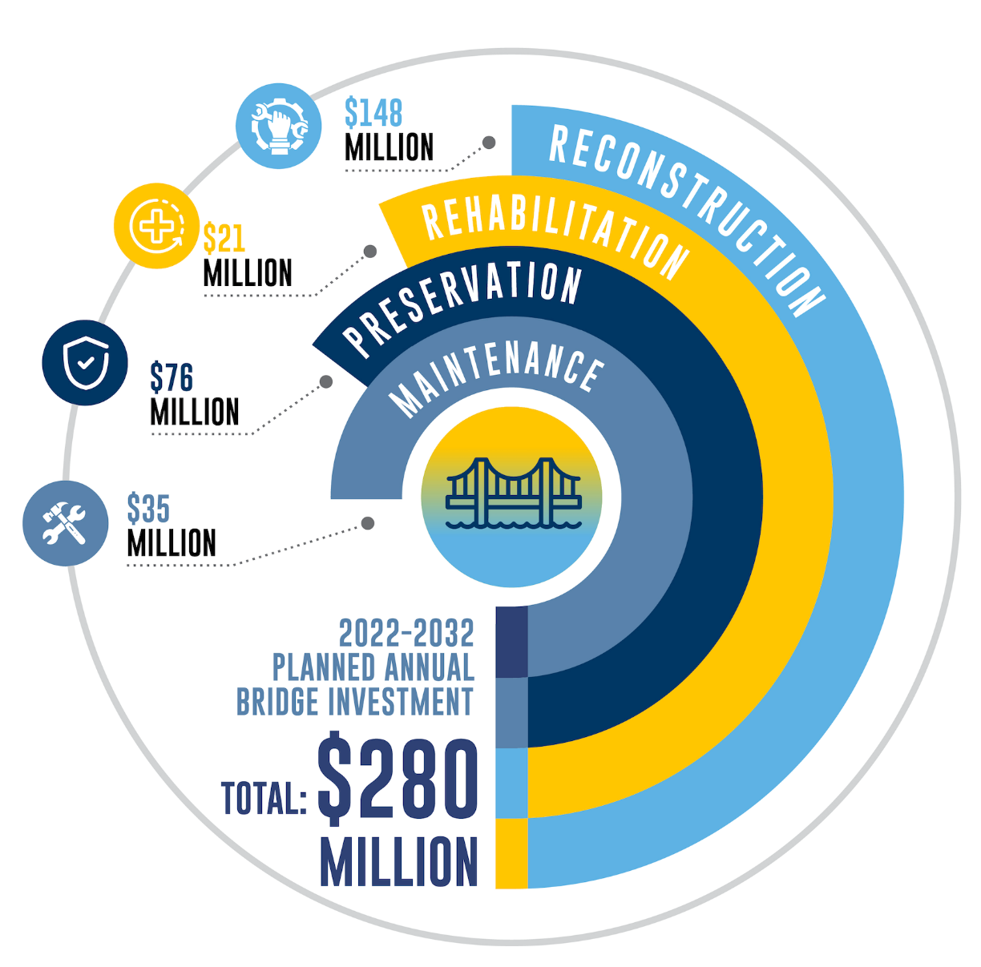
Average Annual Bridge Investment

Slide 5
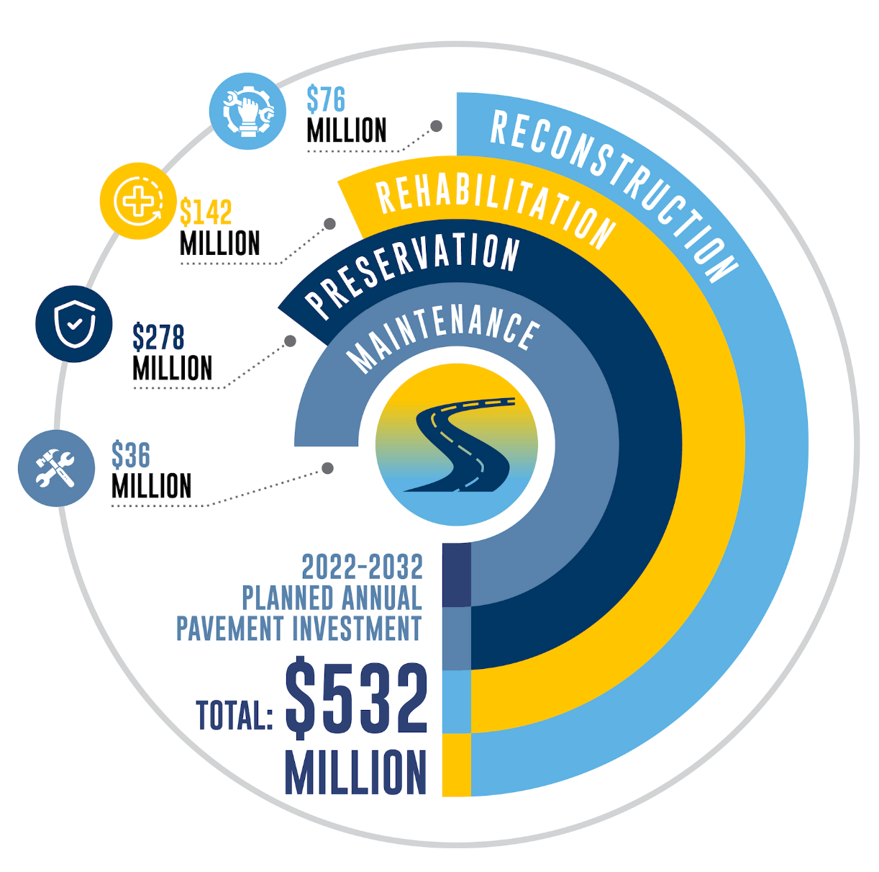
Average Annual Pavement Investment

Slide 6
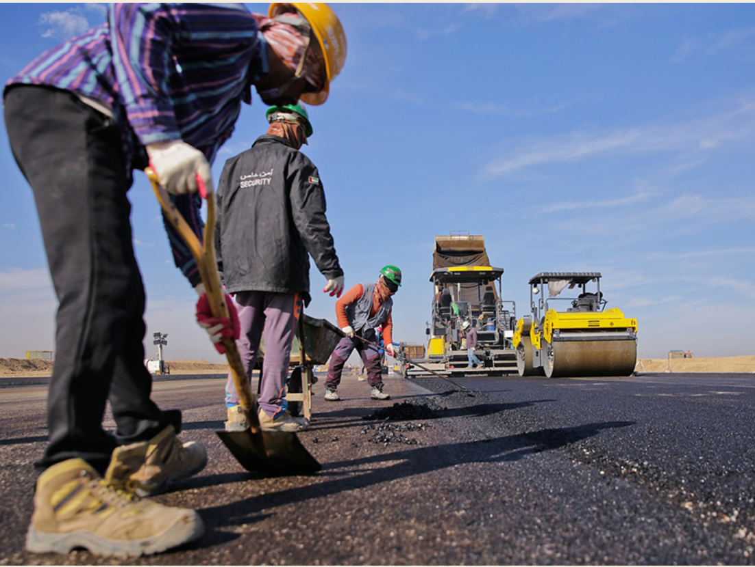
Six Year Plan Approach
Six-Year Plan Approach Provides Leverage
Budget Stewardship Allows:
Anticipate available funding
Plan strategically
Avoid higher costs
Work toward state of good repair
Investment Strategies Prevent:
Community interruptions
Delayed improvements
Negative economic impact
Planning Projects Ensures:
Safety of drivers/travelers
Safety of workers

Slide 7
Asset Management Principles Drive Decisions

Slide 8
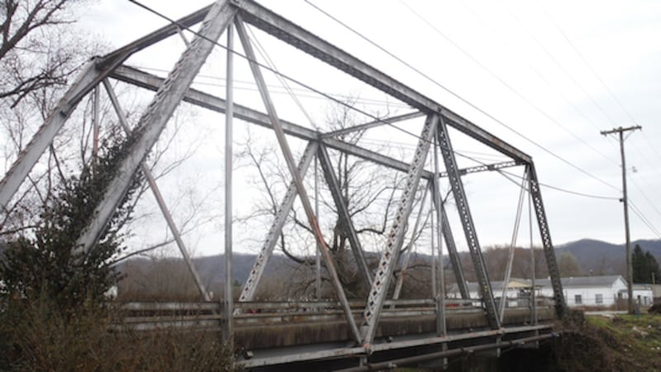
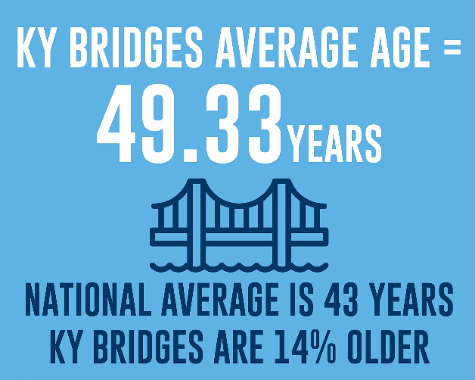
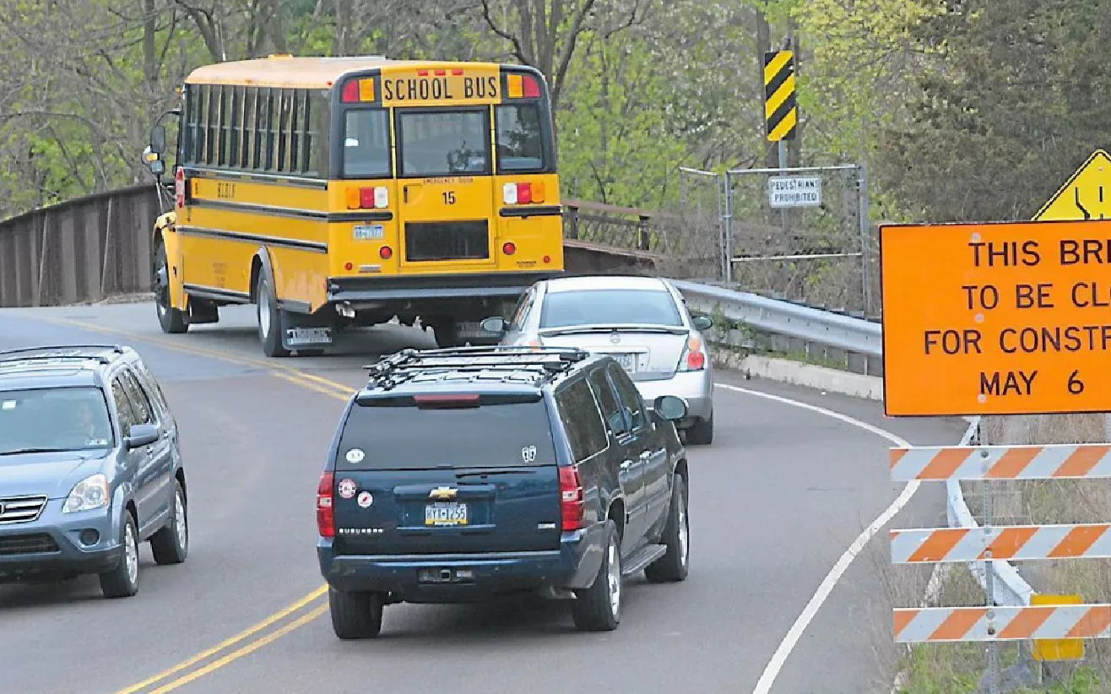
Bridge Challenges
Unmet timely bridge needs result in:
Travel patterns disruptions
Unplanned costs that are higher
Safety risks that are increased
Economic benefits that are decreased
Disruptions on Bridges This Year
17 unscheduled bridge repairs on state-owned structures
About 100 state-owned structures posted for load
11 state-owned structures closed

Slide 9
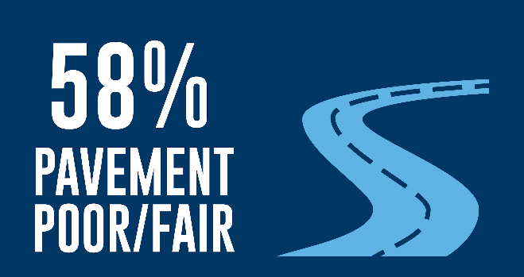
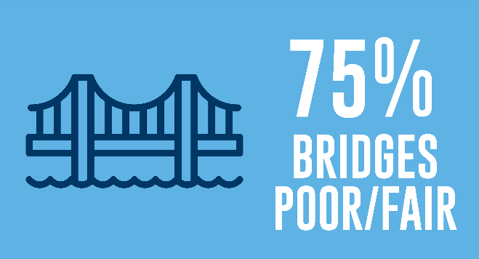
Bridge and Pavement Management
Asset management evaluates poor and fair condition pavement and bridges and applies lower and higher cost fixes
Limits interstate postings (keeps freight moving)
Keeps access open for busses and emergency vehicles
Protects workers’ safety
Provides better outcomes statewide
Maximizes budget by prolonging life of assets and preserves network
Utilizes combination of fixes

Slide 10
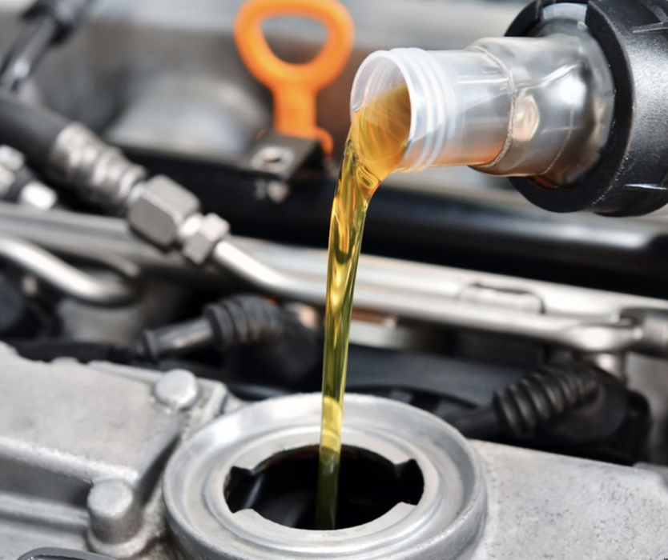
Proactive vs. Reactive
What happens when car isn’t maintained with regular oil changes:
Skipping regularly scheduled oil changes can cause issues:
Excessive wear and damage
Reduced performance
Potential engine failure
Impact can be costly
Regular oil changes: Usually $30-75
Engine repair/replacement: $3,000-10,000+(100-150- fold impact)
Skipping oil changes voids many warranties
Notes:
Engine Wear and Damage
Reduced Performance
Sludge Build-up
Potential Complete Engine Failure
Cost Impact

Slide 11
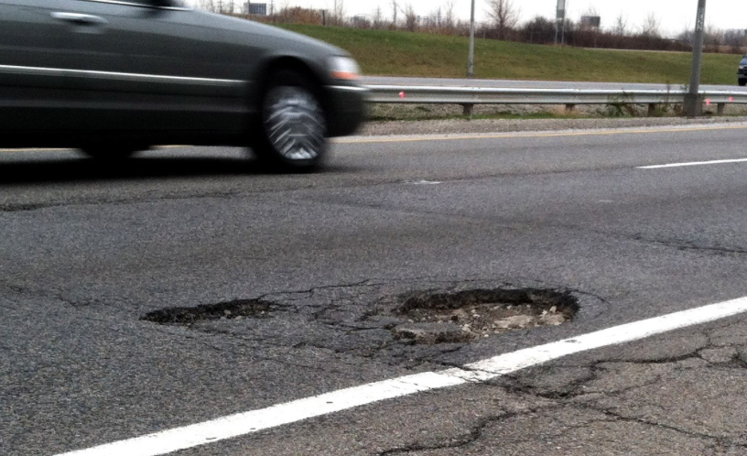
Asset Management & Maintenance Integrated
Daily maintenance impacts lifespan of assets
Pothole example demonstrates importance of budget integration:
Maintenance includes mowing along the roadway, drainage improvements, tree and brush trimming and patching potholes
Less maintenance leads to water on pavement
Water makes potholes worse
Potholes not patched leads to further pavement damage
Asset management must fix damage to pavement and sub-surface from excessive water
With regular maintenance, the life of the roadway is extended and kept in good condition

Slide 12
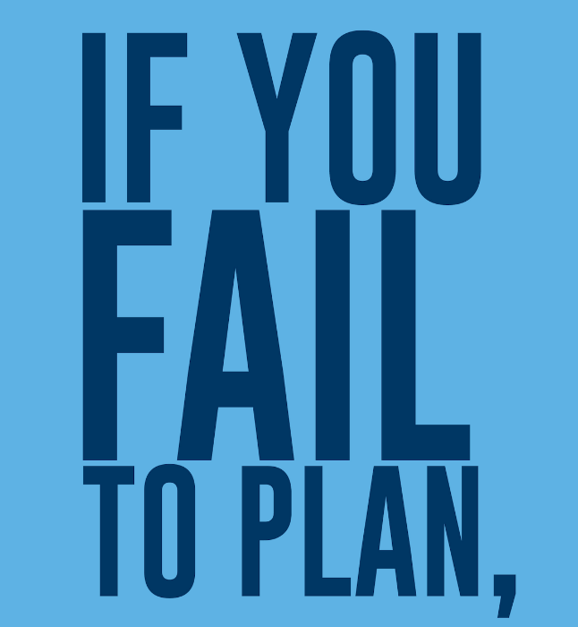
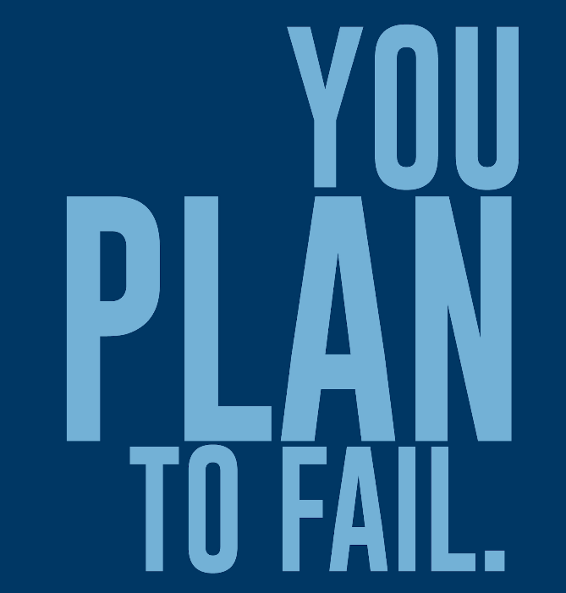
Good Stewardship
Pavement and bridges combined are one of the greatest sources of wealth for the cabinet, essentially for the commonwealth, so we must take care of them in the most responsible way possible.

Slide 13
INTERIM JOINT COMMITTEE ON TRANSPORTATION
November 8, 2024
Asset Management
Tracy Nowaczyk, PE, Assistant State Highway Engineer Department of Highways
- QUESTIONS -

