Slide 1
INTERIM JOINT COMMITTEE ON TRANSPORTATION
November 8, 2024
KAVIS Program Update
Heather Stout, Director Department of Information & Technology

Slide 2
Agenda
2023 vs 2024 Comparison Numbers
Future KAVIS Related Implementations
KYELT/Lien Management

Slide 3
Comparisons 2023 vs 2024
2023 (AVIS)
State Total collected YTD
$1,219,942,233.69
Checkouts
3,357,707
Ad-valorem Collection
$512,453,489.42
2024 (KAVIS)
State Total collected YTD
$1,222,888,802.33
Checkouts
3,500,657
Ad-valorem Collection
$531,974,607.68
YTD numbers are January through Oct 29 for 2023 and 2024

Slide 4
Collections in Top 10 Counties
County Name | Amt Collected 2023 | Amt Collected 2024 | Difference
Jefferson | $195,426,025.63 | $200,354,212.63 | $4,928,187.00
Fayette | $84,501,960.38 | $88,539,490.69 | $4,037,530.31
Boone | $41,474,983.42 | $42,646,669.13 | $1,171,685.71
Kenton | $40,456,655.20 | $42,462,711.55 | $2,006,056.35
Warren | $39,428,754.26 | $40,437,643.19 | $1,008,888.93
Hardin | $31,735,898.30 | $32,757,747.57 | $1,021,849.27
Madison | $27,776,203.48 | $29,734,836.64 | $1,958,633.16
Daviess | $25,384,698.05 | $26,263,073.69 | $878,375.64
Pulaski | $24,575,004.37 | $25,139,214.18 | $564,209.81
Oldham | $22,398,253.31 | $24,261,236.02 | $1,862,982.71

Slide 5
Future KAVIS Related Implementations
Centralized Lien Management
KYELT
Fleets with un-expiring plates
PVA/DOR Valuation
Electric Vehicles
Web Renewal Enhancements
On demand printing of temp tags
Electronic Sheriff Inspection
Improved Verification
Organizations
Individuals without KY License
Insurance System Modernization

Slide 6
KY Electronic Lien and Titling (KYELT)
Allows Dealerships to submit vehicle transactions, supporting documents, and fees electronically to the county clerk
Allows County Clerks to review and reject electronically to request corrections
Allow liens to be electronically requested in the driver's county of residence
Dealerships must be approved by Motor Vehicle Licensing to participate
KAVIS is working on the integration with the ELT system which will increase speed and accuracy of vehicle transactions

Slide 7
KYELT Timeline
April 2024 – ELT Pilot with 8 Counties and Dealerships
August 2024 – October 2024 – Statewide rollout
All County Clerk able to accept Electronic Title Packets via the KyELT system
115 County Clerks have processed transactions
150 MVL approved dealerships
6,205 transactions completed
2025
Direct KAVIS integration
Full Lien Management system

Slide 8
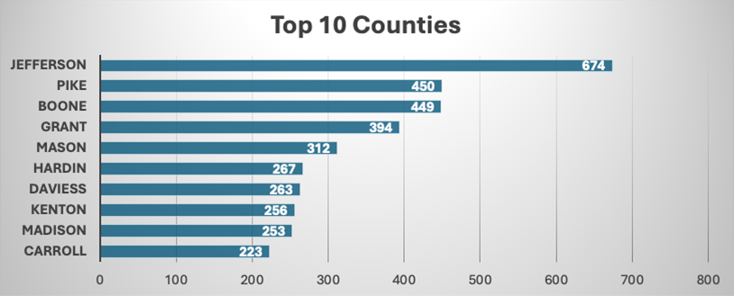
ELT Processing

Slide 9
INTERIM JOINT COMMITTEE ON TRANSPORTATION
November 8, 2024
KAVIS Program Update
Heather Stout, Director Department of Information & Technology
- QUESTIONS -

