Slide 1
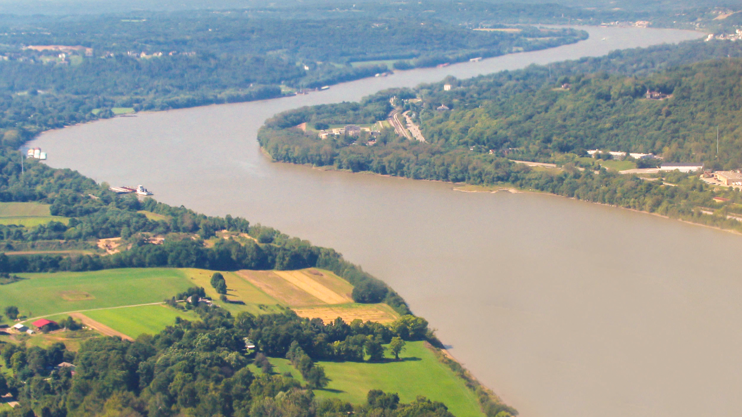
Completing the Connection
I-69 ORX Section 2
July 14, 2025

Slide 2
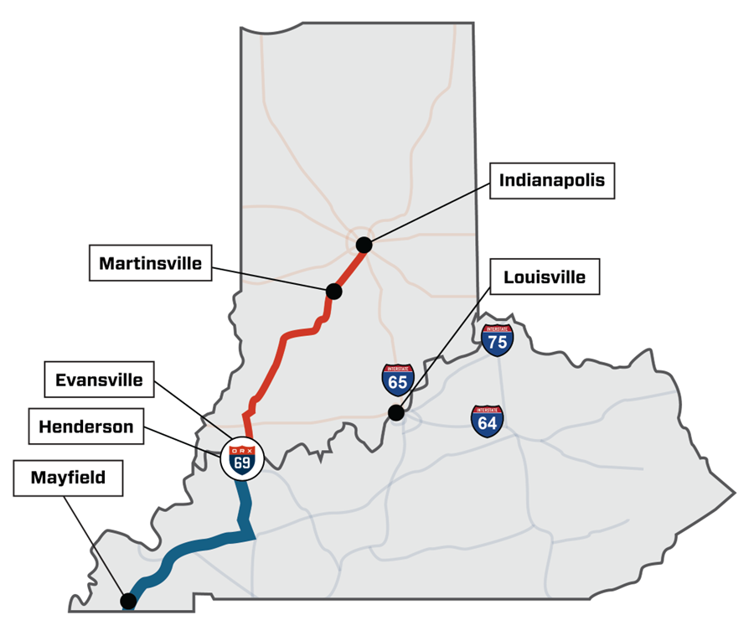
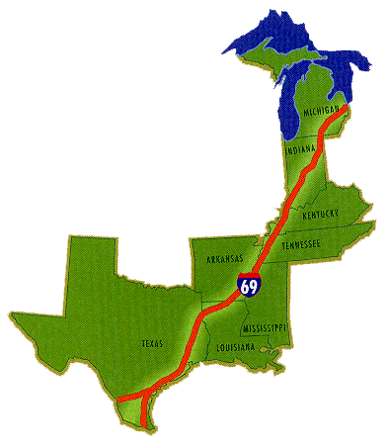
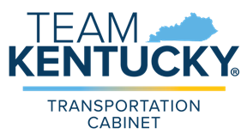
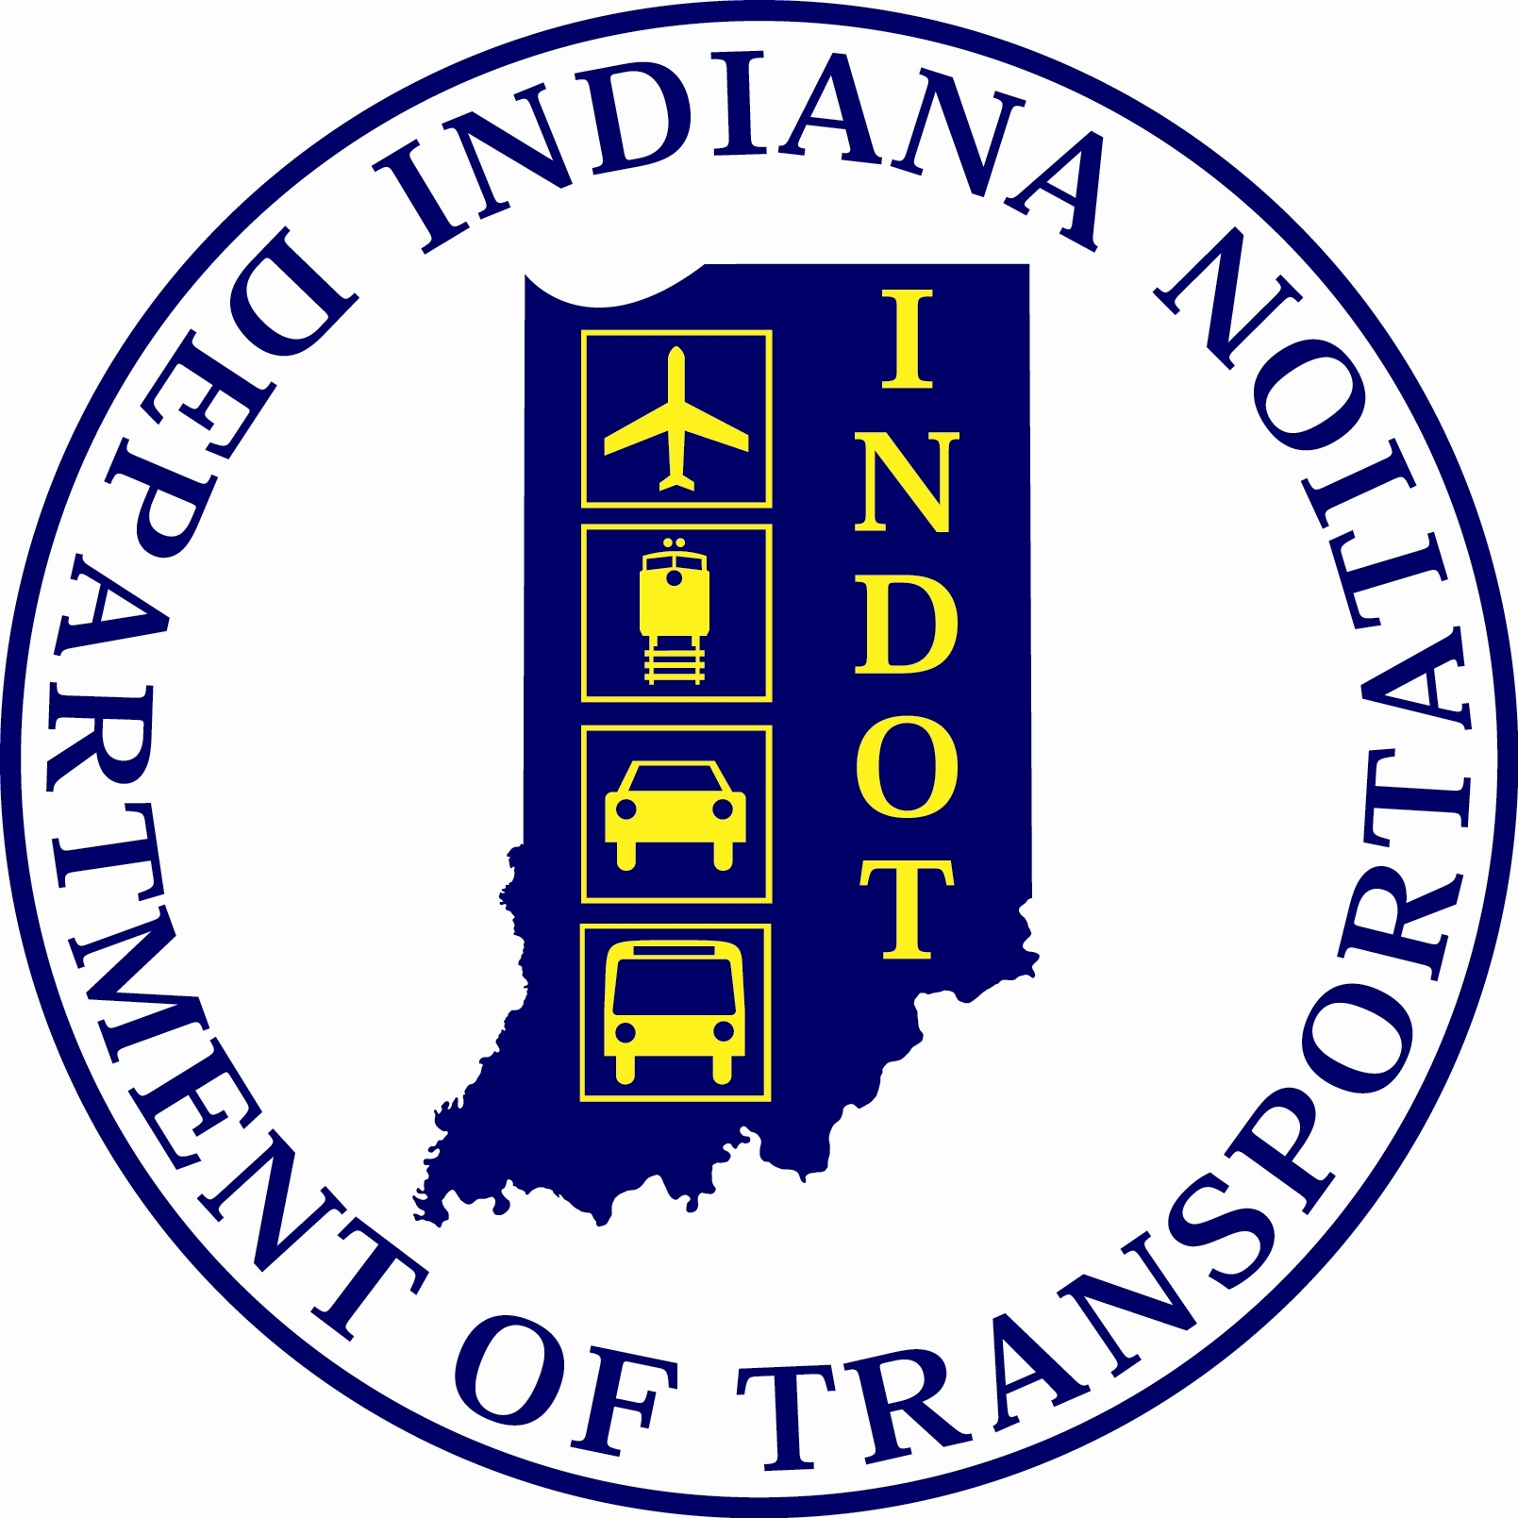
I-69: PROGRESS IN BOTH STATES
INDIANA INVESTMENT
Complete from Evansville to Indianapolis
KENTUCKY INVESTMENT
~147 miles in place from Henderson to Fulton

Slide 3
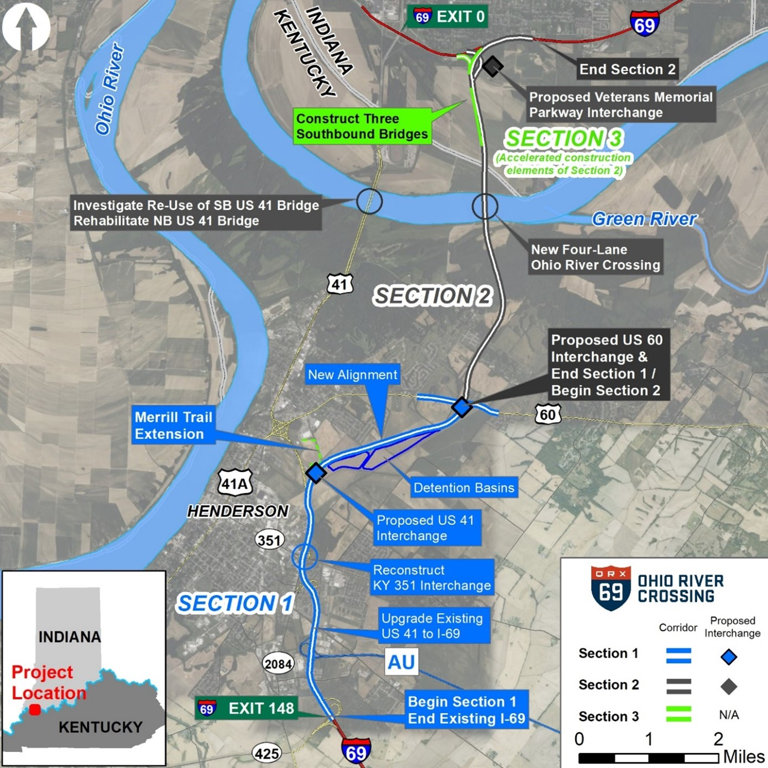
ORX will complete the I-69 connection between Evansville and Henderson
Interstate cross-river connectivity will reduce traffic and delays and improve safety
Includes 11+ miles of new interstate and 4-lane river crossing
Construction underway in Henderson (Section 1) and Evansville (Section 3)

Slide 4
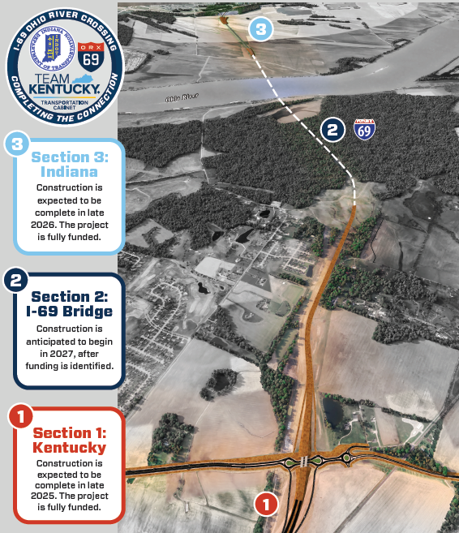
SECTION 2
Bi-state project between Indiana and Kentucky
Completes the connection between Henderson and Evansville
Includes the new, four-lane river crossing
Construction expected to begin in 2027 and to be complete by 2031

Slide 5
SECTION 2
Preliminary engineering complete
Development of alternative delivery procurement underway
Right of way activities beginning
KYTC-INDOT Tolling Agreement Executed in June (HB 546)
Financial Plan and Bi-State Development Agreement Being Finalized

Slide 6
SECTION 2
$933 million project (KY's share $508 million)
Draft Financial Plan:
Tolling (TIFIA Loan)
GARVEE Bonds
Traditional Federal Revenues
Biennial Highway Construction Program
General Fund - $150 million appropriated but not yet released

Slide 7
QUESTIONS?
THANK YOU

