Slide 1
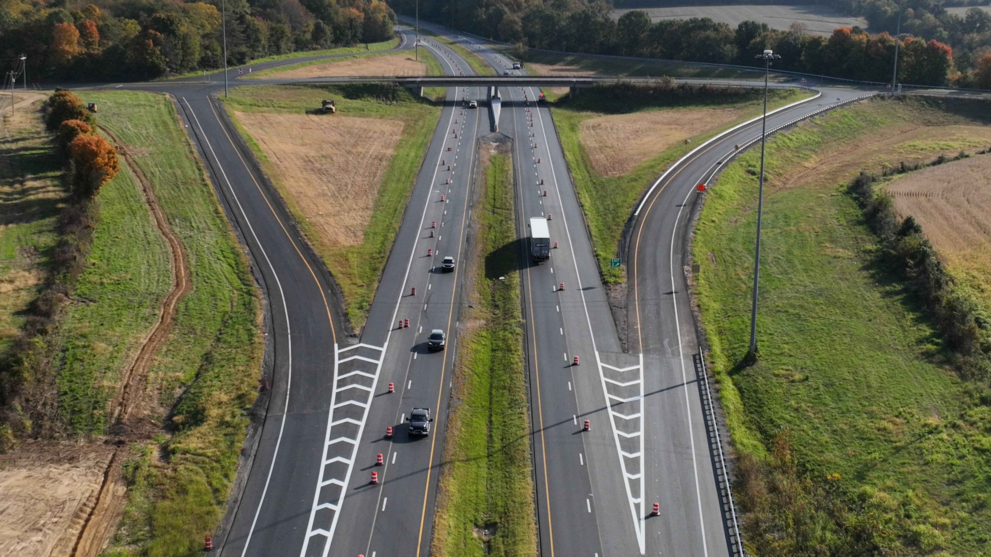

FRANKFORT, KY | JUNE 3, 2026
BR SUB ON TRANSPORTATION
EXECUTIVE ORDER 2026-235
OVERVIEW
Notes:
Delete or hide this slide, depending on the title slide you choose to use. To replace the photo in the background: select the photo, click the picture format tab, select “change picture,” and select “from a file,” and replace with your chosen file. If adjustments need to be made, go to “crop” and move the photo to be framed within the box.

Slide 2



MISSION
To provide a safe, efficient, environmentally sound and fiscally responsible transportation system that delivers economic opportunity and enhances the quality of life in Kentucky.
VISION
Striving to be national leaders in transportation who provide transportation infrastructure and services for the 21st century that deliver new economic opportunities for all Kentuckians.
Notes:
To replace the photos: select the photo, click the picture format tab, select “change picture,” and select “from a file,” and replace with your chosen file. If adjustments need to be made, go to “crop” and move the photo to be framed within the box.

Slide 3
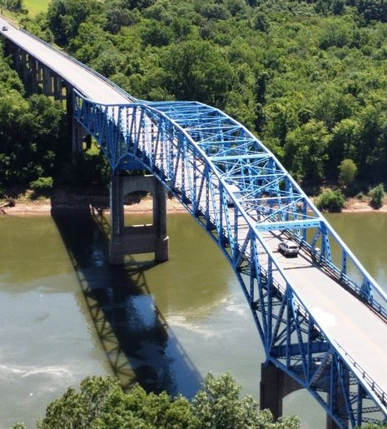

Executive Order 2026-235
  Declared a state of emergency relating to gas prices
  Freezes any increase in motor vehicle property taxes in 2027
  Urges Congress to suspend the federal gas tax until the end of the year
  Freezes the Motor Fuels tax rate at current levels for FY27
  Reduces the Motor Fuels Tax Rate 10-cents/gallon
Notes:
To replace the photos: select the photo, click the picture format tab, select “change picture,” and select “from a file,” and replace with your chosen file. If adjustments need to be made, go to “crop” and move the photo to be framed within the box.

Slide 4
E.O. 2026-235
ROAD FUND IMPACT
  10-cent per gallon reduction, effective May 11
  Estimate impact to the Road Fund at $26.8 million for one month
  $11.8 M less funding for counties and cities
  Direct impact to KYTC is about $15 million
  Freezing the rate, effective July 1
  Prevents the statutory tax increase of 0.6 cents from taking place
  The enacted budget relied on a Road Fund tax rate that was 1.4 cents lower than the current rate
  The budgeted rate will generate about $42 M more annually to the Road Fund
    $23.5 M more for the Transportation Cabinet
    $18.5 M more for counties and cities

Slide 5
E.O. 2026-235
HIGHWAY CONSTRUCTION IMPACT
  Depends on how long the reduction is in effect. Very little (or no) impact if in effect for two months since higher usage rate could offset effects of the reduced tax rate.
  Construction Projects – Projects vary in completion time (and in “spend out”). Each year, KYTC spends more on previously authorized projects than on newly authorized projects. Leadership will reduce planned new authorizations of projects that “spend out” quickly (Resurfacing), to reduce FY27 spending.
  Cash Management Spending Plan requires leadership to meet monthly to review authorizations and maintain sufficient reserves. KYTC will delay authorization of new projects before adjusting currently authorized projects.

Slide 6
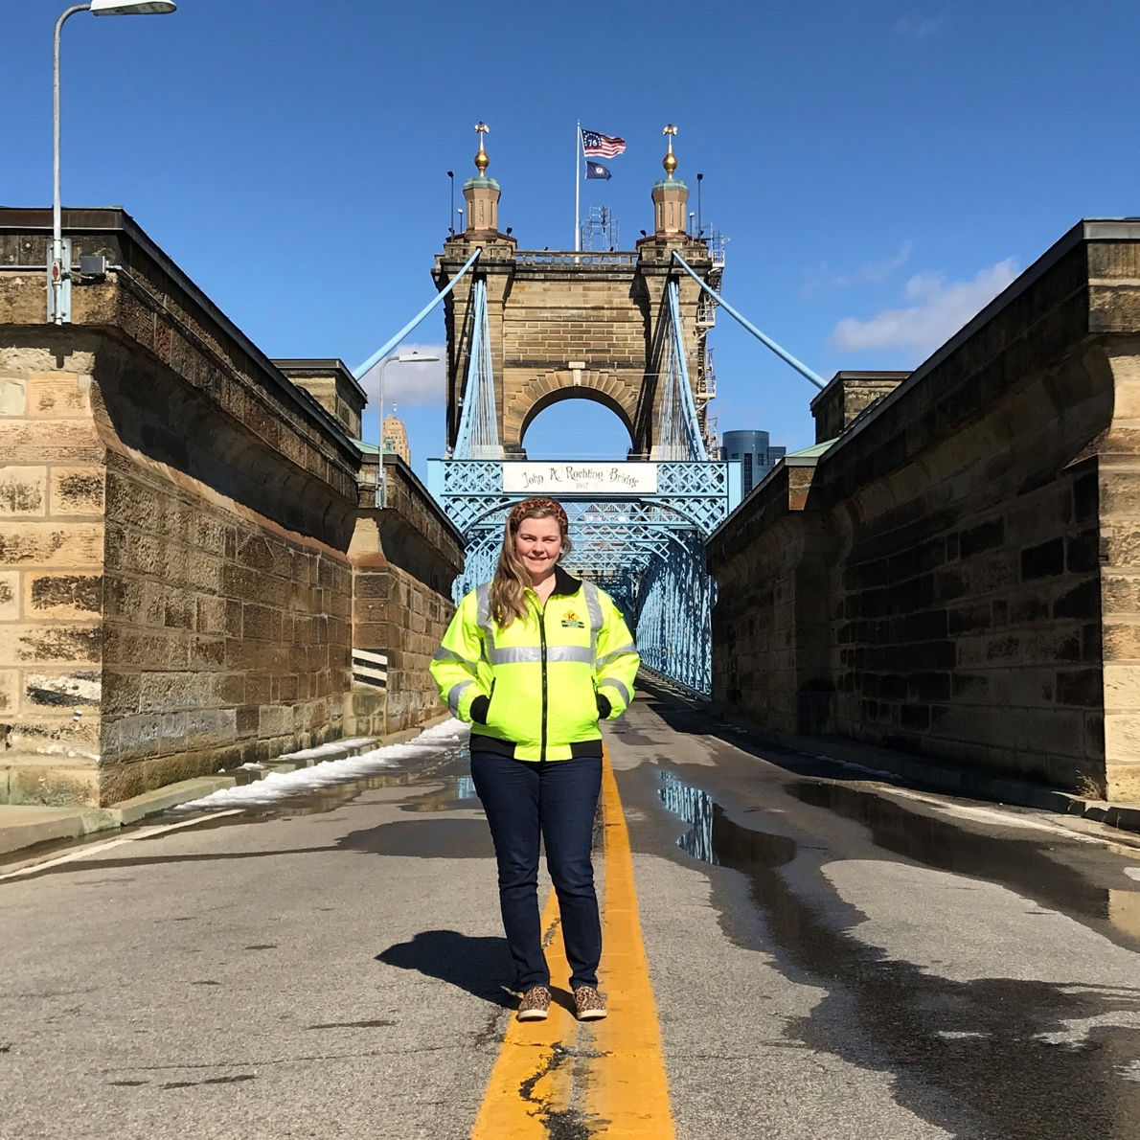
REVENUE SHARING IMPACT
E.O. 2026-235
KYTC typically processes three payments for County Road Aid and Municipal Road Aid (Aug, Jan, July – 60/30/10%) and two for Rural Secondary (Aug, July – 90/10%). The last payment can be more or less than 10%, depending on actual revenues, so they are referred to as “make whole” payments.
Notes:
To replace the photo: select the photo, click the picture format tab, select “change picture,” and select “from a file,” and replace with your chosen file. If adjustments need to be made, go to “crop” and move the photo to be framed within the box.

Slide 7
E.O. 2026-235
REVENU SHARING IMPACT (cont’d)
State funding for the Department of Rural and Municipal Aid’s major programs will align with collections, per statute, for the current fiscal year and in the upcoming biennium.
For FY27, counties and cities will receive less funding in August, and we will adjust payments throughout the year as the situation becomes clearer. As has been done in the past, we may add a payment to the schedule.
If the 10-cent reduction stays in effect through Dec. 2026, the funding available for County Road Aid, Rural Secondary, and Municipal Road Aid would be about 16.9% less than the Consensus Forecast Group’s official estimate.

Slide 8







@KYTC
@KYTC120
QUESTIONS?
transportation.ky.gov
@KYTransportation
@KYTransportation
Shaun.McKiernan@ky.gov

