Slide 1
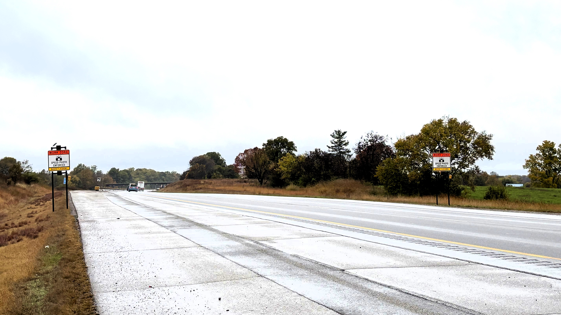


Camera Assisted Speed Enforcement (CASE) in Work Zones
John Moore

Slide 2
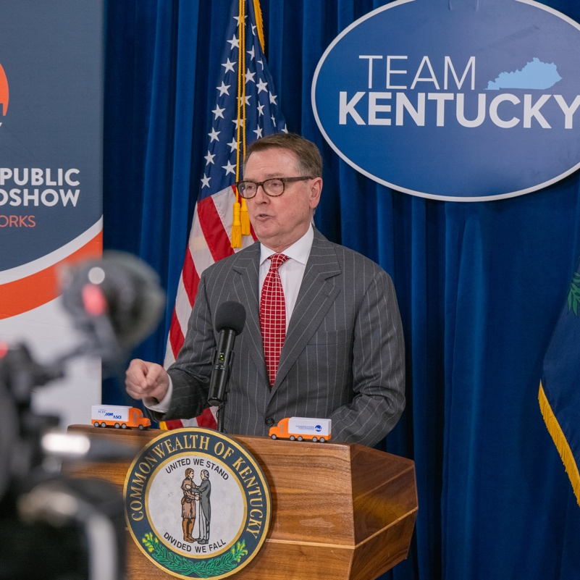
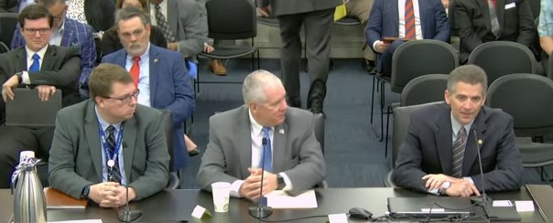
Speed Enforcement Legislation
House Bill 664 (Jared Lee Helton Act)
Work Zone Safety Bill sponsored by Chairman John Blanton ​
Signed into law April 4th, 2025
Notes:
To replace the photos: select the photo, click the picture format tab, select “change picture,” and select “from a file,” and replace with your chosen file. If adjustments need to be made, go to “crop” and move the photo to be framed within the box.

Slide 3

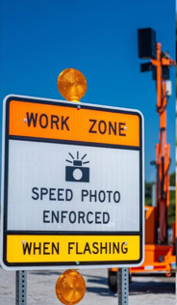
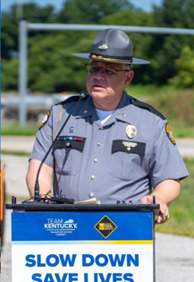
Hybrid Speed Enforcement
Discovery Phase: Feedback from ~20 DOTs identified 5 potential vendors & contract exhibits.
Various Camera Vendors performed demonstrations
KYTC, KSP, and KAHC worked together to determine which technology solutions best suited our needs and identified pilot projects for field testing.
Notes:
April – August – Coordinated with Vendors, KSP, and Industry
Sep – Oct – Implementation and Training
Nov – Apr – 5 Units Available

Slide 4
Reminders
NO personal Information is gathered or retained
All images that are NOT retained as an evidence package are deleted from the system within 15 minutes
All information transmitted and transferred to the officer is encrypted
Unit certification is included on every evidence package
Unit accuracy is confirmed every 24 hours to ensure certified use
Unit will shut down if certification is out of tolerance
Signage with beacons indicate bona fide workers present

Slide 5
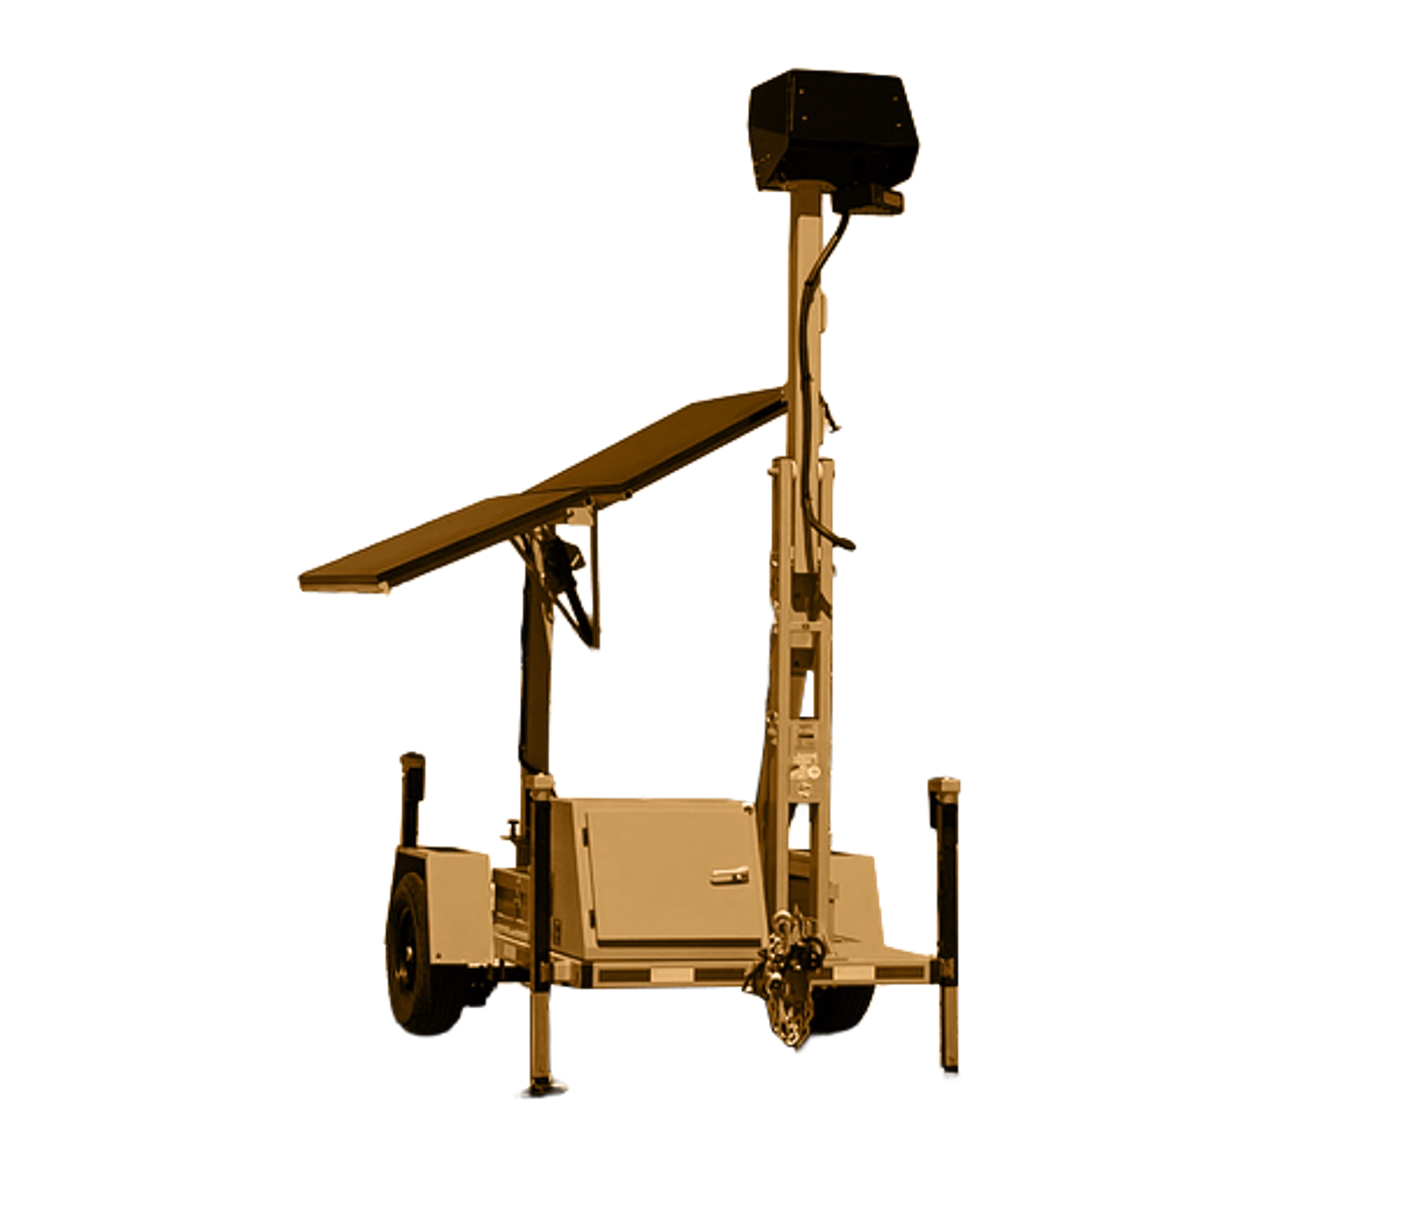


High Detection Radar and Camera
360-Degree Security Surveillance
Hydraulic Mast
Solar Panel
System Components
Battery Bank Under Solar Panel
Hydraulic Actuator Components
Housing Control
Stabilizing Levelling Jacks

Slide 6
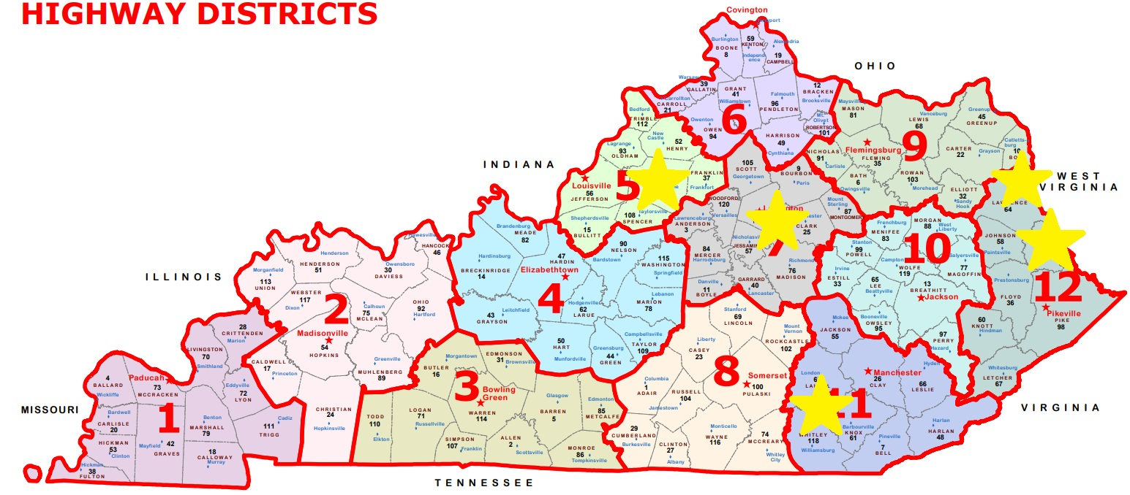
Pilot Projects - Speed Cameras were deployed on pilot projects in the fall 2025 (preference given to projects where workers are not protected by a barrier wall)

Slide 7
Evaluation
Speed Impact – Initial Results
  Oct 1 thru Dec 1
Speed Source Data
  Probe Data
  Unit Information
  Smart Cones
Crash Impact – In Progress

Slide 8
Are drivers slowing down?
Site | Enforcement Status | Avg Speed | 85th Percentile Speed | % Vehicles over WZ Limit | % Vehicles over WZ Limit + 10MPH
I-64 WB Shelby Co | Inactive | 64.4 | 73 | 89.1 | 48.2
 | Active | 60.9 | 69 | 80.8 | 29.2
I-64 EB Shelby Co | Inactive | 61.7 | 69 | 81.7 | 32.3
 | Active | 59.2 | 66 | 73.2 | 18.8
I-75 Whitley Co | Inactive | 65.6 | 74 | 91.5 | 55.1
 | Active | 62.3 | 70 | 84.4 | 37.8
Hwy 3 Martin Co | Inactive | 52.9 | 62 | 79.8 | 42.4
 | Active | 45.4 | 55 | 43.5 | 16.5
Richmond Rd Fayette Co | Inactive | 54.5 | 61 | 95.0 | 94.6
 | Active | 52.7 | 59 | 91.0 | 90.3
Notes:
Enforcement consistently reduces speeds across all five sites. Every site shows lower average speeds, lower 85th-percentile speeds, and lower speeding percentages during active enforcement.
The biggest impact is on the most dangerous drivers ("over limit + 10 mph" column). At Hwy 3 Martin Co, the share of vehicles exceeding the limit by 10+ mph drops significantly from 42.4% to 16.5%. At I-64 WB Shelby Co it drops from 48.2% to 29.2%, and at I-64 EB from 32.3% to 18.8%. Enforcement is pulling back the high-end speeders who pose the greatest crash risk in work zones.

Slide 9
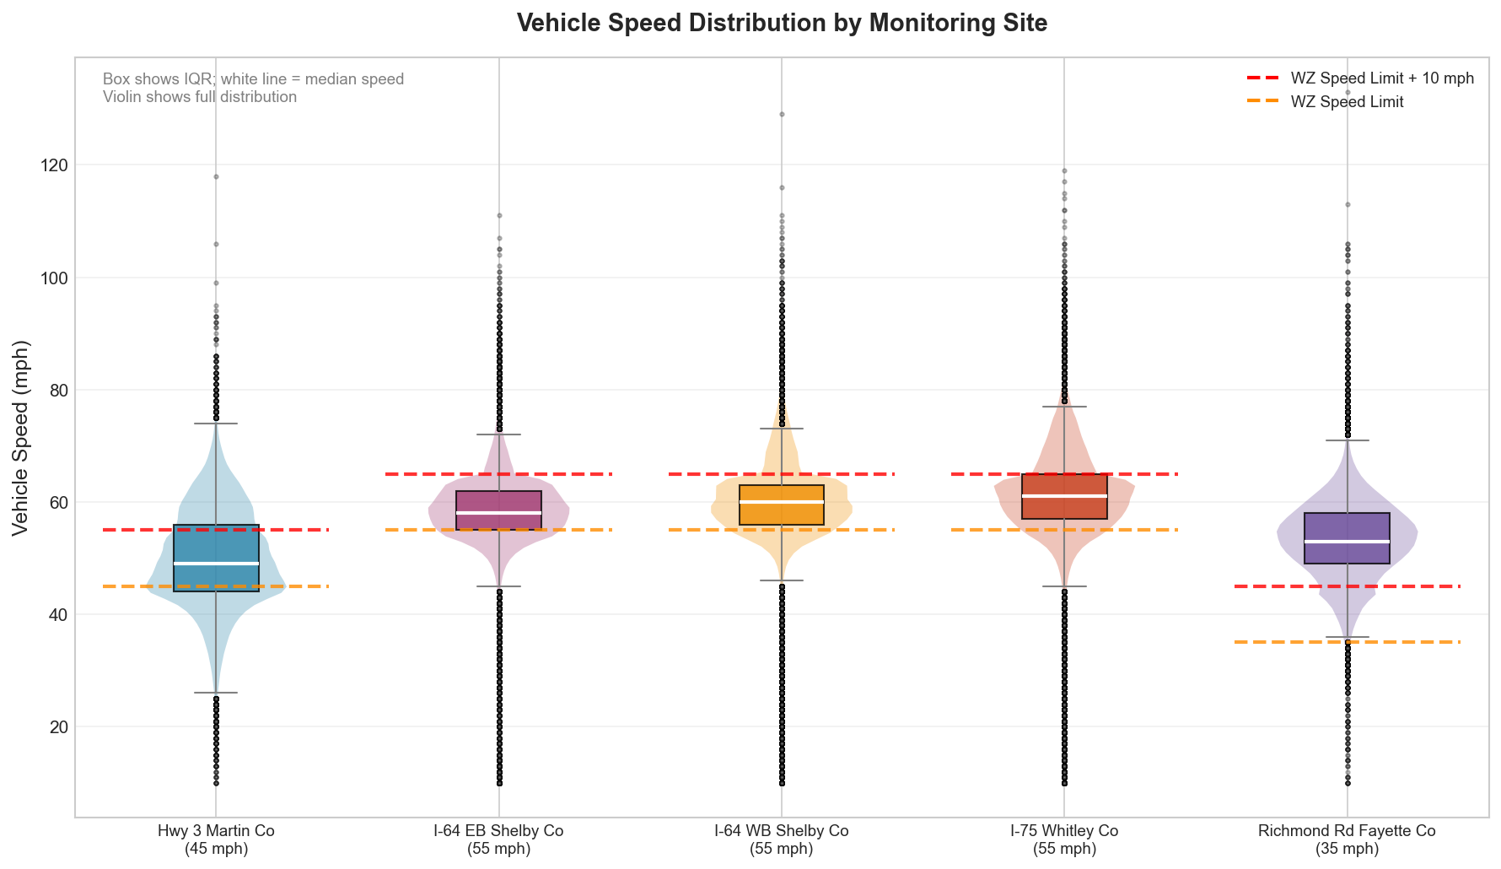
Based on ~4 million individual vehicle speeds collected across 4 sites in 10/1/2025-12/1/2025
Notes:
Active enforcement reduced speeds at every site
The more significant effect was the reduction in severe speeding
Hwy 3 Martin Co: 42.4% → 16.5%
I-64 EB Shelby Co: 32.3% → 18.8%
I-64 WB Shelby Co: 48.2% → 29.2%
I-75 Whitley Co: 55.1% → 37.8%
Hwy 3 Martin Co showed the strongest response to enforcement
Enforcement helped, but did not eliminate speeding
Will integrate with citation data to verify active enforcement timeline

Slide 10
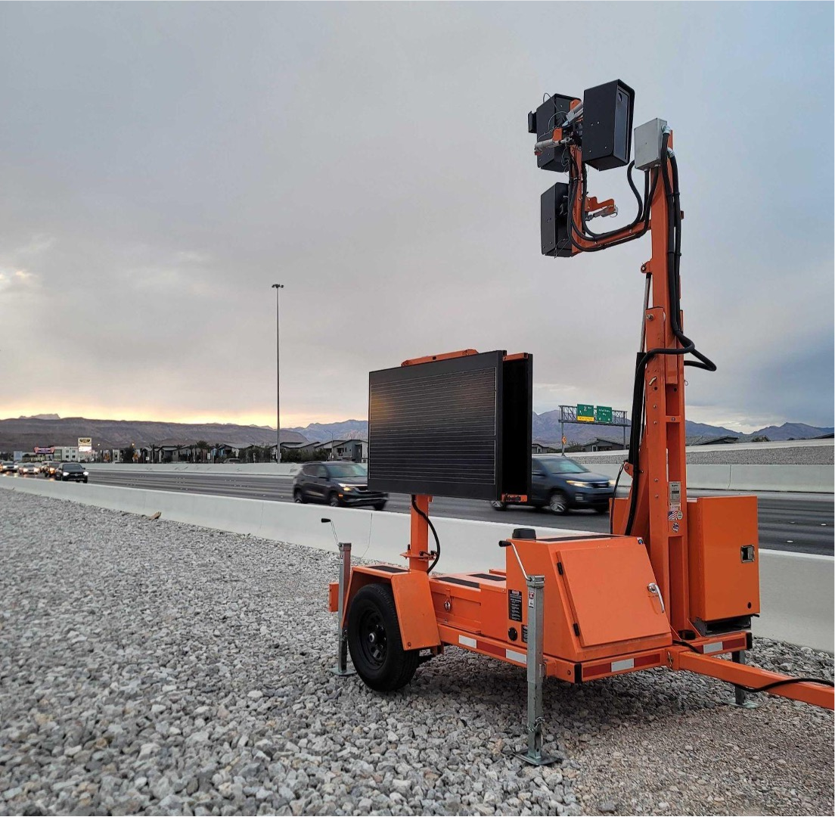
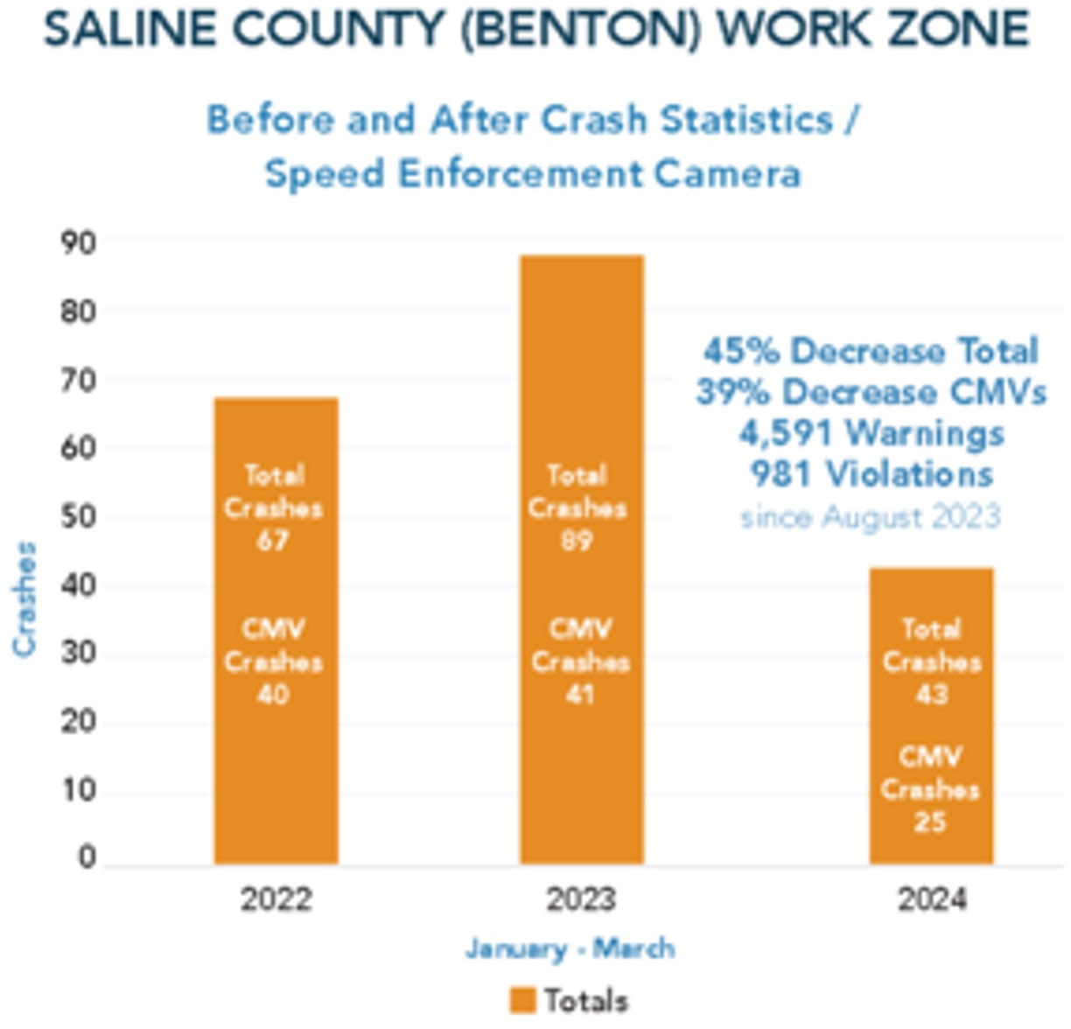
Key Data Insights from Arkansas
The Arkansas Work Zone Speed Program demonstrated a 45% decrease in work zone crashes during the trial period

Slide 11
Next Steps
Procurement to Expand to 12 Units
  Potential to add 12 more (total of 24)
Product Demo on June 1
Law Enforcement Training beyond KSP
Anticipate Additional Roll-Out in Late Summer
Crash Analysis After a Full Year of Use

Slide 12







transportation.ky.gov
@KYTC
John Moore, P.E.
johnw.moore@ky.gov
502-782-5053
@KYTC120
QUESTIONS?
@KYTransportation
@KYTransportation

