Slide 1
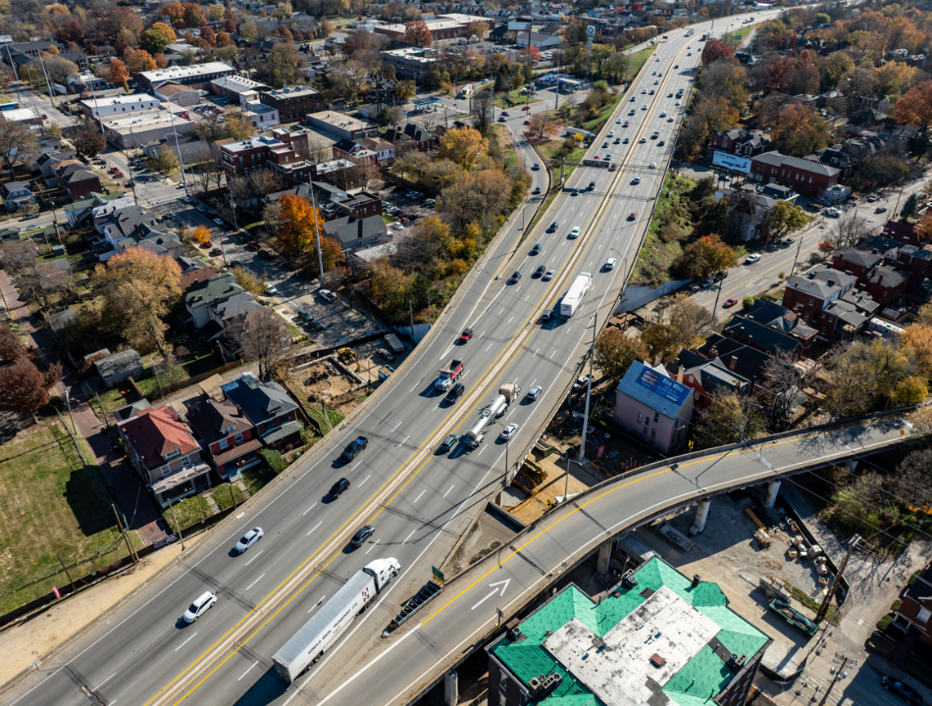

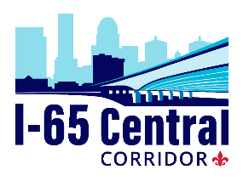
Interim Joint Committee on Transportation
June 2, 2026
James Ballinger, State Highway Engineer
I65CentralCorridor.com

Slide 2
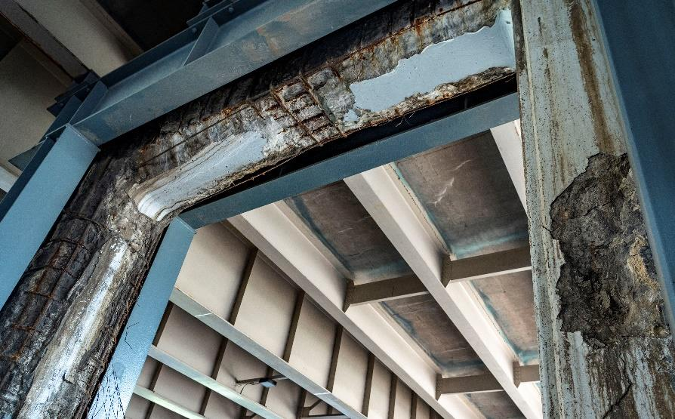
Project Need
Bridges in the corridor were built in the 1950s and 1960s as part of the original interstate construction.
Ongoing maintenance kept bridges safe for travel, but they are at the end of their service life.
Replacing bridges is needed to ensure long-term reliability.
New bridges will last 75 years.
Work includes under bridge lighting upgrades and sidewalk reconstruction.
Notes:
Replacing 3 bridges along I-65 in Louisville; work started last fall. Below bridges with minimal impacts.
Next are some photos of the condition of the three bridges and work we've done so far

Slide 3
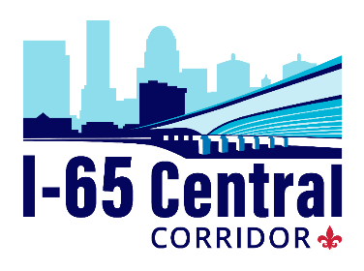
Bridges Under Construction

Slide 4
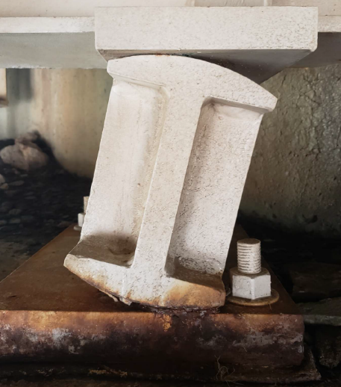
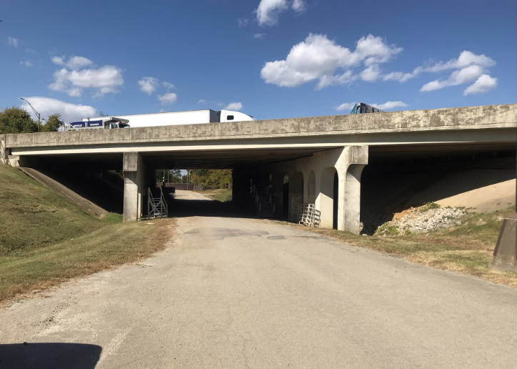
Before: Bradley Bridge

Slide 5
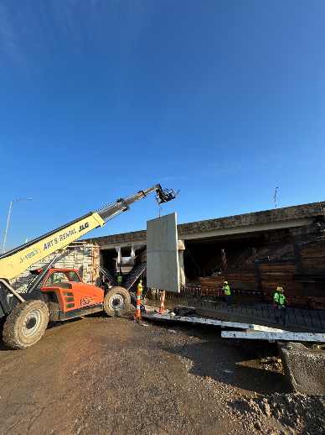
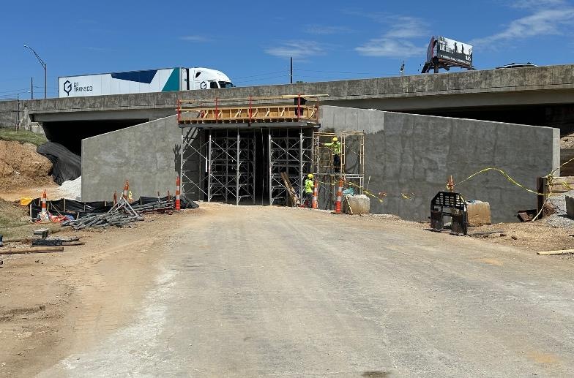
Today: Bradley Bridge

Slide 6
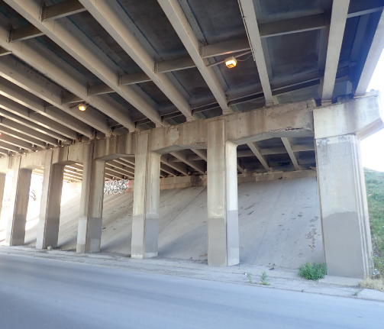
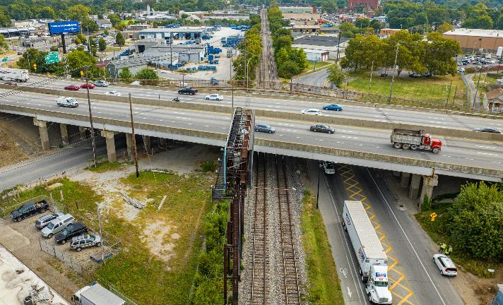
Before: Hill/CSX/Burnett Bridge

Slide 7
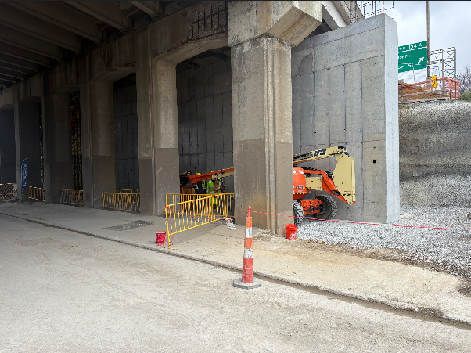
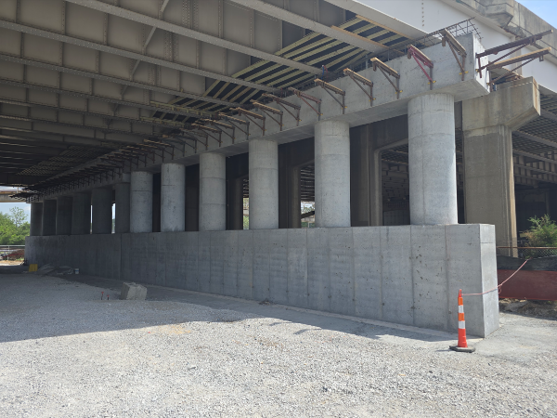
Today: Hill/CSX/Burnett Bridge

Slide 8
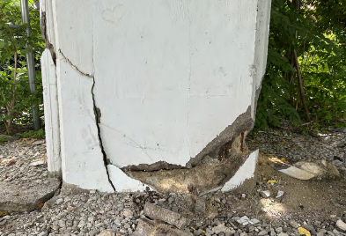
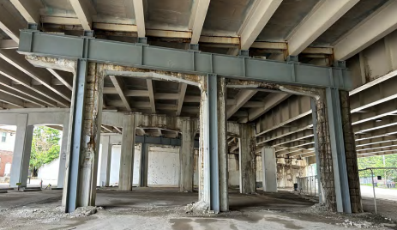
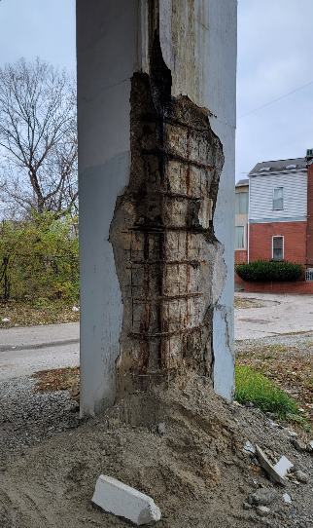
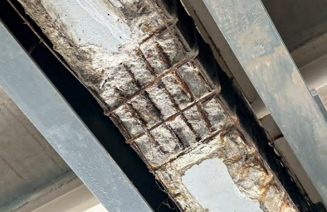
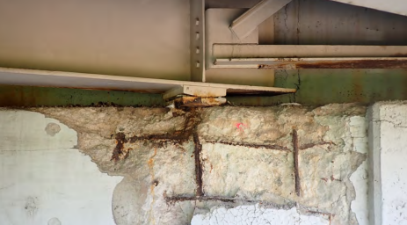
Before: Kentucky/Brook Bridge

Slide 9
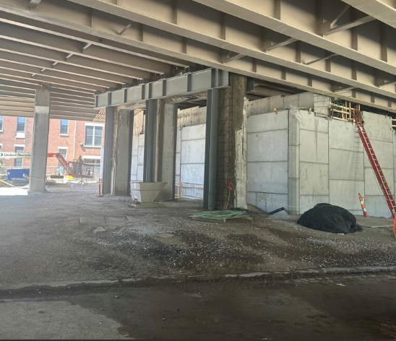
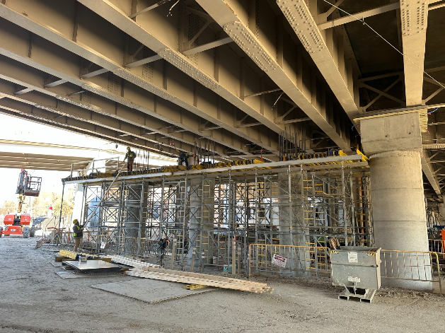
Today: Kentucky/Brook Bridge
Notes:
Time to now move to to do work on the top part of the bridges. Faster and safer to do it with no live traffic so crews can work around the clock. Lots of work has been done in advance to pre-fabricate materials and they are all on hand to waste no time.

Slide 10
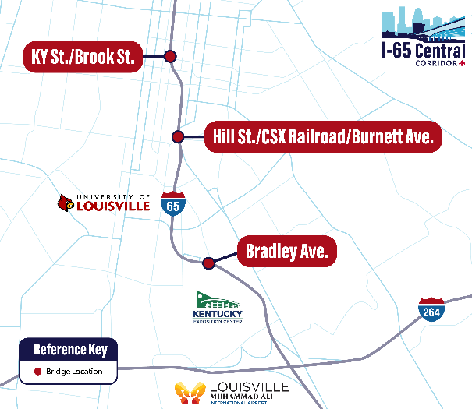
Project Overview
Closure began early June 1
5 miles of I-65 closed between the Watterson Expressway (I-264) and Downtown Louisville (Jefferson Street) June 1 – July 31, 2026.
I-65 is expected to reopen August 1 to two lanes of traffic in each direction.
There will be restrictions, including local road and ramp closures, through the end of the project in late 2027.

Slide 11
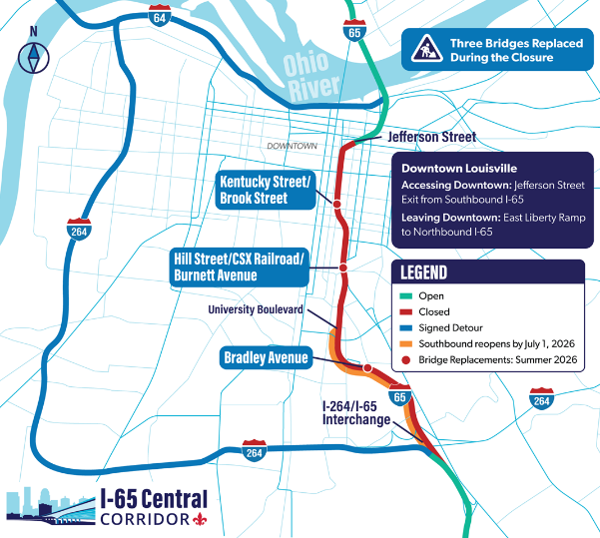
Project Overview
A two-mile section of southbound I-65 from University Boulevard to I-264 is expected to reopen to traffic by July 1.
Six additional bridges will be rehabilitated or replaced.
Plans are still being finalized. Work is expected to continue through the end of 2027.

Slide 12
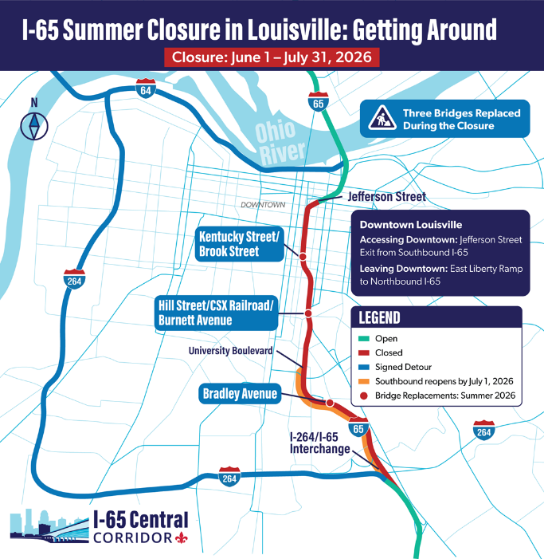
Interstate Detour During Closure
Through traffic detoured to I-264 (Georgia Davis Powers Expressway) on west side of Louisville
Detour route utilizes the most available capacity and creates least traffic impacts
Expected to add an average of about 15 minutes to a trip
Longer delays during peak travel times
Notes:
Can still get where you need to go, including key destinations like the downtown hospitals, Expo Center and Muhammad Ali Airport
I-65 northbound drivers staying in Kentucky: detour onto I-264 West, then use I-64 East
I-65 northbound drivers traveling to Indiana: detour onto I-264 West, take I-64 West and the Sherman Minton Bridge to cross the Ohio River, then use I-265 East to rejoin I-65
I-65 southbound drivers staying in Kentucky: detour onto I-64 West, then use I-264 East
I-65 southbound drivers traveling from Indiana: take I-65 South and the Kennedy Bridge to cross the Ohio River, detour onto I-64 West, then use I-264 East to rejoin I-65

Slide 13
Questions

