Slide 1


Department of Corrections
Division of Addiction Services
Sarah G. Johnson, Director
“We Change Lives, We Change Outcomes
and We Change Tomorrow Today.”

Slide 2
Division of Addiction Services
Organizational Chart
DOC Commissioner
Deputy Commissioner
Community Programs
Director of Addiction Services
Assistant Director of Addiction Services
Executive Staff Advisor
Branch Managers
Central Office Administrative Specialists
Program Administrators
Community SSCs
Institution SSCs
Institution Administrative Specialist

Slide 3
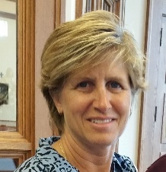
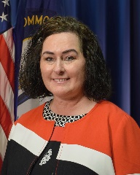
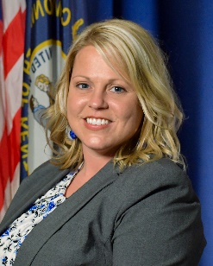
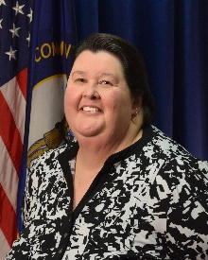
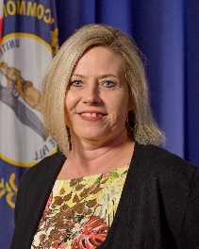
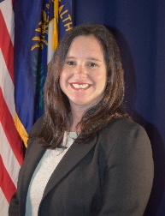
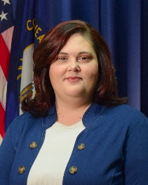
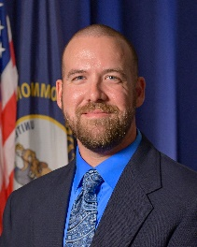
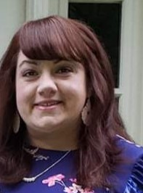
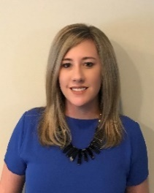
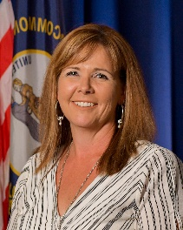
Addiction Services Division Regions
Louisville Region
North Central Region
North East Region
South East Region
South Central Region
South West Region
North West Region
Maryann Strickland
North Central Region
Branch Manager
Sarah G. Johnson
Director
Jeannie Waldridge
Assistant Director
BOONE
CAMPBELL
KENTON
GALLATIN
PENDELTON
BRACKEN
Mylea McFelea
Louisville Region
Branch Manager
CARROLL
GRANT
MASON
LEWIS
GREENUP
TRIMBLE
OWEN
HARRISON
ROBERTSON
Ashley Short
Executive Staff Advisor
OLDHAM
HENRY
NICHOLAS
FLEMING
CARTER
BOYD
Erin Kron-Chia
North West Region
Branch Manager
FRANKLIN
SCOTT
BOURBON
ROWAN
Jay Volkert
North East Region
Branch Manager
JEFFERSON
SHELBY
BATH
ELLIOTT
LAWRENCE
WOODFORD
FAYETTE
MONTGOMERY
BULLITT
SPENCER
ANDERSON
CLARK
MENIFEE
MORGAN
JOHNSON
HANCOCK
MEADE
WASHINGTON
JESSAMINE
POWELL
MARTIN
BRECKINRIDGE
NELSON
MERCER
MADISON
WOLFE
MAGOFFIN
HENDERSON
DAVIESS
HARDIN
GARRARD
ESTILL
LEE
FLOYD
UNION
BOYLE
BREATHITT
PIKE
WEBSTER
MCLEAN
LARUE
MARION
LINCOLN
JACKSON
OWSLEY
OHIO
GRAYSON
TAYLOR
ROCKASTLE
PERRY
KNOTT
CRITTENDEN
HOPKINS
HART
GREEN
CASEY
CLAY
LETCHER
LIVINGSTON
MUHLENBERG
BUTLER
EDMONSON
PULASKI
LAUREL
LESLIE
Denise Thorpe
Special Detailed
South East Region
Branch Manager
CALDWELL
ADAIR
Hillery Ohnemus
South West Region
Branch Manager
BALLARD
McCRACKEN
LYON
WARREN
BARREN
METCALFE
RUSSELL
KNOX
HARLAN
CARLISLE
MARSHALL
CHRISTIAN
TODD
LOGAN
CUMBERLAND
WAYNE
WHITLEY
BELL
TRIGG
SIMPSON
ALLEN
MONROE
CLINTON
MCCREARY
HICKMAN
GRAVES
FULTON
CALLOWAY
Veronica Hunt
South Central Region
Branch Manager

Slide 4

Division of Addiction Services Staff
Position | Total
Director | 1
Assistant Director | 1
Executive Staff Director | 1
Administrative Staff | 8
Branch Managers | 7
Program Administrators | 13
Institution SSCs | 23
Community SSCs | 48
Total Staff | 102

Slide 5
Current DOC Treatment Options
Program Type | Sum of Beds
Intensive Outpatient Program (IOP) | 1,460
Re-entry Services Center (RSC) | 1,211
Jail | 1,635
Prison SAP | 903
Private Prison | 112
Recovery Kentucky Centers (RKC) | 840
Grand Total | 6,161
Current as of June 2020

Slide 6
Substance Abuse Program-SAP
A 6 month evidence-based Substance Use Disorder treatment
Therapeutic Community Model which includes but not limited to:
Prosocial behaviors and attitudes;
Trial and error learning process;
Supported and guided by the community and staff;
New behaviors and attitudes
Accountability
Clear expectations;
Curriculum- Hazelden “New Directions” Workbook Series (Intro to Treatment, Criminal & Addictive Thinking, Drug & Alcohol Drug Education, Socialization, Co-Occurring Disorders, Relapse Prevention, and Preparing For Release.)
Locations
BCC, GRCC, KCIW, KSR, LAC, LSCC, NTC, RCC, WKCC, and Ross Cash
Boyle County Detention Center (M), Breckinridge County Detention Center (M), Bullitt County Detention Center (M), Christian County Detention Center (M), Daviess County Detention Center (M), Fayette County Detention Center (M/F), Fulton County Detention Center (M), Grant County Detention Center (M/F), Grayson County Detention Center (M), Harlan County Detention Center (M), Hardin County Detention Center (M/F), Henderson County Detention Center (M/F), Hopkins County Jail (M), Kenton County Detention Center (M), Laurel County Detention Center (M), Three Forks Regional Jail (M), Marion County Detention Center (M/F), Mason County Jail (M), Pike County Detention Center (M/F), Powell County Detention Center (M), Shelby County Detention Center (M)

Slide 7
Substance Abuse Program Mentor – SAP Mentor
An evidence-based ongoing Substance Use Disorder treatment 6 month in length
Therapeutic Community Model which includes but not limited to:
Model prosocial behaviors and attitudes;
Model success or failure
Model support and guidance
Model new behaviors and attitudes
Model appropriate accountability
Model leadership
Hazelden “Now That You’re Sober” book work
Program Location:
BCC, GRCC, KCIW, KSR, LAC, LSCC, NTC, RCC, WKCC, and Ross Cash
Boyle County Detention Center (M), Breckinridge County Detention Center (M), Bullitt County Detention Center (M), Christian County Detention Center (M), Daviess County Detention Center (M), Fayette County Detention Center (M/F), Fulton County Detention Center (M), Grant County Detention Center (M/F), Grayson County Detention Center (M), Harlan County Detention Center (M), Hardin County Detention Center (M/F), Henderson County Detention Center (M/F), Hopkins County Jail (M), Kenton County Detention Center (M), Laurel County Detention Center (M), Three Forks Regional Jail (M), Marion County Detention Center (M/F), Mason County Jail (M), Pike County Detention Center (M/F), Powell County Detention Center (M), Shelby County Detention Center (M)

Slide 8
Outpatient Substance Abuse Treatment Programs
Evidence-based Substance Use Disorder Treatment for individuals assessed for lower level of care. Modified SAP with less programming hours.
  The primary curriculum for all programs is the Hazelden New Direction Series. Evidence-based interventions such as Cognitive Behavior Therapy, 12 step facilitation, Social Skills Training, Brief Intervention, and Relapse Prevention are also utilized. Clients receive individual and group counseling services, as well as drug and alcohol education throughout the duration of programming. Evidence- based activities and learning tools, such as role-plays and skits, are incorporated in the daily schedule.
Program Locations
KSR and Ross Cash
Henderson County Detention Center

Slide 9
Co-occurring Disorder (COD) SAP
Program Description
Individuals with verifiable histories of Substance Use Disorder and Mental Health Disorders are eligible to receive an integrated treatment program to address both mental health and substance use disorders. Treatment is provided utilizing a modified therapeutic community model.
Program Location
  KCIW and KSR

Slide 10
Co-occurring Disorder (COD) SAP Mentor
Program Description
Individuals who have completed COD SAP may participate in the mentoring program by serving as a mentor. Mentors serve as role models for participants and also complete tasks as assigned by the administrator. Mentors are chosen at the discretion of the program administrator. Mentors are engaged in activities and assignments designed to teach leadership.
Program Location
  KCIW and KSR

Slide 11
SOAR
Supporting Others in Active Recovery
Program Description
SOAR supports clients in their goal to stay safe and sober after completing SAP.
SOAR is targeted toward on relapse prevention, education, and reentry skills/resources.
Evidence-based curriculum from Hazelden called MORE (My Ongoing Recovery Experience).
While enrolled in SOAR, clients are eligible to participate in up to two other reentry programs.
Family communication and engagement.
Location: NTC, Marion County Detention Center, coming soon Fulton Co Jail

Slide 12
SOAR Mentor
SOAR Mentors demonstrate their leadership skills and assist with 6 month programming.
SOAR Mentors expectations:
Model prosocial behaviors and attitudes
Model success or failure
Model support and guidance
Model new behaviors and attitudes
Model appropriate accountability
Model leadership to create clear and understandable expectations
Hazelden- Now That You’re Sober book work
May participate in (2) other reentry evidence based programs
Program Locations - NTC, Marion Co. Detention Center, and Coming Soon Fulton Co Jail

Slide 13
SAMAT- Supportive Assistance with Medications for Addiction Treatment
SAMAT is focused on preventing overdose, relapse, and recidivism for individuals with Opioid Use Disorder and/or Alcohol Use Disorder whom have completed or are currently engaged in a Substance Abuse Program (SAP) through the implementation of FDA-approved medication for addiction treatment, which includes Vivitrol (naltrexone) and at some locations Sublocade.
SAMAT candidates are identified and screened for eligibility approximately 2 months prior to their anticipated release from incarceration.
SAMAT participants are provided medication services for up to 2 months before release from incarceration, which may include 2 injections.
Program Locations:
Vivitrol: All prisons, all jails that offer SAP
Sublocade: NTC, BCC, KCIW and Kenton Co. Detention Center

Slide 14
PSAP- Pretrial Substance Abuse Program
In response to Senate Bill 4, passed into law in 2009, individuals charged with Class C or D felony having no felony convictions within the past 10 years, may be eligible for treatment as an alternative to conviction. At initial incarceration, the Jail Pre-Trial Officer may alert the Division of Addiction Services Branch Manager or Program Administrator to conduct a clinical assessment to determine eligibility for SB4/PSAP. Upon an agreement between the judge, the commonwealth attorney, the client in question, and his/her attorney, successful completion of a jail based six-month treatment program may serve as an alternative to a felony conviction.
Program Location:
All jails that offer SAP for state inmates

Slide 15
County Inmate - SAP
Substance Abuse Program offered for county inmates that is overseen and funded through the Department of Corrections. Utilizes evidence based curriculum and is similar to SAP for state inmates.
Program Locations:
Kenton Co. Detention Center & Louisville Metro Detention Center

Slide 16
Recovery Kentucky Center (RKC)
Reentry Service Center (RSC)
Community Long-term Residential SAP
Program Description
Recovery Kentucky Centers (RKCs):
Through a joint effort by the Kentucky Department of Corrections, Kentucky Housing Corporation, and the Department for Local Government (DLG), Recovery Kentucky was created to assist Kentuckians recover from substance use disorders and to reduce homelessness. There are 14 Recovery Kentucky Centers across the Commonwealth. Each Center offers a total of 100 treatment/recovery beds, with 60 beds contracted by the Kentucky Department of Corrections in each location. As supportive housing projects, each center uses a recovery program model that includes peer support, daily living skills classes, job responsibilities, and establishes new behaviors. This type of supportive housing and recovery program is proven to help people who face the most complex challenges to live more stable, productive lives.
Reentry Service Centers (RSCs):
Those individuals in need of Substance Use Disorder treatment, who meet the classification criteria for community custody, may participate in programs available in reentry service centers approved by the department to offer Substance Use Disorder treatment programming.

Slide 17
RSC & RKC Mentor (SAP Mentor)
Program Description
Recovery Kentucky Centers (RKCs):
Those individuals who have completed all the requirements up through Phase I at an RKC can apply and sign on to stay for Phase II/Peer Mentorship. They begin to give back to the community by acting as role models, mentors, and teachers to the other phases in the program.
Reentry Service Centers (RSCs):
Those individuals who have completed all the requirements for an RSC can apply to stay for Peer Mentorship. They begin to give back to the community by acting as role models, mentors, and teachers to the other phases in the program.
Program Locations: All RSCs and RKCs

Slide 18
Recovery Kentucky Center (RKC) and
Reentry Service Center (RSC)
Community Long-term Residential SAP
RSC
Chrysalis House (F)
CTS Russell
Dismas Diersen (F)
Dismas Owensboro (F)
Healing Place for Women (F)
Healing Place for Men
Hope Center for Women (F)
Jacob’s House
George Privett Center
St. Ann’s
Westcare
RKC
Brighton Place (F)
The Healing Place Campbellsville
Center Point
Cumberland Hope (F)
Genesis
Hickory Hill
Liberty Place (F)
MARC
Morehead Inspiration Center
Owensboro Regional Recovery
SkyHope (F)
Trilogy (F)
WARM (F)

Slide 19
SAP-VOA (Volunteers of America)
Program Description
Opened 7-1-19, Volunteers of America Men’s Halfway Back Program made available a new level of care to male clients on probation or parole. VOA’s contract has been modified to allow for 45, 60, or 90 days of residential treatment. The treatment model is the same as the customary six-month residential treatment program, but the schedule has been modified to allow the client to complete earlier based on their individualized clinical progress. A Treatment Team is held weekly in partnership with VOA and DOC Division of Addiction Services staff to review clinical progress and determine who is appropriate for completion of the program.
Time Frame
This is a short-term 45, 60 or 90 days residential treatment program. Length of stay is based on level of care criteria and treatment team review.
Location: VOA -Louisville

Slide 20
(IOP) Intensive Outpatient Program – Community SAP
Program Description
Through an agreement with the Regional Community Mental Health Centers (CMHC), individuals who meet the clinical and classification criteria may attend a less restrictive 6-month Intensive Outpatient Program (IOP). Clients meet weekly in an outpatient setting to receive evidenced based substance use disorder curriculum. Clients must abide by all treatment program standards and submit to random drug screening.
Because the majority of the clients reside in Louisville, Lexington, or Northern Kentucky, the department contracts with treatment agencies in these areas to provide Substance Use Disorder treatment services akin to those offered in the CMHC’s. Eligible candidates include MRS, probationers, parolees, HIP, and pre-trial diversions.
6 months in length, individuals can be sent from an incarcerated setting to complete remaining treatment at these locations.

Slide 21
(IOP) Intensive Outpatient Program – Community SAP
Locations:
Adanta Group
New Vista
Seven Counties
Communicare
Comprehend
Cumberland
Four Rivers
Kentucky River
Lifeskills
Mountain Comp
Northkey
Pathways
PennyRoyal
River Valley
Hope Center

Slide 22
Supportive Housing for Adaptive ReEntry
Co-occurring Disorder & Serious Mental Illness
SHARE CO & SHARE SMI
SHARE CO
SHARE SMI
SHARE-CO is a facility for men with co-occurring Substance Use Disorders and Serious Mental Illness. The program addresses the substance use component by utilizing the peer-driven therapeutic community model that the Hope Center Men’s and Women’s Recovery Program has utilized for many years in its partnership with the Kentucky Department of Corrections. SHARE-CO utilizes Recovery Dynamics curriculum, integrating the 12 step model with the peer-driven therapeutic community model.
Due to comorbid psychiatric conditions, individuals in the program require certain accommodations to ensure success. This includes supplementing the peer-driven therapeutic community model with licensed mental health professionals to provide direct services and support. It also maintains smaller therapeutic community groups, providing a personal format which allows both staff and clients to focus on the particular needs of this group. SHARE-CO is partnered with New Vista, a local community mental health provider, to provide onsite mental health counseling as well as referrals for outpatient psychiatric counseling as needed. Other accommodations include specialized mental health groups specific to integrating mental health with the 12 step model based Recovery Dynamics curriculum, while still affording clients the opportunity to integrate into classes with the Hope Center Men’s Recovery Program to provide them with the full scope of the Hope Center’s services.
SHARE-SMI is a facility for men with Serious Mental Illness who may not meet criteria for any Substance Use Disorders. Clients receive onsite mental health screening and diagnostic services, psychoeducational and support groups focused on mental health management, and basic life skills groups.
It provides onsite mental health counseling through a partnership with New Vista, a local community health provider, and it also has licensed mental health professionals to offer support services, crisis intervention, and assist with other immediate needs. SHARE-SMI also provides referrals for health care, job training, vocational support services, educational services, and permanent housing. Clients are given the opportunity to be referred for Targeted Case Management services to provide ongoing aftercare support once they transition back into the community.

Slide 23
Reentry Drug Supervision RDS
Program Description
The Reentry Drug Supervision Program (RDS) is a pilot program resulting from SB 120. The program seeks to restore lives and reduce recidivism rates of inmates and parolees suffering from substance use disorder. It consists of two phases lasting a minimum of 12 months or until sentence is completed. Phase one (1) participants will attend group therapy, reentry program team meetings, submit to random drug screens, obtain and maintain full time employment, training, or education, ensure payment of court obligations and supervision fees, indicate an appropriate understanding of recovery principles, attend self-help programs and obtain and maintain housing approved by the re-entry team. Phase two (2) participants will attend weekly meetings with the re-entry team and continue to submit to random drug screens.
Location: Northern KY
Length: 12-18 months

Slide 24
Substance Abuse Program
Jails/Institutions
AODE license
Therapeutic Community
Cognitive Behavioral Therapy
Annual audits from OIG
Annual audits for Addiction Services
Evidence Based Curriculum through Hazelden Betty Ford
RSC must become licensed to comply with new MA

Slide 25
Growth of Treatment Opportunities
Current as of Nov. 2019

Slide 26
Women’s Medical Release
Released to Treatment 123
Refused 74
Completed Treatment 77
Completed WMR Supervision 29
Currently Active in Treatment 10
Violations of WMR 42

Slide 27
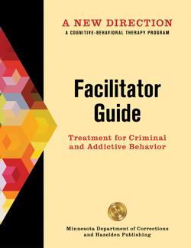
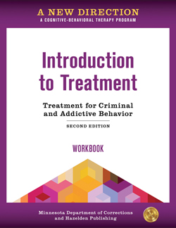
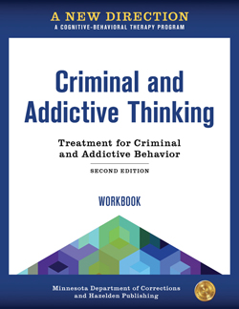
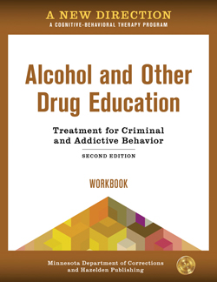
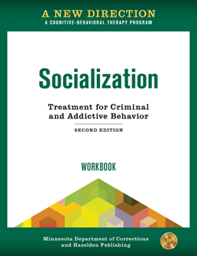
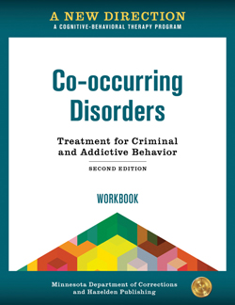
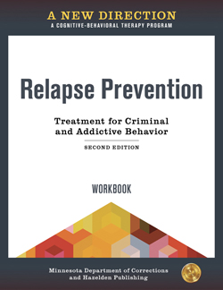
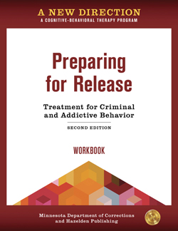
Changes in SAP
Standardization
  Team meetings
  Updated New Directions Curriculum from Hazelden
  Co-Occurring Workbook
  Hazelden trained Addiction Services staff in November
  Training to our contracted partners

Slide 28
Why New Directions?
Cognitive-Behavioral Therapy Program
Hazelden Betty Ford & Minnesota COC
Designed for Criminally Justice involved individuals
Treatment for Criminal and Addictive Behavior
Evidence Based Program
Research shows it reduces all 3 recidivism measures: rearrests, reconviction, and reincarceration
Received the highest rating against recidivism from the Council of State Governments
It identifies, challenges, and replaces distorted thinking to change criminal and addictive behavior
Utilizes therapeutic community, CBT, motivational interviewing, the trans theoretical model (stages of change), 12 step facilitation, Marlatt’s model of relapse prevention, and milieu therapy.
Minnesota DOC study shows 17% reduction for rearrests, 21% for reconviction, and 25% for reincarceration for a new crime

Slide 29

Substance Abuse Programs Added
Fayette County Detention Center- 20 Beds Male & 20 Beds Female
Hope Center- IOP- Fayette County – 60 Treatment Slots
VOA-Reentry Service Center- 45,60,or 90 day residential program
The Men’s Healing Place-60 Beds
Blackburn Correction Complex- 50 Beds
Southeast State Correctional Complex -100 Beds Coming Soon!
Grant County Detention Center- 60 Beds (40 Male & 20 Female)
  Additional 40 beds Coming Soon!
SHARE CO & SHARE SMI
Fulton County SOAR 36 Beds-Coming Soon!

Slide 30
Other Services Provided
Circuit Judges- Evaluation and treatment as a condition of supervision; Probation, Pretrial diversion, Shock probation, Misdemeanor convicted in circuit court
District Judges- In some areas misdemeanor supervision
SB133– Women’s Medical Release
P&P Office- Violation of supervision, violation of HIP, violation of MRS, graduated sanction, or Aftercare needs
Parole Board- Substance abuse evaluation, SAP-IOP, long term residential (RKC/RSC), or Aftercare needs

Slide 31
Community SSC Assessment Total
FY 19
18,317
Assessment Type | Totals
Parolees (27%) | 4,873
Probationers (42%) | 7,693
SAP Aftercare (9%) | 1,676
ISC (2%) | 393
Misdemeanant (3%) | 473
Pre-trial Diversion (18%) | 3,209

Slide 32
S
Supportive Assistance with Medications
for Addiction Treatment
A
Institutions- March 2016- 3 Vivitrol Injections prior to release
Jails-July 2018- 2 Vivitrol Injections prior to release
90 Day Program Good Time Credit- 6 months Vivitrol -July 2018
Contracted RKCs & RSCs must allow Vivitrol
Community SSC – Vivitrol Referrals
Revisions of SAMAT Protocol
Program Administrator position established to oversee operations, provide quality assurance, and assist with protocols for other forms of MAT
New data collection procedures
M
A
T

Slide 33

Justice Community
Opioid Innovation Network
JCOIN
Cooperative agreement funded by NIH/NIDA
Goal to improve capacity of Justice System response to OUD
KY is 1 of 10 sites chosen
Will focus on women in jails
UK-CDAR, DOC, & BHID will work together to offer pretreatment and improve access to MAT
Support will be provided by Voices of Hope
5 year grant - $8.8 Million

Slide 34
Studies/Evaluations
University of Kentucky –Center of Drug and Alcohol Research
  Criminal Justice Kentucky Treatment Outcome Study
    Change of Scope
    Incorporation of ASAMS, DSM-5 criteria for SUDs and common Co-Occurring Disorders
    Addition of Suicidality and overdose measures
  MAT Expansion Outcome Study
    New study to evaluate multiple forms of MAT

Slide 35
CJKTOS – FY 2019
Among SAP graduates from KY jails, prisons, and community corrections facilities interviewed 12 months post-release…
  61.6% had not been re-incarcerated.
  87.8% were living in stable housing.
  76.6% were employed.
  77.1% of those with children reported providing financial support to their children.
  58.8% did not have a positive drug test in the year since release.
  67.5% attended 12-Step meetings.
  67.2% of those referred to aftercare, attended aftercare.

Slide 36
CJKTOS – FY 2019
Of the SAP graduates who returned to DOC custody…
100% were re-incarcerated on a technical or probation/parole violation, though 52.9% also had a new charge.
63.4% were employed, whereas 84.8% of non-recidivists were employed.
80.5% reported using drugs in the year since release and 56.9% had a positive drug test.
Treatment graduates noted positives about SAP participation, including…
81.5% felt better about themselves as a result of treatment.
81.9% received services they needed to get better.
83.1% considered the treatment program to be successful.
Cost offset analysis indicated that…
For every $1 spent on Kentucky corrections-based substance abuse treatment there is a $3.94 cost offset.

Slide 37
Summary of Treatment Updates
Standardizing Treatment
Implementation of Assessment Tool for Level of Care-ASAMS
Additional levels of care and alternative modalities of treatment
Expansion of MAT
Changes to policy and procedure
New audit tool and CAP procedure
Updated Curriculum- Addition of Co-occurring
Referrals to non-contracted treatment programs
Outcome Studies on New Initiatives

Slide 38
  Addiction Services of Kentucky
  New Initiatives
Changing the message- “Treatment is not punishment”
Promoting Recovery instead of just Treatment
Reducing Stigma
Expanding Programming
JCOIN-telehealth
Family & Community Engagement
New Curriculum-Co-occurring
New SMI/CO Program in the community
New short term program in the community
SOAR Aftercare in jails and prisons
Out-patient treatment at Henderson Co.
  Recovery is possible if you ASK for help!

