Slide 1


Department of Corrections
Division of Addiction Services
Sarah G. Johnson, Director
“We Change Lives, We Change Outcomes
and We Change Tomorrow Today.”

Slide 2
Division of Addiction Services
Organizational Chart
DOC Commissioner
Deputy Commissioner
Community Programs
Director of Addiction Services
Assistant Director of Addiction Services
Executive Staff Advisor
Branch Managers
Central Office Administrative Specialists
Program Administrators
Community SSCs
Institution SSCs
Institution Administrative Specialist

Slide 3
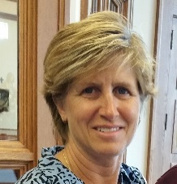
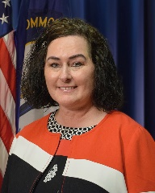
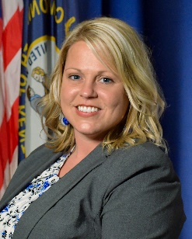
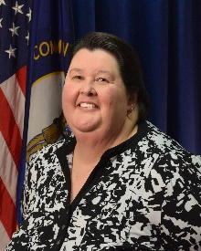
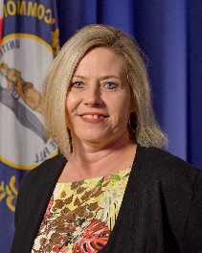
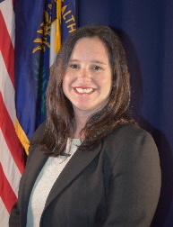
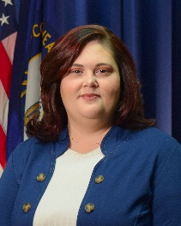
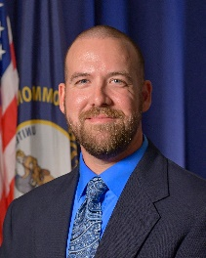
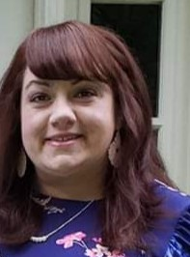
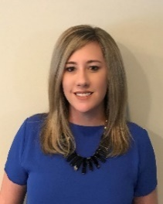
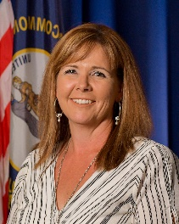
Addiction Services Division Regions
Louisville Region
North Central Region
North East Region
South East Region
South Central Region
South West Region
North West Region
Maryann Strickland
North Central Region
Branch Manager
Sarah G. Johnson
Director
Jeannie Waldridge
Assistant Director
BOONE
CAMPBELL
KENTON
GALLATIN
PENDELTON
BRACKEN
Mylea McFelea
Louisville Region
Branch Manager
CARROLL
GRANT
MASON
LEWIS
GREENUP
TRIMBLE
OWEN
HARRISON
ROBERTSON
Ashley Short
Executive Staff Advisor
OLDHAM
HENRY
NICHOLAS
FLEMING
CARTER
BOYD
Erin Kron-Chia
North West Region
Branch Manager
FRANKLIN
SCOTT
BOURBON
ROWAN
Jay Volkert
North East Region
Branch Manager
JEFFERSON
SHELBY
BATH
ELLIOTT
LAWRENCE
WOODFORD
FAYETTE
MONTGOMERY
BULLITT
SPENCER
ANDERSON
CLARK
MENIFEE
MORGAN
JOHNSON
HANCOCK
MEADE
WASHINGTON
JESSAMINE
POWELL
MARTIN
BRECKINRIDGE
NELSON
MERCER
MADISON
WOLFE
MAGOFFIN
HENDERSON
DAVIESS
HARDIN
GARRARD
ESTILL
LEE
FLOYD
UNION
BOYLE
BREATHITT
PIKE
WEBSTER
MCLEAN
LARUE
MARION
LINCOLN
JACKSON
OWSLEY
OHIO
GRAYSON
TAYLOR
ROCKASTLE
PERRY
KNOTT
CRITTENDEN
HOPKINS
HART
GREEN
CASEY
CLAY
LETCHER
LIVINGSTON
MUHLENBERG
BUTLER
EDMONSON
PULASKI
LAUREL
LESLIE
Denise Thorpe
Special Detailed
South East Region
Branch Manager
CALDWELL
ADAIR
Hillery Ohnemus
South West Region
Branch Manager
BALLARD
McCRACKEN
LYON
WARREN
BARREN
METCALFE
RUSSELL
KNOX
HARLAN
CARLISLE
MARSHALL
CHRISTIAN
TODD
LOGAN
CUMBERLAND
WAYNE
WHITLEY
BELL
TRIGG
SIMPSON
ALLEN
MONROE
CLINTON
MCCREARY
HICKMAN
GRAVES
FULTON
CALLOWAY
Veronica Hunt
South Central Region
Branch Manager

Slide 4

Division of Addiction Services Staff
Position | Total
Director | 1
Assistant Director | 1
Executive Staff Director | 1
Administrative Staff | 8
Branch Managers | 7
Program Administrators | 13
Institution SSCs | 23
Community SSCs | 48
Total Staff | 102

Slide 5
Current DOC Treatment Options
Program Type | Sum of Beds
Intensive Outpatient Program (IOP) | 1,460
Re-entry Services Center (RSC) | 1,211
Jail | 1,635
Prison SAP | 903
Private Prison | 112
Recovery Kentucky Centers (RKC) | 840
Grand Total | 6,161
Current as of June 2020

Slide 6
Addiction Services
Treatment Modalities
SAP
SAP Mentor
Outpatient SAP
Co-Occurring Disorder SAP
Co-Occurring Disorder SAP Mentor
SOAR-Aftercare
SOAR Mentor
SAMAT
PSAP
County SAP
RSC/RKC
RSC/RKC Mentor
Short term SAP-VOA
IOP
SHARE CO/SHARE SMI
RDS

Slide 7
Substance Abuse Program
Jails/Institutions
AODE license
Therapeutic Community
Cognitive Behavioral Therapy
Annual audits from OIG
Annual audits for Addiction Services
Evidence Based Curriculum through Hazelden Betty Ford
RSC must become licensed to comply with new MA

Slide 8
Growth of Treatment Opportunities
Current as of Nov. 2019

Slide 9
Women’s Medical Release
Released to Treatment 123
Refused 74
Completed Treatment 77
Completed WMR Supervision 29
Currently Active in Treatment 10
Violations of WMR 42

Slide 10
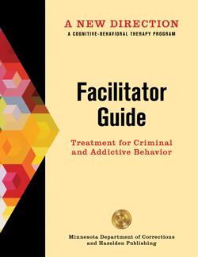
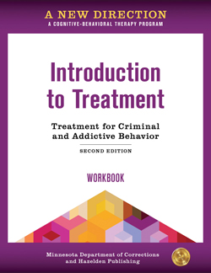
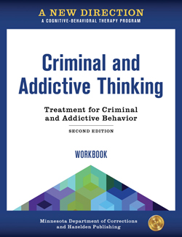

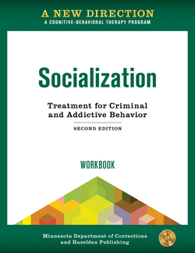
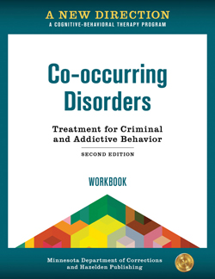
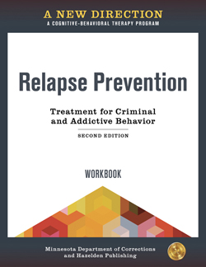
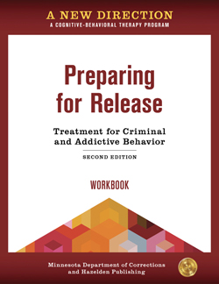
Changes in SAP
Standardization
  Team meetings
  Updated New Directions Curriculum from Hazelden
  Co-Occurring Workbook
  Hazelden trained Addiction Services staff in November
  Training to our contracted partners

Slide 11
Why New Directions?
Cognitive-Behavioral Therapy Program
Hazelden Betty Ford & Minnesota COC
Designed for Criminally Justice involved individuals
Treatment for Criminal and Addictive Behavior
Evidence Based Program
Research shows it reduces all 3 recidivism measures: rearrests, reconviction, and reincarceration
Received the highest rating against recidivism from the Council of State Governments
It identifies, challenges, and replaces distorted thinking to change criminal and addictive behavior
Utilizes therapeutic community, CBT, motivational interviewing, the trans theoretical model (stages of change), 12 step facilitation, Marlatt’s model of relapse prevention, and milieu therapy.
Minnesota DOC study shows 17% reduction for rearrests, 21% for reconviction, and 25% for reincarceration for a new crime

Slide 12

Substance Abuse Programs Added
Fayette County Detention Center- 20 Beds Male & 20 Beds Female
Hope Center- IOP- Fayette County – 60 Treatment Slots
VOA-Reentry Service Center- 45,60,or 90 day residential program
The Men’s Healing Place-60 Beds
Blackburn Correction Complex- 50 Beds
Southeast State Correctional Complex -100 Beds Coming Soon!
Grant County Detention Center- 60 Beds (40 Male & 20 Female)
  Additional 40 beds Coming Soon!
SHARE CO & SHARE SMI
Fulton County SOAR 36 Beds-Coming Soon!

Slide 13
Other Services Provided
Circuit Judges- Evaluation and treatment as a condition of supervision; Probation, Pretrial diversion, Shock probation, Misdemeanor convicted in circuit court
District Judges- In some areas misdemeanor supervision
SB133– Women’s Medical Release
P&P Office- Violation of supervision, violation of HIP, violation of MRS, graduated sanction, or Aftercare needs
Parole Board- Substance abuse evaluation, SAP-IOP, long term residential (RKC/RSC), or Aftercare needs

Slide 14
Community SSC Assessment Total
FY 19
18,317
Assessment Type | Totals
Parolees (27%) | 4,873
Probationers (42%) | 7,693
SAP Aftercare (9%) | 1,676
ISC (2%) | 393
Misdemeanant (3%) | 473
Pre-trial Diversion (18%) | 3,209

Slide 15
S
Supportive Assistance with Medications
for Addiction Treatment
A
Institutions- March 2016- 3 Vivitrol Injections prior to release
Jails-July 2018- 2 Vivitrol Injections prior to release
90 Day Program Good Time Credit- 6 months Vivitrol -July 2018
Contracted RKCs & RSCs must allow Vivitrol
Community SSC – Vivitrol Referrals
Revisions of SAMAT Protocol
Program Administrator position established to oversee operations, provide quality assurance, and assist with protocols for other forms of MAT
New data collection procedures
M
A
T

Slide 16

Justice Community
Opioid Innovation Network
JCOIN
Cooperative agreement funded by NIH/NIDA
Goal to improve capacity of Justice System response to OUD
KY is 1 of 10 sites chosen
Will focus on women in jails
UK-CDAR, DOC, & BHID will work together to offer pretreatment and improve access to MAT
Support will be provided by Voices of Hope
5 year grant - $8.8 Million

Slide 17
Studies/Evaluations
University of Kentucky –Center of Drug and Alcohol Research
  Criminal Justice Kentucky Treatment Outcome Study
    Change of Scope
    Incorporation of ASAMS, DSM-5 criteria for SUDs and common Co-Occurring Disorders
    Addition of Suicidality and overdose measures
  MAT Expansion Outcome Study
    New study to evaluate multiple forms of MAT

Slide 18
CJKTOS – FY 2019
Among SAP graduates from KY jails, prisons, and community corrections facilities interviewed 12 months post-release…
  61.6% had not been re-incarcerated.
  87.8% were living in stable housing.
  76.6% were employed.
  77.1% of those with children reported providing financial support to their children.
  58.8% did not have a positive drug test in the year since release.
  67.5% attended 12-Step meetings.
  67.2% of those referred to aftercare, attended aftercare.

Slide 19
CJKTOS – FY 2019
Of the SAP graduates who returned to DOC custody…
100% were re-incarcerated on a technical or probation/parole violation, though 52.9% also had a new charge.
63.4% were employed, whereas 84.8% of non-recidivists were employed.
80.5% reported using drugs in the year since release and 56.9% had a positive drug test.
Treatment graduates noted positives about SAP participation, including…
81.5% felt better about themselves as a result of treatment.
81.9% received services they needed to get better.
83.1% considered the treatment program to be successful.
Cost offset analysis indicated that…
For every $1 spent on Kentucky corrections-based substance abuse treatment there is a $3.94 cost offset.

Slide 20
Summary of Treatment Updates
Standardizing Treatment
Implementation of Assessment Tool for Level of Care-ASAMS
Additional levels of care and alternative modalities of treatment
Expansion of MAT
Changes to policy and procedure
New audit tool and CAP procedure
Updated Curriculum- Addition of Co-occurring
Referrals to non-contracted treatment programs
Outcome Studies on New Initiatives

Slide 21
  Addiction Services of Kentucky
  New Initiatives
Changing the message- “Treatment is not punishment”
Promoting Recovery instead of just Treatment
Reducing Stigma
Expanding Programming
JCOIN-telehealth
Family & Community Engagement
New Curriculum-Co-occurring
New SMI/CO Program in the community
New short term program in the community
SOAR Aftercare in jails and prisons
Out-patient treatment at Henderson Co.
  Recovery is possible if you ASK for help!

