Slide 1


Slide 2

Jail Treatment SAP Model
30 Bed Outpatient Pilot Program for male inmates with a history of limited or no prior treatment
Inmates are approved for work release & Required to work
Program hours begin after work
24 Week - Stepdown Recovery Method
Utilizes Hazelton New Directions series & other evidence based curriculum approved by KY DOC Clinical Supervisor

Slide 3
PHASE 1
Intake & Orientation
Drugs & Alcohol
Socialization
Criminal & Addictive Thinking
Medical Assessment & Job Assignment
Early Treatment
EDUCATION
&
GROUP THERAPY

Slide 4
PHASE 2
Anger Management
Release & Reintegration
Co-Occurring Disorders
12 Step Work
Middle Treatment
Begin to decrease Education hours & Increase Group Therapy hours

Slide 5
PHASE 3
Re-Entry Treatment
Intense Relapse Prevention
Resumes, Interviews, & Life Skills
Healthy Relationships, Codependency & Boundaries
Individual Assignments

Slide 6
Participation & Completion Results 2018-2020

Slide 7
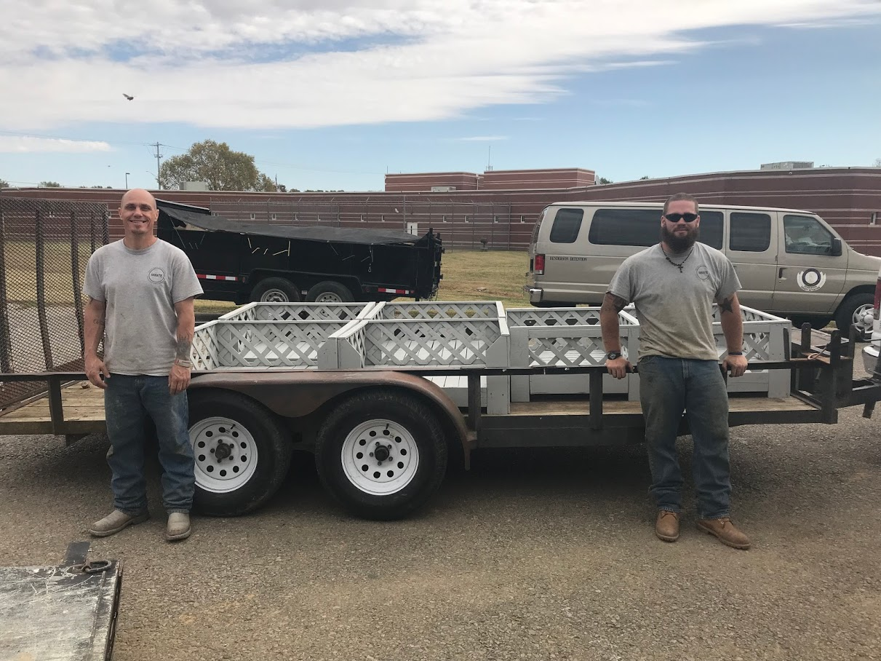
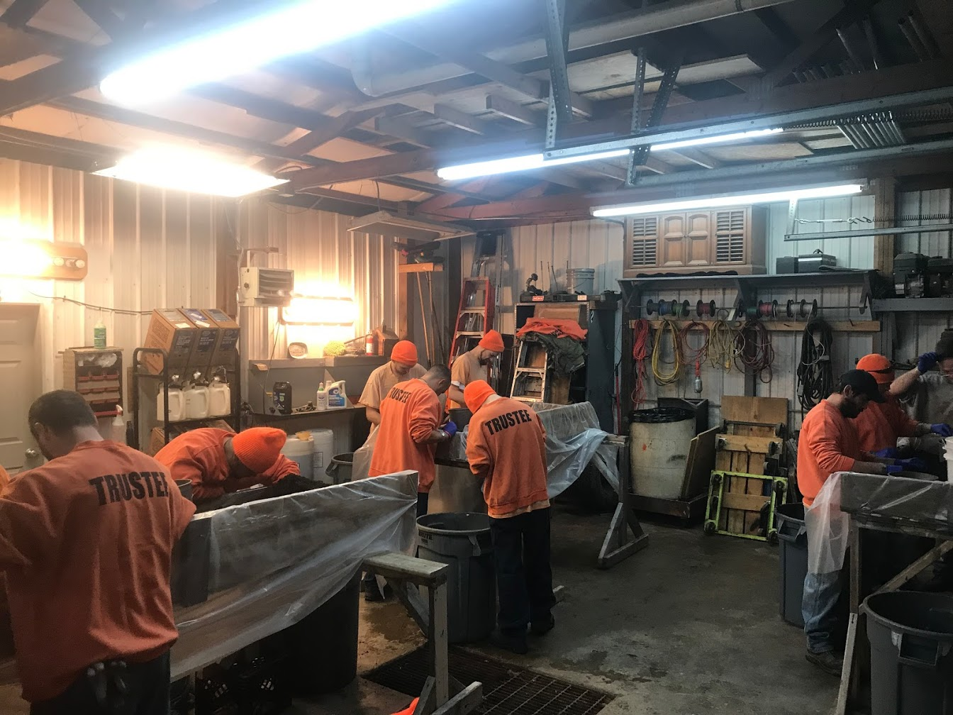
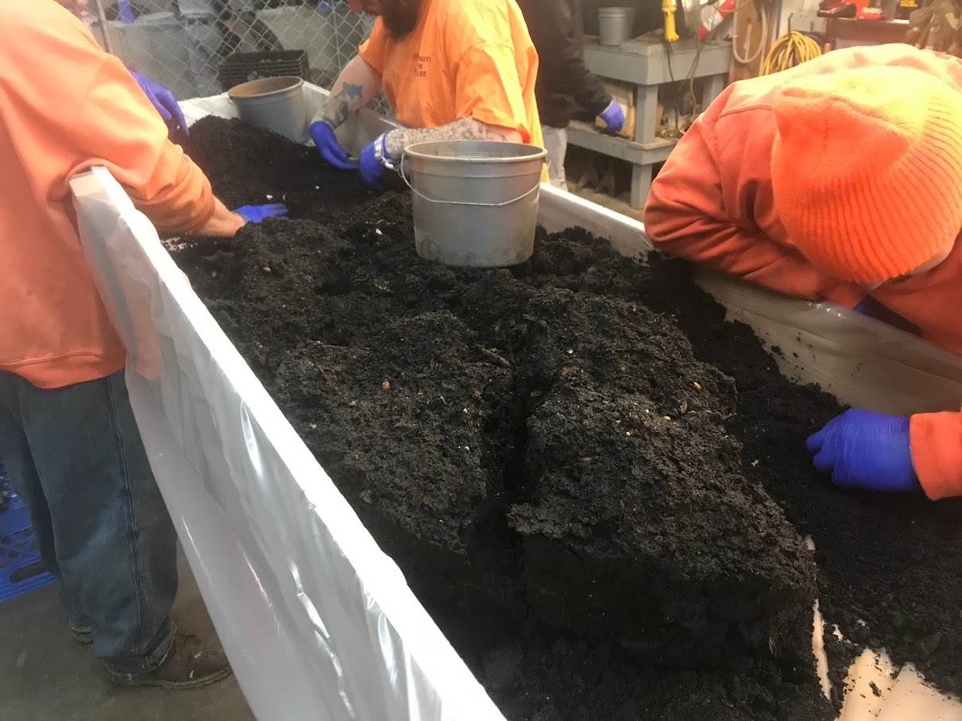

Slide 8
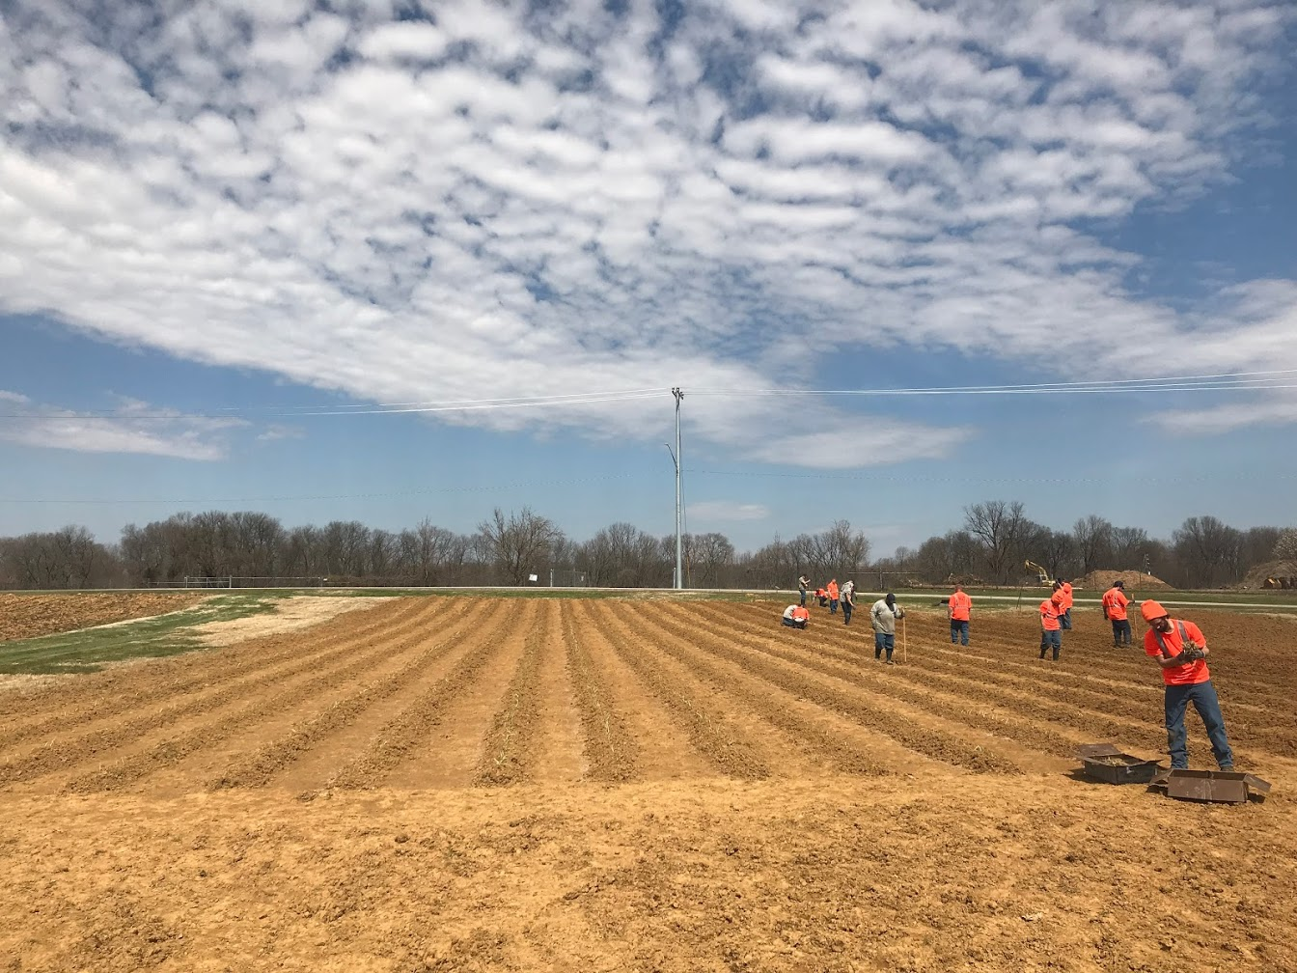
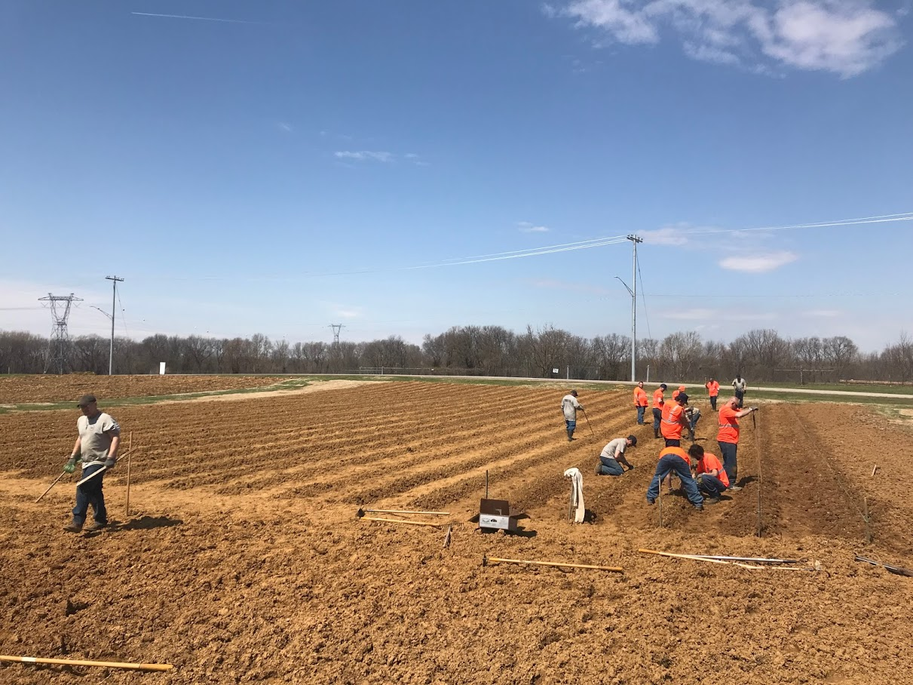

Slide 9

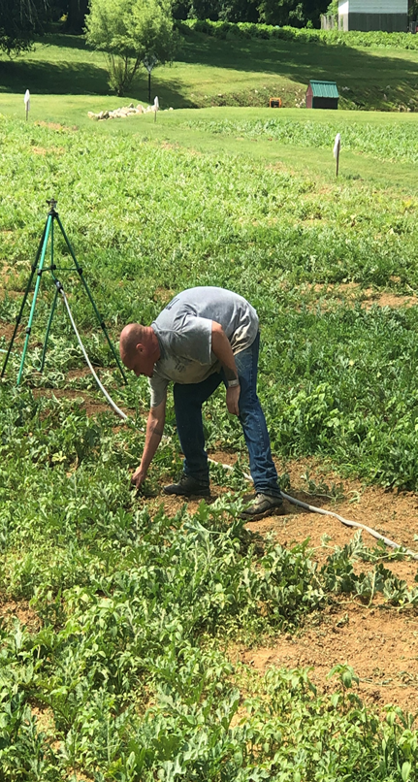
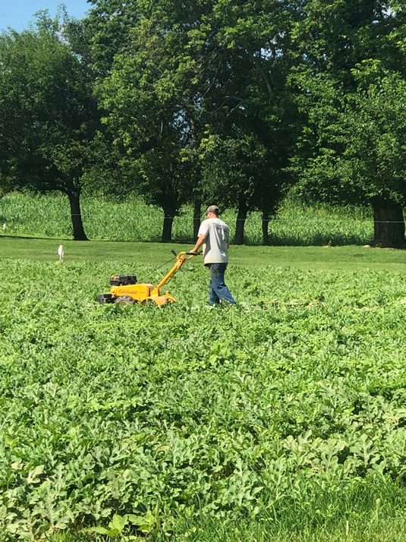
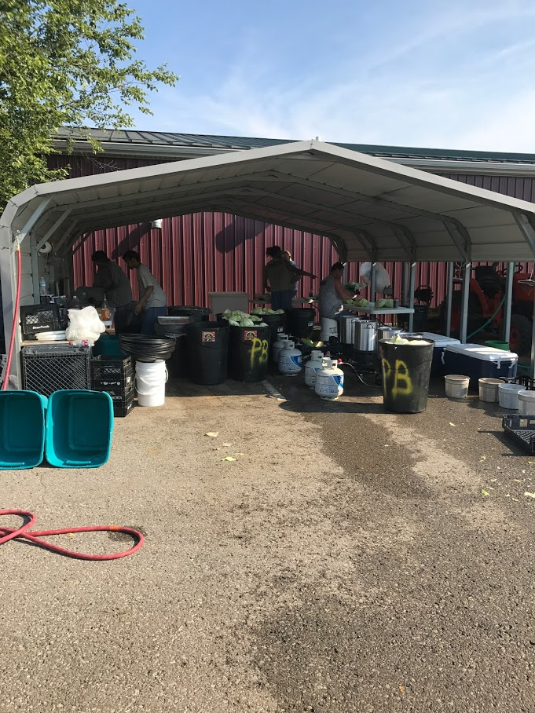
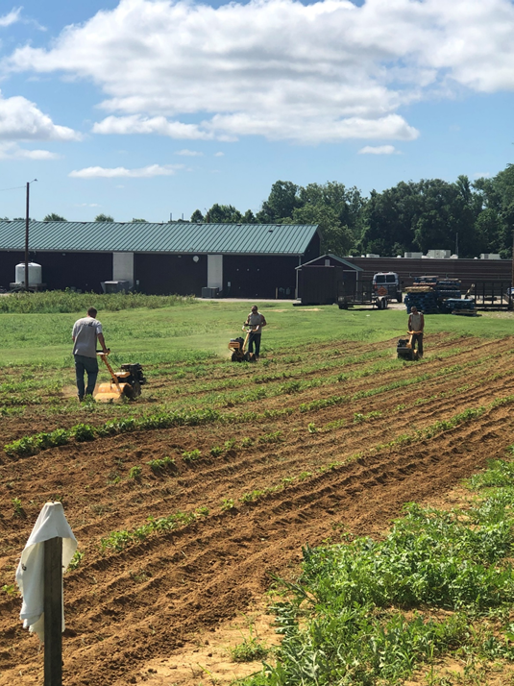


Slide 10
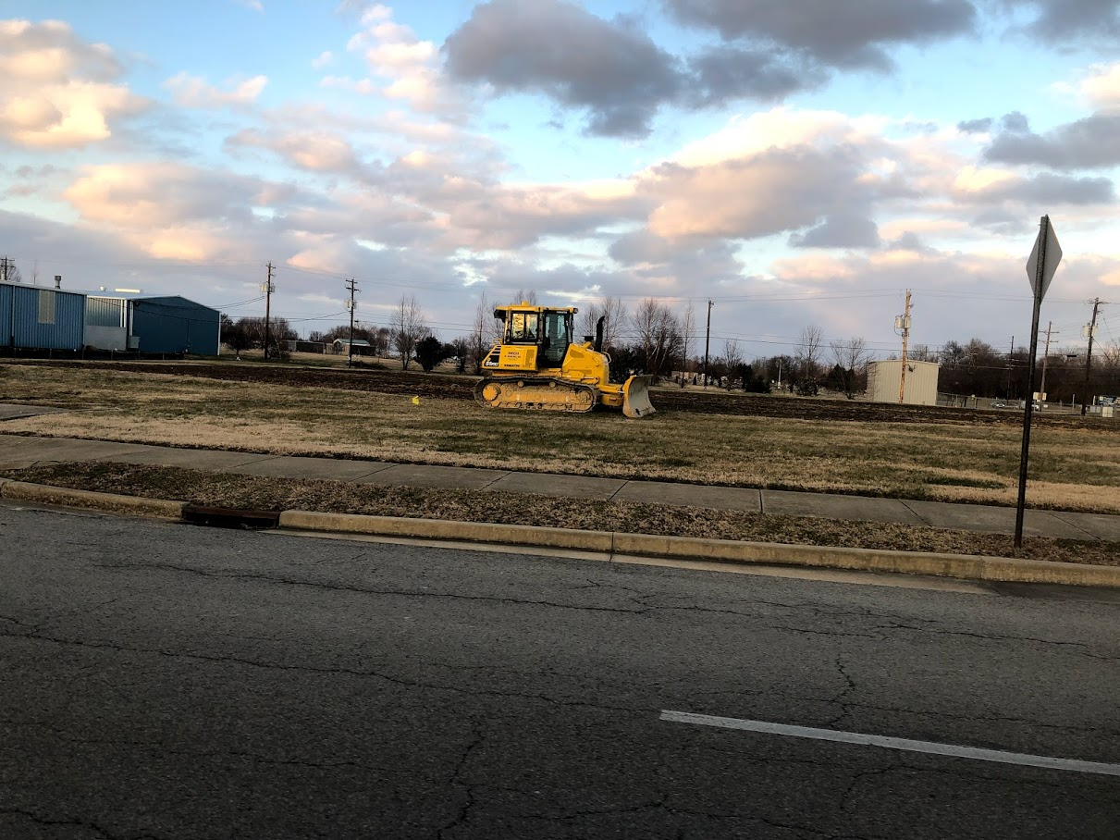
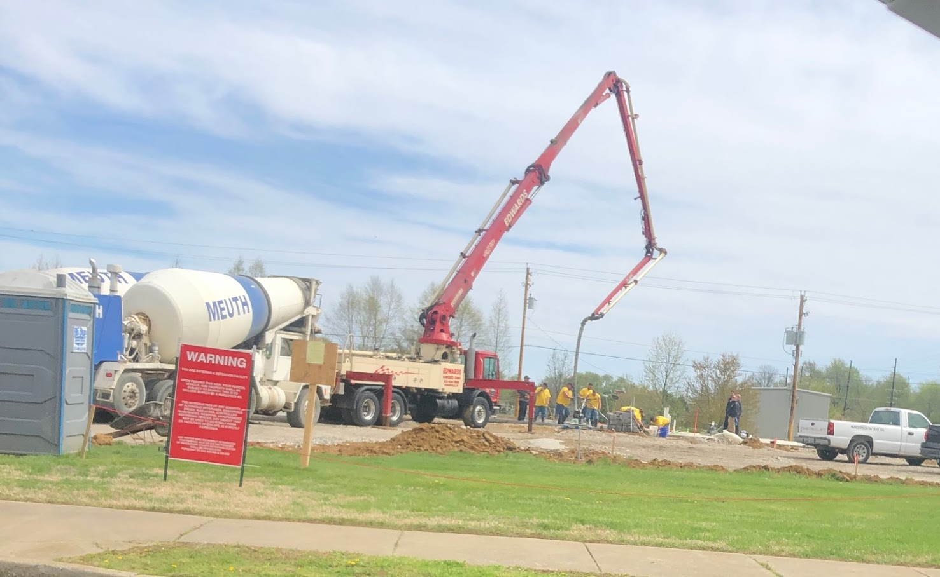
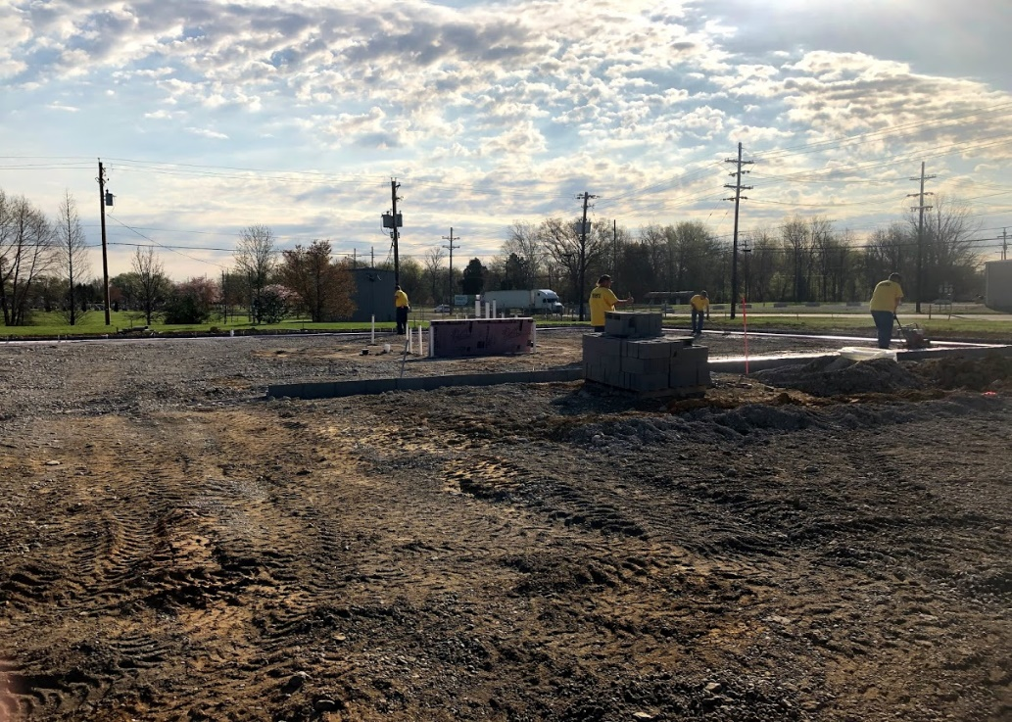

Slide 11
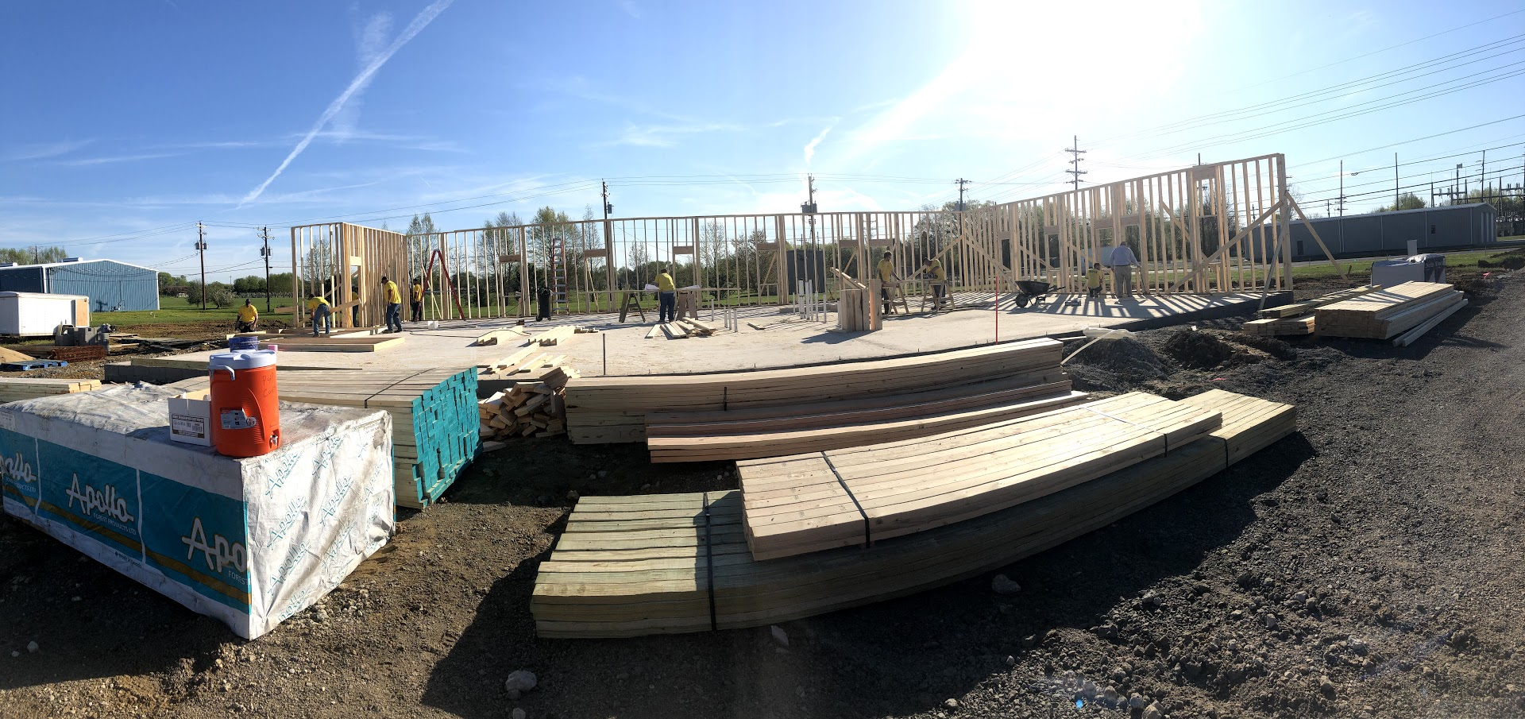
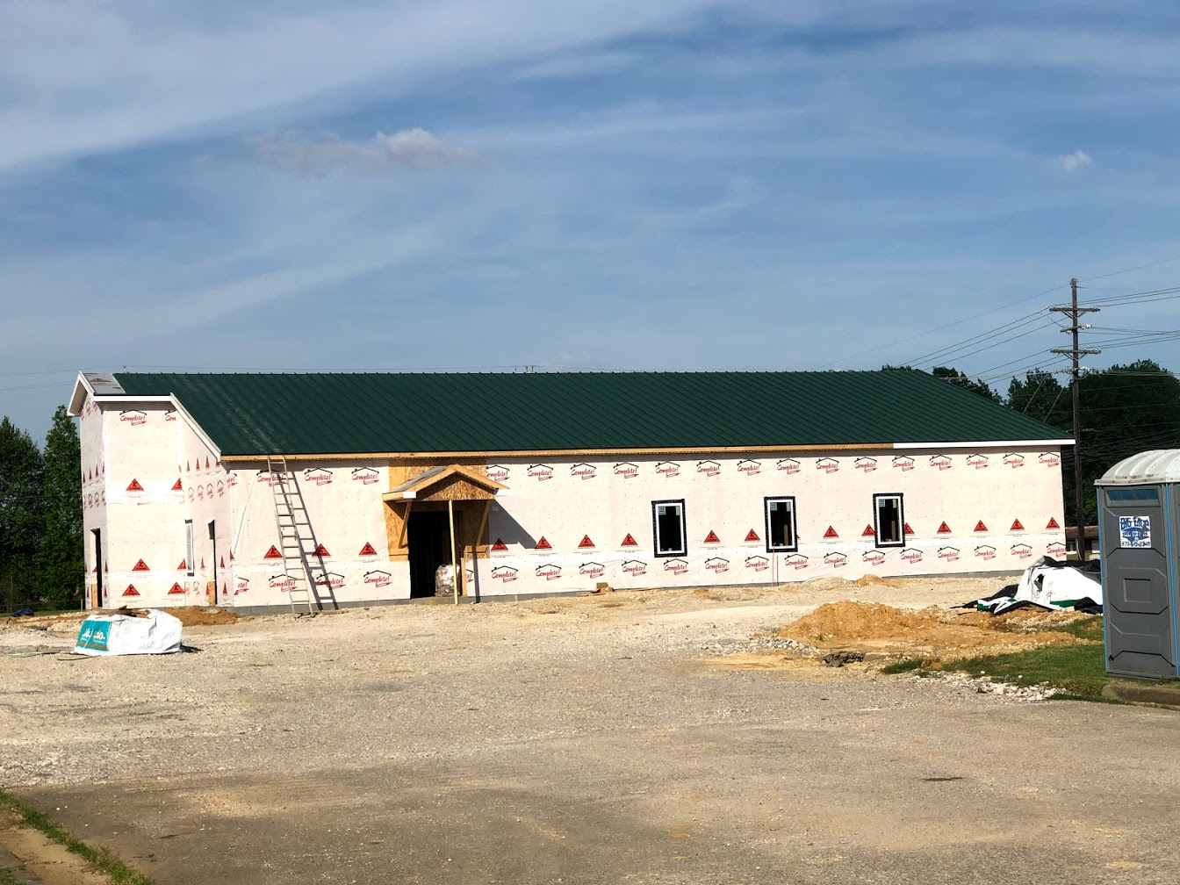
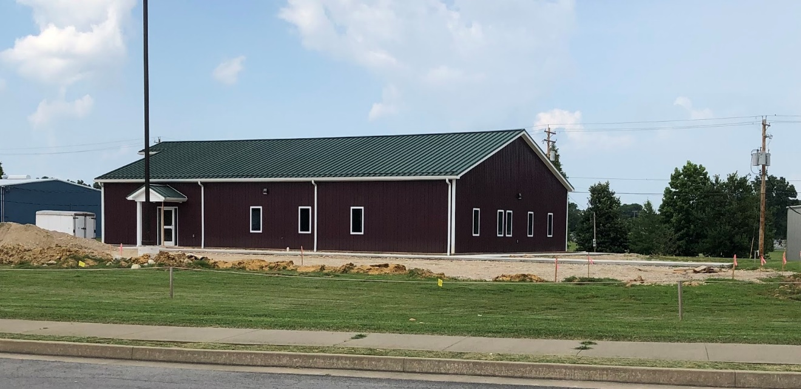

Slide 12
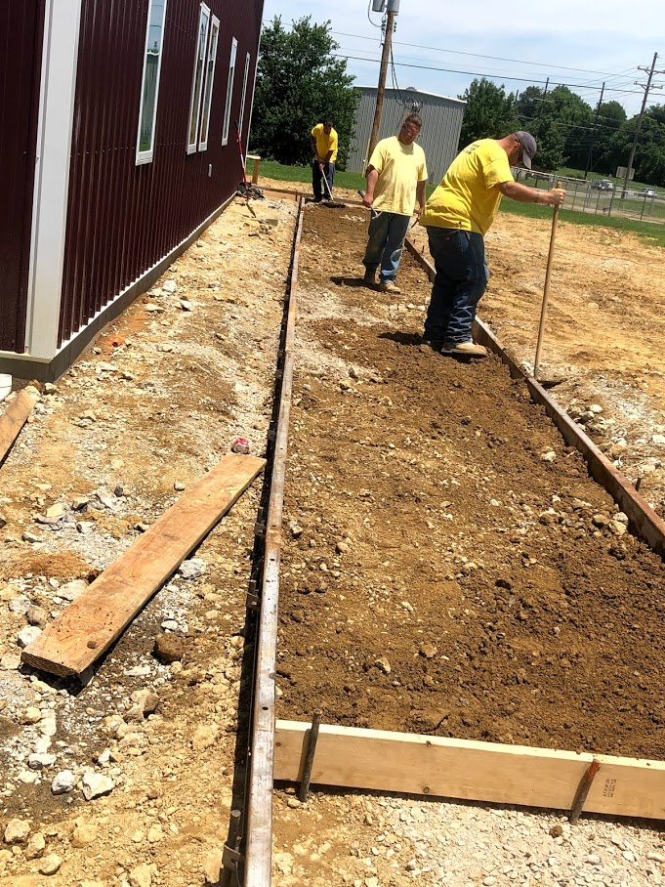
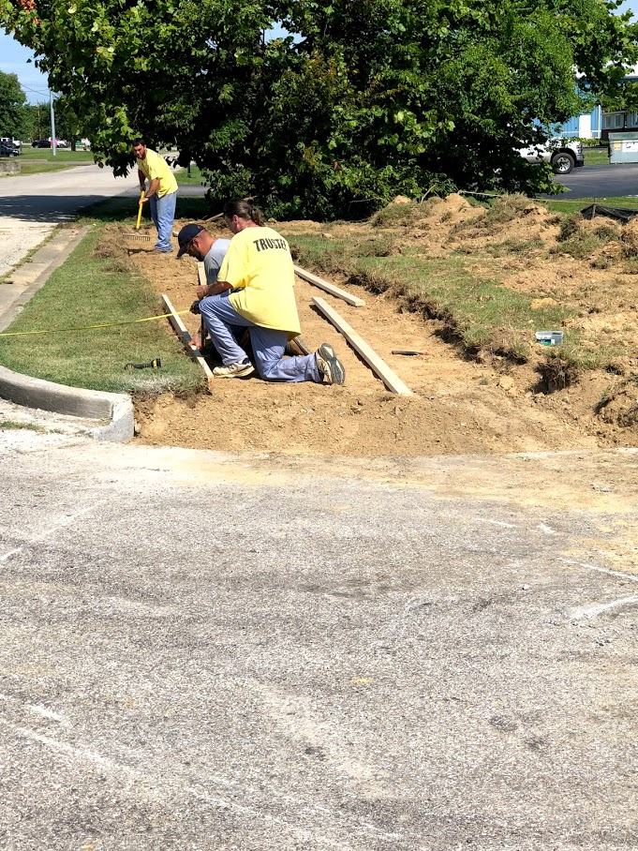
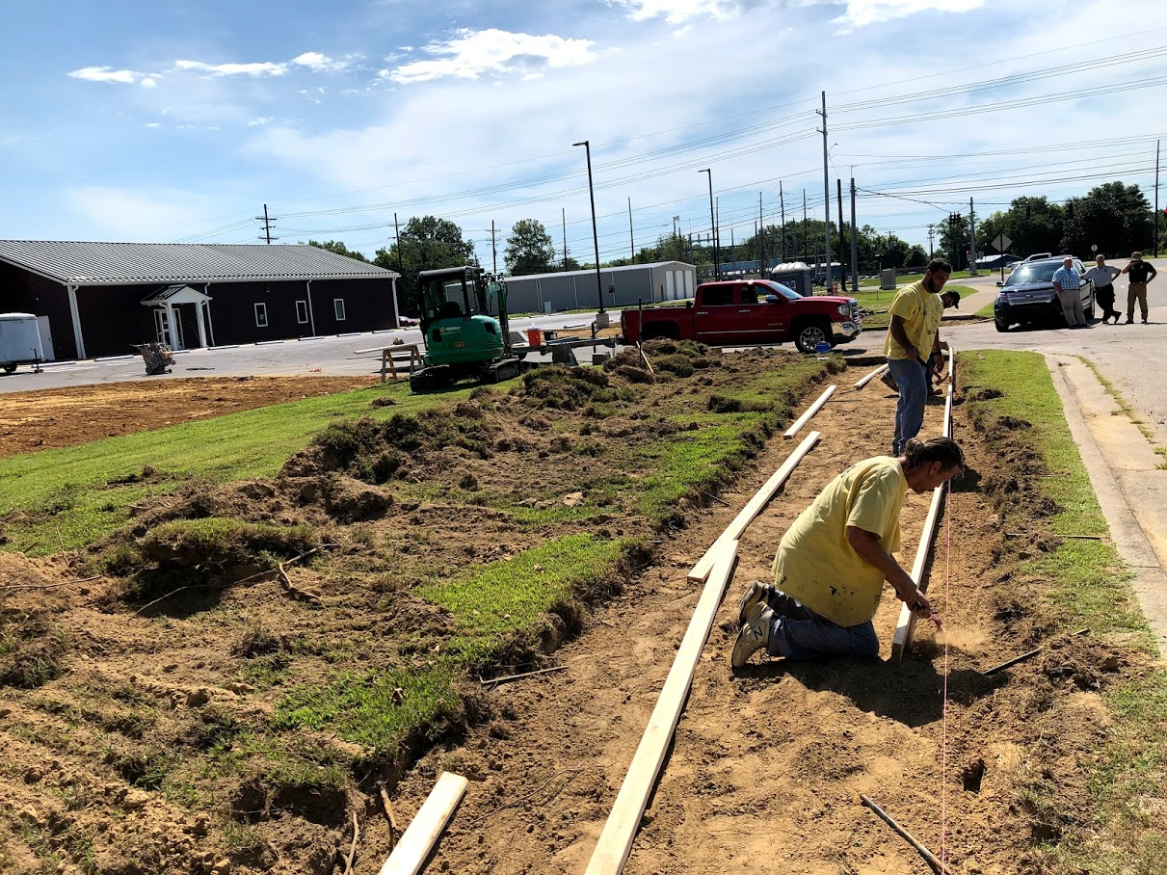

Slide 13
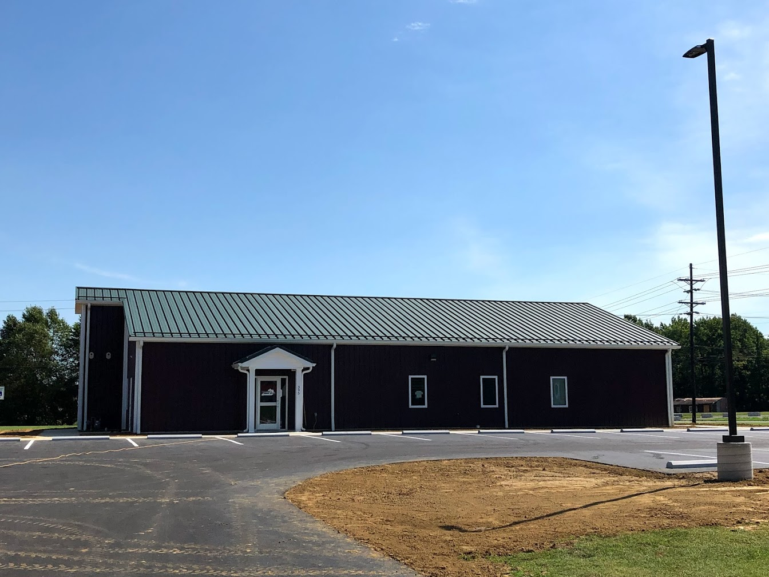
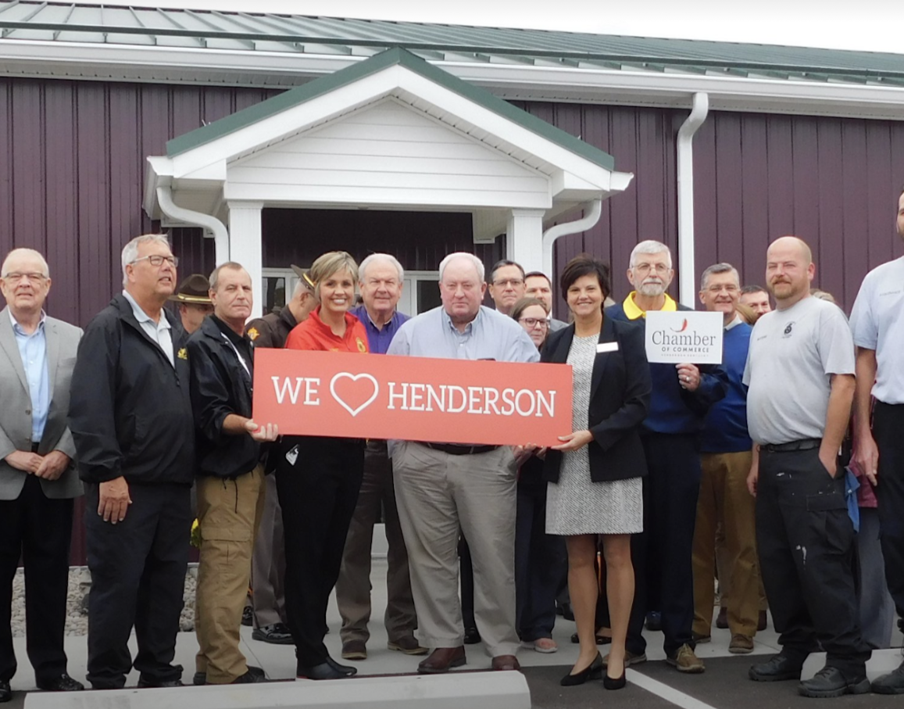

Slide 14

