Slide 1
Second Chance Employment
Jamie Johnson – Vice President, KY Operations

Slide 2
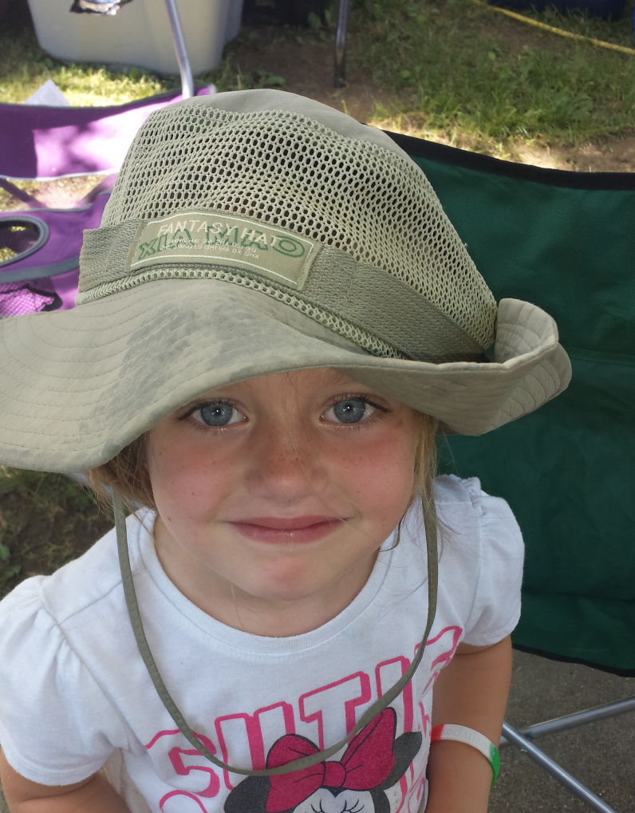
Background
Notes:
Alexis Danielle
November 2014
Staying with some friends
Fifth Family
One of 7 siblings
Behavioral Problems
Falling behind her peers

Slide 3
A lot of great people doing great things
Where does a business fit into the solution, I’m not an expert, I’m a business leader?
Is there a critical mass of people in my work community as impacted as I am?
How do we connect with and change real lives, not statistics
The Indiana Drug Czar (Jim McClelland) said it well, “We need better wrap around programs”.

Slide 4
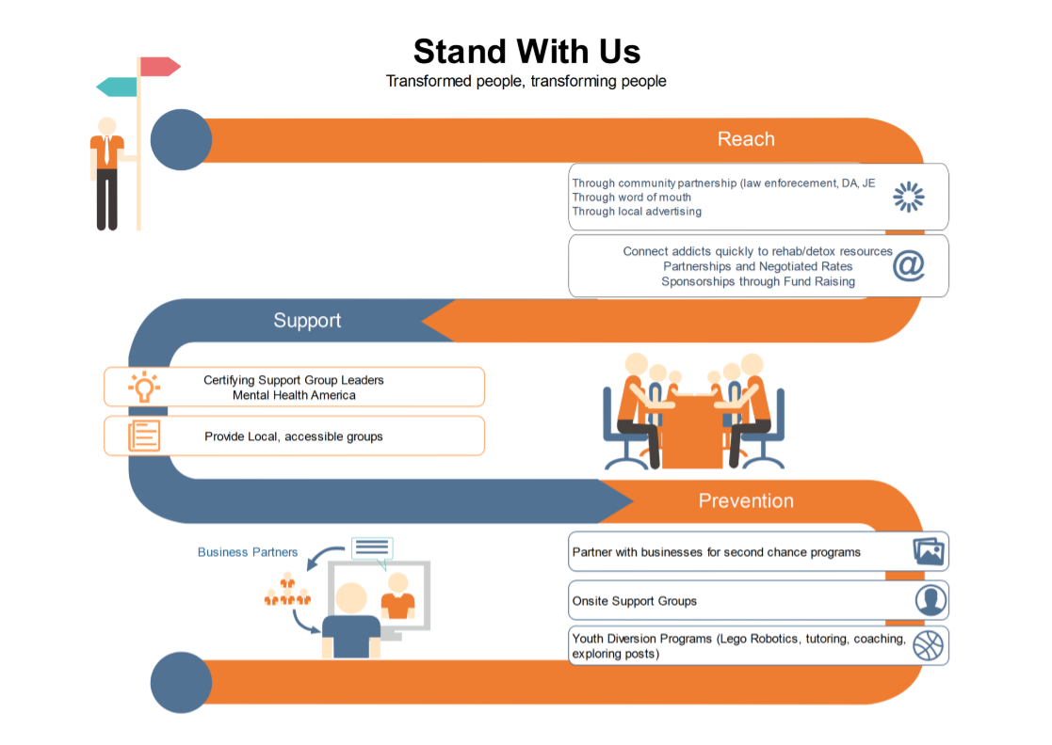
A
W
A
R
E
N
E
S
S
A
W
A
R
E
N
E
S
S

Slide 5
Where’s the win-win?
Employee engagement programs build purpose
Community stewardship builds pride in the work place
Employee led committees empower the team to escalate the speed at which the organization can change
Second chance opportunities are not diametrically opposed to success
  Workers Comp claims today a fraction of baseline
  Favorable reaction by customers and communities (Personal Notes)
  Exponential growth at the site in the last 6 years
  Cost of operations continues to shrink year after year

Slide 6
Challenges facing businesses today
Belief that addiction recovery = unreliable
  Turnover rates have proven consistent in both populations
  Incentives for second chance (Improved workforce participation rate)
Average relapse occurrence before maintaining sobriety = 7 times
  How can state agencies and businesses partner to better detect relapse
Belief that second chances = <safety
  Need independent research to educate business community on the facts
  Policies and practices must assume drug abuse exists as a constant

Slide 7
Questions?
Jamie Johnson
jajohnson@dormanproducts.com

