Slide 1
Implementation of HB 127 2022 Regular Session & Assisted Outpatient Treatment
Wendy Morris, Commissioner
Phyllis Millspaugh, Assistant Director
Legislative Oversight and Investigations Committee
September 15, 2022

Slide 2
Assisted Outpatient Treatment (AOT)
AOT is the practice of providing community-based mental health treatment under civil court commitment, as a means of: (1) motivating an adult with mental illness who struggles with voluntary treatment adherence to engage fully with their treatment plan; and (2) focusing the attention of treatment providers on the need to work diligently to keep the person engaged in effective treatment.
An AOT program is an organized, systematic effort within a mental health system to ensure that AOT will be made available to those who need it to live safely in the community.
Source: Treatment Advocacy Center (TAC)

Slide 3
The essential elements of an AOT program are to:
Identify individuals within the service area who appear to be persistently non-adherent with needed treatment for their mental illness and meet criteria for AOT under state law;
Ensure that whenever such individuals are identified, the mental health system itself takes the initiative to gather the required evidence and petition the court for AOT, rather than rely on community members to do so (although community members should not be impeded from initiating an AOT petition or investigation where permitted by state law);
Safeguard the due process rights of participants at all stages of AOT proceedings;
Maintain clear lines of communication between the court and the treatment team, such that the court receives the clinical information it needs to exercise its authority appropriately and the treatment team is able to leverage the court’s powers as needed;
Provide evidence-based treatment services focused on engagement and helping the participant maintain stability and safety in the community;
Continually evaluate the appropriateness of the participant’s treatment plan throughout the AOT period, and make adjustments as warranted;
Employ specific protocols to respond in the event that an AOT participant falters in maintaining treatment engagement;
Evaluate each AOT participant at the end of the commitment period to determine whether it is appropriate to seek renewal of the commitment or allow the participant to transition to voluntary care;
Ensure that upon transitioning out of the program, each participant remains connected to the treatment services they continue to need to maintain stability and safety.
Source: Treatment Advocacy Center (TAC)

Slide 4
Assisted Outpatient Treatment (Tim’s Law) in Kentucky
Developments and Implementation Timeline
HB1 provided $1.5M General Fund appropriation to BHDID to expand pilot project in remainder of the state.
2017
2019
2021
Mountain Comprehensive Care Center (MCCC) received an AOT grant to work in collaboration with Big Sandy Assisted Outpatient Treatment Program, partnering with the Kentucky District Courts, criminal justice system, and community-based resource providers. MCCC reported only limited success and no momentum among stakeholders to establish a mental health court.
Eligibility criteria expanded by HB 127 to include “history of non-adherence” to treatment, which may be reflected in 2 hospitalizations or arrests in preceding 48 months, or evidence of acts/threats of related violence in preceding 24 months; and clarification of impairment in mental health decision making.
General Fund requested in BHDID biennial budget request, but no appropriation received.
Original enabling legislation, HB91, passed after many years’ advocacy by family & stakeholder groups, but with no funding.
Pilot project grant year 1, Phase 1, completed in July.
First Kentucky AOT order entered in Jefferson County District Mental Health Court; Seven Counties Services provided services.
Eligibility criteria expanded by SB122 to include 2 hospitalizations in preceding 24 months, in addition to original “anosognosia” requirement.
20 petitions filed in 8 months of operation (of 27 projected for full year).
Eligibility criteria included 2 hospitalizations in preceding 12 months and “anosognosia.”
BHDID began drafting SAMHSA grant for AOT pilot project with state and local stakeholders, including Administrative Office of the Courts, community mental health centers, Department of Public Advocacy, local crisis intervention training (CIT), local courts, Louisville Metro Dept. of Corrections, and University of Kentucky.
Grant year 2 completed in July, with 30 petitions filed (of 35 projected).
BHDID-sponsored team of state & local stakeholders participated in national AOT development conference.
First Kentucky AOT order completed successfully.
2016
BHDID received SAMHSA AOT Pilot Project grant award in August, and petitioned first client in December. UK is providing evaluation.
Phase 2 and Grant Year 3 began in August, with expansion to Western State Hospital (WSH) Region; 65 petitions anticipated.
General Fund requested in BHDID biennial budget request, but no appropriation received.
2018
2020
2022

Slide 5
AOT in Kentucky
Mountain Comprehensive Care Center (MCCC) received AOT grant from SAMSHA in 2016
Local judges did not support
DBHDID visited local court in effort to rally support and provide education
Tim’s Law, originally passed by Kentucky General Assembly in 2017, provides for involuntary assisted outpatient treatment (AOT) as part of KRS 202A
Implementation contingent upon funding
DBHDID sponsored team to attend national AOT development conference
Community mental health center (CMHC) & National Alliance for Mental Illness (NAMI) & representatives, Department of Public Advocacy, and Judge Burke
First official order for AOT generated at in Jefferson County 2019

Slide 6
DBHDID Acquires Grant Funds for Tim’s Law
Competitive SAMHSA federal grant, awarded July 2020
$4M award: $1M per year for four years (2020-2024)
Services initiated December 2020
Projected to serve 192 clients, over 4 years, across two regions
Allowed for dedicated staff at DBHDID to oversee implementation
Implemented in 2 phases:
Phase 1 – Central State Hospital Region (2020-2024)
Communicare and Seven Counties Services community mental health center (CMHC) regions
Phase 2 – Western Kentucky Hospital Region (2022-2024)
Pennyroyal Center and River Valley Behavioral Health CMHC regions

Slide 7
AOT Pilot Project Objectives
Improve outcomes for individuals with serious mental illness (SMI)
Demonstrate cost savings
Develop a sustainable model for statewide implementation and continuation through collaboration, evaluation, and experience

Slide 8
Pilot Project AOT Treatment & Oversight Services
State psychiatric hospital initiates AOT petition with District Court; judge determines probable cause and orders evaluation/ treatment plan
After completed evaluation, judge may order AOT for up to 360 days with regular reviews during term of order
CMHC provides services specified in treatment plan, including therapy, medication, and supportive services
CMHC staff collaborate with law enforcement, family, and other stakeholders to promote the individual’s community success
Regular interface with court to monitor compliance

Slide 9
Expansion of Tim’s Law
Tim’s Law first expanded in 2020 legislative session
SB 122
Expanded from 2 hospitalizations in preceding 12 months to 2 hospitalizations in preceding 24 months
Eligibility for Tim’s Law expanded again in 2022 legislative session
HB 127
Hospitalization are no longer required
The term “anosognosia” was removed from the statute in favor of language clarifying evidence of an individual’s impairment in mental health decision making.

Slide 10
State General Funds Allocated for Tim’s Law
$1.5M in General Fund was recommended by the Governor and included in….”. BFY 2022-2024 DBHDID budget to include 2 expansion phases:
Eastern State Hospital region in FY2023
CMHCs: New Vista, NorthKey, Adanta, Pathways and Comprehend
Projected to serve 50 clients, over 2 years
Appalachian Regional Hospital region in FY 2024
CMHCs: Mountain, Cumberland River and Kentucky River
Projected to serve 25 clients, over 1 year

Slide 11
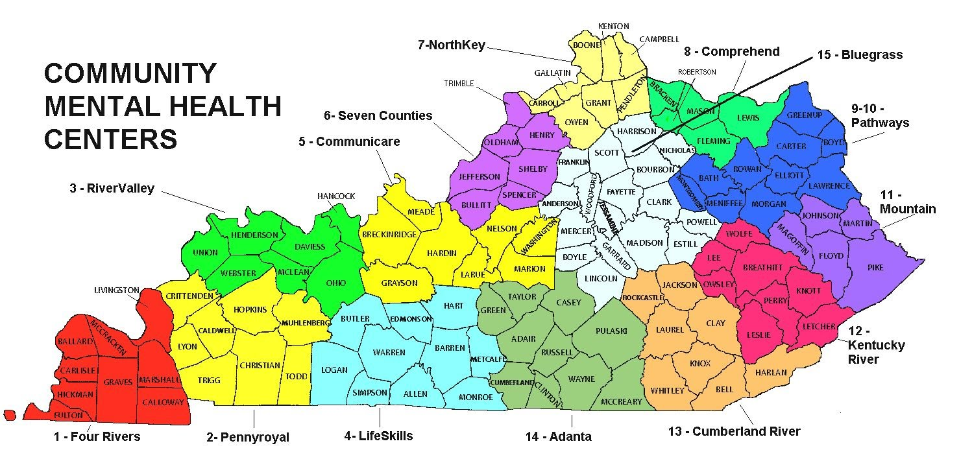
Statewide AOT Pilot Project Service Areas
Central State Region, Phase 1 –Operational, SAMHSA-Funded
Western State Region, Phase 2 –Operational, SAMHSA Funded
Eastern State Region, Phase 3, FY 2023, General Fund
Appalachian Region, Phase 4-FY2024, General Fund
Central State Hospital
- New Vista
6 – Seven Counties
Appalachian Regional Hospital
Western State Hospital
Eastern State Hospital

Slide 12
Implementation of HB127
AOC forms were updated and posted in July 2022
Funding continues to be limiting factor
Request sent to SAMSHA to broaden the scope of AOT grant to include community referrals
State General Fund allocation allows for new approach in 2nd pilot
Pilot in ESH and Appalachian Regional Hospital (ARH) regions will incorporate referrals to be generated from community
Referrals accepted based on new eligibility criteria included in HB127
Stakeholder meeting held in Lexington with Judge Tackett, NAMI representatives, and New Vista CMHC

Slide 13
Intersectionality of Initiatives
Tim’s Law/AOT pilot expansion
988 implementation
Mobile Crisis Planning Grant
SB 90 Diversion Pilot
Mental Health First Aid training
Kentucky Judicial Commission on Mental Health

Slide 14
Why AOT implementation matters
Kentucky’s behavioral health system is strained
Increasing 202A involuntary psychiatric hospitalization petitions
Increasing 202B petitions for those with intellectual disabilities
Kentucky Correctional Psychiatric Center (KCPC) waitlist growing
Workforce shortages abound
Fewer residential providers
Finding ways to collaborate across initiatives and create synergy will help us rely less on institutions (hospitals and jails) and more on community providers, specifically our public behavioral health safety net, the CMHCs
AOT is an important tool to accomplish that vision

Slide 15
Thank You!
Contact Information:
Kentucky Department for Behavioral Health, Developmental & Intellectual Disabilities
502/564-4527
https://dbhdid.ky.gov/dbh/aot.aspx

