Slide 1
Legislative Oversight and Investigations Committee
September 15, 2022

Slide 2
Presenters
Jamie Link, Secretary
Sam Flynn, Chief of Staff and General Counsel
Buddy Hoskinson, Executive Director of Office of Unemployment Insurance

Slide 3
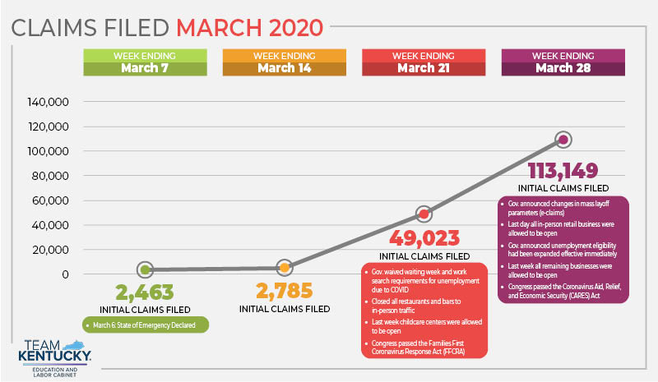

Slide 4
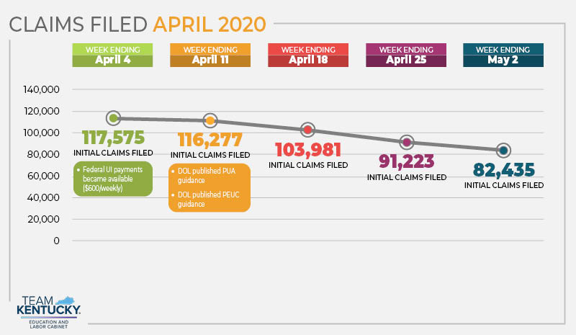

Slide 6
UI Appointments

Slide 7
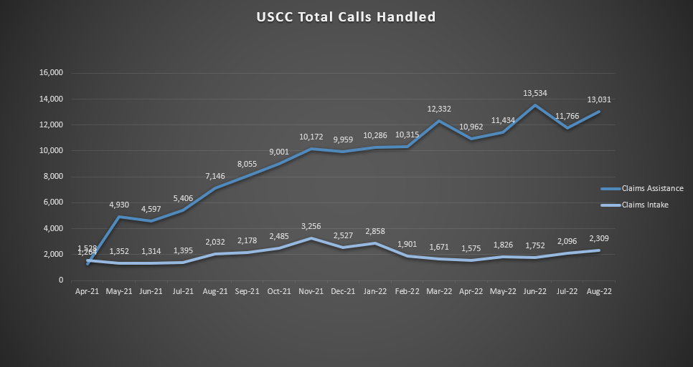
Call Center – Total Calls Handled

Slide 8
Unemployment Insurance Program Letter (UIPL) 2020 Glossary (53 total)
2020 - PANDEMIC-RELATED UIPLs
Tab | UIPL Number | Date | Topic
1 | CARES Act - Section 2102 |  | Pandemic Unemployment Assistance
2 | 18-17 Change 1 | 11/7/2019 | Announcing next steps in the implementation of the Unemployment Insurance (UI) Benefits Operations State Self-Assessment Tool, including frequency of future reviews
3 | 10-20- | 3/12/2020 | Unemployment Compensation for Individuals Affected by COVID-19
4 | 10-20 Change 1 | 5/15/2020 | Unemployment Compensation for Individuals Affected by COVID-19-Interpretation of Between and Within Terms Denial Provisions
5 | 10-20 change 2 | 5/25/2021 | Unemployment Compensation for Individuals Affected by COVID - Short-Time Compensation
6 | 11-18 Change 1 | 7/16/2020 | Employment and Training Administration (ETA) 9177 Report - Pre-implementation planning checklist report for state UI Information Technology (IT) modernization projects - ETA 9177 Report and Instructions
7 | 11-20- | 3/19/2020 | Minimum Disaster Unemployment Assistance Weekly Benefit Amount
8 | 12-20- | 3/20/2020 | Renewal of Form ETA 581 Contribution Operations
9 | 13-20 | 3/22/2020 | FFCRA Division D Emergency UI Stabilization and Access Act
10 | 13-20 Change 1 | 5/4/2020 | FFCRA Division D Emergency UI Stabilization and Access Act-Reporting Instructions, Modification to Early Access Grants, and Q&A
11 | 13-20 Change 2 | 6/3/2021 | FFCRA Division D Emergency UI Stabilization and Access Act-Review of State Compliance for Receipt of Emergency Administrative Grants and Clarification on Benefit Offset
12 | 13-20 Change 3 | 7/1/2021 | Families First COVID Response Act, Division D Emergency UI Stabilization and Access Act of 2020 (EUISAA) Ending the Emergency Flexibilities Authorized under Section 4102 (b)
13 | 14-20 | 4/2/2020 | CARES Act-Summary of Key UI Provisions and Guidance re Temporary Emergency Staff Flexibility
14 | 14-20 Change 1 | 8/12/2020 | COVID Aid, Relief, and Economic Security (CARES) Act Questions and Answers
15 | 15-20 | 4/4/2020 | CAREA Act-FPUC Program Operating, Financial and Reproting Instructions
16 | 15-20 Change 1 | 5/9/2020 | CAREA Act-FPUC Program Operating, Financial and Reproting Instructions and Q&A
17 | 15-20 Change 2 | 6/15/2020 | CAREA Act-New Data Collection Instrument and Revised Reporting Instructions for FPUC
18 | 15-20 Change 3 | 1/5/2021 | Continued Assistance for Uemployed Workers Act-Federal Pandemic Unemployment Compensation (FPUC) Reauthorization and Modification and Mixed Earners UI (MEUC) Program Operating Reporting and Financial Instructions
19 | 15-20 Change 4 | 3/26/2021 | American Resuce Plan Act-Extensions to the Federal Pandemic Unemployment Compensation (FPUC) Program and Mixed Earners Unemployment Compensation (MEUC)
20 | 16-20 | 4/5/2020 | CARES Act-PUA Program Operating, Financial and Reporting Instructions
21 | 16-20 Change 1 | 4/27/2020 | CARES Act-PUA Program Reporting Instructions Q&A
22 | 16-20 Change 2 | 7/21/2020 | CARES Act-PUA Additional Q&A
23 | 16-20 Change 3 | 8/27/2020 | COVID Aid, Relief and Economic Security (CARES) Act-Eligibility of Individuals who are Caregivers for PUA in the Context of School Systems Reopening
24 | 16-20 Change 4 | 1/8/2021 | Continued Assistance for Unemployed Workers Act-PUA; Updated Operating Instructions
25 | 16-20 Change 5 | 2/25/2021 | Expanded Eligibility Provisions for the PUA Program
26 | 16-20 Change 6 | 9/2/2021 | PUA: Updated Operating Instructions and Reporting Changes
27 | 17-20 | 4/10/2020 | CARES Act-PEUC Program Operating,Financial and Reporting Instructions
28 | 17-20 Change 1 | 5/13/2020 | CARES Act-PEUC Program Q&A and Revised Reporting Instructions
29 | 17-20 Change 2 | 12/31/2020 | Continued Assistance for Unemployed Workers Act-Pandemic Emergency Unemployment Compensation (PEUC); Extension, Transition Rule, Increase in Total Benefits
30 | 17-20 Change 3 | 3/26/2021 | American Resuce Plan Act of 2021 (ARPA) - Pandemic Emergency Unemployment Compensation (PEUC) Program: Extension, Elimination of Transition Rule, Increase in Total Benefits, and Extension of Coordination Rule
31 | 18-20 | 4/27/2020 | COVID Aid, Relief, Economic Security (CARES) Act-Emergency UI Relief for State and Local Governmen Entities, Certain Nonprofit Organizations and Federally Recognized Indian Tribes
32 | 18-20 Change 1 | 8/12/2020 | Amendments to COVID Aid, Relief, Economic Security (CARES) Act-Emergency UI Relief for State & Local Government Entities, Certain Nonprofit Organizations & Federally Recognized Indian Tribes
33 | 18-20 Change 2 | 3/26/2021 | American Rescue Plan Act (ARPA) Amendments to the Emergency UI Relief for State and Local Government Entities, Certain Nonprofit Organizations, and Federally-Recognized Indian Tribes
34 | 19-20- | 4/29/2020 | Procedures for the Completion and Publication of UI BAM Data for Improper Payment Information Act (IPIA) Reporting Year 2020
35 | 20-20 | 4/30/2020 | CARES Act-Section 2105 Temporary Full Fuinding of Waiting Week
36 | 21-20 | 5/3/2020 | Coronavirus Aid, Relief, and Economic Security (CARES) Act of 2020 - Short-Time Compensation (STC) Program Provisions and Guidance Regarding 100 Percent Federal Reimbursement of Certain State STC Payments.
37 | 22-20 | 5/10/2020 | COVID Aid, Relief, and Economic Security (CARES) Act-Short-Time Compensation (STC) Program
38 | 23-20 | 5/11/2020 | Program Integrity for UI and CARES Act and FPUC and PUA and PEUC Programs
39 | 24-20 | 5/14/2020 | Temporary Changes to Extend Benefits Program due to COVID 19 Emergency
40 | 24-20 Change 1 | 12/31/2020 | Continued Assistance for UI Workers Act (Continued Assistance Act)-Provisions Affecting the Federal-State EB Program
41 | 24-20 Change 2 | 4/7/2021 | American Rescue Plan Act-Provisions Affecting the Federal-State EB Program
42 | 25-20 | 6/15/2020 | Benefit Accuracy Measurement (BAM) Program Operations in Response to COVID
43 | 26-20 | 6/25/2020 | Minimum Disaster UI (DUA) Weekly Benefit Amoutn 7/1/20-9/30/20
44 | 27-20 | 8/12/2020 | Presidential Memo on Authorizing the Other Needs Assistance Program for Major Disaster Declarations Related to COVID; UI Related Technical Assistance for States Administering Lost Wages Assistance (LWA)
45 | 27-20 Change 1 | 8/17/2020 | Presidential Memo on Authorizing the Other Needs Assistance Program for Major Disaster Declarations Related to COVID; UI Related Technical Assistance for States Administering Lost Wages Assistance (LWA) Questions and Answers
46 | 27-20 Change 2 | 11/16/2020 | Presidential Memo on Authorizing the Other Needs Assistance Program for Major Disaster Declarations Related to COVID; UI Related Technical Assistance for States Administering Lost Wages Assistance (LWA)
47 | 28-20 | 8/31/2020 | Fraud in the UI System and Providing States with Funding to Assist with Efforts to Prevent and Detect Fraud and Identity Theft and Recover Fraud Overpayments in PUA and PEUC Programs
48 | 28-20 Change 1 | 1/15/2021 | Funding for Identity Verification or Verification of PUA Claimants and Funding to assist with Efforts to Prevent and Detect Fraud and Identity Theft as well as Recover Fraud Overpayments in PUA and PEUC Programs
49 | 28-20 Change 2 | 8/11/2021 | Additional Funding to Assist with Strengthening Fraud Detection and Prevention Efforts and Recovery of OP in the PUA and PEUC Programs, Guidance on Processes for Combatting Identity Fraud
50 | 28-20 Change 3 | 9/17/2021 | Extension of Time to Submit Requests for Funding under Grant Opportunity Announced in UIPL 28-20 Change 2
51 | 28-20 Change 4 | 7/22/2022 | Support for States to Resolve Outstanding Items from the Expired Coronavirus Aid, Relief, and Economic Security (CARES) Act Unemployment Compensation (UC) programs, Including additional funding to assist states with reporting and detection and recovery of overpayments
52 | 29-20 | 9/14/2020 | Additional Planning guidance for the Fiscal Year (FY) 21 UI State Quality Service Plan (SQSP)
53 | 30-20 | 9/24/2020 | Acceptable Narrative Reasons for Separation Used in the UI Compensation for Ex-Servicemembers (UCX) Program and Processing Discrepancies
UIPLs are policies issued by the U.S. Department of Labor

Slide 9
Unemployment Insurance Program Letter (UIPL) 2021 Glossary (37 total)
2021 - PANDEMIC-RELATED UIPLs
Tab | UIPL Number | Date | Topic
1 | Program Letter 1-21 | 10/1/2020 | Minimum Disaster Unemployment Assistance e(DUA) Weekly Benefit Amount 10/1/20-12/31/20
2 | 04-17 Change 1 | 8/3/2021 | Requirement for States to refer allegations to Unemployment Compensation (UC) fraud, waste, abuse, mismanagement, or misconduct to the Department of Labor's Office of Inspector General's (DOL-OIG) and to disclose information related to the COVID (CARES) Act for purposes of UC Fraud Investigation and audits
3 | 2-21- | 10/26/2020 | FY 21 State Workforce Agency UI Resource Planning Targets and Guidelines
4 | 2-21 Change 1 | 11/30/2020 | Corrected Attachments I and II to UI Program Letter (UIPL 2-21)
5 | 3-21- | 10/29/2020 | Replacement of Information Technology Hardware supporting the State UI Data Base Management System (UIDBMS)
6 | 3-21 Change 1 | 12/27/2021 | Work Opportunity Tax Credit (WOTC) Initial Funding Allotments for FY 2022
7 | 4-21- | 11/2/2020 | UI Information5-21- Technology (IT) Security Additional Information
8 | 5-21- | 11/30/2020 | 2020 Decennial Census Separations
9 | 6-21- | 12/10/2020 | Minimum Disaster UI (DUA) Weekly Benefit Amount 1/1/21-3/31/21
10 | 7-21- | 12/17/2020 | Performance Measures for Reemployment Services and Eligibility Assessments (RESEA) and UI participants
11 | 8-21- | 12/17/2020 | Federal Military Pensions Cost of Living adjustment (COLA)
12 | 9-21- | 12/30/2020 | Continued Assistance for UI Workers Act of 2020 (Continued Assistance Act) Summary of Key UI Provisions
13 | 10-21- | 1/4/2021 | Social Security Annuities and Federal Civilian Pensions
14 | 11-21- | 1/7/2021 | 2021 Pay Adjustments for Annual Salary Rates for General Schedule (GS) Federal Employees in 53 Locality Pay Areas
15 | 12-01 Change 2 | 1/8/2021 | States ability to exercise flexibility in staffing models for the performance of certain Unemployment Compensation (UI) administrative activities
16 | 12-21- | 1/19/2021 | Implementation of Sequestration under the Budget Control Act of 2011 (BCA) for Mandatory UI Programs for FY 2021
17 | 13-21- | 1/19/2021 | FY 2021 Funding Allotments and Operations Guidance for UI Reemployment Services and Eligibility Assessments (RESEA) Grants
18 | 14-21- | 3/15/2021 | American Rescue Plan Act of 2021 (ARPA) Key UI Provisions
19 | 14-21 Change 1 | 7/12/2021 | State Responsibilities after the Temporary UI Benefit Programs under the Coronavirus Aid, Relief, and Economic Security (CARES) Act, End Due to State Termination of Administration or When the Programs Expire
20 | 15-21- | 3/23/2021 | Minimum Disaster UI Assistance (DUA) Weekly Benefit Amount 4/1/21-6/30/21
21 | 16-21- | 4/13/2021 | Identity Verification for UI Claims
22 | 17-21- | 4/27/2021 | Guidelines for FY 21 State Agency UI Resource Allocations, Supplemental Budget Requests (SBRs) and Above-Base Funding
23 | 18-21- | 5/3/2021 | Procedures for the Completion and Publication of UI Benefit Accuracy Measurement (BAM) Data for Payment Integrity Information Act (PIIA) Reporting Year 2021
24 | 19-21- | 5/4/2021 | Benefits Held by Banks and Financial Institutions as a Result of Suspicious and/or Potentially Fraudulent Activity and the Proportional Distribution Methodology Required for Recovering/Returning Federally Funded UI Compensation (UC) Program Funds
25 | 20-21- | 5/5/2021 | State Instructions for Assessing Fraud Penalties and Processing Overpayment Waivers under the Coronavirus Aid, Relief, And Economic Security (CARES) Act
26 | 20-21 Change 1 | 2/7/2022 | Additional State Instructions for Processing Waivers of Recovery of Overpayments under the Coronavirus Aid, Relief, and Economic Security (CARES) Act
27 | 21-21- | 6/21/2021 | Minimum Disaster UI (DUA) Weekly Benefit Amount 7/1/21-9/30/21
28 | 22-21 | 8/11/2021 | Grant Opportunity to Support State with Fraud Detection and Prevention, Including Identity Verification and OP Recover Activities in All UC Programs
29 | 22-21 Change 1 | 9/17/2021 | Extension of Time to Submit Request for Funding under Grant Opportunity Announced in UIPL 22-21
30 | 23-21 | 8/17/2021 | Grant Opportunity for Promoting Equitable Access to UC Programs
31 | 23-21 Change 1 | 11/1/2021 | Extension of Time to Submit Request for Fuinding under Grant Opportunity Announced in UIPL No 23-21
32 | 23-21 Change 2 | 12/20/2021 | Further extension of time to submit request for funding under Grant Opportunity Announced in UIPL NO 23-21
33 | 23-21 Change 3 | 4/4/2022 | Extension of Period of Performance for Awards related to Grant Opportunity Announced in UIPL 23-21
34 | 24-21 | 8/20/2021 | Additional Planning Guidance for the FY 22 UI SQSP
35 | 25-21 | 9/2/2021 | FY 22 State Workforce Agency UI Resource Planning Targets and Guidelines
36 | 25-21 Change 1 | 5/13/2022 | Revised and final fiscal year (FY) 2022 State Workforce Agency Unemployment Insurance (UI) resource planning targets and guidelines
37 | 26-21 | 9/24/2021 | Minimum Disaster DUA WBA 10/1/21-12/31/21
UIPLs are policies issued by the U.S. Department of Labor

Slide 10
Overall Objective of Contracting with Ernst & Young
Increase the number of UI staff to provide Kentuckians assistance.

Slide 11
Objectives for Testifying
Discuss the process by which Ernst & Young (EY) contracts and payments were approved
Discuss EY goals and how EY staff were utilized during the contracts

Slide 12
Timeline
9/7/2017: All in-person UI services were removed from Kentucky Career Centers
3/6/2020: Kentucky declares State of Emergency
3/13/2020: National Emergency Declaration
3/27/2020: CARES Act is signed
7/1 - 8/30/2020: Ernst & Young, 1st Contract
Modification: 7/24/2020
Modification: 8/19/2020
9/9/2020 - 1/6/2021: Ernst & Young, 2nd Contract
4/15/2021: Reestablished UI services in 12 Kentucky Career Center’s for in- person services
Increased call center capacity

Slide 13
Unemployment Insurance Challenges
Previous state hiring freeze had resulted in an 18% decrease in field personnel and a 25% decrease in office personnel
Only 23 staff in the Adjudications Branch who could adjudicate UI claims
Overdue technology upgrades
UI system that was coded in 1970’s COBOL
Staff reduction in 2017 of employment services and UI
95 employees
UI services were moved to a call center in Frankfort
Zero staff dedicated to in-person unemployment services at KCC’s

Slide 14
Actions Taken Prior to EY Contract
Pop-up locations across the Commonwealth, including:
Frankfort, Ashland, Owensboro, Louisville, Somerset, Hopkinsville, Covington, and Prestonsburg
Staff were used to implement new federal programs
Surge of claims exceeded the amount of UI staff and manageable workloads
This included phone line capacity and UI transition to Labor
USDOL flexibility allowed the Cabinet to hire previously retired individuals who were highly trained and knowledgeable in implementing UI polices and procedures

Slide 15
EY Contract Goals
1st contract:
Provide the Commonwealth with immediate support in adding claims processing to reduce the backlog of UI claims
2nd contract:
Provide continued support of reducing the backlog of UI claims by extending its contract to more fully assist Kentucky staff
Fact-finding, preparing, and reviewing adjudication functions

Slide 16
Ernst & Young: PON2-531-2000004458
First Contract
7/1/2020 - 8/30/2020
Contract amount: $7,598,000
Cited Authority: FAP 111-43-00-03-STD- PSC Sole Source or Emergency Exemption-Standard
Finance approved
Government Contract Review Committee reviewed at its July 14, 2020 meeting and took action to enable the contract to proceed.
Contract Modification 7/24/2020: modified to extend contract through 8/30/2020
Modification increase: $4,453,293, totaling: $12,051,293
Contract Modification 8/19/2020: modified the scope of services

Slide 17
Ernst & Young: PRC-102-2100052023
Cited Authority: Not feasible to bid
Finance Approved
Contract was with Education and Workforce Development Cabinet, UI was moved to Labor Cabinet
Labor needed to pay EY for those services in the contact
Contract expired on 8/30/2020 and invoice was not received until 9/24/2020

Slide 18
Ernst & Young: PON2-142-2100000707
Second Contract
9/9/2020 - 1/6/2021
Contract Amount: $4,989,768
Cited Authority: FAP-111-09-00-12 - not feasible to bid
Finance approved
Government Contract Review Committee reviewed at its October 13, 2020 meeting and took action to enable the contract to proceed.

Slide 19
How EY Staff were Utilized
1st Contract
Collected missing data from claimants and employers and ensured all claims had a complete set of information so UI adjudicators could make a UI decision
200 personnel for 2 weeks
100 personnel for 1 week
50 personnel for 1 week
25 personnel for 1 week
2nd Contract
Focused on performing adjudicator functions and assisted UI in reviewing claims and writing determination letters
100 personnel (first four weeks)
25 personnel

Slide 20
EY Achievements
1st Contract 7/1/2020-8/30/2020
141,223 claims and issues worked
2nd Contract 9/9/2020-1/6/2021
35,995 claims and issues worked and letters drafted

Slide 21
Shelby Lewis
Executive Director
Office of Legislative Services
shelby.lewis@ky.gov
502-564-0003

Slide 22
Thank You!

