Slide 1
Assisted Outpatient Treatment
Dr. Patti Clark, Director, Division of Mental Health
Stephanie Craycraft, Deputy Commissioner
Department for Behavioral Health, Developmental & Intellectual Disabilities
Legislative Oversight and Investigations Committee
September 14, 2023

Slide 2
Assisted Outpatient Treatment (AOT)
AOT is the practice of providing community-based mental health treatment under civil court commitment, as a means of:
Motivating an adult with mental illness, who struggles with voluntary treatment adherence, to engage fully with their treatment plan; and
Focusing the attention of treatment providers on the need to work diligently to keep the person engaged in effective treatment.
Source: Treatment Advocacy Center (treatmentadvocacycenter.org)

Slide 3
Impact of AOT Services
In states where AOT models are being implemented, those who received AOT services versus those who did not:
77% fewer psychiatric hospitalizations
83% fewer arrests
74% less homelessness
87% less incarceration
44% decrease in harmful or dangerous behaviors
Four times less likely to perpetuate violence
50% less likely to be victimized
Source: Treatment Advocacy Center (treatmentadvocacycenter.org)

Slide 4
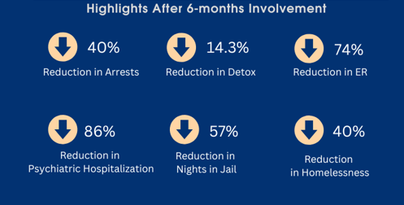
Kentucky Impacts (Data collected within grant-funded regions)
UK College of Social Work KY
AOT Pilot Program
Evaluation Team
Dr. Aubrey Jones, Co-Investigator and Evaluation Team Lead & Dr. Aaron Brown, Co-Investigator

Slide 5
Statutory Eligibility for AOT KRS 202A - Tim’s Law; 2022 revision
Diagnosed with a serious mental illness;
History of repeated nonadherence with mental health treatment, which has:
Been a significant factor in necessitating hospitalization or arrest at least twice within the last 48 months; or
Resulted in an act, threat, or attempt at serious physical harm within the last 24 months.

Slide 6
Statutory Eligibility for AOT - continued
Unlikely to adequately adhere to outpatient treatment on a voluntary basis
based on qualified mental health professional’s:
Clinical observation; and
Identification of specific characteristics of the person’s clinical condition that significantly impair the person’s ability to make and maintain a rational and informed decision as to whether to engage in outpatient treatment voluntarily;
In need of court-ordered AOT as the least restrictive alternative mode of treatment presently available and appropriate.

Slide 7
SAMHSA Grant Awarded for AOT
Competitive SAMHSA federal grant, awarded July 2020
Implemented in 2 phases:
Phase 1 – Central State Hospital Region (2020-2022)
Communicare and Seven Counties Services community mental health center (CMHC) regions
Phase 2 – Western State Hospital Region (2022-2024)
Pennyroyal Center, River Valley Behavioral Health, Four Rivers Behavioral Health, and LifeSkills CMHC regions

Slide 8
AOT Pilot Project Objectives
Improve outcomes for individuals with serious mental illness (SMI)
Demonstrate cost savings
Develop a sustainable model for statewide implementation and continuation through collaboration, evaluation, and experience

Slide 9
Pilot Project AOT Treatment & Oversight
State psychiatric hospital initiates AOT petition with District Court; judge determines probable cause and orders evaluation/ treatment plan
After completed evaluation, judge may order AOT for up to 360 days with regular reviews during term of order
Community mental health center (CMHC) provides services specified in treatment plan, including therapy, medication, and supportive services
CMHC staff collaborate with law enforcement, family, and other stakeholders to promote the individual’s community success
Regular interface with court to monitor adherence

Slide 10
State General Funds Allocated for Tim’s Law
$1.5M in General Fund was recommended by the Governor and included in FY 2022-2024 DBHDID budget to include 2 expansion phases:
Phase 3 - Eastern State Hospital region
CMHCs: New Vista, NorthKey, Adanta, Pathways and Comprehend
Phase 4 - Appalachian Regional Hospital region
CMHCs: Mountain, Cumberland River and Kentucky River

Slide 11
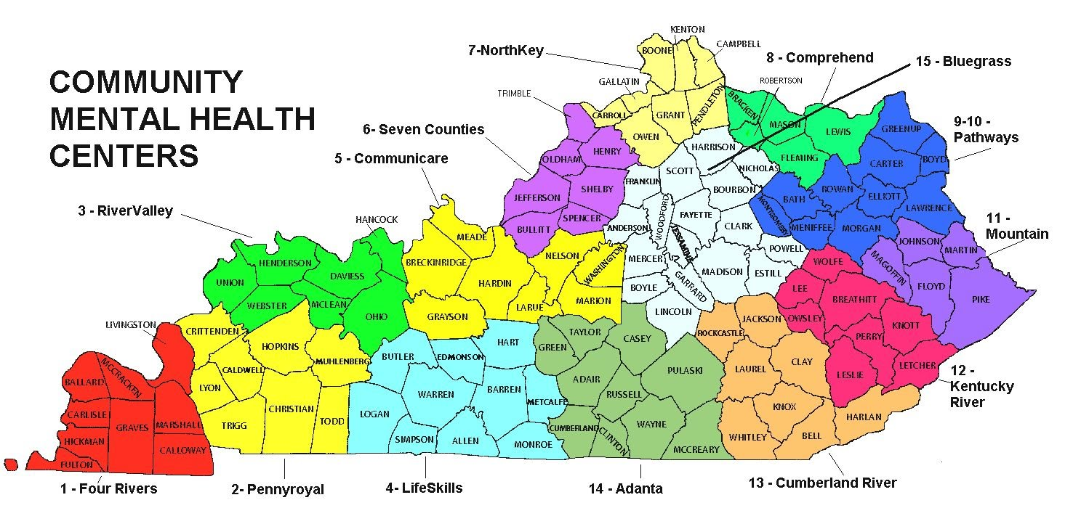
Statewide AOT Pilot Project Service Areas
Central State Region, Phase 1 –SAMHSA-Funded
Western State Region, Phase 2 – SAMHSA Funded
Eastern State Region, Phase 3 – General Fund
Appalachian Region, Phase 4 -General Fund
Central State Hospital
- New Vista
6 – Seven Counties
Appalachian Regional Hospital
Western State Hospital
Eastern State Hospital

Slide 12
AOT Client Data
85 AOT participants to date; 51 currently active
62% male, 37% female
56% white, 40% black, 4% other
Primary diagnoses: schizophrenia, schizoaffective disorder, bipolar disorder
Program graduates consistently report:
Taking medications as prescribed
Getting along with family
Doing well in social situations

Slide 13
Next Steps
Further training on AOT procedures to be offered
Courts
Attorneys
Mental health providers
Families
Ongoing collaboration to continue implementation with community partners

Slide 14
Thank You!

