Slide 1



KY SERVS
STATEWIDE
EMERGENCY
RESPONDER
VOICE
SYSTEM

Slide 2
Updated - 06132025
Kentucky Statewide Emergency Responder Voice System
KY SERVS
KY SERVS is a resilient, interoperable, secure, and robust statewide communications platform designed and being constructed for all disciplines of first responders (fire, emergency management, emergency medical services, and law enforcement) of all public safety agencies (state, local, and federal) represented in the Commonwealth of Kentucky, in the form of a P25 digital, encrypted, trunked radio system.

Slide 3
Phase I
$35,100,000
2 Cores
70 Console Positions
18 Tower Sites
(4 Greenfield)
Subscriber Equipment (Radios)

Slide 4
Phase I
$35,100,000
2 Cores
70 Console Positions
18 Tower Sites
(4 Greenfield)
Subscriber Equipment

Slide 5
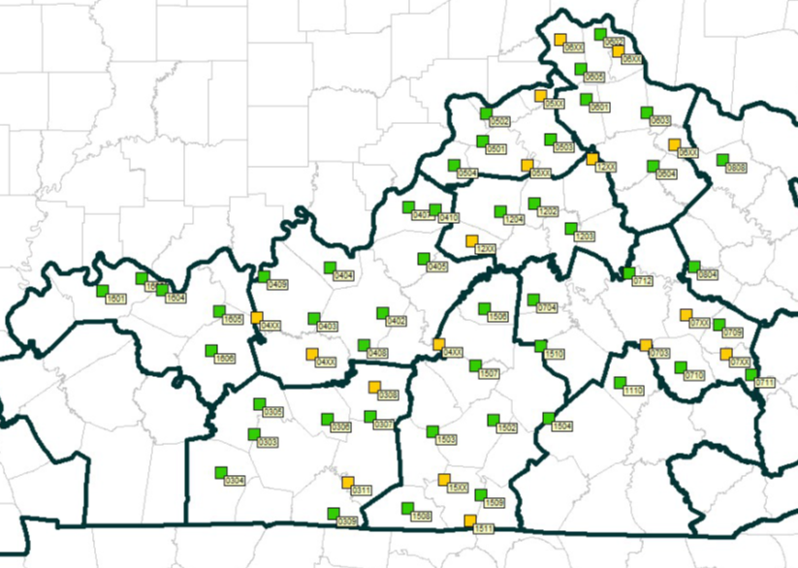
Phase II
$52,450,000
47 Existing Sites, Complete
17 New Tower Sites - Acquisition/Construction

Slide 6
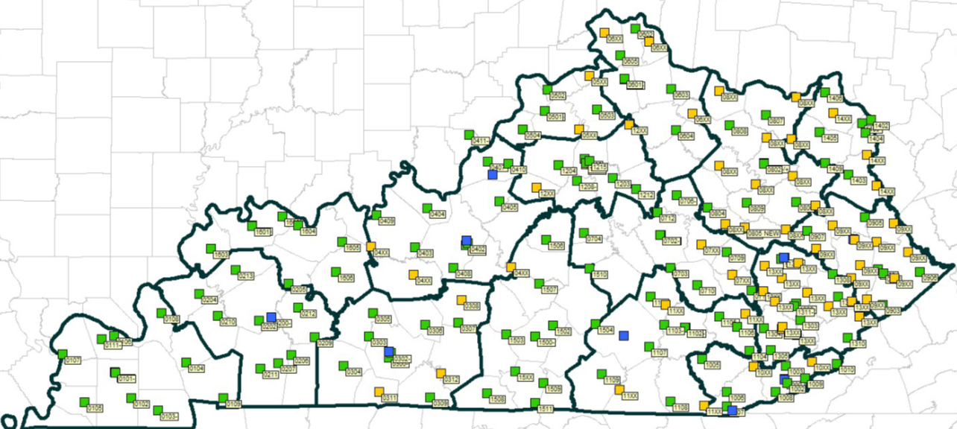
Phase III
$80,909,000
Router Upgrade
130 Replaced
57 for Greenfield
7 TBD w/ Microwave

Slide 7
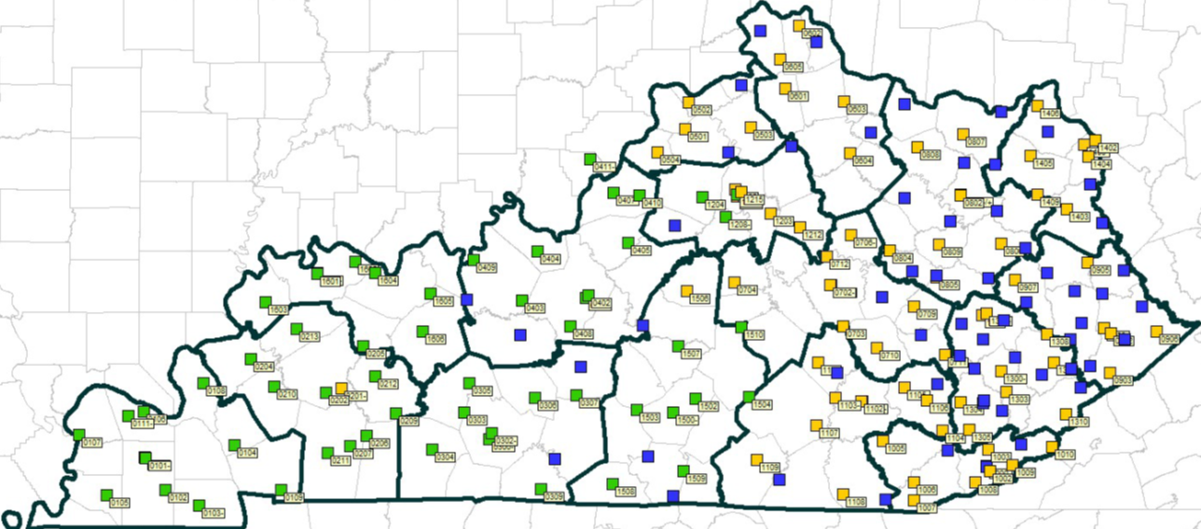
Phase III
$80,909,000
Microwave Upgrade
56 Replaced
76 in 2026
60 Greenfield

Slide 8
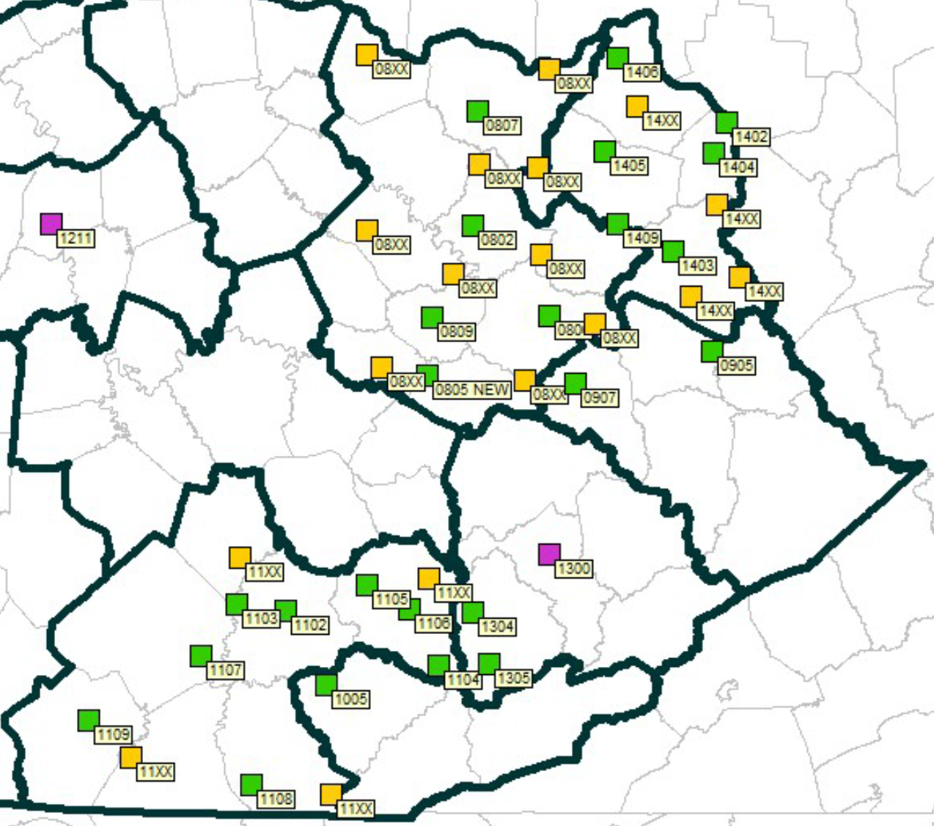
Phase IIIA
$47,900,000
SERVS Expanded
2 Cores
24 Existing Sites 2026
18 Greenfield

Slide 9
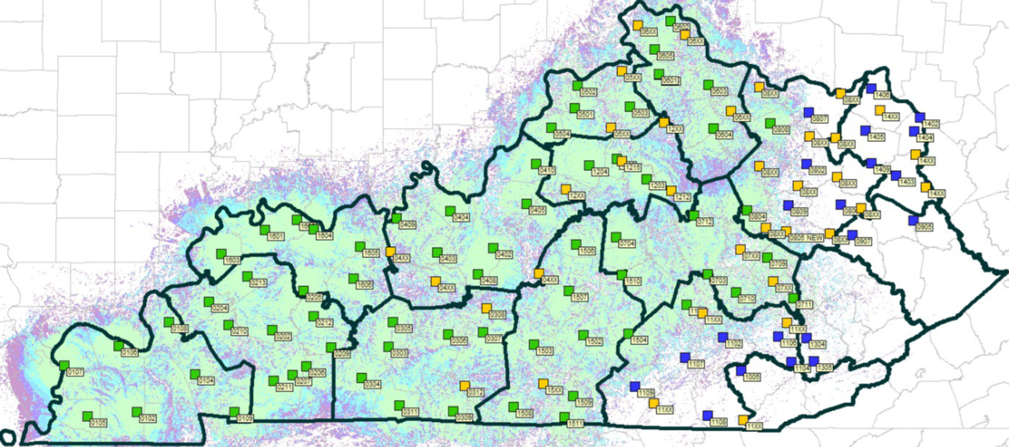
Phase IIIA
$47,900,000
SERVS Expanded
Today…
Coverage

Slide 10
Closeout Phase
SERVS Completion
16 Existing Sites
25 Greenfield Sites

Slide 11


QUESTIONS/DISCUSSION
Would you like to see interactive coverage maps?
Brandon Marshall
brandon.marshall@ky.gov
502-229-1090
https://spectrum.center/se/login

