Slide 1

Update from the Kentucky Department
of Juvenile Justice
August 29, 2025
Commissioner Randy White
Deputy Secretary Mona Womack

Slide 2
DJJ operates 27 facilities across Kentucky as of 08/25/2025.
  8 secure detention centers with 248 youth.
  6 youth development centers with 119 youth.
  8 Group Homes with 54 youth.
  5 Day Treatment Centers (DJJ operated)
DJJ serves the youth population that is assigned to detention or post-adjudication services by the court.
The Department of Juvenile Justice serves as part of the juvenile justice system providing pre-conviction and post-disposition services.

Slide 3
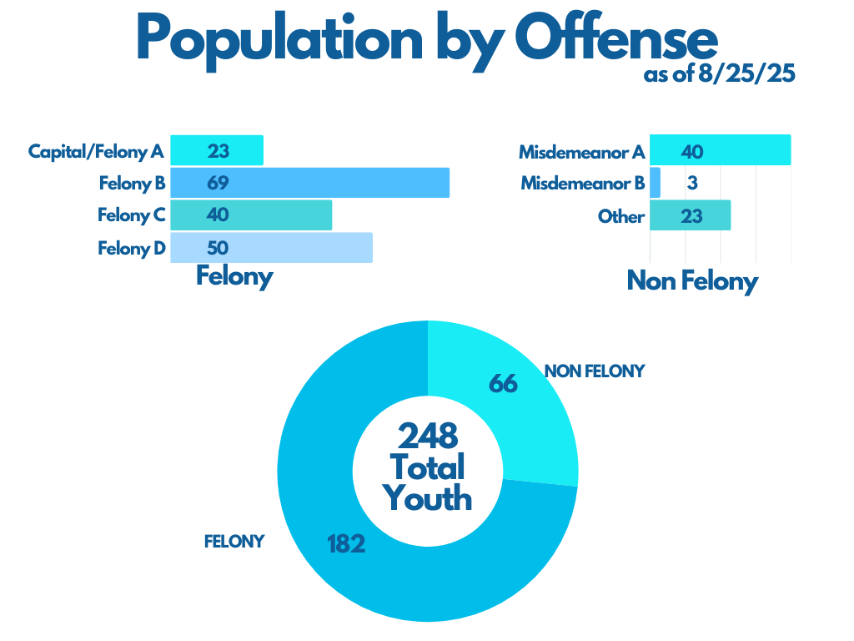
Over the past decade, the juvenile justice detention center population has changed, resulting in a decrease in non-felony charges and an increase in felony charges. This is driven in part by SB 200 implementation in 2014.

Slide 4
Impacts of Legislation on DJJ Population
23 HB 3 required automatic detention of youth charged with violent crimes starting 07/01/24.
24 HB 5 expanded the definition of violent crime, enhanced penalties for certain existing crimes, and created new crimes. DJJ expects more youth to be both in detention and post-adjudication services and for longer periods as a result.
24 SB 20 required that youth who use a firearm in the commission of a crime to be charged as adults. This will result in youth serving longer sentences within DJJ and subsequently transferred to DOC custody.

Slide 5
2023 Regular Session:
SB 162
23RS SB 162 codified investments the Beshear administration has made in DJJ since 2022 and provided requested statutory language to continue improvements to staffing and security.
  It also required that JPSC develop and implement a plan to create a new model of regional detention as soon as practicable while safely segregating males and females and separating violent and nonviolent offenders.
  It provided critical funding for salary increases and additional staff, a youth offender management system, security upgrades, and transportation, among others.

Slide 6
2023 Regular Session:
HB 3
23 RS HB 3 provided appropriations to reopen the Louisville detention facilities:
  $13.4 million to design the first phase of renovating the downtown Louisville Youth Detention Center
  $4.5 million to DJJ for the renovation for the Jefferson Regional Juvenile Detention Facility at Lyndon.
Its also required automatic detention of youth who are charged with violent crimes starting 07/01/24.

Slide 7
Capacity Issues
23RS SB 162 requires that juveniles be detained at their closest detention center as soon as practicable while safely segregating males and females and separating violent and nonviolent offenders.
  This would require that high-offender males and low-offender males be housed in the same facility but kept separated from one another.
  Without the two additional female-only facilities that were requested, the current female-only facility must house both levels, as well.
To ensure safety, separation requires not only separate sleeping quarters, but separate programming, schooling, dining, and recreational activities.
The legislature did not fund the request for two additional female-only detention facilities.

Slide 8
Initiatives to Address Staffing
In December 2021, Gov. Beshear announced a 10% raise for all security positions at DJJ.
In July 2022, the enacted budget provided an 8% increase for all state employees, including DJJ.
In October 2022, Youth Worker starting salaries were increased to $44,616.16.
In February 23, 2023, Gov. Beshear raised the starting salaries further to $50,000.
In 2023, at the request of the Beshear administration, the General Assembly appropriated:
  $3.2 million to sustain previous DJJ salary increases
  $30 million to bring the starting salary to $50,000 for all DOC correctional officers
  The General Assembly appropriated $4.8 million to increase the salaries for all DJJ workers.
Three years ago, the starting pay in Juvenile Detention Centers was only $30,000. Today, it is $50,000.

Slide 9
Recruitment and Retention
In the past two years, because of the administration’s efforts, DJJ has increased frontline correctional officers by 63%.
  This is the highest number DJJ has employed in recent history, and DJJ is continuing to recruit and retain staff which further secures our facilities.
DJJ has heavily invested in improving its mental health and medical staffing.
  For the first time, every facility has a treatment director, and two facilities are in the process of hiring a second treatment director.

Slide 10
Training
DJJ collaborated with DOC and law enforcement on a training in 2022 for all DJJ detention and YDC facility superintendents.
  DJJ has dedicated staff who cooperate with local law enforcement to stay up-to-date on STG information, and statewide trainings are held annually and at individual facilities as requested or directed by DJJ leadership.
In June 2023, the DJJ Training Division reviewed and updated the security topics included in its monthly emergency response training for all facilities. The first training began July 2023 and has continued since.
In March 2024, Troy Pollock was appointed the Director of Training at DJJ, and in August 2025, he was appointed as the new Director of Detention.
DJJ commonly recommends additional training in corrective actions for staff as needed.

Slide 11
Reorganization
For the first time in Kentucky’s juvenile justice system, a Director of Security position and a Director of the Office of Detention position were created and filled in 2023.
  The Director of provides assessments and recommendations on security for DJJ’s facilities. The Director of the Office of Detention oversees the detention facilities as predisposition facilities face different challenges than post-disposition facilities and should be managed as such.
DJJ also created the Division of Transportation in 2023.
DJJ created the Compliance Branch in January 2023 to conduct unannounced facility inspections and staff interviews to ensure best practices are identified and followed. It also makes recommendations to leadership for improvement and assists with training of new staff at the Training Academy.

Slide 12
Processes
DJJ appropriations are tracked internally, individual to each facility, and maintenance requests have been updated to include priority level.
The Compliance Division is reviewing automated systems. However, a bid for an automated system would require additional funding, and the development of a new system internally would require additional staff.
DJJ has implemented new requirements for facility leadership to track staff schedules to improve staffing efficiency and reduce overtime.
  DJJ facilities offer voluntary overtime, and DJJ only uses staff trained in security to perform security roles. Facility-based social workers receive security training at the DJJ Academy, and community-based social workers can attend the training, if they want to work overtime in a security role.
DJJ Human Resources monitors staff grievances filed with the Personnel Cabinet, as well as staff roster requirements. They also monitor exit interviews, but these are voluntary.

Slide 13
Regulations & Policies
DJJ policies and regulations identify the Internal Investigations Branch (IIB) as the gatekeeper for all complaints involving instance of abuse.
  DJJ is working on a regulation package that includes a new Ombudsman regulation and updates to reconcile with IIB regulations.
DJJ designated grievance officers in each facility to review every grievance and assist juveniles if the grievance filed does not comply with the process.
DJJ is working on a regulation package to address isolation and room placement. There will also be an updated incident report form.

Slide 14
Data
The safety, security, and wellbeing of youth and staff depends on accurate and timely data. DJJ data systems were built for a different time and a different population and were outdated, siloed, and inadequate for current needs.
DJJ has been added to the Kentucky Offender Management System (KOMS) Master Agreement to upgrade DJJ’s offender management system.
  DJJ is in the process of replacing the DJJ owned and operated Detention Booking System, which supports the Juvenile Detention Centers, with the appropriate JKOMS modules.
  To date, DJJ has bought 35 modules to track and identify individual resident information. Five of the seven detention centers have access to JKOMS.

Slide 15
Facilities
Critical improvements have been underway or completed at the detention centers.
JPSC contracted with the American Correctional Association to inspect facilities and identify necessary improvements. This is separate from the regular audits and standard collaboration DJJ has with the ACA.
  The DJJ Director of Security also assessed each detention center and recommended needed improvements.
23RS SB 162 included $4 million for security upgrades, which are underway.

Slide 16
Facilities
In 23RS HB 3 and 24RS HB 6, the legislature directed DJJ to renovate the Jefferson County Youth Detention Center and appropriated funding in required phases. From the start, DJJ has worked diligently to complete each phase of the project as directed and appropriated by the legislature.
  As required by the legislature, the design and construction of JCYDC was contingent on the completed transfer of the property deed from Louisville Metro to the Commonwealth. It took two years for Louisville Metro to transfer the deed to the state, during which time the state continued to work through the design phase.
  The deed was transferred to the state in April 2025, and in the same month, an RFP for construction was issued, which closed in May 2025. A contractor was selected and under contract in early June 2025. As of August 20, 2025, demolition is 50% complete. Estimated completion is Spring 2027.
The Lyndon facility was also provided additional funding in 24RS HB 6 to fully fund the required facility modifications. As previously reported, this project is underway, and construction is estimated to take 24 months. Estimated completion is Fall 2026.

Slide 17
Facilities
DJJ hired design consultants to review the status of each facility and components and to make recommendations based on projected population and 23RS SB 162 mandates for separation.
  As a result, DJJ requested funding for modifications and expansions at Breathitt, Fayette, and McCracken to support the male population which were funded in 24RS HB 6 and are in the final stages of design.
  Based on the consultant review, Governor Beshear requested funding for two female facilities and one high acuity mental health facility during the 2024 and 2025 legislative sessions. These were not funded by the legislature. They have been included again in DJJ’s 26-32 Capital Plan submission.
  Through this process, DJJ also received updated facility assessments and has prioritized facility repairs and maintenance projects to be addressed with Maintenance Pool funds.

Slide 18
Mental Health
23RS SB 162 required DJJ to enter into sufficient contracts to ensure availability of institutional treatment for youth with severe mental illness. DJJ is also required to provide youth in crisis in a DJJ facility access to mental health professionals.
23RS HB 3 required automatic detention of youth accused of public offenses considered violent felony offenses for up to 48 hours, exclusive of weekends and holidays, pending a detention hearing.
  Youth detained for these offenses are required to be assessed by a mental health professional
  Any treatment recommended must be provided by DJJ and may be provided via contract between JPSC and a behavioral health services organization.
  Effective date of automatic detention provision was 07/01/2024, and 483 assessments have been performed as of 08/19/25.

Slide 19
Mental Health Services
DJJ has hired a qualified mental health professional at every detention center and YDC.
  DJJ also amended its contract with UK Department of Psychiatry to allow advanced practice providers to treat youth in DJJ. As a result, two psychiatric nurse practitioners evaluate and treat youth on a weekly basis at every detention center.
Youth detained in DJJ detention facilities complete initial medical and mental health screenings during the intake process.
  Results from both screeners are reviewed by trained staff.
  Additional screening is conducted when areas of need are identified and followed by referral to onsite counseling staff or DJJ’s regional psychologists for further evaluation.

Slide 20
Challenges to Mental Health Services in Detention
Detention staff must handle a wide variety of youth and situations due to the nature of detention, and they must triage immediate needs of youth in custody.
Mental health and education services are provided to youth in detention. However, because their cases have not concluded, DJJ is limited in the programming it can provide in detention.
Formal evidence-based treatment is limited in detention:
  Youth may not be guilty of the offense for which detained
  Youth and parents have the right to refuse treatment. Parents must give informed consent.
  Duration of detention is unpredictable and often not long enough for effective services.
  Not all youth need treatment services.

Slide 21
Continued Need for a High Acuity Mental Health Facility
Private healthcare organizations are not required to accept DJJ youth, and DJJ has historically faced significant barriers to placement for violent youth with severe mental health issues. Private treatment facilities often will not admit, or will prematurely discharge, severely mentally ill youth who are aggressive or violent.
Absent any clinical mental health alternative, DJJ detention facilities may be the “custodian of last resort.” However, a child suffering from severe mental illness cannot be adequately treated in a detention center neither designed nor staffed as a clinical facility.
At the direction of Governor Beshear, DJJ and CHFS requested a separate mental health facility for high acuity youth in detention.
  This was included in the Governor’s budget, as well as 24RS SB 242 and 25RS SB 111. It has not been funded by the legislature.

