Slide 1


Phase I 2 Cores Completed 70 Console Positions Completed 14 Existing Sites Radio Install Completed 4 Greenfield sites built, and radios installed Subscriber Equipment Completed

Slide 2
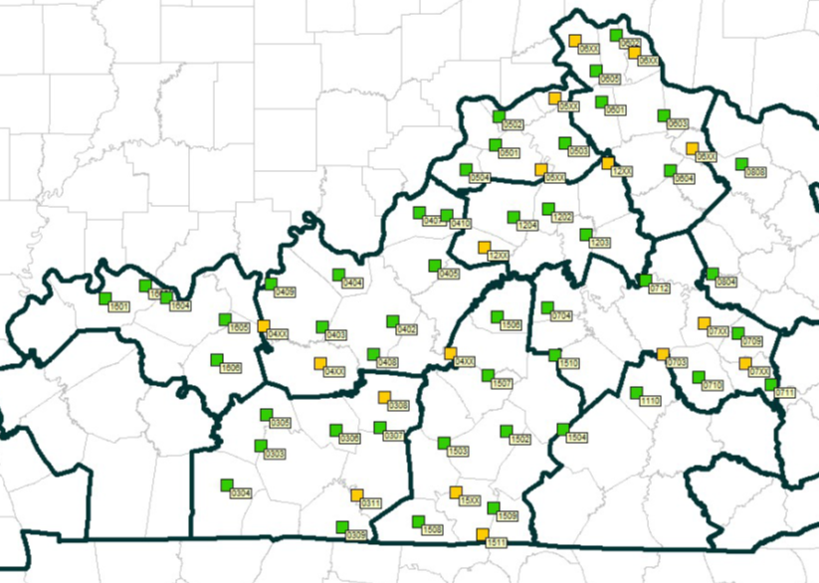
Phase II 47 Existing Sites, Radio Installs Complete 15 New Tower Sites – Acquisition Pending 3 sites under construction

Slide 3
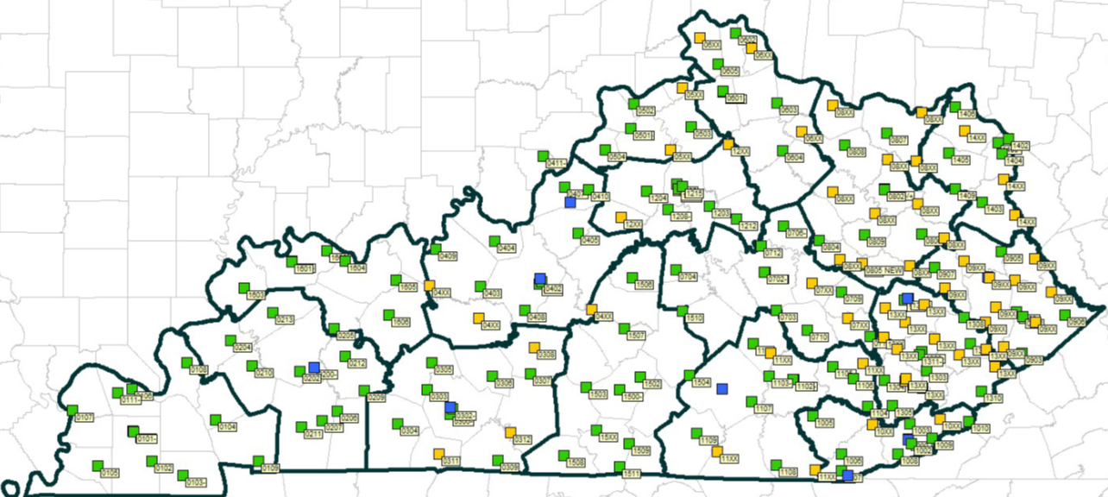
Phase III Router Upgrade 130 Sites Replaced 57 for Greenfield Sites

Slide 4
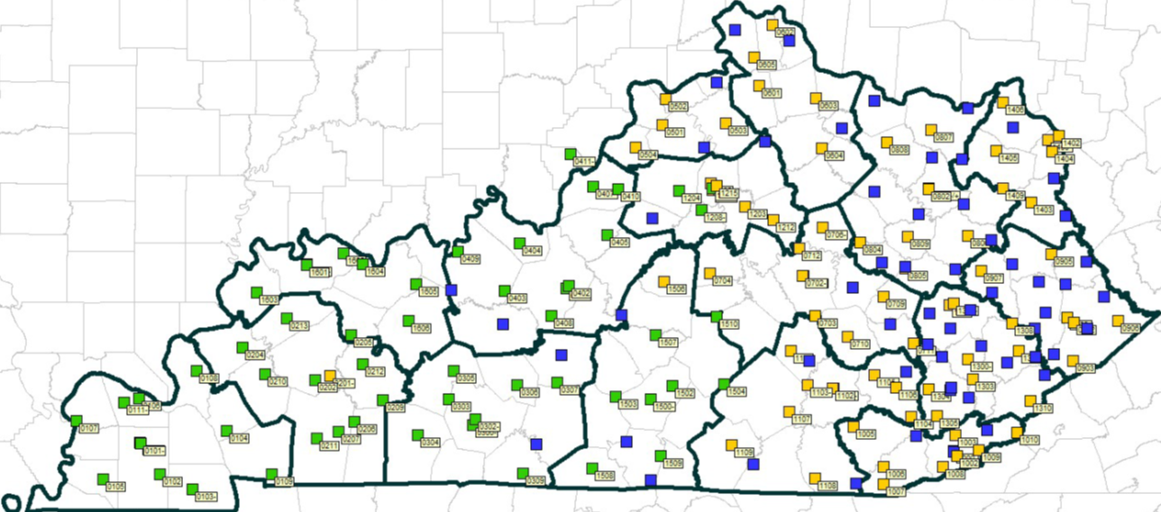
Phase III Microwave Upgrade 73 Sites Replaced 59 Sites ongoing 60 Greenfield Sites

Slide 5
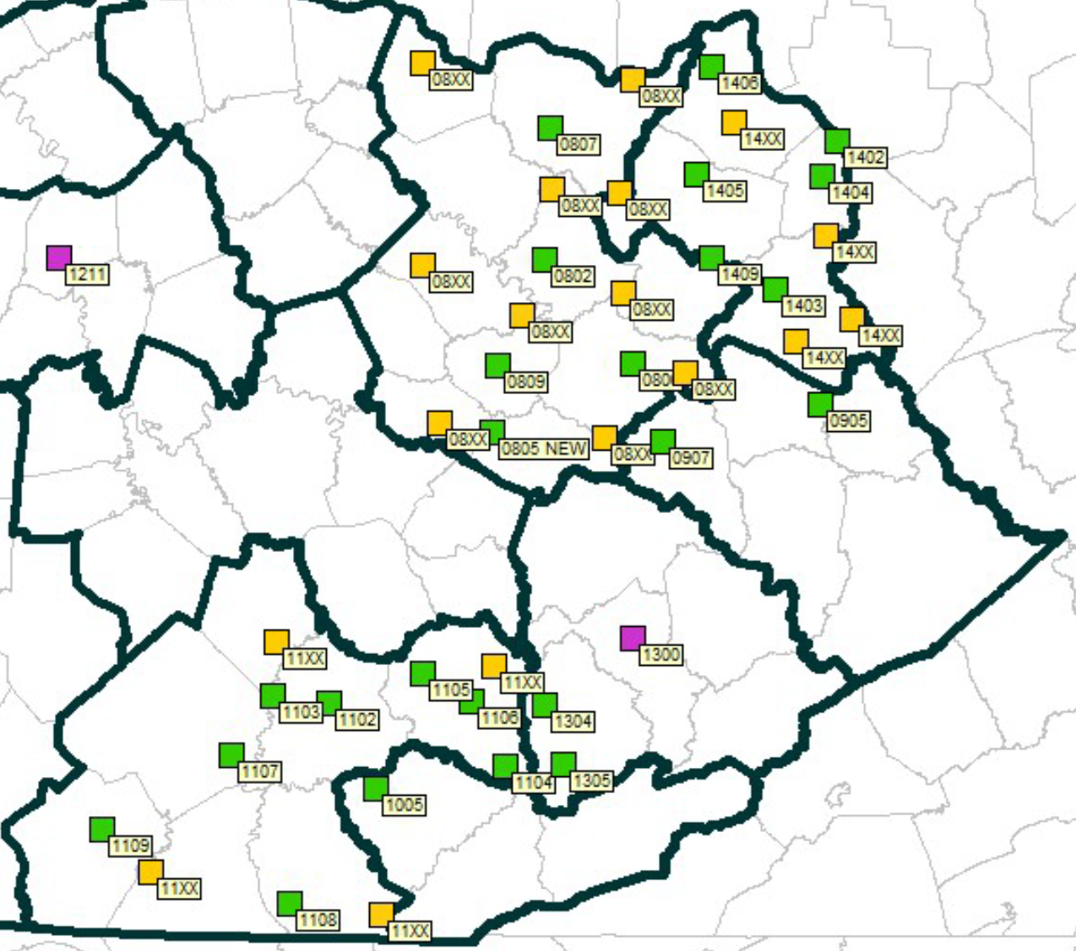
Phase IIIA 2 Cores 24 Existing Sites 2026 18 Greenfield Sites
Notes:
PHASE IIIA
Post 14, 8, 11 Cores in Post 13 and Site 1 Kews

Slide 6
Closeout Phase SERVS Completion 16 Existing Sites 25 Greenfield Sites
Notes:
FY KSP Post 9, Post 10, and Post 13

Slide 7
Phase I Radio Coverage Post1 and 2 fully operational

Slide 8
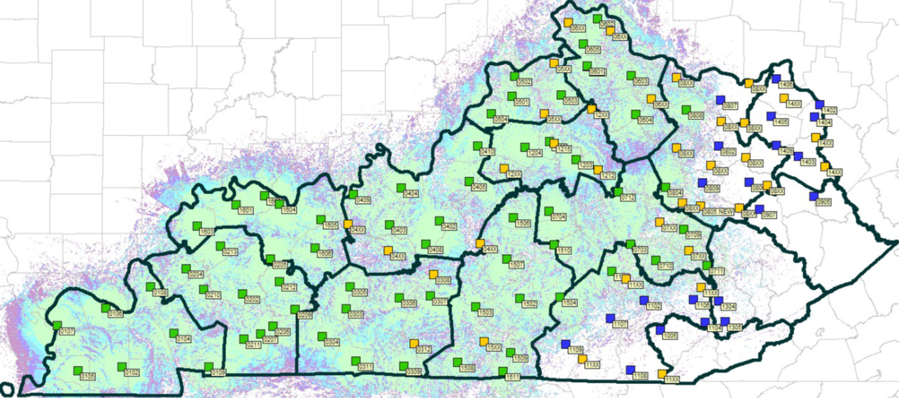
Phase 1 and 2 Today… Coverage

